Slide 1
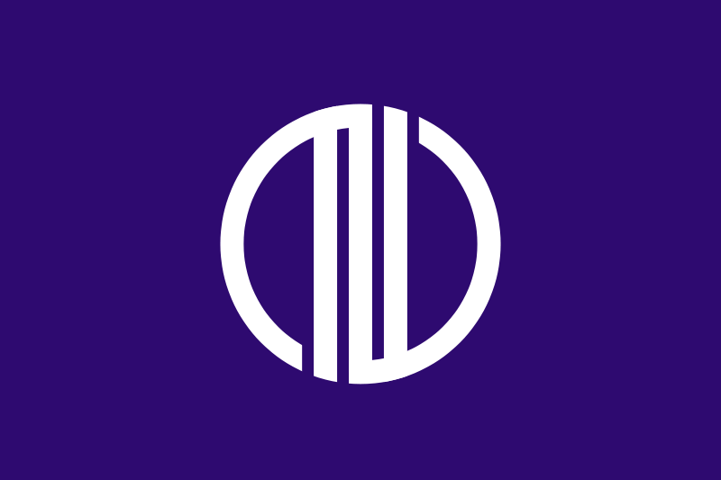
Sendai Japan
Presented by
Fellow Cruiser
Marc Silver

Slide 2
What I Will Cover
My Port Philosophy
Don’t Miss the Ship
Japanese Money
About Sendai
Area Map of Sendai
Map of Sendai
Sendai Transportation
Places to see or at least consider
A few restaurant recommendations
Conclusion

Slide 3
My Port Philosophy
I have been cruising for over 45 years and have taken over 100 cruises.
So, I consider myself an experienced cruiser.
The information I will present is based on those many years of
experience.
When I am on a cruise where the city, I want to visit is not the port city,
I always recommend taking a ship’s tour.
But when I am in a port with multiple attractions nearby and easy to see
on my own -
I will do it on my own.
This presentation is not like that.

Slide 4

Don’t Miss the Ship
How to Avoid Missing Your Ship
Pay attention to the time. - Ship time and local time are often
different.
Put a return-to-ship reminder on your phone.
Choose excursions wisely.
If a ship-sponsored excursion is late returning to port, the ship will
wait for you. If you are on your own???
Be Prepared
Have your Passport, Credit Card, and phone numbers for your ship
port agent.
What to Do If You Miss the Ship
Most cruise lines have port agents stationed in the port area to assist if your ship has left without you. If your are lucky, when cruisers are late returning to the vessel, the ship’s crew will often remove the passengers’ essential items – passports, cell phones, and medication -- from the ship to leave with the port agents.
The Port Officials can help you with contacting your ship
and making necessary travel arrangements.

Slide 5
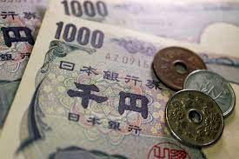
Japanese Money
The Yen is the official currency of Japan
Official Exchange is 100 Yen is 72 cents US
Or 142.15 Yen to the US Dollar

Slide 6

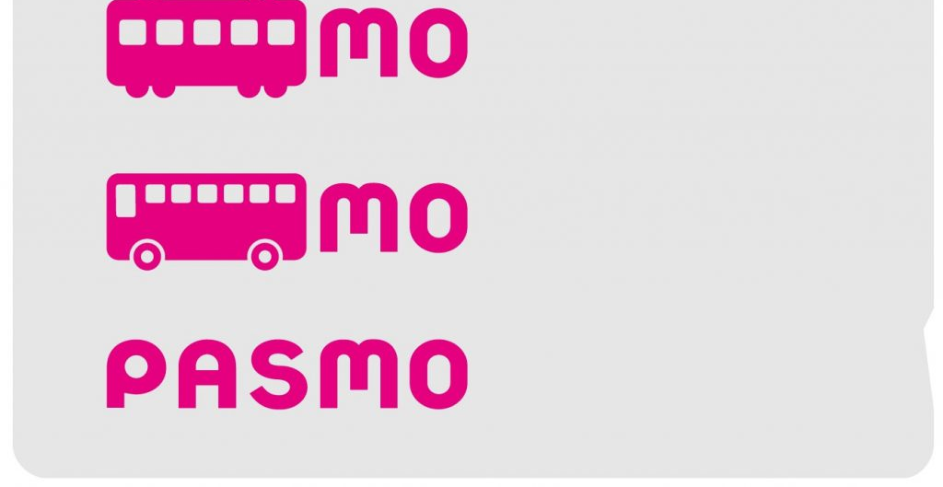
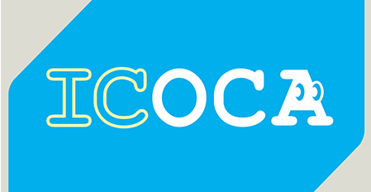
PASMO, Suica, & ICOCA Cards
The PASMO, Suica, and ICOCA Cards are e-money IC cards that can be used for travel and shopping across Japan.
Cashless fare payment
Use it for shopping
No waiting for change
Get special privileges
Apple phone u
ers can also link with all three cards.
PASMO refunds - If you no longer need your PASMO, it can be refunded. Suica and ICOA cards do not offer refunds.

Slide 7
About Sendai
Sendai is the capital city of Miyagi Prefecture, the largest city in the Tōhoku region. As of 1 March 2023, the city had a population of 1,097,563 and is one of Japan's 20 designated cities.

Slide 8
About Sendai
Sendai is the capital city of Miyagi Prefecture, the largest city in the Tōhoku region. As of 1 March 2023, the city had a population of 1,097,563 and is one of Japan's 20 designated cities.
The city was founded in 1600 by the daimyō Date Masamune. It is nicknamed the City of Trees; there are Japanese zelkova trees lining many of the main thoroughfares such as Jōzenji Street and Aoba Street.

Slide 9
About Sendai
Sendai is the capital city of Miyagi Prefecture, the largest city in the Tōhoku region. As of 1 March 2023, the city had a population of 1,097,563 and is one of Japan's 20 designated cities.
The city was founded in 1600 by the daimyō Date Masamune. It is nicknamed the City of Trees; there are Japanese zelkova trees lining many of the main thoroughfares such as Jōzenji Street and Aoba Street.
In the summer, the Sendai Tanabata Festival, the largest Tanabata festival in Japan, is held. In winter, the trees are decorated with thousands of lights for the Pageant of Starlight.

Slide 10
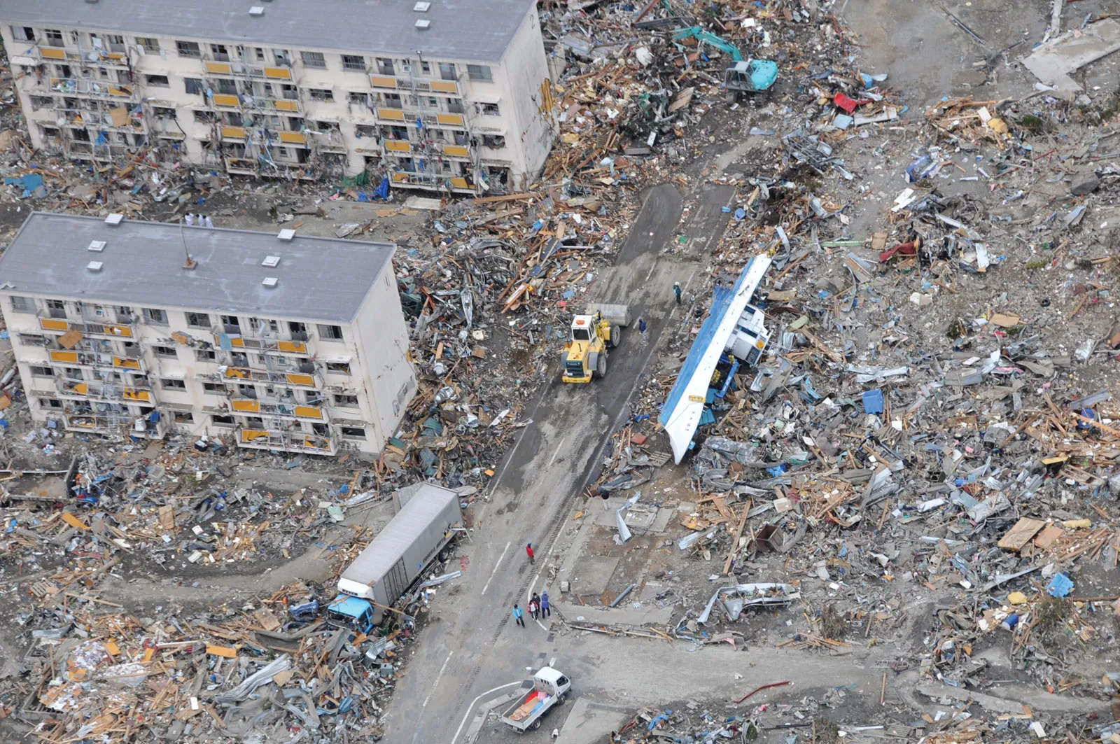
About Sendai
On 11 March 2011, coastal areas of the city suffered catastrophic damage from a magnitude 9.0 offshore earthquake, which triggered a destructive tsunami.

Slide 11
Sendai’s History
Although the Sendai area was inhabited as early as 20,000 years ago, the history of Sendai as a city began in the1600s when the daimyō Date Masamune relocated.
Masamune ordered the construction of Sendai Castle in December 1600 and the construction of the surrounding castle town in 1601.
The grid plan roads in modern-day central Sendai are based upon his plans.
Sendai was an ideal location, being in the center of Masamune's newly defined territories, upon the major road from Edo.
Tokugawa Ieyasu gave Masamune permission to build a new castle in Aobayama after the Battle of Sekigahara.
The previous ruler of the Sendai area had used a castle located on Aobayama.

Slide 12
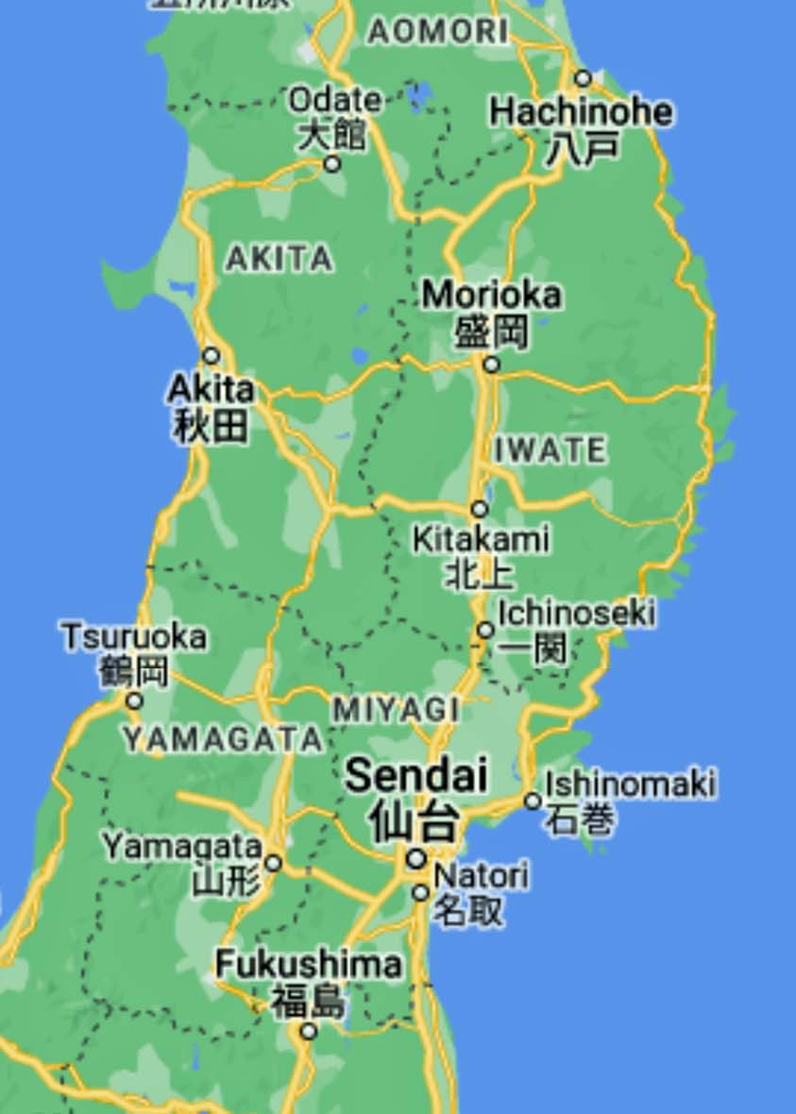
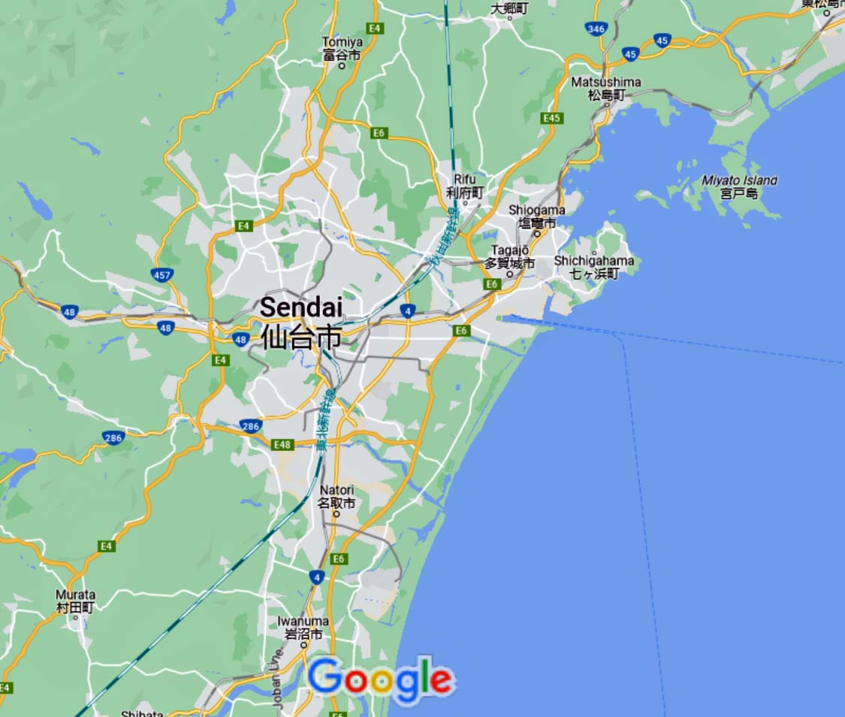
Area Map of Sendai

Slide 13
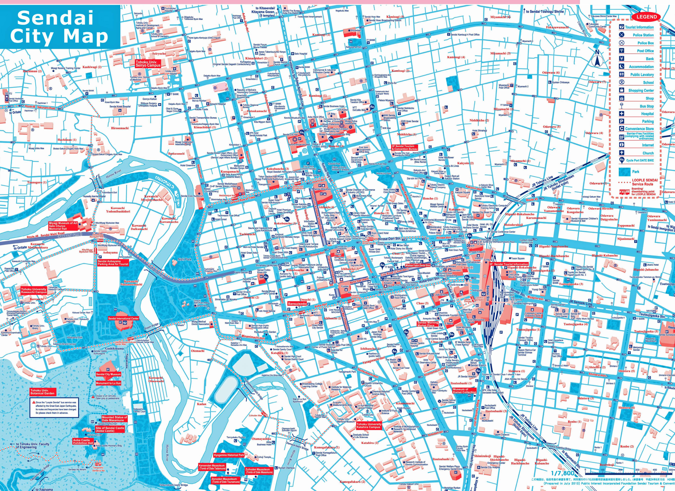
Map of Sendai

Slide 14

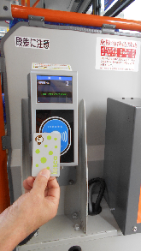
Sendai Transportation
Sendai Rapid Transit has both city buses and a subway system. Tickets may be purchased from ticket counters, operation offices or licensed retailers located throughout the city. You need to purchase a commuter pass or icsca card prior to boarding the bus or subway.
Bus Fares vary between 160 and 1160 yen depending upon the distance of travel. Subway fares vary between 210 and 370 yen.
When boarding and exiting the bus you need to scan your ticket.
All-day Subway pass price: Adults: 840 yen Children: 420 yen
All-day Inner City Bus Pass price: Adults: 650 yen Children: 330 yen
Tickets are only available from automatic ticket vending machines.

Slide 15
Ishinomaki to Sendai
There are several ways to travel from Ishinomaki to Sendai Station. The most convenient and cost-effective way is by train.
The Train takes about 1h 30min and costs $6-9 US one way. The train runs every hour.
A taxi takes about 45 minutes, but the cost is $110-$140.
You can also hire a private car or rent a car.
You can also book a Sendai City Tour.

Slide 16
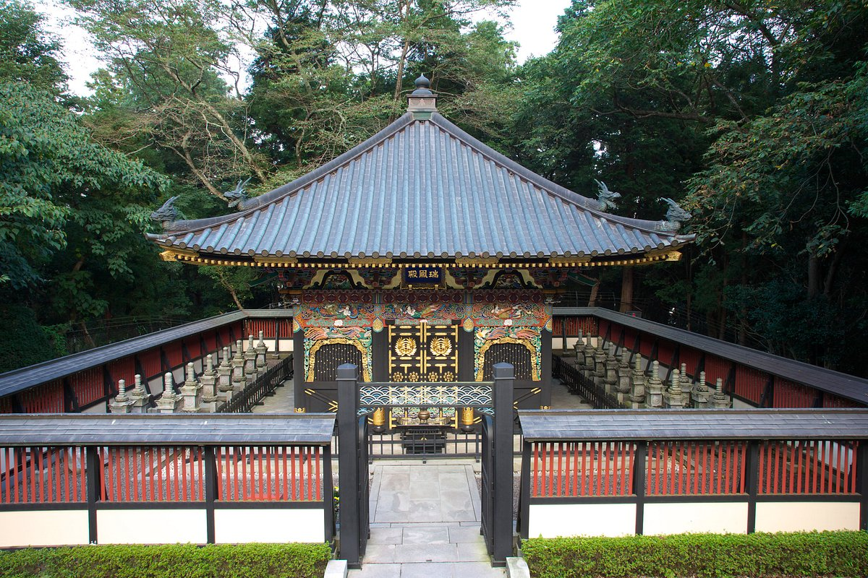
Zuihoden Temple
Zuihoden is located in a “hilly area” which called Kyogamine.
The approach to the reception desk is very steep and has about 80 steps.
The precincts of Zuihoden consist mainly of stone pavements as well as about 30 steps.
It would be extremely challenging for
visitors with wheelchairs to visit.
Adult admission: 570Yen

Slide 17
Conclusion
Sendai is a beautiful City with a rich history and numerous attractions.
Regardless of what you're looking for, Sendai has something for everyone.
I hope this presentation will help when we visit Sendai!

Slide 18
Thanks For Coming
If you have any more questions, please ask.
I will do my best to answer them for you.
Have a great visit in Sendai !

