Slide 1
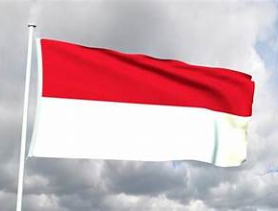
Semarang, Java
Presented by
Marc Silver

Slide 2
What I Will Cover
My Port Philosophy
Don’t Miss the Ship
Indonesian Money
About Semarang
Maps
Getting Around Semarang
What Semarang is Famous For
Food and Drink
Conclusion

Slide 3
My Port Philosophy
I have been cruising for over 46 years and have taken over 100 cruises.
So, I consider myself an experienced cruiser.
The information I will present is based on those many years of
experience.
When I am on a cruise where the city, I want to visit is not the port city,
I always recommend taking a ship’s tour.
But when I am in a port with multiple attractions nearby and easy to see
on my own -
I will do it on my own.
This presentation is not like that.

Slide 4

Don’t Miss the Ship
How to Avoid Missing Your Ship
Pay attention to the time. - Ship time and local time are often
different.
Put a return-to-ship reminder on your phone.
Choose excursions wisely.
If a ship-sponsored excursion is late returning to port, the ship will
wait for you. If you are on your own???
Be Prepared
Have your Passport, Credit Card, and phone numbers for your ship
port agent.
What to Do If You Miss the Ship
Most cruise lines have port agents stationed in the port area to assist if your ship has left without you. If your are lucky, when cruisers are late returning to the vessel, the ship’s crew will often remove the passengers’ essential items, but it is not guaranteed. – passports, cell phones, and medication -- from the ship to leave with the port agents.
The Port Officials can help you with contacting your ship
and making necessary travel arrangements.

Slide 5
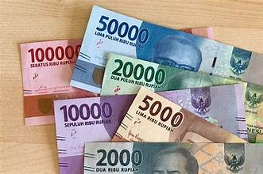
Money
As of January 2026, the exchange rate for USD to IDR is approximately
$1 US dollar = 16,000 to 17,000 IDR.
Don’t be misled, The big numbers don't mean their money is worthless - Java just never 'reset' their
currency.
Think of it like this: their smallest practical bill is
like our $1, it just says 1,000
instead of 1.
Java's inflation is actually
lower than the US right now at
around 3%.
Coins technically exist, but in
practice most transactions use
paper bills.

Slide 6
About Semarang
A Colonial Port, a Sacred Monument, and the Long Memory of Trade
When ships arrive in Semarang, they are not just docking at another Southeast Asian port.
They are stepping into one of the great crossroads of Asian history, a place shaped by trade winds, empires, religion, and patience. Semarang doesn’t announce itself loudly. It reveals itself slowly.
Located on the north coast of Java, Semarang has long been a gateway city.
For centuries, merchants, missionaries, soldiers, and administrators passed through its harbor, leaving behind layers of architecture and influence that still define the city today.

Slide 7
A City Built on Commerce
Semarang rose to prominence during the age of global trade. By the seventeenth century, the Dutch had identified this stretch of coast as strategically vital. It offered access to Java’s fertile interior, reliable anchorage, and a position along the maritime routes connecting China, India, and Europe.
What emerged was a colonial city carefully designed for administration and efficiency. Wide streets. Formal squares. Warehouses, offices, and residences built in European styles, adapted just enough to survive the tropical heat.

Slide 8
A City Built on Commerce
This historic core, often called the Old Town, is now recognized by UNESCO as a preserved example of colonial urban planning in Southeast Asia.
Yet Semarang was never just a European outpost. Javanese, Chinese, Arab, and later Indonesian communities lived alongside colonial officials, creating a layered society where cultures overlapped, cooperated, and sometimes collided.
The city’s architecture still reflects this mix, with Dutch facades standing near Chinese temples and local mosques.

Slide 9
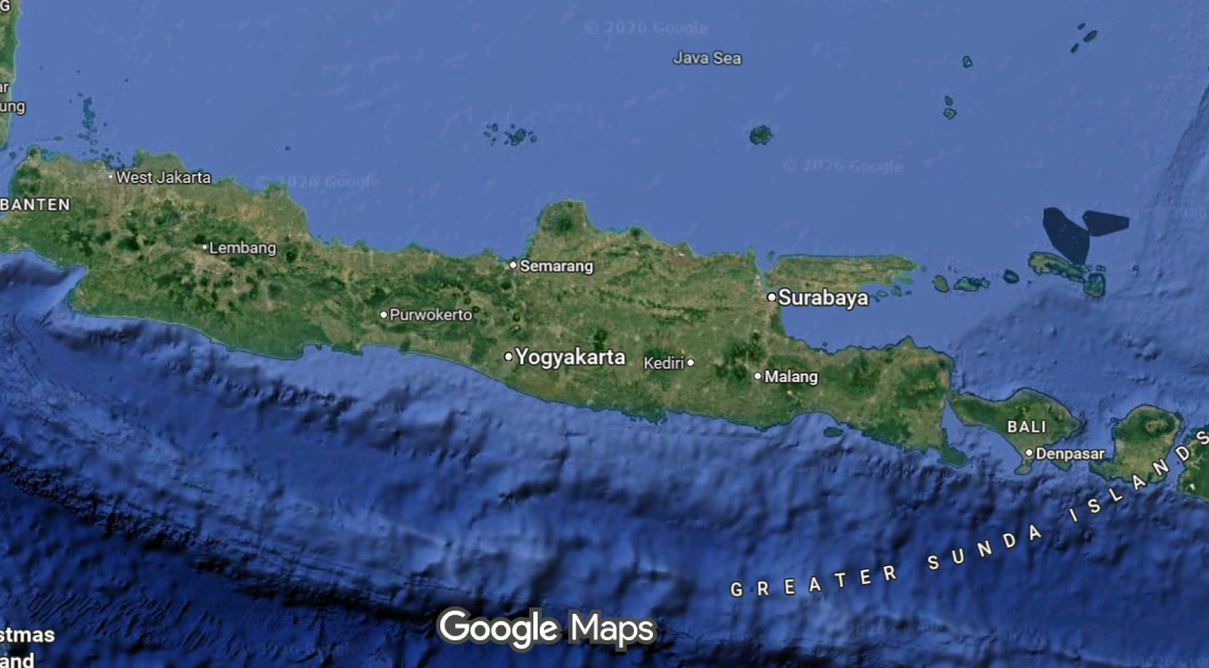
Port >

Slide 10
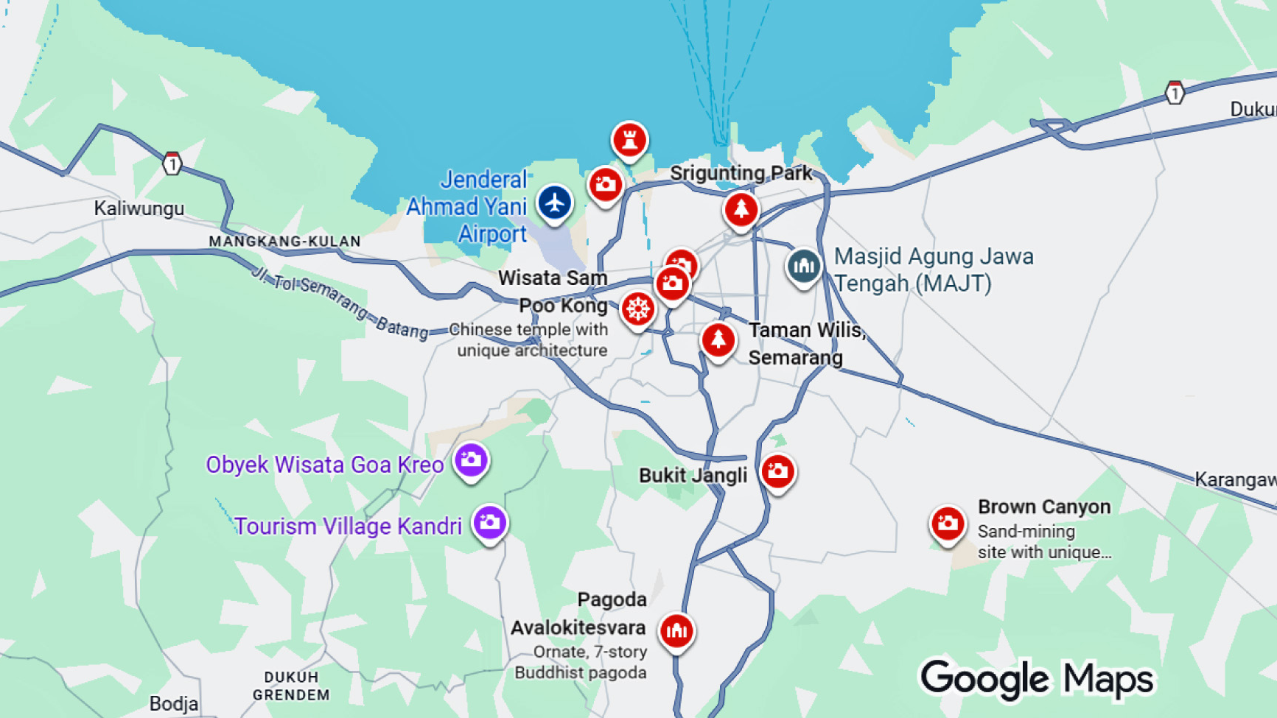
Cruise Port

Slide 11
Java Beyond the Image
Java is often reduced to a single image. Temples at sunset. Offerings placed carefully on stone paths. Dancers frozen in perfect poses.
All of that is real. But it is incomplete.
Java’s culture is not staged for visitors. It is lived, daily, through ritual, obligation, and rhythm. Religion here is not a weekly activity. It is woven into time itself. Calendars are ceremonial. Days are named for gods. Life events are marked by offerings and prayer.
This continuity is easier to sense away from the island’s busier centers.
Northern Java reveals a slower tempo. Ceremonies are still elaborate, but they are not abbreviated. Community obligations remain central. The island breathes at its own pace.

Slide 12
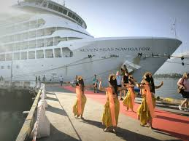
Not the Java You Expect
Semarang exists on cruise itineraries because some journeys are designed to slow down.
This is not a highlight port. It is a context port.
It offers a different way to understand Java, not as a destination, but as a living system. A place where ritual continues without explanation. Where temples serve communities, not cameras. Where daily life has not been reorganized around outside expectations.
For longer voyages, this matters. It provides contrast. It deepens understanding. It reminds travelers that islands, like cultures, cannot be reduced to a single version.

Slide 13
A Living City, Not a Museum
Modern Semarang is very much alive. It is an industrial city, a port, a university town, and a cultural center. The old colonial buildings are no longer symbols of foreign rule. They have been repurposed, reinterpreted, and absorbed into Indonesian identity.
Street life moves easily between centuries. A former Dutch office might house a café. A colonial warehouse might become a gallery. The past is present, but not frozen.
This is an important distinction. Semarang is not preserved to impress outsiders. It is preserved because it matters locally. It represents a period of hardship, adaptation, and eventual independence. Indonesia’s history did not pause under colonialism. It continued, quietly and persistently.

Slide 14
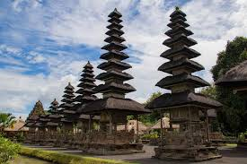
Getting Around
From Semarang, taxis and organized tours are the best way to explore, as attractions are spread across the island.
Traffic can be heavy, so allow time for travel.
Shore excursions typically cover either cultural Java (Ubud and temples) or beach resorts in the south.

Slide 15
Semarang Self-Guided Walking Tour
Experience the cultural heart of Semarang on this easy 2km walk from Dutch colonial Old Town to historic Chinatown. Start at the iconic Blenduk Church with its copper dome, wander through pastel-colored colonial buildings perfect for photos, then walk southeast to vibrant Chinatown. Visit the ornate Tay Kak Sie Temple and explore atmospheric alleyways lined with traditional shophouses. Sample Semarang's famous lumpia (spring rolls) along the way.
Highlights: Colonial architecture, Chinese temple, local markets, authentic street food
Perfect for cruise passengers: Easy 15-minute taxi ride from Tanjung Emas Port, straightforward route, plenty of time to return to ship. If you get lost, just ask someone for directions.

Slide 16
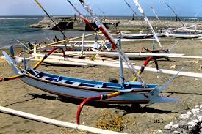
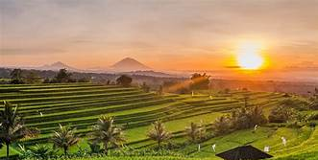
What Semarang is Famous For
Traditional Fishing Villages
Right outside the port area, you’ll see small coastal villages where life still revolves around fishing.
Colorful jukung boats line the shore. Nets are repaired by hand. Daily rituals happen in the open.
It’s not curated for tourists, which makes it feel authentic. A short walk with a local guide helps turn simple observations into context.

Slide 17
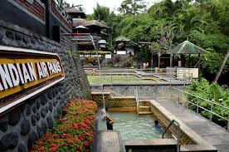
Highlights for Visitors
Banjar Hot Springs
About 30 minutes inland, these sulfur-fed pools date back to the 19th century. Stone spouts shaped like dragon heads feed warm mineral water into tiered bathing pools.
It’s relaxed, scenic, and easy to combine with a monastery visit.

Slide 18
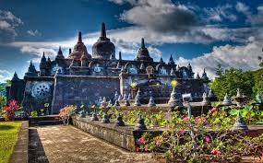
Highlights for Visitors
Brahmavihara Arama
Often paired with Banjar, this is
Java’s largest Buddhist monastery.
The setting is calm, green, and
elevated, with views toward the
sea.
White stone stupas and a miniature
Borobudur-style structure give it a
very different feel from Java’s Hindu temples.

Slide 19
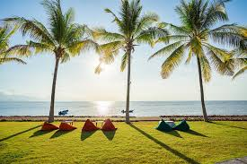
Highlights for Visitors
Lovina Beach
Lovina is known for its black-sand beaches and dolphin sightings.
Early-morning boat trips head offshore to spot pods swimming just beyond the reef.
Even without the dolphins, Lovina offers a slower, less commercial seaside experience than southern Java.

Slide 20
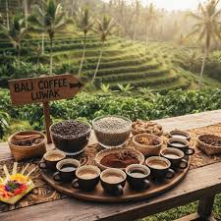
Highlights for Visitors
Coffee and Spice Plantations
Northern Java is cooler and greener, ideal for small plantations.
Many shore excursions stop at family-run farms where guests see coffee, cacao, vanilla, cloves, and cinnamon growing together.
Yes, kopi luwak is often part of the visit, but the real value is understanding how deeply agriculture shapes Javanese life.

Slide 21
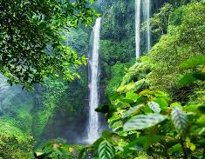
Highlights for Visitors
Waterfalls and Mountain Scenery
If the itinerary allows, inland drives reveal rice terraces, jungle valleys, and waterfalls like Gitgit or Munduk.
These trips are more about scenery than ticking off landmarks, but they give a strong sense of Java beyond the coast.

Slide 22
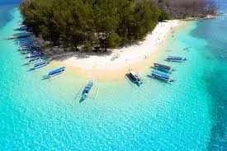
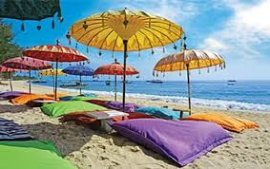
Highlights for Visitors
What Makes Semarang Different
This port isn’t about shopping districts or headline attractions. It’s about contrast.
Quiet villages instead of beach clubs. Temples tucked into hills instead of Instagram backdrops. Everyday Java, not resort Java.
For cruise travelers, that makes Semarang a pause. A place to slow down, observe, and absorb northern Java’s rhythm before the ship moves on.

Slide 23
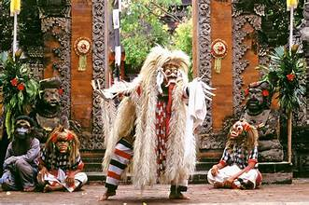
Highlights for Visitors
Barong Dance Performances: Traditional storytelling through dance and costume.

Slide 24
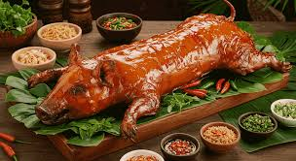
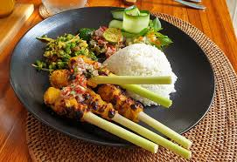
Food and Drink
Javanese cuisine is aromatic and colorful.
Try babi guling (suckling pig), nasi campur (rice with assorted dishes), and satay lilit (minced seafood satay wrapped on sticks).
For dessert, tropical fruits like snake fruit and rambutan abound.
Don’t miss a cup of kopi Java (Javanese coffee).

Slide 25
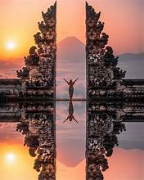
Reflection
Java is more than just a tropical island, it’s a living culture of rituals, temples, and art layered over breathtaking landscapes.
Whether you’re watching dancers in Ubud, walking barefoot on the beach, or standing before a temple at sunset,
Java leaves an impression of harmony between the spiritual and the natural.

Slide 26
Thanks For Coming
If you have any more questions, please ask.
I will do my best to answer them for you.
Have a great visit in Semarang!

