Slide 1
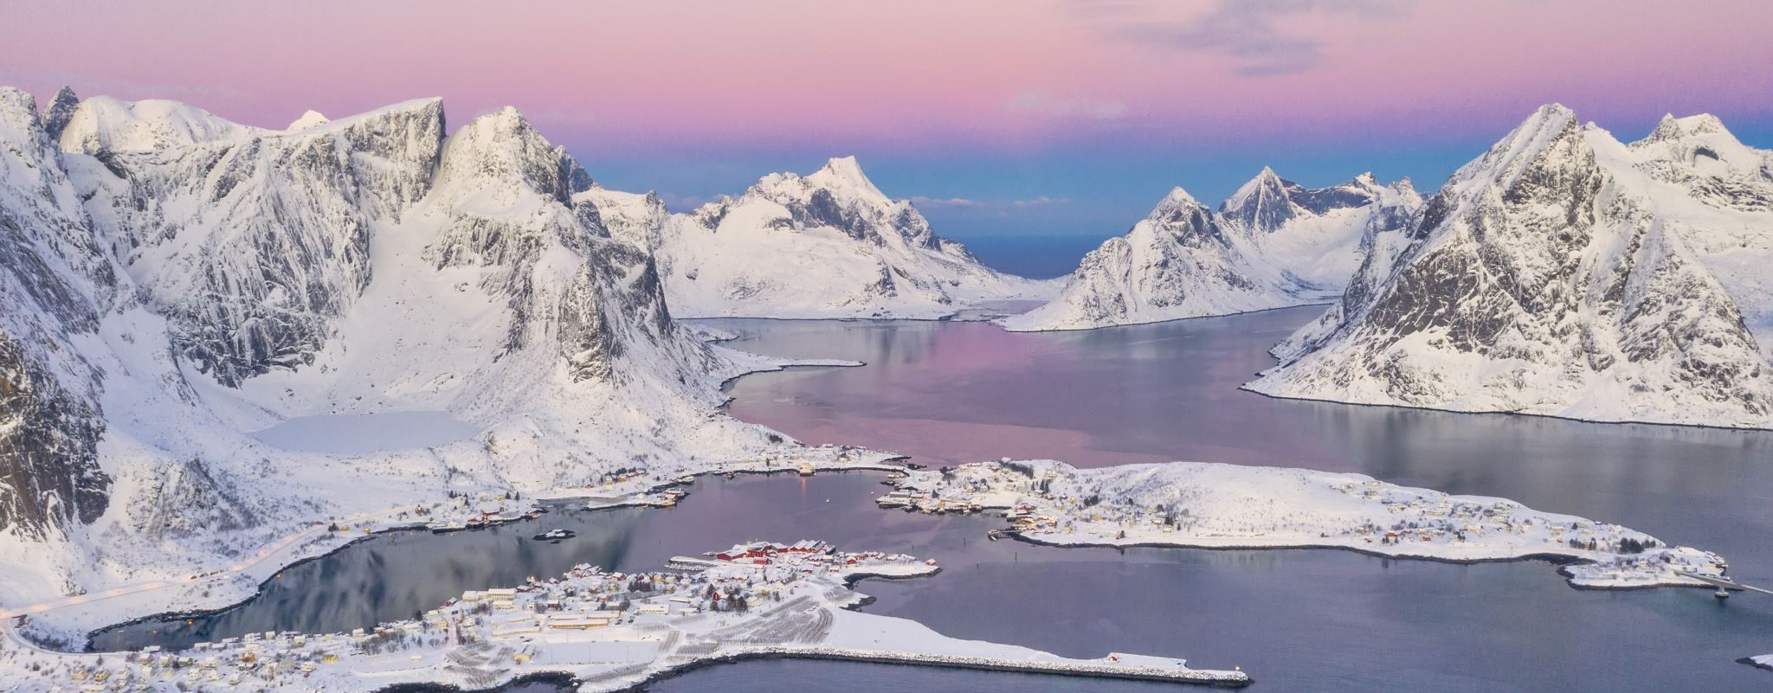
Fun Facts About Scandinavia Presented by Marc Silver

Slide 2
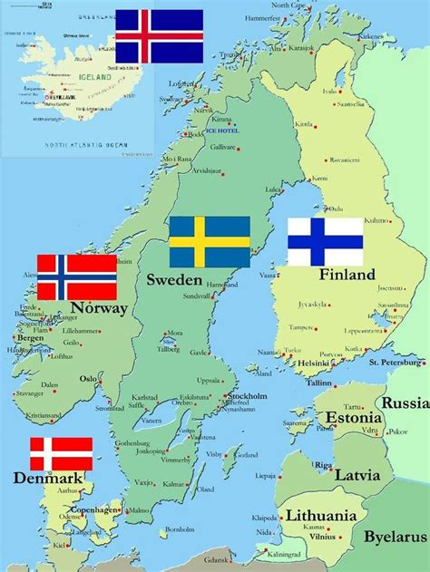
Fun Facts About Scandinavia
Scandinavia is on the bucket list of many international travelers, and with good reason.
Best known for its beautiful Fiords and Northern Lights, but how much do you really know about the region?
I am here to tell you a little more about the region and uncover some Scandinavian secrets.

Slide 3
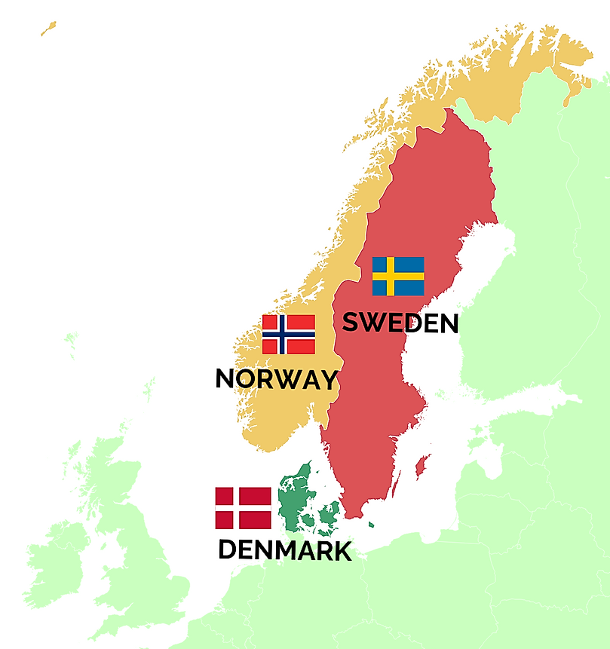
Scandinavia consists of three countries.
Some definitions also include Finland and Iceland, but this wider group is more commonly known as the Nordic region. The Faroe Islands, Greenland and Åland also participate in Nordic cooperation initiatives via the Nordic Council, but Scandinavia technically is just the big three.
The Scandinavian Peninsula is a large peninsula reaching west from northern Europe over the north side of the Baltic Sea. Norway, Sweden and some of Finland are on the peninsula, also known as Fennoscandia. Denmark, not Finland, however, is regarded as part of Scandinavia. This is because Danish is a Scandinavian language but Finnish is not.
The Scandinavian Peninsula is sparsely populated and covered with large forests of pine, birch, and spruce. The western and northern parts are mountainous; the Scandinavian mountains are some of the oldest in the world. The tallest mountain is Galdhøpiggen in Norway.

Slide 4
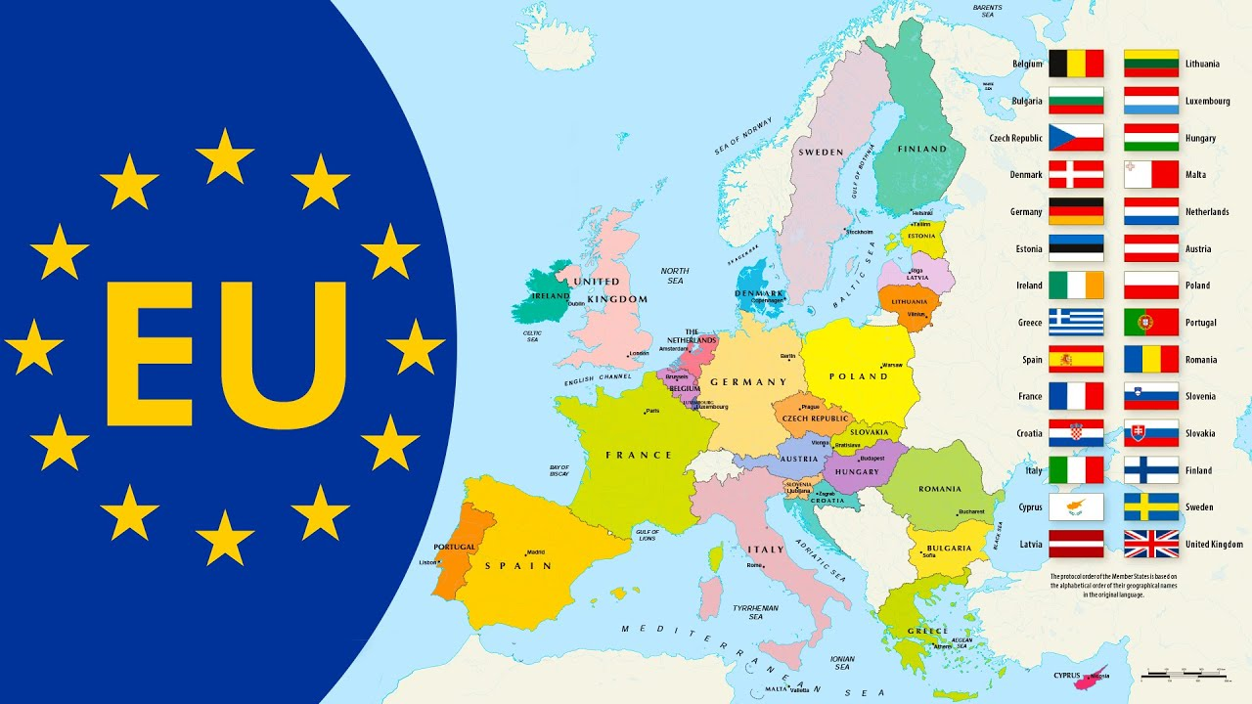
Scandinavia EU and Nato.
Denmark, Sweden and Finland are members of the European Union, but only Finland uses the euro, while the other Nordic countries still use their own currency, each called krone or krona ("crowns").
Norway and Iceland, which are not members of the EU, are members of NATO. Only Denmark and Sweden are member of both the EU and NATO.
You’ll often hear Finland and Iceland lumped into this region, but technically that’s not true.
Finland has strong historic links with the region, and the English-speaking world is prone to include Finland when referring to Scandinavia
Finland is not formally considered part of the Scandinavian region, but the four are all part of the Nordic region.

Slide 5
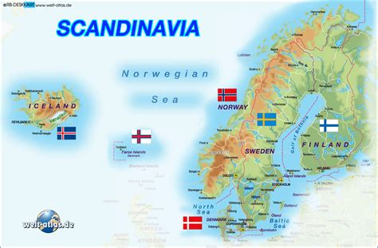
Scandinavia Political Ties.
Finland has very strong political, financial, and cultural ties to the larger Nordic region. Denmark, Norway and Sweden all share portions of the Scandinavian Peninsula, while this isn’t the case for Finland or Iceland. All of these countries, however, are considered to be Nordic countries, which is why you often find them grouped together.
Scandinavia is a historical and geographical region centered on the Scandinavian peninsula of Northern Europe. Theoretically, Scandinavia is defined as the three kingdoms that historically shared the Scandinavian Peninsula.

Slide 6
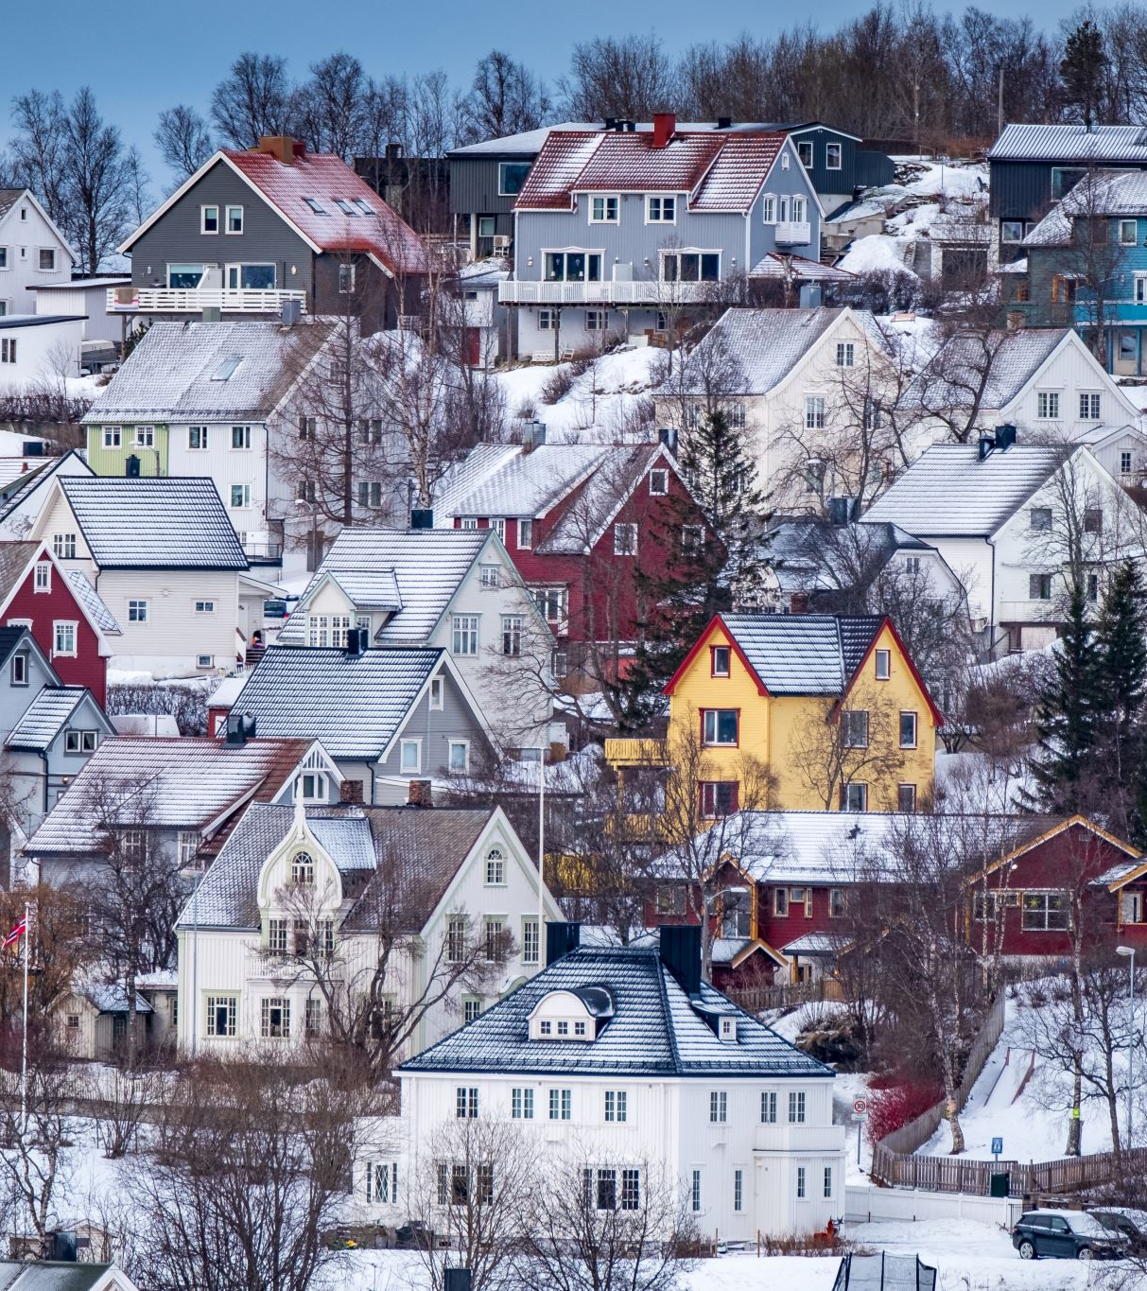
Scandinavian Foundation
Culturally Iceland, Finland, and the Faroe Islands are usually included when referring to "Scandinavia" (Nordic Countries). Scandinavia has a total population of nearly 28 million people.
The term Scandinavia has only been around since the 18th century Scandinavia was coined by Swedish and Danish universities in the 18th century, as they delved into the shared arts, mythology and history of Norway, Sweden and Denmark.

Slide 7
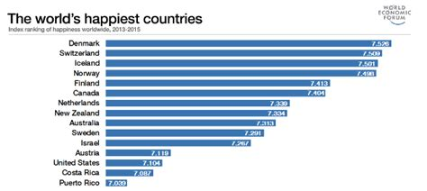
Forget Disneyland, Scandinavia is the happiest place on earth!
In spite of taxes that Americans would consider insanely high, year after year, the Scandinavian countries consistently make the top 10 countries in the United Nation’s World Happiness report.
While there’s no black and white answer as to why this is the case, it’s thought to be due to factors such as extensive welfare benefits, low corruption, a well-functioning democracy, generally higher levels of autonomy and social trust towards each other.
The Nordic countries have a long history of alcohol consumption. Today, alcohol drinking levels are among the lowest in the European Union.

Slide 8
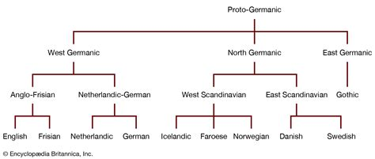
Scandinavian Languages
The Scandinavian languages (Swedish, Norwegian, Danish, Icelandic and Faroese) are closely related, and many Scandinavians are able to understand some of the other languages, with some difficulty.
These languages are generally sorted into East-Scandinavian (Danish, Swedish) and West-Scandinavian (Norwegian, Icelandic) languages. Finnish belongs to the Finno-Ugric language family.

Slide 9
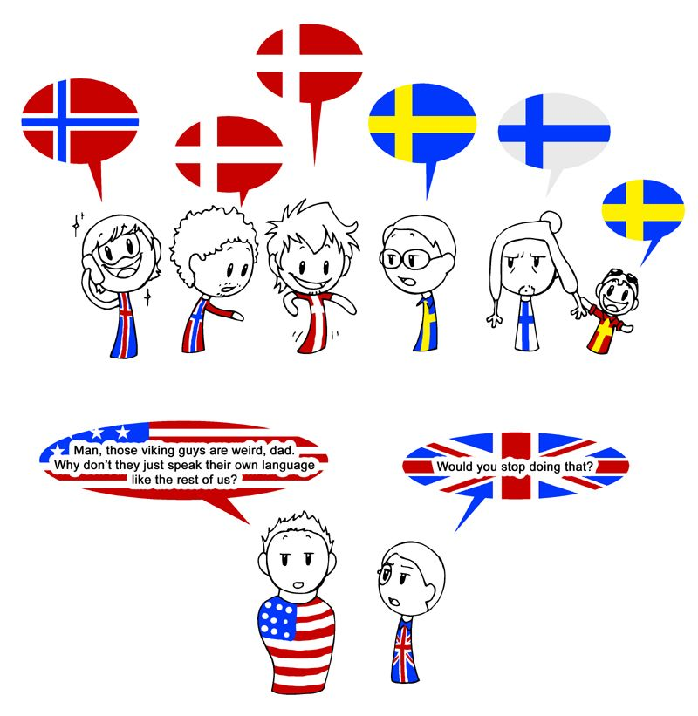
English in Scandinavia
Dialects and strong accents can complicate matters. So much so, that business between Danes, Norwegians and Swedes are sometimes conducted in English just to be sure there are no misunderstandings.
Scandinavians speak excellent English.
Most children in Denmark, Norway and Sweden today grow up at least partly bilingual.
English is taught from a young age in school, while British and American TV and movies are hugely popular.
You'll never get lost only speaking English in Scandinavia!

Slide 10
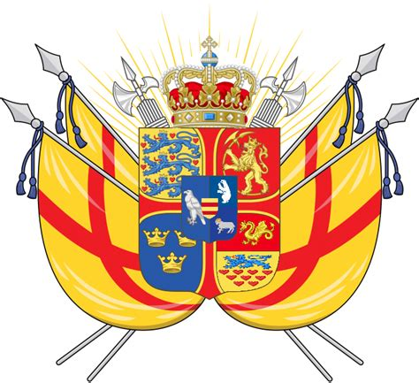
The Kalmar Union
All three countries used to be in a union. The Kalmar Union ran (with a few interruptions) from 1397 until 1523. Denmark, Norway & Sweden retained their separate identity in domestic matters, but foreign and economic policy were directed by a single monarch.
A French Army officer became a Scandinavian King. The man behind the title Karl XIV Johan, who took the Swedish throne, was actually Jean Baptiste Bernadotte.
The Frenchman was a career soldier whose life took an unexpected turn due to the Napoleonic Wars, the decline of Swedish power in the Baltic, and the unexpected early death of a Danish prince.

Slide 11
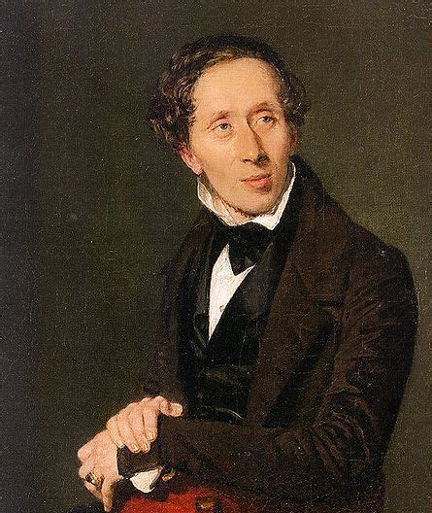
Hans Christian Andersen
The term ‘Scandinavia’ came to be in the 18th century. Some historians say this was a time when ideas about a common heritage started to appear.
The term became political later.
In 1839, Hans Christian Andersen penned ‘I am a Scandinavian’ after a visit to Sweden. He was known as a proponent of political ‘Scandinavism’.

Slide 12
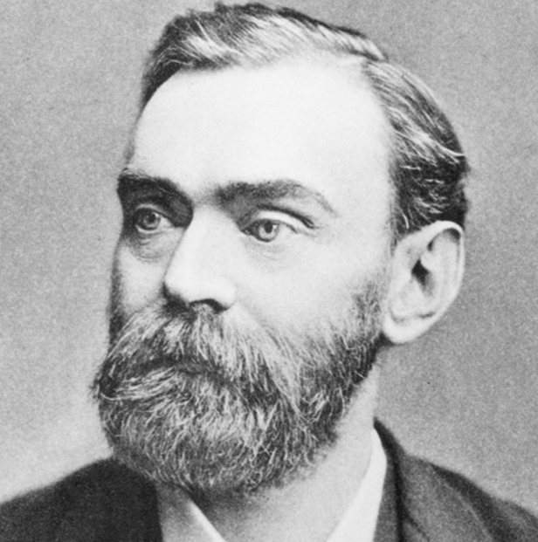
Alfred Nobel
Alfred Nobel, Born on October 21, 1833, in Stockholm, Sweden, the inventor of dynamite, left his fortune to establish the prestigious Nobel Prizes, recognizing outstanding achievements in science, literature, and peace. His legacy continues to inspire generations worldwide.
In his will, Alfred Nobel specified that the prizes should be awarded to those individuals who have made the greatest benefit to humanity.
Aside from dynamite, Nobel held 355 different patents. including a more stable and safer form of nitroglycerin, a blasting cap, and a detonator.

Slide 13
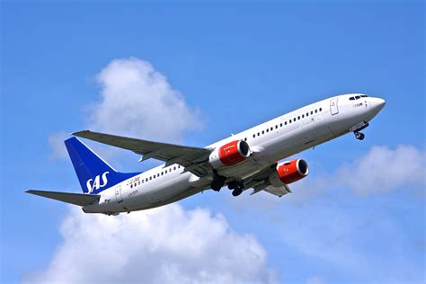
Scandinavian Airlines
Scandinavian Airlines was started by the three governments. In 1946, the three governments formed a consortium to cooperate on transatlantic operations for their national airlines.
Five years later, the individual airlines merged to form SAS. Things have changed now, as the Norwegian government recently sold all its shares.

Slide 14
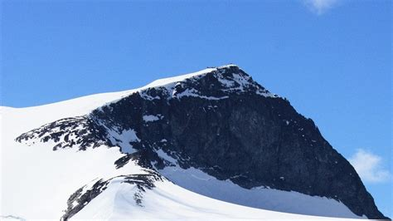
Scandinavia’s Mountains
The Scandinavian mountains are more than 1056 miles long. The range runs right through the Scandinavian peninsular.
At 8100 feet high, Norway’s Galdhøpiggen in Jotunheimen National Park is the highest peak in mainland Northern Europe.

Slide 15
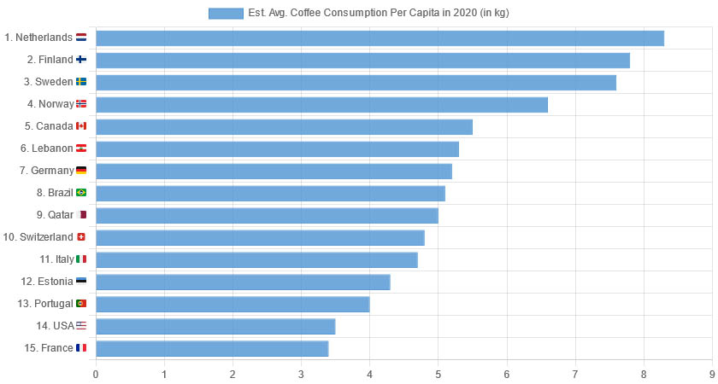
Coffee Culture
The region is coffee-obsessed. Nordic coffee culture is not the secret it used to be. Five Nordic countries place in the world’s six biggest coffee consumers.
The highest Scandinavian country is Norway, which has a per capita elsewhere.
consumption average of 9.9kg every year.
Scandanavia in particular is known for its lighter roast coffees that are starting to catch on in other areas of Europe.

Slide 16
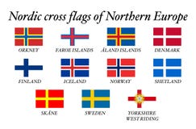
The Nordic Cross
All Nordic countries use the Nordic cross as part of their flag design!
The flags of Denmark, Norway & Sweden all share a similar off-center cross. The colors are different, and the Norwegian flag has a slightly more complex design.
The Scandinavia cross flag originated as a symbol of Christianity and was used on banners during war. The Kalmar Union, which was the kingdom that united Denmark, Sweden, and Norway, as well as parts of Finland between 1397 – 1523, adopted a flag with a red cross and yellow body.

Slide 17
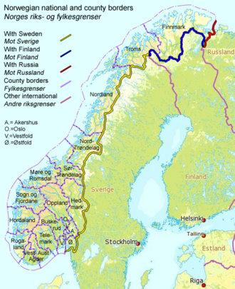
Norway and Sweden’s Boarder
A 1,630km-long EU border splits Norway and Sweden. Sweden is an EU member, Norway is not. Despite this, several of the border crossings in the sparsely populated areas are unattended.
The agreement between the EU and Norway means that Norway is connected to the EU common market.
The border has changed several times because of war. After the Treaty of Kiel and the Convention of Moss (1814), the union between Sweden and Norway was established, and the Norway–Sweden border became a border we see today.

Slide 18
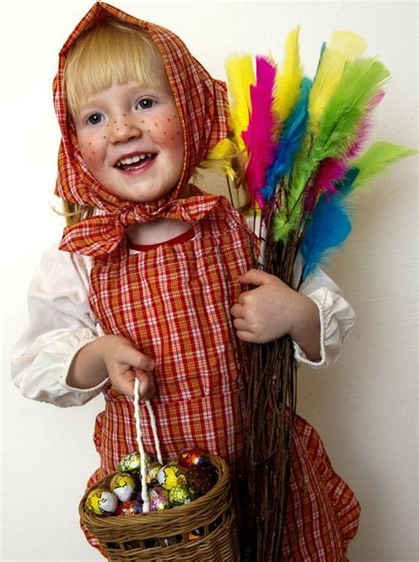
Easter Witches
Swedish kids do Halloween at Easter. They don’t dress up as ghosts or ghouls, rather witches!
Children dress up as Easter witches; clad in discarded clothes, gaily colored headscarves and red-painted cheeks, they go from house to house in the neighborhood and present the occupants with paintings and drawings in the hope of getting sweets in return.

Slide 19
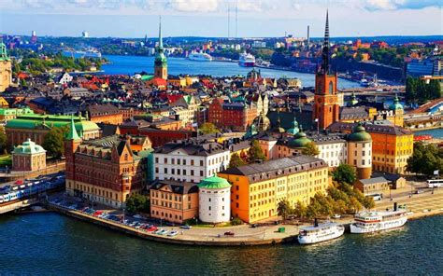
Major Cities in Scandinavia
The cities in Scandinavia are wonderful travel destinations for every visitor in the mood for interesting Scandinavian city life and modern urban atmosphere.
The capitals of the Scandinavian countries are Stockholm (Sweden), Oslo (Norway), Copenhagen (Denmark), Helsinki (Finland), and Reykjavik (Iceland). Other great city destinations include the Norwegian city of Bergen and Malo and Gothenburg in Sweden.

Slide 20
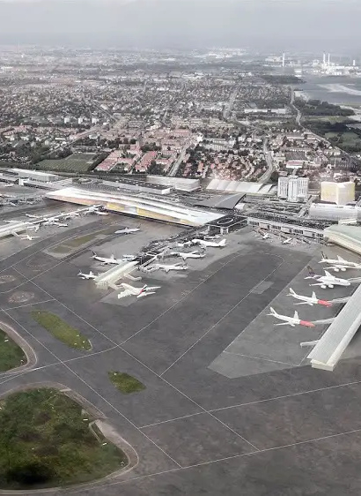
Copenhagen Airport
Copenhagen has the region’s busiest airport. More than 30 million passengers used CPH in 2018. It is a hub for SAS and Norwegian Air and offers long-haul flights to Asia and the USA. Oslo Airport (OSL) ranks second with 28.5m passengers, with Stockholm Arlanda (ARN) ranked third.
More than 1.7 million passengers passed through Copenhagen Airport during the opening month of 2024, a 7 per cent year-on-year increase.

Slide 21
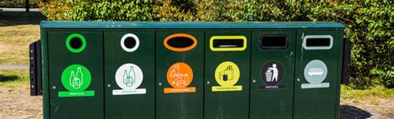
Swedes are big on recycling.
More than half of the world’s waste — 59% of it, in fact — ends up in landfills. This means that most of the world’s trash eventually ends up releasing toxins that contaminate the soil and groundwater and emit dangerous greenhouse gases.
Sweden is setting an example for the rest of the world. Less than 1% of Sweden’s household waste ends up in landfills. Of the 4.4 million tons of household waste produced by the nation every year, 2.2 million are converted into energy by a process called waste-to-energy (WTE).

Slide 22
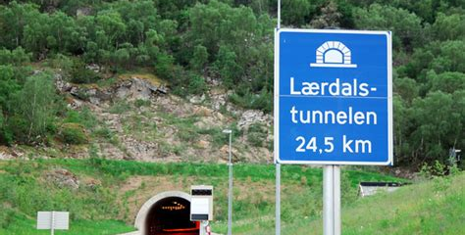
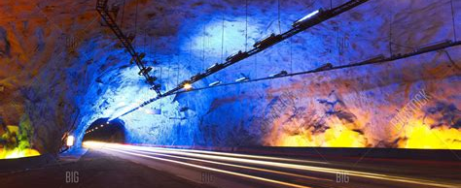
Norway’s Tunnel
The world’s longest road tunnel is in Norway Connecting the small towns of Lærdal and Aurland is the 24.5km long Lærdal Tunnel.
With unique features to help manage the mental drain on drivers, the design has been admired throughout the world.
Every 6 kilometres you’ll come across caves that break up the monotony of the tunnel, and the lighting also changes throughout to try and keep the drive interesting.

Slide 23
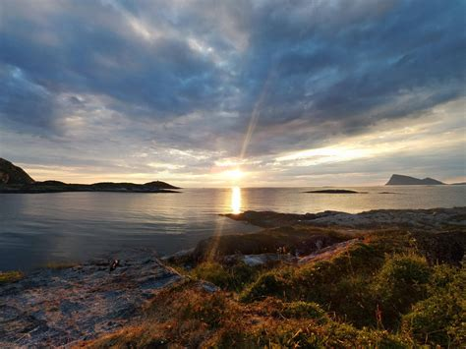
Midnight Sun
Norway is home to the Midnight Sun phenomenon that occurs in summer around the Arctic circle and is a period of time where the sun never sets.
Due to its northern location, you can also experience this phenomenon in Svalbard in Norway’s north. Here, the sun doesn’t set at all between 20 April and 22 August each year!
Some parts of Norway only get 3 hours of sunshine a day in winter… or none at all!

Slide 24
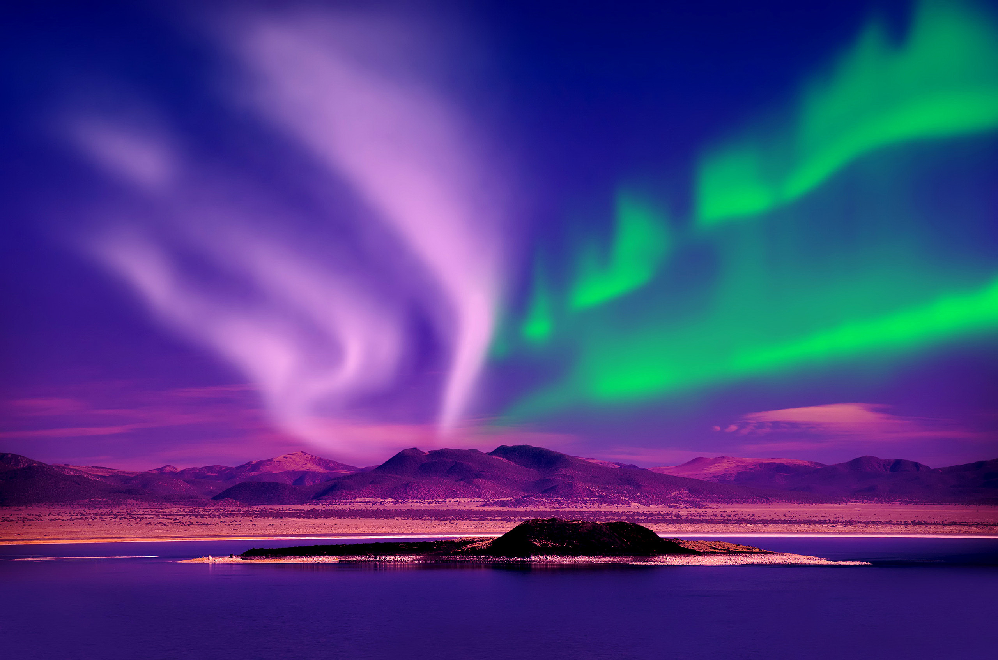
Northen Lights
Scandinavia puts on quite a show year-round, and it's free. The northern lights are an atmospheric phenomenon that's regarded as the Holy Grail of skywatching.
The northern lights, or the aurora borealis, are beautiful dancing ribbons of light that have captivated people for millennia.
The northern lights are created when energized particles from the Sun slam into Earth's upper atmosphere.

Slide 25
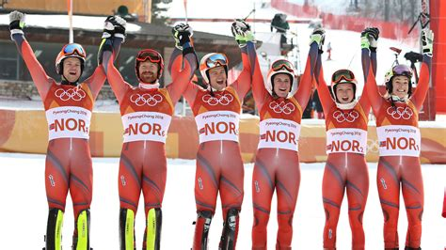
Norway dominates in the Winter Olympics
Since the Winter Olympics first began back in 1924, Norway has won a total of 368 medals, including 132 gold, which is far more than any other country. Cross-country skiing and speed skating are the country’s specialties, with more than half of the medals coming from these two sports.
At the last two Winter Olympics, Norway reset the records for total medals a single Winter Games (39) and gold medals at a single Winter Games (16).

Slide 26
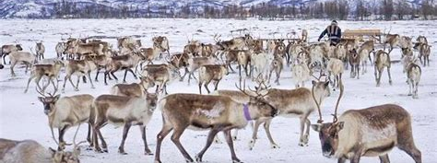
Reindeer Herders
Norway has the most reindeer herders in the whole world. The habitants and herders have a great relationship. People were initially hunting the reindeer. Later they started domesticating them, then finally breeding them

Slide 27
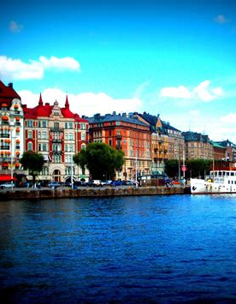
Sweden
Stockholm is known as the ‘Venice of the North’ Sweden’s elegant capital is located on the south-east coast, on the Baltic Sea. Spread across 14 islands of distinctly different character, and connected by 57 bridges, it’s easy to see why it is often referred to as the ‘Venice of the North’.
Europe’s oldest national parks are in Sweden With so much incredible natural beauty across the country, we can understand why in 1909 Sweden was the first country to establish national parks. In that year, nine national parks were created, but today there are 29 that cover a combined area of 731,589 hectares.

Slide 28
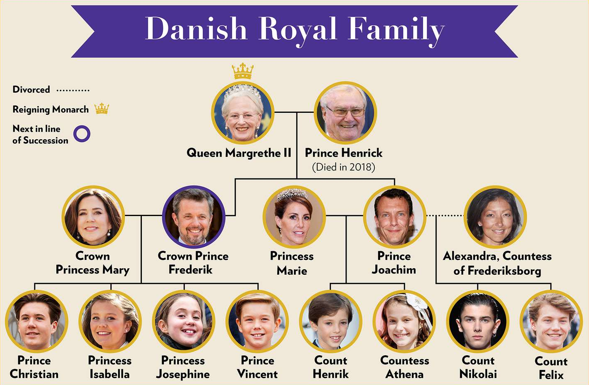
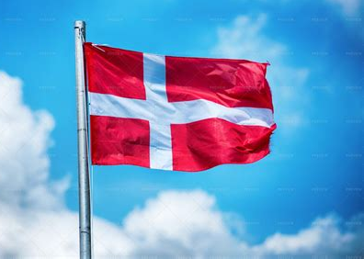
Denmark
The Danish monarchy is one of the oldest in the world The Danish Monarchy began way back in the year 935, and is still in place today. Beginning as an elective monarchy, it changed to a hereditary monarchy in the 17th century, before becoming the constitutional monarchy it remains as today in 1849.
The Danish flag is the oldest in the world Denmark’s iconic red flag with a white cross is thought to have first appeared back in 1219, inspiring the Dane’s to victory against Latvia in the Battle of Lyndanisse.

Slide 29
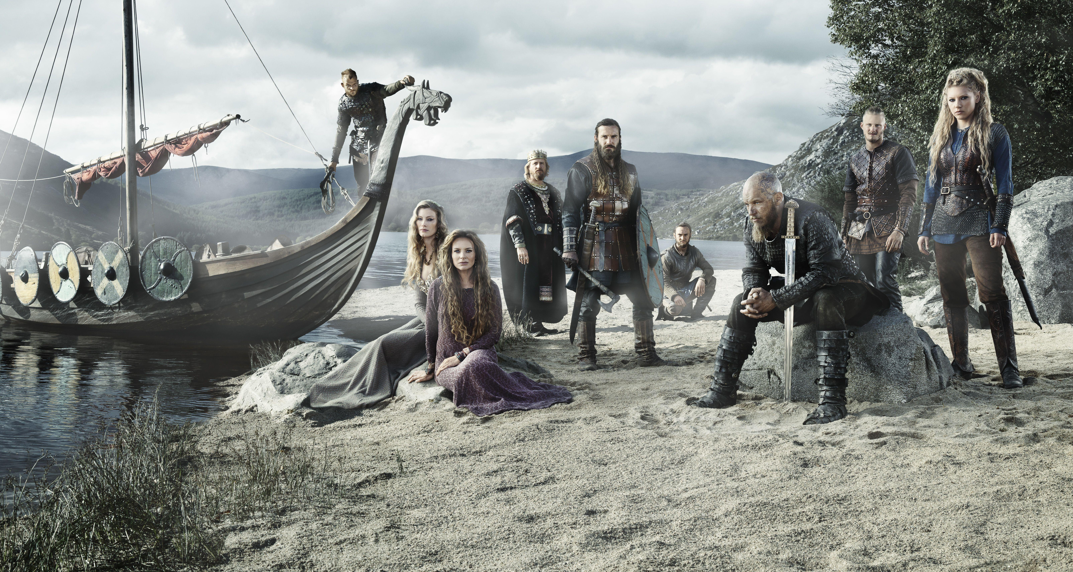
Scandinavian People
The best-known stereotypes of Scandinavian people relate to the Vikings of the Middle Ages. The Vikings from Sweden are best known as traders, traveling as far as what we now know as Ukraine and starting trade routes to bring goods from the Middle East to Scandinavia. The Vikings from Norway are best known as explorers, crossing the North Atlantic in their longships and settling Iceland and Greenland.
The Norwegian explorers even reached the east coast of what we now call Canada, where they set up a colony, but it only lasted a few years. The Vikings from Denmark, however, left the biggest mark on the English. The Danish raiders attacked England repeatedly and brutally, demanding payment that came to be called "Danegeld" (Danish gold) and making the priests and bishops of churches along the eastern coast England say and write down the famous prayer, "deliver us, O Lord, from the wrath of the Norsemen!" But the modern stereotypes of the Vikings actually were invented much later, in the 19th century, when Richard Wagner and other people of the Romantic period (1800s) invented descriptions of ancient Germanic culture in the opera and the other arts, often showing

Slide 30
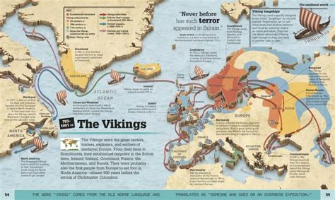
Scandinavian People
The Norwegian explorers even reached the east coast of what we now call Canada, where they set up a colony, but it only lasted a few years. The Vikings from Denmark, however, left the biggest mark on the English. The Danish raiders attacked England repeatedly and brutally, demanding payment that came to be called "Danegeld" (Danish gold) and making the priests and bishops of churches along the eastern coast England say and write down the famous prayer, "deliver us, O Lord, from the wrath of the Norsemen!"
Modern stereotypes of the Vikings actually were invented much later, in the 19th century, when Richard Wagner and other people of the Romantic period (1800s) invented descriptions of ancient Germanic culture in the opera and the other arts, often showing Vikings wearing furs and winged or horned helmets and drinking from large horns. This is just wrong.

Slide 31
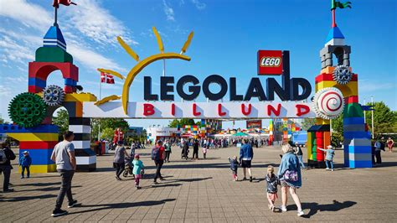
LEGOS®
The worldwide-known LEGO brand was founded in Denmark, in the beginning, however, instead of toys they were producing wooden stairs and Lego started as wooden blocks!
LEGO came into being around 1930, when a Danish carpenter from Billund in Jutland fell on hard times building houses. He supplemented his trade making wooden toys and was so successful that he was soon only making his wooden building blocks.
He called the company LEGO®, a mix of the Danish words for 'to play' - 'at lege' and 'good' - 'godt'. It was the perfect name for a perfectly simple toy.

Slide 32
Thankyou for Coming!
I hope you enjoyed my talk!
If you have any more questions, please ask.
I will do my best to answer them for you.
I can be reached by e-mail at
marcs@sonic.net

