Slide 1
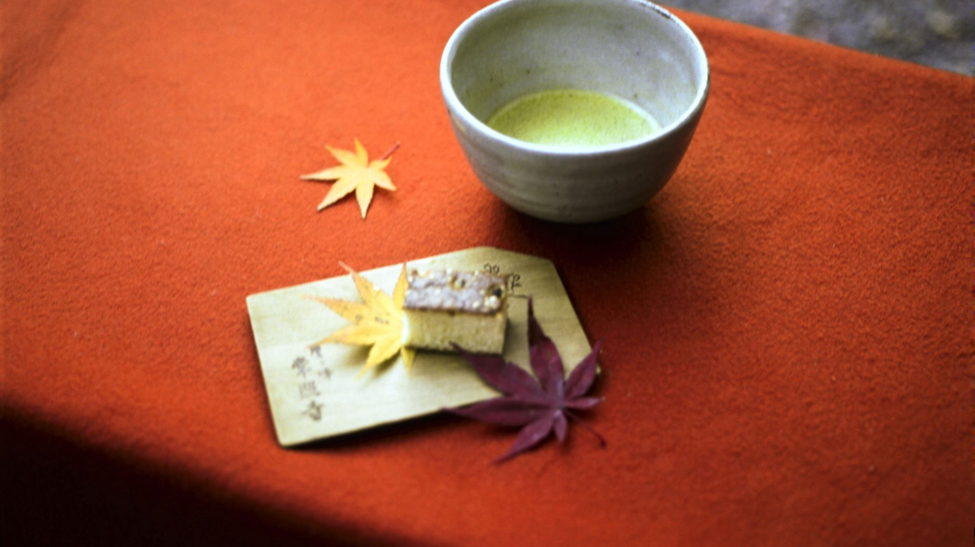
Sasebo, Japan
Presented by
Marc Silver

Slide 2
What I Will Cover
My Port Philosophy
Don’t Miss the Ship
Money
About Sasebo, Japan
History of Sasebo
Points of Interest
Places to see or at least consider
A few restaurant recommendations
Conclusion

Slide 3
My Port Philosophy
I have been cruising for over 44 years and have taken over 200 cruises.
So, I consider myself an experienced cruiser.
The information I will present is based on those many years of
experience.
When I am on a cruise where the city, I want to visit is not the port city,
I always recommend taking a ship’s tour.
But when I am in a port with multiple attractions nearby and easy to see
on my own -
I will do it on my own.
This presentation is for that type of port.

Slide 4

Don’t Miss the Ship
How to Avoid Missing Your Ship
Pay attention to the time. - Ship time and local time are often
different.
Put a return-to-ship reminder on your phone.
Choose excursions wisely.
If a ship-sponsored excursion is late returning to port, the ship will
wait for you. If you are on your own???
Be Prepared
Have your Passport, Credit Card, and phone numbers for your ship
port agent.
What to Do If You Miss the Ship
Most cruise lines have port agents stationed in the port area to assist if your ship has left without you. If your are lucky, when cruisers are late returning to the vessel, the ship’s crew will often remove the passengers’ essential items – passports, cell phones, and medication -- from the ship to leave with the port agents.
The Port Officials can help you with contacting your ship
and making necessary travel arrangements.

Slide 5
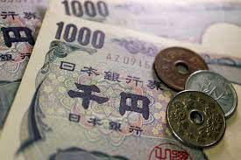
Money
The Yen is the official currency of Japan
Official Exchange is 100 Yen is 72 cents US
Or 142.15 Yen to the US Dollar

Slide 6
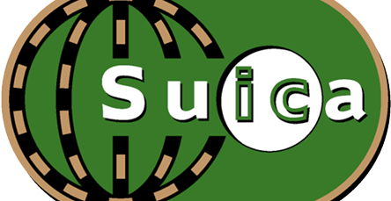
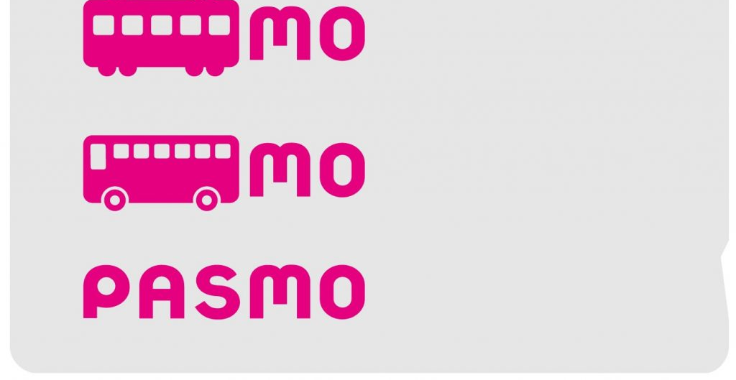
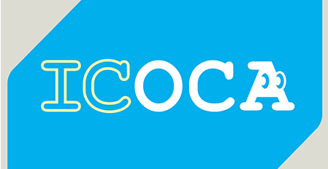
PASMO, Suica, & ICOCA Cards
The PASMO, Suica, and ICOCA Cards are e-money IC cards that can be used for travel and shopping across Japan.
Cashless fare payment
Use it for shopping
No waiting for change
Get special privileges
Apple phone users can also link with all three cards.
PASMO refunds - If you no longer need your PASMO, it can be refunded. Suica and ICOA cards do not offer refunds.

Slide 7
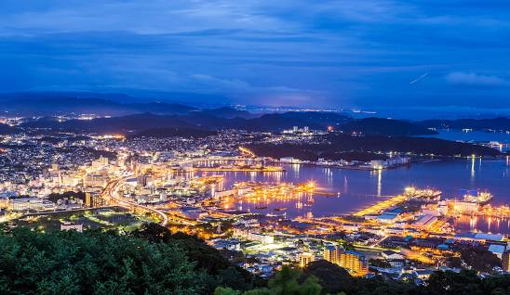
About Sasebo
Sasebo is a city on Japan’s Kyushu Island. It's known for Huis Ten Bosch, an amusement park modeled after a Dutch town, with canals, replica buildings, windmills, and flower gardens. Kujukushima Aquarium has dolphins, coral reefs, and many jellyfish. Off the coast, boats cruise
among the forested Kujukushima Islands, part of Saikai National Park. To the south, Saikai Bridge is a popular spot to view cherry blossoms.

Slide 8
History of Sasebo
The area of present-day Sasebo was a small fishing village under the control of the nearby Hirado Domain until shortly after the start of the Meiji period. Imperial Japanese Navy Admiral Tōgō Heihachirō, when surveying the coasts of northwestern Kyūshū for the site of a navy base, selected his location based on its protected, deep-water harbor, geographic proximity to China and Korea, and the presence of nearby coal fields. Sasebo Naval District, founded in 1886, became the major port for the Japanese navy in its operations in the First Sino-Japanese War and Russo-Japanese War and remained a major naval base to the end of World War II. Along with the base facilities, the navy also constructed the Sasebo Naval Arsenal, which included major shipyards and repair facilities.
Sasebo City was founded on April 1, 1902. The city which had 206,000 inhabitants in 1945 suffered severe damage by bombing on June 29, 1945, during World War II. 48% of the city was destroyed. Sasebo was one of the original 17 targets selected for the dropping of the atomic bomb.
After the end of the war, part of the base facilities were taken over by the United States Navy, forming U.S. Fleet Activities Sasebo. Some parts of the base are shared with the Japan Self-Defense Forces, in particular the JMSDF, though the primary base of the JGSDF's Western Army Infantry Regiment is also among the facilities there.

Slide 9
Points of Interest
US Navy Sasebo Base
Sasebo Harbor
Kujukushima Aquarium
Yumiharidake Lookout
Sasebo Morning Market
Maritime Self-Defense Force Sasebo Museum
Tenjin Park
Yumiharidake Lookout
Kujukushima Zoological and Botanical Garden
Kujuku Islands

Slide 10
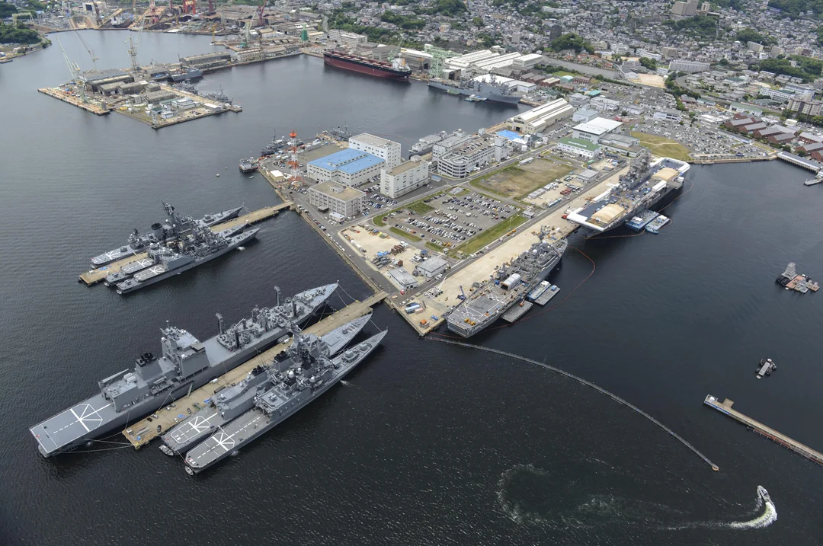
US Navy Sasebo Base
US Navy Sasebo Base is just bursting with military history. If this interests you, check for any tours and special events.
This military installation doesn't cost a thing to visit, which is welcome news if you're watching your pennies. US Navy Sasebo Base is located in Sasebo. After your visit, Sasebo Harbor, Kujukushima Aquarium, and Yumiharidake Lookout are close by and also worth exploring.

Slide 11
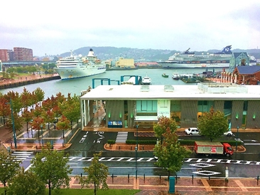
Sasebo Harbor
It was from Sasebo Harbor that the Japanese Navy sortied for war with China over influence in Korea, during the first Sino-Japanese War in 1894, and later, where Admiral Togo set sail with his Combined Fleet, to engage Russia's Baltic Fleet in what would become Japan's epic and victorious Battle of Tsushima Strait

Slide 12
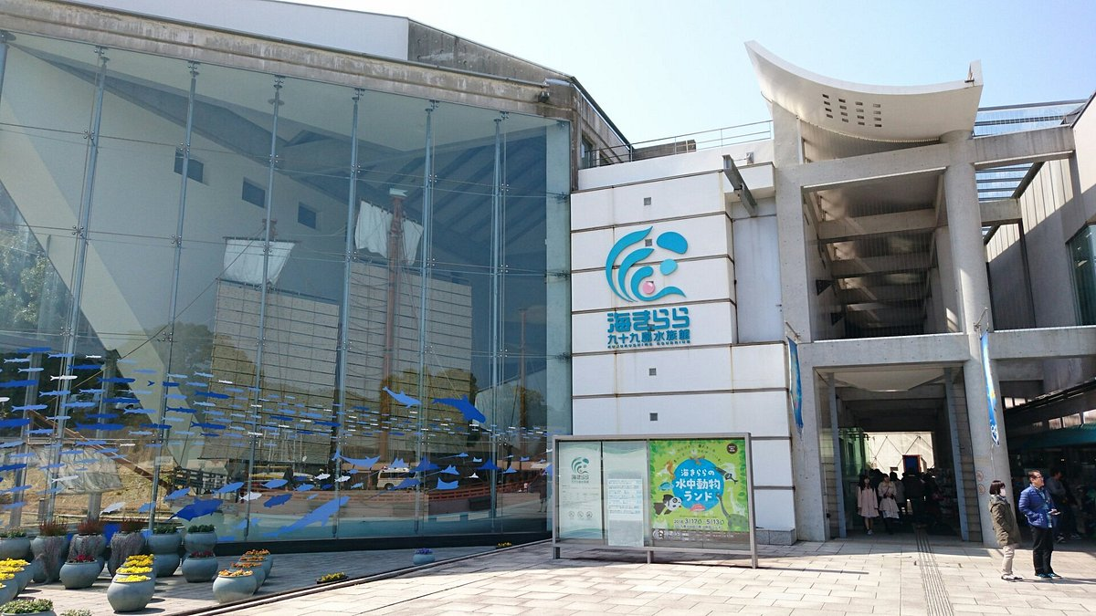
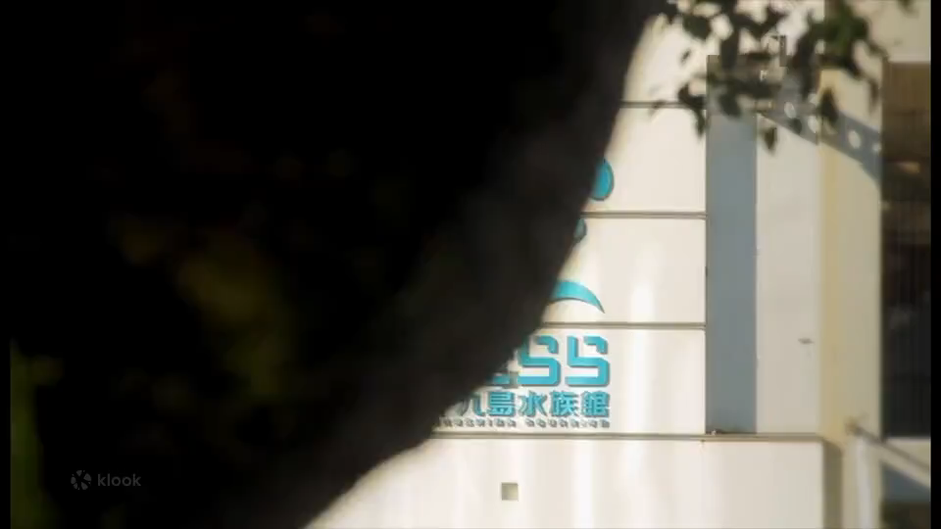
Kujukushima Aquarium
Visit the massive Kujukushima Aquarium to see Japan's only outdoor water tank. Immerse yourself in the tranquil marine world. Learn about marine life and view a variety of species in their natural habitat.
Explore different exhibit areas in the Kujukushima Aquarium
Learn more about a variety of intelligent animals by watching animal shows
Participate in the pearl harvesting activity and take home a gorgeous pearl (pearl jewelry is subject to surcharges)
Admission US$ 9.69 / 1,370 JPY

Slide 13
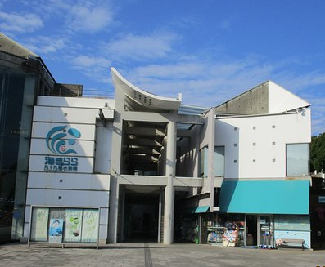
Kujukushima Aquarium
The Kujukishima aquarium introduces the creatures that inhabit Kujukushima in Saikai National Park. Approximately 370 species (16,000 individuals) including fish, dolphins, and jellyfish are on display. There is a jellyfish exhibition corner, one of the largest in Japan, and a large outdoor tank, which is rare in Japan.
Admission: USD $9.27

Slide 14
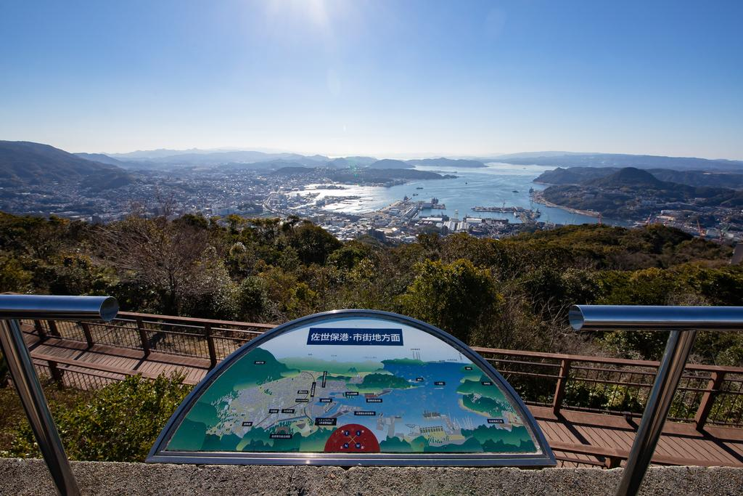
Yumiharidake Lookout
To the west of the observatory is Kujukushima; on a clear day, one can even see the Goto Islands in the far distance. To the south of the observatory is Sasebo Port and its deep cove. To the East of the observatory is the beautiful cityscape of Sasebo.
Yumiharidake Observatory offers both spectacular daytime view of Kujukushima, as well as the dazzling night view of Sasebo City and Sasebo Port.

Slide 15
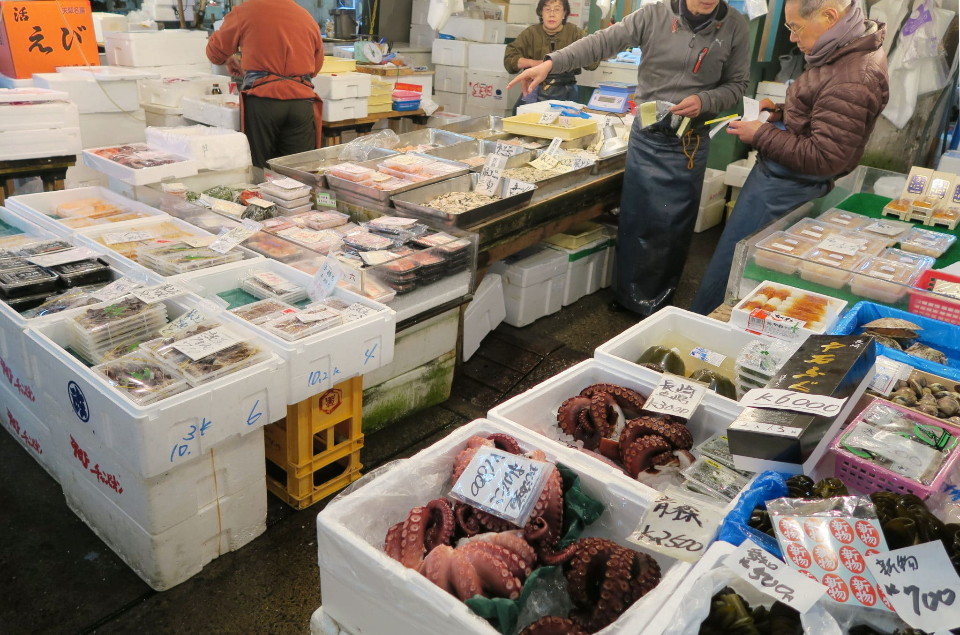
Sasebo Morning Market
For great early-morning sightseeing, visit the Sasebo Morning Market, about a ten-minute walk from Sasebo Station. Things start moving at an eye-opening three o’clock in the morning, but the peak hours for goods are between five and seven o’clock, so you can still enjoy the morning market without sacrificing that much sleep. In addition to freshly caught seafood, you will find fresh produce, tsukemono pickles, dried foods and many other delectables to buy.

Slide 16
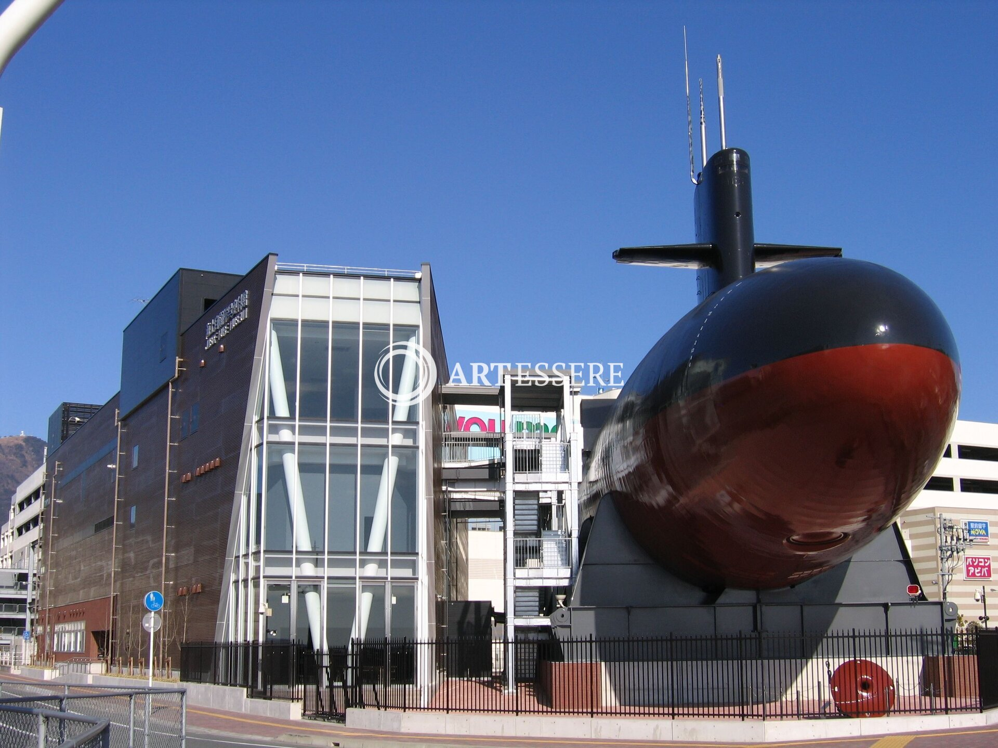
Maritime Self-Defense Force Sasebo Museum
Discover what inspires acts of warfare and peace, as well as the machinery used in times of hostility, at the Maritime Self-Defense Force Sasebo Museum. The collections here bring battles to life.
You’ll find this exhibition of military memorabilia in Sasebo. If you’re looking for things to do on a budget, you’ll be happy to hear entry is free. When you’re done at the Maritime Self-Defense Force Sasebo Museum, check out some nearby attractions. Sasebo Harbor, Kujukushima Aquarium and Yumiharidake Lookout are traveler favorites.

Slide 17
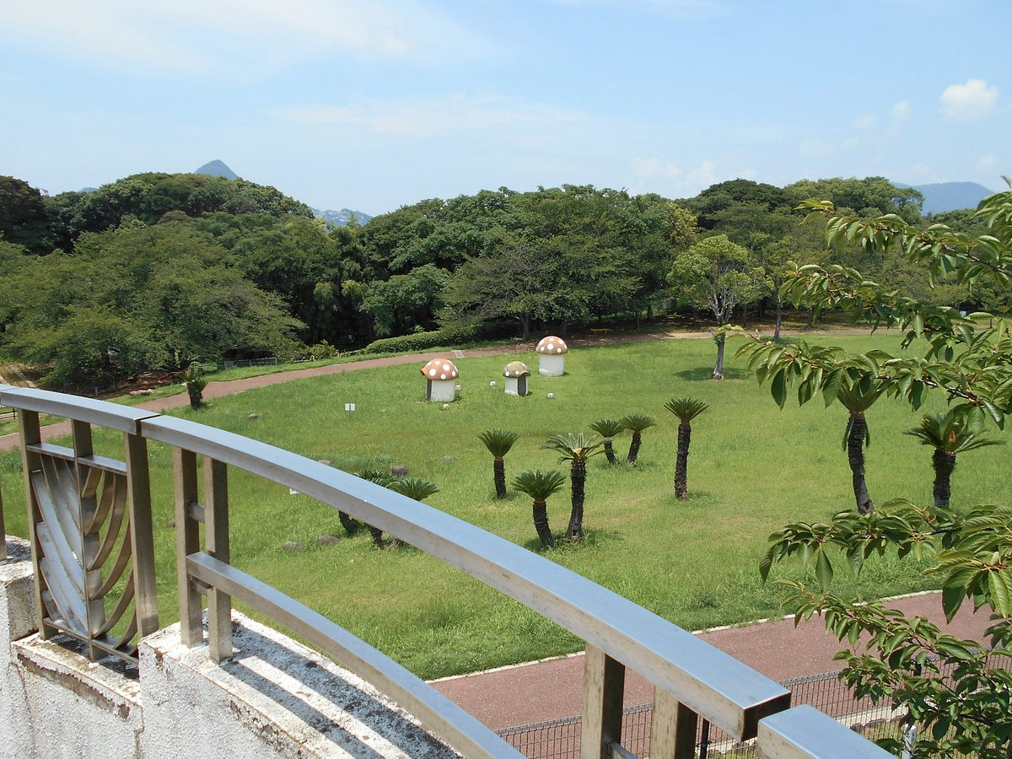
Tenjin Park
Take things slower at Tenjin Park. Kick back with a good book or lie on the soft grass and rest for a while.
If you love the word "free" as much as most do, you'll be glad to know this recreation and green space is exactly that. Tenjin Park is located in Sasebo. If you want to keep your sightseeing schedule full while you're in these parts, also stop by Sasebo Harbor, Kujukushima Aquarium and Yumiharidake Lookout.

Slide 18
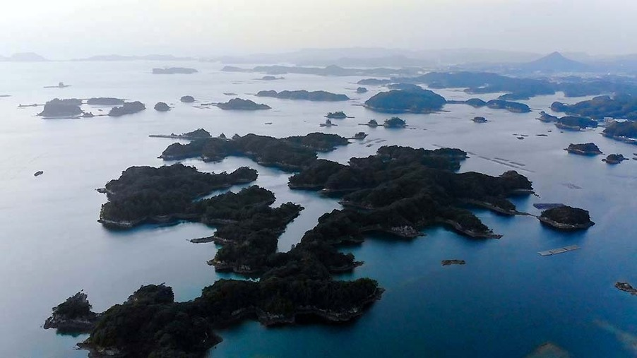
Yumiharidake Lookout
About 20 minutes outside the city center is the Tenkaiho Observatory. From here, you can see wide, beautiful panoramas of the scenery that take in the complex Rias coastline and the 208 Kujuku Islands. This area served as the opening to The Last Samurai. It is always beautiful here, and when the sun sets, it feels like there is magic in the air.

Slide 19
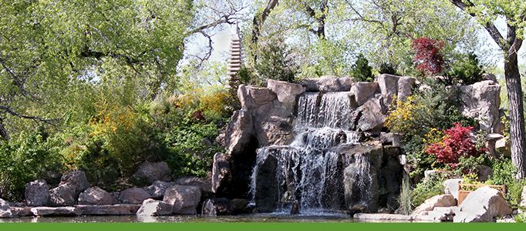
Kujukushima Zoological and Botanical Garden
The staff at Kujukushima Zoological and Botanical Garden have an extensive knowledge about the critters they look after. Ask them questions about your favorite animals as you explore the grounds.
Need to know where
Kujukushima Zoological and Botanical Garden is situated? It's in Sasebo, and an entry fee applies. If you have spare time, swing by Sasebo Harbor, Kujukushima Aquarium, and Yumiharidake Lookout too. They're not far from the wildlife attraction.
Admission 830yen

Slide 20
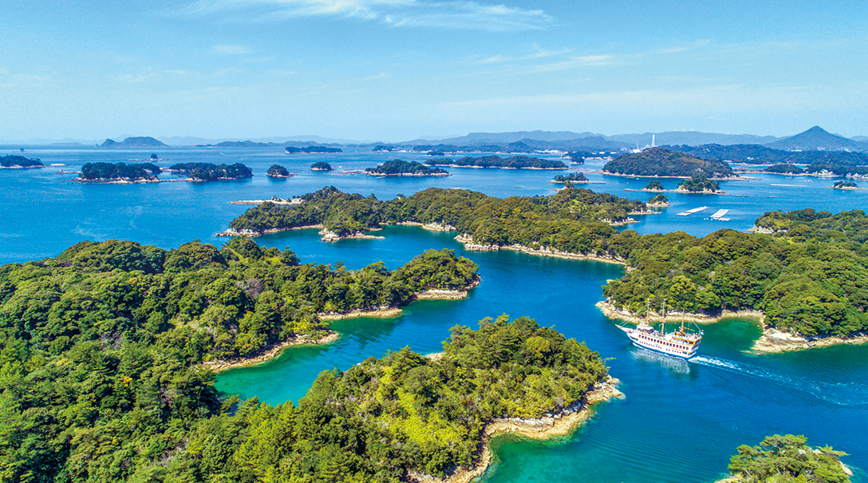
Kujuku Islands
About 20 minutes outside the city
center is the Tenkaiho Observatory.
From here, you can see wide, beautiful
panoramas of the scenery that take in
the complex Rias coastline and the 208
Kujuku Islands. This area served as the
opening to The Last Samurai. It is
always beautiful here, and when the
sun sets, it feels like there is magic in
the air. With the rays of the setting sun reflecting off the water and the islands in silhouette, it seemed as though I was looking at a black ink painting. Well worth finding a tour from the ship.

Slide 21
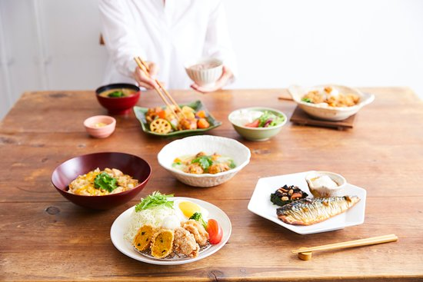
Sasebo Restaurants
Sasebo has multiple any excellent restaurants. Many of us on the ship are foodies, so naturally, we’re always on the hunt to eat at the most exclusive spots anytime we travel.
Here are a few Restaurants to consider:
Anchor's Lounge $$$$ Cafe
De Admiral $$$$ French
OOTOYA Sasebo Gobangai $$$$ Japanese Healthy
Koran $$ - $$$ Chinese
Hachimura Restaurant $$ Japanized western restaurant
For those of you that just like good food, you can’t go wrong just about anywhere you go in Sasebo.
GOOD EATING

Slide 22
Conclusion
Sasebo is a beautiful City with a rich history and numerous attractions. Whether you're looking for stunning beaches, historic sites, or unique attractions, Sasebo has something for everyone.
I hope this presentation will help when we visit Sasebo!

Slide 23
Thanks For Coming
If you have any more questions, please ask.
I will do my best to answer them for you.
Have a great visit to Sasebo!

