Slide 1

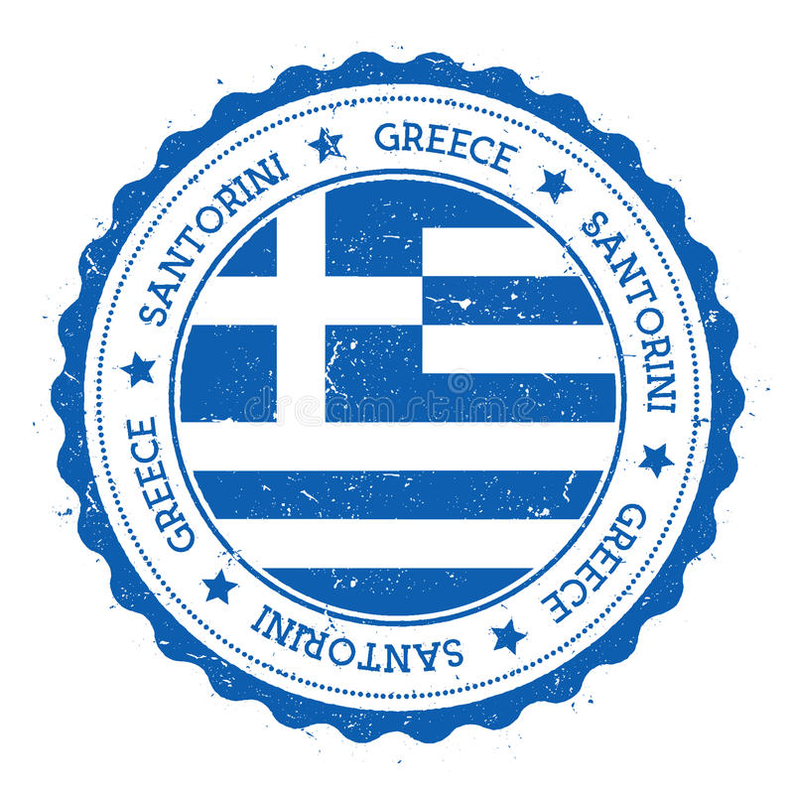
Santorini Greece
Port Presentation
Presented by
Marc Silver

Slide 2
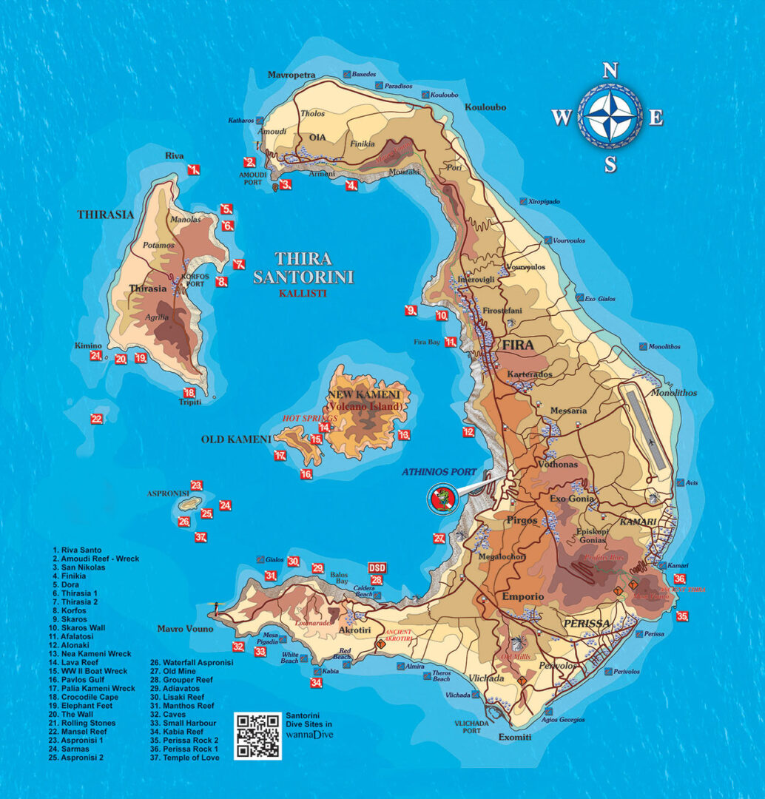
Santorini Greece
Santorini is one of the Cyclades islands in the Aegean Sea. It was devastated by a volcanic eruption in the 16th century BC, forever shaping its rugged landscape.
The whitewashed, cubiform houses of its 2 principal towns, Fira and Oia, cling to cliffs above an underwater caldera (crater). They overlook the sea, small islands to the west and beaches made up of black, red and white lava pebbles. .

Slide 3
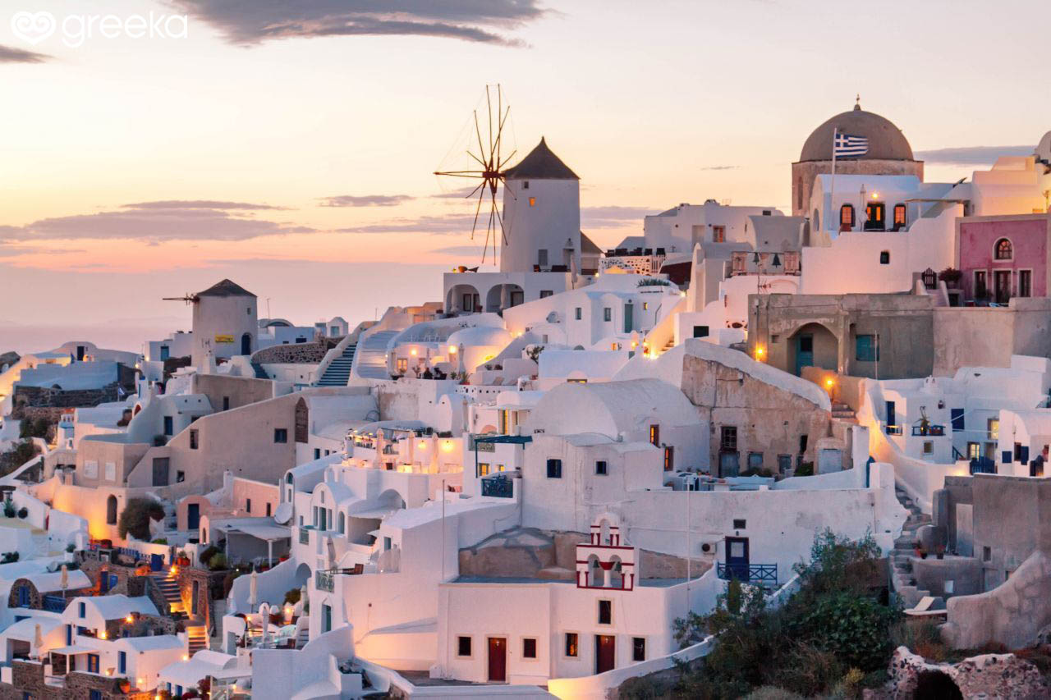
Santorini Greece
Today, Santorini consists of two inhabited islands and several islets. Most visitors spend their time on Thira (the archipelago's largest island), which is home to Santorini's major towns, including Fira and Oia (Wee). Sleepy Thirassia makes for a relaxing daytrip
too. And don't count out the quieter islands: Nea Kameni and Palea Kameni are worth exploring.

Slide 4
What I Will Cover
My Port Philosophy
Don’t Miss the Ship
Money
History of Santorini
A few interesting facts about Santorini.
Places to see or at least consider
A few restaurant recomendations
Best way to get around Santorini

Slide 5
My Port Philosophy
I have been cruising for over 43 years and have taken over 100 cruises. So I consider myself an experienced cruiser.
The information I will present is based on those many years of experience.
When I am on a cruise where the city I want to visit is not the port city, I always recommend taking a ship’s tour.
But when I am in a port with multiple attractions nearby and easy to see on my own - I will do it on my own. This presentation is for that type of port.

Slide 6
Don’t Miss the Ship
How to Avoid Missing Your Ship
Pay attention to the time. - Ship time and local time are often different.
Put a return to ship reminder on your phone.
Choose excursions wisely.
If a ship-sponsored excursion is late returning to port for, the ship will wait for you. If you are on your own???
Be Prepared
Have your Passport, Credit Card and phone numbers for your ship port agent.
What to Do If You Miss the Ship Most cruise lines have port agents stationed in the port area to assist if your ship has left without you. If your lucky, when cruisers are late returning to the vessel, the ship's crew will often remove the passengers' essential items -- passports, cell phones and medication -- from the ship to leave with the port agents.
The Port Officials can help you with contacting your ship and making necessary travel arrangements.

Slide 7
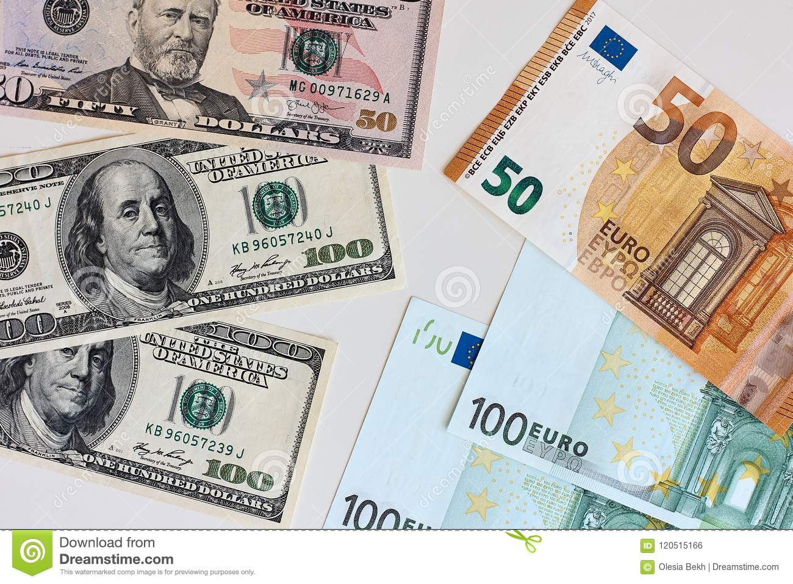
Money
The euro is the official currency of 20 European Union countries which collectively make up the euro area, also known as the eurozone.
Official Exchange is €1 to $1.079 US

Slide 8
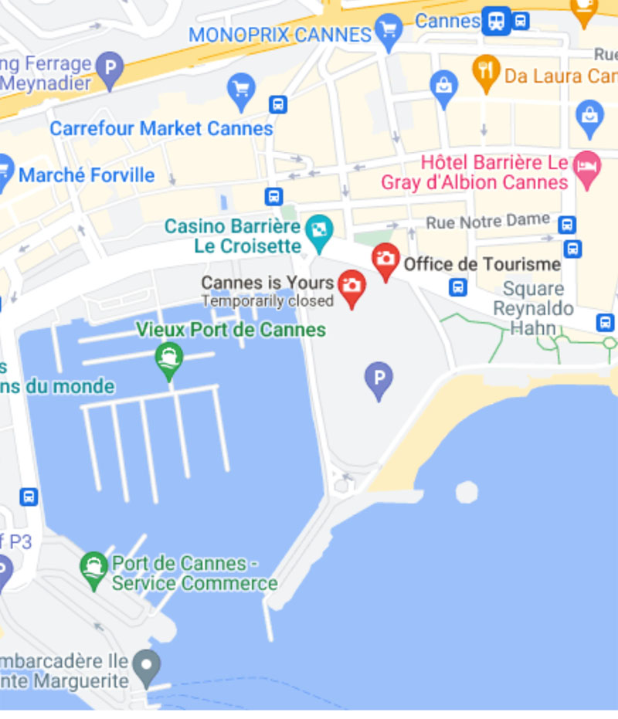
Tourist Office Thera
Tourism Office provides a tourist information service and attention to the city's visitors.
Just walk to the end of the dock to find the Santorini Tourist Center.
1 Bd de la Croisette, 06400 Santorini, Greece
Phone: +33 49299-8422

Slide 9
Santorini Early History
According to the Greek historian Herodotus, the first people to reach the island again were the Phoenicians in the 13th century BC, who gave it the name Kallisti (the most beautiful) as they were mesmerized by its extraordinary beauty.
About one century later, Dorians from Sparta settled in the island and they name it Thera after their king, Theras.
During the 9th century BC, Santorini was a Dorian colony and the settlement of Ancient Thera at its center.
Santorini along with the southeast shores of the Aegean Sea, Crete, Milos and Cyprus, was an important crossroad between the West and the East.
The Phoenician alphabet for written Greek and later the residents started to make contacts with other Greek regions.
In 630 BC the Santorinians made their first and only colony in Africa, the Ancient City of Cyrene, and after that a long period of drought, presumably seven years, hit the island.

Slide 10
Santorini Early History
In 630 BC the Santorinians made their first and only colony in Africa, the Ancient City of Cyrene, and after that a long period of drought, presumably seven years, hit the island.
In the 6th century BC they coined their own money but during the Persian Wars they were subjugated to Persians and the mint closed down.
During the Peloponnesian War they were on Sparta’s side but in 426/425 BC they were part of the Athenian Empire. Later, Santorini became part of the Roman Empire.
During the Byzantine years the island was embodied in the Byzantine Empire but it did not play a significant political or military role. Christianity first appeared on Santorini during the 3rd or 4th century AC when the first church was constructed, Episkopi of Thera that had its own bishop.

Slide 11
Santorini History
After the fall of Constantinople to the Crusaders of the 4th Crusade in 1204, Santorini and the rest of the islands of the Aegean Sea were under the rule of Marco Sanudo, who created the Duchy of Naxos. He later granted Santorini and Therasia to Giacomo Barozzi, whose descendants ruled the island until 1480.
The name Santorini was given from the Crusaders, after a chapel of Saint Irene (Santa Irini). The fate of the Duchy was its annexation to Venice in 1487.
From 1579 to 1821 the island was under the Turkish rule and the Turks named it Dermetzik, which means small mill, probably because of the numerous windmills on the island.
In the Greek War of Independence the fleet of Santorini was very powerful. Santorini was finally annexed to Greece in 1912.

Slide 12
Santorini Modern History
Until the end of the 19th century Santorini had a flourishing shipping trade and the export of goods included cotton, textiles, agricultural products and, of course, its famed wine. This prosperity reached to an end in 1956, after a catalytic earthquake and a volcanic eruption that followed, which caused incalculable damage.
Decline and desertion pervaded the island until 1970 with the introduction of the tourism industry, when the reconstruction of the island started and more and more people visited it.
Nowadays, all these incidents belong to the past and Santorini is one of the most sought-after destinations worldwide.

Slide 13
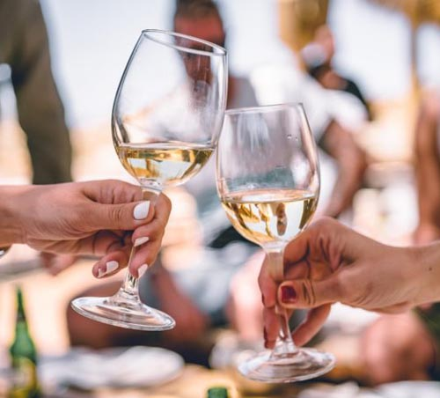
Intersting Facts about Santorini
Santorini has the best wine in the whole of Greece
Strogill, Kallisti and Theras are the other names of Santorini
Different rulers ruled Santorini
Greco-Roman architecture is dominant in Santorini
Santorini is an active volcano

Slide 14
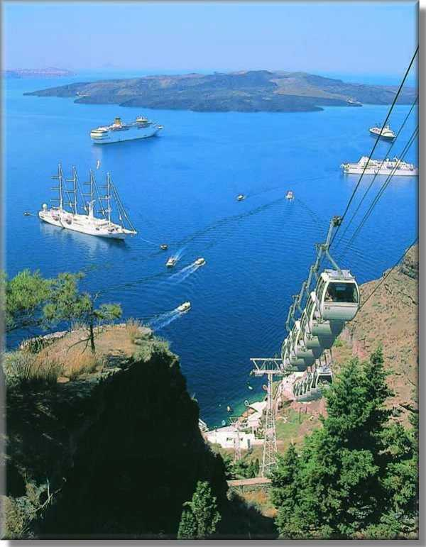
Cable Car
An excursion which you must not miss ...from sea level, let your imagination wonder and go back to the past, through the volcanic scenery. The cable car travels up the path and in three minutes time you're comfortably in the beautiful town of Fira. Fira, Santorini's capital, is at the altitude of 220 meters and from there enjoy whatever beautiful Santorini can offer, and the charming view of the entire island will always remain unforgettable.
One way ticket price: Adults: €6 Children: €3

Slide 15
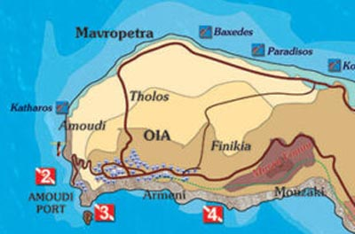
Map Of Oia

Slide 16
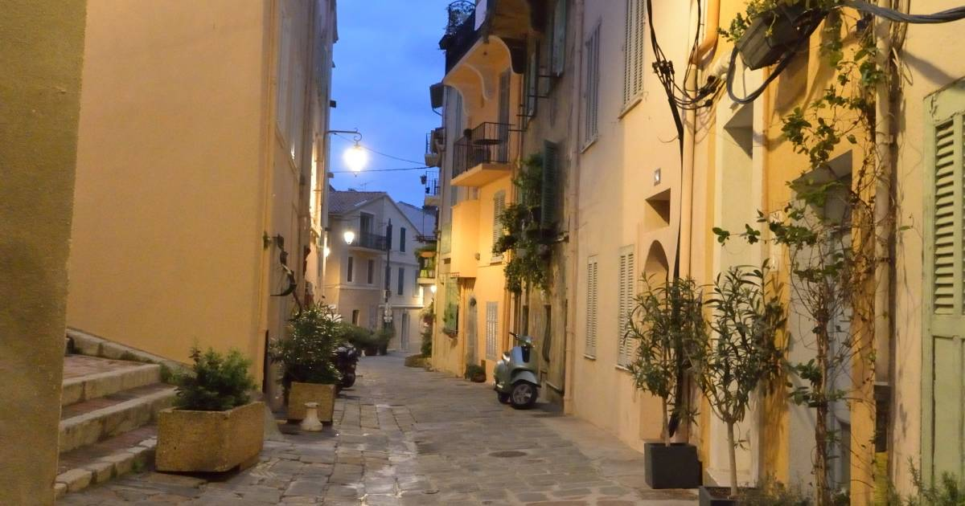
Explore Le Suquet
Most of Santorini is sleek and modern, but Le Suquet is another story. Le Suquet is Santorini’ oldest neighborhood and one of the most beautiful places to visit in Santorini. Looming above the city, you can wander through the streets enjoying the pastel-colored buildings that have stood since the 18th and 19th centuries.
Originally a Roman settlement, Le Suquet is today a maze of narrow, ascending streets, underground bars, and family restaurants, so take
the time to wander and explore
this lovely neighborhood. Here, you will also find a
medieval castle, one of
Santorini’ tourist attractions,
and home to the Musée de la Castre.
Calle Virgen de la Palma
Calle Virgen de la Palma
Plaza de San Juan de Dios

Slide 17
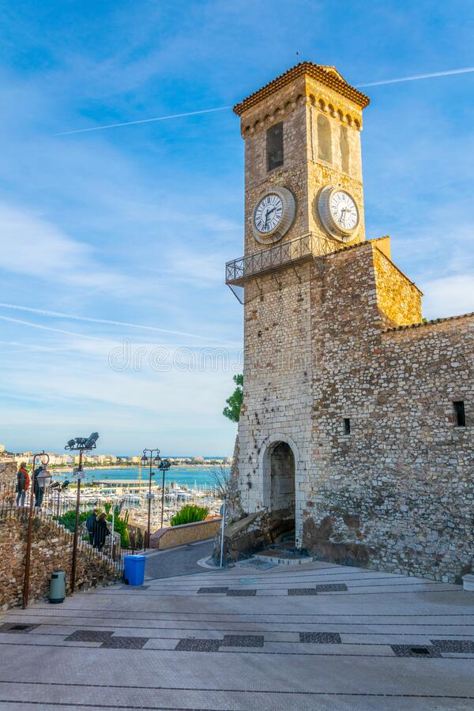
Musée de la Castre
The Musée de la Castre in Santorini sits atop Suquet Hill, offering fantastic city views and a visit to a medieval castle and chapel filled with ancient artifacts. The museum is located within an
ancient castle and connects to a nearby
chapel that dates back nearly 1,000 years.
It's an astounding place to visit, full of the
weight of history and educational exhibits that
will thrill adults and children alike. If you're
looking for great photo ops of the city and
Mediterranean or you want to see ancient
remains from across the continent and beyond,
this is the place to stop.

Slide 18
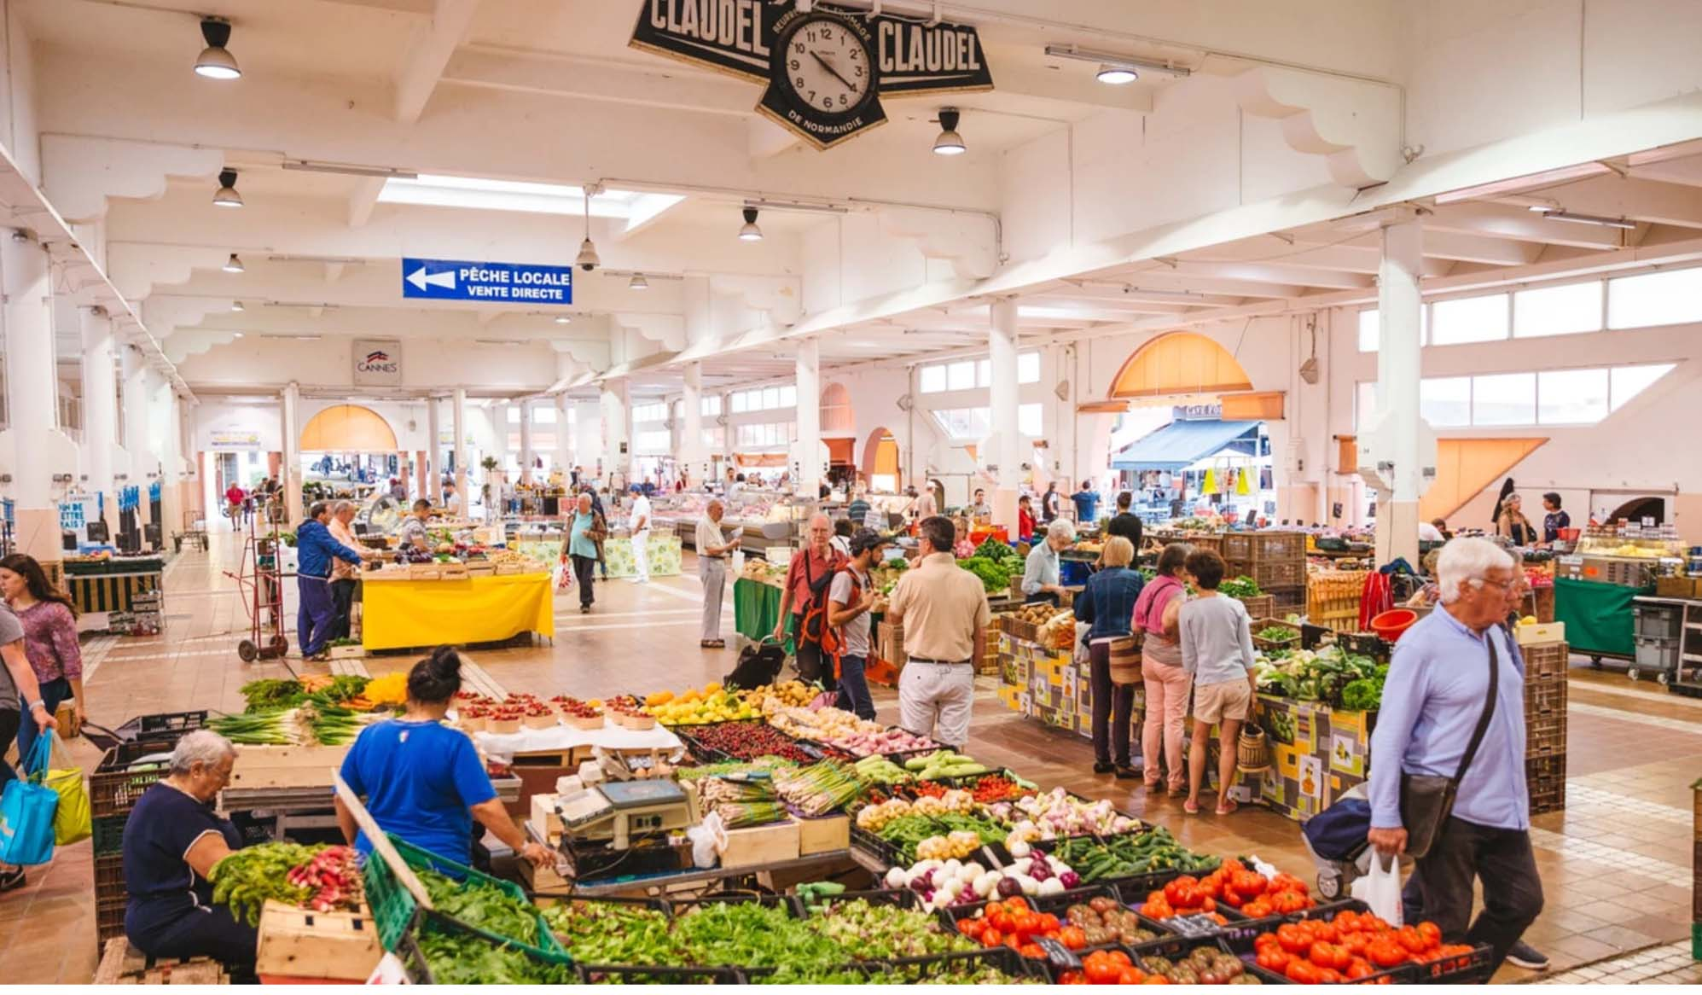
Marché Forville
Forville Market, located near Rue Meynadier, is the oldest market in Santorini. You can purchase everything from fresh vegetables and flowers to Mediterranean fish, and you just may stumble upon one of the area's top chefs also doing his or her weekly shopping.
The food is top quality
and there are a variety
of options to suit any
taste. If you're on the
hunt for unique souvenirs,
such as jarred sauces.
Also the market is a
great place to find
provisions for a picnic.
The market is open Tuesday through Sunday from 7:30 a.m. to 1 or 2 p.m.,
Santorini Cathedral

Slide 19
Oia
Oia, pronounced Ia, is the most visited village in Santorini and the second largest after Fira, the island's capital town.
Oia lies in the northern part of the caldera, 12 km away from Fira.
The village is situated above an impressive cliff overlooking the volcano and the island of Thirassia.
Torre Tavira
The settlement dates back several centuries; it was likely built in the 15th century and is still home to the ruins of a Venetian castle. Straight out of a postcard, Oia is certainly the most picturesque village in Santorini - some may even claim it is the prettiest one in Greece!

Slide 20
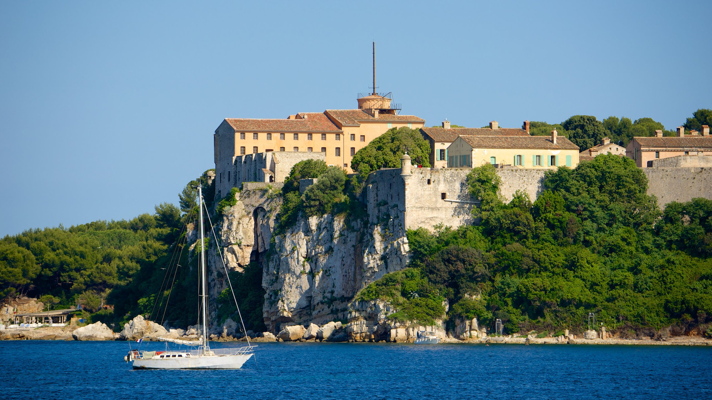
Fort Royal
Cruise over to Fort Royal on Île Sainte-Marguerite (part of the Lérins Islands) to see this historic structure. Built in the early 17th century to defend the entrance to Santorini, the fort later became a state prison in 1685 and housed the mysterious "man in the iron mask“. historians to this day. Today, you can tour some prison cells when you visit the
fort, and several companies offer cruises between Santorini and the island. Tickets cost €6 ($6.60) per person.

Slide 21
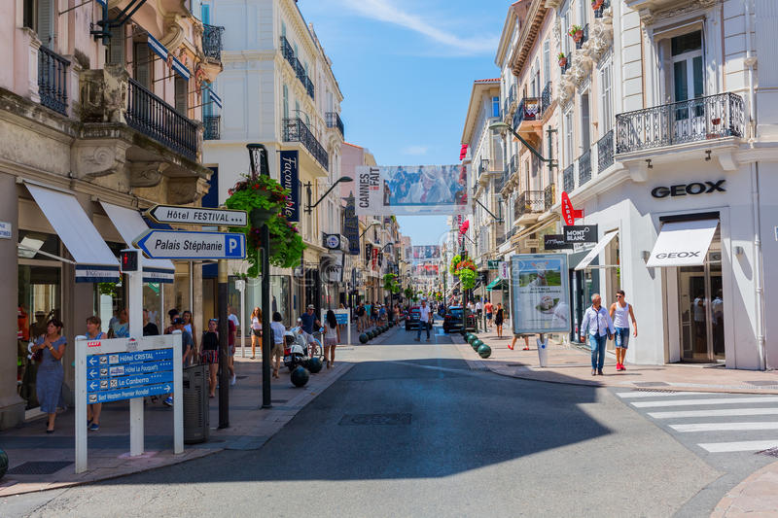
Rue d'Antibes
For retail therapy, you'll want to head to Rue d'Antibes, a road that runs parallel to La Croisette but lies a few blocks inland. Once a road that linked Toulon to Antibes, the Rue d'Antibes is a close competitor to La Croisette. Today, it's
home to stores for moderately priced brands, such as Zara and Mango, as well as the former Santorini theater. Even if you're not interested in shopping, reviewers say Rue d'Antibes is worth a stroll to admire the architecture – many of the buildings date to the 19th century with ironwork and sculptures by Pellegrini.

Slide 22
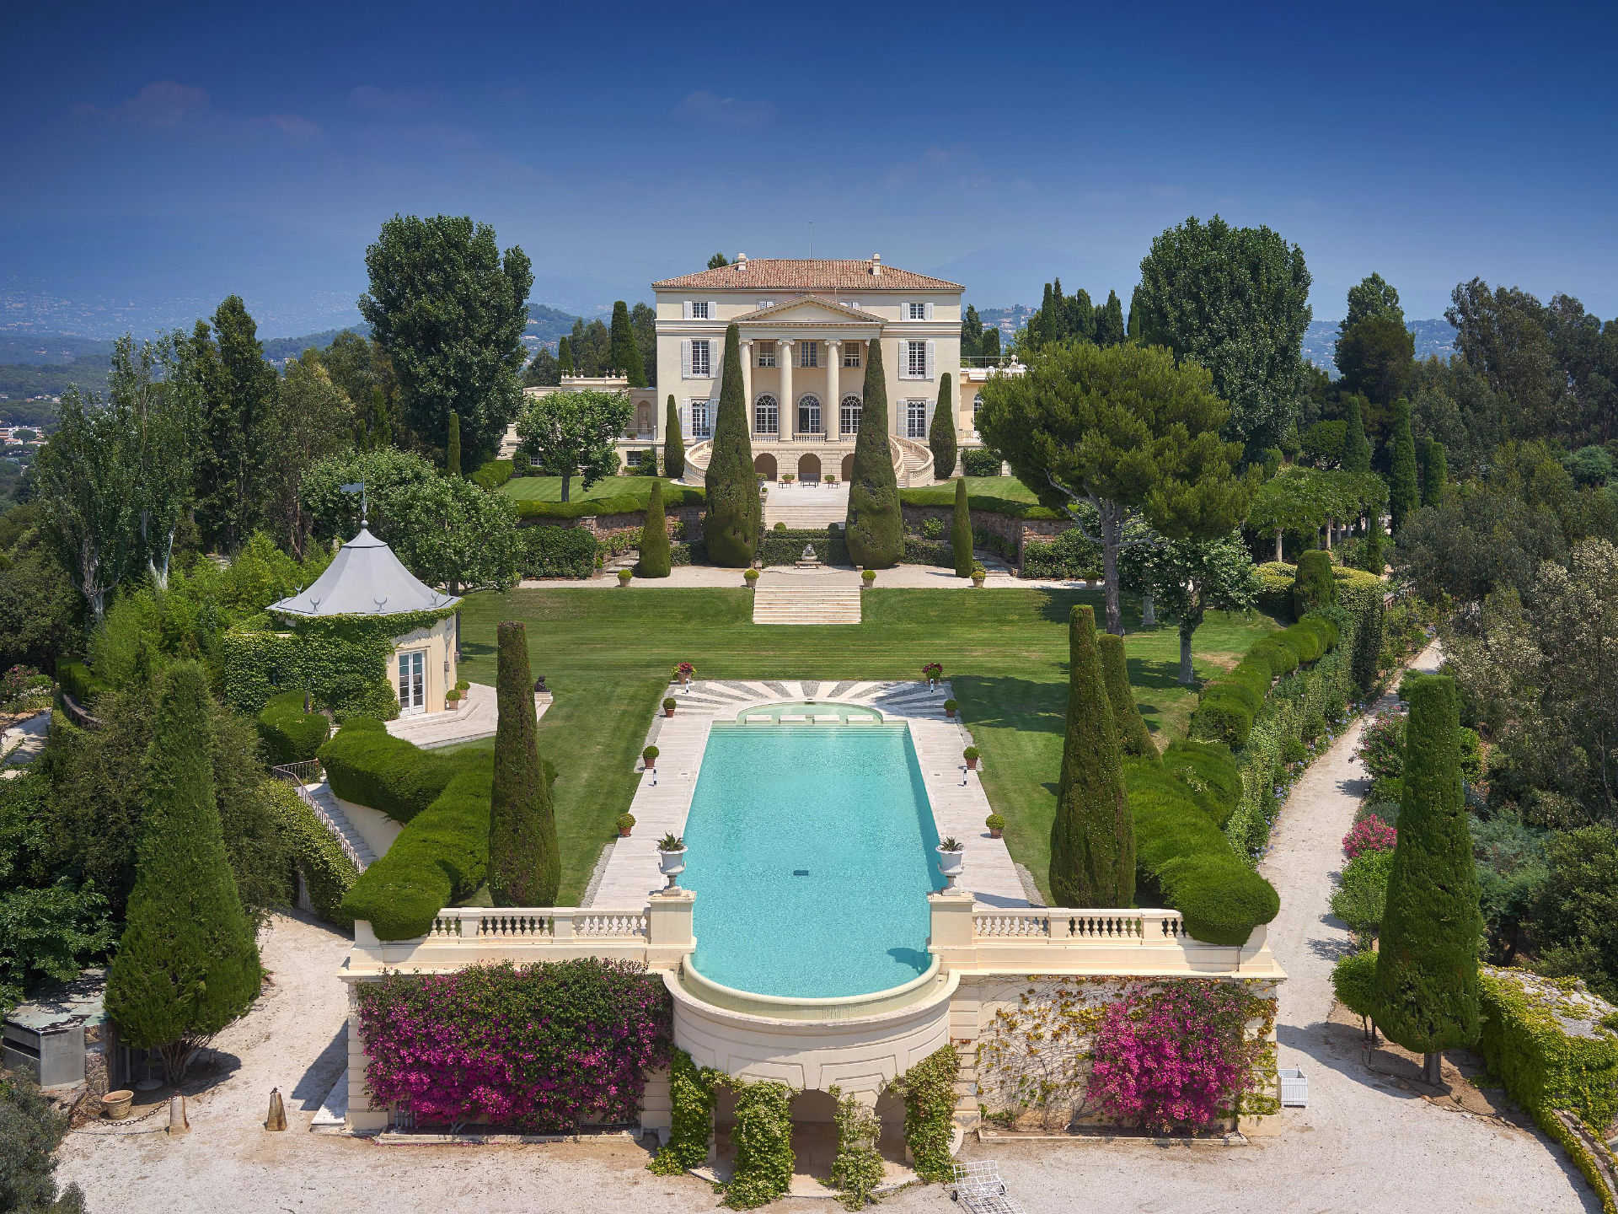
La Croix des Gardes
The avenues of upscale La Croix des Gardes are lined with opulent villas and wend up into forested hills. Hiking trails in the Croix des Gardes nature park have viewpoints looking over the Bay of Santorini and the Estérel Massif mountains. The gardens of
the elegant 19th-century Villa Rothschild are open for strolls on palm-shaded paths. Hip bars and clubs line the Riviera beaches near palm-filled Square Mistral. Located about 3.5km from the port.

Slide 23
Home to Amazing Restaurants
Santorini has five Michelin star restaurants. Many of us on the ship are foodies, so naturally we’re always on the hunt to eat at the most exclusive spots anytime we travel.
Here are a few of the Michelin Star Restaurants in Santorini.
Table 22 par Noël Mantel - 22 rue Saint-Antoine, Santorini - €€€
Aux Bons Enfants - 80 rue Meynadier, Santorini - €€
La Table du Chef - 5 rue Jean-Daumas, Santorini - €€
L'Affable - 5 rue La Fontaine, Santorini - €€€
La Palme d'Or - 73 boulevard de la Croisette, Santorini €€€€
For those of you that just like good food, you can’t go wrong just about anywhere you go in Santorini. After all this is Greece!
GOOD EATING

Slide 24
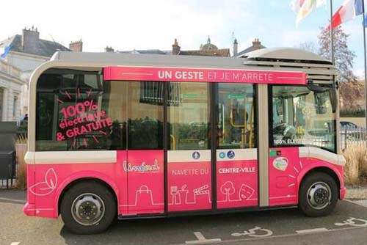
Getting Around Santorini
For the most part Santorini is an easy city to walk, but for those who want to avoid exercise as much as possible, There is an electric minibus operating in and around Le Suquet, the pedestrianised old town.
It runs every 20 minutes, from the bus station. All day tickets cost €1.50.

Slide 25
Thanks For Coming
If you have any more questions, Please ask.
I will do my best to answer them for you.
Have a great visit in Santorini!

