Slide 1
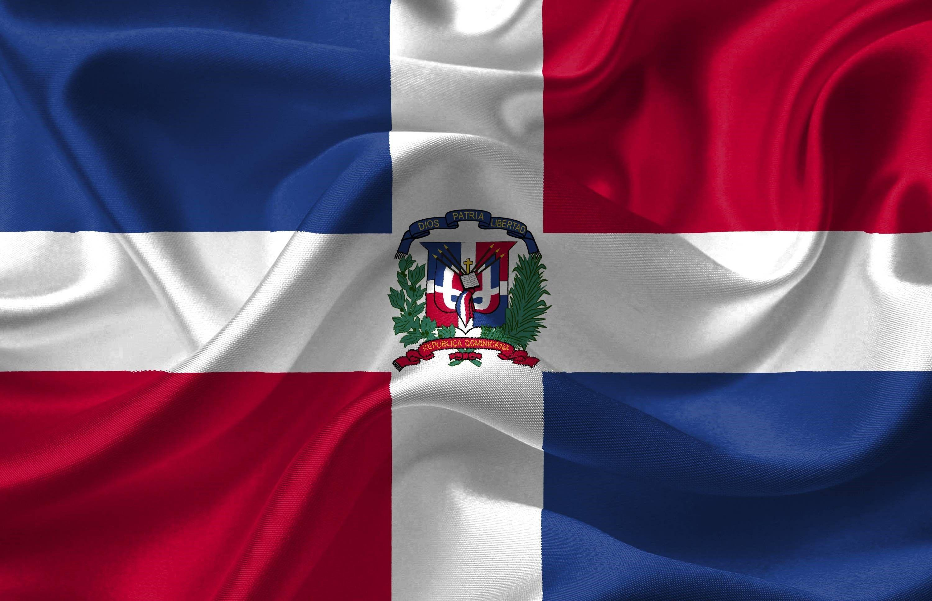
Santo Domingo
Dominican Republic
Presented by
Marc Silver

Slide 2
What I Will Cover
My Port Philosophy
Don’t Miss the Ship
Money
About Santo Domingo
Area Map of Dominican Republic
Map of Santo Domingo
Santo Domingo Transportation
Places to see or at least consider
A few restaurant recommendations
Conclusion

Slide 3
My Port Philosophy
I have been cruising for over 45 years and have taken over 100 cruises.
So, I consider myself an experienced cruiser.
The information I will present is based on those many years of
experience.
When I am on a cruise where the city, I want to visit is not the port city,
I always recommend taking a ship’s tour.
But when I am in a port with multiple attractions nearby and easy to see
on my own - I will do it on my own.
This presentation is for that type of port.

Slide 4

Don’t Miss the Ship
How to Avoid Missing Your Ship
Pay attention to the time. - Ship time and local time are often
different.
Put a return-to-ship reminder on your phone.
Choose excursions wisely.
If a ship-sponsored excursion is late returning to port, the ship will
wait for you. If you are on your own???
Be Prepared
Have your Passport, Credit Card, and phone numbers for your ship
port agent.
What to Do If You Miss the Ship
Most cruise lines have port agents stationed in the port area to assist if your ship has left without you. If your are lucky, when cruisers are late returning to the vessel, the ship’s crew will often remove the passengers’ essential items – passports, cell phones, and medication -- from the ship to leave with the port agents.
The Port Officials can help you with contacting your ship
and making necessary travel arrangements.

Slide 5
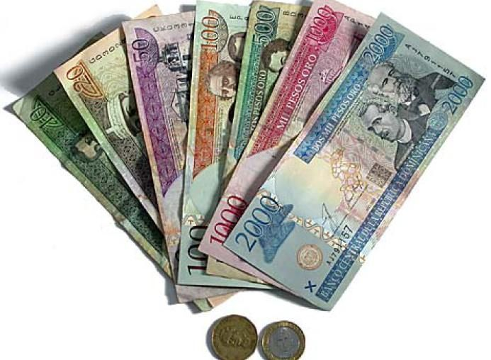
Money
The Dominican Peso official currency of the
Dominican Republic
1 US Dollar =
58.42 Dominican Peso
Its symbol is "$", with "RD$" used when distinction from other pesos (or dollars) is required; its ISO 4217 code is "DOP". Each peso is divided into 100 centavos

Slide 6
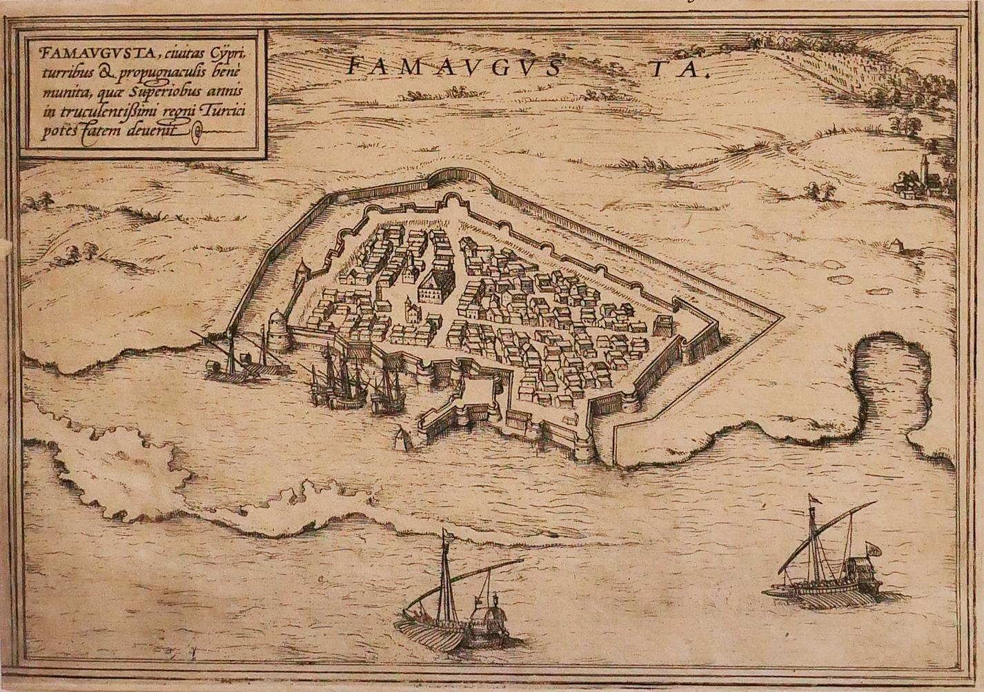
Dominican Republic History
Santo Domingo was founded in 1496 by Bartholomew Columbus, brother of Christopher Columbus, as the capital of the first Spanish colony in the New World.
The original city site was located on the east bank of the Ozama River and was called Nueva Isabela in honor of Queen Isabella I of Spain.
It was destroyed by a hurricane, however, and was rebuilt in 1502 at its present location on
the west bank of the river. It became the starting
point of most of the Spanish expeditions of
exploration and conquest of the other islands of
the West Indies and the adjacent mainland.
The colony prospered as the seat of government
of the Spanish possessions in the Americas until
the conquest of Mexico and Peru, after which
its importance declined.

Slide 7
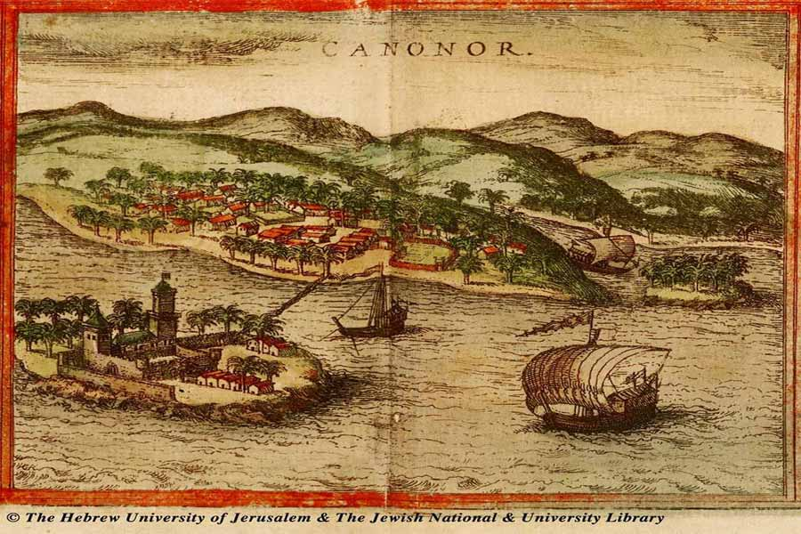
Dominican Republic History Cont.
In 1586 Sir Francis Drake, the English buccaneer, sacked the city. In 1655 its inhabitants defeated a British force that had been sent to seize the city. .
From 1795 to 1809 Santo Domingo was under French domination, and then, after another brief Spanish period, it was conquered by invaders from Haiti, its neighbor to the west on Hispaniola. Independence was proclaimed in 1844, and Santo Domingo became the capital of
the new Dominican Republic until the republic’s annexation to Spain in 1861–65.
The city has been the Dominican capital since the restoration of independence in 1865.
The city’s name, officially changed in 1936 to Ciudad Trujillo in honor of the dictator Rafael Trujillo, was restored after his assassination in 1961

Slide 8
About Santo Domingo
Santo Domingo is the capital city of the island of the Dominican Republic. Walking tours are available in The Colonial City, offering visitors a glimpse of life in the historic area, once visited by the pioneers of American exploration. You should plan on about three hours for the tour.
The Colonial City stretches one square mile and is chock full of historical sites and architecture.
Founded in 1498, it is the one and only World Heritage Site found in the country.
You can see palaces, forts, plazas, and churches, just to name a few. The city’s main street, Calle Das Lamas, is the oldest in the New World.
Santo Domingo, once known as Ciudad Trujillo, is home to the first cathedral, hospital, customs house, and university in the Americas.

Slide 9
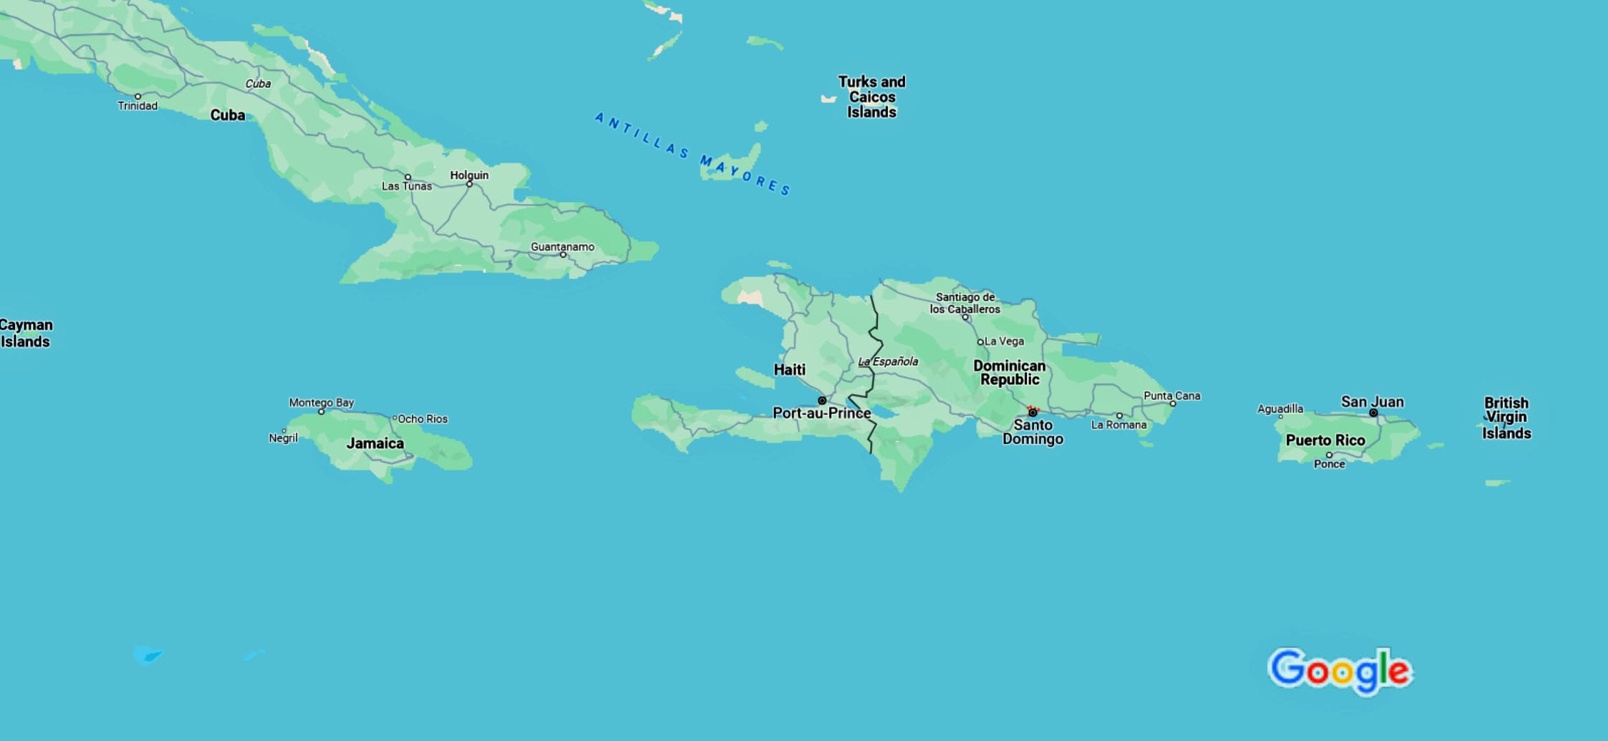
Area Map of the Dominican Republic

Slide 10
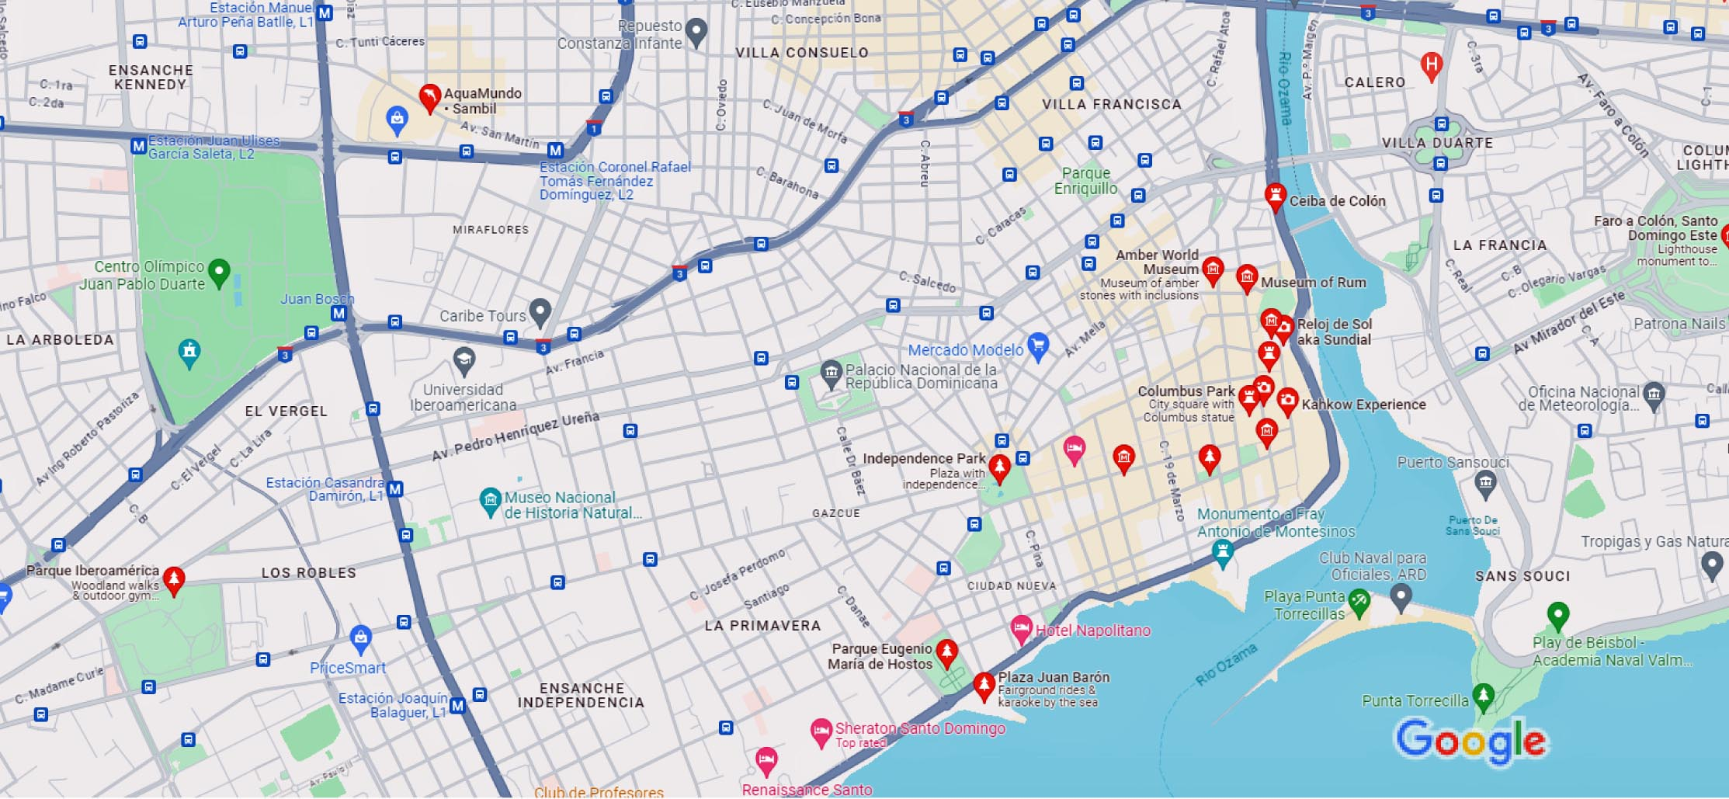
Map of Santo Domingo

Slide 11
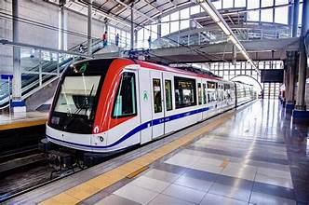
Santo Domingo Subway
Metro Santo Domingo operates two lines, mostly used by residents commuting to work. But there are a couple of stops convenient to sights.
Line 1 runs north to south along Máximo Gómez Avenue, from the Villa Mella area all the way to Centro de los Héroes, where Congress, the Supreme Court of Justice, and the Department of Migration, among other government offices, are located.
The Casandra Damirón stop on Line 1 lands you directly into Plaza de la Cultura, home to key museums and the National Theater.
Line 2 runs east to west on John F. Kennedy
Avenue, passing by Ágora Mall at the Pedro Mir
stop, and the Felix Sánchez Olympic Stadium.
A roundtrip subway fare costs RD$15
RD$80 for a day-pass.

Slide 12

Ride Shares & Taxis
UBER launched in the Dominican Republic in 2015 and is now operating in three major cities: Santo Domingo, Santiago, and Puerto Plata.
Cabify also operates in Santo Domingo. These apps are as safe to use. The advantage is no language barrier. You just hop in and go. The cars are also usually in better condition, with working seatbelts and air-conditioning, in addition lower reduced fares during off-peak times.
Taxis are easily to find, usually stationed outside major bus stations, or hotel and tourist zones. In Santo Domingo. In Santo Domingo, Apolo Taxi and Aero are popular.
Always ask for the price of the fare to your
destination, but rates within cities are set by the
taxi association.

Slide 13
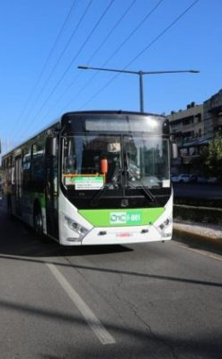
Santo Domingo Bus System
The inner-city guaguas (minibuses) tend to be white vans, stopping to pick up or drop off anyone along the designated route as many times as it takes, and are the slowest form of getting around.
Passengers are crammed in, and space appears magically just when you think there isn’t any left.
It’s also the cheapest way to travel within a city or town limits. Be sure to carry small change for the fare, as these vans don’t carry much cash. Each guagua has a driver, and a conductor who calls out for passengers along the road, handles collecting fares, and hollers out requested stops to the driver. Inform the conductor of your destination as soon as you board, and prepare to pay right away or as soon as requested.

Slide 14
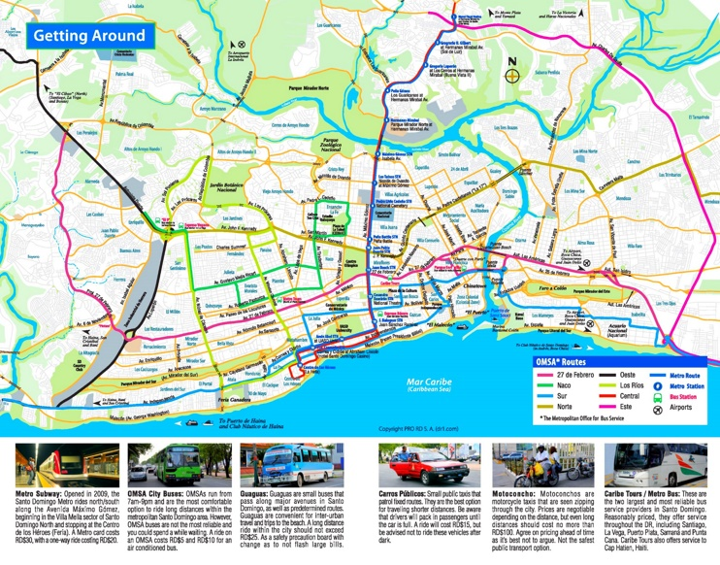
Santo Domingo Bus Sysem

Slide 15
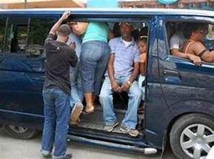
Shared Taxis or Conchos
Also known as carrito–conchos, carritos, or just conchos, these four-door sedans are shared taxis, similar to the in-city guaguas because they travel specific routes and stop anywhere on the route as requested by passengers. You can find them in the city, as well as in towns and villages.
They are slightly more comfortable
method than the guagua, but passengers
are also crammed in at the back and the
front.
Fares range from RD$25-50 depending on
the distance–significantly cheaper than a
private taxi fare, which start at RD$150.

Slide 16
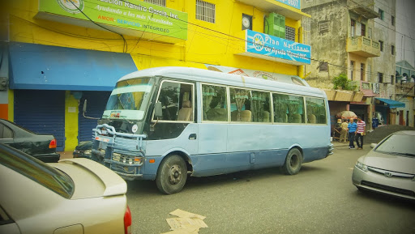
Minibuses - Guaguas
Smaller, privately-owned and operated minivan buses called guaguas travel scheduled routes daily, taking travelers within a city, or long-distance to small and large destinations around the Dominican Republic.
The long-distance guaguas are just as comfortable as the large coach buses, seating no more than 20-25 passengers, each with a dedicated seat and offering Wi-Fi connection. Look out for the ones labeled “Expreso” to your destination–they don’t stop along the road to pick up passengers, unlike the regular ones, which shortens your trip.

Slide 17
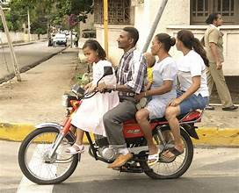
Santo Domingo Motor Bikes
Motorbike taxis also called Moto concho’s, are popular among locals in Santo Domingo, because they are the cheapest and fastest way to get past traffic.
But this is also the most dangerous way to travel, particularly in cities or areas of heavy traffic. Many motorbike taxis don’t provide helmets, though they are legally required to do so.
Fares range from RD$25 to RD$75 in-city, depending on the distance.

Slide 18
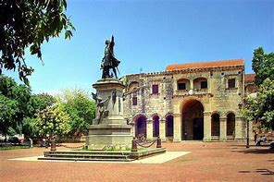
Zona Colonial
Partially barricaded by stone walls, accented with baroque architecture and lying on cobblestone streets, Santo Domingo's Zona Colonial marks the area where Columbus settled in the New World.
The Zona Colonial is definitely a must-see, considering the city’s best-known historic sites are located here. You can explore the area entirely on foot: For all that's crammed inside, there's really only 11 blocks worth of sights.
Even though Zona Colonial is free to explore, keep in mind that several of the area's museums and historic properties charge an entry fee. Typical admission fees range from RD$60 ($1.33 USD) to RD$100 ($2.21 USD).

Slide 19
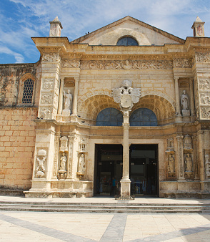
Catedral Primada
de America
Probably best known as the first cathedral of the Americas. Some people refer to this church by its official name, Catedral Santa María La Menor, This coral-limestone building is magnificent inside and out.
Showcasing elements of Gothic, Baroque, and plateresque architectural styles, the Cathedral still holds Sunday afternoon mass. If you're not interested in services, plan your visit from sometime between 9 a.m. and 4:30 p.m. Monday through Saturday. Remember to bring some Dominican pesos since the cathedral costs RD$60 (or about $1.33 USD) for adults to enter. Kids, though, get in free of charge.
Should you choose to go inside, remember to follow the dress code.

Slide 20
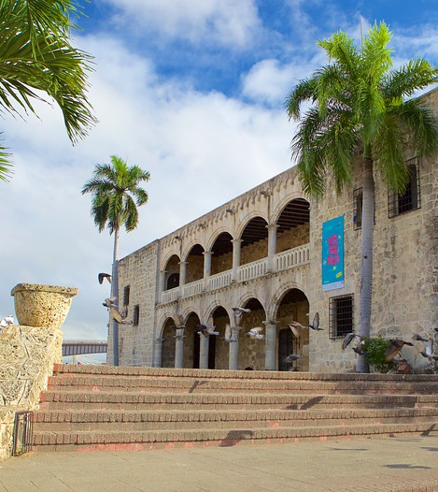
Alcázar de Colón
Once the home of Diego Colón, Christopher Columbus' son, this 16th-century viceregal palace (or residence of the governor/viceroy) was the nucleus of the Spanish court for more than 60 years. Inside, you'll find a museum housing an impressive collection of late medieval and Renaissance art. The house itself is also a work of art, featuring Moorish, Gothic, and Renaissance touches.
Located along Calle Las Damas in the Zona Colonial,
Hours are: Tuesday - Saturday 9 a.m. to 5 p.m and on Sundays from 9 a.m. to 4 p.m. Admission is: 100 Dominican pesos $2.21 US

Slide 21
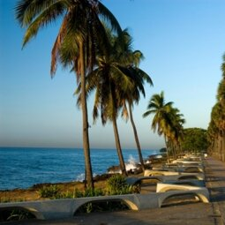
Malecon
This picturesque part of Santo Domingo is where the new mixes with the old.
Nowhere in sight is the crumbling cobblestone of the Zona Colonial; in its place are shiny waterfront casinos and hotels that sit beside a handful of cafes and nightclubs.
It’s a good place for some sightseeing a delicious meal, or a little nighttime merengue and bachata dancing.
There is also gambling available at the casinos.

Slide 22
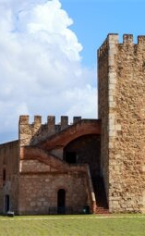
Fortaleza Ozama
The Fortaleza Ozama is the oldest fort in the Americas. It as a great place to learn a bit of local history while snapping photos of Santo Domingo.
Built in 1502, the fort served the military interests of Spain, England, France, Haiti, Gran Colombia, the U.S., and, of course, the Dominican Republic until it was decommissioned and reopened for public use in 1970.
You'll find this fort at the southern end of Calle Las Damas. Hours are 9 a.m. to 6:30 p.m. Monday through Saturday.
On Sundays La Fortaleza closes at 4 p.m.
Admission is RD$70 or about $1.55 USD

Slide 23
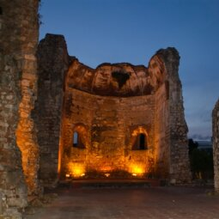
Monasterio de San Francisco
If you're into history, you may want to make a special visit to this site. Although used mainly as a monastery, after it was rebuilt following a second earthquake in the 18th century, officials decided to convert the space into a mental asylum.
During the day, this Zona Colonial ruin isn't much to look at. After all, the Monasterio de San Francisco has been steadily crumbling since a 16th-century demolition squad and a 17th-century earthquake practically decimated it.
Admission to the site is free
and worth every penny.

Slide 24
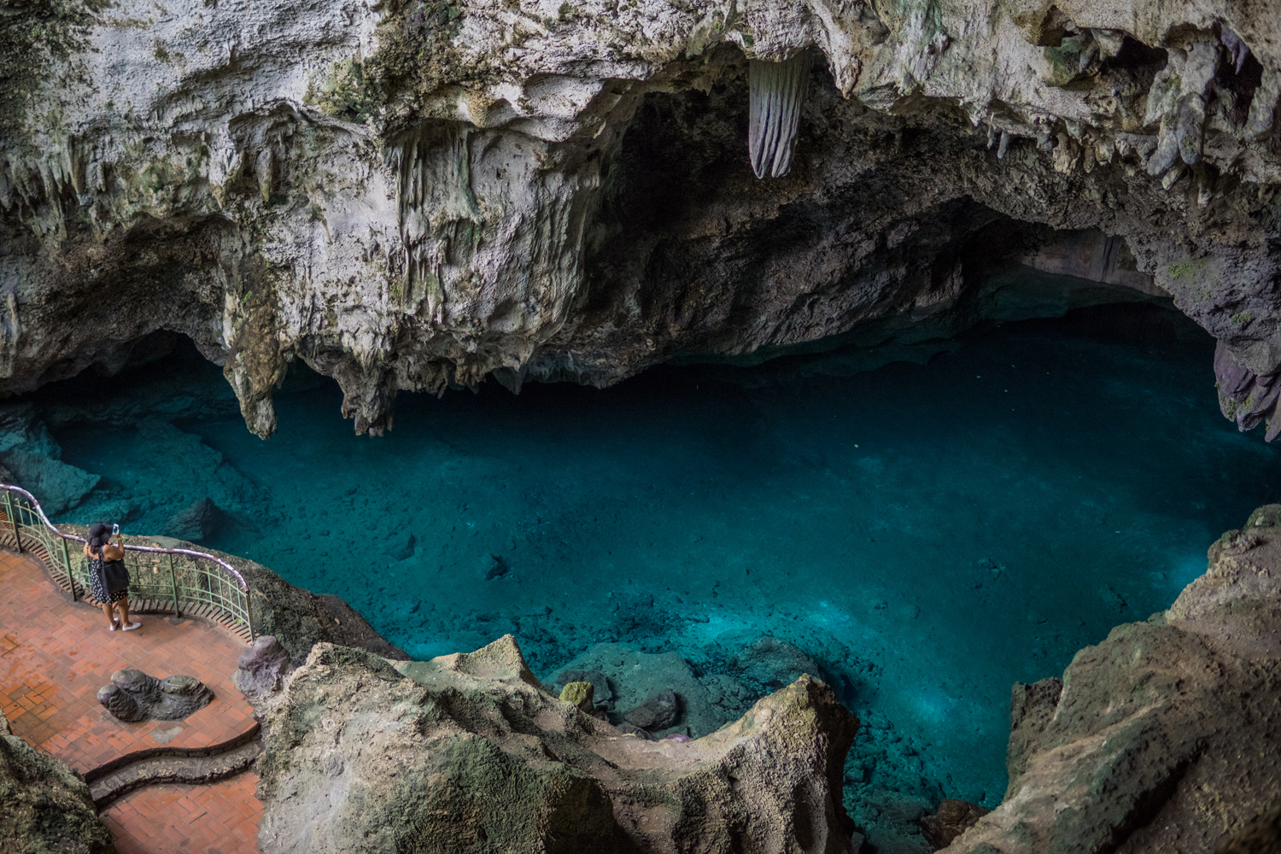
Los Tres Ojos
For those looking to take a break from the city's rich history, consider exploring Santo Domingo's tranquil Los Tres Ojos (which translates to "The Three Eyes" in English).
This national park sits about 5 miles east of the Zona Colonial and is best reached by taxi.
There are three limestone caverns, each of which features a lake. (swimming is not allowed in any of the lakes.) Once inside the caves, you can either explore by foot or by boat (an additional $0.55 USD fee applies).
Los Tres Ojos hours: 8:30 a.m. to 5:30 p.m. daily.
Should you desire a guide, several are located within the caves to show you around for a small fee.
An RD$100 (or $2.21 USD) entrance fee is required.

Slide 25
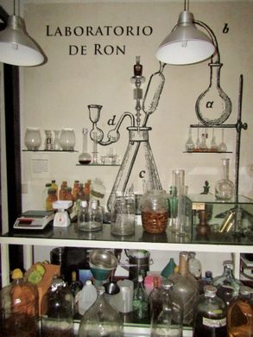
Museum of Rum
Built inside a 16th-century restored building, the Museum of Rum and Sugar Cane is one of the newest museums in the Colonial Zone opened in 2008. There are pictures of the original building before reconstruction inside.
Within the museum are numerous exhibits showing the history of rum and sugar cane, both its basis in slavery and its transformation into a source of revenue for the island.
There are numerous items from the history of rum making in the Dominican Republic, as well as equipment and other items used for harvesting the sugar cane.
At the front of the museum you may find all the Dominican rums for sale at reasonable prices.

Slide 26
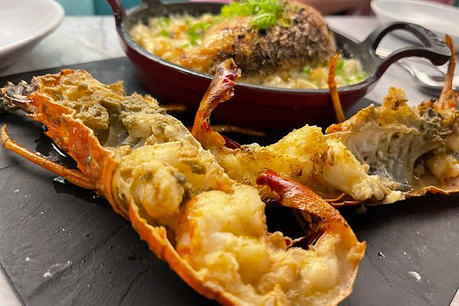
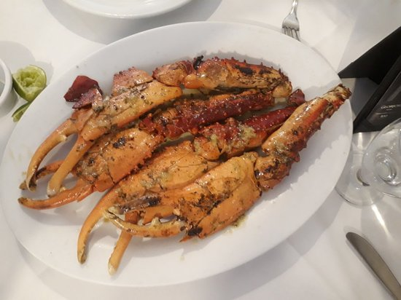
Restaurants
There are a lot of excellent restaurants in Santo Domingo. Especially for seafood.
Here are some recommendations:
Casa Vera $$ - $$$ Caribbean, Latin, Seafood,
53 Avenida Sarasota, Santo Domingo
El Meson De La Cava $$$$ Caribbean, Latin, Seafood,
Sur 1 Avenida Mirador, Santo Domingo
Ajualä $$$$ Caribbean, Latin, Vegan Options,
Andres Julio Aybar # 13, Piantini Entre Humano y el Banco Popular de la López de Vega., Santo Domingo
Restaurante Boga Boga $$ - $$$ Seafood, Mediterranean, European
Av Simón Bolívar 203, Santo Domingo
Café Casabe Restaurant $$ - $$$ Caribbean, Latin, International
365 Ave. George Washington, Santo Domingo
ENJOY!

Slide 27
Conclusion
Santo Domingo is a beautiful City with a rich history and numerous attractions. Regardless of what you're looking for, Santo Domingo has something for everyone.
I hope this presentation will help when we visit Santo Domingo!

Slide 28
Thanks For Coming
If you have any more questions, please ask.
I will do my best to answer them for you.
Have a great visit in Santo Domingo!

