Slide 1

Santarem, Brazil Presented by Marc Silver

Slide 2
What I Will Cover
My Port Philosophy
Don’t Miss the Ship
Money
About Santarem
Santarem History
Area Map of Santarem
Map of Santarem
Santarem Transportation
Places to see or at least consider
A few restaurant recommendations
Conclusion

Slide 3
My Port Philosophy
I have been cruising for over 44 years and have taken over 200 cruises. So, I consider myself an experienced cruiser.
The information I will present is based on those many years of
experience.
When I am on a cruise where the city, I want to visit is not the port city,
I always recommend taking a ship’s tour.
But when I am in a port with multiple attractions nearby and easy to see
on my own - I will do it on my own.
This presentation is not like that.

Slide 4

Don’t Miss the Ship
How to Avoid Missing Your Ship
Pay attention to the time. - Ship time and local time are often different.
Put a return-to-ship reminder on your phone.
Choose excursions wisely.
If a ship-sponsored excursion is late returning to port, the ship will wait for you. If you are on your own.
Be Prepared
Have your Passport, Credit Card, and phone numbers for your ship port agent.
What to Do If You Miss the Ship Most cruise lines have port agents stationed in the port area to assist if your ship has left without you. If your are lucky, when cruisers are late returning to the vessel, the ship’s crew will often remove the passengers’ essential items – passports, cell phones, and medication -- from the ship to leave with the port agents.
The Port Officials can help you with contacting your ship and making necessary travel arrangements.

Slide 5
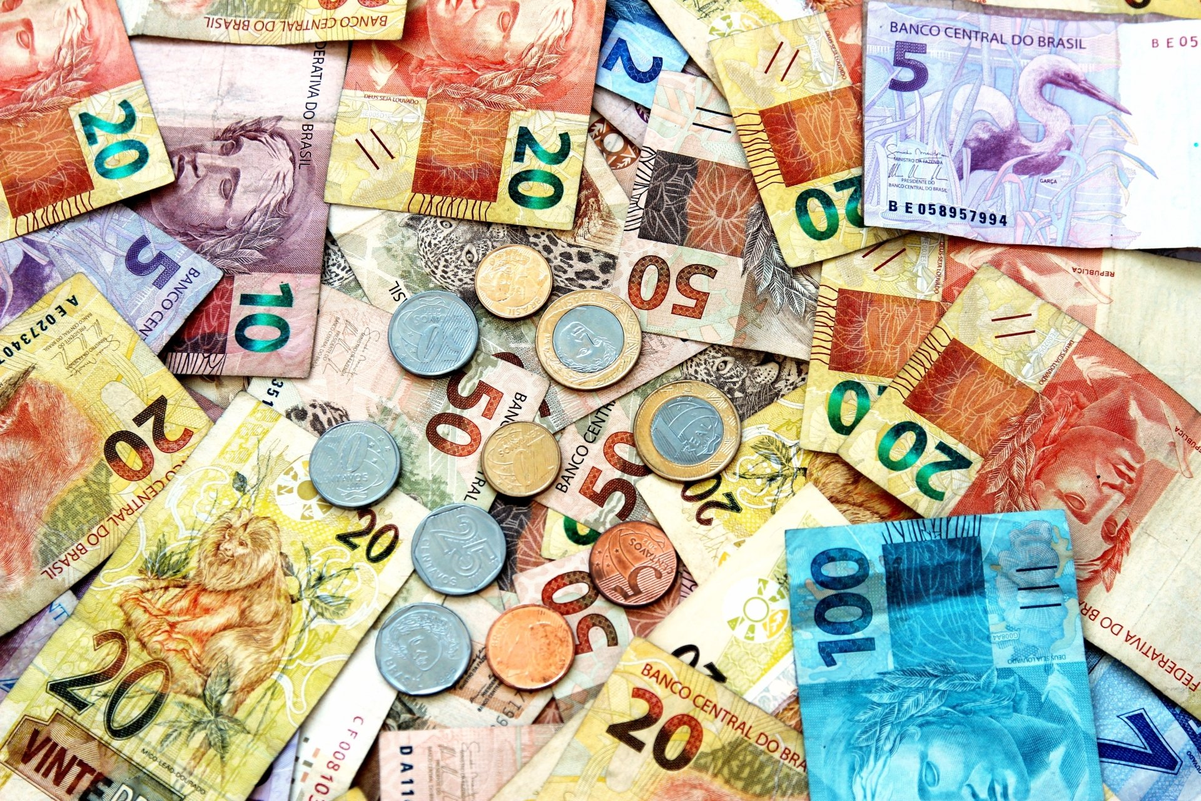
Money
The Brazilian Real
The official exchange rate:
$1.00 US = 4.9310457 Real
1.00 Brazilian Real = 0.2028 US Dollars

Slide 6
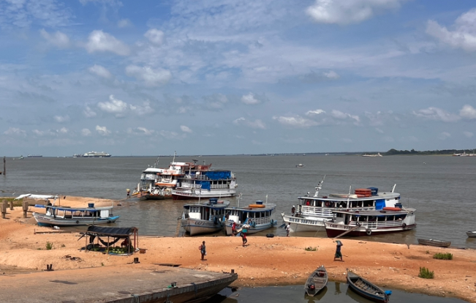
About Santarem, Brazil
Santarém is now the most important town on the Amazon between Belém, some 600 miles downriver to the east, and Manaus, about 450 miles upstream to the west, and is a port of call for river steamers.
The Tapajós River is navigable for steamers to the rapids 170 miles (275 km) above Santarém and for small boats to a point near Diamantino in Mato Grosso state.
A modest trade comes from the settlements along the riverbanks.
Rosewood oil, rubber, lumber, and jute are the region’s most important exports.
Manufacturers include auto parts, machinery, and electrical equipment.

Slide 7
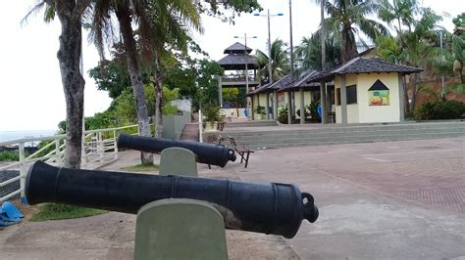
Santarem, Brazil History
Santarém was founded in 1661 as a Jesuit mission to a Tapajó Indian settlement (aldeia) and grew around a fort built by Pedro Teixeira. It was given town status in 1758, with the name of Tapajós, and was elevated to city rank in 1848.
A group of Confederate exiles settled in Santarém after the American Civil War (1861–65); some of their descendants still live in the area, but disillusioned, most of the original settlers returned, to the United States.
Over the centuries, the government tried to renovate the fortress, the last being in 1867 when the government sent six cannons to arm it. The renovation was never finished, and the cannons were left in the street. Today not much remains of the fortress, as materials were taken for other building projects.
In 1900 a high school was built on the site. Early in the first decade of the 21st century, a tourist attraction, was built behind the school.

Slide 8
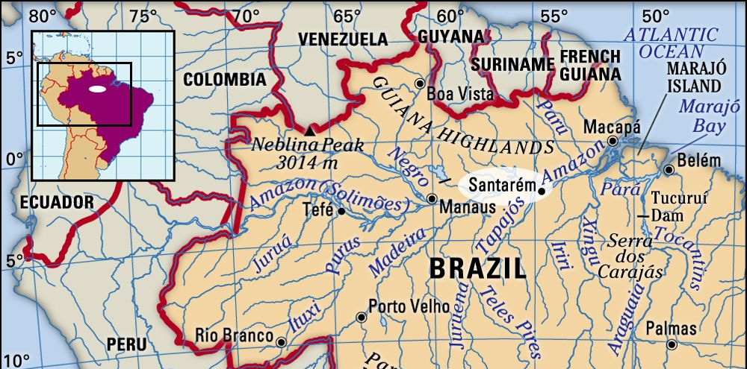
Area Map of Santarem, Brazil

Slide 9
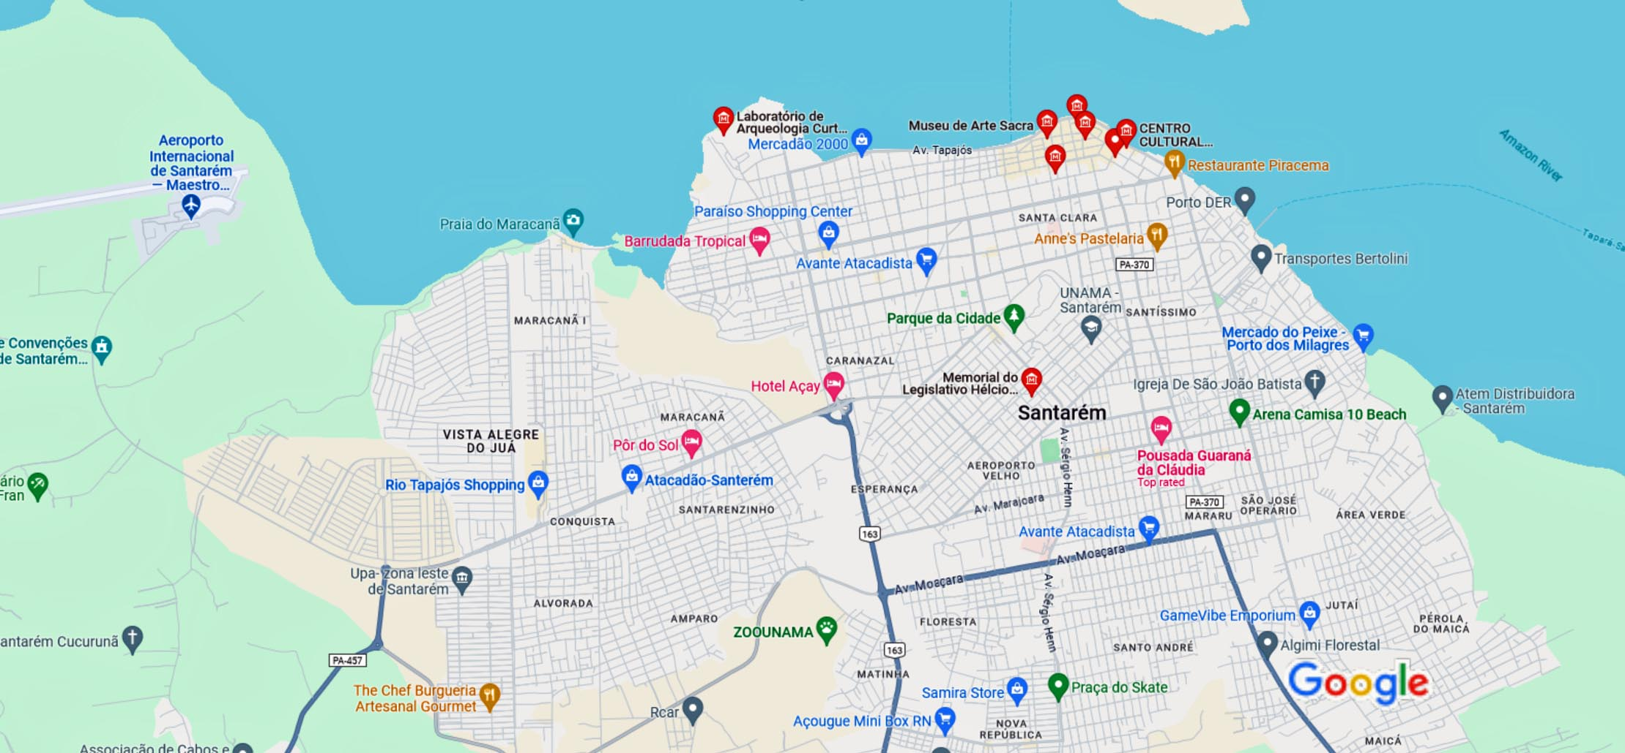
Map of Santarem

Slide 10
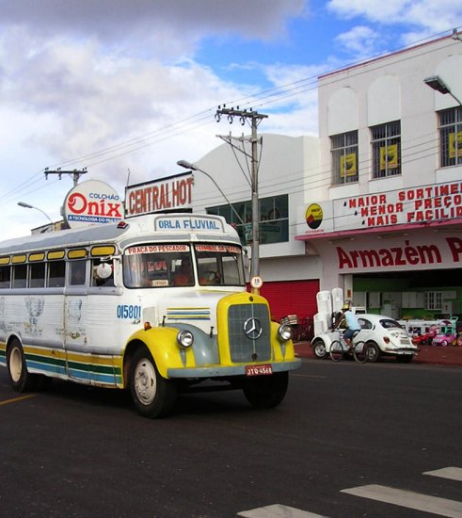
Santarem City Bus
Santarem has a very simple and inexpensive bus system with many bus routes. Traveling north and south along the Malecon makes it easy to reach not just the beaches but also the malls and shopping centers.
Traveling by bus is safe and is an interesting experience if you like to mingle with the locals.

Slide 11
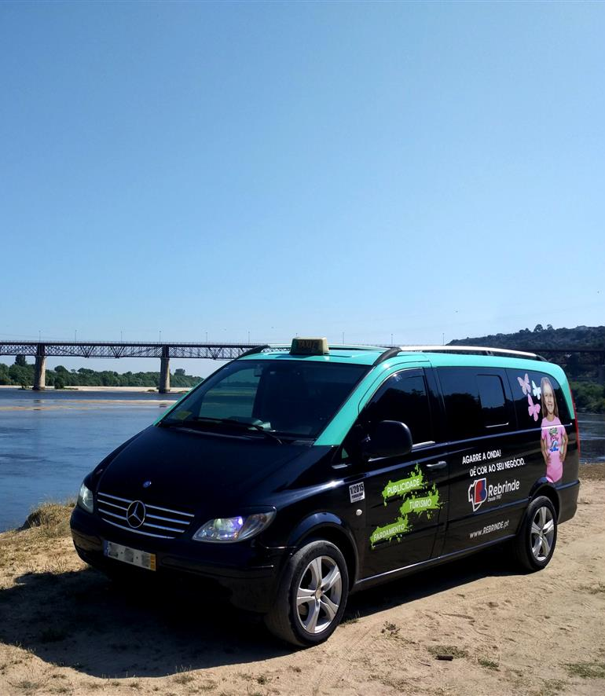
Santarem, Brazil Transportation
Taxis in Santarem are plentiful. Taxis can be very reasonable, as long as you ask the price BEFORE you get in.
Fares are fixed by zones; rates for trips in town and to more distant points posted at local hotels.
You can request a ride when you need to travel in Santarém with the Uber app. You’ll also enjoy 24-hour requesting, helpful in-app safety features, and upfront pricing to budget ahead for your trip. Try this day-or-night ride option to head to your destination.
Make sure you have small change. Taxis will not carry change so they can keep yours.
You do not tip taxi drivers. The tip is included in the price.

Slide 12
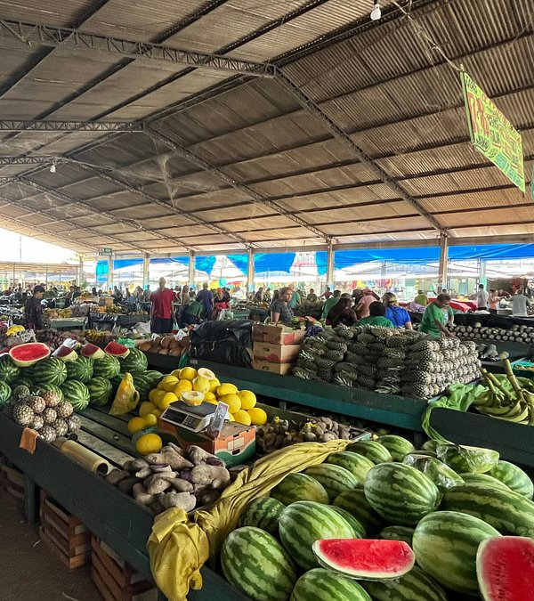
Mercadão 2000
Mercadão 2000 is the largest street market in Santarem and one of the most visited tourist attractions in the area.
Located less than .8 miles from the cruise port, Mercado 2000 has regional fruits, handicrafts, medicinal plants, and other natural drugs produced from native species with empirically proven healing power. The market doesn’t leave anything to be desired when finding fresh items from the Amazon region.

Slide 13
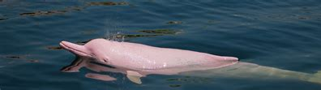
Pink River Dolphins
The Amazon River can be a dangerous place if you venture out on your own. I recommend using a guide to safely cruise the water between the Amazon River and Tapajos in search of wildlife such as pink river dolphins or black piranhas.
It’s possible to charter a fishing boat to take you around to other islands in the area while you search for the playful river dolphins, and other wildlife.
A half-day trip costs around 150 BRL (US$30) for up to four people.

Slide 14
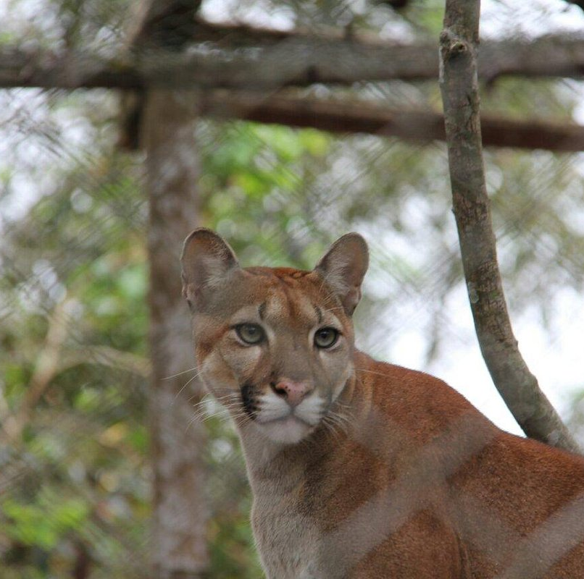
ZooFIT - Zoologico de Santarem
ZooFIT is a small zoo but one that is well kept with healthy animals, well worth a visit.
The facility is an animal rescue and rehab center to release animals back into the wild. As such the enclosures are quite basic but allow close-up viewing of the animals.
You will see many wild monkeys in the trees, plus jaguars, coatis, tapirs, and many exotic birds.
Entrance to the park is only 3 Real per person.

Slide 15
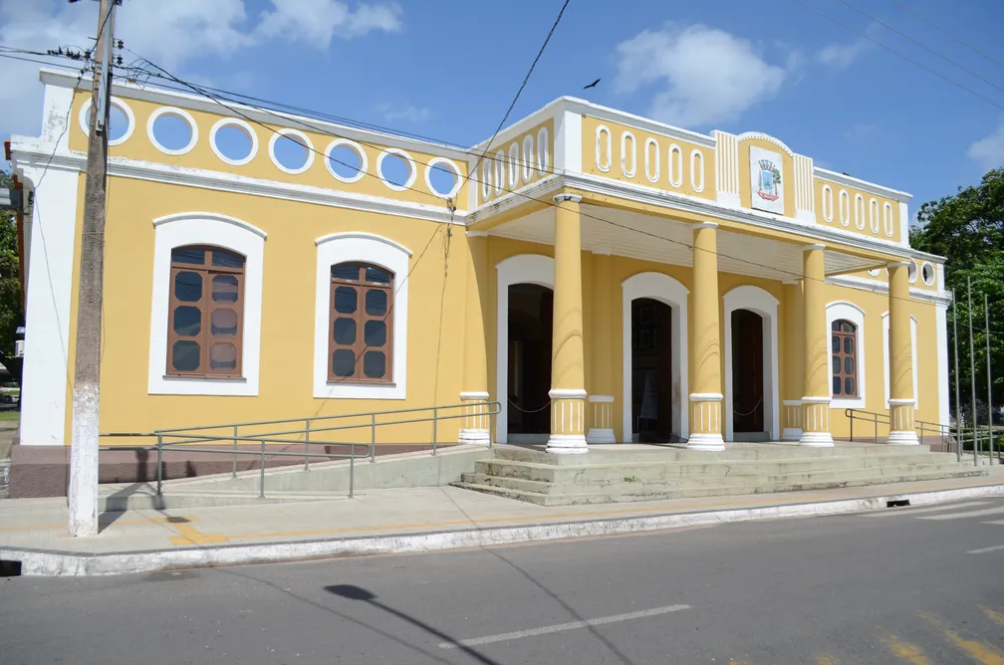
CENTRO CULTURAL - JOÃO FONA
Included in the João Fona Museum is a collection where you will see rare pieces of tapajonic pottery. Items discovered in excavations portray the daily lives of the populations that lived in the region before the arrival of Portuguese colonization.
They also have pieces of indigenous crafts, images carved in stone and clay,
and hunting weapons, among others.
The building was initially a mansion built in colonial style. Construction began in 1853, completed in 1868, and was inaugurated in 1869. The architect took advantage of the Amazonian landscape, erecting a mansion on the beach.
Admission is Free

Slide 16
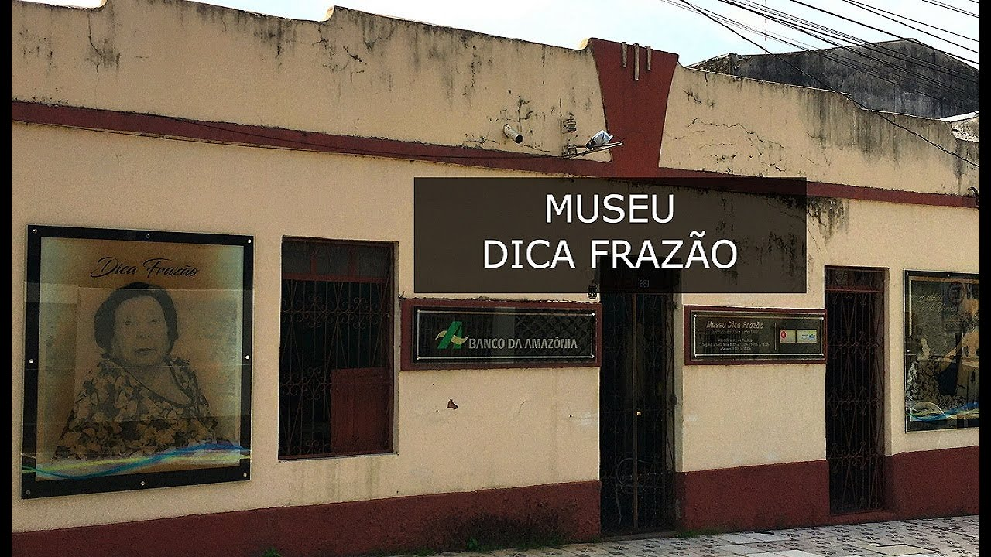
Museu Dica Frazão
Dedicated to the work of Dona Dica Frazão who spent three-quarters of a century making clothing and fabrics from natural fibers, including grasses and wood pulp.
She died at age 96 in 2017, but the museum continues with a display room of her creations, including a dress made for a Belgian queen, a tablecloth for a pope and costumes for the Boi-Bumbá festival.

Slide 17
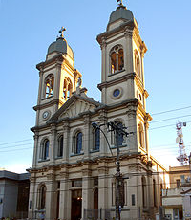
Catedral Metropolitana Nossa Senhora da Conceição
It is an eclectic building, with a predominance of baroque and neoclassical elements, whose construction began in 1902, organized by parish priest Caetano Pagliuca, being inaugurated in 1909. It replaced the old Matrix, of the nineteenth century, which had been demolished. In 1910 it was elevated to the status of the Cathedral.
The interior has beautiful altars in carving, stained glass windows of the Casa Genta, and an important series of mural paintings by Aldo Locatelli, on the life of the Virgin Mary. The main altar has an image of the Virgin of Parisian origin. The belfry has a missionary bell from 1684.
In 2002 the cathedral was listed as a Historic Heritage of Santa Maria.

Slide 18
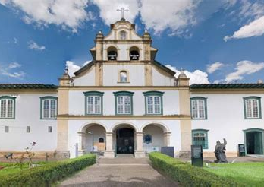
Museu de Arte Sacra
The diocese of Santarém acquired the large residence, next to the Cathedral of Our Lady of the Conception.
The magnificent Sacred Museum has become possible with the generous donation of contributors to giving greater brilliance to the Mocoronga culture.
The idea was to create a "Permanent Barraca" of the Feast of Our Lady of Conception, patron saint of the Archdiocese of Santarém.

Slide 19
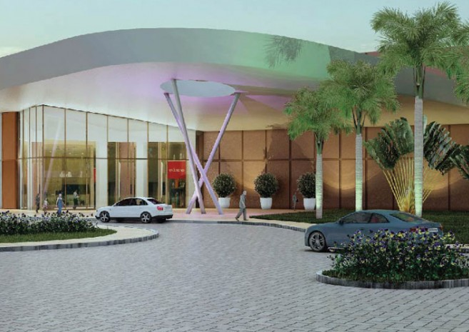
Rio Tapajós Shopping
In 2014, the Rio Tapajós Shopping Center opened bringing Santarem a modern Shopping Mall with a complete mix of entertainment, food, and national brands, thus providing greater comfort and variety at the time of shopping.
The Rio Tapajós Shopping has 137 stores including nine anchor and semi-anchor stores, a Food Court, and five multiplex stadium movie theaters.

Slide 20
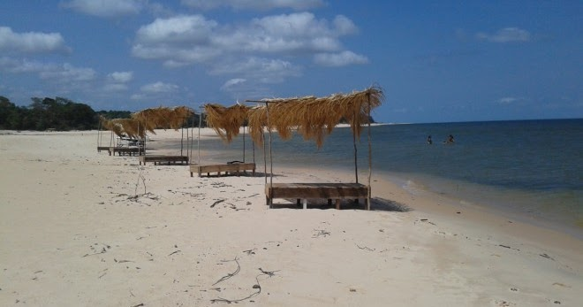
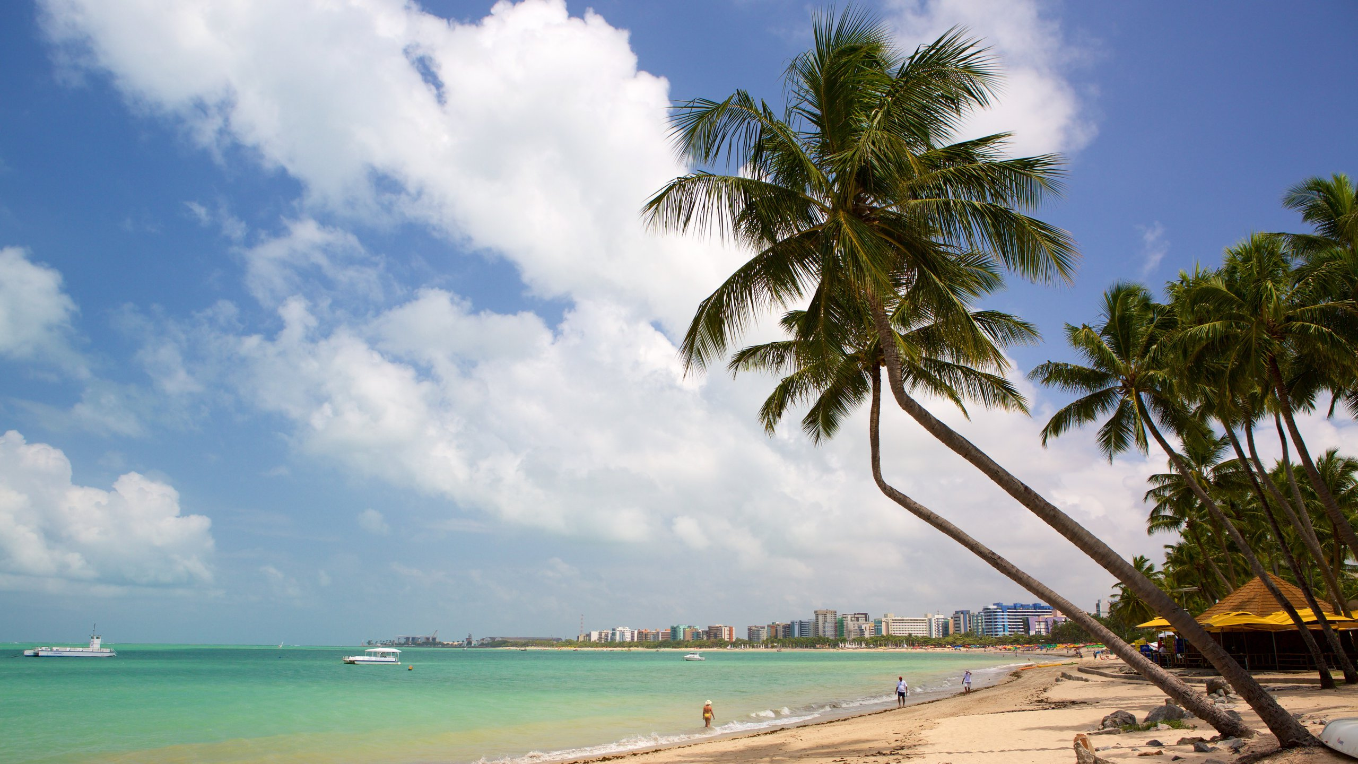
Pajucara Beach
Carapanari Beach
Carapanari Beach is Located about 20 km west of Santarem while Pajucara Beach is slightly closer. These are both beautiful beaches well worth a visit.

Slide 21
Q&A
Questions & Curiosities
Let’s experience the rhythm of Rio together!

Slide 22
Thanks For Coming
If you have any more questions, please ask.
I will do my best to answer them for you.
Have a great visit to Santarem!

