Slide 1
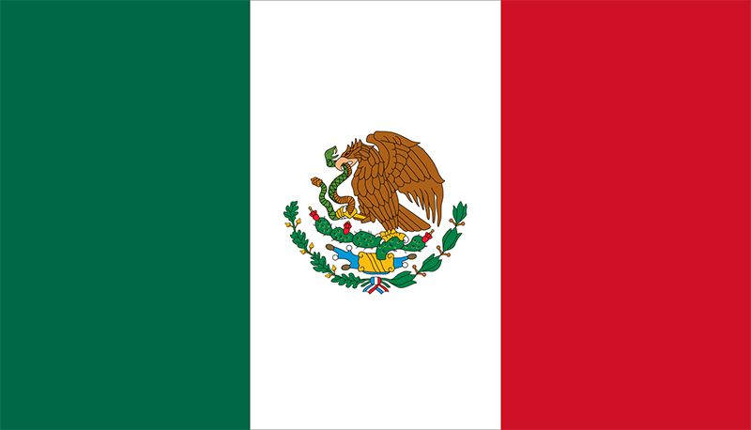
Santa Rosalía, Mexico
Presented by
Marc Silver

Slide 2
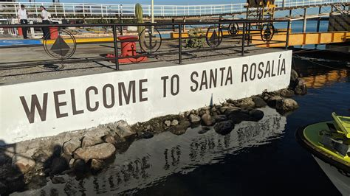
What I Will Cover
My Port Philosophy
Don’t Miss the Ship
Money
About Santa Rosalía
History of Santa Rosalía
Map of Santa Rosalía
Weather of Santa Rosalía
Getting Around
Points of Interest and things to do
A few restaurant recommendations
Conclusion

Slide 3
My Port Philosophy
I have been cruising for over 45 years and have taken over 100 cruises.
So, I consider myself an experienced cruiser.
The information I will present is based on those many years of
experience.
When I am on a cruise where the city, I want to visit is not the port city,
I always recommend taking a ship’s tour.
But when I am in a port with multiple attractions nearby and easy to see
on my own -
I will do it on my own.
This presentation is for that type of port.

Slide 4
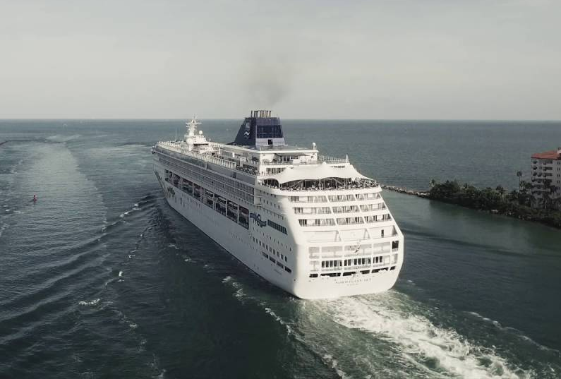
Don’t Miss the Ship
How to Avoid Missing Your Ship
Pay attention to the time. - Ship time and local time are often
different.
Put a return-to-ship reminder on your phone.
Choose excursions wisely.
If a ship-sponsored excursion is late returning to port for, the ship will
wait for you. If you are on your own???
Be Prepared
Have your Passport, Credit Card and phone numbers for your ship port agent.
What to Do If You Miss the Ship
Most cruise lines have port agents stationed in the port area to assist if your ship has left without you. If you’re lucky, when cruisers are late returning to the vessel, the ship's crew will often remove the passengers' essential items -- passports, cell phones and medication -- from the ship to leave with the port agents.
The Port Officials can help you with contacting your ship
and making necessary travel arrangements.

Slide 5
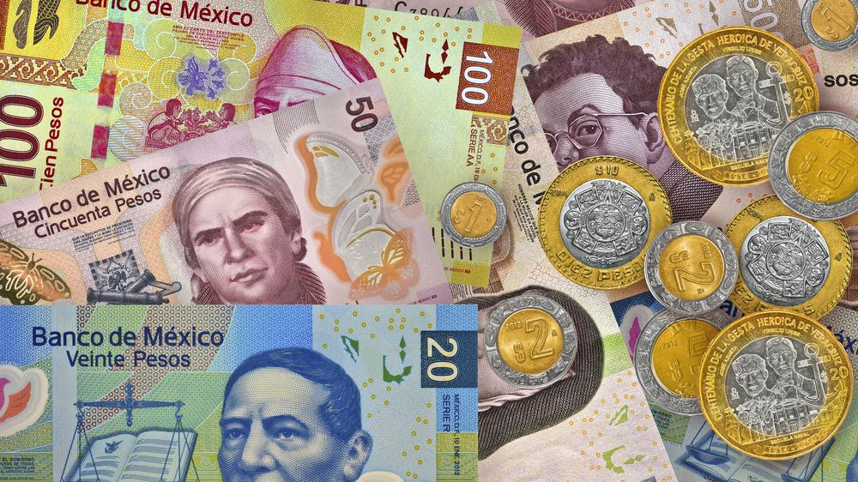
Money
The Peso is the official currency of Mexico
Official Exchange is 100 Pesos is $5.80 US
Or 17.35 Pesos to the US Dollar

Slide 6
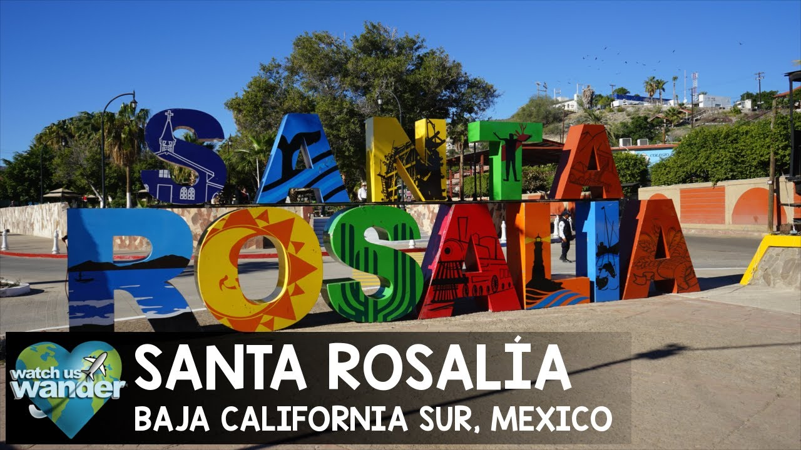
About Santa Rosalía Mexico
Santa Rosalía is a city and municipal seat of Mulegé Municipality, in Baja California Sur, situated along the Gulf of California. Located on the east coast of the Baja Peninsula, the town had a population of 14,357 inhabitants in 2020.
The city was founded as a company town by the French Compagnie du Boleo in 1884, which established the local copper mines. Today the city is a popular tourist destination.
The town was named after Santa Rosalía, although the mission is not located by the town, but is in its original location Mulegé, about 100 km (62 mi) south.
Santa Rosalía boasts French influence, particularly in its architecture. The French Compagnie du Boleo founded the town in 1884 and exploited copper mines there until they closed in 1954. They built houses and installed the metallic Iglesia de Santa Bárbara.

Slide 7
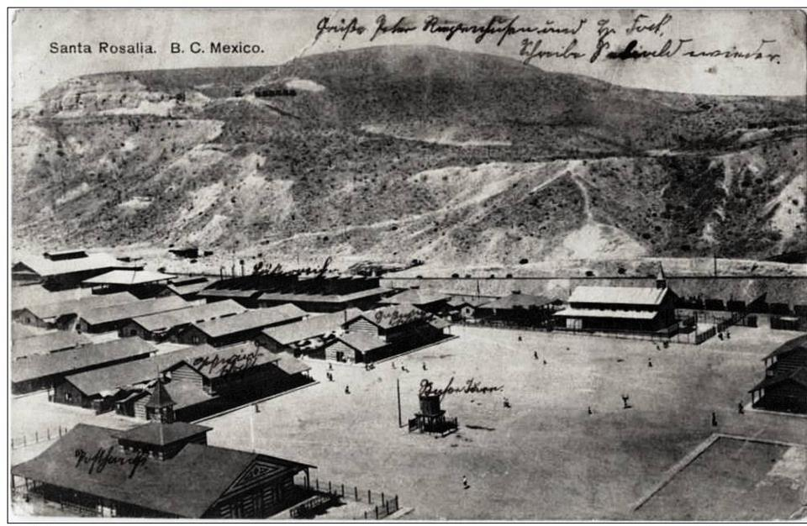
Historical Santa Rosalía
Santa Rosalia, Baja California, had its beginnings when a rancher named Jose Rosas discovered curious round green copper-bearing pellets in its vicinity in 1868. Interested in their possible value, he sent them to Guaymas to be analyzed via the captain of a ship he traded with, and the response was quick.
Two Germans, G. Blumhardt and Julio Müller, paid Rosas 16 pesos to reveal the site and began prospecting immediately.

Slide 8
Historical Santa Rosalía
After two years many other Spanish had declared claims, yet Guillermo Eisenmann and Eustaquio Valle managed to merge most of the concessions granted to other small companies that had been working in the area since 1870.

Slide 9
Historical Santa Rosalía
Further interest was sparked in 1883 when gold was discovered In Las Palomas, creating a gold rush centered around Calmallí.
Due to this discovery, in 1884 a commission was sent by the Mexican government to explore Baja California’s mineral resources.
This commission carried out extensive studies and determined that from 1870 to 1884, 42,000 tons of copper had been mined and, up to July of 1884, 6,000 ounces of gold had been produced.

Slide 10
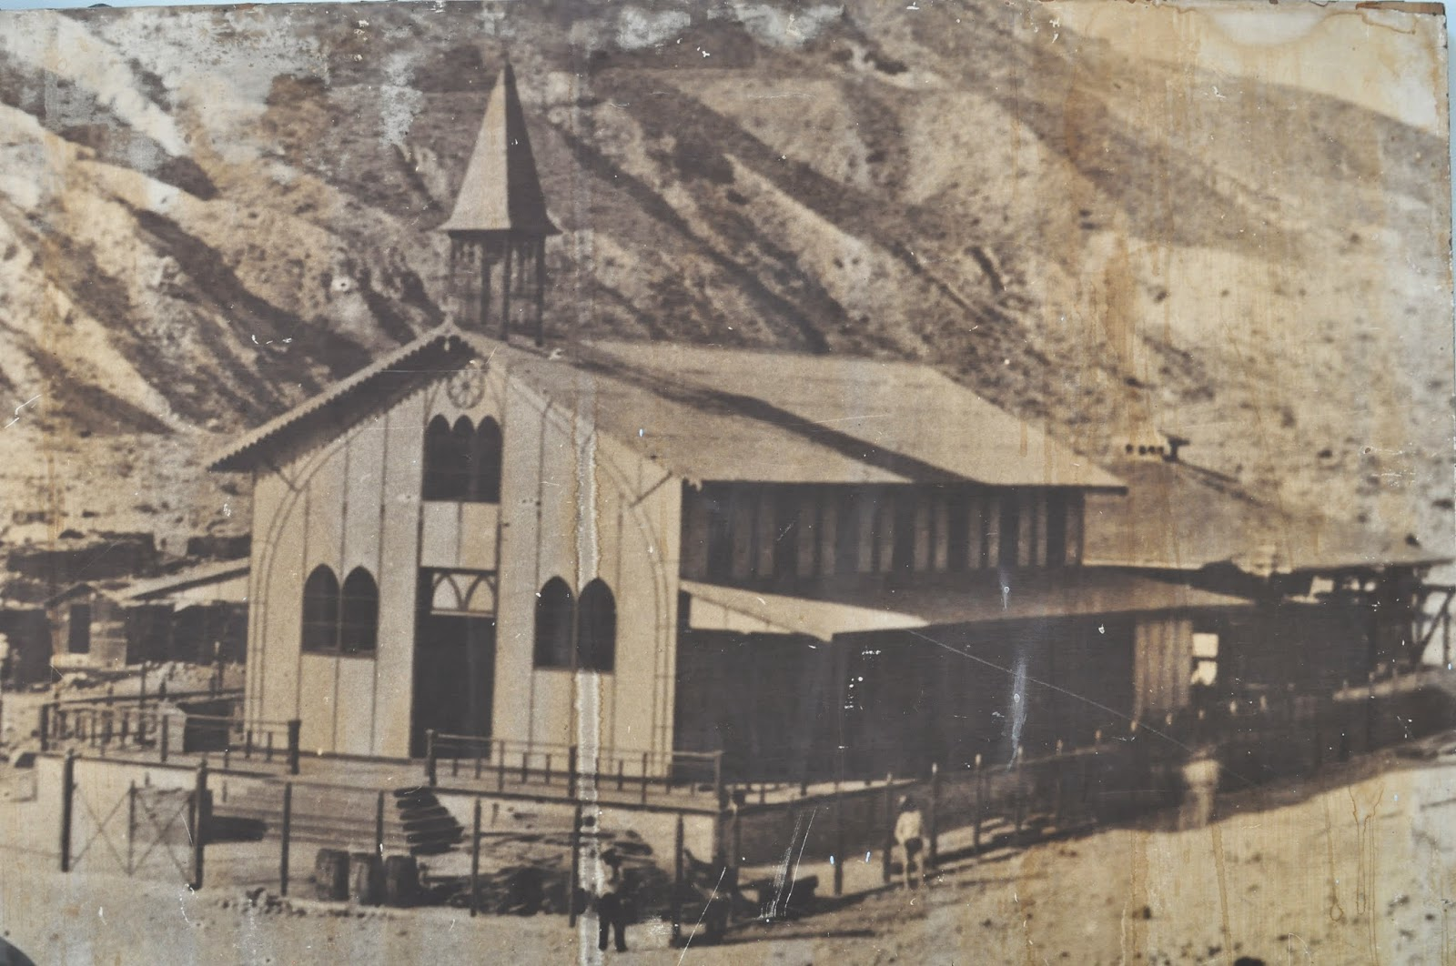
Historical Santa Rosalía
By 1884 Eisenmann and Valle were operating a copper mining company called El Boleo (after the Spanish word for the copper-bearing pellets).
The enterprise entailed eleven mines with a good network of tunnels and galleries located at mining camps called Santa Rosalía, Providencia, Purgatorio, and Soledad.

Slide 11
Historical Santa Rosalía
One hundred Yaqui Indians brought from the prison of Guaymas were the first laborers to dig the mineral, and ore was brought out of the mines in leather sacks called “tanates.” Many more Yaquis would be brought in time to live in barracks and continue to be an important labor force.
By 1886 the French had begun building their main center of operations in the canyon of Providencia, calling the town Santa Rosalía, after the arroyo that ran through there and the Mission of Mulegé.

Slide 12
Historical Santa Rosalía
By 1886 the French had begun building their main center of operations in the canyon of Providencia, calling the town Santa Rosalía, after the arroyo that ran through there and the Mission of Mulegé.

Slide 13
Historical Santa Rosalía
On the other side of the gulf, 98 miles away, was the port of
Guaymas with a population of 15,800, and of importance
because the railroad that came from Laredo, Texas, ended there, while to the south another line linked it to Mazatlán and Manzanillo.
1887 After Mexico City, Santa Rosalía was the second city in
Mexico to have electricity.

Slide 14
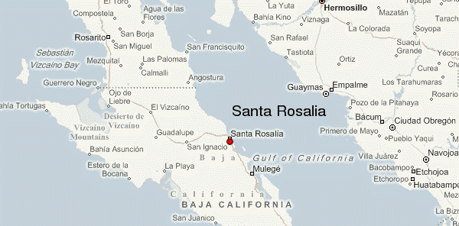
Map of Baja

Slide 15
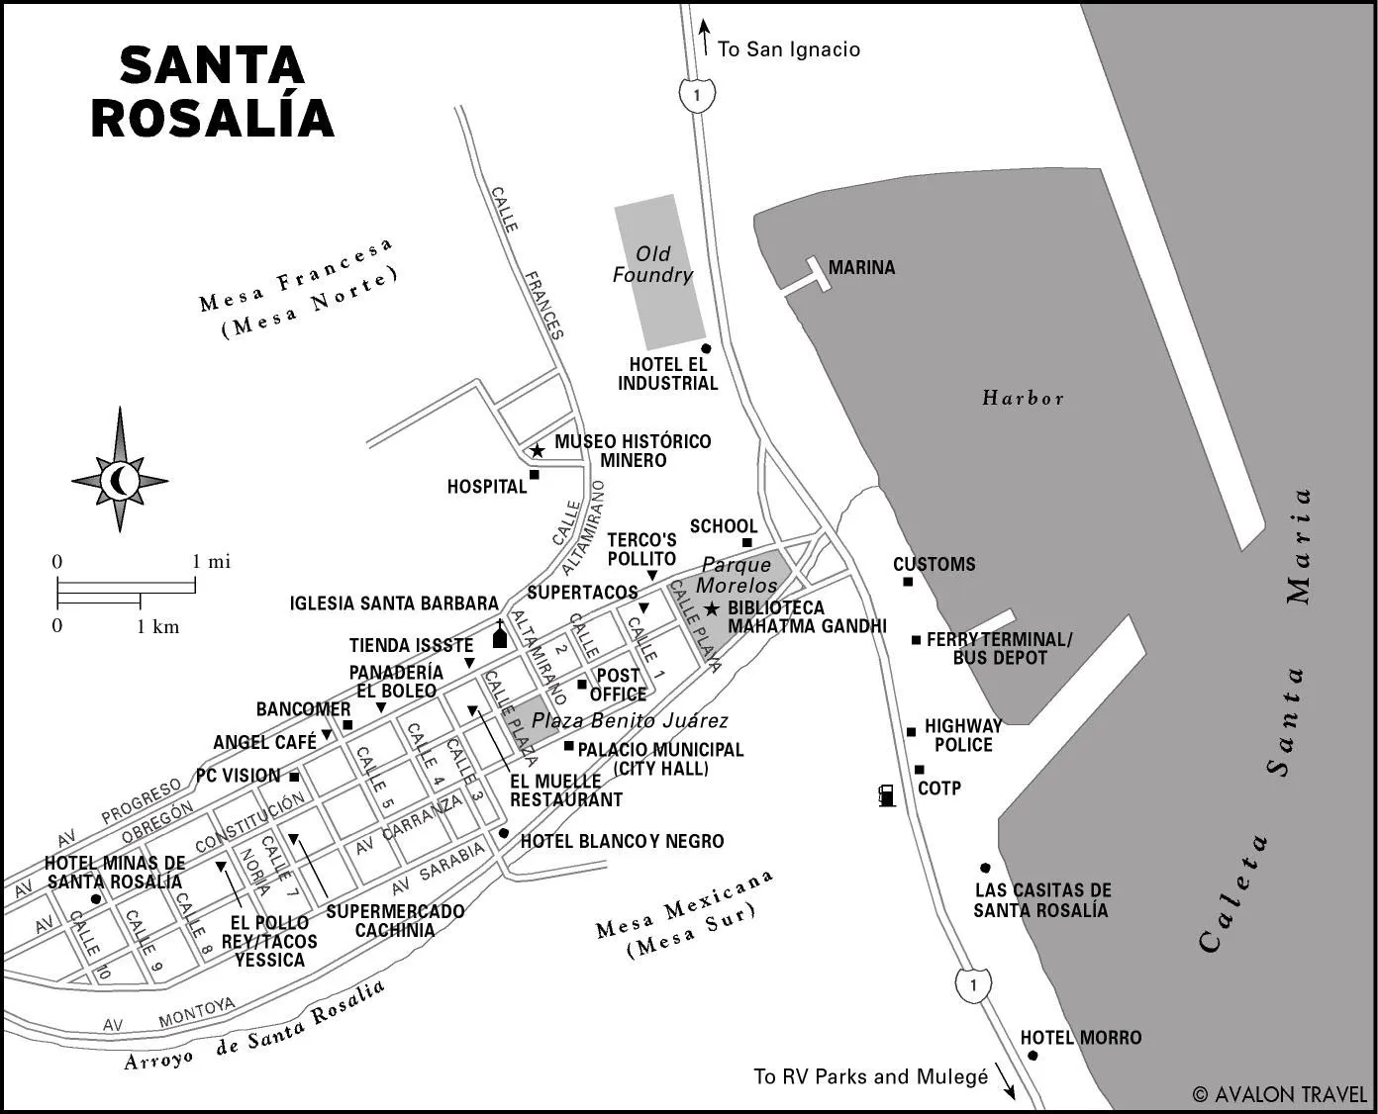
Map of Santa Rosalía

Slide 16
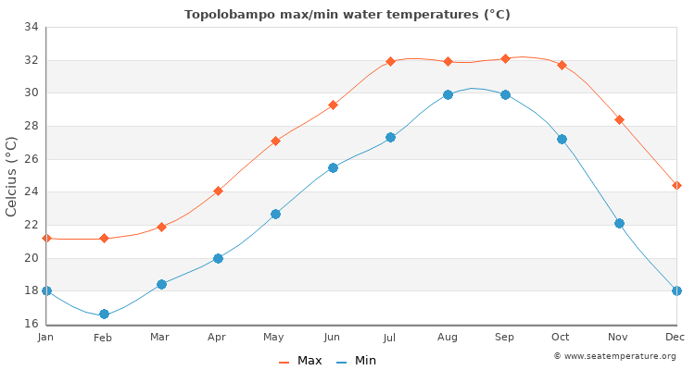
Weather in Santa Rosalía
Santa Rosalía sits at sea level and has a semi-arid climate. The temperature is usually warm or hot year-round.
April – October: daytime highs usually range from 32 to 38°C (90 to 100°F), night-time lows from 15 – 25°C (59 – 77°F). The rainy season is from July through September and the cities have occasionally been hit by hurricanes.
November – March: daytime highs range from 26 to 30°C (79 to 86°F), while nightly lows are
between 11 and 15°C (51 and 59°F).
The best time to go is in October as the landscape will be lush after the rain. However, as the weather is warm year-round, it’s easy to enjoy outdoor activities most of the year. It’s probably best to avoid July and August due to extreme temperatures and heavier rain.

Slide 17
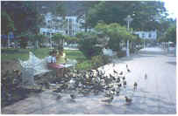
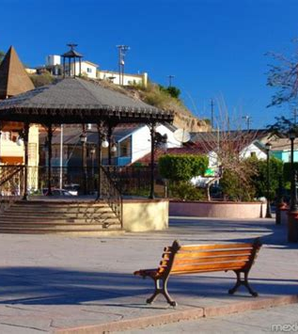
Getting Around Santa Rosalía
From the dock to the Estadio De Futbol (Soccer Field) on the far west side of town, it is about a 30-minute walk of just over 2Km. So, unless you are going to visit something outside of town you should be able to walk everywhere.

Slide 18
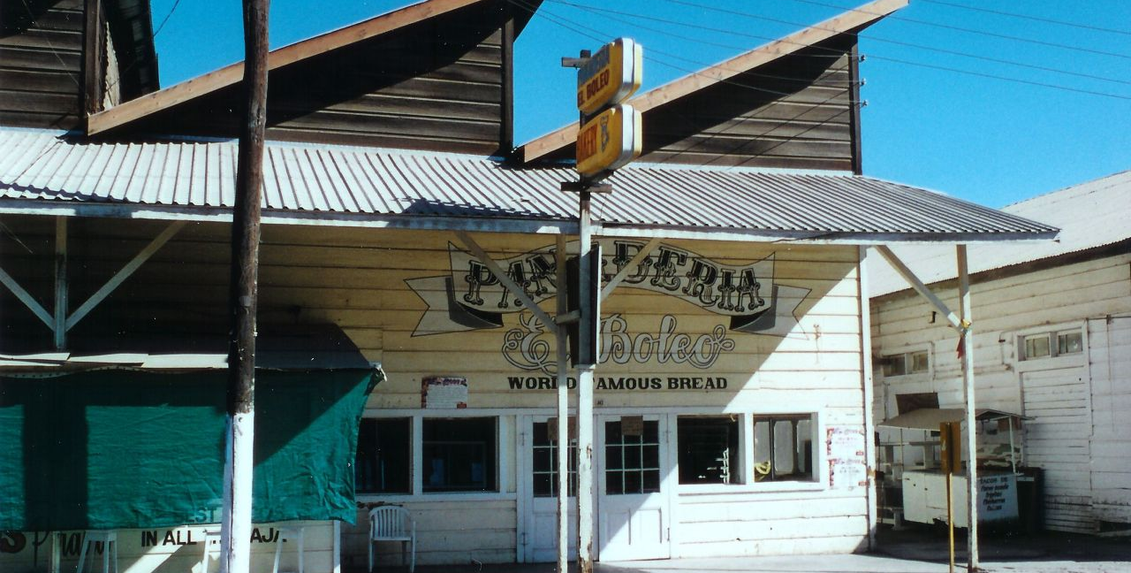
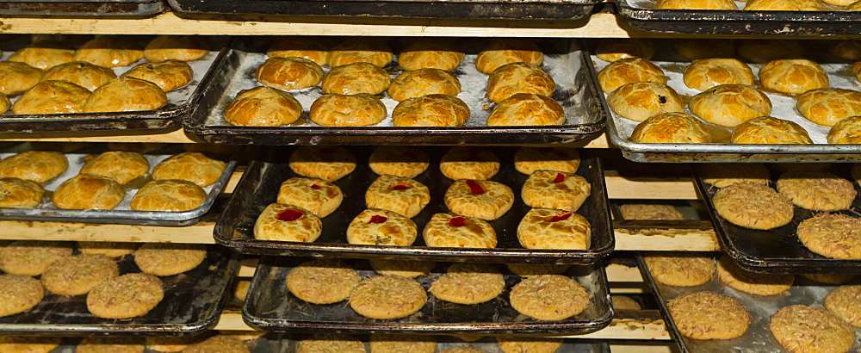
El Boleo Bakery
More than a bakery, El Boleo is part of the history of Santa Rosalía.
Baptized with the same name as the French company that exploited the copper deposits in the region, since 1901 their furnaces have worked to offer exquisite French bread.
Try them all. The Bolillo, conchas, empanadas, telera, virote, whether you choose sweet, savory, or both, the rule is that if you are in Santa Rosalia you must try their bread.

Slide 19
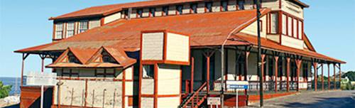
Museo el Boleo
Built in 1885 by the French to house the offices of the Boleo Company, this mining museum watches over the town and the copperworks from its perch on the hill. The views are lovely, and it's surrounded by cool abandoned locomotives and other pieces of machinery.

Slide 20
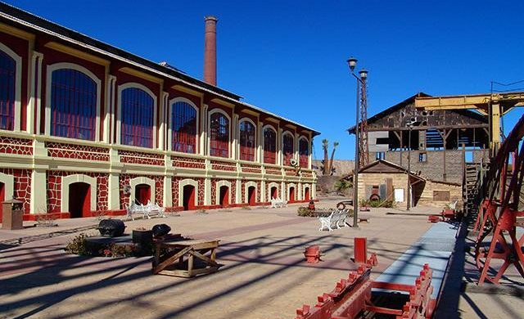
Museo de Historia de la Minería de Santa Rosalía
(Mineral Museum of Santa Rosalía)
The city of Santa Rosalía, declared a historical monument in 1984 by the Congress of Baja California Sur, was built at the end of the last century by the French company El Boleo, which had obtained the concession to exploit the copper deposits in the place. After the mining boom, the Santa Rosalía Mining History Museum rescues everything related to this flourishing period of the town. In the room that was set up for its exhibition, you can see
furniture, equipment, and pieces from the
beginning of the last century in an original
building of the time. At the entrance is the Little
Train, which is a small locomotive formerly used
in the mine.
The charming village has a strong French imprint. This museum rescues everything related to the flowering stage of the people.

Slide 21
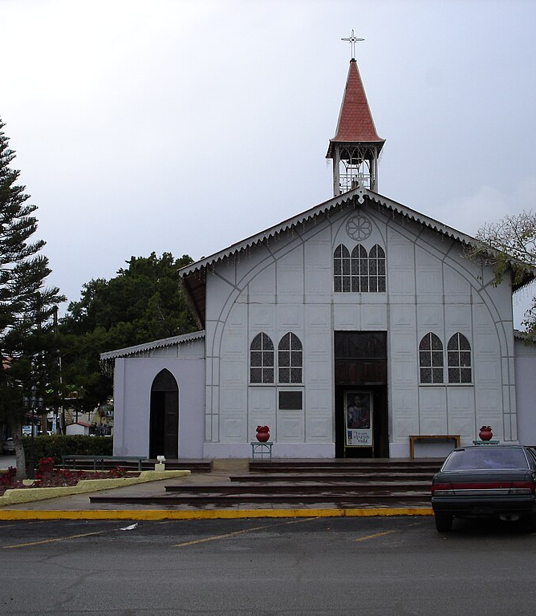
Santa Barbara Church
The Santa Barbara church in the center of town is not considered part of the historic Mission trail. Gustav Eiffel, architect of the Eiffel Tower took first place for both this church and the tower at the 1880 World Fair in Paris.
Carlos La Frogue acquired the church and he had its metal plates shipped individually to be reconstructed in Santa Rosalia. High above the altar is an intense stained glass depicting Christ's death.
The church was blessed and put under the protection of the miner’s patron saint, Santa Barbara. The dark wooden pews and golden light from the street-level windows create an interior warmth that beckons the faithful.

Slide 22
Conclusion
Santa Rosalía is a quaint village with a rich mining history.
I don’t say this very often, but I highly recommend booking a tour through the ship, unless you just need some downtime to relax and refresh on board.
I hope this presentation will help when we visit Santa Rosalía!

Slide 23
Thanks For Coming
If you have any more questions, please ask.
I will do my best to answer them for you.
Have a great visit in Santa Rosalía!

