Slide 1
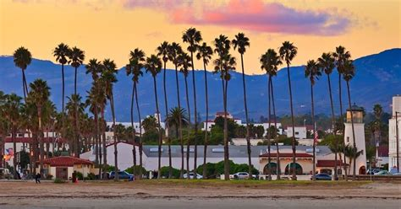
Santa Barbara Full of Charm and Adventure Presented by Marc Silver
A Coastal Escape

Slide 2
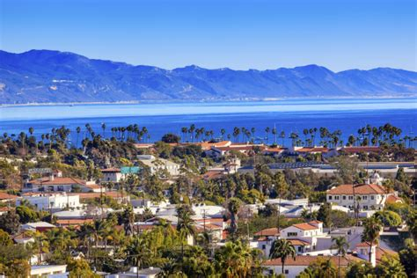
America’s Western Riviera
Santa Barbara, affectionately known as the "American Riviera," is a captivating blend of Spanish colonial charm, stunning landscapes, and vibrant culture.
Whether you're strolling along its picturesque harbor, diving into its rich history, or indulging in its fantastic cuisine, Santa Barbara offers endless opportunities for adventure and relaxation.
Ready to explore? Let’s dive into your ultimate guide to this coastal gem.

Slide 3
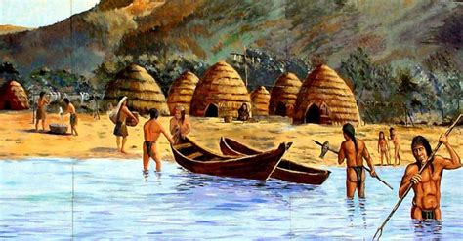
A Glimpse into Santa Barbara’s History
Santa Barbara’s story begins with the Chumash people, who thrived in this coastal paradise for thousands of years.
Skilled in craftsmanship and seafaring, they created a vibrant culture deeply connected to the land and sea.
Fast forward to 1542, when Spanish explorer Juan Rodríguez Cabrillo sailed into the region, naming it after Saint Barbara.
The Spanish colonial influence took root in 1786 with the establishment of Mission Santa Barbara, a cornerstone of the city’s identity.
Over the centuries, Santa Barbara has evolved, blending its rich past with modern sophistication. Today, it’s a destination cherished for its stunning architecture, lively culture, and breathtaking views.

Slide 4
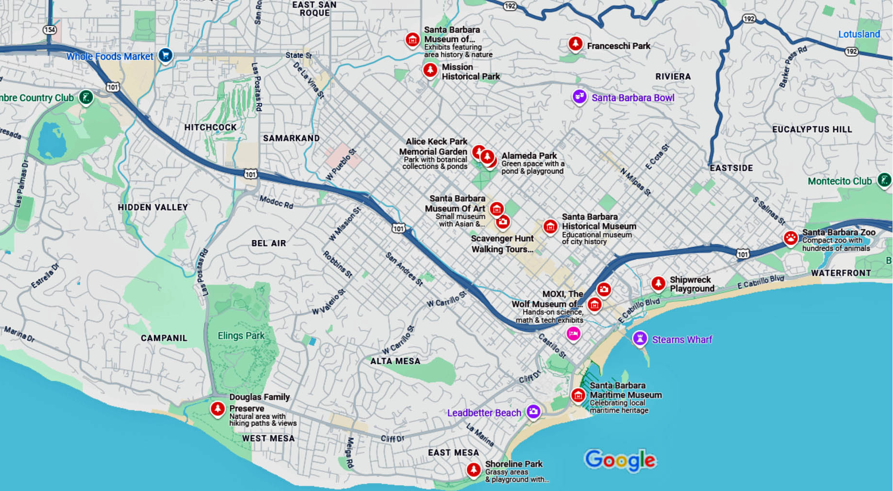
Getting Around Santa Barbara
Navigating Santa Barbara is a breeze, thanks to its compact layout and diverse transportation options.
Whether you prefer exploring on foot, cycling along the coast, or hopping on a bus, here’s how to get around:
Walking
Bus
Bike and Scooter
Taxi or Ride Share

Slide 5
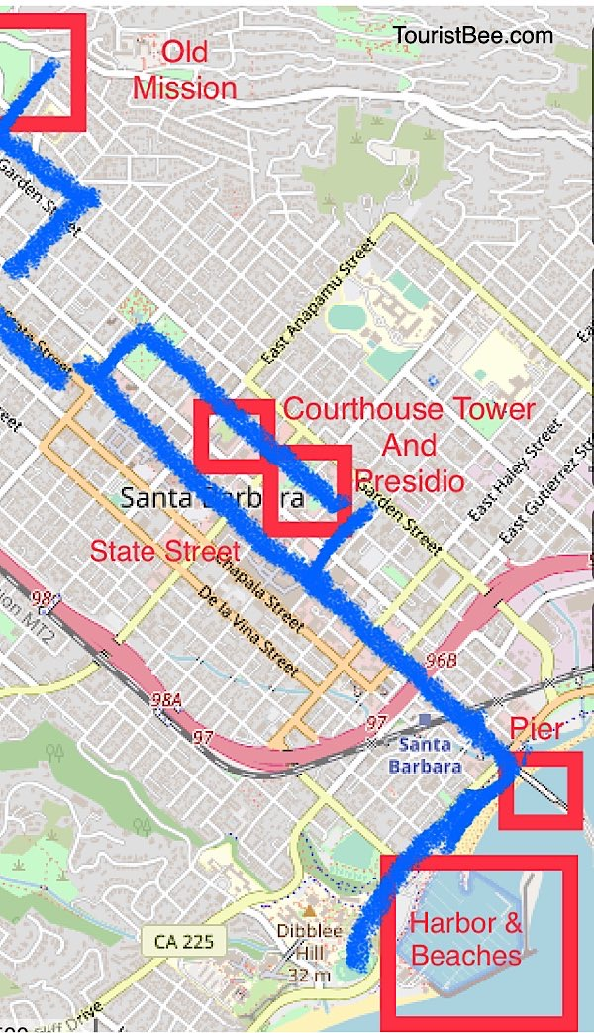
Walking Tours
Want to immerse yourself in Santa Barbara’s history and charm? A walking tour is the way to go.
Downtown Santa Barbara Walking Tour: Stroll through the city’s historic landmarks, like El Presidio de Santa Bárbara and the historic Chinatown, on this 2.5-hour tour. Prices start at $95 per person.
Private History and Architecture Tour: Dive deeper into the city’s architectural gems on this private 2-3 hour tour. Priced from $99 per person.

Slide 6
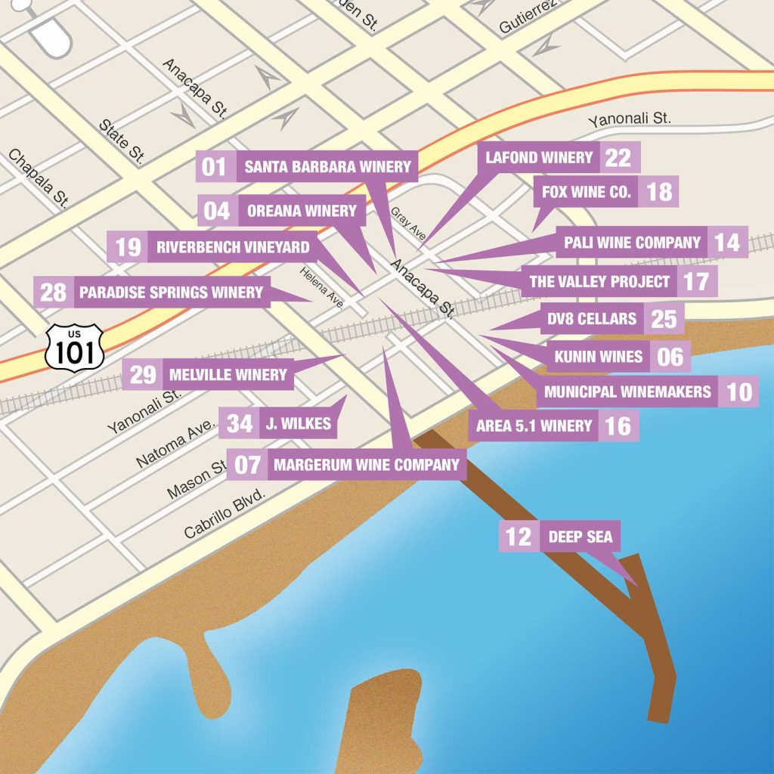
Walking Tours
Santa Barbara Urban Wine Trail
Santa Barbara is one of the premier wine destinations not just in California, but in the world.
The first tasting room, Santa Barbara Winery, opened in downtown Santa Barbara in 1962.
Around the turn of the millennium, many of the wineries that grow grapes in the surrounding mountains began opening tasting rooms in the city.
The Urban Wine Trail refers to over 20 tasting rooms located within just a couple blocks from each other in the downtown area.
It’s not only an excellent way to try the spectacular wines this area is known for, but it’s also a treat to get to know what defines this exciting and beautiful city.
Santa Barbara Urban Wine Trail
Pick up a map at the Downtown Visitor Center

Slide 7
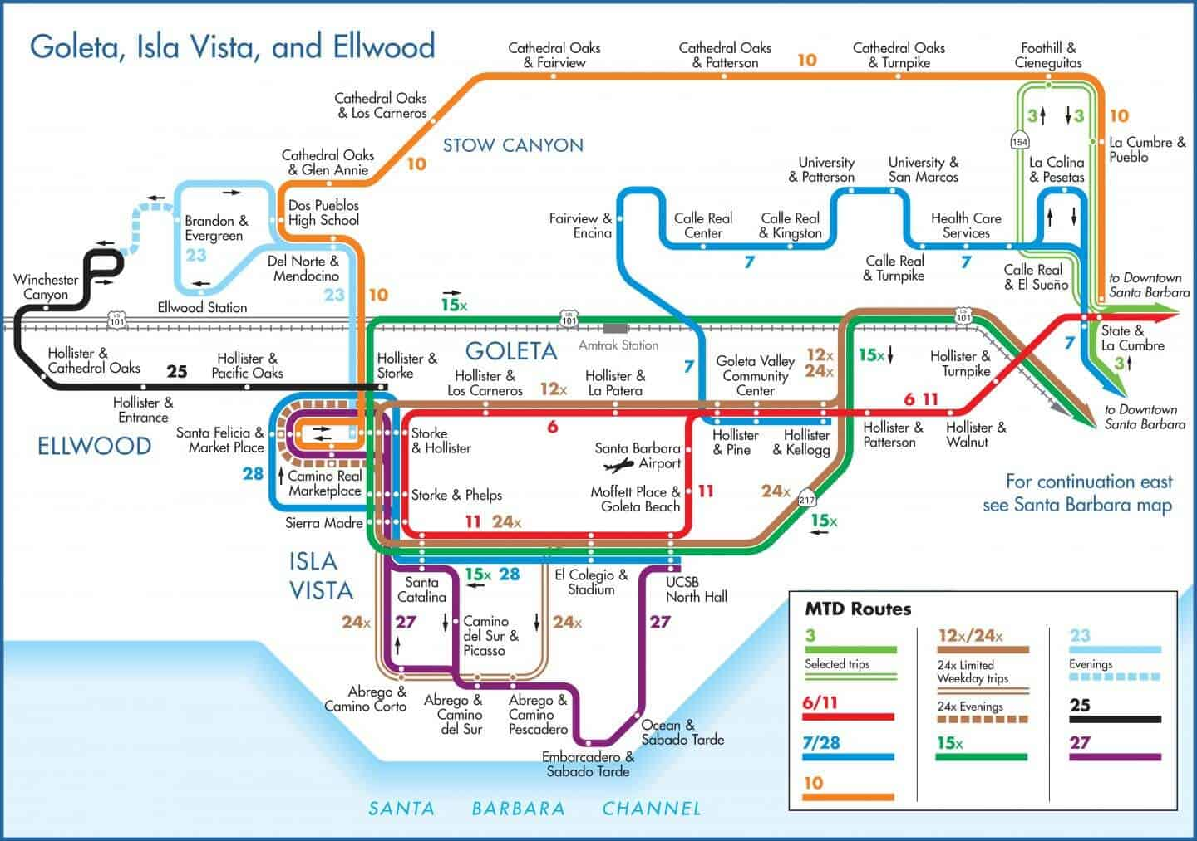
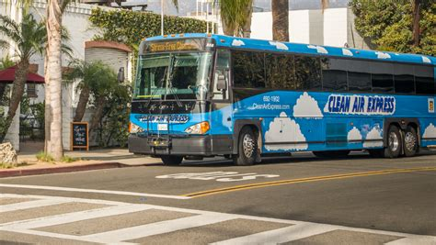
Getting Around Santa Barbara
Local Bus Transportation
Santa Barbara’s Metropolitan Transit District (MTD) offers an extensive and affordable bus network.
Fares: Single Ride: $1.75
Day Pass: $6 Seniors (age 62+) $0.85
Reduced fares are available for seniors, people with disabilities, and children under 45 inches ride free.

Slide 8
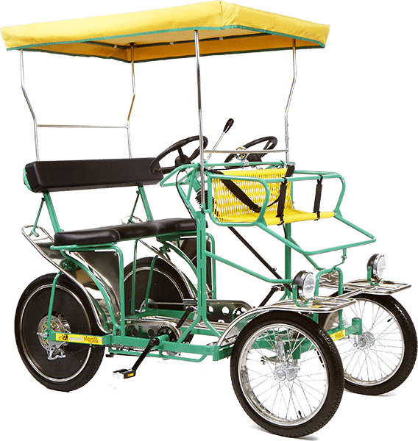
Getting Around Santa Barbara
Bike and Scooter Rentals
Feeling adventurous? Rent a bike or scooter and explore the city’s scenic routes.
Wheel Fun Rentals: Located about .4 miles south of the harbor. Perfect for beach cruisers and specialty bikes, ideal for a leisurely ride.
Wheel Fun Rentals | 24 E. Mason St. is about .5 miles just past Wheel Fun. Surrey Half Day rental: $60.
Cal Coast Adventures: Rent high-end bikes or join a guided tour to make the most of your exploration. They are about 1.5 miles from the harbor.

Slide 9
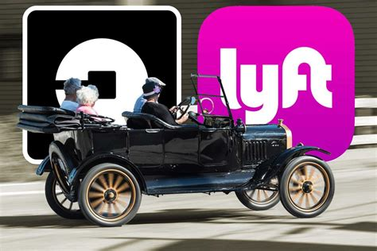
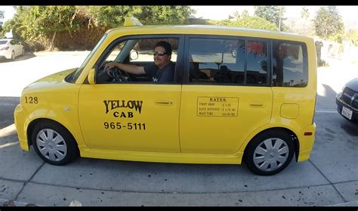
Getting Around Santa Barbara
Taxi and Ride-Share
For quick and convenient travel, taxis and ride-share services like Uber and Lyft are readily available. Pricing varies by distance and demand.

Slide 10
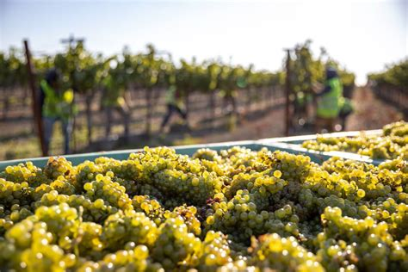
Welcome to Santa Barbara Wine Country
Santa Barbara County is a truly unique wine destination nestled along California’s stunning Central Coast. Known as the “American Riviera” for its Mediterranean-like climate, this region boasts not only breathtaking scenery but also a rich winemaking history that has rapidly evolved into a world-class wine culture.
While Santa Barbara’s winemaking history may not stretch back centuries, its remarkable growth and innovation have put it on the map as one of California’s premier wine regions.
Over the decades, successful vineyards and world-renowned wineries have emerged, blending large estates with intimate boutique producers that reflect the area’s distinct character.

Slide 11
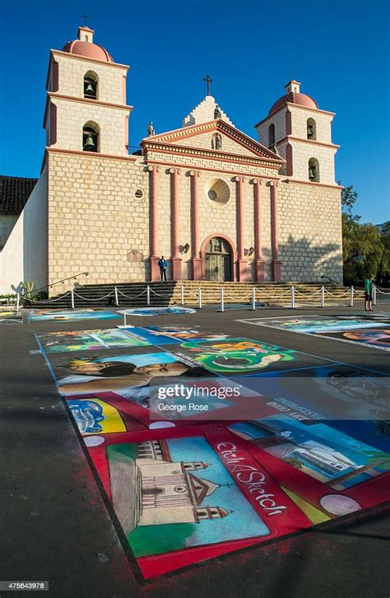
Top Attractions in Santa Barbara
Mission Santa Barbara
Known as the "Queen of the Missions," this iconic landmark blends stunning Spanish colonial architecture with fascinating history. Wander through the mission’s lush gardens, peaceful church, and museum.
Hours: Daily, 9:30 a.m.–5:00 p.m. (last entry at 4:00 p.m.)
Admission: Adults $17, Seniors $15, Youth $12, Children under 5 Free

Slide 12
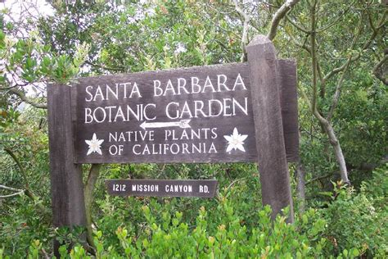
Top Attractions in Santa Barbara
Santa Barbara Botanic Garden
A serene escape featuring California’s native plants, the Botanic Garden is a must-visit for nature lovers. With peaceful trails and stunning views, it’s perfect for a morning of reflection or exploration.
Hours: Daily, 10:00 a.m.–5:00 p.m.
Admission: Adults $20, Seniors $16, Students $14, Youth $12, Children under 3 Free

Slide 13
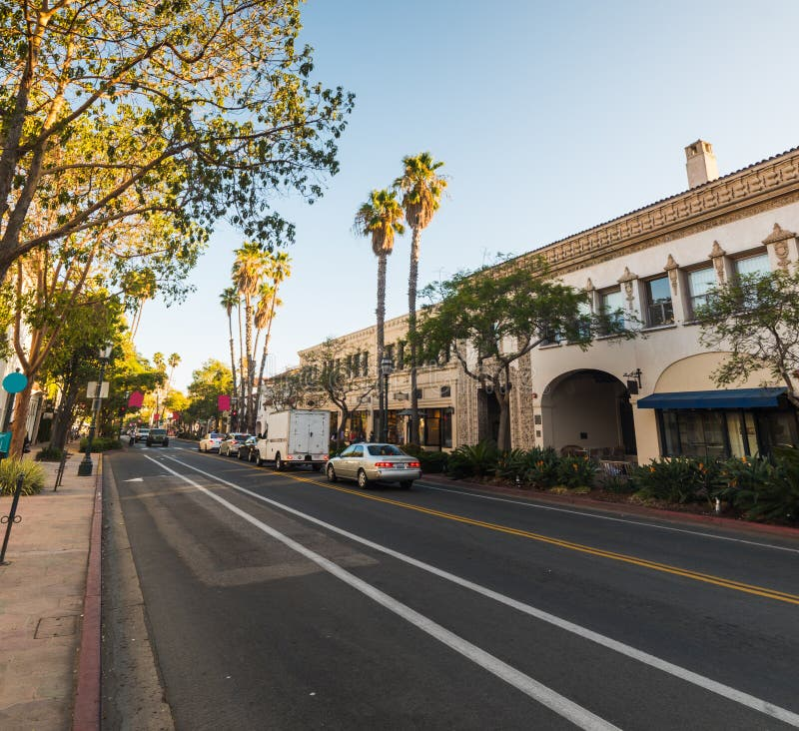
Top Attractions in Santa Barbara
State Street
This lively promenade is the beating heart of Santa Barbara.
Packed with boutique shops, street performers, and cozy cafes, State Street invites you to soak up the city’s vibrant culture.
Don’t miss the local art galleries and weekend farmers’ markets!

Slide 14
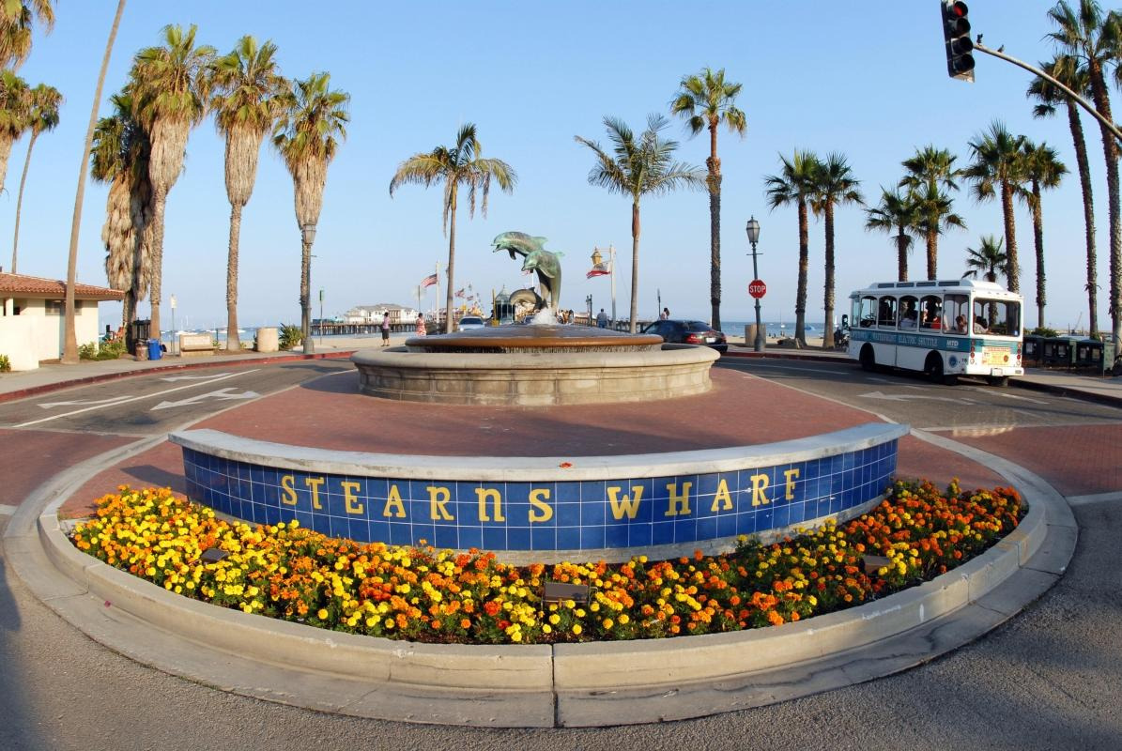
Top Attractions in Santa Barbara
Santa Barbara Harbor
Looking for coastal charm? The harbor offers stunning views, fresh seafood restaurants, and the Santa Barbara Maritime Museum, where you can explore the city’s nautical heritage.
The Santa Barbara Channel has become the ninth Whale Heritage Area in the world. This designation highlights the region’s commitment to promoting responsible ecotourism, education, and scientific research.

Slide 15
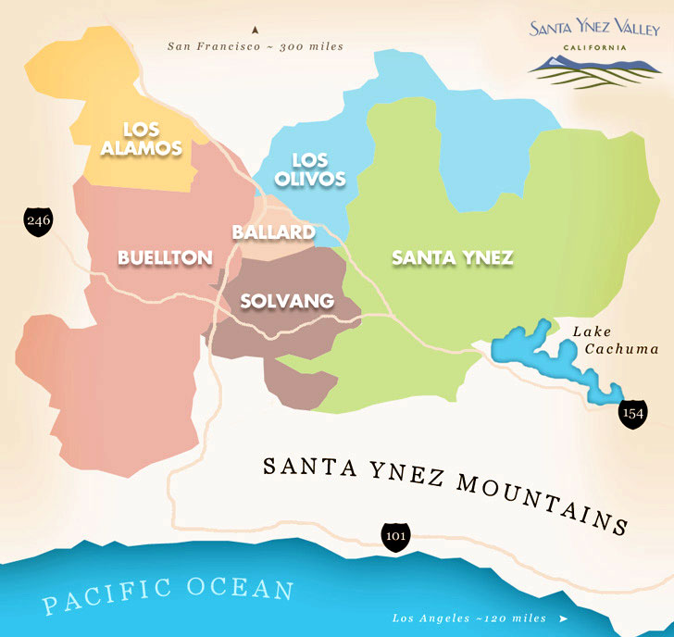
Explore the Wine of Santa Ynez Valley
Just a short drive from Santa Barbara, this picturesque wine region is a haven for wine lovers. With rolling vineyards, charming towns like Solvang, and award-winning wineries, it’s the perfect day trip.
Spanning over 76,000 acres, the Santa Ynez Valley is the largest of the Santa Barbara regions, renowned for its diverse microclimates and broad range of grape varietals.
This diversity creates ideal conditions for cultivating everything from crisp Sauvignon Blanc to rich Bordeaux varietals like Cabernet Sauvignon and Merlot.
The western areas of the valley, cooled by ocean breezes, excel in producing vibrant white wines and delicate reds with bright acidity and aroma.

Slide 16
Explore the Los Olivos Wine Region
Located in the heart of Santa Barbara County, the Los Olivos District is a picturesque area known for its charming boutique wineries and exceptional small-batch production.
This region specializes in a diverse range of Rhône and Mediterranean varietals, including Syrah, Grenache, Mourvèdre, and Viognier, alongside unique expressions of traditional varietals like Cabernet Sauvignon and Sangiovese.
With its gently rolling hills, sun-soaked vineyards, and gravelly alluvial soils, the district provides ideal growing conditions that enhance flavor complexity and structure.
This area captures the spirit of artisanal winemaking, offering a rich tapestry of flavors and styles that celebrate the skill and creativity of Santa Barbara’s winemakers.

Slide 17
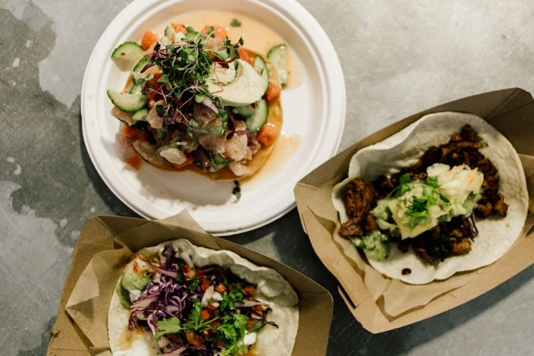
Local Cuisine to Try
Santa Barbara’s culinary scene is just as diverse as its attractions. Here’s where to eat and what to try:
Johnny’s Mexican Food: Famous for its breakfast burritos that are so satisfying, you’ll skip lunch. Affordable and delicious, meals range from $8–$12.
The Natural Cafe: A go-to for fresh, wholesome dishes like the “Good Karma Burger,” a tempeh delight. Meals cost $10–$15.
Sammy’s Pizza: A local favorite for wood-fired pizzas in a laid-back atmosphere. Try the margherita pizza; prices are $12–$18.
Caffe Primo: Start your day with their almond croissants and rich coffee. Breakfast here will set you back $10–$15.
The Good Lion: A cozy spot to wind down with a craft cocktail. Try the "Lion’s Tail," a spicy bourbon creation. Drinks cost $12–$18.

Slide 18
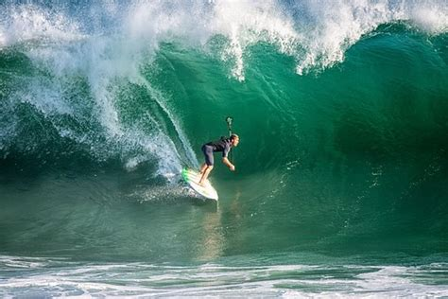
Activities for Every Traveler
Surfing at Mondo’s Beach: Take a private surfing lesson and ride the waves like a local. Perfect for first-timers!
Santa Barbara Museum of Art: Explore a diverse collection of works ranging from ancient artifacts to modern masterpieces.
Coastal Walks and Scenic Drives: Meander along Santa Barbara’s pristine beaches or take a scenic drive up to the mountains for panoramic views.

Slide 19
Travel Tips
What to Pack: Light layers work best for Santa Barbara’s mild climate. Comfortable shoes are essential for walking tours.
Plan for Priorities: Short on time? Focus on Mission Santa Barbara, the Botanic Garden, and State Street.
Local Favorites: Don’t be afraid to ask locals for recommendations—they know the best spots for everything from tacos to hidden hiking trails!

Slide 20
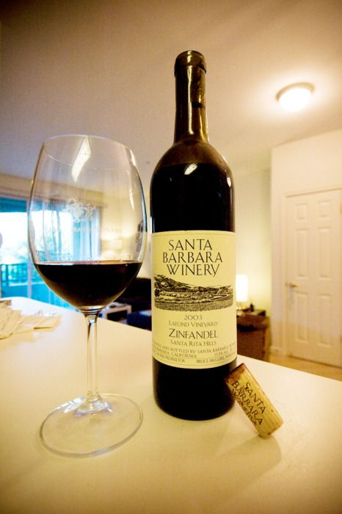
Why Visit Santa Barbara?
Santa Barbara is more than a destination—it’s an experience.
For me it’s to experience the wine, but for you maybe it’s something else.
From its sun-soaked beaches and historic landmarks to its vibrant food scene and welcoming atmosphere, this city has a way of leaving a lasting impression.
So, embrace the adventure, and let Santa Barbara’s charm sweep you off your feet.

Slide 21
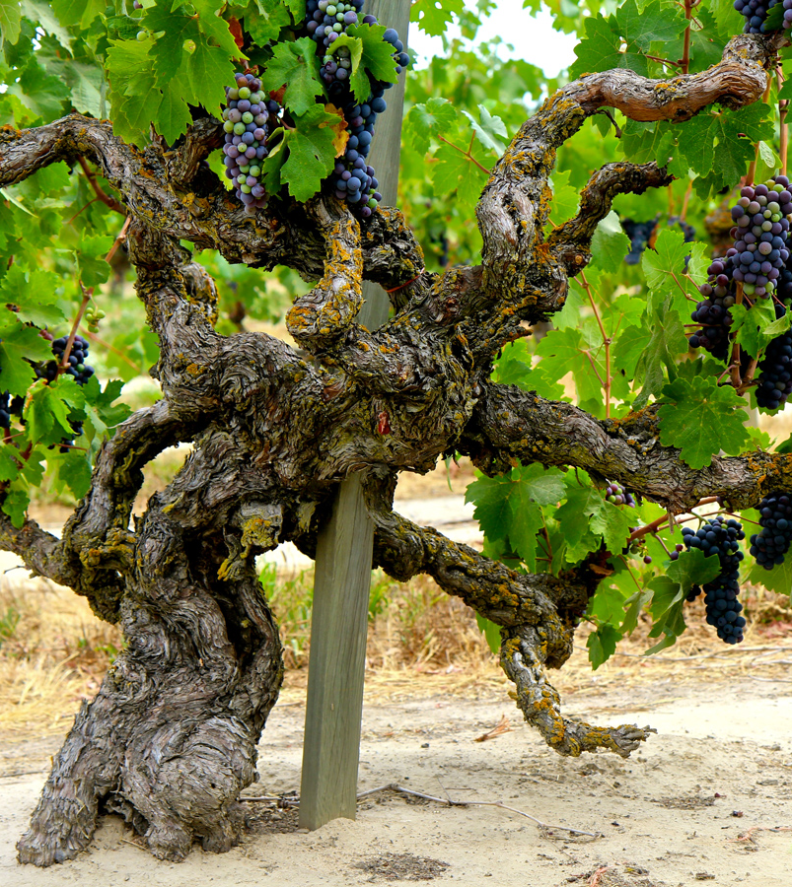
Conclusion
Santa Barbara County offers a wine-tasting experience like no other. With its coastal beauty, diverse AVAs, and welcoming wineries, every sip is a chance to connect with the land, the craft, and the laid-back elegance that defines this region.
Whether you’re strolling through a vineyard, savoring a bold Syrah, or toasting with a crisp Chardonnay, Santa Barbara is a wine lover’s paradise.
So grab your glass and let the flavors, scenery, and charm of Santa Barbara wine country create memories you’ll savor long after your visit. Cheers!

Slide 22
Acknowledgement
My seminars are the result of many years of experience combined with many hours of research over the internet.
I would like to acknowledge the many source I have accessed.
These include Wine Spectator, Wine Enthusiast, BKWine Magazine, Wine & Spirits Magazine, American Vineyard Magazine, The Grapevine Magazine, Wikipedia.com, Britannica.com, and the various Government websites.

Slide 23
References and Citations
Santa Barbara Mission. (n.d.). Visit Santa Barbara Mission. https://www.santabarbaramission.org
Santa Barbara Botanic Garden. (n.d.). Plan Your Visit. https://sbbotanicgarden.org/visit
Downtown Santa Barbara. (n.d.). State Street Promenade Guide. https://www.downtownsb.org
Visit Santa Barbara. (n.d.). Official Santa Barbara Travel Guide. https://santabarbaraca.com
Natural Cafe Menu. (n.d.). Healthy Dining in Santa Barbara. https://naturalcafe.com
The Good Lion. (n.d.). Craft Cocktails in Santa Barbara. https://thegoodlion.com
Santa Ynez Valley Wine Country. (n.d.). Discover Santa Ynez. https://www.visitsyv.com

