Slide 1
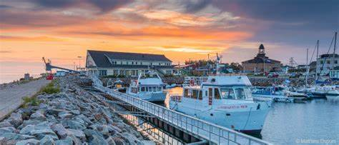
Saint Pierre, Canada
Presented by
Marc Silver

Slide 2
What I Will Cover
My Port Philosophy
Don’t Miss the Ship
Money
Exchanging Money
A Brief History of Civitavecchia
Maps
Transportation
Top Attractions & Points of Interest
Local Cuisine & Dining Options
Important Tips & Practical Advice
Conclusion

Slide 3
My Port Philosophy
I have been cruising for over 46 years and have taken over 100 cruises.
So, I consider myself an experienced cruiser.
The information I will present is based on those many years of
experience.
When I am on a cruise where the city, I want to visit is not the port city,
I always recommend taking a ship’s tour.
But when I am in a port with multiple attractions nearby and easy to see
on my own -
I will do it on my own.
This presentation is not like that.

Slide 4

Don’t Miss the Ship
How to Avoid Missing Your Ship
Pay attention to the time. - Ship time and local time are often
different.
Put a return-to-ship reminder on your phone.
Choose excursions wisely.
If a ship-sponsored excursion is late returning to port, the ship will
wait for you. If you are on your own???
Be Prepared
Have your Passport, Credit Card, and phone numbers for your ship
port agent.
What to Do If You Miss the Ship
Most cruise lines have port agents stationed in the port area to assist if your ship has left without you. If your are lucky, when cruisers are late returning to the vessel, the ship’s crew will often remove the passengers’ essential items – passports, cell phones, and medication -- from the ship to leave with the port agents.
The Port Officials can help you with contacting your ship
and making necessary travel arrangements.

Slide 5
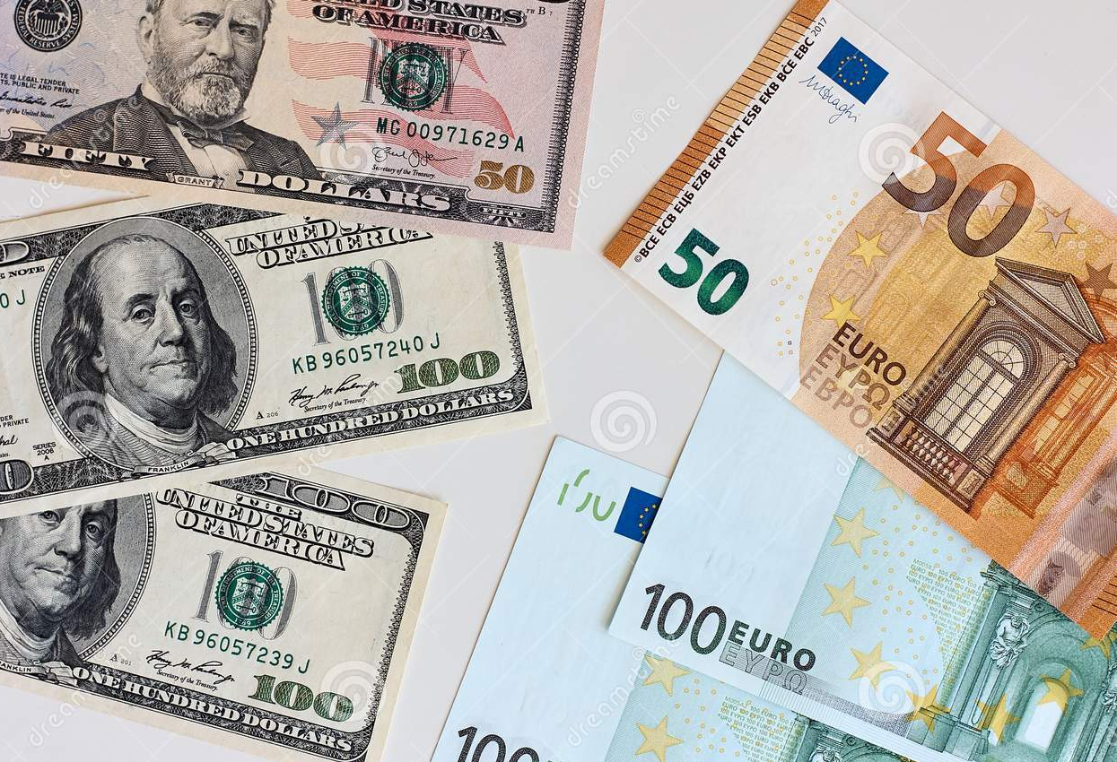
Money
As a general reference:
1 Euro equals roughly 1.05 U.S. dollars, though rates change.
Credit cards are accepted in many places, but not everywhere. This is a small community, and cash is still useful.
Avoid currency exchange kiosks at the port. Fees tend to be high and rates unfavorable.
If you want cash, use an ATM connected to a local bank. Carry small bills for cafés, bakeries, and shops.

Slide 6
A Brief History of Saint-Pierre & Miquelon
Saint-Pierre & Miquelon is a small French territory just off the coast of Newfoundland. It is the last remaining piece of France in North America.
Its history is tied closely to fishing, particularly cod, and to centuries of rivalry between France and Britain in the North Atlantic.
The islands changed hands multiple times before finally remaining French in the early 19th century. During Prohibition in the United States, Saint-Pierre became a major hub for alcohol smuggling, supplying much of the eastern seaboard.
Today, the islands blend French culture with North Atlantic geography in a way you won’t find anywhere else.

Slide 7
Orientation and Maps
The cruise pier is right in Saint-Pierre town.
When you step off the ship, you are already close to:
• Shops and cafés • Museums and historic buildings • The waterfront promenade • Local bakeries and markets
The town is compact and mostly flat, making it easy to explore on foot.

Slide 8
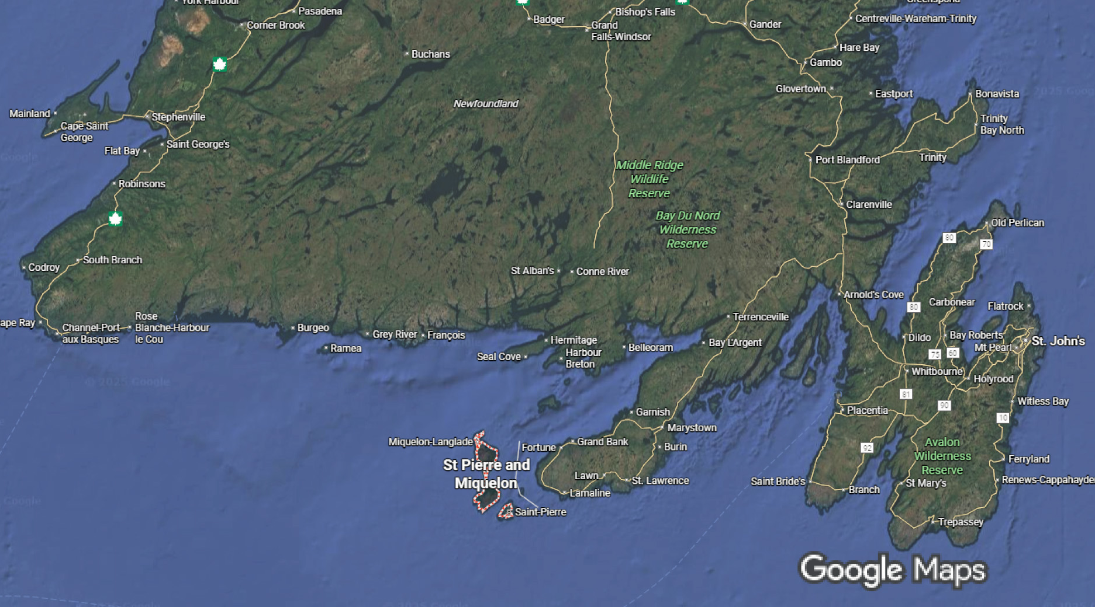
Area Map
^
Saint Pierre City

Slide 9
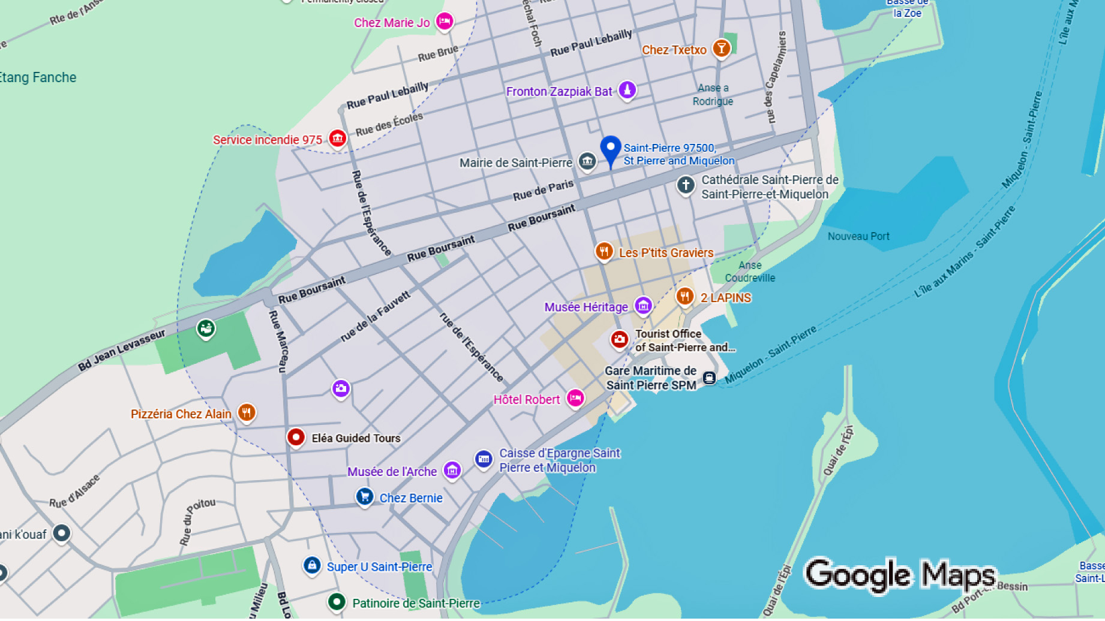
City Map

Slide 10
Transportation
Walking
Walking is the best way to experience Saint-Pierre. Distances are short, and the town is easy to navigate.
Taxis
Taxis are available but rarely necessary unless mobility is an issue.
Guided Tours
Small group tours are offered and can be useful if you want deeper historical context or visits beyond town limits.

Slide 11
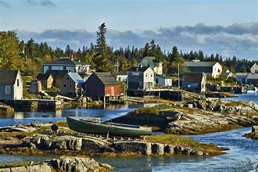
Top Attractions & Points of Interest
Town Center
Colorful buildings, French signage, and a relaxed pace make wandering the town part of the experience.

Slide 12
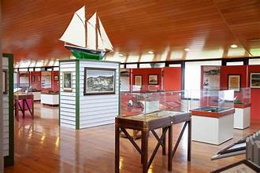
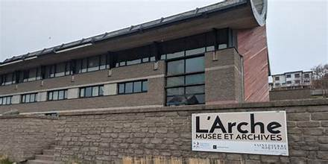
Top Attractions & Points of Interest
L’Arche Museum
This museum offers insight into island history, fishing culture, and everyday life.

Slide 13
Top Attractions & Points of Interest
Waterfront Promenade
An easy walk with views of the harbor, fishing boats, and the surrounding hills.

Slide 14
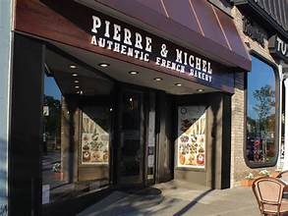
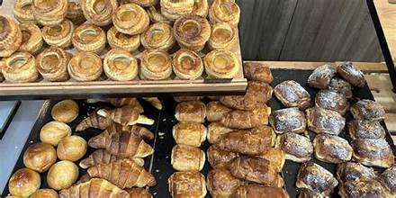
Top Attractions & Points of Interest
Local Shops and Bakeries
Fresh bread, pastries, and French groceries are highlights. This is a great place for simple souvenirs.

Slide 15
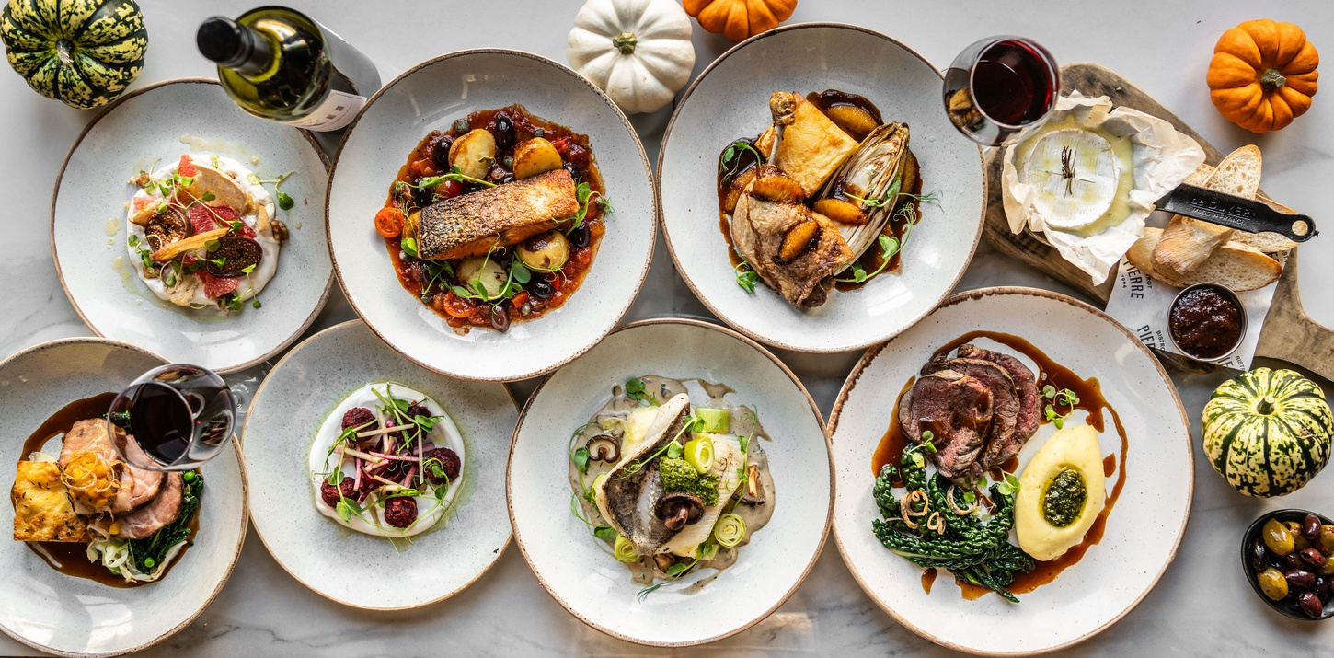
Local Cuisine & Dining Options
Food here feels unmistakably French, with a North Atlantic twist.
What to Try
Fresh seafood
French pastries and bread
Cheese and charcuterie
Simple bistro-style meals
Where to Eat
Follow the locals rather than menus aimed at tourists.
Cafés near the harbor are usually reliable.
Tipping is modest. Rounding up or leaving a small amount for good service is appreciated but not expected.

Slide 16
Important Tips & Practical Advice
This is a quiet port. Shops may close for lunch or keep limited hours.
French is the primary language. English is spoken, but learning a few basic phrases is appreciated.
Weather can change quickly. Bring a light jacket even on warm days.
Give yourself plenty of time to return to the ship. There’s no reason to rush here.

Slide 17
Final Thoughts
Saint-Pierre & Miquelon is not about big attractions or packed schedules. It’s about atmosphere, culture, and the novelty of stepping into France without leaving North America.
Take your time, enjoy a coffee or pastry, wander the streets, and soak in a place that feels genuinely different.

Slide 18
Thanks For Coming
If you have any more questions, please ask.
I will do my best to answer them for you.
Have a great visit in Le Havre!

