Slide 1

Rome & Civitavecchia
Cruise Port Guide
Presented by
Marc Silver

Slide 2
Some Advice
By following this guide, you’ll be well-prepared for a seamless transition between Rome and Civitavecchia, while making the most of your cruise experience.
Remember, Rome is a city with a population of over 2.8 million people but it is surprisingly easy to explore at your own pace—so take your time and enjoy!

Slide 3
What I Will Cover
My Port Philosophy
Don’t Miss the Ship
Money
Exchanging Money
A Brief History of Civitavecchia
Maps
Transportation
Top Attractions & Points of Interest
Local Cuisine & Dining Options
Important Tips & Practical Advice
Conclusion

Slide 4
My Port Philosophy
I have been cruising for over 45 years and have taken over 100 cruises.
So, I consider myself an experienced cruiser.
The information I will present is based on those many years of
experience.
When I am on a cruise where the city, I want to visit is not the port city,
I always recommend taking a ship’s tour.
But when I am in a port with multiple attractions nearby and easy to see
on my own -
I will do it on my own.
This presentation is not like that.

Slide 5

Don’t Miss the Ship
How to Avoid Missing Your Ship
Pay attention to the time. - Ship time and local time are often
different.
Put a return-to-ship reminder on your phone.
Choose excursions wisely.
If a ship-sponsored excursion is late returning to port, the ship will
wait for you. If you are on your own???
Be Prepared
Have your Passport, Credit Card, and phone numbers for your ship
port agent.
What to Do If You Miss the Ship
Most cruise lines have port agents stationed in the port area to assist if your ship has left without you. If your are lucky, when cruisers are late returning to the vessel, the ship’s crew will often remove the passengers’ essential items – passports, cell phones, and medication -- from the ship to leave with the port agents.
The Port Officials can help you with contacting your ship
and making necessary travel arrangements.

Slide 6
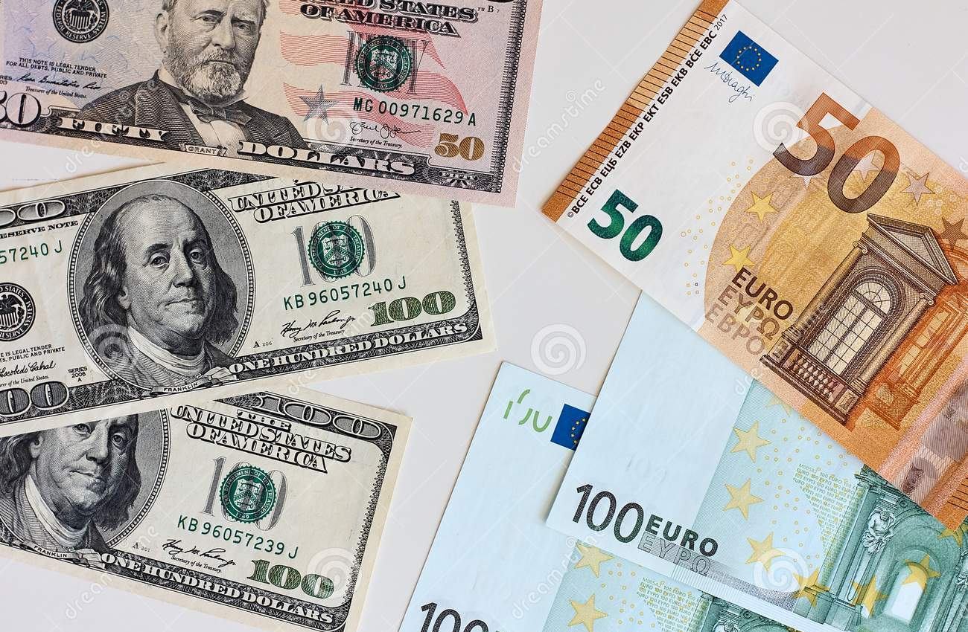
Money
Italy uses the Euro (€) as its official currency.
As of October 2024, the exchange rate between
the Euro and the U.S. Dollar (USD) is about
1 EUR = 1.05 USD.
This means U.S. travelers should anticipate slightly higher prices in terms of conversion, but Spain remains a relatively affordable destination compared to many other Western European countries.
When exchanging money, it’s best to avoid doing so at the port exchange kiosks, as they tend to have higher fees and less favorable rates.
Instead, consider using ATMs to withdraw Euros directly, as they often offer better rates. Additionally, credit and debit cards are widely accepted throughout Alicante, though having some cash on hand is always a good idea for smaller purchases or tips.

Slide 7
Exchanging Money
When exchanging money, it’s best to avoid doing
so at the port exchange kiosks, as they tend to
have higher fees and less favorable rates.
Instead, consider using ATMs to withdraw Euros
directly, as they often offer better rates.
Additionally, credit and debit cards are widely accepted throughout Italy, though having some cash on hand is always a good idea for smaller purchases.

Slide 8
A Brief History of Civitavecchia
Civitavecchia, often called the gateway to Rome for cruise passengers, has a long and rich history. It was founded by the Romans in the 2nd century AD. The port was crucial for trade and defense, linking the Roman Empire to the Mediterranean. Over centuries, it has seen its fair share of battles, from the Saracens to the World Wars, yet it remains an essential hub for commerce and tourism.
Today, Civitavecchia maintains much of its old-world charm, with a blend of historical sites like the Michelangelo Fortress and a bustling modern port. It serves millions of tourists yearly, particularly those embarking or disembarking from Mediterranean cruises.

Slide 9
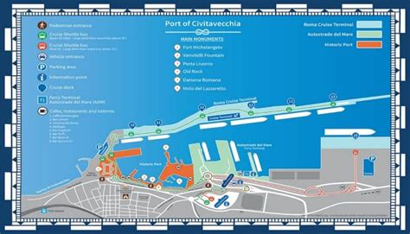
Map of ___________
Port of Civitavecchia
Shuttle to ship >

Slide 10
Airport to Civitavecchia
Getting from Rome’s Fiumicino Airport to Civitavecchia:
If you are transferring directly from your plane to the ship follow these directions:
Airport to Civitavecchia (Fiumicino to Civitavecchia) by Train
There are two options the Regional direct train or the Express through Rome.
  Option 1: Take the Leonardo Express to Roma Termini (€14, 32 minutes).
  Then take a regional train from Roma Termini to Civitavecchia (€5, 70-80 minutes). Total cost: €19 per person. Total time: 1.5 to 2 hours
  Option 2: Take the Regionale (example: #20579 06:57AM Fiumicino Aeroporto 1h50 arrives at 08:47AM Civitavecchia station with 1 transfer - see map) $13 (€11)
  rain frequency 25 a day
Shuttle Bus: Direct from Fiumicino to Civitavecchia.
  Cost: €8 per person. Time: 1.5 to 2 hours
Private Car or Taxi: The fastest and most convenient.
  Cost: €120-150 Up to 4 people. Time: 45-60 minutes

Slide 11
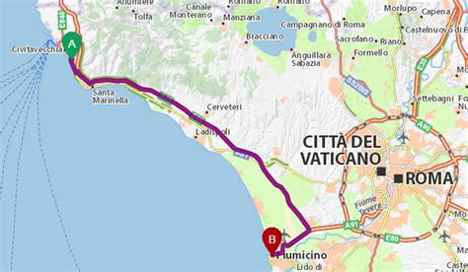
Airport to Civitavecchia

Slide 12
Airport to Rome
Airport to Rome (Fiumicino Airport to Roma Termini)
If you are transferring directly from your plane to Rome follow these directions:
Train (Leonardo Express): The quickest and easiest way.
  Cost: €14 per person. Time: 32 minutes
  How: Trains leave every 15-30 minutes from the airport to Roma Termini.
Shuttle buses: These are available but less frequent and not as direct as trains.
Note: Different trains may cost different amounts and take different times to get to and from the Airport. If you are confused ask at the ticket office for help.

Slide 13
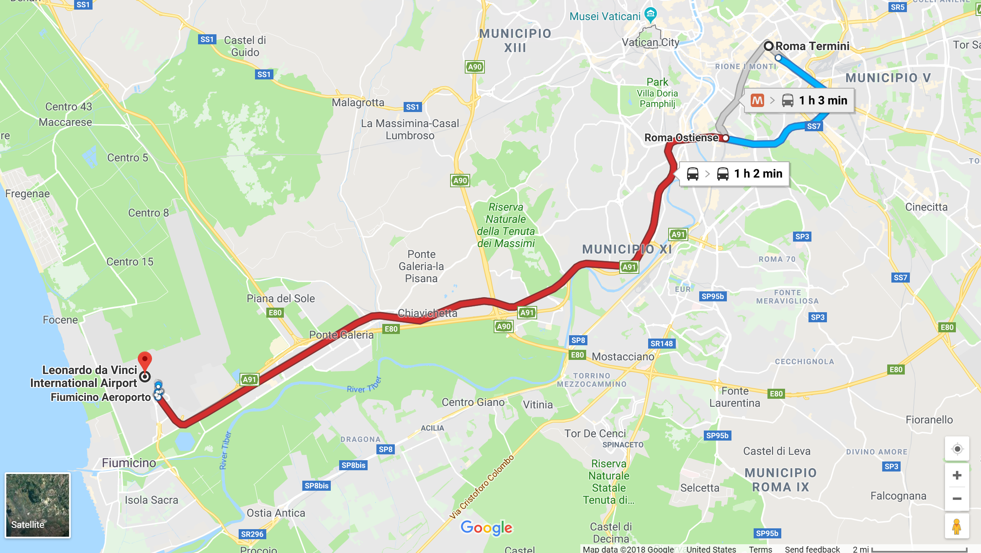
Airport to Rome

Slide 14
Civitavecchia to Rome
If you are transferring from Rome to the ship follow these directions:
Getting from Civitavecchia to Rome (Post-cruise):
Train: Again, the train is your best bet. Regional trains run frequently and cost only 5€. It takes about an hour to reach central Rome.
Private transfer: You can also hire a taxi or pre-book a car service. Prices range from 100-150€, depending on your destination in Rome.
Airport transfer: Direct shuttles are available, but the train is often faster and cheaper if you don't have a lot of luggage.

Slide 15
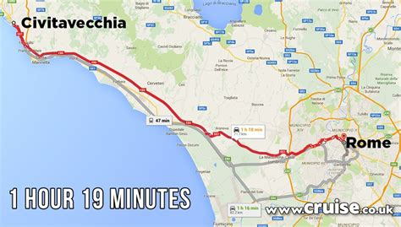
Map of ___________

Slide 16
Getting Around Rome
Rome is a large city, but getting around is manageable with the following options:
Public buses: Cheap but often crowded. A single ticket is 1.50€, valid for 100 minutes.
Hop-on, hop-off bus: Ideal for first-timers. Prices start at 24€ for a day pass.
Taxis/Rideshare: Taxis are reliable, with a 3€ start rate. Uber operates in Rome, but taxis are usually more convenient.
Walking: Rome is a walkable city, especially in the historic center. Just be ready for cobblestones!

Slide 17
Rome Tourist Pass
One option is the Roma Pass. It offers discounts for so many attractions it would be impossible to see them all in one long weekend. You’ll enjoy one or two free tickets for Rome attractions of your choice and discounted tickets for everything else. You’ll also have free access to all public transport (excluding trains), making your destinations easier to get to.
Museums and Attractions – There are over 50 to choose from.
Colosseum, Roman Forum, and Palatine. Castel Sant’Angelo, Borghese Gallery, with masterpieces by Bernini, Caravaggio, and Titian.
Capitoline Museums – with impressive archeological displays.
MAXXI – The top museum in Rome for contemporary art. Plus much more.
Roma Pass - 72 hour $65.41 Go online for more information.

Slide 18
Top Attractions & Points of Interest
Top Attractions & Points of Interest
The Colosseum: A must-see for first-time visitors. Tickets start at 16€, and it’s best to book online in advance.
Vatican Museums & Sistine Chapel: Admission is 17€, but expect long lines. Booking a skip-the-line tour is worth the extra cost.
Trevi Fountain: Free to visit, just toss a coin for luck!
The Roman Forum and Palatine Hill: Combo tickets with the Colosseum cost 16€.
Piazza Navona and the Pantheon: Both are free to visit and offer a fantastic glimpse of Rome’s Baroque architecture.

Slide 19
Local Cuisine & Dining Options
Must-try dishes: Start with Cacio e Pepe (pasta with cheese and pepper) or Carbonara. Don't forget supplì (fried rice balls) for a quick snack.
Where to eat, but be prepared for sticker shock!:
  Trastevere: Great for authentic Roman food in a lively neighborhood.
  Campo de' Fiori: A bit touristy but with several excellent spots if you explore beyond the square.
  Avoid restaurants near major attractions: These often overcharge tourists for subpar meals.
Tipping culture: It’s not mandatory, but rounding up the bill or leaving a couple of euros for good service is appreciated.

Slide 20
Important Tips & Practical Advice
Time to visit attractions: Most of the major sites can be visited in 1-2 hours, but plan for 3-4 hours at the Vatican if you want to see it all.
Booking excursions: Cruise lines offer packages, but you’ll find better value booking independently through reputable tour companies.
Safety: Rome is generally safe, but watch out for pickpockets in crowded tourist areas. Stick to tap water—it's safe to drink and widely available.

Slide 21
Thanks For Coming
If you have any more questions, please ask.
I will do my best to answer them for you.
Have a great visit in Rome!
I can be reached at: marcs@sonic.net

