Slide 1

Rio de Janeiro, Brazil
Presented by
Marc Silver

Slide 2
What I Will Cover
My Port Philosophy
Don’t Miss the Ship
Money
About Rio de Janeiro
Rio de Janeiro History
Area Map of Rio de Janeiro
Map of Rio de Janeiro
  Rio de Janeiro Transportation
Places to see or at least consider
A few restaurant recommendations
Conclusion

Slide 3
My Port Philosophy
I have been cruising for over 47 years and have taken over 100 cruises.
So, I consider myself an experienced cruiser.
The information I will present is based on those many years of experience.
When I am on a cruise where the city, I want to visit is not the port city, I always recommend taking a ship’s tour.
But when I am in a port with multiple attractions nearby and easy to see on my own - I will do it on my own.
This presentation is not like that.

Slide 4

Don’t Miss the Ship
How to Avoid Missing Your Ship
Pay attention to the time. - Ship time and local time are
often different.
Put a return-to-ship reminder on your phone.
Choose excursions wisely.
If a ship-sponsored excursion is late returning to port, the
ship will wait for you. If you are on your own.
Be Prepared
Have your Passport, Credit Card, and phone numbers for your ship port agent.
What to Do If You Miss the Ship
Most cruise lines have port agents stationed in the port area to assist if your ship has left without you. If your are lucky, when cruisers are late returning to the vessel, the ship’s crew will often remove the passengers’ essential items – passports, cell phones, and medication -- from the ship to leave with the port agents.
The Port Officials can help you with contacting your ship
and making necessary travel arrangements.

Slide 5

Money
The Brazilian Real
The official exchange rate:
$1.00 US = ~ 5 Real
1.00 Brazilian Real = ~ 0.20 US Dollars
Be aware exchange rates do change often.

Slide 6
About Rio de Janeiro, Brazil
Nestled between lush green mountains and golden beaches, Rio de Janeiro is a city of breathtaking contrasts. Its iconic landmarks—the towering Christ the Redeemer statue, the sweeping Sugarloaf Mountain, and the vibrant shores of Copacabana and Ipanema—are recognized worldwide.
Founded in 1565, Rio served as the capital of Brazil for nearly 200 years, leaving a rich legacy of historic buildings in its downtown Centro district, like the Imperial Palace and the Municipal Theater.
Beyond the postcard images, Rio pulses with a vibrant energy, fueled by samba, futbol passion, and its famous Carnival—a spectacular explosion of music, dance, and colorful parades. While a city of stark social contrasts, its stunning natural beauty and infectious carioca spirit make it an unforgettable destination, truly earning its title as the "Marvelous City."

Slide 7
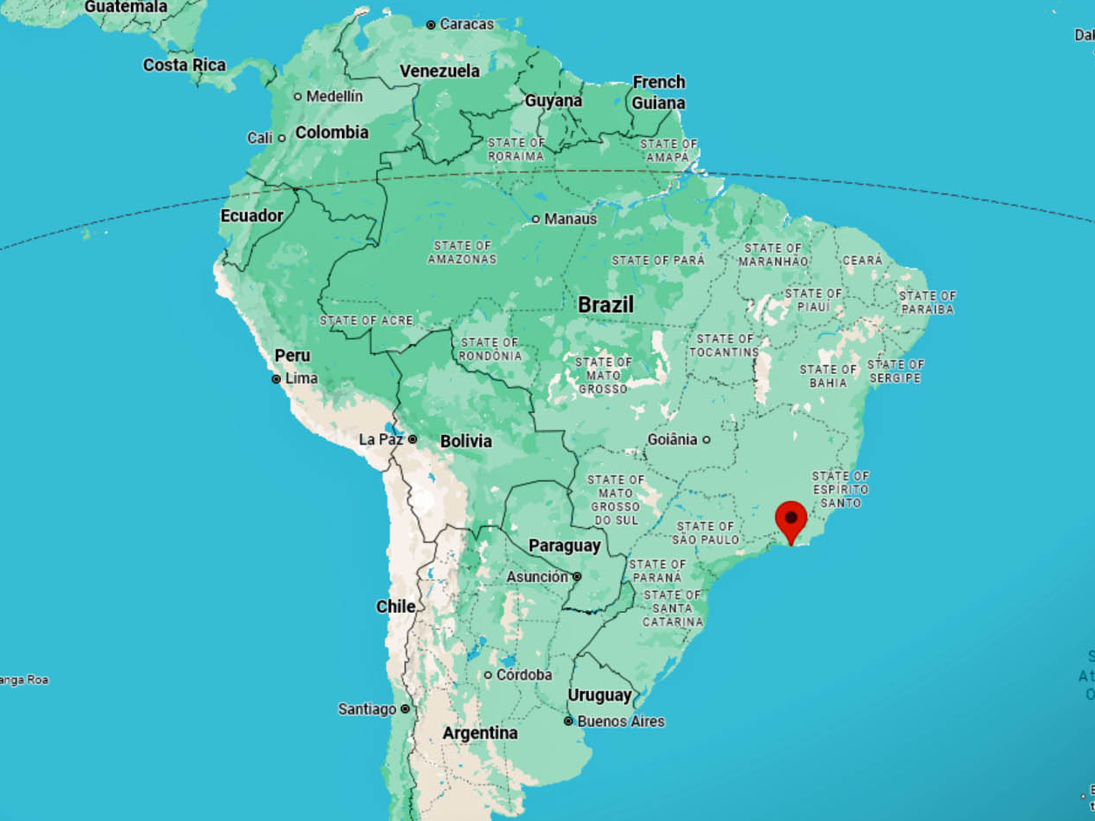
Brazil Map
Rio de Janeiro

Slide 8
Where Are We
Rio de Janeiro lies on Brazil’s southeastern coast, framed by lush mountains and the Atlantic Ocean.
It’s famous for its stunning scenery, samba rhythm, and vibrant energy.

Slide 9
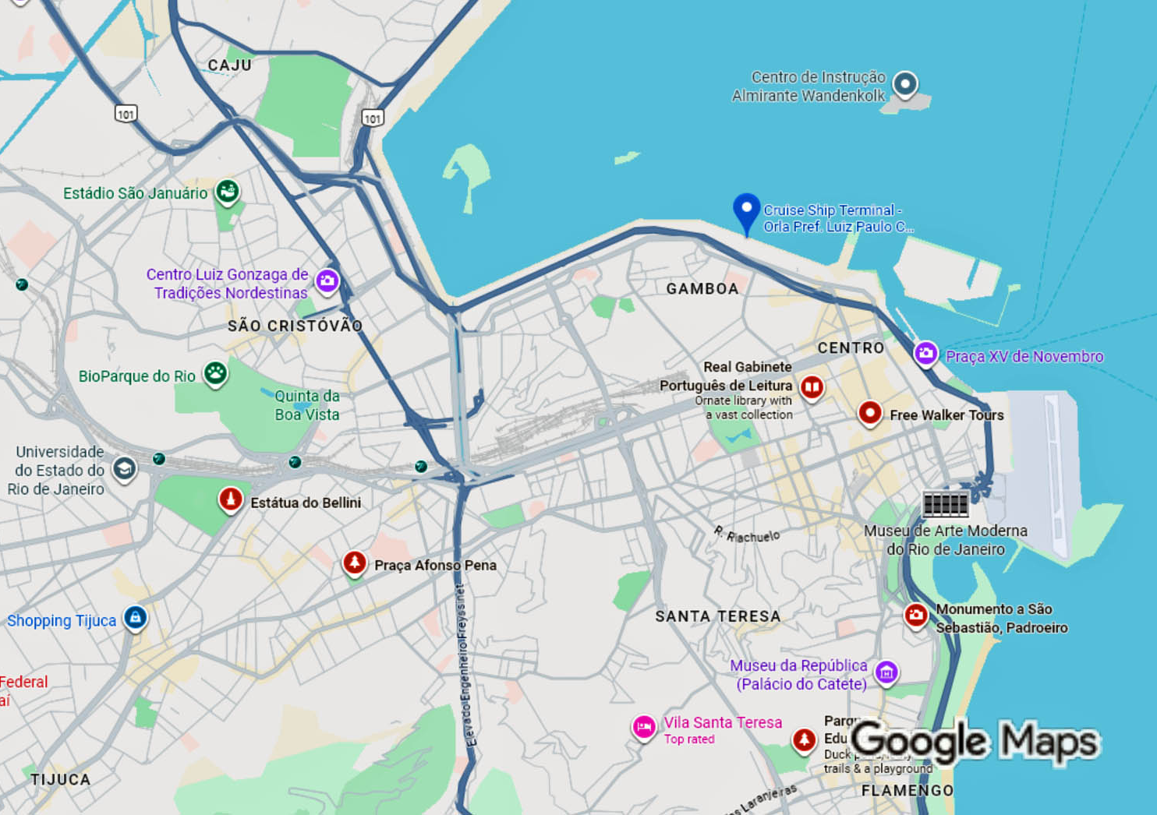
Rio Cruise Port

Slide 10
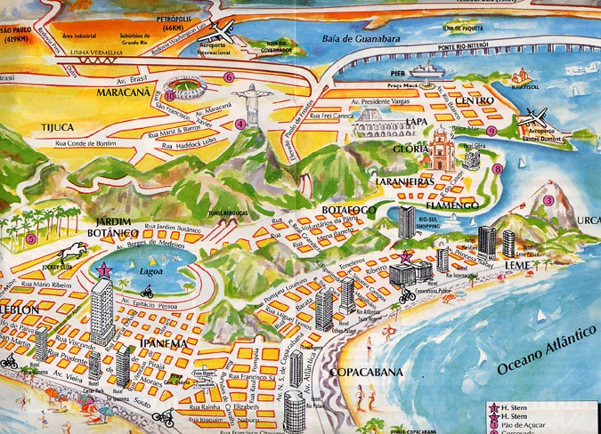
Rio Map

Slide 11
A Brief History
Founded in 1565 by Portuguese explorers, Rio de Janeiro's strategic location made it a vital colonial port.
Its fortunes soared in the 18th century, fueled by a gold rush and later by massive coffee exports, which financed much of the city's grand architecture.
Serving as the capital of Brazil for nearly 200 years, it was the heart of the Portuguese Empire and later the Brazilian nation until the capital moved to Brasília in 1960.
Today, Rio has transformed into a global cultural icon, renowned for its spectacular natural beauty, the infectious rhythm of samba, and the dazzling spectacle of its annual Carnival.
Its stunning landscape of mountains and beaches, coupled with its vibrant cultural legacy, solidifies its title as the "Marvelous City."

Slide 12
The Landscape
Rio is defined by its geography, dramatic peaks, sweeping beaches, and tropical forests.
Famous landmarks include Sugarloaf Mountain, Corcovado with Christ the Redeemer, and Guanabara Bay.

Slide 13
Rio City Bus
Rio de Janeiro boasts an extensive and inexpensive bus network, making it a practical way to traverse the city. While the system is vast, it is not simple for newcomers; navigating it requires checking route numbers and using apps like Google Maps.
The key coastal avenue connecting the famous beaches is Avenida Atlântica, not the "Malecon." Buses from this corridor provide access to beaches, malls, and shopping centers.
While buses offer a genuine local experience, safety requires vigilance. Petty theft is a risk, so conceal phones and valuables, especially during crowded rides.
It is an authentic way to ge around, but travel after dark is not recommended for tourists.

Slide 14
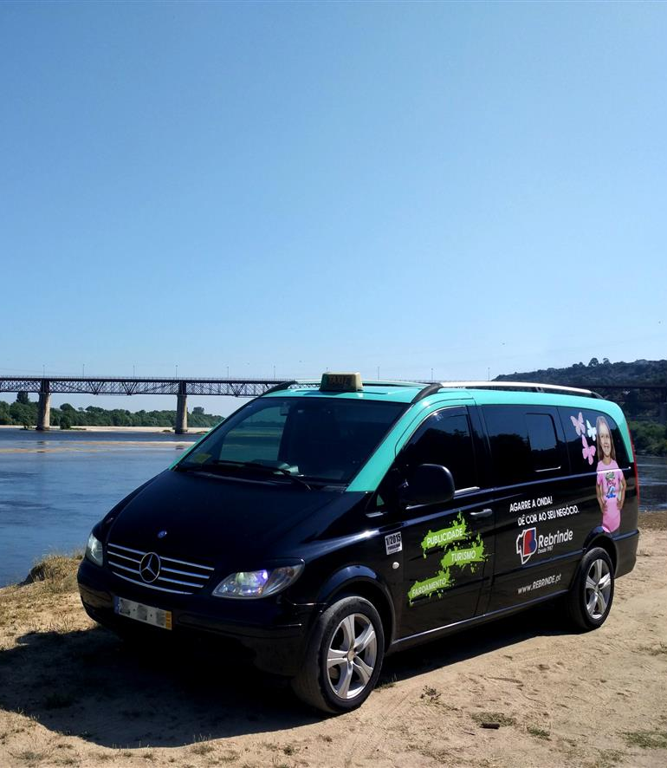
Rio de Janeiro, Brazil Transportation
Taxis in Rio de Janeiro are plentiful. Taxis can be very reasonable, as long as you ask the price BEFORE you get in.
Fares are fixed by zones; rates for trips in town and to more distant points should be posted at local hotels.
You can request a ride when you need to travel in Santarém with the Uber app. You’ll also enjoy 24-hour requesting, helpful in-app safety features, and upfront pricing to budget ahead for your trip. Try this day-or-night ride option to head to your destination.
Make sure you have small change. Taxis will not carry change so they can keep yours.
You do not tip taxi drivers. The tip is included in the price.

Slide 15
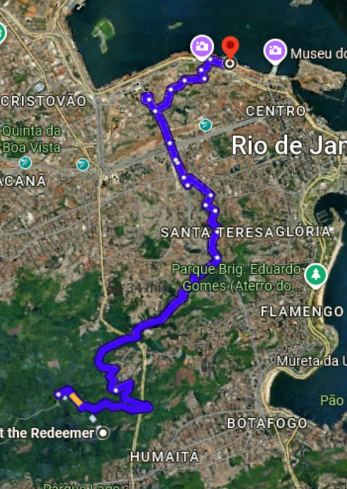
Top Attractions
Christ the Redeemer: 98-foot statue overlooking the city.
  Distance from Port: ~20 km (12.5 miles) by road.
  Reaching the summit requires an additional van or train ride.
  Tour recommended.
Sugarloaf Mountain: Cable car rides with breathtaking views.
  Distance from Port: ~15 km (9.5 miles) by road. The base
  of the cable car is in the Urca neighborhood. Tour recommended
Copacabana Beach: 2.5 miles of golden sand.
  Distance from Port: ~18 km (11 miles) by road.
Ipanema Beach: Trendy and lively.
  Distance from Port: ~22 km (13.5 miles) by road.
Selarón Steps: Mosaic stairway celebrating Brazilian culture.
  Distance from Port: ~5 km (3 miles) by road. This is the closest major landmark and is easily integrated into a downtown walking tour.
Important Note: These distances are by road and can vary significantly with Rio's famous traffic. Allow ample travel time, as a journey can take over an hour depending on the time of day.

Slide 16
Downtown Rio
Free Walking Tour
Join the most popular walking tour in Rio de Janeiro! Over 250,000 travelers have already joined the first Free Walking Tour in the city.
Travel back in time on this Free Walking Tour Downtown Rio and relive the past as you stroll through Rio’s charming colonial streets and learn about the city’s four centuries of history. Join our Rio de Janeiro Free Walking Tour to gain a deeper understanding of the origins of Brazilian culture and society from colonization to the present day.
Free Tour 4 times a day M-F 2 times on Saturday
Tour starts at the Clock Tower at Largo da Carioca (close to Exit C of Carioca Metro Station)
Duration: 2-3 hours - I recommend making a reservation on line.

Slide 17
Rio's Historic Walking Tour
Leg 1: Port to Imperial Heart
Begin at Mauá Pier. As you exit, the stunning Museum of Tomorrow offers a prime photo opportunity on your left.
Stroll the waterfront for 10-15 minutes to reach the historic XV Square, one of Rio's most important plazas, featuring the old port. Here, visit the Imperial Palace, home to the Portuguese royal family after 1808. Step inside for its courtyard and free exhibitions with historical photos.
In the same square, admire the two key churches central to the Portuguese court: Nossa Senhora do Carmo Church (Imperial Chapel) and the Igreja da Ordem Terceira do Carmo.
XV Square
Imperial Palace

Slide 18
Rio's Historic Walking Tour
Leg 2: Into the Lanes of History
Travessa do Comércio: Walk through the Arco do Teles from XV Square into this charming lane. It's the old commercial part of the city, with Portuguese pavement and beautiful colonial houses. Today, it's full of cozy bars and restaurants (a great mental note for a happy hour spot later!).
Confeitaria Colombo: A short walk from Travessa do Comércio, head to this, the most famous confectionery in Brazil, opened in 1894. Even if you don't sit for a full meal, step inside to be awestruck by the Parisian-style architecture, mirrors, and stained glass. It's the perfect place for a coffee and a traditional Portuguese or Brazilian sweet (brigadeiro or pastel de nata).
Arco do Teles
Confeitaria Colombo

Slide 19
Rio's Historic Walking Tour
Leg 3: Art, Culture & Indigenous Voices
Casa Tucum: From the Colombo, make your way towards the Uruguaiana area. This space of art and resistance brings to light the history of Rio from the perspective of indigenous peoples. It's a powerful and unique stop to discover beautiful crafts and hear voices that were silenced for centuries.

Slide 20
Rio's Historic Walking Tour
Leg 4: The Grandeur of Cinelândia
Walk to Cinelândia: From Casa Tucum, head
west towards the grand square known as
Cinelândia. The name comes from the cinemas
that made it a place for the city’s elite, nicknamed
the “Paris of Rio” or “Brazilian Broadway.”
Municipal Theater (Theatro Municipal):
Located in Cinelândia, this is a miniature version of the Paris Opera. Admire the incredible eclectic building full of gold details from the outside (or book a tour inside if time allows).
National Library (Biblioteca Nacional): Facing the same square, see nothing more and nothing less than the largest library in Latin America. Its collection is based on the 60,000 books that Dom João VI brought from Portugal in 1808. The building has recently been renovated and is incredible to see from the outside.
Quadrilátero Cultural da Cinelândia

Slide 21
Rio's Historic Walking Tour
Leg 5: The Modern Icon & Return
The Metropolitan Cathedral: From Cinelândia,
walk up the lively Avenida Presidente Vargas
(use underpasses to cross safely) to see the
stunning, modern cone-shaped Cathedral. Step
inside for a moment of awe under the massive
stained-glass windows.
Return via Av. Rio Branco: Walk back down
towards the port along the elegant Avenida Rio Branco, enjoying the blend of old and new architecture.
Final Glimpse & Return to Ship: Your path will lead you back towards the Museum of Tomorrow and the modern port area, completing your loop and returning you to the Mauá Pier.

Slide 22
Culture and Carnival
Rio’s Carnival is the world’s largest, five days of parades, samba schools, and street parties.
Music and dance define Rio’s identity: samba, bossa nova, and funk carioca.
Locals, or Cariocas, celebrate life with color and rhythm year-round.

Slide 23
Nature and Outdoor Life
Hike in Tijuca National Park, one of the world’s largest urban rainforests.
Hang glide over the city from Pedra Bonita.
Take a sunset sail in Guanabara Bay.
Rio blends city life with nature like nowhere else.

Slide 24
Cariocas
Cariocas, natives of Rio de Janeiro, embody a unique cultural identity. The term originates from the indigenous Tupi-Guarani word "kari’oka" ("white person’s house").
This mindset is defined by:
Relaxation: A "let life take me" philosophy.
Celebration: Deep passion for samba, music, and Carnival.
Beach Life: Treating the shore as a social hub and sports field.
Resilience: Navigating urban challenges with creative wit ("jeitinho carioca").
More than residents, Cariocas personify Rio's vibrant rhythm and natural beauty.

Slide 25
Local Life and Cuisine
Cariocas are laid-back, friendly, and love the beach.
Cuisine highlights: feijoada (black bean stew), pão de queijo (cheese bread), and caipirinha cocktails.
Street food and beach vendors add to Rio’s flavor.

Slide 26
Practical Tips
Currency: Brazilian Real (BRL).
Language: Portuguese.
Weather: Tropical—warm year-round.
Safety: Be alert in crowds and at night.
Souvenirs: Havaianas, gemstones, music and art.

Slide 27
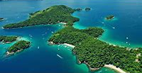
Day Trip Ideas
Ilha Grande – Pristine island
with beaches and trails.
Petropolis – Imperial summer
retreat.
Niterói – Art museum and city views.
Barra da Tijuca – Expansive modern beachfront district.

Slide 28
Reflections
“In Rio, even the mountains dance.”
The city’s energy, beauty, and spirit make it unforgettable.
Solar City Tower in Rio de Janeiro

Slide 29
Q&A
Questions & Curiosities
Let’s experience the rhythm of Rio together!

Slide 30
Thanks For Coming
If you have any more questions, please ask.
I will do my best to answer them for you.
Have a great visit to Rio!

