Slide 1
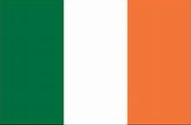
Ringaskiddy (Cork), Ireland Port Guide Presented by Marc Silver

Slide 2
What I Will Cover
My Port Philosophy
Don’t Miss the Ship
Money
Exchanging Money
A Brief History of Cork
Maps
Transportation
Top Attractions & Points of Interest
Local Cuisine & Dining Options
Important Tips & Practical Advice
Conclusion

Slide 3
My Port Philosophy
I have been cruising for over 45 years and have taken over 100 cruises. So, I consider myself an experienced cruiser.
The information I will present is based on those many years of
experience.
When I am on a cruise where the city, I want to visit is not the port city,
I always recommend taking a ship’s tour.
But when I am in a port with multiple attractions nearby and easy to see
on my own - I will do it on my own.
This presentation is not like that.

Slide 4

Don’t Miss the Ship
How to Avoid Missing Your Ship
Pay attention to the time. - Ship time and local time are often different.
Put a return-to-ship reminder on your phone.
Choose excursions wisely.
If a ship-sponsored excursion is late returning to port, the ship will wait for you. If you are on your own???
Be Prepared
Have your Passport, Credit Card, and phone numbers for your ship port agent.
What to Do If You Miss the Ship Most cruise lines have port agents stationed in the port area to assist if your ship has left without you. If your are lucky, when cruisers are late returning to the vessel, the ship’s crew will often remove the passengers’ essential items – passports, cell phones, and medication -- from the ship to leave with the port agents.
The Port Officials can help you with contacting your ship and making necessary travel arrangements.

Slide 5
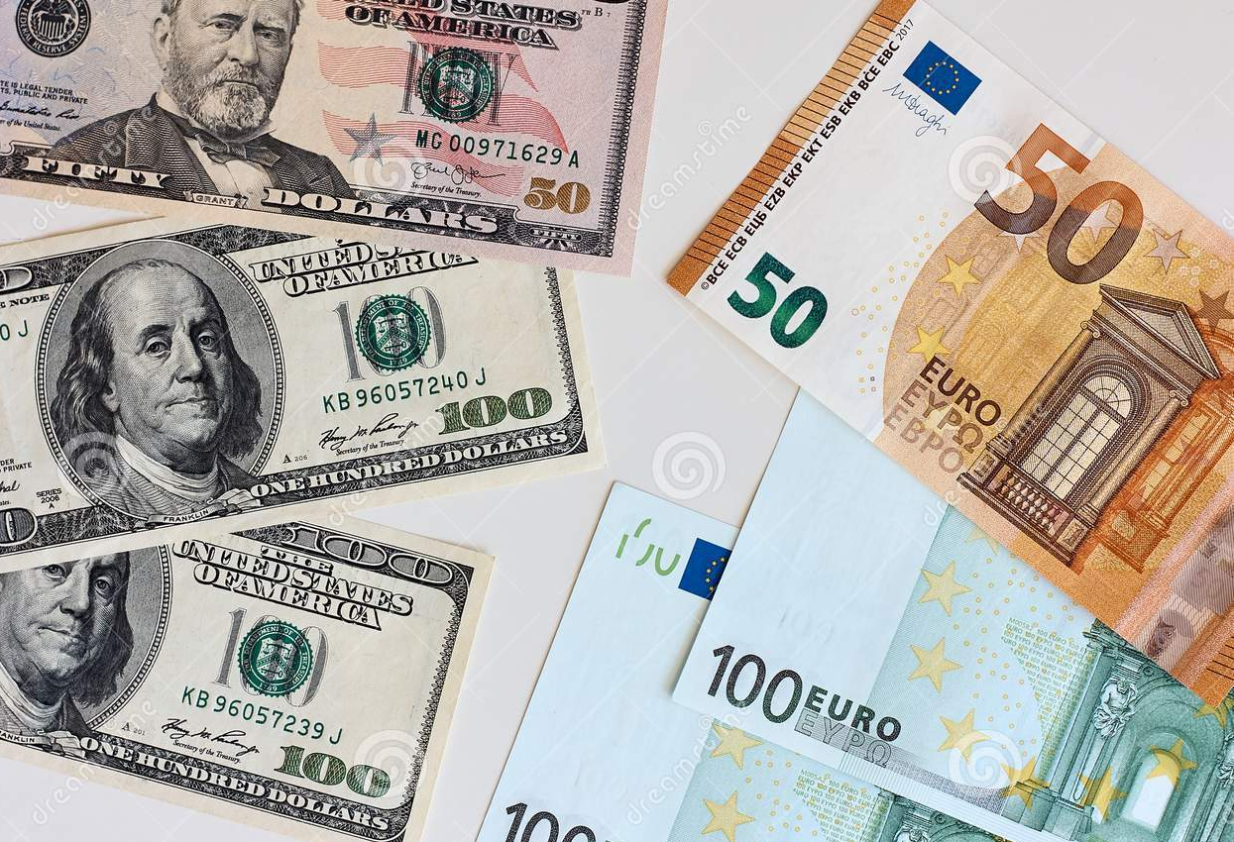
Money
Ireland uses the Euro (€) as its official currency. As of January 2026, the exchange rate between the Euro and the U.S. Dollar (USD) is about 1 EUR = $1.17 USD.
Ireland actually does use the Euro (€) as its official currency.
When exchanging money, it’s best to avoid doing so at the port exchange kiosks, as they tend to have higher fees and less favorable rates.
Instead, consider using ATMs to withdraw Euros directly, as they often offer better rates. Additionally, credit and debit cards are widely accepted throughout Alicante, though having some cash on hand is always a good idea for smaller purchases or tips.

Slide 6
A Brief History of Cork
Cork, Ireland's second-largest city, was founded as a monastery by Saint Finbarr in the 6th century.
Vikings established a settlement there in the 9th century, which later became a significant Norman stronghold.
The city earned the nickname "Rebel Cork" for its resistance during Ireland's independence struggle.
Built on marshland where the River Lee splits into channels, Cork developed into a major port city and remains an important cultural and economic center in southern Ireland today.

Slide 7
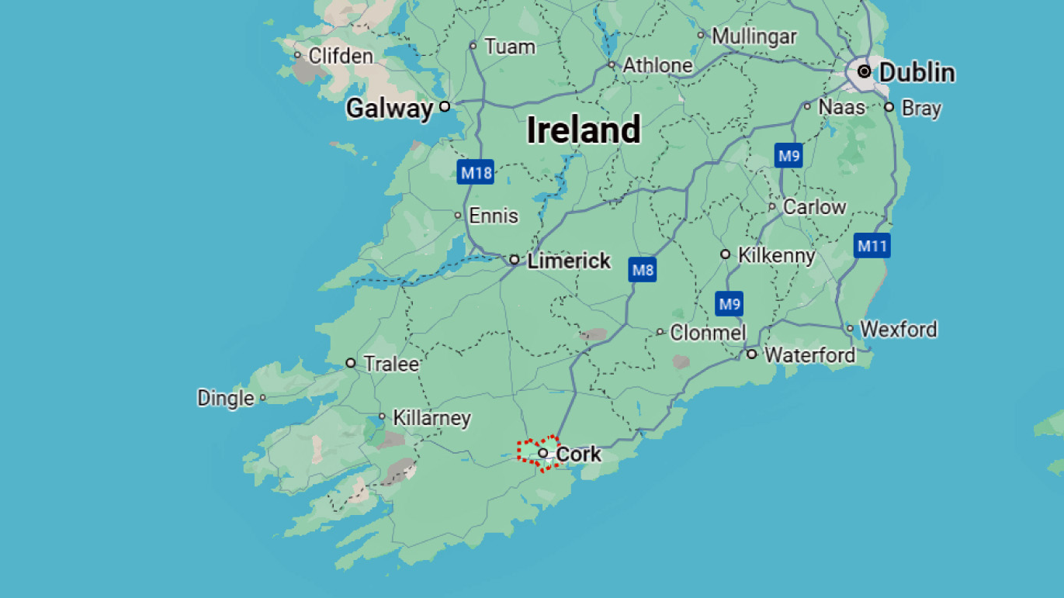

Slide 8
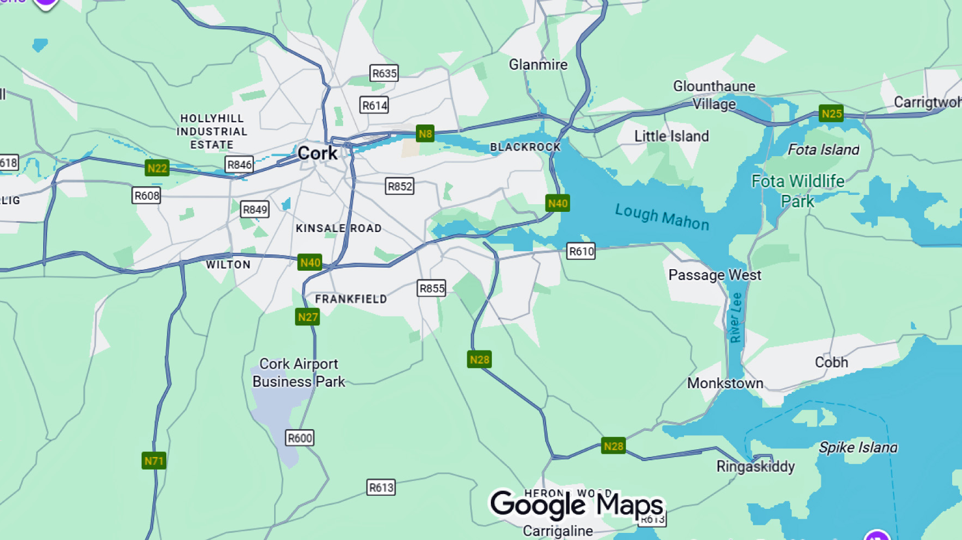

Slide 9
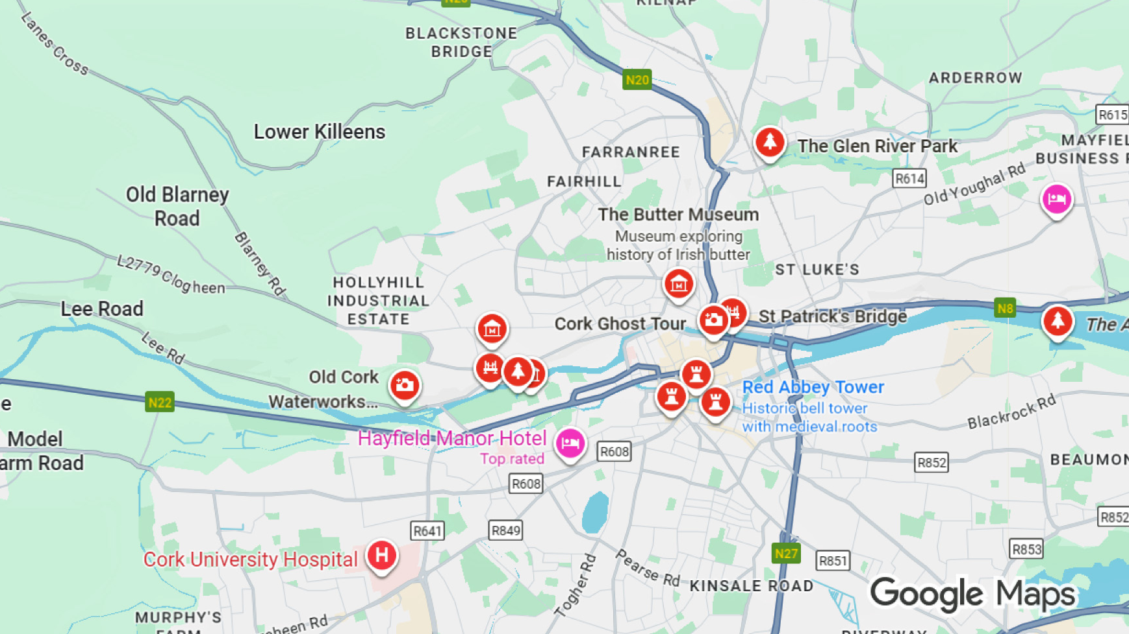

Slide 10
Transportation
Cruise Ship Shuttles: Many cruise lines do provide shuttle services from Ringaskiddy, though they typically don't announce these until closer to the sailing date to encourage shore excursion sales.
Some lines offer shuttles to Cork City rather than Cobh, especially if their organized tours already go to Cork. Check with your specific cruise line.
Best Option: If your cruise line offers a shuttle to Cork, that's your easiest bet. Otherwise, the direct bus is the most economical option, while a taxi offers convenience if you're traveling with others to split the cost.

Slide 11
Transportation
Public Transportation Options:
Bus: Bus Éireann operates scheduled service between Ringaskiddy and Cork City, taking about 25 minutes
Taxi: Taxis cost approximately €35-45 one way to Cork City. That makes the round trip about €70-90, but if you travel with friends that isn’t to bad.
Via Cobh: You can take a ferry from Ringaskiddy to Passage West, then a train from nearby Carrigaloe station into Cobh, and from there catch a train to Cork (24 minutes)

Slide 12
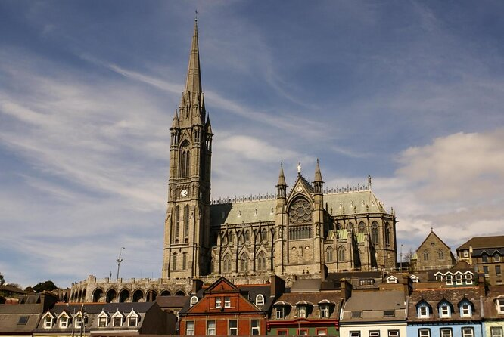
Top Attractions & Points of Interest
St. Colman's Cathedral: This stunning neo-Gothic cathedral took 47 years to build and features intricate stone carvings, stunning stained glass, and the largest carillon in Ireland with 49 bells.
The cathedral sits atop a hill with panoramic harbor views and is one of Cobh's most recognizable landmarks.

Slide 13
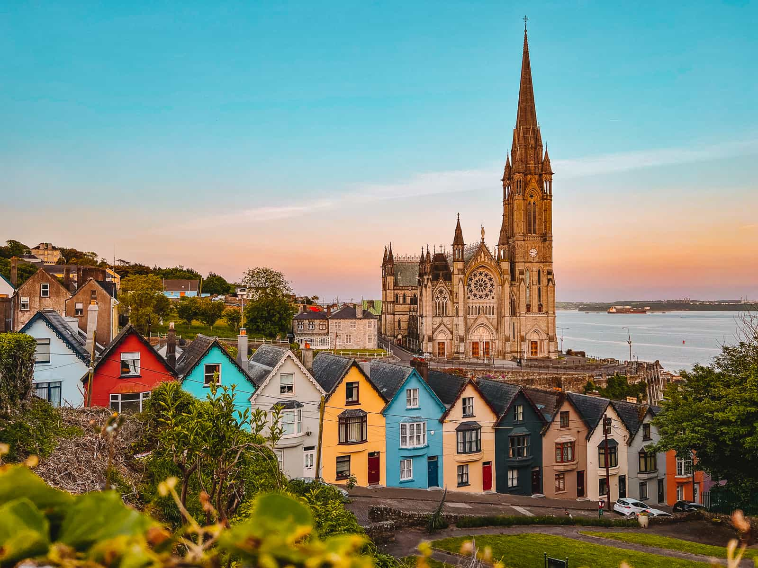
Top Attractions & Points of Interest
The Deck of Cards: These iconic colorful row of 23 houses cascade down a steep hill, creating an instantly recognizable postcard view with St.
Colman's Cathedral as the backdrop. It's one of the most photographed spots in Ireland.

Slide 14
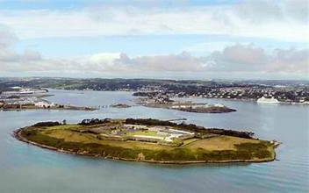
Top Attractions & Points of Interest
Spike Island: This 103-acre island in Cork Harbor is known as Ireland's Alcatraz and was used as a prison.
The island holds over 1,300 years of Irish history, having served as a 7th-century monastery and 24-acre fortress before becoming a Victorian jail.
It's accessible only by ferry and requires advance booking.

Slide 15
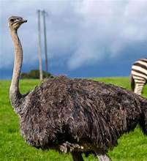

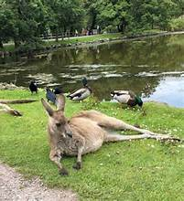


Top Attractions & Points of Interest
Fota Wildlife Park: Just 15 minutes from Cobh, this park features animals roaming freely across 30 mammal and 50 bird species, making it perfect for families.

Slide 16
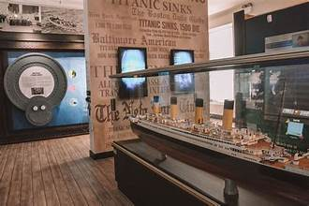
Top Attractions & Points of Interest
Historic Titanic Sites: The Titanic Experience Cobh is located in the original White Star Line Ticket Office where the final 123 passengers boarded the ill-fated ship.
The museum features interactive displays and audio-visual tours | telling the stories of those who departed from Cobh.
You can also take the Titanic Trail, a guided walking tour through the historic streets and piers that remain unchanged since 1912.

Slide 17
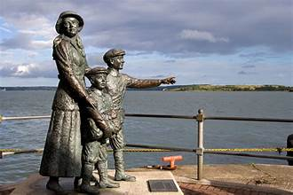
Top Attractions & Points of Interest
Cobh Heritage Centre: Located in a restored Victorian railway station, this museum explores Ireland's maritime and emigration history, including the stories of convicts transported to Australia and Irish emigrants.

Slide 18
Local Cuisine & Dining Options
Cork has earned its reputation as the food capital of Ireland, offering everything from traditional Irish fare to cutting-edge modern cuisine. Here's what makes the local dining scene special:
Traditional Irish Dishes: Cork's culinary heritage includes hearty staples like the full Irish breakfast, featuring sausages, black and white pudding, bacon, eggs, baked beans, and grilled tomatoes.
Don't miss spiced beef, a traditional Cork specialty, or sample dishes featuring colcannon (mashed potatoes with cabbage or kale).
Irish brown bread, made with wheat and bran flour, is commonly served alongside soups and is best enjoyed slathered with butter.

Slide 19
Local Cuisine & Dining Options
The English Market: Dating back to 1788, the English Market is one of Europe's oldest covered markets and the heart of Cork's food scene. Here you'll find exceptional local produce, artisan cheeses, fresh seafood, and traditional meats. The Farmgate Café, perched on a balcony overlooking the market, specializes in traditional seasonal foods.
Local Specialties: Cork excels in artisan products—look for locally smoked wild salmon from smokeries like Woodcock Smokery, farmhouse cheeses from producers like Toons Bridge Dairy (which makes Italian-style mozzarella and burrata using local milk), and award-winning black pudding. Fresh seafood features prominently, with oysters, monkfish, and seafood chowder appearing on many menus.

Slide 20
Local Cuisine & Dining Options
Where to Eat: For fine dining, Ichigo Ichie offers Michelin-starred Japanese cuisine with tasting menus starting around €120. Market Lane sources meat from the English Market and brews its own beer. Goldie specializes in fresh seafood, while Café Paradiso is celebrated as one of Europe's best vegetarian restaurants. For casual dining, try Nash 19 for breakfast and lunch, or the Good Day Deli at Nano Nagle Place.
Drinks: While Guinness dominates elsewhere in Ireland, Cork proudly favors its own stouts—Murphy's and Beamish. The city also boasts a thriving craft beer scene with microbreweries like Franciscan Well, Elbow Lane, and Eight Degrees Brewing Company offering tours and tastings.

Slide 21
Important Tips & Practical Advice
Practical Tips: Farmers' markets operate throughout the week, with the Saturday Cornmarket Street market being particularly popular. Most restaurants accept cards, though having cash for smaller establishments is wise. The city's compact size makes it easy to explore multiple dining spots on foot.
Time to visit attractions: Most of the major sites can be visited in 1-2 hours, but give yourself extra time if you want to see it all.
Booking excursions: Cruise lines offer packages, but you’ll find better value booking independently through reputable tour companies.
Safety: Cork is generally safe, but watch out for pickpockets in crowded tourist areas.

Slide 22
Thanks For Coming
If you have any more questions, please ask.
I will do my best to answer them for you.
Have a great visit in Le Havre!

