Slide 1

Reykjavik, Iceland Port Guide Presented by Marc Silver

Slide 2
What I Will Cover
My Port Philosophy
Don’t Miss the Ship
Money
Exchanging Money
A Brief History of Reykjavik
Maps
Transportation
Top Attractions & Points of Interest
Local Cuisine
Important Tips & Practical Advice
Conclusion

Slide 3
My Port Philosophy
I have been cruising for over 45 years and have taken over 100 cruises. So, I consider myself an experienced cruiser.
The information I will present is based on those many years of
experience.
When I am on a cruise where the city, I want to visit is not the port city,
I always recommend taking a ship’s tour.
But when I am in a port with multiple attractions nearby and easy to see
on my own - I will do it on my own.
This presentation is not like that.

Slide 4

Don’t Miss the Ship
How to Avoid Missing Your Ship
Pay attention to the time. - Ship time and local time are often different.
Put a return-to-ship reminder on your phone.
Choose excursions wisely.
If a ship-sponsored excursion is late returning to port, the ship will wait for you. If you are on your own???
Be Prepared
Have your Passport, Credit Card, and phone numbers for your ship port agent.
What to Do If You Miss the Ship Most cruise lines have port agents stationed in the port area to assist if your ship has left without you. If your are lucky, when cruisers are late returning to the vessel, the ship’s crew will often remove the passengers’ essential items – passports, cell phones, and medication -- from the ship to leave with the port agents.
The Port Officials can help you with contacting your ship and making necessary travel arrangements.

Slide 5
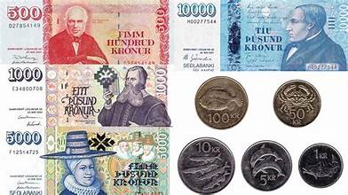
Money
The official currency is the Icelandic Króna (ISK).
Iceland is almost entirely cashless. Credit and debit cards are accepted everywhere, including taxis, cafés, museums, and even public restrooms.
Carrying cash is unnecessary for most travelers.
1 ISK = 0.008 USD That means roughly 125 ISK = 1 USD at current mid-market rates.
For quick conversions: 1,000 ISK ≈ $8 USD

Slide 6
Currency Exchange & ATMs in Iceland
Currency exchange bureaus are available in Reykjavík, often with long operating hours and generally competitive rates.
Even so, fees can vary, so it pays to compare rates before exchanging money. ATMs are widely available throughout Reykjavík, in hotels, shopping centers, and major tourist areas.
Most accept Visa and Mastercard and offer English-language instructions. Travelers should be aware that both their home bank and local Icelandic banks may charge withdrawal fees.

Slide 7
A Brief History of Reykjavik
Reykjavík was founded in 874 AD by the Norse settler Ingólfur Arnarson, who chose the site after observing steam rising from the area’s geothermal hot springs, giving the city its name, “Smoky Bay.”
For centuries it remained a modest fishing and farming settlement, shaped by a harsh climate and isolation.
Real growth did not begin until the 18th and 19th centuries, when trade expanded and Iceland moved toward independence from Danish rule.
Today, Reykjavík is Iceland’s political, cultural, and economic heart, home to roughly two-thirds of the country’s population and the world’s northernmost national capital.

Slide 8
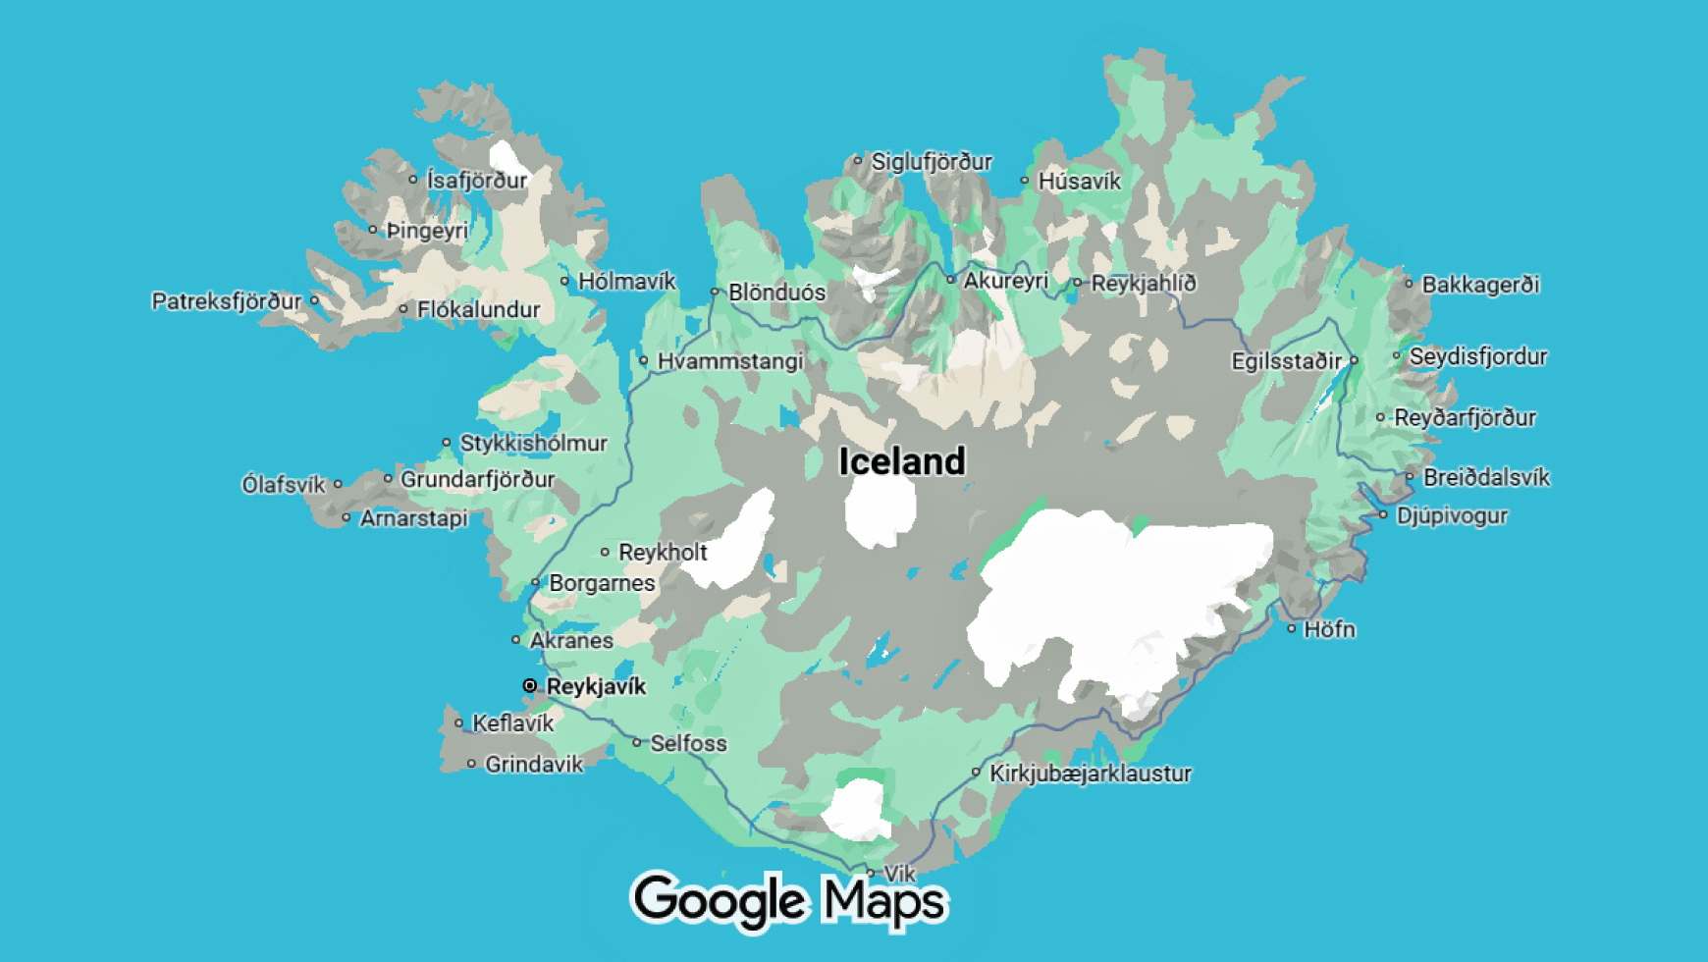

Slide 9
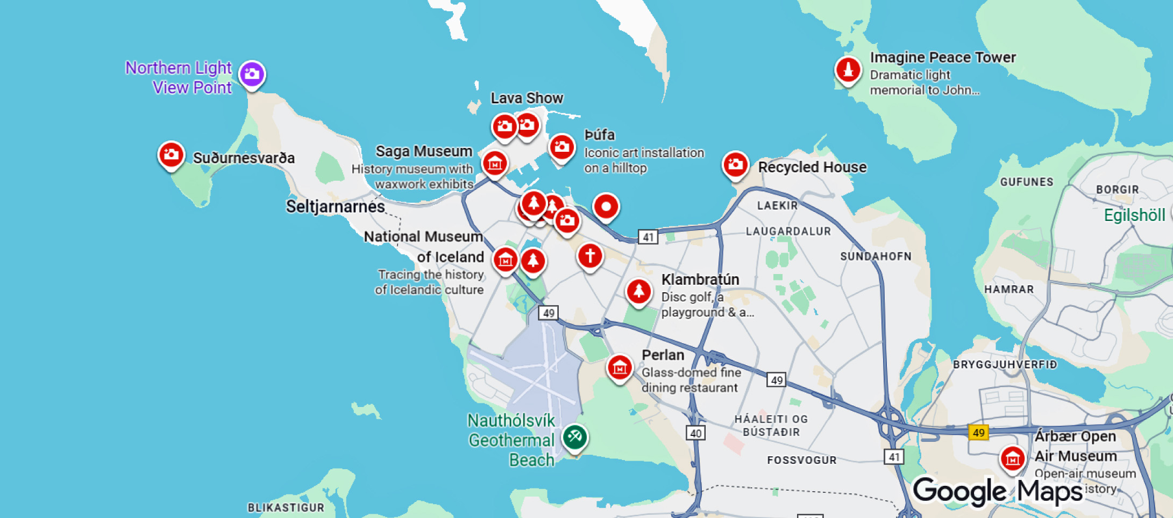

Slide 10
Transportation
The cruise port is about 2–3 miles from downtown Reykjavík. Shuttle buses, taxis, public buses, and walking are all options.
Many cruise lines provide a shuttle from Skarfabakki to the Harpa Concert Hall area, often included in the cruise fare.
Taxis are reliable but expensive.
Public city buses are inexpensive at about ISK 650 (around $5–6), though a short walk may be required.
Independent shared shuttles typically cost about $30–40 per person, with private transfers costing more depending on group size.

Slide 11
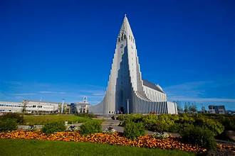
Top Attractions & Points of Interest
Hallgrímskirkja is Reykjavík’s most iconic landmark and the largest church in Iceland.
Rising 244 feet above the city, its striking design was inspired by Iceland’s volcanic basalt formations and natural landscape.
Designed by architect Guðjón Samúelsson and completed in 1986, the church is named after poet and cleric Hallgrímur Pétursson and has become a powerful symbol of Icelandic identity.

Slide 12
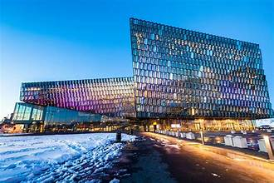
Top Attractions & Points of Interest
Harpa Concert Hall: Modern architecture on the waterfront.
Harpa is one of Reykjavik‘s greatest and most distinguished landmarks.
It is an enchanting destination for intrigued travellers and its grand-scale award-winning architecture has attracted millions of guests since its opening in May 2011.

Slide 13
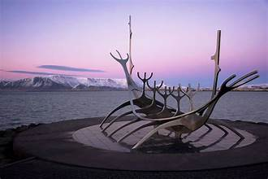
Top Attractions & Points of Interest
The gleaming steel sculpture on Reykjavík’s waterfront, shaped like a Viking longship, is Sólfarið, or The Sun Voyager, created by Icelandic artist Jón Gunnar Arnason.
Set along the bay with Mount Esja rising in the background, it is a favorite spot for locals and visitors alike.
The sculpture is especially striking at sunset, when the light and reflections make it one of the city’s most photographed landmarks.

Slide 14
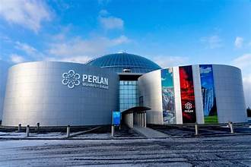
Top Attractions & Points of Interest
Perlan, or “The Pearl,” is an interactive museum that explores Iceland’s natural forces through modern exhibits and immersive displays.
Highlights include a man-made ice cave built from hundreds of tons of snow and exhibits that explain Iceland’s glaciers, volcanoes, and geothermal activity in an engaging, easy-to-understand way.

Slide 15

Local Cuisine
Must-try foods include Icelandic lamb, fresh seafood, and skyr.
Hot dogs are a local favorite.
Dining is expensive, but quality is high.
Tipping is not expected in Iceland.

Slide 16
Important Tips & Practical Advice
Dress in layers and expect changing weather. Tap water is safe and excellent.
English is widely spoken. Plan conservatively and allow extra time to return to the ship.
Time to visit attractions: Most of the major sites can be visited in 2-3 hours, but plan for extra time to see more sites.
Booking excursions: Cruise lines offer organized excursions that are competitively priced by Icelandic standards and include transportation and guaranteed return to the ship. Independent tours are widely available and well run, but prices are often comparable rather than cheaper.

Slide 17
Thanks For Coming
If you have any more questions, please ask.
I will do my best to answer them for you.
Have a great visit in Le Havre!

