Slide 1
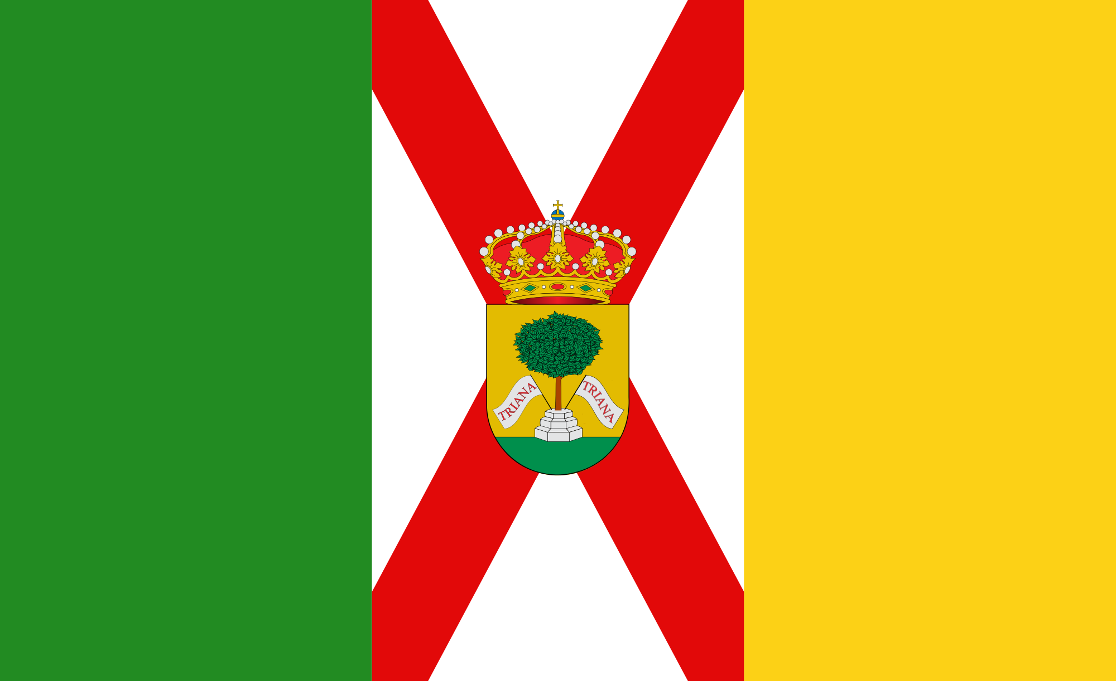
Puntarenas, Costa Rica
Presented by
Fellow Cruiser
Marc Silver

Slide 2
What I Will Cover
My Port Philosophy
Don’t Miss the Ship
Money
About Puntarenas, Costa Rica
History of Puntarenas, Costa Rica
Transportation
Points of Interest
Places to see or at least consider
A few restaurant recommendations
Conclusion

Slide 3
My Port Philosophy
I have been cruising for over 45 years and have taken over 100 cruises.
So, I consider myself an experienced cruiser.
The information I will present is based on those many years of
experience.
When I am on a cruise where the city, I want to visit is not the port city,
I always recommend taking a ship’s tour.
But when I am in a port with multiple attractions nearby and easy to see
on my own -
I will do it on my own.
This presentation is for that type of port.

Slide 4
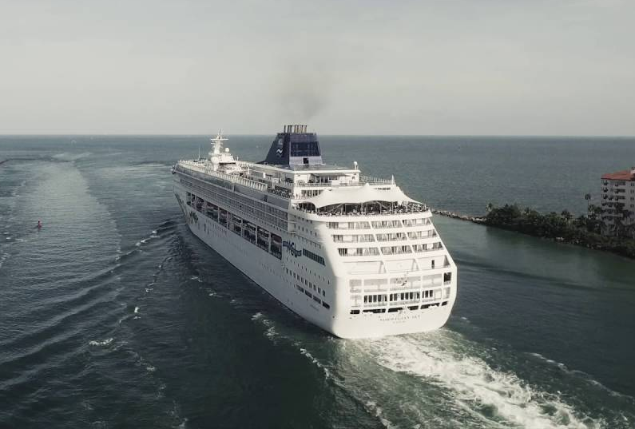
Don’t Miss the Ship
How to Avoid Missing Your Ship
Pay attention to the time. - Ship time and local time are often
different.
Put a return-to-ship reminder on your phone.
Choose excursions wisely.
If a ship-sponsored excursion is late returning to port for, the ship will
wait for you. If you are on your own???
Be Prepared
Have your Passport, Credit Card and phone numbers for your ship port agent.
What to Do If You Miss the Ship
Most cruise lines have port agents stationed in the port area to assist if your ship has left without you. If you’re lucky, when cruisers are late returning to the vessel, the ship's crew will often remove the passengers' essential items -- passports, cell phones and medication -- from the ship to leave with the port agents.
The Port Officials can help you with contacting your ship
and making necessary travel arrangements.

Slide 5

The Costa Rican Colones is the official currency of Costa Rica
Official Exchange is 520 Colones = $1.00 US
500 colones is equivalent to approximately one dollar.
The exchange rate may go up or down, but it won’t make that much difference in everyday purchases. 1,000 colones is about $2, 4,000 colones ~ $8, 5000 ~ $10. 10,000 colones ~ $20.
A good trick is to look at the first number and double it to equal the approximate dollar amount.
Money

Slide 6
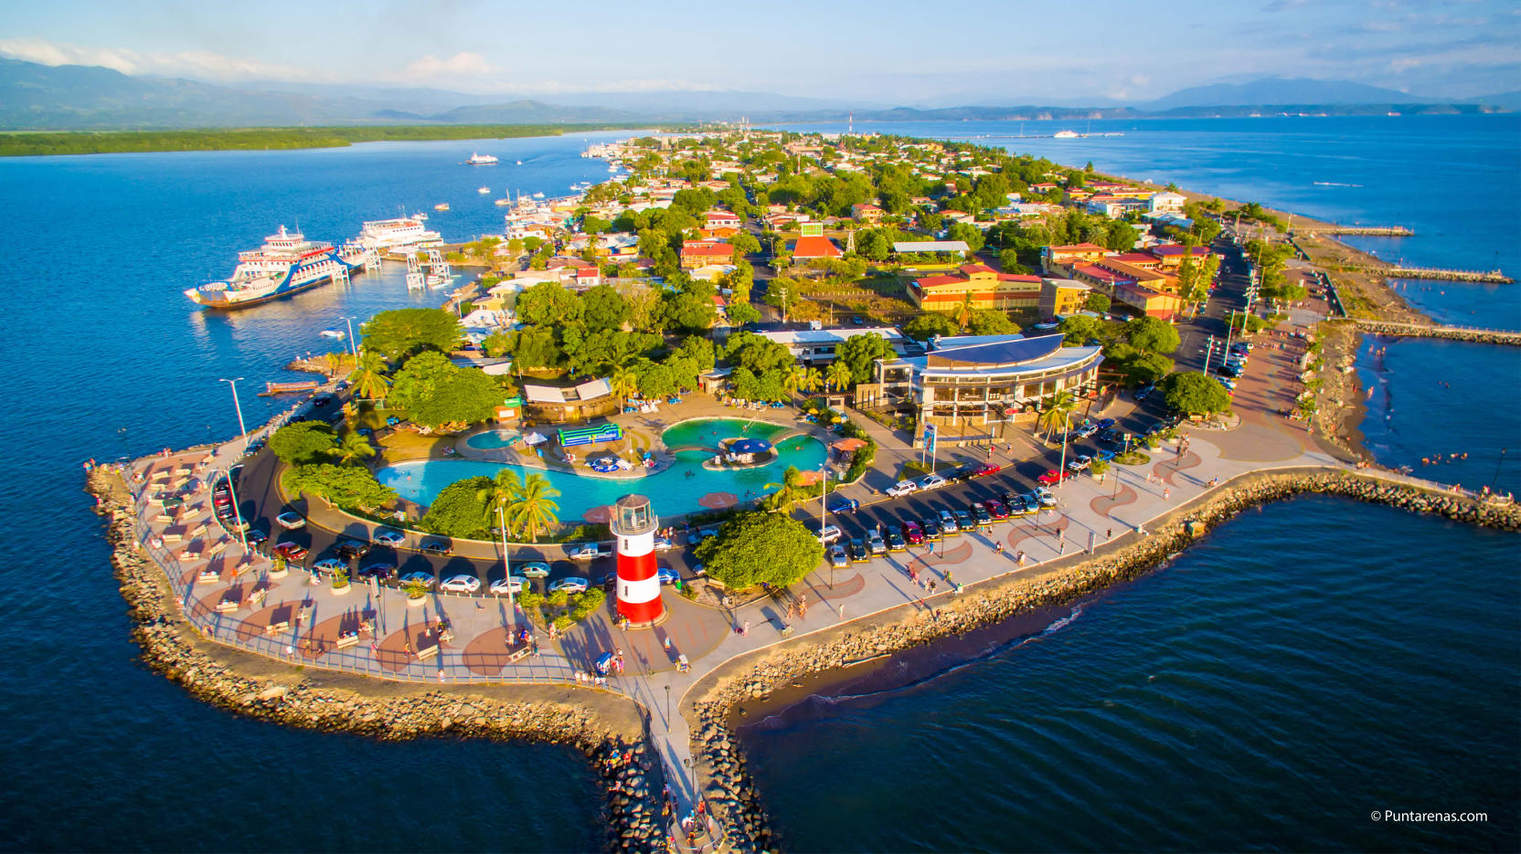
About Puntarenas
Puntarenas, a bustling city situated on a narrow peninsula in the Gulf of Nicoya, is a hub of activity for locals and tourists alike. As the largest city on the Central Pacific coast, it has a rich history as the country’s principal port, and today, it continues to thrive as a popular destination for fishing, seafood, and lively beachfront entertainment.
While the water may be murky and
the beach a bit urban, Puntarenas
comes alive on weekends when
people from nearby San José flock to
its waterfront restaurants and bars.
The town’s open-air cafes that line the
beach are particularly popular, offering
up refreshing fruit drinks and ice cream,
perfect for beating the heat and
enjoying a sweet treat.

Slide 7
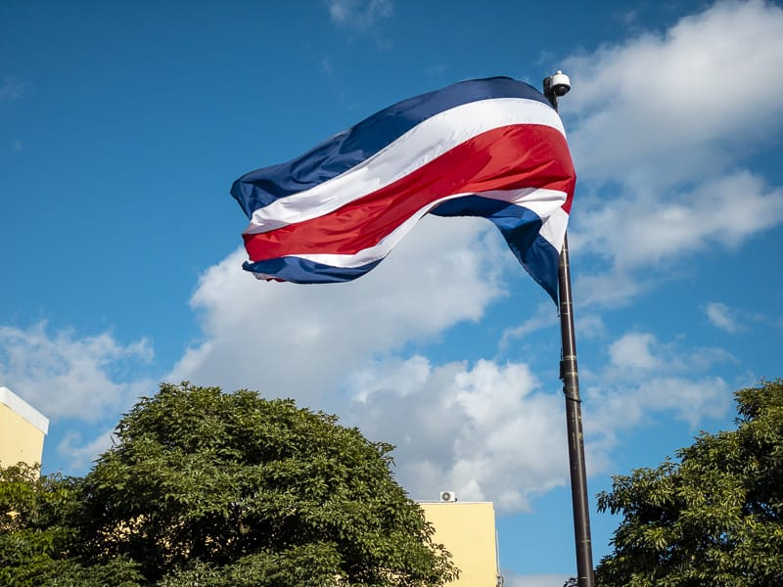
About Cost Rica
Of all the Central American countries, Costa Rica is generally regarded as having the most stable and most democratic government.
In 1949 its constitution provided for a unicameral legislature,
a fair judicial system, and an independent electoral body.
Moreover, the constitution abolished the country’s army, gave
women the right to vote, and provided other social, economic,
and educational guarantees for all of its citizens.
Throughout the 1970s and ’80s Costa Rica managed to stay
relatively peaceful compared with its war-torn neighbors.
It has one of the highest literacy rates in the Western Hemisphere and a solid educational system. Several renowned universities and an active network of bookstores and publishing houses tend to make San José the nucleus of intellectual life in Central America. Because of the country’s peaceful reputation and its commitment to human rights, several nongovernmental organizations and pro-democracy foundations have their headquarters in San José.
Costa Rica is also known for its strong commitment to the environment and for protecting its numerous national parks.

Slide 8

Historical Costa Rica
The first indigenous peoples of Costa Rica were hunters and gatherers, and when the Spanish conquerors arrived, Costa Rica was divided into two distinct cultural areas due to its geographical location in the Intermediate Area, between Mesoamerican and the Andean cultures, with influences of both cultures.
Christopher Columbus first dropped anchor in Costa Rica in 1503 at Isla Uvita. His forces overcame the indigenous people. He incorporated the territory into the
Captaincy General of Guatemala as a province of New Spain in
1524. For the next 300 years, Costa Rica was a colony of Spain.
As a result, Costa Rica's culture has been greatly influenced by
the culture of Spain. During this period, Costa Rica remained
sparsely developed and impoverished.

Slide 9
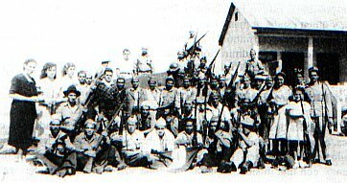
History of Puntarenas Continued
Following the Mexican War of Independence (1810–1821), Costa Rica became part of the independent Mexican Empire in 1821. Costa Rica was part of the Federal Republic of Central America in 1823, before gaining full independence in 1828.
Its economy struggled due to a lack of connections with European suppliers. In 1856, Costa Rica resisted United States settlers from mounting a take-over of the government.
After 1869, Costa Rica established a democratic government.
After the Costa Rican Civil War in 1948, the government drafted a new constitution, guaranteeing universal suffrage and the dismantling of the military.
Today, Costa Rica is a democracy that relies on technology and eco-tourism for its economy. Although poverty has declined since the turn of the 21st century, economic problems still exist. Costa Rica is facing problems of underemployment, foreign and internal debt, and a trade deficiency.

Slide 10
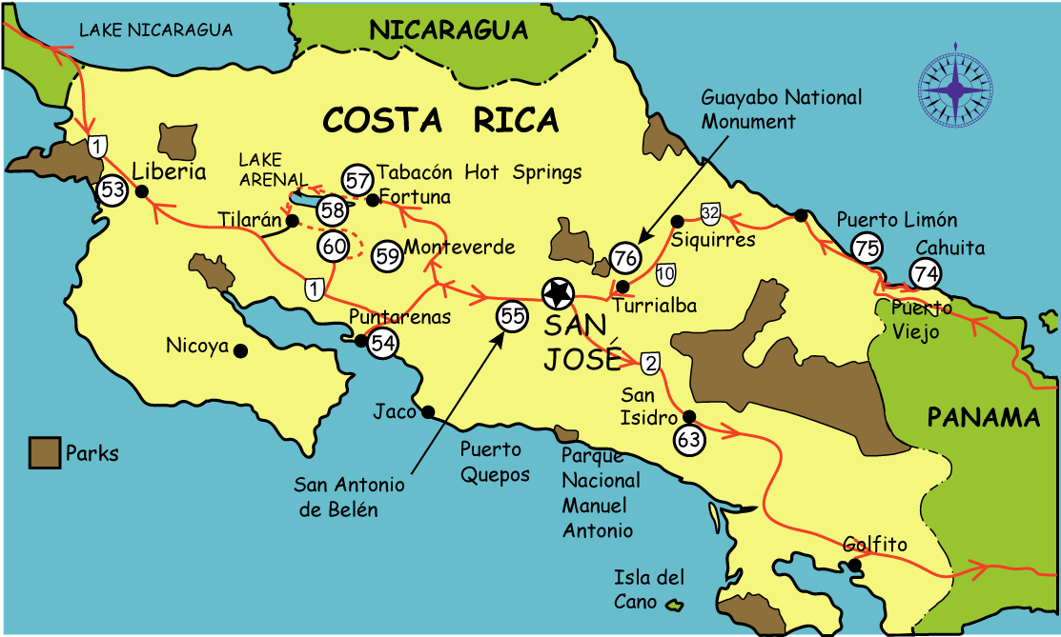
Map of Puntarenas

Slide 11
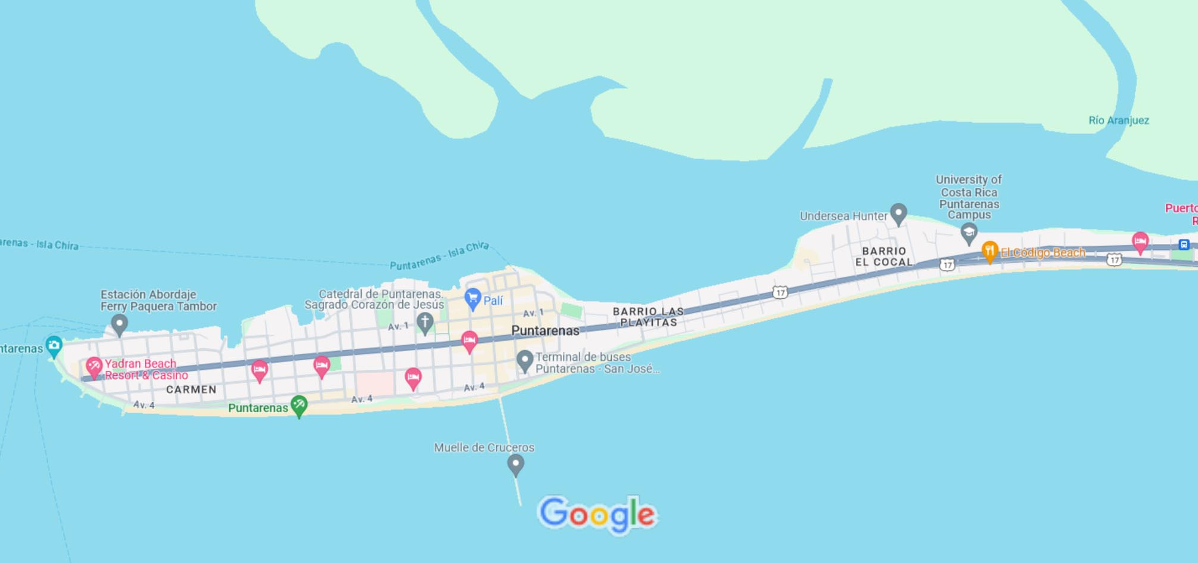
Puntarenas City Map

Slide 12
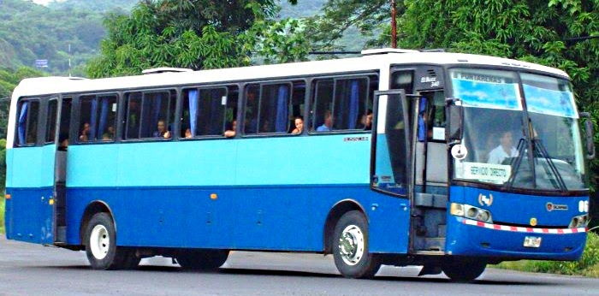
Puntarenas City Bus
Puntarenas has a very simple bus system. There are public buses that run to and from Puntarenas throughout the day.
The nice thing about Puntarenas is that a lot of buses depart from here to different areas of the country. It’s a bit of a bus hub.
Traveling by bus is safe and is an interesting experience if you like to mingle with the locals.
Request a bus schedule idea from the driver who can share when the buses come more or less.
Buses run about every 20 minutes. Local buses are very inexpensive, usually no more than $1.
If you plan to take a bus farther afield, regional buses are usually around $5.

Slide 13
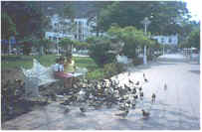
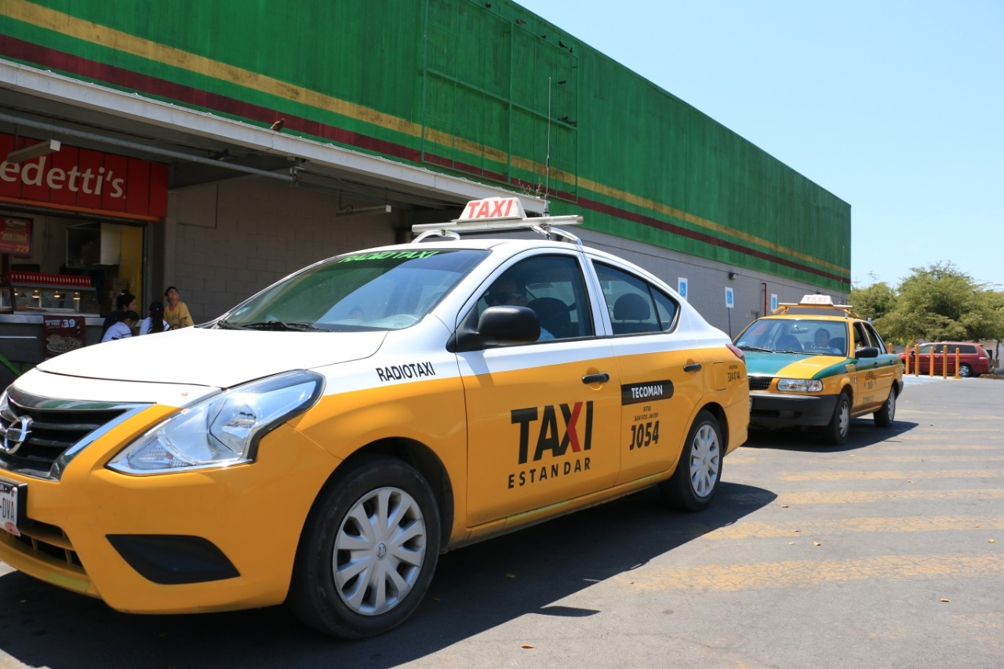
Puntarenas Taxis
Taxis in Puntarenas are plentiful. Taxis can be very
reasonable, as long as you ask the price BEFORE you
get in.
Make sure you have small change. Taxis will not carry change so they can keep yours.
You do not tip taxi drivers. The tip is included in the price.
Be aware that Hotel taxis charge a premium rate because they've paid a higher union fee to sit in front of the hotel.

Slide 14
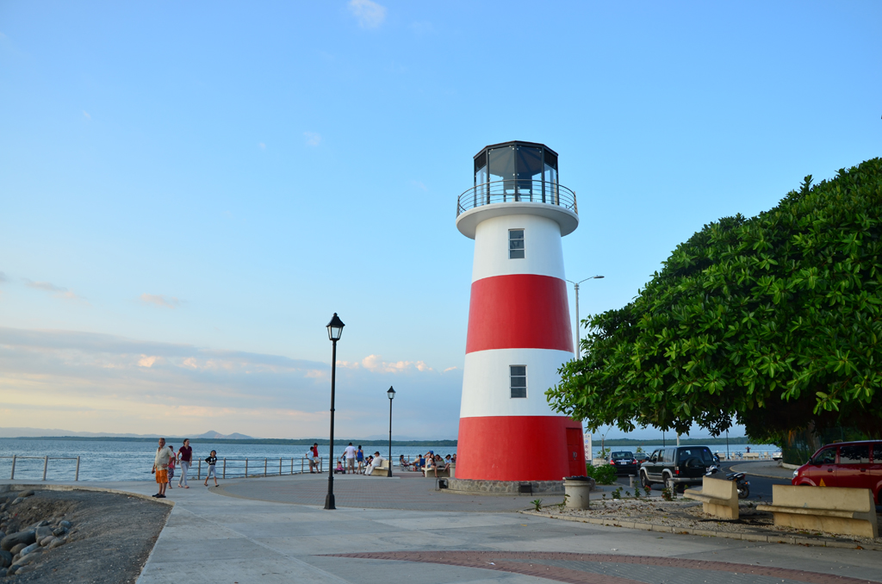
The Malecón
For those who prefer to take it easy, a leisurely stroll along the town’s malecón (boardwalk) is a great way to take in the sights and sounds of Puntarenas.
From street performers to vendors selling souvenirs and local handicrafts, there is always something to see and do along this lively stretch of waterfront.

Slide 15


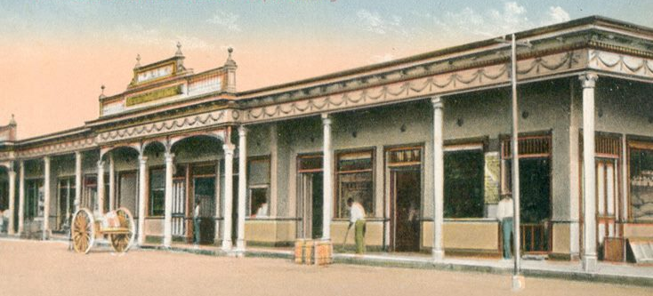
The "Mercado"
Puntarenas’s Mercado, or market, offers a variety of items for consumption The Puntarenas Market, located next to the dock that overlooks the estuary and traveled daily, has 30 to 40 sections of vegetables and meals, among others.
The property was erected in 1907 and stands out the constructive technique known as French bahareque, which employs wooden structures and cane covered with raw mud.
This constructive system began to be used in
Costa Rica during the
second half of the 19th
century.
Nearby, bus stops from
three communities in
the area are located
near the market.

Slide 16
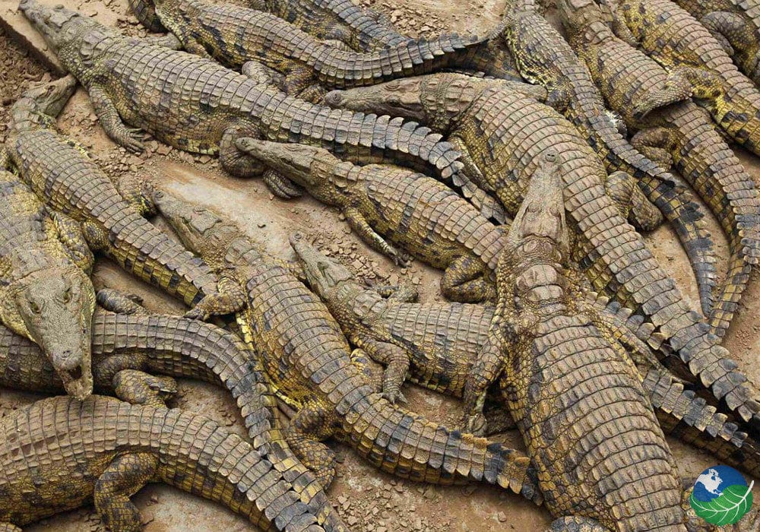
The Crocodile Bridge
Tárcoles is a quiet little town that lies just on the outskirts of northern Puntarenas, Costa Rica. Though it may be small, it boasts an abundance of both indoor and outdoor activities, beautiful fauna, and exotic wildlife.
Tarcoles River Bridge and look at some gigantic Costa Rican crocodiles! The Tarcoles River is famous in Costa Rica because as you drive over the Tarcoles Bridge, you can look down and see at least a dozen impressive crocodiles sunbathing below.

Slide 17
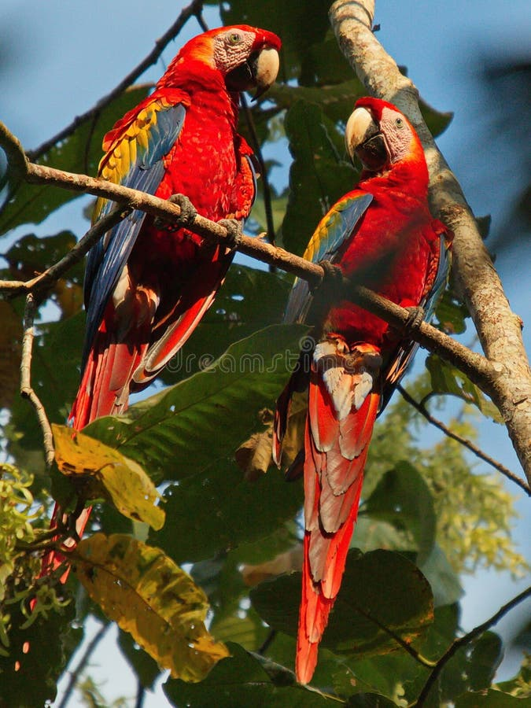
Carara National Park
Unlike other heavily visited parks in Costa Rica, such as Arenal or Monteverde, Carara National Park is less visited, and you might want to consider including it on your travel itinerary as the experience is rawer but not less spectacular.
Once inside the park, you will find here several well-maintained trails worth exploring. The park is rich with fauna and flora, like insects, spiders, monkeys, and huge trees, and the destination is a favorite with wildlife enthusiasts and bird watchers thanks to the many species that call this place home and a high chance to take some fantastic photos.
Admission: Adult $10 + VAT
• Child from 2 to 12 years old: $5 + VAT

Slide 18
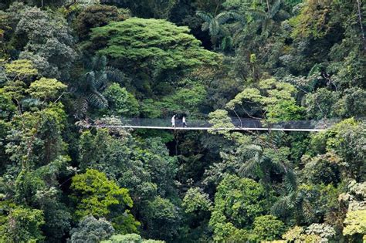
Rainforest Hanging Bridges
Experience the beauty of the rainforest through Villa Lapas Sky Way walking tour 1.5 miles (2.5 km) in length, and five suspended bridges at more than 180 feet above the ground.
Each of these bridges is an astonishing 300 feet in length, crossing through the very heart of the tropical rainforest.
You experience the primary and secondary rainforest vegetation. Make yourself one with the jungle. Keep your eyes open to see the numerous bird species, mammals, and other varied fauna that call this forest home. The nature walk lasts about one
hour and it includes some areas with some steps, ups and
downs.
Admission: Adult $32
65 and Older: $26
Teens 11-18 years old: $21
• Child under 11 old: Free

Slide 19
The Tarcoles River of Costa Rica
Enjoy a pleasant boat tour with a professional naturalist tour guide and enjoy its rich and abundant wildlife. It is a habitat for American crocodiles, while the marshes located at the river's mouth have many waterfowl and wading birds. Among the many herons and egrets are the boatbill and bare-throated tiger heron, and other birds found here include double-striped thick-knee, mangrove warbler, and American pygmy kingfisher. The total list known of birds well exceeds 320 species including the little-known Guacalillo Canals.
The Tarcoles River may be known as the country’s dirtiest and most polluted basin but it is ironically considered as one of Costa Rica’s tourist attractions. Its claim to fame is that it houses one of the world’s largest crocodile populations with about 25 crocodiles living per square kilometer. This river isn’t only important to over 2000 crocs in the area, it also acts as a very significant watershed of the Central Valley.
One of the four rivers that flow out from the Nicoya Peninsula into the Pacific Ocean, the Tarcoles River measures 111 km long and its watershed covers up to 2,121 km. More than its crocodiles, this Rio also boasts of a hefty number of bird, reptile, and animal species.

Slide 20
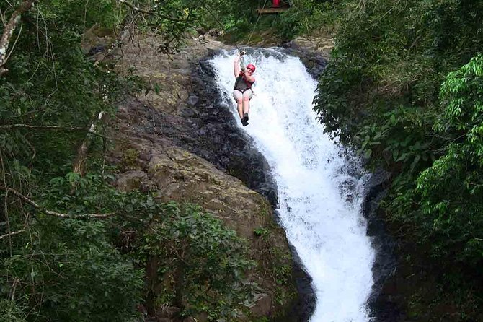
Zipline over Waterfalls
Feel the adrenaline rush of soaring over 11 different waterfalls on this small-group canopy tour at Adventure Park Costa Rica.
Enjoy breathtaking views over the ocean, mountains, and rainforest on 25 zipline cables, the longest in Costa Rica. Bottled water are included.
Participants must be at least seven years old and weigh less than 280 pounds.
Admission: $89 at the park

Slide 21
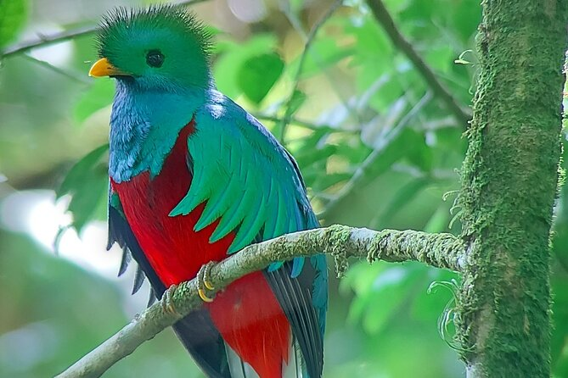
Monteverde Cloud Forest
The Monteverde Cloud Forest Biological Reserve deserves to be a rich learning experience discovering the secrets of the lush cloud forest.
Explore its biodiversity, where more than 85 species of mammals live, more than 350 bird species, 120 species of amphibians and reptiles, more than 3,000 species of plants, of which 400 are orchids, in addition to thousands of insects.
You will have a great chance to watch the unique tropical Cloud Forest Ecosystems.

Slide 22
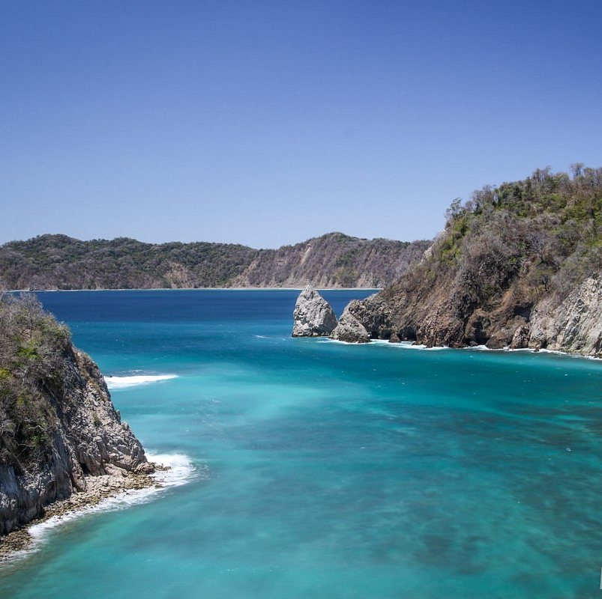
Turtle Island
Enjoy the best of Tortuga Island on a private full-day excursion. Travel there by boat and don’t miss the dolphins along the way. On the island, you can snorkel, observe spider monkeys, and visit the spectacular stone arch from where you will enjoy a great view of the island and the ocean. It will be a great day for families or groups of friends either way,
you'll find what you're looking for on Isla Tortuga.
From $115.00 per adult
.

Slide 23
Puntarenas Beaches
Playa Manuel Antonio - Quepos walk 7 km by paved road to the entrance of Manuel Antonio National Park. Offering three exotic white sand beaches, campsites, showers, toilets, drinking water, and dense vegetation, twelve islands, multiple inputs, and forests are just some of the attractions of this interesting place. An absolute paradise.
Espadilla Beach – Dark sand beach, with beautiful, lush vegetation, reaching the edge of the beach. Its cliffs maintain the original vegetation and autumn in shallow water, we can see a large number of invertebrates, small fish and corals that are protected so that they can be used for scientific tourism. The temperature is high, between 77° and 80° F. remaining constant throughout the year. Its length is 3.6 km. In the rainy season, the weather is nice for tourists, as it usually rain freshening. Fishing is abundant and can be found, snapper, snook, mullet, pomfret, etc..
Playa Cabo Blanco and Balsitas - Located in the province of Puntarenas, Puntarenas Canton. They are part of the Cabo Blanco Absolute Reserve, one of the most scenic areas of the Pacific coast. You enter through the sector Cabuya or Mal Pais.
Playa Cabo Blanco and Balsitas are the only extensive beaches that remain in state primary. A deep blue sea, vegetation dominated by evergreen species and reaches the edge of the coast, interesting geological formations, and lots of low tidal lagoons which are caught several species of marine organisms.

Slide 24
Puntarenas Beaches
Playa Boca Vieja - This beach is located in Quepos, so it is very popular among the residents of this city. It is located between the mouth of the river Paquita and its old mouth, from which it takes its name. It is very suitable for hiking and swimming. You can take boat trips on the river Paquita.
Playa Dominical - Playa Dominical is located at the boundary between the Central Pacific and the South Pacific region. Ideal place for a beach holiday and surf. Dominical is surrounded by mountains and rivers with tropical forests with abundant water and is one of the most prosperous areas in tourism and real estate development as it takes less than three hours from San José by the new American highway. It is just minutes from famous places like Manuel Antonio and Whale Park.
Playa Hermosa - It is located in the province of Puntarenas, in the Canton of Garabito. It has an area of 10 km, is dark sand. Its main attraction is its natural condition without development, the annual nesting sea turtles, and the special high waves for surfing. The beach means sun, sand, sea, hiking and surfing.
Playa Cocalito - Located in the province of Puntarenas in Puntarenas Canton, 8 km south of Playa Tambor. To get there take the ferry of Paquera recommended as this is the shortest way.
Thick, dark sand, is located in a coastal area of vertical section, which forms a cliff with a beautiful waterfall. Beach of sun, sand, sea, photography, snorkeling.

Slide 25
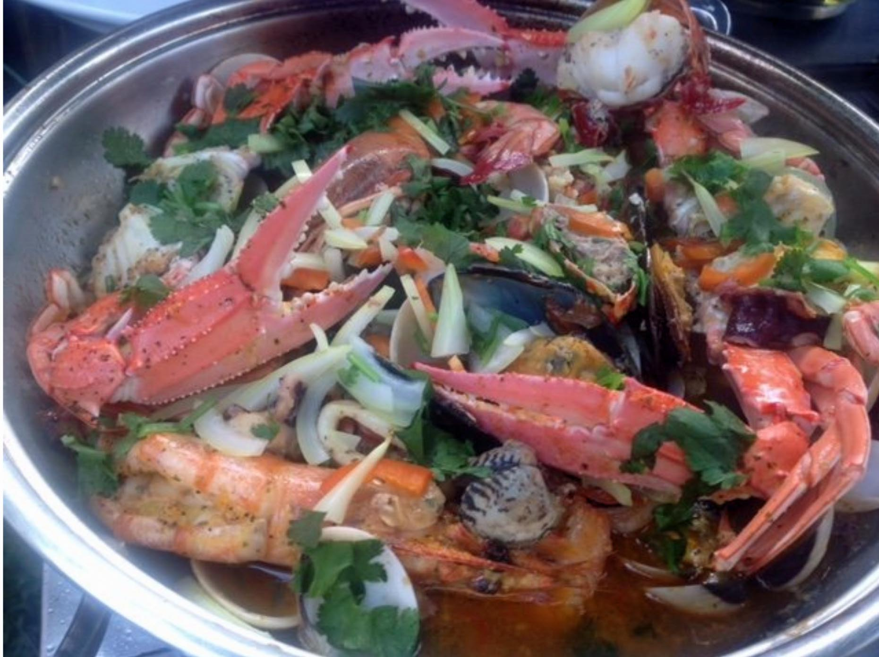
Puntarenas Michelin Star Restaurants
Puntarenas has many excellent restaurants. Many of us on the ship are
foodies, so naturally, we’re always on the hunt to eat at the most
exclusive spots anytime we travel.
Here are a few of the best restaurants to consider in downtown.
Restaurante Los Toneles $$ - $$$ Latin Seafood International
100 meters north of Clup Punta leona, Puntarenas
Casa Almendro $$ - $$$ Latin Sea food International
Calle 21 Paseo de Los Turistas, Puntarenas Hotel Tioga, Puntarenas
la Cueva del Diablo $$ - $$$ Seafood El Roble Puntarenas, de la
entrada principal a el Roble 1 kilometro al este, El Roble, Puntarenas
Restaurante Marino Ballena $$ - $$$ Seafood South American Costa Rican Parque Nacional Marino Ballena, Puntarenas
Restaurante y Marisqueria Mar Azul $$ - $$$ Seafood South American Costa Rican Puntarenas 23, Puntarenas
For those of you who just like good food, you can’t go wrong just about anywhere you go in Puntarenas.
GOOD EATING

Slide 26
Conclusion
Puntarenas is a beautiful City with a rich history and numerous attractions. Whether you're looking for an Eco adventure, stunning beaches, historic sites, or unique attractions, Puntarenas has something for everyone.
I hope this presentation will help when we visit Puntarenas!

Slide 27
Thanks For Coming
If you have any more questions, please ask.
I will do my best to answer them for you.
Have a great visit in Puntarenas!

