Slide 1


Puerto Vallarta, Mexico Presented by Fellow Cruiser Marc Silver

Slide 2
What I Will Cover
My Port Philosophy
Don’t Miss the Ship
Money
About Puerto Vallarta, Mexico
History of Puerto Vallarta, Mexico
Transportation
Points of Interest
Places to see or at least consider
A few restaurant recommendations
Conclusion

Slide 3
My Port Philosophy
I have been cruising for over 45 years and have taken over 100 cruises. So, I consider myself an experienced cruiser.
The information I will present is based on those many years of
experience.
When I am on a cruise where the city, I want to visit is not the port city,
I always recommend taking a ship’s tour.
But when I am in a port with multiple attractions nearby and easy to see
on my own - I will do it on my own.
This presentation is for that type of port.

Slide 4
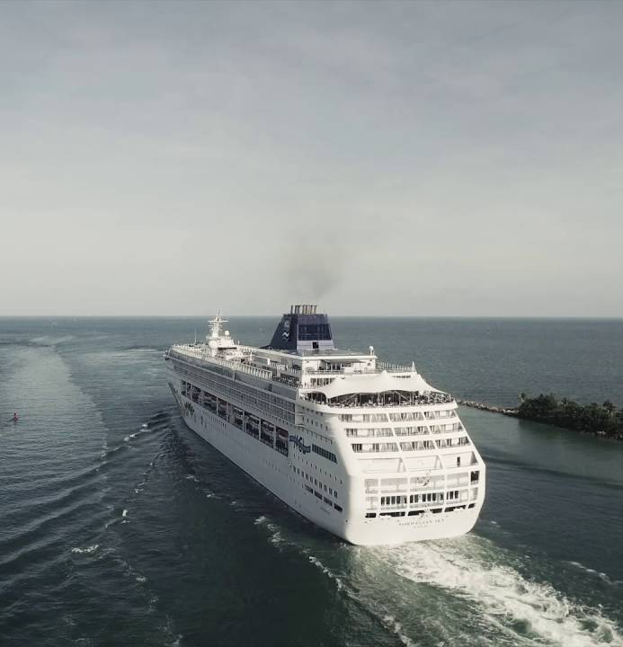
Don’t Miss the Ship
How to Avoid Missing Your Ship
Pay attention to the time. - Ship time and local time are often different.
Put a return-to-ship reminder on your phone.
Choose excursions wisely.
If a ship-sponsored excursion is late returning to port, the ship will wait for you. If you are on your own???
Be Prepared
Have your Passport, Credit Card, and phone numbers for your ship port agent.
What to Do If You Miss the Ship Most cruise lines have port agents stationed in the port area to assist if your ship has left without you.
The Port Officials can help you with contacting your ship and making necessary travel arrangements.

Slide 5
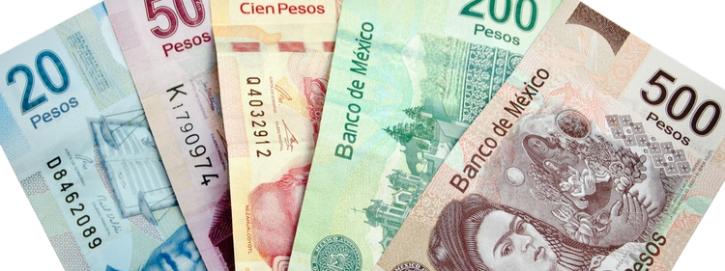
Money
The Peso is the official currency of Mexico
Official Exchange is 100 Pesos is $5.80 US
Or 17.35 Pesos to the US Dollar

Slide 6
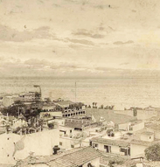
About Puerto Vallarta, Mexico
Puerto Vallarta Puerto Vallarta is the second largest city in the state after Guadalajara. Puerto Vallarta's proximity to the Bay of Banderas, the agricultural valley of the Ameca River, and the important mining centers in the Sierra have given the town a more interesting past than most Mexican tourist destinations. Puerto Vallarta was a thriving Mexican village long before it became an international tourist destination. Tourism is a major economic activity because of the climate, scenery, tropical beaches, and rich cultural history. The early village name for Puerto Villarta was Tintoque and the name Tintoque Puerto Villarta is still used formally to describe the city.
Playa Los Muertos (Beach of the Dead) In the 16th century, Hernán Cortés explored the Pacific side of Mexico by ship. Cortés used the established port of Acapulco to resupply and anchor his ships along the journey. During the early 1500s, he sent two of his ships North to explore the coastline without him. One of his ships wrecked in Banderas Bay and all but three men were reportedly killed. It is believed the corpses of the lost sailors washed ashore. Native villagers encountered numerous corpses on the beach for days after the wreck.

Slide 7
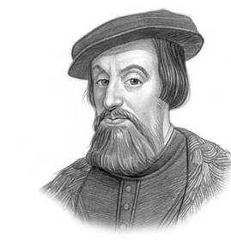
Historical Puerto Vallarta
Few details are known about the history of the area prior to the 19th century. There is archaeological evidence to suggest continuous human habitation from 580 BC, and similar evidence that the area belonged to the Aztlán culture which dominated Jalisco, Nayarit, and Michoacán from c. 900–1200. The limited evidence in occidental Mexican archeology has limited the current knowledge about pre-historic life in the area.
Pirates were known to attack ships along the Pacific Coast of Mexico as early as the 16th century. In the early 1500s, the famous explorer Hernán Cortés and his crew set foot on the beach, a mob of angry villagers believed he and his crew were pirates and surrounded them with weapons in hand. Villagers were mesmerized by the red flags the crew carried and suddenly lowered their weapons, allowing the explorers to pass peacefully

Slide 8
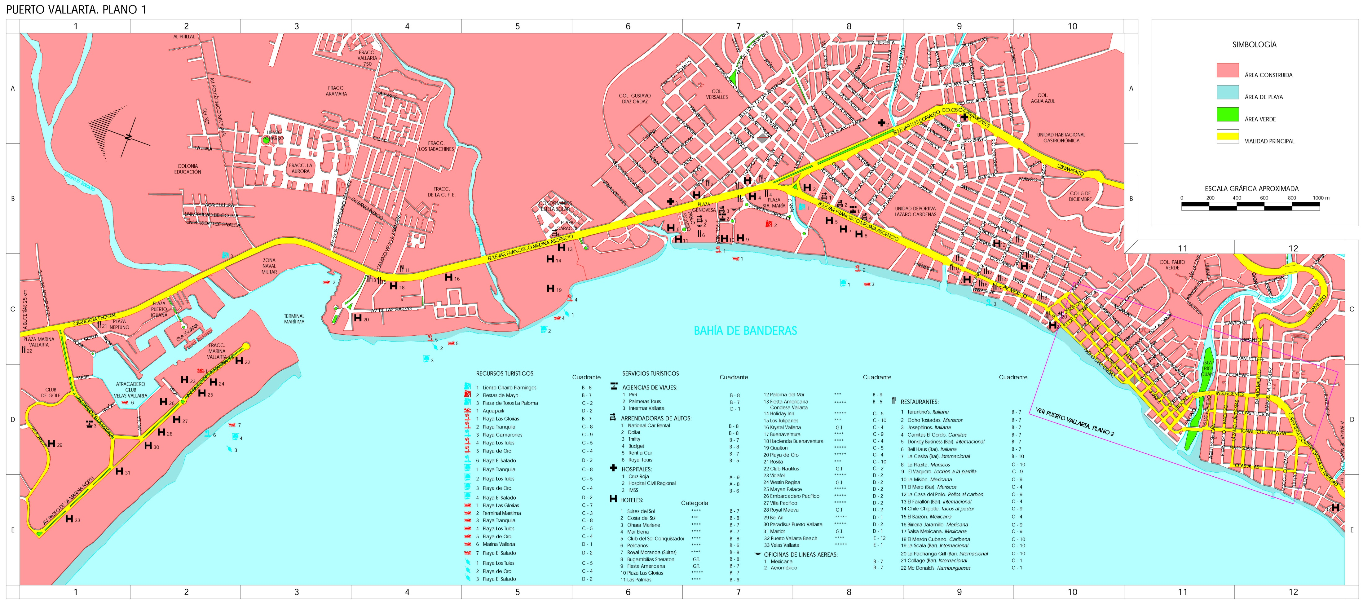
Puerto Vallarta Map

Slide 9
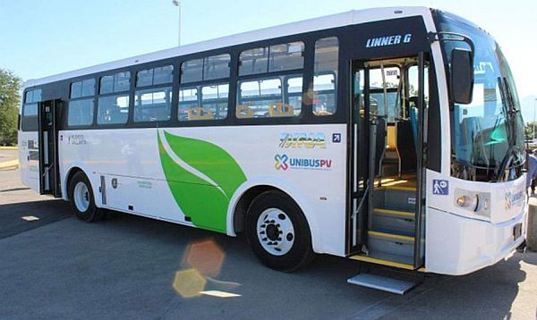
Puerto Vallarta City Bus
A few tips to remember
Each bus fare is a one-time use only and there are no transfers.
There are no round trips available.
Before the bus arrives have the correct change ready for the driver.
The two seats directly behind the driver (sometimes marked in yellow) are reserved for pregnant women, the elderly, and the physically challenged.
When boarding as a female/male couple, it’s customary for the female to board first, and when the male boards he pays for both fares.
When traveling with a group of family and friends it’s customary for everyone in your group to quickly board, and when the last male from your group boards the bus he pays for everyone in the group. This method shows courtesy to the other passengers and to the driver by speeding up the boarding and payment process.
Hold onto your ticket. Inspectors hop on and off buses to check that passengers have tickets.
From Marina Vallarta to downtown Puerto Vallarta (Centro/Malecon) Bus fare is $10 pesos ($.58 US)

Slide 10
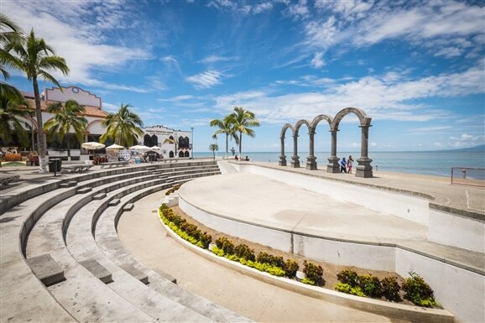
Los Arcos and El Malecón
Stretching for more than a mile along Bahía de Banderas (Banderas Bay), El Malecón is a great place to stroll any time of day, but especially in the evenings. Along the way, visitors will see everything from sand sculptures and bronze sculptures to the iconic Church of Our Lady of Guadalupe.
El Malecón is also home to the Los Arcos Amphitheater, another iconic symbol of Puerto Vallarta that plays hosts to free performances, featuring live musicians and traditional Mexican dance troupes, just about every night.
I recommend grabbing a bite along the way at one of the street vendors and enjoying the ambiance of the evening.

Slide 11
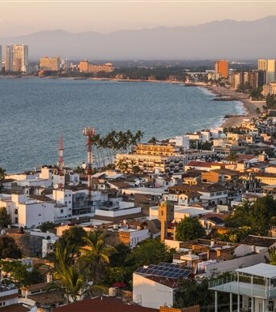
Zona Romantica
This charming south-side neighborhood is like a detached, unpretentious beach village that serves PV’s more laid-back and less resort-conscious tourists. It’s also the center of the city’s thriving gay population and has a bevy of gay beaches, bars, and restaurants lining Olas Atlas. Travelers should keep in mind that this area is also known as Old Vallarta or Old Town.
Zona Romantica is a must-see. The area contains a number of the city's best restaurants, excellent cultural opportunities, and the most popular beach in the city: Playa Los Muertos. It's also home to a pier built in 2013.

Slide 12
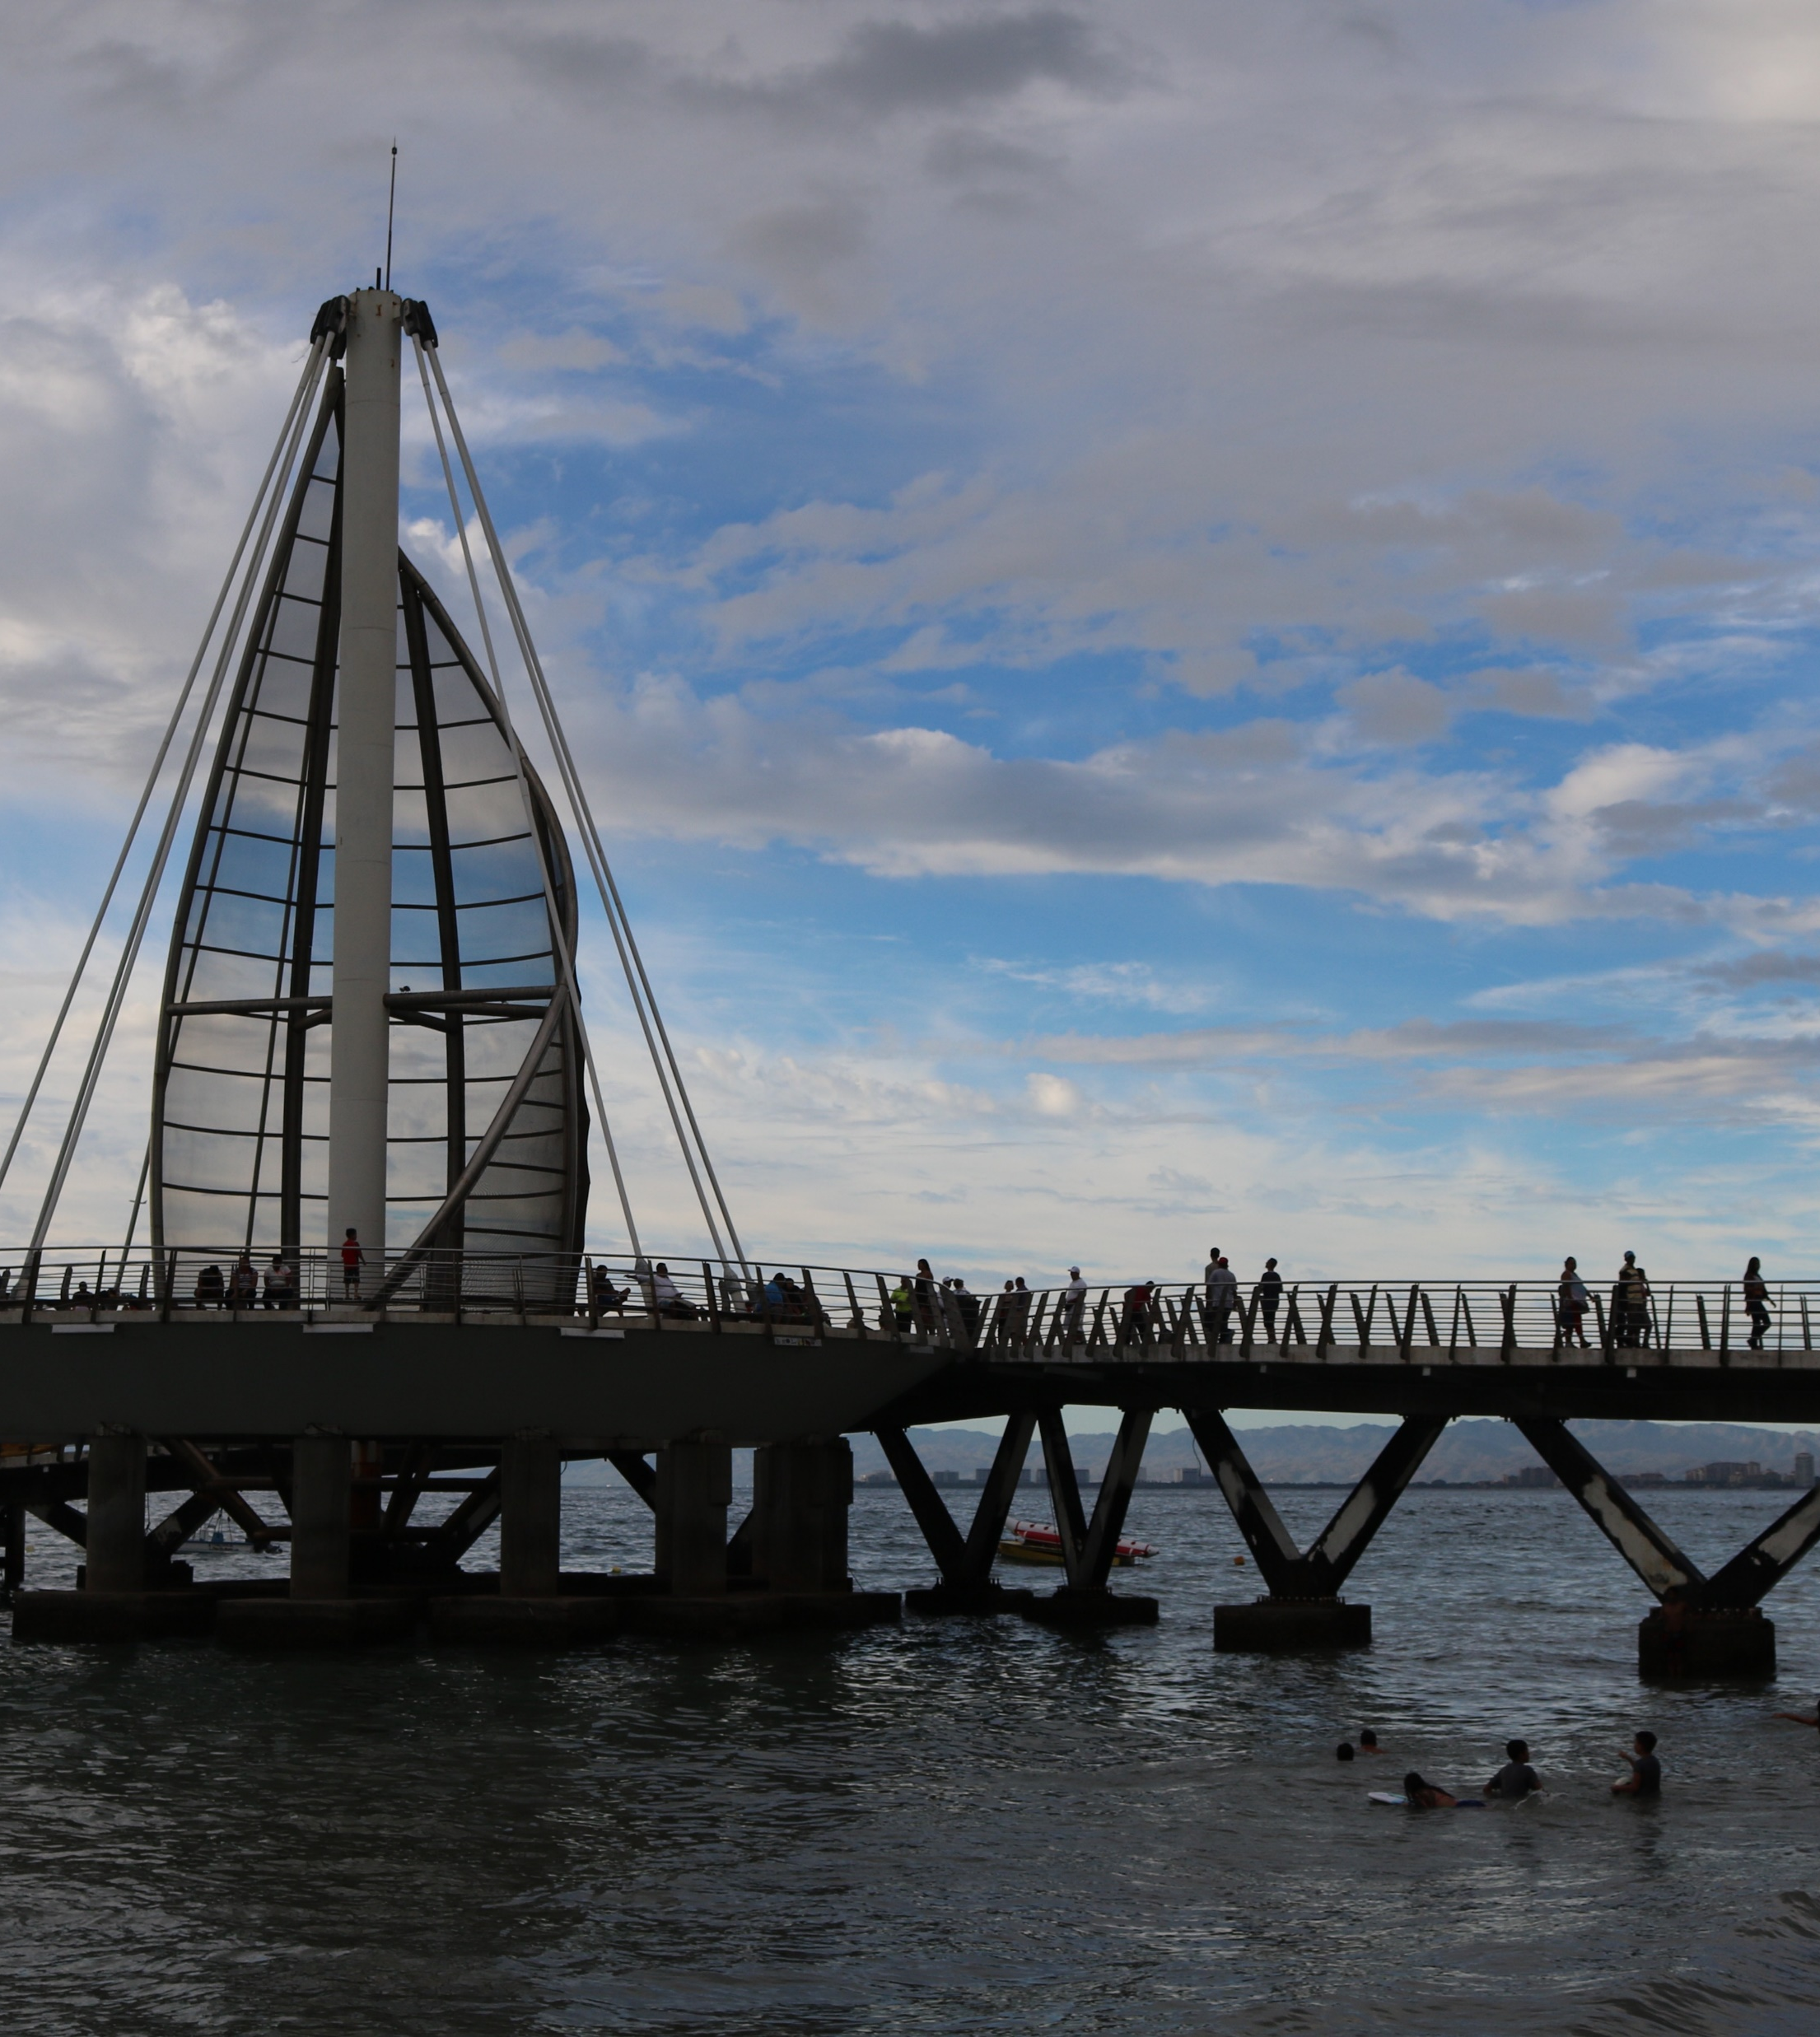
Playa de los Muertos
The most popular shoreline in Puerto Vallarta, Playa de los Muertos (Dead Man's Beach) in the Zona Romantica, offers opportunities to Jet Ski, windsurf and even parasail and an assortment of excellent restaurants and bars. Try out some of the land sports as well, such as beach volleyball, which can be equally fun but cheaper than water sports.
Travelers generally say that Playa de los Muertos is a nice area with plenty of space and a great spot for people-watching. It is also considered a party haven for PV's LGBTQ travelers..

Slide 13
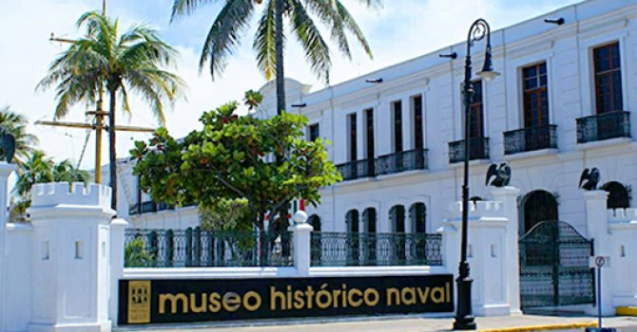
Museo Histórico Naval de Puerto Vallarta
This museum shows the history of Mexico in relation to the sea, from the conquest to modern times. The permanent collection exhibits: paintings, models, photographs, documents, cartographies, scale models, and navigation instruments. It exhibits a collection of weapons known as mosquetón, of which one of them is Mexican manufactured.
The topics presented cover expeditions and discoveries of the South Sea, expeditions to the Philippines, the voyage of the Naos, and the defense of the fleets. It highlights the theme of the beginning of the settlement that would later become Puerto Vallarta, as well as a brief historical review of it, the San Blas station, and the Mexican Navy.

Slide 14
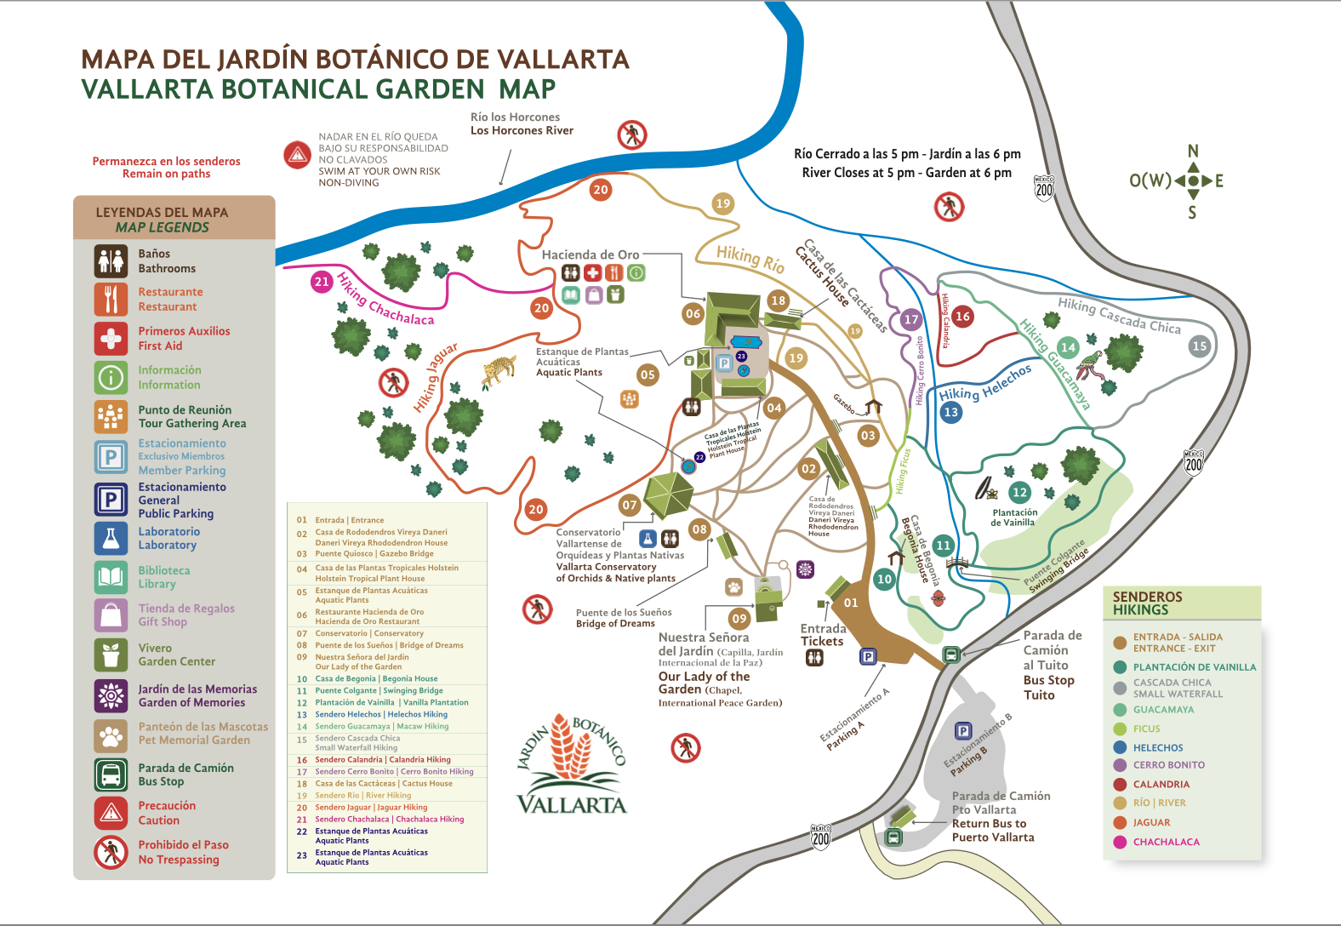
Vallarta Botanical Gardens
To explore beyond Puerto Vallarta, you might want to try the popular Jardín Botánico Vallarta (Vallarta Botanical Gardens). The gardens feature an assortment of wildflowers, including orchids, and insect life that provide a relaxing and romantic getaway from the day-to-day hustle of Vallarta's downtown.
Some travelers expect to spend one or two hours walking around the gardens but ended up staying the entire day since along with enjoying the magnificent plant life, you can also boulder the jungle's rocks and swim a section of the river. Some reviewers only recommend these activities for fit travelers. Also, be sure to buy a meal, at the very least, a drink at the on-site restaurants, which come highly recommended by both travelers and experts. If you plan to hike, you'll want to bring insect repellent (it's also available
to purchase on-site) and consider wearing long sleeves and pants.
Adult Admission
MX$300.00 each

Slide 15
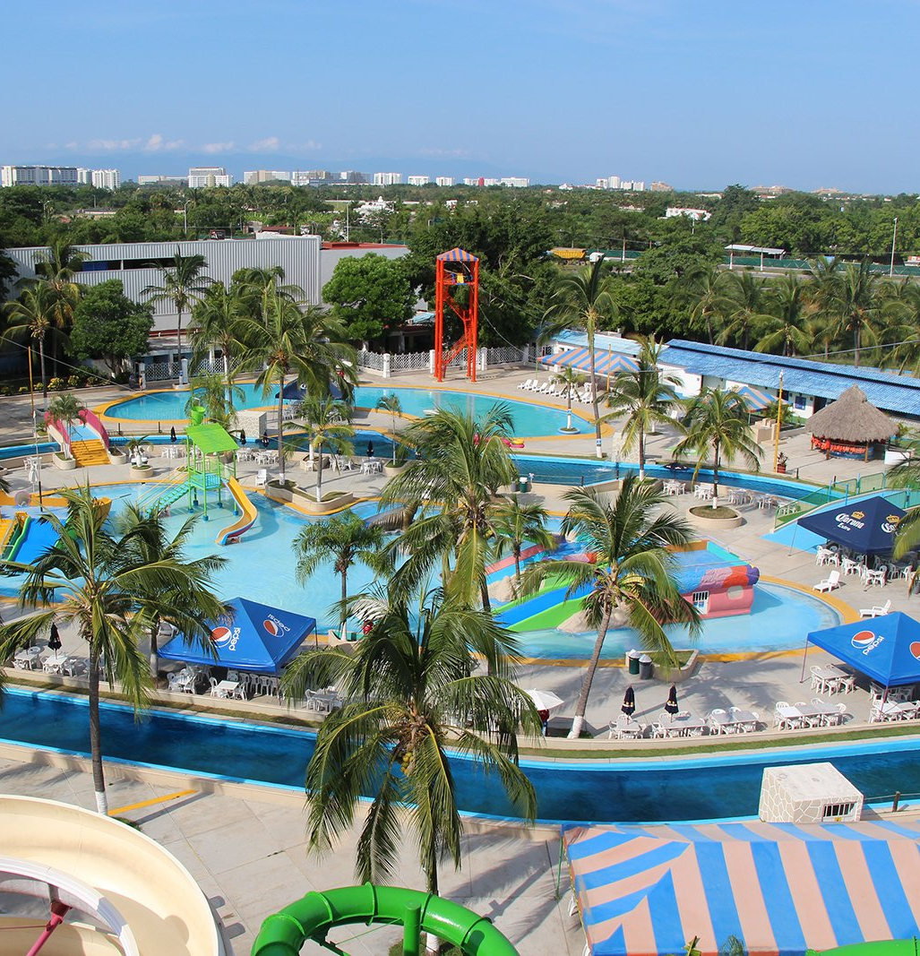
Aquaventuras Park & Dolphin Discovery
A favorite activity for families traveling with kids, Aquaventuras water park & Dolphin Discovery Puerto Vallarta gives travelers the chance to swim with dolphins and sea lions. The Dolphin Discovery features four different programs that offer varying levels of interaction with the animals.
The least expensive option, Sea Lion Discovery, costs $59 and includes a hug and kiss from one of the five sea lions that call the water park home. You’ll also learn about sea lions, their habitat, and conservation efforts from one of the park’s marine mammal specialists. The sea lions also perform tricks during the program. If you’d rather swim with dolphins, choose from one of the park’s three dolphin programs, ranging from $99 to $169. The basic Dolphin Encounter includes 40 minutes with the dolphins in which you’ll swim, shake hands, and hug. The most expensive option, the Dolphin Royal Swim, promises the most interaction with the dolphins, including the foot push, where two dolphins push you from your feet above the water.
You will find tons of fun for all your family members during a day full of action, adventure, and entertainment. Feel the emotion and speed of their 10 water slides and enjoy a fresh ride along the river; kids will have great moments in their playground while their parents enjoy the swimming pool area.

Slide 16
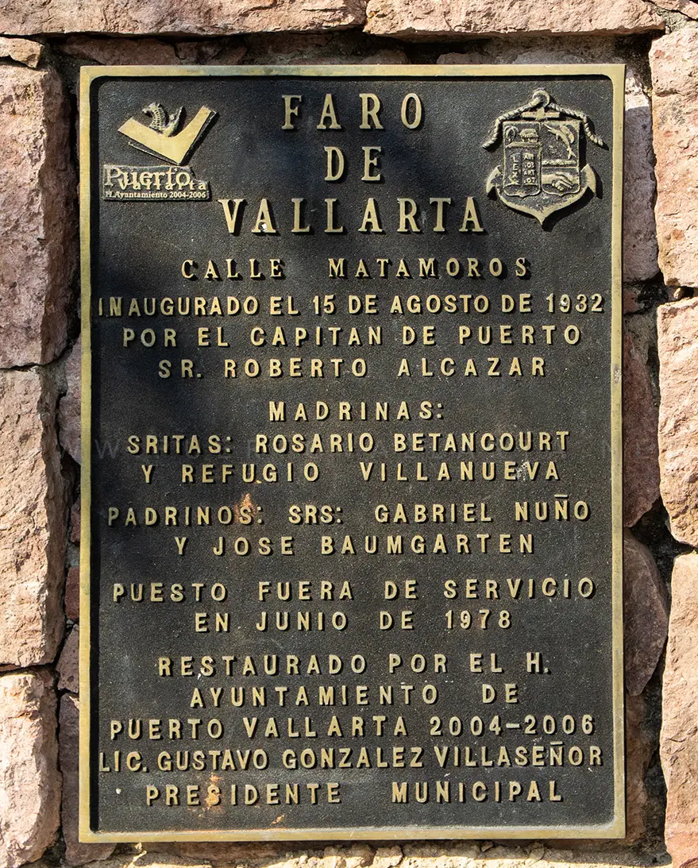
Faro de Matamoros Lighthouse in Puerto Vallarta
Matamoros Lighthouse (Faro de Matamoros) along Matamoros Street, in colonia Centro, Puerto Vallarta, is not really a lighthouse, it’s a beacon. The structure was built by Roberto Alcazar and inaugurated on August 15, 1932. It operated until June 1978, and upon retirement, was deemed a historic landmark.
In 2006, the structure was remodeled and converted into a lookout with stair access. The structure, now considered a tourist attraction, provides panoramic views of the city and Banderas Bay.

Slide 17
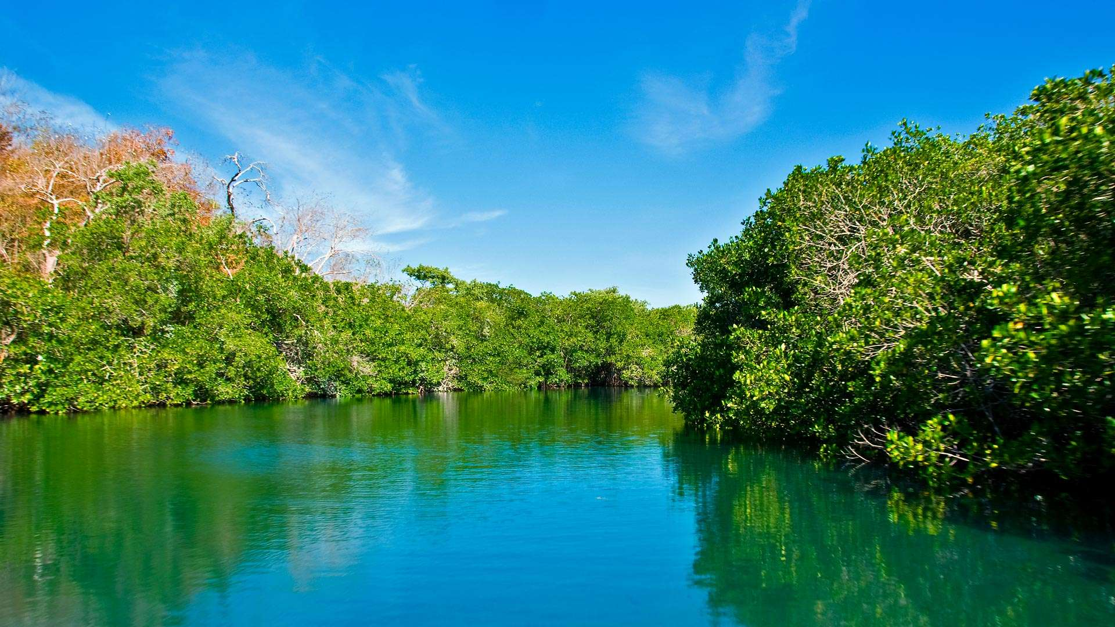
Estero El Salado Nature and Wildlife area in Puerto Vallarta
Nestled in the heart of Puerto Vallarta, Estero El Salado State Park is a remarkable urban estuary that offers visitors an incredible chance to discover the wonders of nature. Estero El Salado State Park, a protected estuary, boasts a stunning blend of lush vegetation and diverse wildlife, making it one of Mexico’s ecological treasures and a must-see of Puerto Vallarta things to do.
Take the 90-minute tour and learn about this fascinating ecosystem, right in the middle of the city. In 2000, this area became a protected natural area so that it will be protected from further development. View crocodiles, herons, as well as vultures. The waterway is very beautiful and peaceful, with the driver stopping the boat several times to allow you to take pictures. It's a once-in-a-lifetime experience that should not be missed. Be sure to email for reservations before arriving. They are only open from Tues-Sat..
Admission: 300 pesos

Slide 18
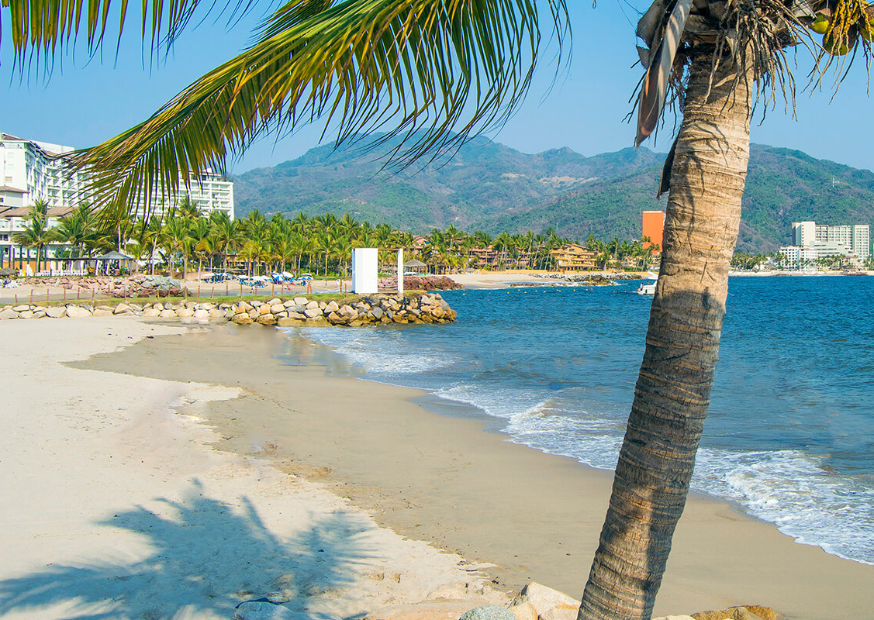
Playa Las Glorias Beach
Las Glorias Beach is the name for the long stretch of beautiful golden sand from Playa Pelicanos (which is just north of Los Muertos Beach) all the way to the canal that divides Marina Vallarta from the Marine Terminal where ships on Pacific cruises dock. There are numerous hotels in Playa Las Glorias as this area of the downtown area (El Centro) is in the center of what is called the Hotel Zone. It is easy enough to get away from the crowds by just walking south a bit to Playa Pelicanos, which often has fewer people.

Slide 19
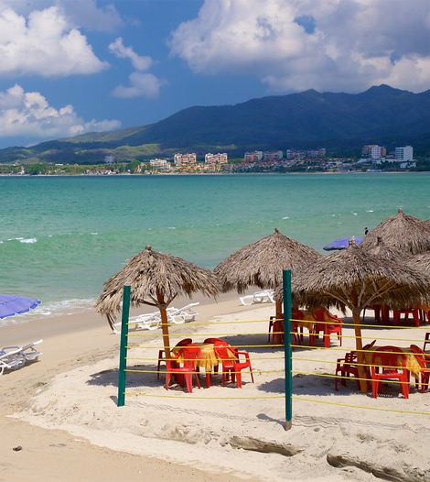
Bucerías
A great place to experience the joys of a resort town without the tourist-palooza that is Puerto Vallarta, the small fishing village of Bucerías is steadily becoming a popular day trip for PV vacationers. If you have the time to spare, take a bus to this beach hideaway up the coastline for an afternoon of fishing or swimming.
To visit Bucerias from Puerto Vallarta, you'll need to take a bus that departs from the Walmart located across the street from the ferry terminal. The bus journey usually takes around 30 minutes, and a one-way ticket costs 35 pesos (about $1.75). Taxis or Ubers are also an option.

Slide 20
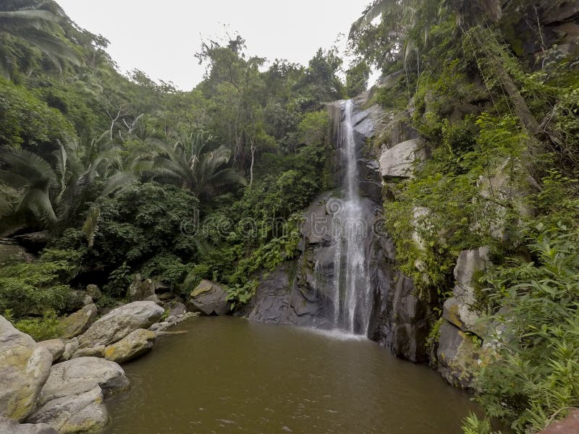
Yelapa
For a break from the tourist crowds of Puerto Vallarta, head about 20 miles south to Yelapa. Considered by travel experts to be one of Mexico's few "undiscovered" beach towns, Yelapa is only reachable by boat, which is part of the reason why it sees relatively fewer travelers than other popular areas along Bahía de Banderas.
Many travelers come to Yelapa for its unspoiled beach, but if you're looking for a little more adventure, you won't be disappointed. There's a waterfall not too far from town that you can reach via a paved walking path. Consider swimming in the pool beneath the waterfall’s clean, refreshing waters.

Slide 21
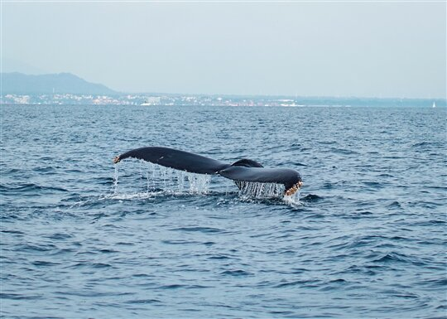
Whale Watching
Spotting a humpback whale as it crests the surface of the ocean is an awe-inspiring sight, and Puerto Vallarta is one of the best places to do just that. Keep in mind that the prime whale-watching season runs from early December to late February or early March when humpback whales congregate in the warm waters of Puerto Vallarta's Banderas Bay to have their babies. And although you can bring your binoculars and look for whales from the shore your best chance for seeing them up close is aboard a tour operator's boat.
Wildlife Connection is a recommended operator, offering half-day whale and dolphin watching tours, starting at $72 for adults and $48 for kids (if booked online). Along with a bilingual guide, Wildlife Connection also serves their guests bottled water and lunch.

Slide 22
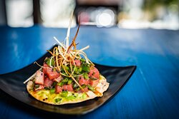
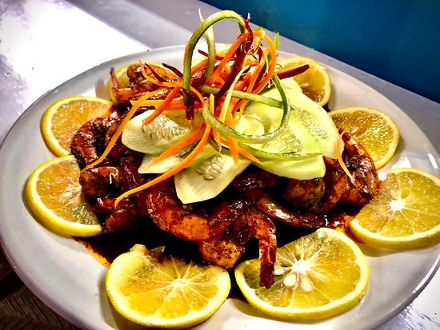
Puerto Vallarta Restaurants
Puerto Vallarta has many excellent restaurants. Many of us on the ship are foodies, so naturally, we’re always on the hunt to eat at the most exclusive spots anytime we travel.
Here are a few of the best restaurants to consider in Puerto Vallarta.
Serrano´s Grill
$$$$ Steakhouse International Grill - Calle Púlpito 377, Puerto Vallarta
Porfirio's Vallarta $$ - $$$ Mexican Bar International - Plaza Peninsula Shopping Center,.
Señor Frog's Puerto Vallarta
$$ - $$$ Mexican Bar International - Calle Paseo Diaz Ordaz 786.
Bonito Kitchen & Bar
$$ - $$$ Asian, Vietnamese, Vegetarian – just East of Costco
For those of you who just like good food, you can’t go wrong just about anywhere you go in Puerto Vallarta.
GOOD EATING

Slide 23
Conclusion
Puerto Vallarta is a beautiful City with a rich history and numerous attractions. Whether you're looking for stunning beaches, historic sites, or unique attractions, Cabo San Lucas has something for everyone.
I hope this presentation will help when we visit Puerto Vallarta!

Slide 24
Thanks For Coming
If you have any more questions, please ask.
I will do my best to answer them for you.
Have a great visit to Puerto Vallarta!

