Slide 1

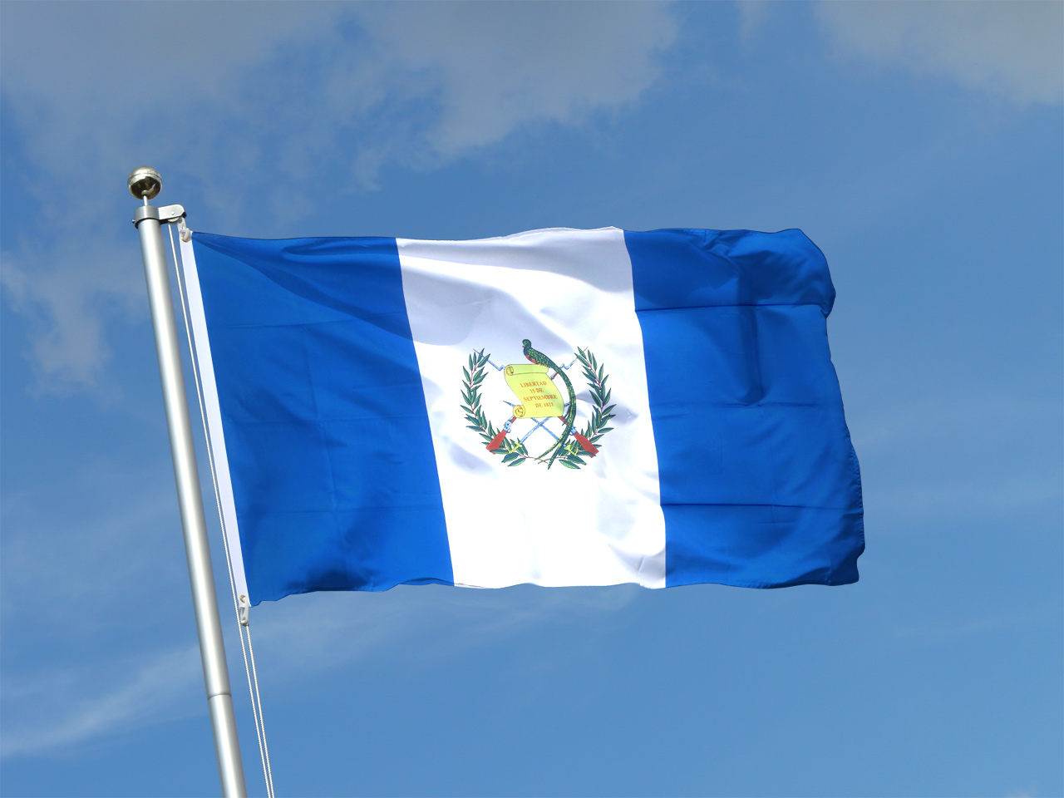
Puerto Quetzal
(Puerto San Jose)
Guatemala
Presented by
Marc Silver

Slide 2
What I Will Cover
My Port Philosophy
Don’t Miss the Ship
Money
About Puerto Quetzal
Puerto San Jose
Transportation
Points of Interest
Places to see or at least consider
A few restaurant recommendations
Conclusion

Slide 3
My Port Philosophy
I have been cruising for over 45 years and have taken over 100 cruises.
So, I consider myself an experienced cruiser.
The information I will present is based on those many years of
experience.
When I am on a cruise where the city, I want to visit is not the port city,
I always recommend taking a ship’s tour.
But when I am in a port with multiple attractions nearby and easy to see
on my own -
I will do it on my own.
This presentation is for that type of port.

Slide 4
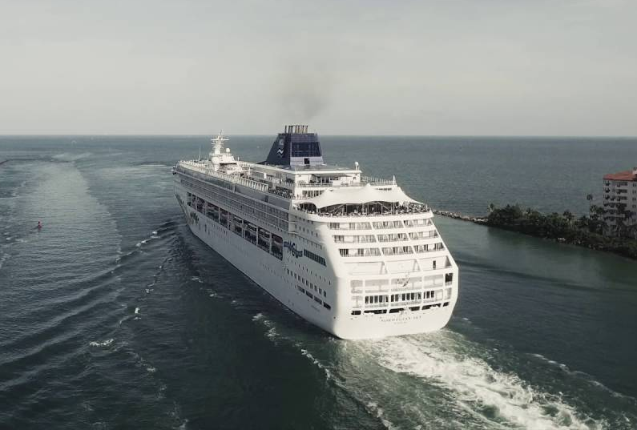
Don’t Miss the Ship
How to Avoid Missing Your Ship
Pay attention to the time. - Ship time and local time are often
different.
Put a return-to-ship reminder on your phone.
Choose excursions wisely.
If a ship-sponsored excursion is late returning to port for, the ship will
wait for you. If you are on your own???
Be Prepared
Have your Passport, Credit Card and phone numbers for your ship port agent.
What to Do If You Miss the Ship
Most cruise lines have port agents stationed in the port area to assist if your ship has left without you. If you’re lucky, when cruisers are late returning to the vessel, the ship's crew will often remove the passengers' essential items -- passports, cell phones and medication -- from the ship to leave with the port agents.
The Port Officials can help you with contacting your ship
and making necessary travel arrangements.

Slide 5
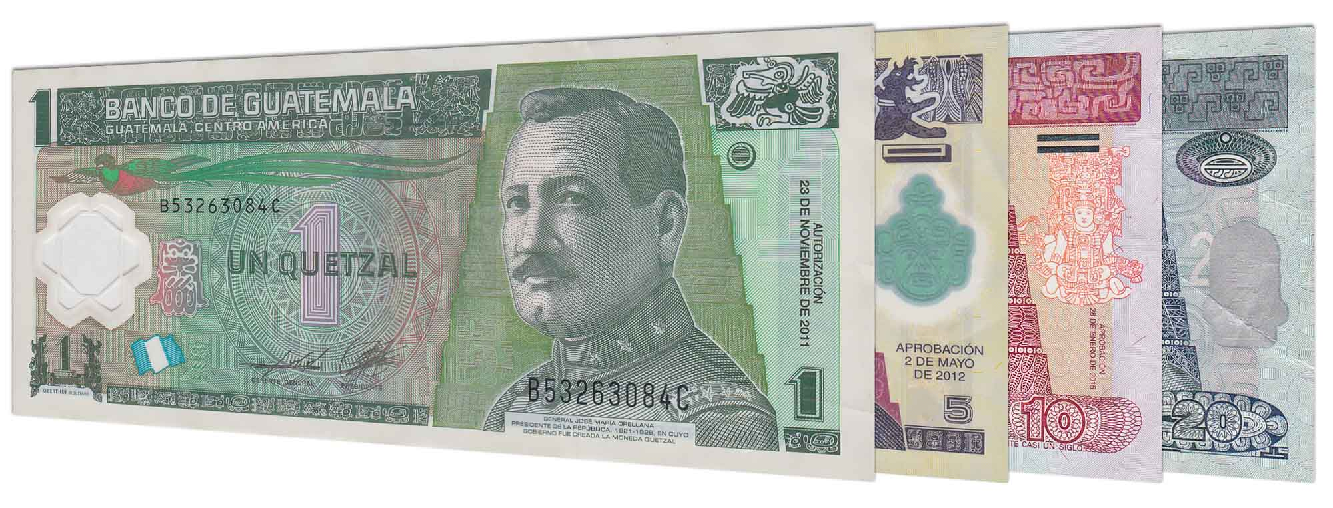
Money
The Quetzal is the official currency of Guatemala
Official Exchange is 100GTQ is $12.71 US
Or 7.87 GTQ to the US Dollar

Slide 6
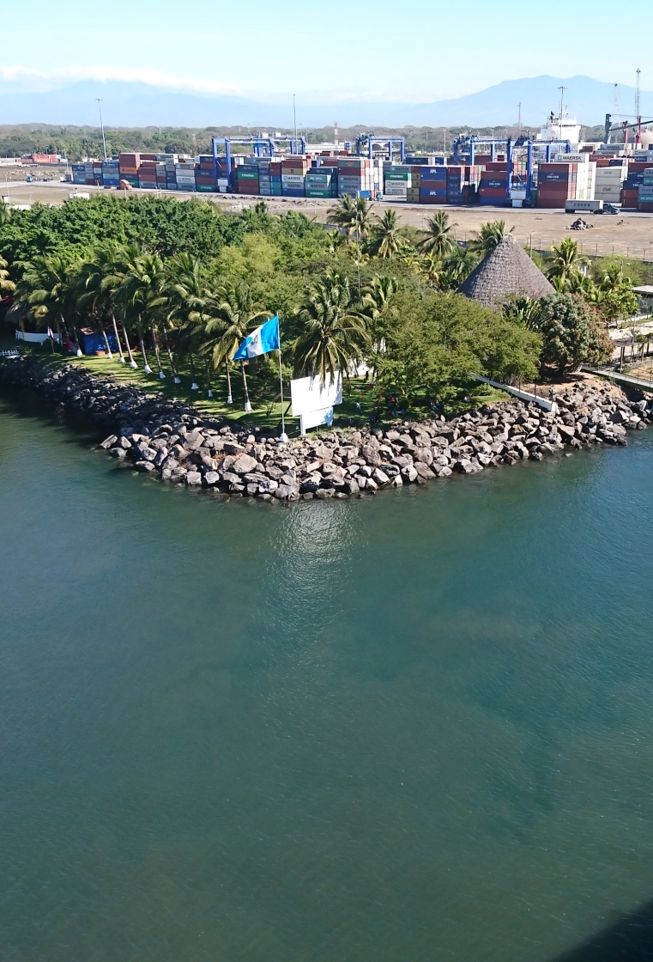
About Puerto Quetzal
We dock at Puerto Quetzal Guatemala, but the closest city is Puerto San Jose. Puerto Quetzal is a wonderful port of call and the gateway to Guatemala! Puerto Quetzal was named after Quetzales; Guatemala’s national bird. Although the port area doesn’t offer anything within walking distance, this is your opportunity to venture out to explore the untouched country of Guatemala. Most people visit the beautiful capital city of Antigua. Others will choose to explore the old Mayan temples of Yaxha or Iximche or perhaps one of the many coffee plantations. There are plenty of things to see and do as long as you are willing to venture out and not stay at the cruise terminal itself.

Slide 7
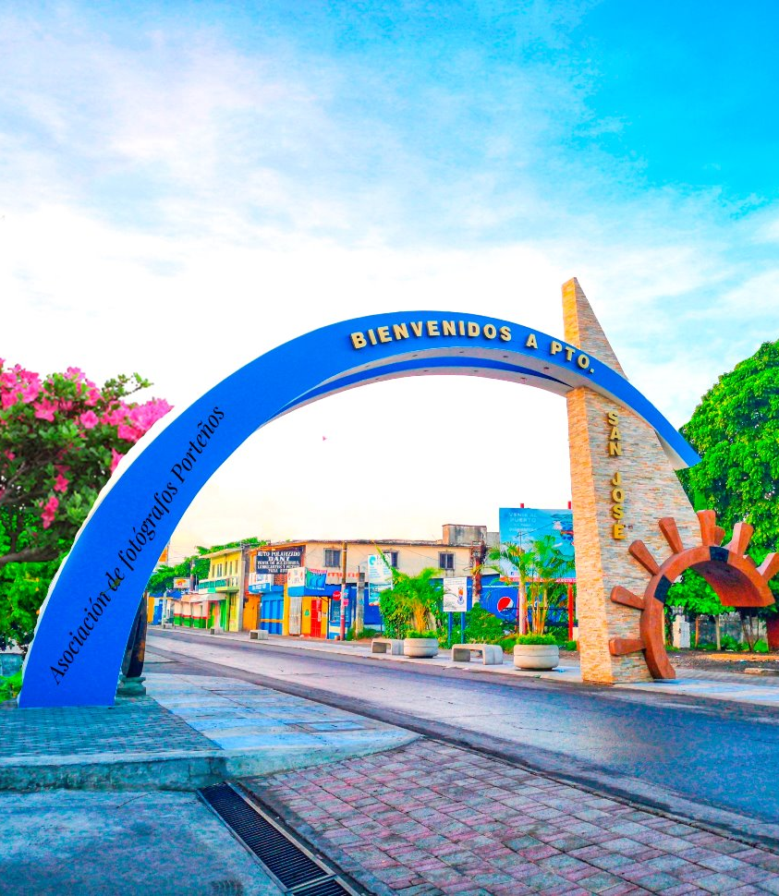
San José
Puerto de San José, also called San José, port town, in south-central Guatemala, situated along the Pacific Ocean. Opened in 1853, it is a sheltered offshore anchorage area for ships. with a long wharf; passengers and cargo are transferred from ships anchored 1 mile (1.6 km) offshore. It served as Guatemala’s principal Pacific port until the early 1980s, when Puerto Quetzal, a cargo and cruise ship port, took on this role. San José still handles exports of molasses, coffee, cotton, sugar, lumber, and honey. The resort of Iztapa, once a Spanish fort, lies to the east. San José is linked to Escuintla, 26 miles (42 km) to the north, and to Guatemala City by railroad and highway. Pop. (2002) 17,430.

Slide 8
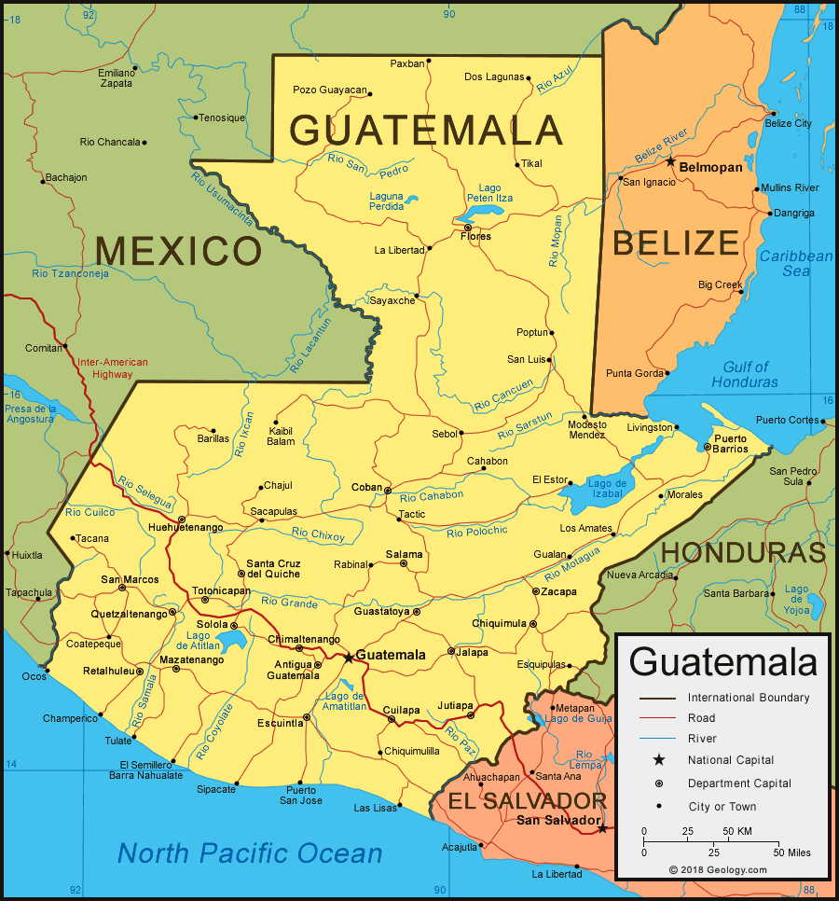
Map of Guatemala

Slide 9
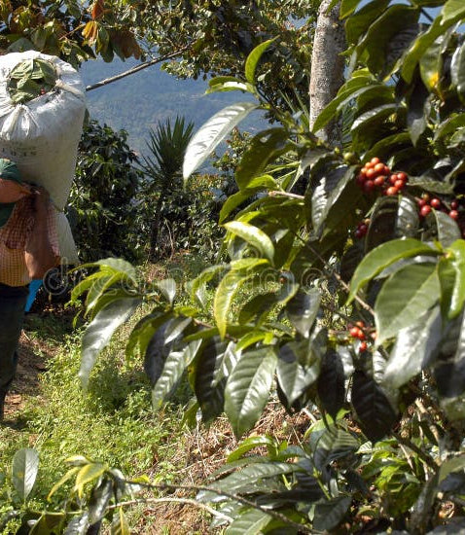
Coffee Plantation
The coffee industry began to develop in Guatemala in the 1850s and 1860s, initially mixing its cultivation with cochineal. Small plantations flourished in Amatitlán and Antigua areas in the southwest. Initial growth though was slow due to lack of knowledge and technology. Many planters had to rely on loans and borrow from their families to finance their coffee estates (fincas) with coffee production in Guatemala increasingly owned by foreign companies who possessed the financial power to buy plantations and provide investment.
A scarcity of laborers was the main obstacle to a rapid increase in coffee production in Guatemala.
Many acres of land were suitable for this cultivation, and the varieties that were produced in the temperate regions were superior. Coffee was grown around Guatemala City, Chimaltenango, and Verapaz.
Anacafé (Asociación Nacional del Café) was established in 1960 as a national coffee association, representing all coffee producers in Guatemala.

Slide 10
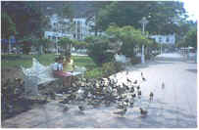
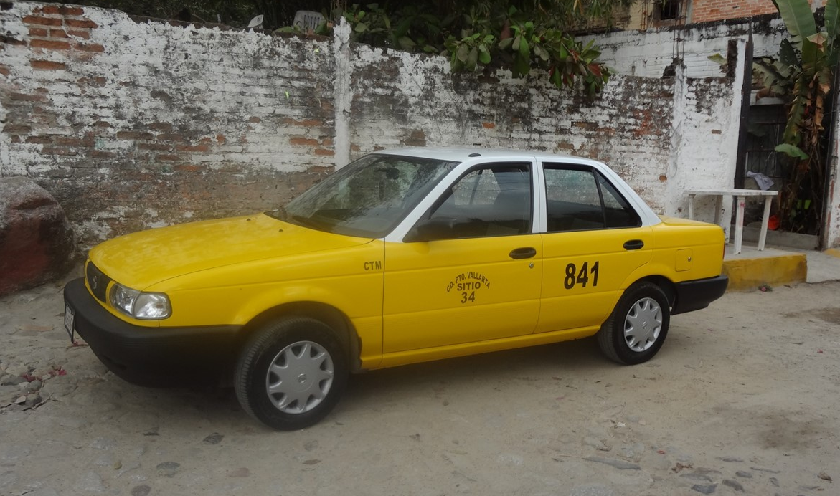
Taxis
There are taxis waiting for you when you exit the port. Note that some of the cars might not be in great technical condition. Negotiate with a taxi
driver or tour guide before you step into
the taxi. There are no fixed prices and
depending on your negotiation skills and
group size you might pay between $30 and
$60 US dollars per person for a trip to
Antigua.

Slide 11
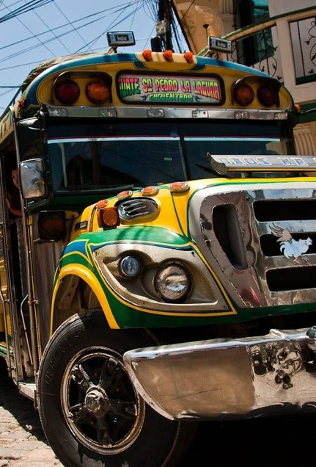
Chicken Buses
Normally I take local buses because I enjoy being immersed in local culture, but there is a limit to what I feel comfortable with. In the case of Guatemala, I recommend taking a taxi or tour to sightsee.
Guatemala’s most iconic form of transport, chicken buses are usually old American school buses that have been painted in jazzy new colors. These are how most Guatemalans get around, and a trip to the country wouldn’t be complete without a journey on one. They’re also hard to avoid, as they’re often the only way of getting from town to town.
Like collectives, chances are someone will be leaning out the door announcing the destination. They’ll also often advertise their route on the front of the bus. Once on board, someone will come and collect your fare.

Slide 12


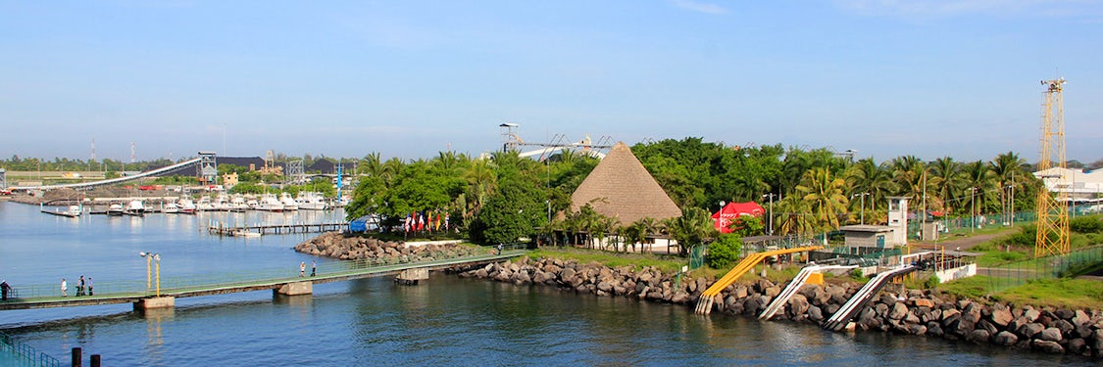
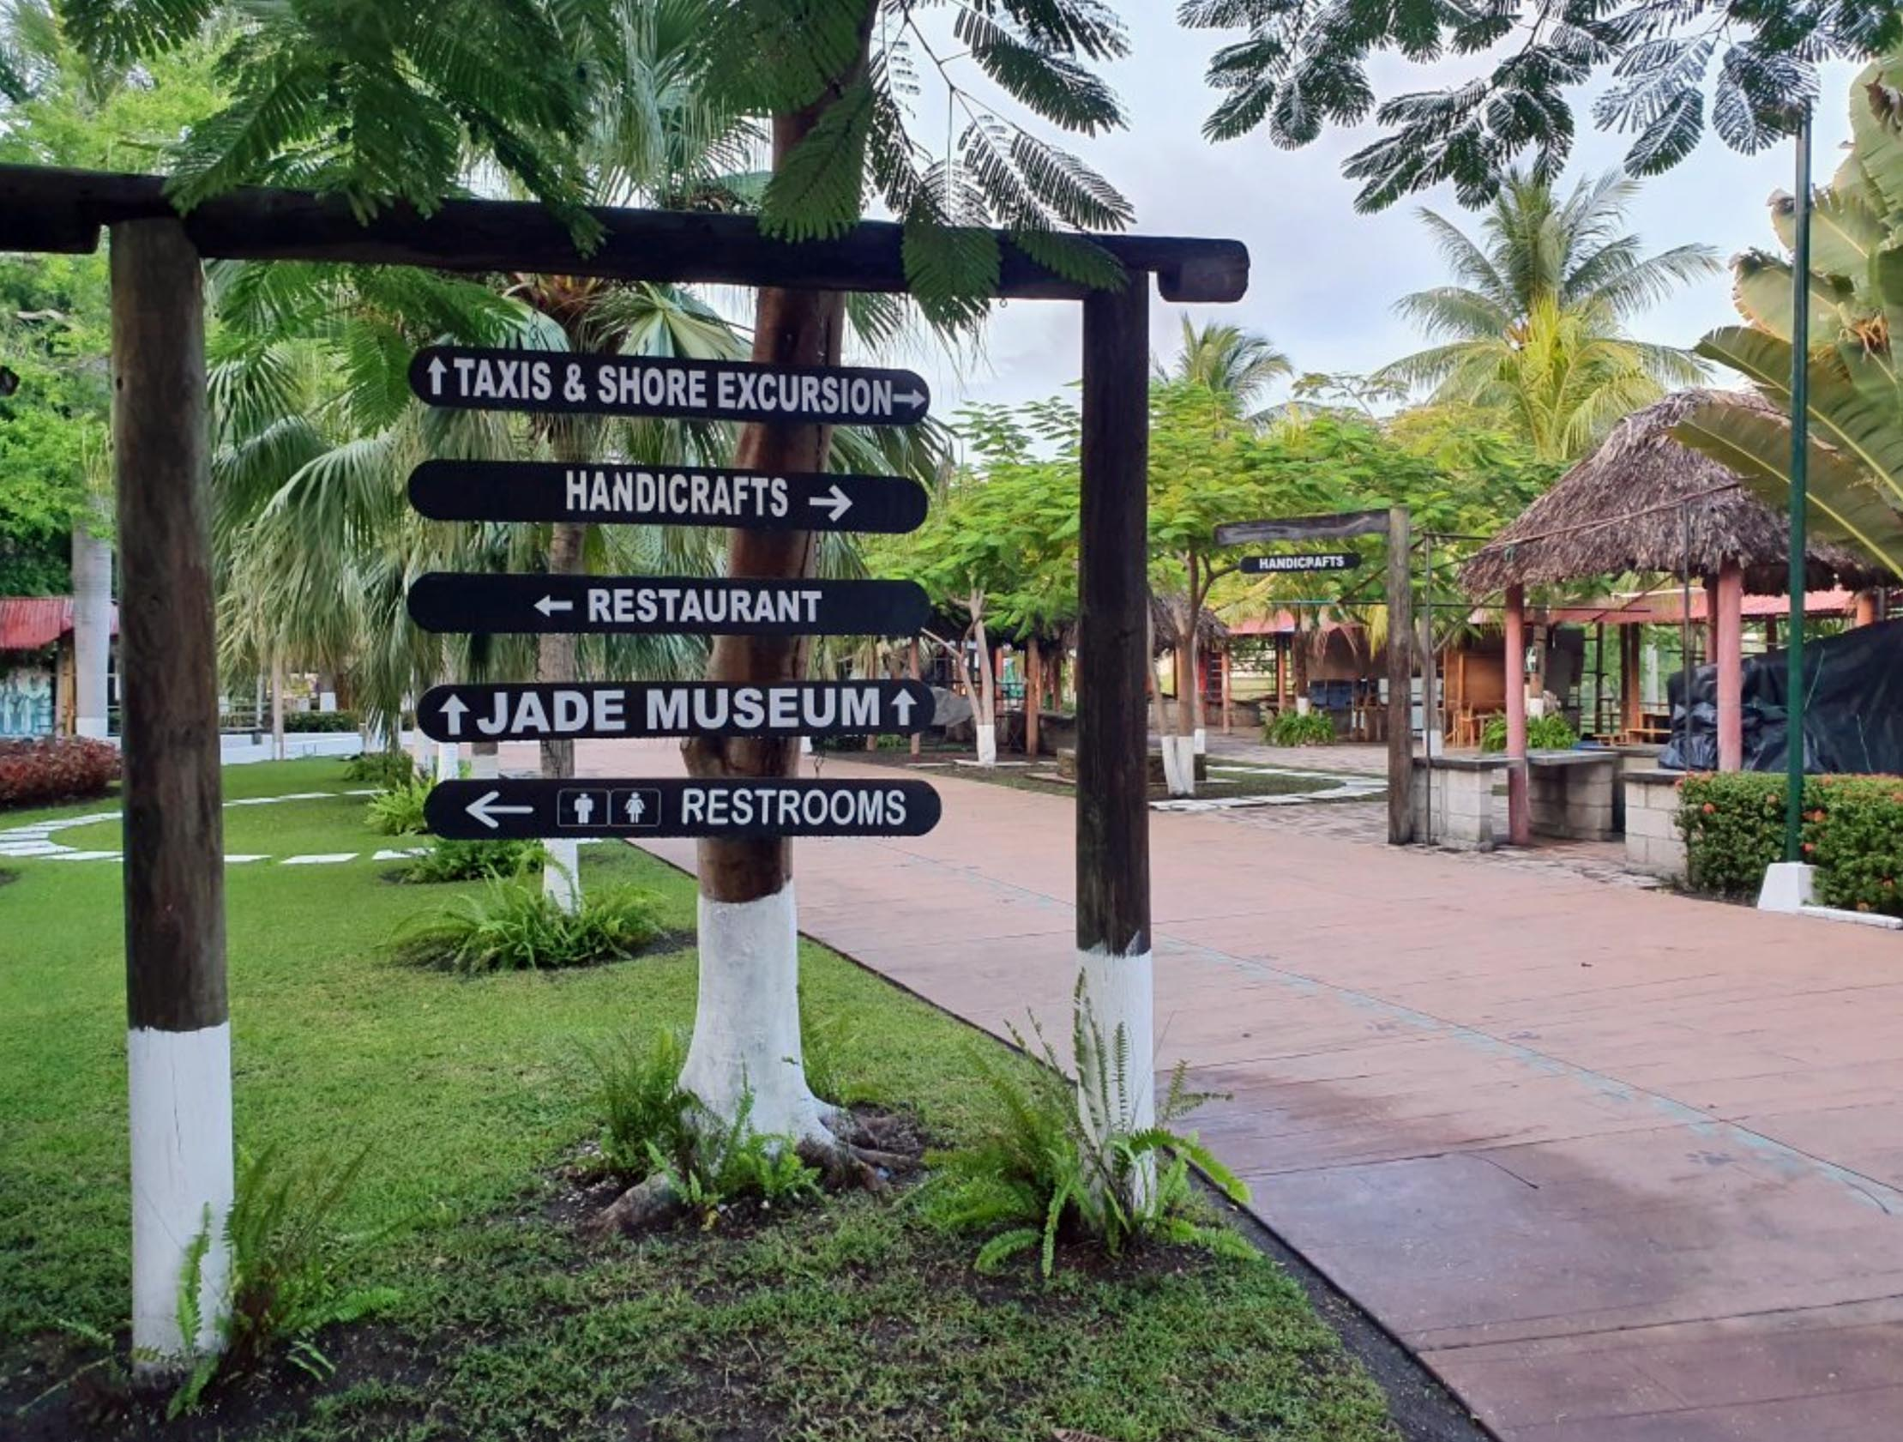
Port Souvenir Market
The cruise terminal offers a small market where you can buy your local souvenirs. Find them as soon as you step out of the welcoming center. You will be able to buy all your local T-shirts, art and jewelry.
Port Wi-fi:
There are a couple of restaurants and bars where you can get free Wi-Fi as long as you buy a refreshment.

Slide 13
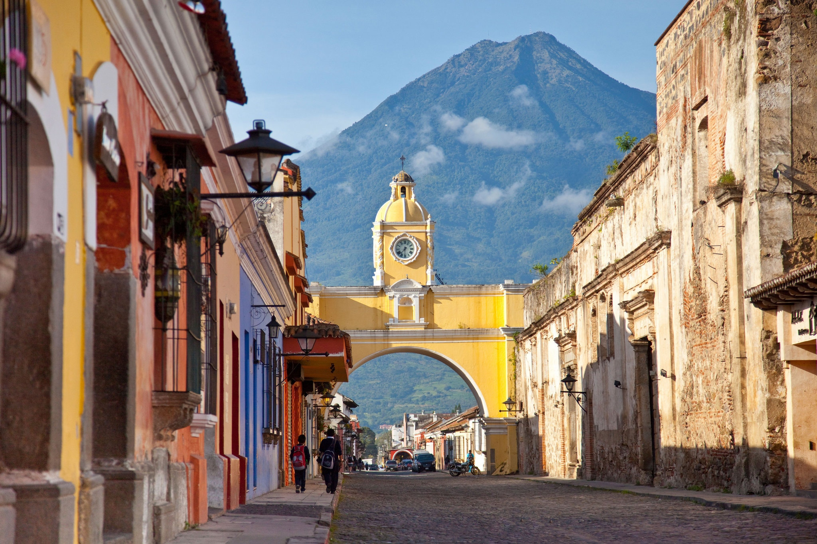
Antigua
Visiting the colonial capital Antigua is the most popular thing to do from Puerto Quetzal. Antigua lies at a higher altitude, 5200 feet above sea level. Keep in mind it will be cooler up there. From the cruise terminal in Puerto Quetzal, the ride to Antigua is 50 miles or about 90 minutes. The ride is very scenic and will take you past the famous coffee plantations and volcanoes of Guatemala. Consider an organized tour because the last thing you would want is to get stranded in the middle of nowhere with a non-functioning taxi.

Slide 14
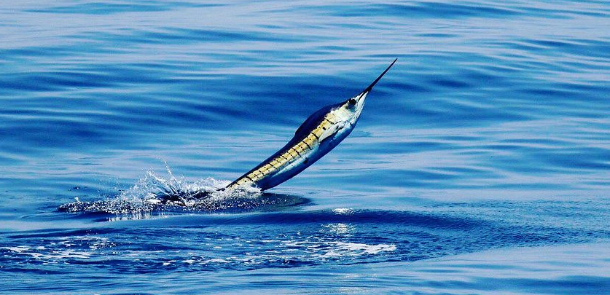
Sport Fishing
Spend your days catching Sailfish, Dorado, Yellowfin Tuna, and maybe even a Blue, Black, or Striped Marlin. The undisputed sailfish capital – Guatemala has the perfect conditions to attract huge numbers of billfish throughout the year. Laws making possession of sailfish illegal coupled with strong conservation ensure that the fishery continues to flourish. The fleet averages 15-20 billfish each day throughout the season.
The Pacific Coast of Guatemala has flat seas,
and great weather has it all. There are huge
numbers of sailfish here, that average 70-90lbs,
eight to ten feet in total length, and are superb
sport on light conventional tackle or fly-fishing
gear. Most boats practice catch and release!
Be aware taking a Sailfish trip can
cost about $3,345US per person for a party of 2.

Slide 15
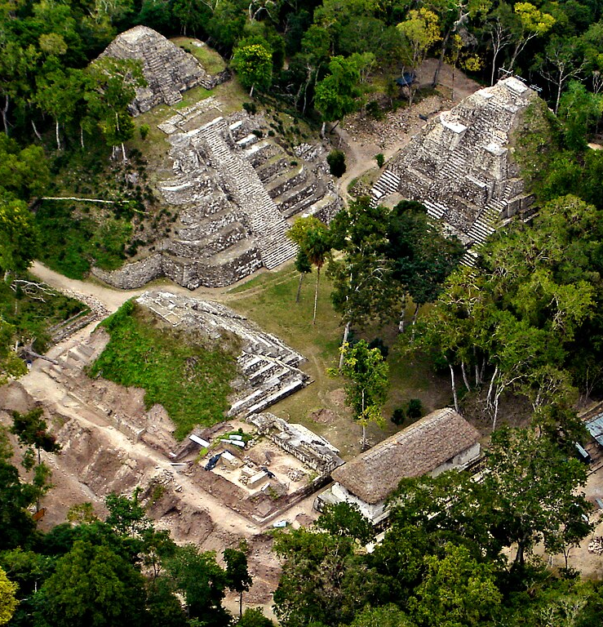
Visit the old Mayan site of Yaxha and Iximche
Yaxha is a Mesoamerican archaeological site in the northeast of the Petén Basin region, and a former ceremonial center and city of the pre-Columbian Maya civilization. Yaxha was the third largest city in the region and experienced its maximum power during the Early Classic period (c. AD 250–600).
The city was located on a ridge overlooking Lake Yaxha. The name of the city derives from the Mayan for "blue-green water"; it is a notable survival of a Classic period place name into the modern day. The Yaxha kingdom is estimated to have covered an area of 237 square kilometers (92 sq mi) and to have had a peak population of 42,000 in the Late Classic period of Mesoamerican chronology
Iximche is a small Mayan archaeological site that can be found in the western highlands of Guatemala, about two hours away from Guatemala City. This is a tiny and not very popular place that hides a lot of importance for the history of modern Central America and especially for Guatemala. That’s why in the 1960s it was declared a national monument.

Slide 16
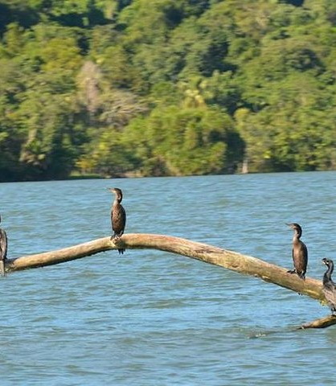
Kayak & Bird Watching Combo Tour
The natural wetlands and mangroves of Guatemala make it a perfect place to bird-watch. You will need to find a tour to go kayaking through the calm channels in search of several species of endemic birds as well as other animals and vegetation. Take in the beautiful landscapes around you and learn about the local environment from your guide.

Slide 17
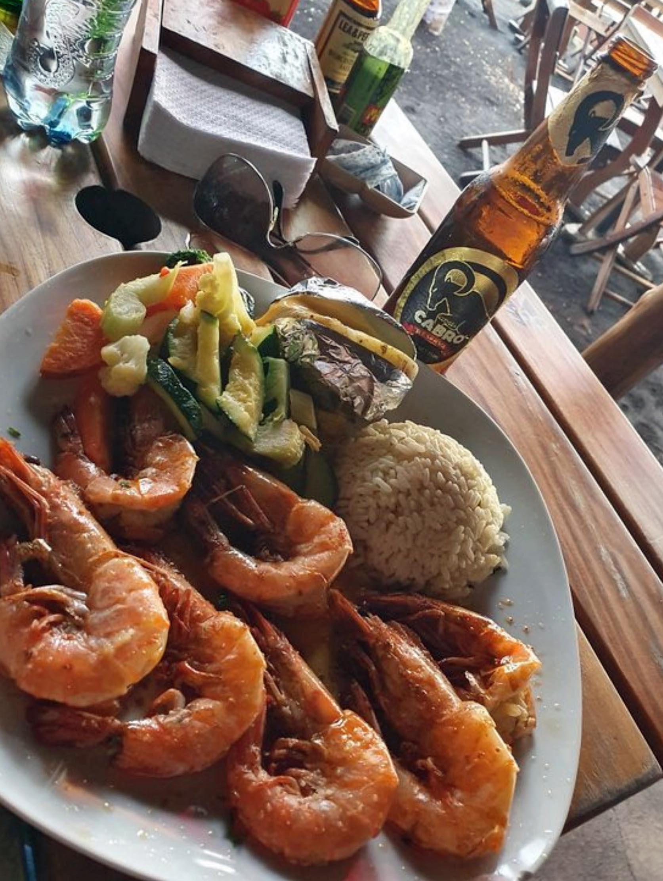
Puerto San Jose Restaurants
Puerto San Jose has some restaurants. Many of us on the ship are
foodies, so naturally, we’re always on the hunt to eat at the most exclusive
spots anytime we travel.
Here are the best restaurants to consider in Puerto San Jose.
Restaurant Marina Pez Vela - $$ Latín, Seafood, Spanish
Km 112.5 Carretera Puerto de San Jose
Nautilus - $$ Guatemalan, South American
Av. del Comercio, Puerto de San Jose Guatemala
For those of you who just like good food, in this port I recommend considering making reservations at one of the excellent specialty restaurants on board.
GOOD EATING

Slide 18
Conclusion
Guatemala is a beautiful country with a rich history and numerous attractions. Whether you're looking for stunning beaches, historic sites, or unique attractions, Guatemala has something for everyone.
I hope this presentation will help when we visit Puerto Quetzal
!

Slide 19
Thanks For Coming
If you have any more questions, please ask.
I will do my best to answer them for you.
Have a great visit to Puerto Quetzal!

