Slide 1
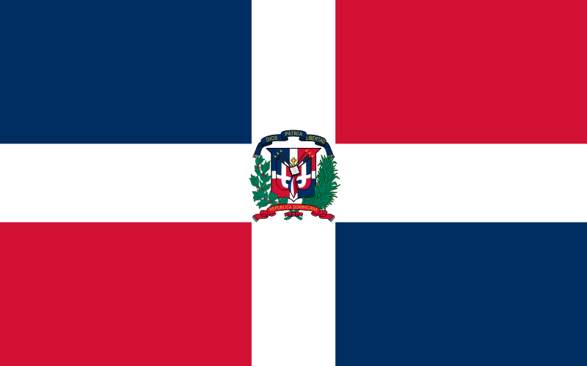
Exploring Puerto Plata Dominican Republic Presented by Marc Silver

Slide 2
What I Will Cover
My Port Philosophy
Don’t Miss the Ship
Money
Maps
Puerto Plata Transportation
Historical Highlights
Outdoor Adventures
Natural Wonders and Beaches
Cultural Experiences
A few Restaurant Recommendations
Final Thoughts

Slide 3
My Port Philosophy
I have been cruising for over 45 years and have taken over 100 cruises. So, I consider myself an experienced cruiser.
The information I will present is based on those many years of
experience.
When I am on a cruise where the city, I want to visit is not the port city,
I always recommend taking a ship’s tour.
But when I am in a port with multiple attractions nearby and easy to see
on my own - I will do it on my own.
This presentation is not like that.

Slide 4

Don’t Miss the Ship
How to Avoid Missing Your Ship
Pay attention to the time. - Ship time and local time are often different.
Put a return-to-ship reminder on your phone.
Choose excursions wisely.
If a ship-sponsored excursion is late returning to port, the ship will wait for you. If you are on your own???
Be Prepared
Have your Passport, Credit Card, and phone numbers for your ship port agent.
What to Do If You Miss the Ship Most cruise lines have port agents stationed in the port area to assist if your ship has left without you. If your are lucky, when cruisers are late returning to the vessel, the ship’s crew will often remove the passengers’ essential items – passports, cell phones, and medication -- from the ship to leave with the port agents.
The Port Officials can help you with contacting your ship and making necessary travel arrangements.

Slide 5
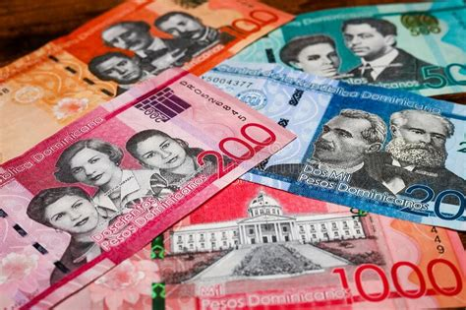
Money
The Dominican Peso is the official currency of Dominican Republic
Official Exchange is 1.00 US Dollar = 60.66 Dominican Pesos or
100.00 Dominican Pesos = $1.65 US Dollars

Slide 6
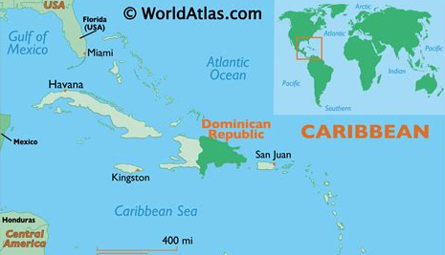
Dominican Republic

Slide 7
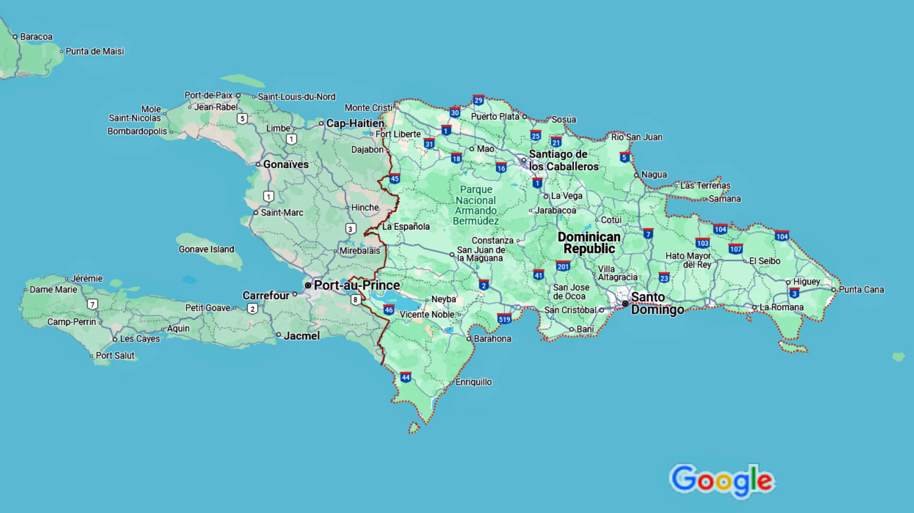
Dominican Republic

Slide 8
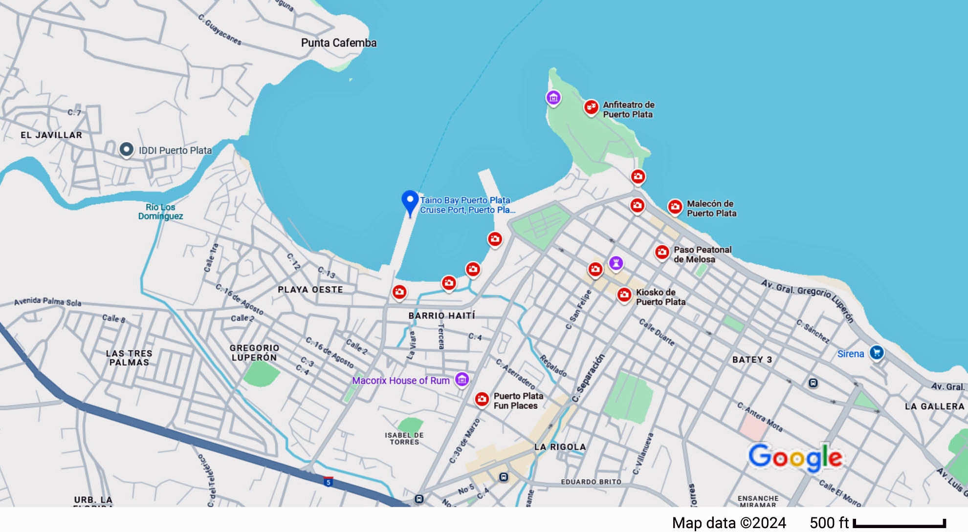
Puerto Plata
ship

Slide 9
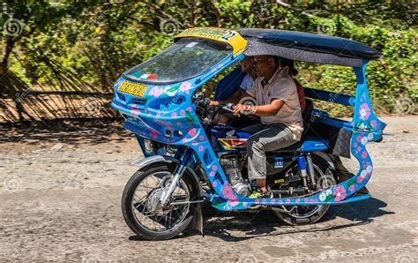
Puerto Plata Transportation
The Dominican Republic’s public transportation system is surprisingly modern and extensive.
Taxis are ubiquitous, Uber is available in three major cities–Santo Domingo, Santiago, and Puerto Plata, and there’s always a form of bus service, big or small, going to any town or city you want to explore.
Motorbike taxis are popular among locals in the big cities like Santo Domingo or Puerto Plata, and even Jarabacoa, because they are the cheapest and fastest way to get past traffic. I don’t recommend mortobike taxis for cruisers, but that is up to you.

Slide 10
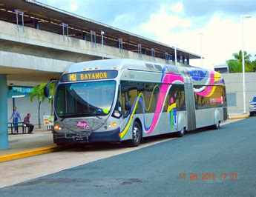
Puerto Plata Buses
Aside from being the most affordable way to travel, public transportation is a great way to glimpse every day life in the DR, and is guaranteed to be a memorable experience.
Smaller, privately-owned and operated minivan buses called guaguas travel scheduled routes daily, taking travelers within a city, or long-distance to small and large destinations around the Dominican Republic.
I only recommend using local buses if you are a bit adventurous. Otherwise stick to either a ships tour or using a local tour operator.

Slide 11
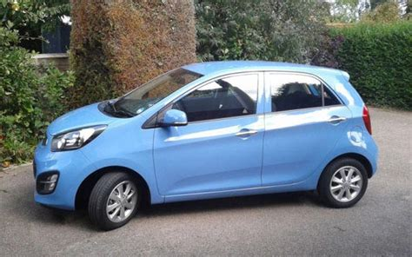
Puerto Plata Car Rental
All the major car rental companies are present in the Dominican Republic, located in-city. For the best rates, book online ahead of your arrival.
I recommend you stick to well-known brands or ask at any major hotel for referrals. Pick a four-wheel drive for added safety, and make sure you have a good country roadmap on hand.
Investing in a reputable travel guidebook is a solid investment as well, and know a few key Spanish phrases.

Slide 12
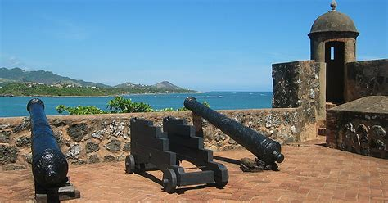
Historical Highlights
Puerto Plata’s rich history is woven into its streets and landmarks. Start your journey in the heart of the city at the Fortaleza San Felipe. This 16th-century fortress, built to protect against pirates, offers breathtaking views of the Atlantic and an engaging peek into the area’s colonial past.
The fortress now serves as a museum, displaying artifacts that provide insights into the island’s tumultuous history of colonization and maritime battles. Its sturdy stone walls and cannons are a testament to the strategic importance of Puerto Plata during the Spanish. colonization era.
Wander further into the historic district, where cobblestone streets are lined with Victorian-style architecture. These colorful, gingerbread-trimmed buildings are a legacy of the 19th-century boom in the Dominican Republic’s trade economy. The restoration of these homes and businesses reflects the city’s pride in preserving its cultural heritage.

Slide 13
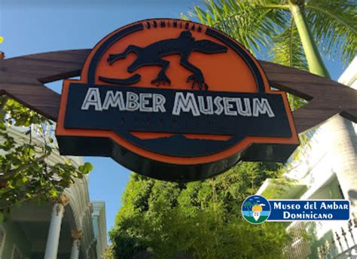
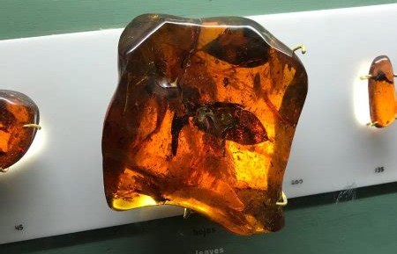
Historical Highlights
Don’t miss the Amber Museum, housed in a stunning Victorian mansion. Here, you can marvel at ancient fossils preserved in Dominican amber, one of the finest in the world. Some of the pieces date back millions of years and include encapsulated insects and plant life, offering a window into prehistoric times.
The museum also highlights the significance of amber in Dominican culture and its role in the global gemstone market.

Slide 14
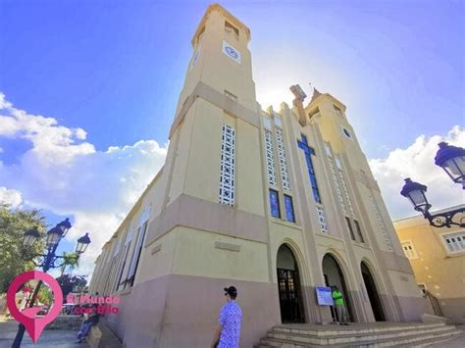
Historical Highlights
For a spiritual and historical experience, visit the Catedral San Felipe, a striking example of modernist architecture that stands as a focal point in the city’s central square.
Though the current structure is relatively new, replacing an older building destroyed by an earthquake, it represents the enduring faith and resilience of Puerto Plata’s community.

Slide 15
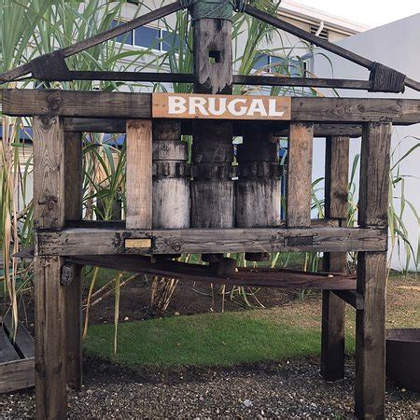
Historical Highlights
Finally, take a trip to the Brugal Rum Distillery. Established in the late 19th century, Brugal is one of the Dominican Republic’s most iconic rum brands.
A tour of the distillery offers not just a taste of the Caribbean’s finest spirits but also a look at the traditional methods of rum production that have been perfected over generations.

Slide 16
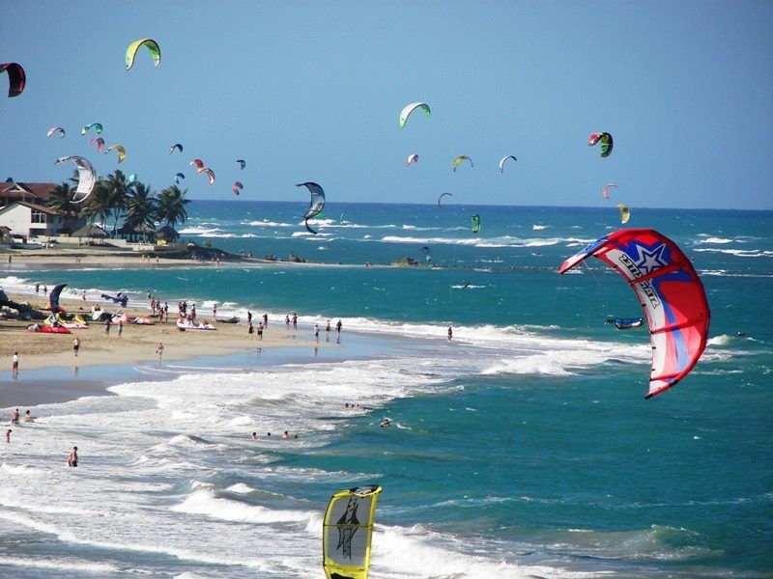
Outdoor Adventures
Puerto Plata is an adventurer’s paradise. Explore the underwater world with scuba diving or snorkeling excursions along the coral reefs of Sosúa Bay.
Thrill-seekers can try kiteboarding in Cabarete, known as the windsurfing capital of the Caribbean.

Slide 17
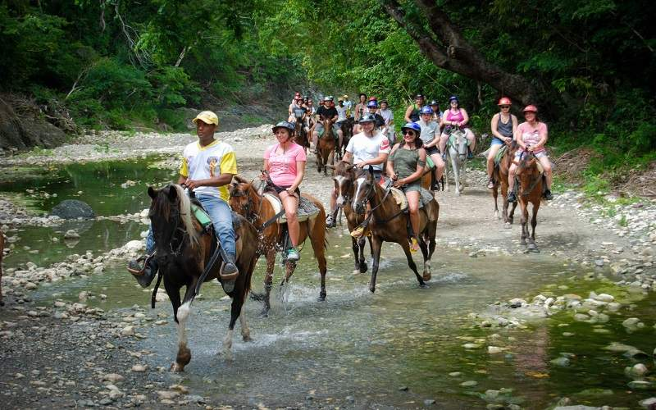
Outdoor Adventures
For a different perspective, embark on a horseback riding tour through the countryside or take a catamaran cruise along the coast.
Golf enthusiasts can tee off at the world-class courses of Playa Dorada, set against stunning ocean backdrops.
.

Slide 18
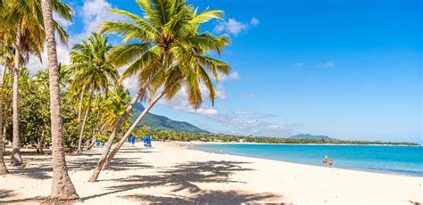
Natural Wonders and Beaches
No trip to Puerto Plata is complete without soaking up the sun on its stunning beaches. Playa Dorada is a favorite for its golden sands and turquoise waters, ideal for both relaxation and water sports.
For a more secluded experience, visit Sosúa Beach or Playa Encuentro, a haven for surfers.

Slide 19
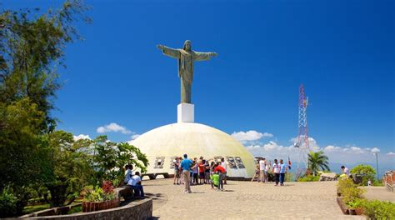

Mount Isabel de Torres
Nature lovers will be enchanted by Mount Isabel de Torres. Take a cable car ride to the summit for panoramic views and explore the lush botanical gardens surrounding the iconic Christ the Redeemer statue.
If you’re up for an adventure, the 27 Waterfalls of Damajagua offer an exhilarating experience, where you can hike, slide, and jump through cascading falls.

Slide 20
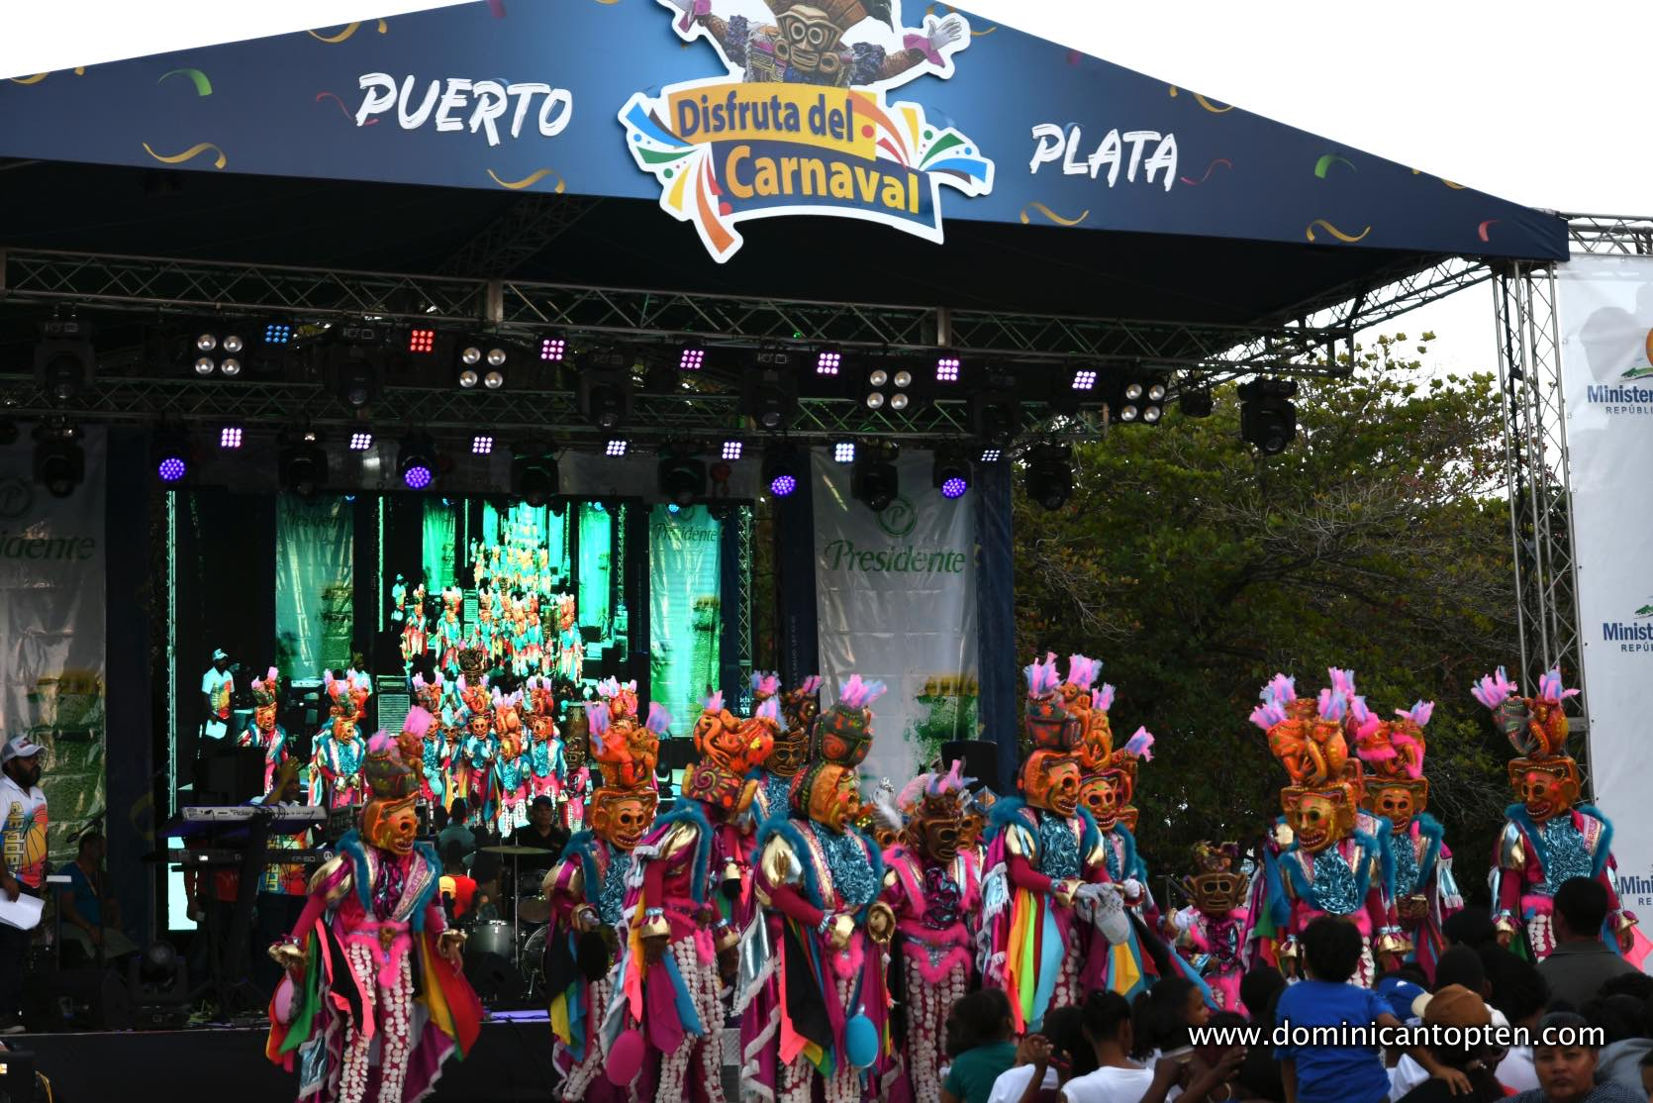
Cultural Experiences
Immerse yourself in the local culture by visiting Central Park (Parque Central), a bustling hub of activity where you can mingle with locals and enjoy live music.
The city’s colorful festivals, such as the Puerto Plata Carnival in February, provide a joyous celebration of Dominican traditions, complete with lively parades and rhythmic merengue.

Slide 21
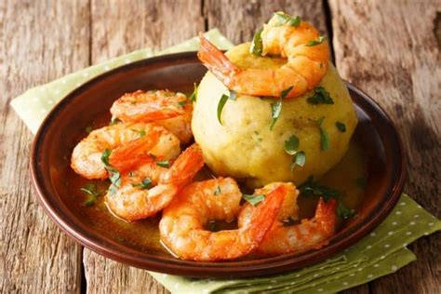
Cultural Experiences
Food lovers will appreciate the rich culinary scene.
Savor traditional dishes like mofongo and fresh seafood at local eateries, or sip on a refreshing mamajuana, a uniquely Dominican drink infused with rum, honey, and spices.

Slide 22
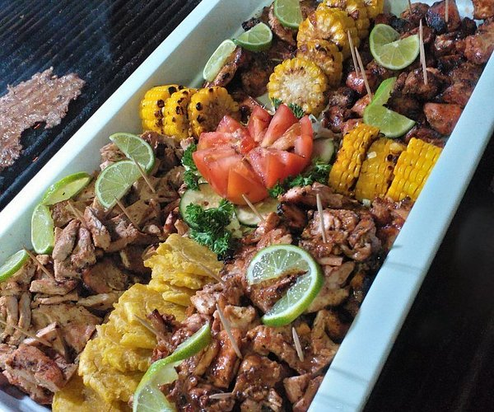
Restaurants
If your looking for a change from ships cuisine, there are a lot of excellent restaurants in Puerto Plata to consider, especially for seafood.
Here are some recommendations for some excellent food in Puerto Plata:
Waterfront Playa Alicia Caribbean, Seafood, $$ - $$$
Le Papillon Seafood, International, $$ - $$$
Ristorante Passatore Italian, Seafood, $$ - $$$
Charros CaribeMex Mexican, Caribbean, $$ - $$$
Le Petit Francois Caribbean, Canadian, $$ - $$$
la Catalina Latin, International, $$ - $$$
El Asadero Rincon Parrillero Steakhouse, Caribbean, $$ - $$$
Enjoy your dining ashore!

Slide 23
Practical Tips
Best Time to Visit: The dry season, from December to April, offers ideal weather for outdoor activities and beach days.
Getting Around: Taxis and motoconchos (motorcycle taxis) are readily available, but renting a car provides more flexibility to explore.
Local Currency: The Dominican Peso (DOP) is the official currency, though US dollars are widely accepted in tourist areas.
Language: Spanish is the official language, but English is commonly spoken in tourist areas.

Slide 24
Final Thoughts
With its perfect mix of natural beauty, rich history, and warm hospitality, Puerto Plata invites you to create unforgettable memories.
Whether you’re lounging on pristine beaches, exploring cultural landmarks, or diving into thrilling adventures, this Dominican gem has something for everyone.
Get ready to discover the magic of Puerto Plata!

Slide 25
Thanks For Coming
If you have any more questions, please ask.
I will do my best to answer them for you.
Have a great visit in Puerto Plata!

