Slide 1
Puerto Madryn, Argentina Gateway to Patagonia’s Wildlife
Presented by
Marc Silver

Slide 2
What I Will Cover
My Port Philosophy
Don’t Miss the Ship
Money
About Puerto Madryn
Maps
Puerto Madryn History
A Brief History
Getting Around Puerto Madryn
Wildlife Highlights
Peninsula Valdés
Places to see or at least consider
Day Trip Ideas
Practical Tips
Conclusion

Slide 3
My Port Philosophy
I’ve been cruising for over 46 years and have taken more than
100 cruises, so I consider myself an experienced cruiser.
The information I’m sharing comes from all those years at sea.
When the city I want to visit isn’t the same as the port city,
I always recommend taking a ship’s tour.
But when a port has plenty to see nearby and it’s easy to explore,
I’ll do it on my own.
This time, it’s worth letting the ship handle the logistics.

Slide 4

Don’t Miss the Ship
How to Avoid Missing Your Ship
Pay attention to the time. - Ship time and local time
are often different. Ship time doesn’t always match
local time. Put a return-to-ship reminder on your phone.
Choose excursions wisely.
If a ship-sponsored excursion is late returning to port,
the ship will wait for you. If you are on your own.
Be Prepared
Have your Passport, Credit Card, and phone numbers for your ship port agent.
What to Do If You Miss the Ship
Most cruise lines have port agents stationed in the port area to assist if your ship has left without you. If you are lucky, when cruisers are late returning to the vessel, the ship’s crew will often remove the passengers’ essential items – passports, cell phones, and medication -- from the ship to leave with the port agents.
The Port Officials can help you with contacting your ship
and making necessary travel arrangements.

Slide 5
Money
The Argentine Peso
The official exchange rate is:
$1.00 US = 1,400 Argentine Pesos (ARS$)
100 Argentine Peso = 0.07 US Dollar
As of 2025, the rate hovers around 1,400 ARS to 1 USD,
but it changes daily.

Slide 6
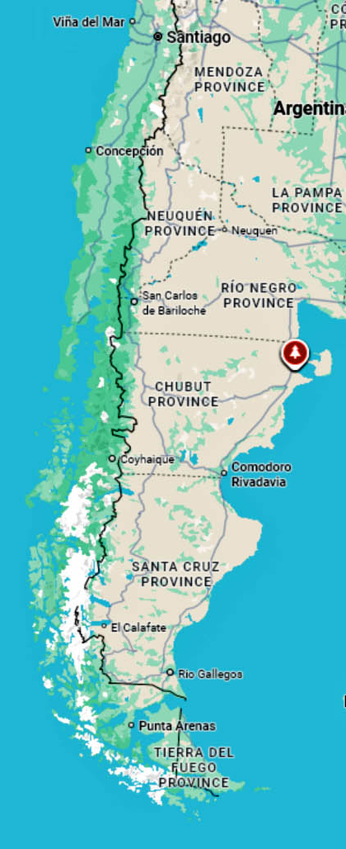
About Puerto Madryn
Puerto Madryn lies on the shores of the Golfo Nuevo in northern Patagonia. It’s considered one of the best places
in the world for marine wildlife encounters.
Every summer, southern right whales gather in the calm
gulf waters, often visible right from the shoreline.
Nearby Península Valdés, a UNESCO World Heritage
Site, shelters sea lions, elephant seals, penguins, and
orcas that occasionally beach themselves to hunt.
The city’s relaxed waterfront, marine museums, and easy access to nature reserves make it a gateway to Patagonia’s rich coastal ecosystem.
Whether you’re watching whales from a cliffside or visiting a penguin colony, Puerto Madryn offers a rare blend of culture, history, and untamed beauty.

Slide 7
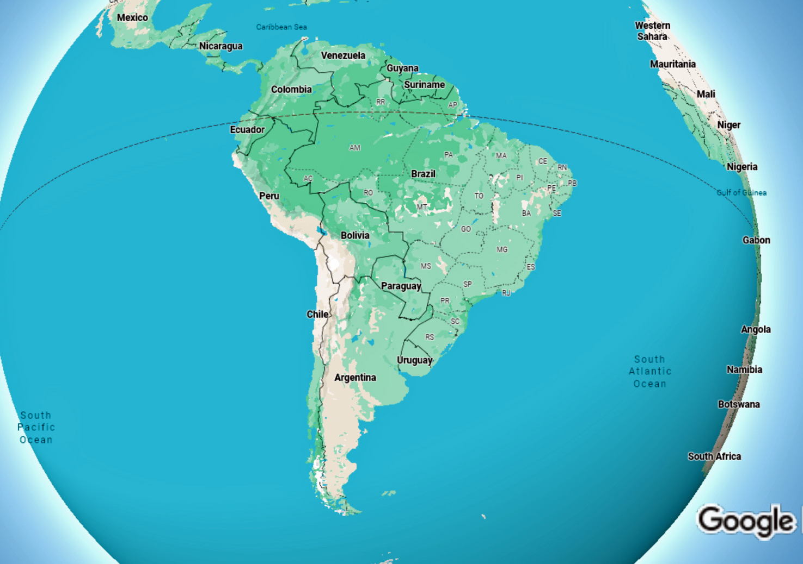
Puerto Madryn

Slide 8
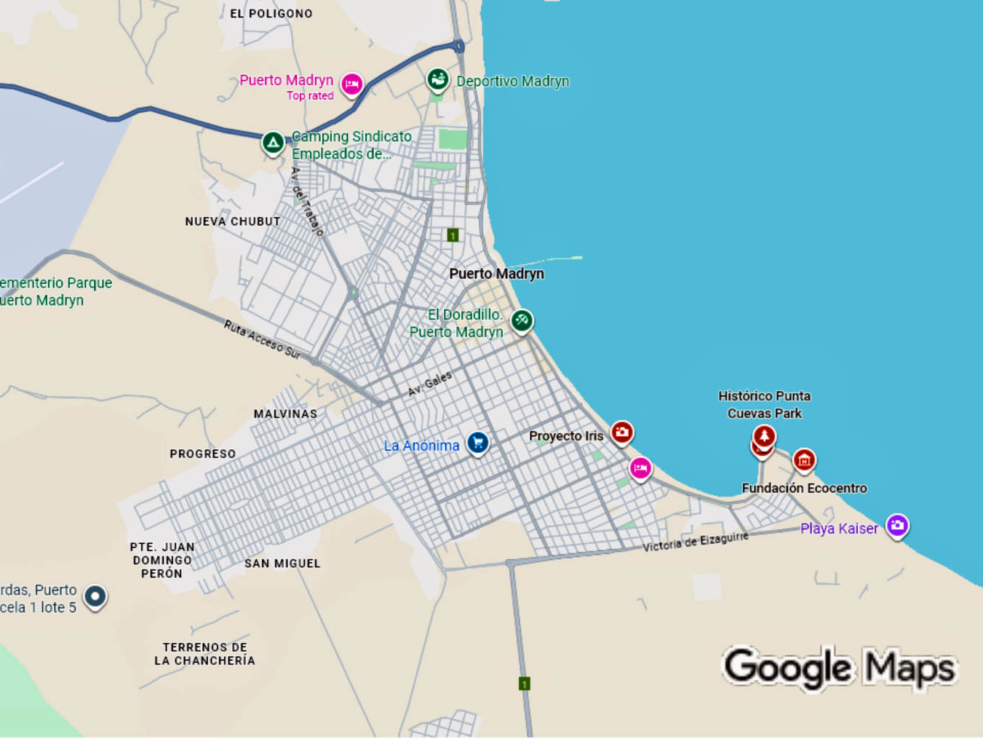
Puerto Madryn
cruise ship pier
Cruise Port

Slide 9
A Brief History
Puerto Madryn was founded in 1865 by Welsh
immigrants who arrived aboard the ship
Mimosa, seeking a new life in Patagonia.
The settlement, named after Love Jones-Parry,
the Baron of Madryn, their leader from Wales.
The settlers built irrigation canals and farms, transforming the dry landscape into productive farmland.
Their legacy lives on in nearby Welsh communities such as Gaiman, about an hour west of Puerto Madryn, where traditional tea houses, chapels, and cultural festivals celebrate their heritage.
Together, these towns preserve a unique blend of Welsh and Patagonian traditions that still shape the region’s identity today.

Slide 10
Getting Around Puerto Madryn
Getting around Puerto Madryn is easy and affordable. The city is compact, so most attractions, restaurants, and beaches are within walking distance.
Taxis are widely available and metered, while local buses connect the city center with nearby areas and the Ecocentro museum.
For exploring farther afield, like Península Valdés, Punta Tombo, or Gaiman, it’s best to join a guided tour or rent a car, since public transport doesn’t reach the main wildlife reserves.
The waterfront promenade is perfect for strolling, and bike rentals are available for visitors who want to explore at their own pace along the scenic coastal routes.

Slide 11
Wildlife Highlights
Southern Right Whales – June–December
breeding season.
Magellanic Penguins – Colonies at Punta
Tombo 112 miles south of Madryn.
Elephant Seals & Sea Lions – Valdés beaches
about 75 miles North East.
Orcas – Noted for strand-feeding.
Guanacos & Rheas – Patagonian wildlife inland.

Slide 12
Peninsula Valdés
Declared a UNESCO site in 1999.
Breeding ground for marine mammals.
Home to 180+ bird species and 40 mammal species.
Guided tours
available from
from $105 USD.

Slide 13
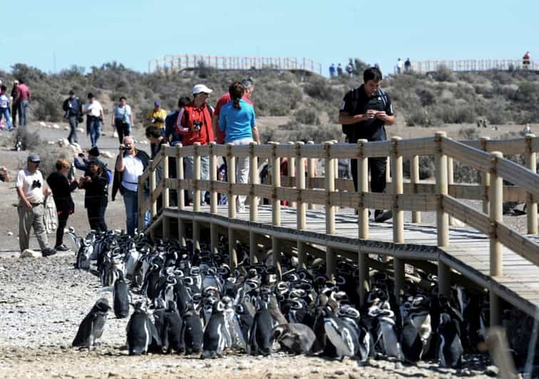
Punta Tombo Penguin Colony
One of the largest Magellanic penguin colonies in South America.
Over half a million penguins nest each summer.
Visitors walk along marked trails; penguins often cross paths.
Best visiting months: October–February.
Tours go from $110 to over $600.

Slide 14
Day Trip Ideas
Peninsula Valdés Tour – Whales, sea lions, seals.
Punta Tombo Penguin Reserve – Walk among penguins.
Gaiman Welsh Tea House –
Culture and cuisine. Tours from
about $85
Trelew Paleontological Museum
– Fossils and history.

Slide 15
Practical Tips
Currency: Argentine Peso (ARS).
Language: Spanish; some Welsh and English in Gaiman.
Weather: Windy and dry; best season Nov–Mar.
Souvenirs: Penguin carvings, wool goods, Welsh sweets.
Eco-Tip: Respect wildlife boundaries.

Slide 16
Practical Tips
Currency: Argentine Peso (ARS).
Language: Spanish; some Welsh and English in Gaiman.
Weather: Windy and dry; best season Nov–Mar.
Souvenirs: Penguin carvings, wool goods, Welsh sweets.
Eco-Tip: Respect wildlife boundaries.

Slide 17
Reflections
“Here, nature rules — vast, unspoiled, and magnificent.”
Puerto Madryn is Patagonia’s frontier — where land meets sea and wildlife reigns free.

Slide 18
Reflection & Closing
“Here, nature rules — vast, unspoiled, and magnificent.”
Puerto Madryn is Patagonia’s frontier — where land meets sea and wildlife reigns free.

Slide 19
Q&A
Questions & Curiosities
Let’s explore Patagonia together.

Slide 20
Thanks For Coming
If you have any more questions, please ask.
I will do my best to answer them for you.
Have a great visit to Puerto Madryn!

