Slide 1
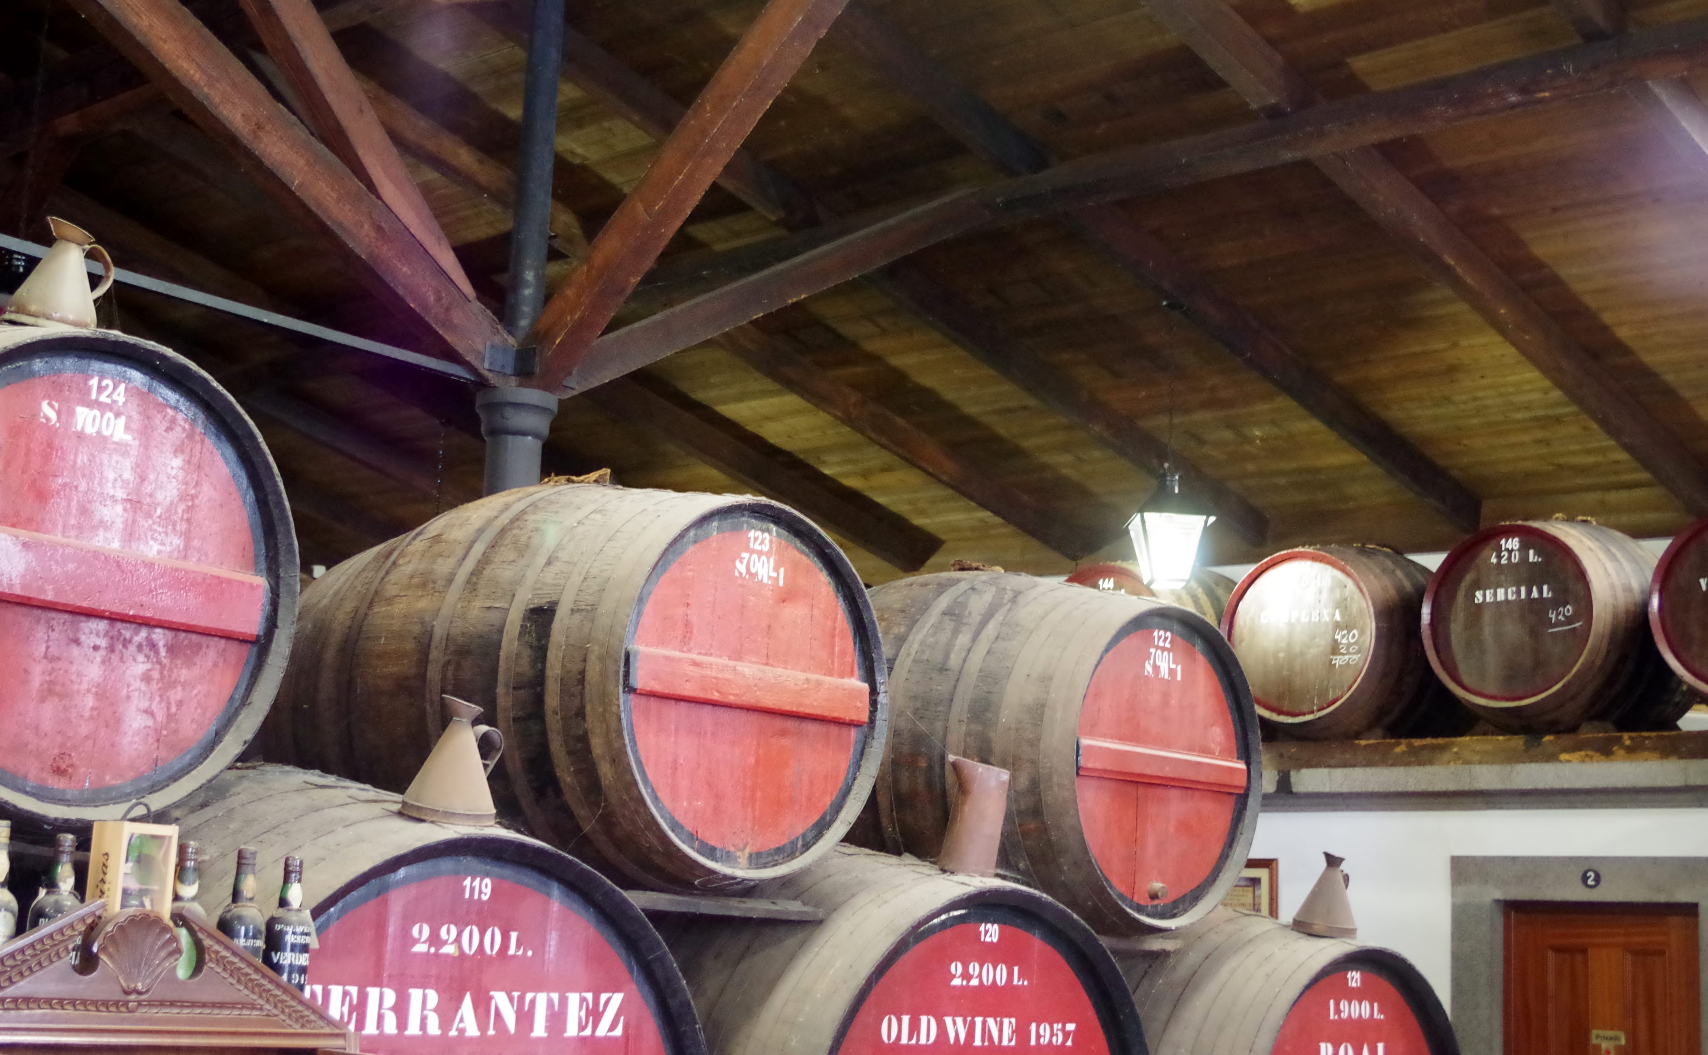
Wines of Portugal Pt II
Presented by
Marc Silver

Slide 2
What I will cover
What I covered in Part I
Today’s Topics
Production Technique of Port Wine
The Differences between Traditional vs. Modern Winemaking
The Influence of Terroir and Climate
Impact on Wine Styles
Conclusion
Acknowledgement

Slide 3
Previously
In Part I I discussed Portugal’s long and illustrious winemaking history that dates back thousands of years. Its viticulture traditions aand the importance of Portuguese culture and how it affects it’s economy :
I explained how wine production in Portugal is intertwined with its cultural identity and it’s role in Portuguese life.
I included why wine tourism contributes significantly to the country's revenue and promotes regional development.
I discussed how Wine production is a vital sector of Portugal's economy, and Portuguese wines have earned widespread acclaim and recognition in global markets.
I explained Portugal is home to several key wine regions, each known for unique grape varieties and styles of wine.
I discussed Portugal is home to several key wine regions, their varitals and the various characteristics of each. Additionally, I included unique indigenous varietals to Portugal.

Slide 4
Today’s Topics
Today I will be covering:
Production Technique of Port wine.
Grape Varieties:.
Vineyard Management:
Harvesting:
Winemaking Process:
Fermentation:
Fortification:
Aging:
Blending
Labeling and Regulation
The differences between Traditional vs. modern winemaking practices.
The influence of terroir and climate on Portuguese wine production
Climate
Impact on Wine Style
In conclusion I will Recap of key points about Portuguese wines

Slide 5
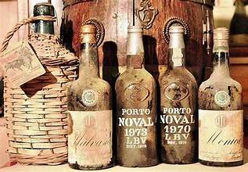
Production Technique of Port Wine
Port wine, known as Vinho do Porto in Portuguese, is a fortified wine produced primarily in the Douro Valley region of Portugal. Here's an overview of the production technique for Port wine:
Grape Varieties:
  Port wine is typically made from a blend of indigenous grape varieties, including Touriga Nacional, Touriga Franca, Tinta Roriz (Tempranillo), Tinta Barroca, and others. These grapes are selected for their ability to thrive in the hot and dry climate of the Douro Valley.

Slide 6
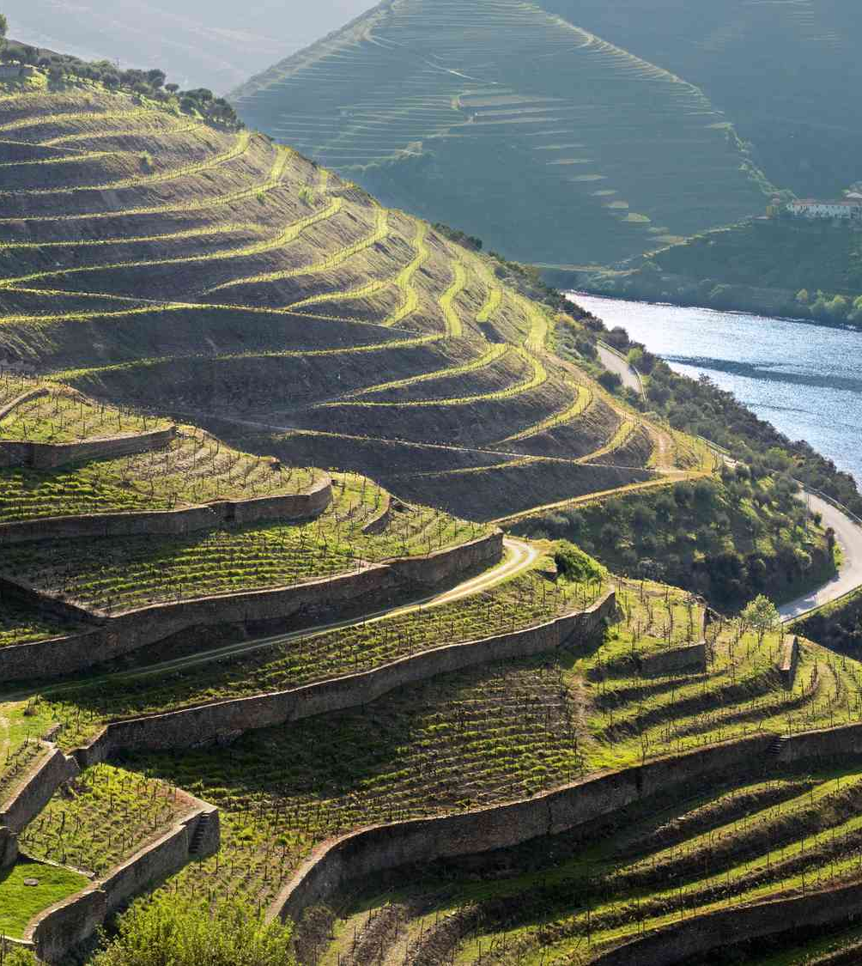
Production Technique of Port Wine Cont.
Vineyard Management:
  The vineyards in the Douro Valley are often planted on steep terraces known as "patamares" or "socalcos," which are supported by stone walls to prevent erosion and maximize sun exposure. The vines are planted in schist soils, which are rich in minerals and help regulate water retention.

Slide 7
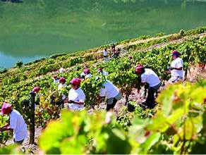
Production Technique of Port Wine Cont.
Harvesting:
  The grapes for Port wine are harvested by hand, typically in late September to early October.
  The timing of the harvest is crucial, as winemakers aim to pick grapes with optimal ripeness and sugar levels to achieve the desired balance of flavors and alcohol content.

Slide 8
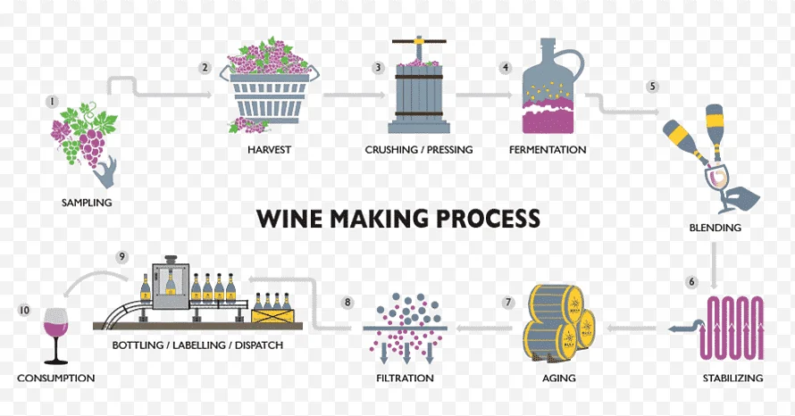
Production Technique of Port Wine Cont.
Winemaking Process:
  After harvesting, the grapes are transported to the wineries, where they undergo destemming and crushing to release the juice and skins.
  Traditionally, grape stomping (foot treading) was used to crush the grapes, although modern wineries now employ mechanical crushers.

Slide 9
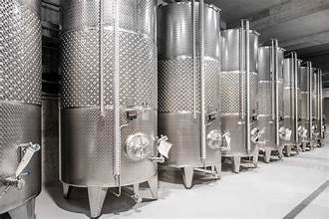
Production Technique of Port Wine Cont.
Fermentation:
  The fermentation process begins with the addition of grape spirit (brandy), typically around the midpoint of fermentation when the desired level of sugar extraction from the grapes is reached.
  This addition stops the fermentation process and preserves the natural sweetness of the grapes.

Slide 10
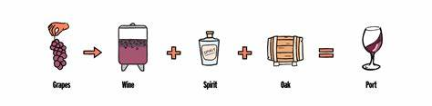
Production Technique of Port Wine Cont.
Fortification:
  The addition of grape spirit raises the alcohol content of the wine to approximately 19-20% ABV (alcohol by volume).
  This fortification process not only stops fermentation but also contributes to the unique character and flavor profile of Port wine.

Slide 11
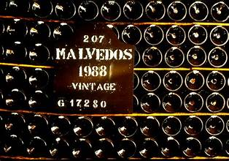
Production Technique of Port Wine Cont.
Aging:
  After fortification, Port wine is aged in oak barrels for varying lengths of time, depending on the style of Port being produced:
    Ruby Ports: Generally aged for a shorter period in large oak vats to preserve their fruity flavors and vibrant color.
    Tawny Ports: Aged for longer periods in smaller oak barrels, allowing them to develop nutty, caramelized flavors and a tawny color.
    Vintage Ports: Considered the highest quality, they are aged in bottle for a minimum of two years and typically improve with decades of aging.

Slide 12
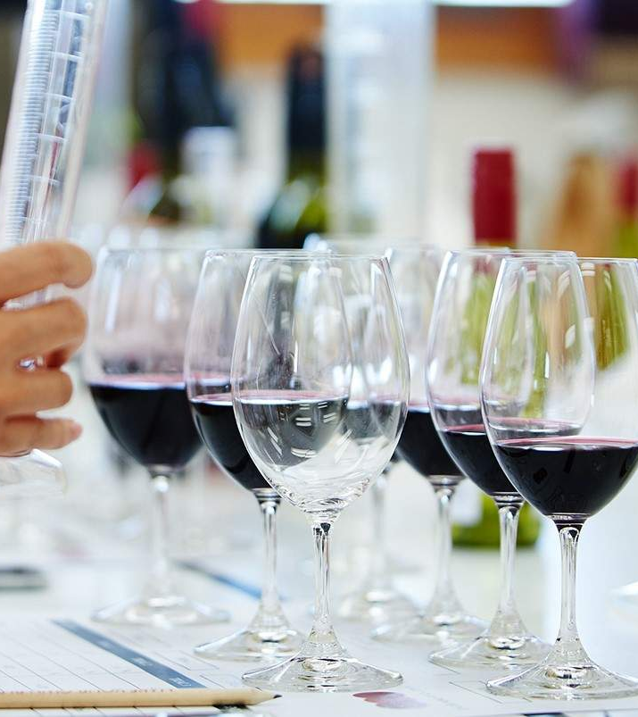
Production Technique of Port Wine Cont.
Blending:
  Port wine is often blended to achieve consistency and balance across different batches and vintages.
  Master blenders (or "mestres") have the expertise to combine wines from different vineyards, varieties, and ages to create harmonious blends.

Slide 13
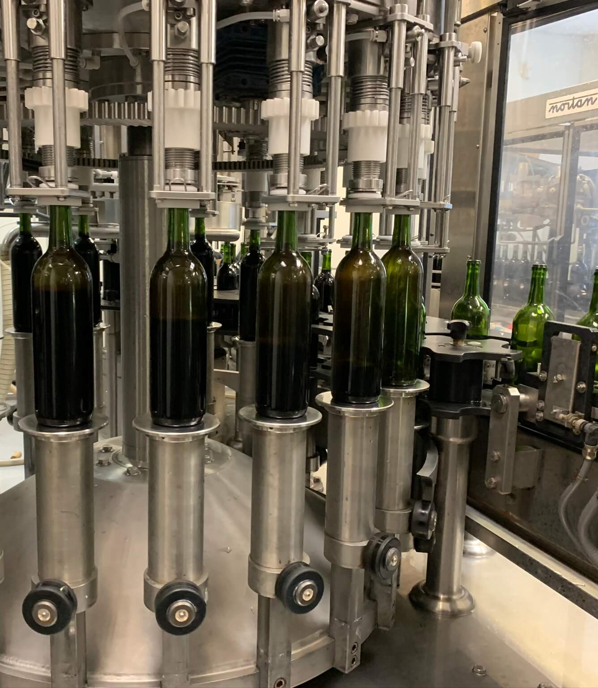
Production Technique of Port Wine Cont.
Bottling:
Port wine is bottled according to its style and aging profile.
Vintage Ports are bottled without filtration to preserve their depth and complexity, while other styles may undergo filtration before bottling

Slide 14
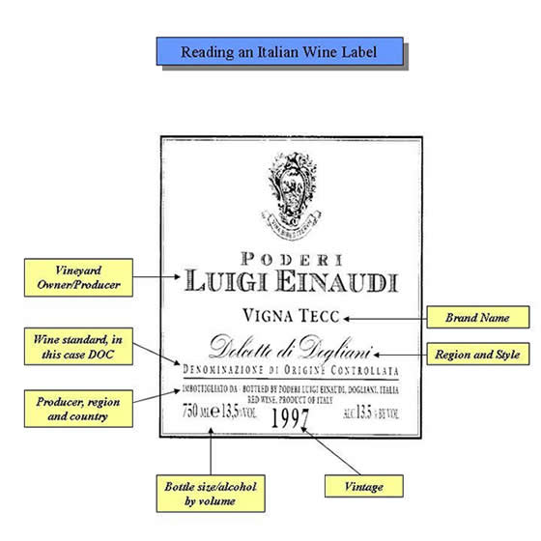
Production Technique of Port Wine Cont.
Labeling and Regulation:
  Port wine is subject to strict regulations governed by the Instituto dos Vinhos do Douro e Porto (IVDP), ensuring quality standards and geographical indication protection.
  Labels indicate the style of Port (e.g., Ruby, Tawny, Vintage), age designation (e.g., LBV, 10-year-old, 20-year-old), and producer information.
Overall, the production of Port wine involves a combination of traditional winemaking techniques, meticulous vineyard management, and careful aging processes that contribute to its rich and complex flavors, making it one of Portugal's most revered and internationally recognized wines.

Slide 15
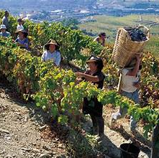
The Differences between
Traditional vs. Modern Winemaking
Traditional and modern winemaking practices represent distinct approaches to producing wine, each influenced by historical techniques, technological advancements, and cultural preferences. Here are the key differences between these two approaches:
Traditional Winemaking Practices:
Hand Harvesting
  Grapes are typically harvested by hand, allowing for selective picking of ripe fruit and gentle handling to avoid damaging the grapes.

Slide 16
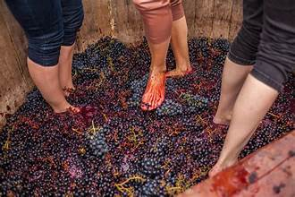
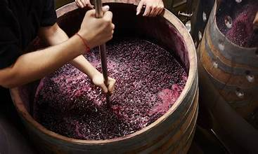
The Differences between
Traditional vs. Modern Winemaking Cont.
Grape Crushing:
  Traditional winemaking often involves grape stomping (foot treading) or gentle crushing by hand or with traditional presses. This method can be slower but is believed to extract flavors more delicately.
Fermentation:
  Natural or ambient yeast present on grape skins or in the winery initiates fermentation. Temperature control may be limited, relying on cellar conditions to guide fermentation speed and style.

Slide 17
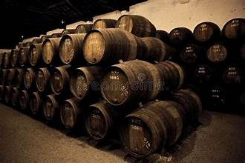
The Differences between
Traditional vs. Modern Winemaking Cont.
Aging:
  Wines may be aged in large, old oak barrels or other neutral vessels that impart minimal flavor. The focus is on allowing the wine to evolve slowly, with minimal intervention.
Additives:
  Sulfites, also known as sulfur dioxide plays a crucial role in the process of making wine. They are naturally occurring compounds found in many foods and beverages including wine.
  Red wines with high acidity may not need additional sulfites because they have inherent preservation properties. However. White wines or those with lower acidity might benefit from an extra dose of this preservative.

Slide 18
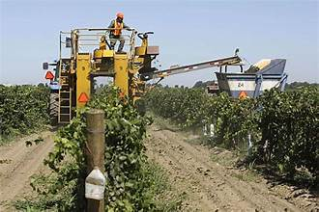
The Differences between
Traditional vs. Modern Winemaking Cont.
Modern Winemaking Practices:
Mechanized Harvesting:
  Grapes are often harvested mechanically, which is faster and more cost-effective. This method can be less selective but ensures efficiency in large vineyards.
Grape Processing:
  Crushed mechanically with advanced destemming and crushing machines that ensure rapid processing of large quantities of grapes. This can lead to more rapid extraction of flavors and tannins.

Slide 19
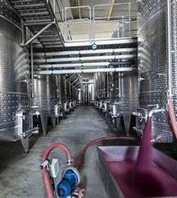
The Differences between
Traditional vs. Modern Winemaking Cont.
Fermentation:
  Selected yeast strains are often used for predictable fermentation results. Temperature-controlled stainless-steel tanks or other vessels allow precise control over fermentation conditions.
Aging:
  Wines may be aged in small oak barrels, often new or lightly toasted, which impart specific flavors and aromas to the wine. Aging times may be shorter to maintain fruit-forward characteristics.

Slide 20
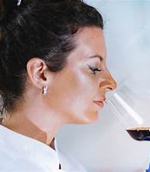
The Differences between
Traditional vs. Modern Winemaking Cont.
Additives:
  Use of commercial yeast strains, enzymes, fining agents, and other additives to control fermentation, stabilize the wine, adjust acidity, or enhance flavors and aromas.
Philosophy:
  Focus on consistency, quality control, and market preferences. Modern winemakers often aim to produce wines that are fruitier, more approachable in their youth, and aligned with consumer taste preferences.

Slide 21
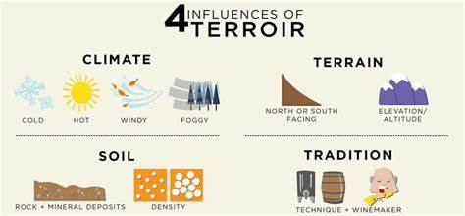
The Differences between
Traditional vs. Modern Winemaking Cont.
Key Considerations:
Technology: Modern winemaking relies heavily on technological advancements in equipment, vineyard management, and cellar techniques to optimize quality and efficiency.
Terroir vs. Consistency: Traditional methods prioritize the expression of terroir and natural grape characteristics, while modern methods prioritize consistency and meeting market demands.

Slide 22
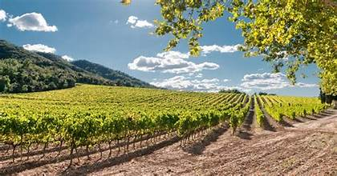
The Influence of Terroir and Climate
The confluence of soil, climate, and topography, or terroir, is evident in Portugal’s varied wines. Indigenous grapes like Touriga Nacional, Alvarinho, and Arinto, among others, are true reflections of the country’s unique viticultural landscape.
The influence of terroir and climate on Portuguese wine production is profound, shaping the characteristics and quality of wines produced across the country's diverse wine regions.

Slide 23
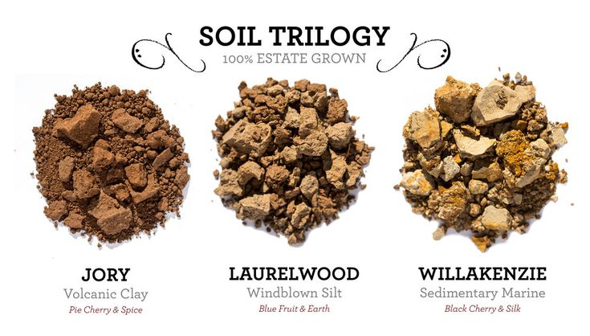
The Influence of Terroir and Climate Cont.
Terroir: is widely used in Portugal to describe the natural environment in which grapes are grown.
Soil Composition:
  Portugal boasts a variety of soil types due to its diverse geography. In the Douro Valley, schist soils prevail, offering good drainage and mineral uptake, which contributes to the complexity and minerality of Port wines.
  In regions like Dão and Alentejo, clay-limestone soils can impart different characteristics to the wines, influencing their structure and texture.

Slide 24
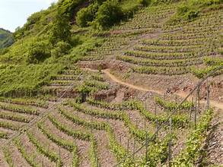
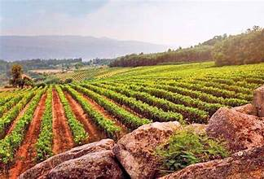
The Influence of Terroir and Climate Cont.
Topography:
  The terrain varies significantly across Portugal’s wine regions, from the steep terraced vineyards of Douro to the rolling hills of Alentejo. Slope orientation affects sun exposure and drainage, influencing grape ripeness, acidity levels, and overall wine quality.

Slide 25
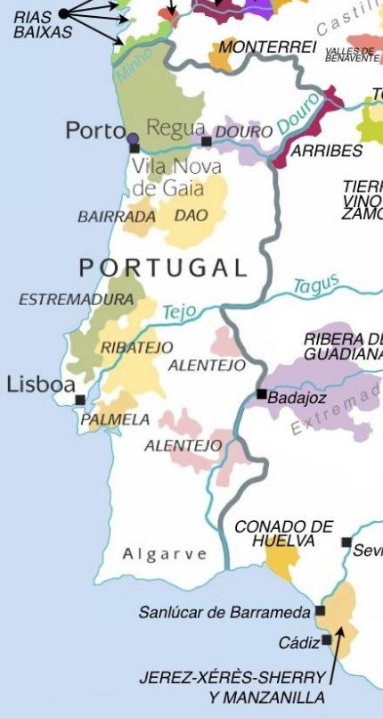
The Influence of Terroir and Climate Cont.
Macroclimate:
  Portugal experiences a range of climates, from the temperate maritime climate of the coastal regions (e.g., Vinho Verde, Lisboa) to the Mediterranean climate of central and southern Portugal (e.g., Alentejo, Dão). These climates influence overall grape ripening, disease pressure, and harvest timing.
Microclimate:
  Each wine region in Portugal has its own microclimate, influenced by altitude, proximity to the Atlantic Ocean, and mountain ranges. For example, the coastal regions like Vinho Verde benefit from cool, maritime influences that preserve acidity in white wines, while inland regions like Douro experience hotter, drier summers, ideal for the production of robust red wines.

Slide 26
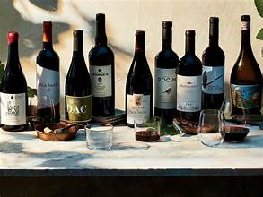
The Influence of Terroir and Climate Cont.
Local Varieties:
  Portugal is home to numerous indigenous grape varieties adapted to specific terroirs.
  For instance, Touriga Nacional thrives in the schist soils of Douro, while Baga excels in the limestone-rich soils of Bairrada.
  These varieties have evolved to express the unique terroir of their respective regions.

Slide 27

The Influence of Terroir and Climate Cont.
Temperature:
  Temperature variations between day and night, as well as throughout the growing season, affect grape development and sugar accumulation. Warmer regions like Alentejo produce riper, fuller-bodied wines, while cooler regions like Bairrada produce wines with higher acidity and more delicate flavors.
Rainfall:
  Rainfall patterns influence vine growth, grape development, and disease pressure. Regions like Vinho Verde benefit from higher rainfall, contributing to the fresh, vibrant acidity in their wines. Regions like Alentejo rely on irrigation due to lower rainfall levels.

Slide 28
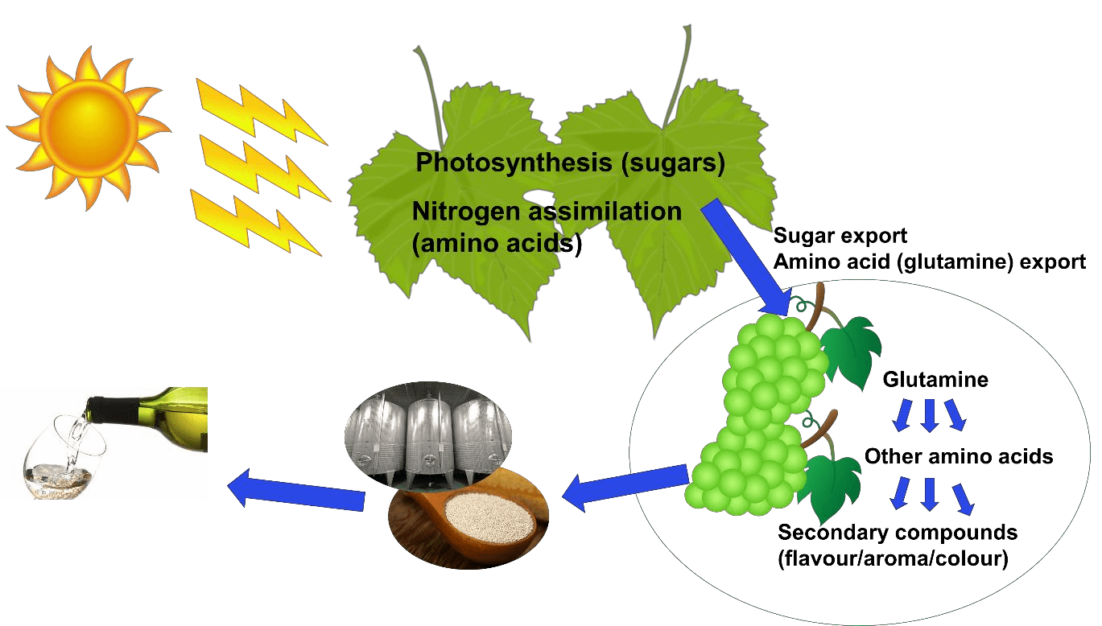
The Influence of Terroir and Climate Cont.
Sunlight:
  Sunlight intensity and duration impact grape photosynthesis, sugar levels, and flavor development. Regions with ample sunlight, such as Douro, produce wines with rich fruit flavors and robust tannins, suitable for aging.

Slide 29
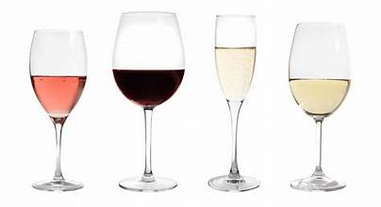
Impact on Wine Styles
White Wines: In cooler, coastal regions like Vinho Verde, the
climate preserves acidity and freshness in white wines made
varieties like Alvarinho and Loureiro.
Red Wines: In warmer, inland regions like Alentejo and
Douro, intense sunlight and heat produce ripe, bold red wines
with concentrated flavors and structured tannins.
Fortified Wines: The hot, dry climate of Douro Valley is ideal for the production of fortified Port wines, with high sugar content and robust flavors developed through grape fortification and aging.
Overall, terroir and climate in Portugal play pivotal roles in defining the diversity and quality of Portuguese wines, showcasing the unique expressions of each region’s viticultural landscape.

Slide 30
Conclusion
Portuguese wine holds significant historical and cultural importance due to its unique production process and storied past.
Portugal offers wines with distinct flavors, ranging from dry to sweet, with varied styles and complexity.
Today, Portuguese wine continues to be cherished for its versatility in cooking and pairing with various dishes, from desserts to savory courses. Their wines offer rich flavors and robust character make it a favorite among wine enthusiasts and collectors worldwide.

Slide 31
Wines of Portugal
I hope you found this presentation about the Wines of Portugal interesting and informative.
If you haven’t already, I hope you all get the opportunity to experience Portuguese wines soon.
Thank you for coming!

Slide 32
Acknowledgement
My seminars are the result of many years of travel experience
combined with many hours of research over the internet.
I would like to acknowledge the many sources I have accessed.
These include: Wikipedia.com, Britannica.com, and the
various Museum, Park and Government websites.

