Slide 1
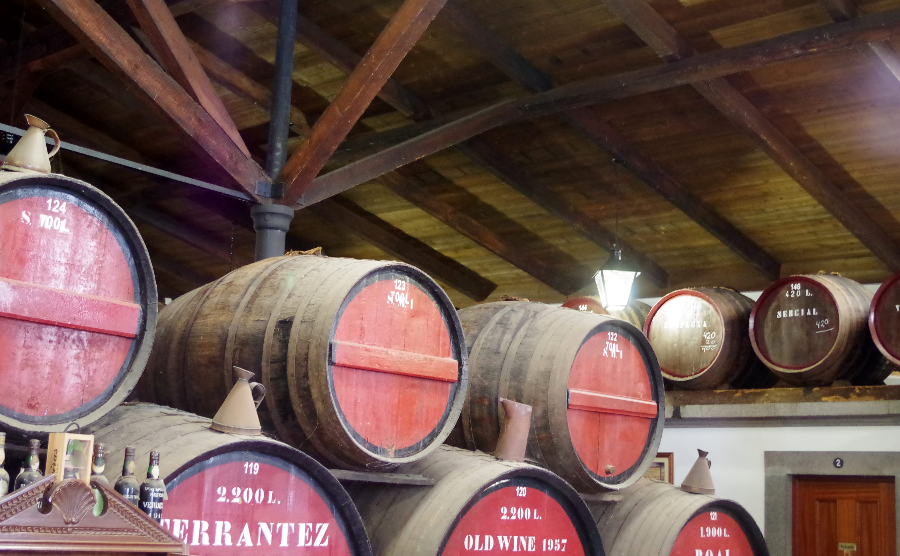
Wines of Portugal Pt I
Presented by
Marc Silver

Slide 2
What I will cover
Portugal’s Rich Winemaking History
Importance of Wine in Portuguese Culture and Economy
The Diversity and Uniqueness
Portuguese Wine Regions
Portuguese Grape Varieties
Portugal’s Characteristics and Specialties
Varieties Unique to Portugal
Indigenous Portuguese Varietals
Conclusion
Acknowledgement

Slide 3
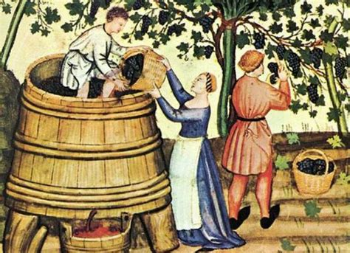
Portugal’s Rich Winemaking History
Portugal boasts a long and illustrious winemaking history that dates back thousands of years. Its viticulture traditions are deeply rooted in ancient times, influenced by Phoenician, Greek, and Roman civilizations. The Romans, in particular, introduced advanced winemaking techniques to the region.
During the Middle Ages, Portuguese wines gained prominence due to the country's geographical position along major trade routes. Port wine, a fortified wine produced in the Douro Valley, became especially renowned and remains a symbol of Portugal's winemaking expertise.

Slide 4
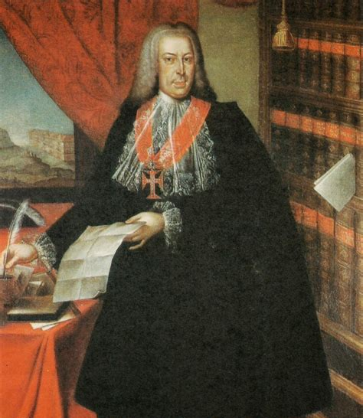
Winemaking History Cont.
In the 18th century, the Marquis of Pombal established the Douro Wine Company, laying the groundwork for regulating and demarcating wine regions, making Portugal one of the earliest countries to implement such measures.
In the modern era, Portugal continues to innovate while preserving its winemaking heritage. The country produces a wide array of wines, including Vinho Verde, Madeira, and a diverse range of regional varietals.
The dedication to quality and tradition has earned Portuguese wines international acclaim, cementing Portugal's place as one of the world's most respected wine-producing nations.

Slide 5
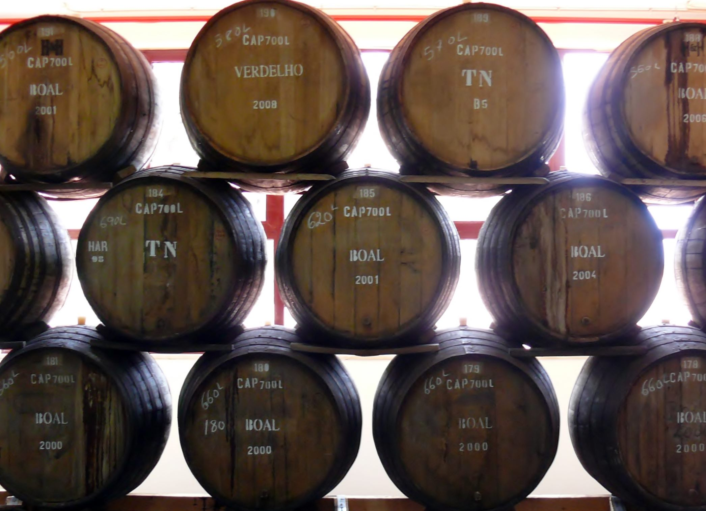
Importance of Wine in Portuguese
Culture and Economy
Wine holds significant importance in both Portuguese culture and its economy for several reasons:
Cultural Heritage: Wine production in Portugal is deeply intertwined with its cultural identity. From ancient times to the present day, winemaking traditions have been passed down through generations, shaping local customs, festivals, and culinary practices. Wine is often enjoyed as part of social gatherings, celebrations, and religious ceremonies, reflecting its integral role in Portuguese life.
Tourism: Portugal's wine regions, such as the Douro Valley, Alentejo, and Vinho Verde, attract a large number of tourists interested in wine tourism. Visitors come to explore vineyards, taste local wines, and experience the cultural richness associated with winemaking. This influx of tourists contributes significantly to the country's tourism revenue and promotes regional development.

Slide 6
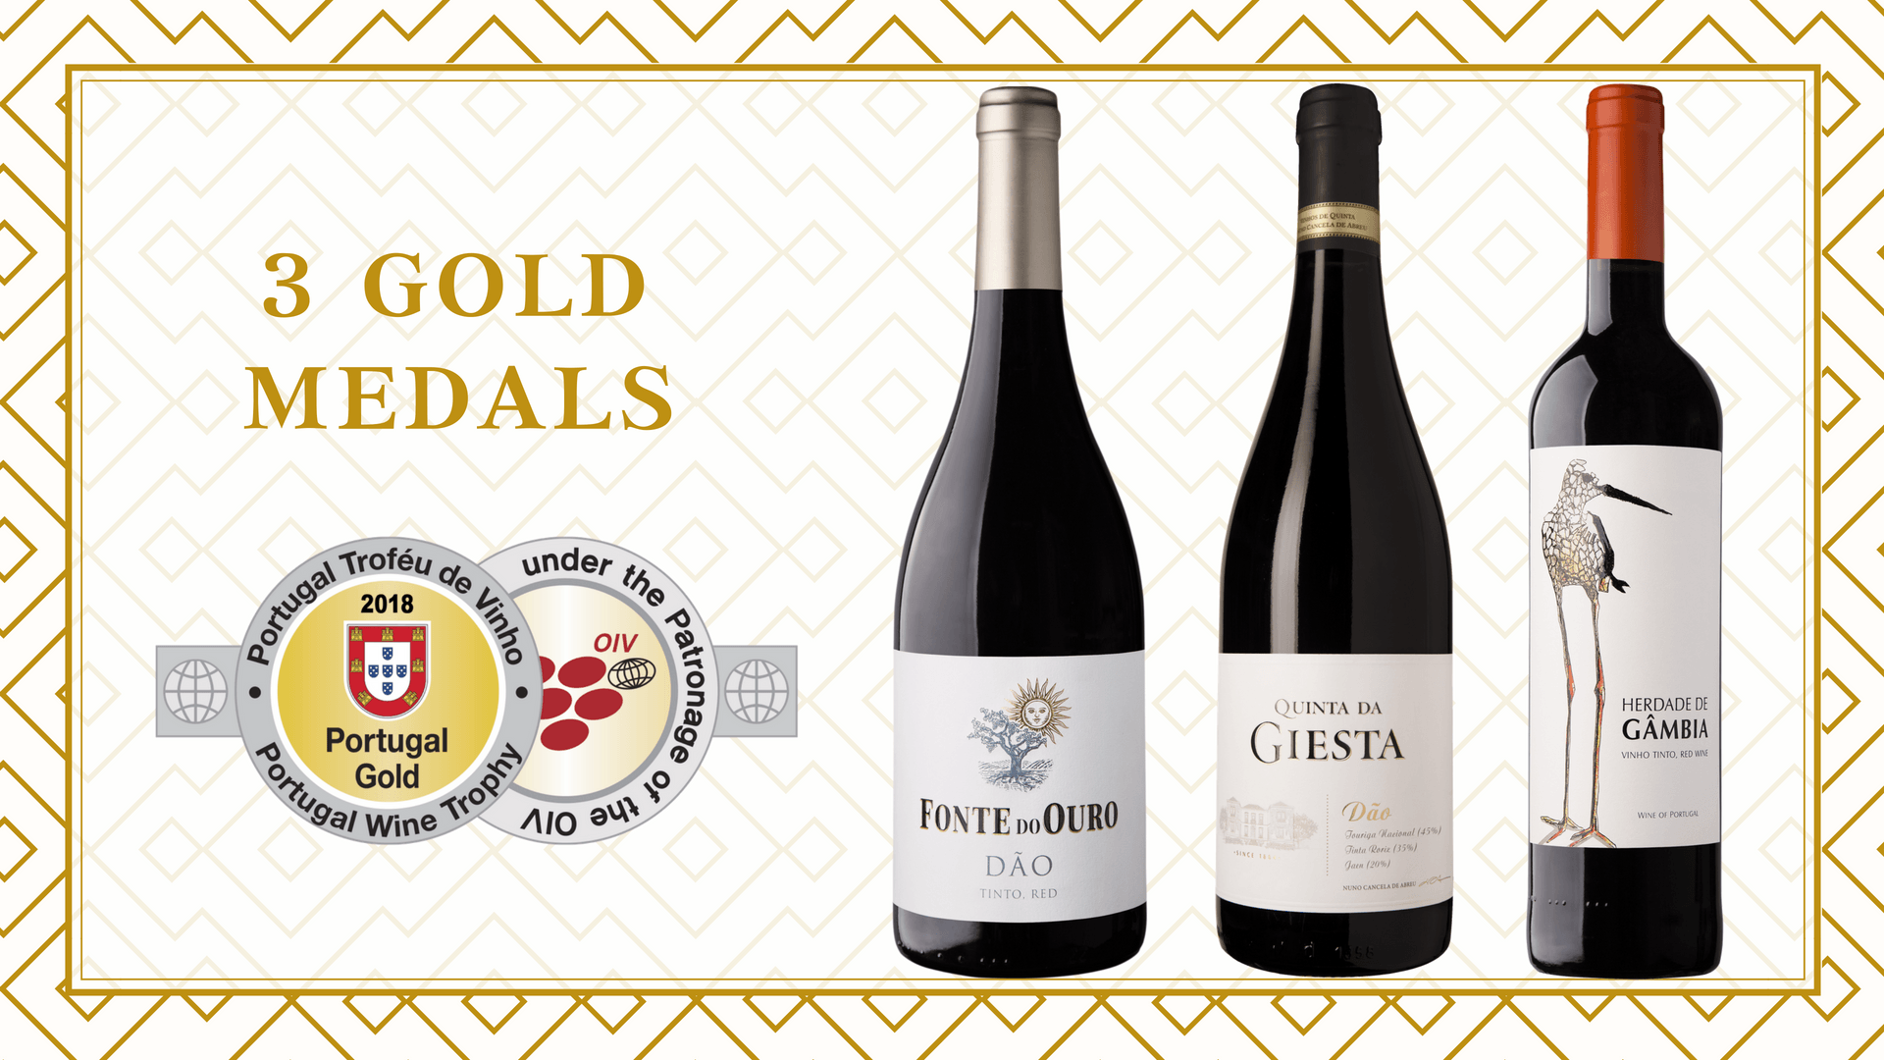
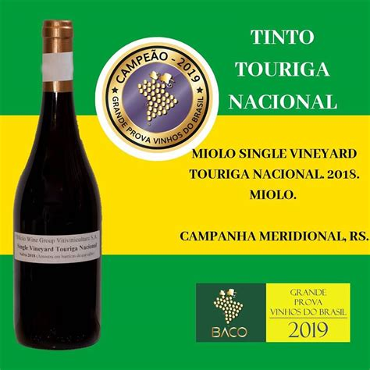
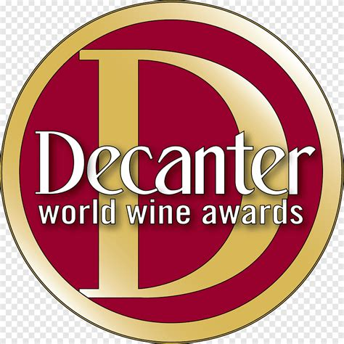
Culture and Economy Cont.
Economic Contribution: Wine production is a vital sector of Portugal's economy. It provides employment opportunities across various stages of production, from vineyard cultivation to wine distribution. The export of Portuguese wines, particularly Port wine and Vinho Verde, generates substantial revenue and contributes positively to the country's balance of trade.
International Recognition: Portuguese wines have earned widespread acclaim and recognition in global markets. The quality, diversity, and distinctiveness of Portuguese varietals, such as Touriga Nacional, Alvarinho, and Baga, have garnered numerous awards and accolades.

Slide 7

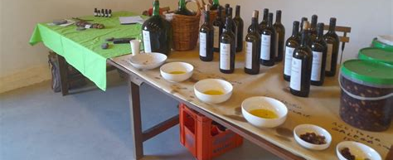
The Diversity and Uniqueness
Wine holds significant importance in both Portuguese culture and its economy for several reasons:
Cultural Heritage: Wine production in Portugal is deeply intertwined with its cultural identity.
From ancient times to the present day, winemaking traditions have been passed down through generations, shaping local customs, festivals, and culinary practices.
Wine is often enjoyed as part of social gatherings, celebrations, and religious ceremonies, reflecting its integral role in Portuguese life.

Slide 8
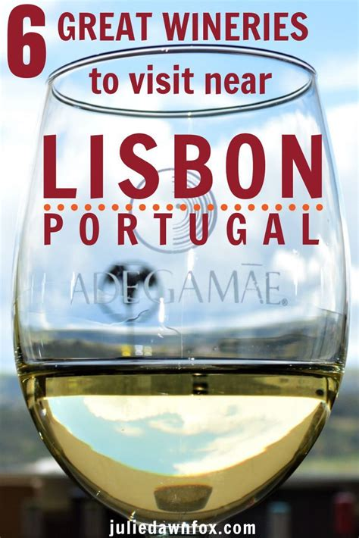
The Diversity and Uniqueness Cont.
Tourism: Portugal's wine regions, such as the Douro Valley, Alentejo, and Vinho Verde, attract a large number of tourists interested in wine tourism. Visitors come to explore vineyards, taste local wines, and experience the cultural richness associated with winemaking. This influx of tourists contributes significantly to the country's tourism revenue and promotes regional development.
Economic Contribution: Wine production is a vital sector of Portugal's economy. It provides employment opportunities across various stages of production, from vineyard cultivation to wine distribution. The export of Portuguese wines, particularly Port wine and Vinho Verde, generates substantial revenue and contributes positively to the country's balance of trade.

Slide 9
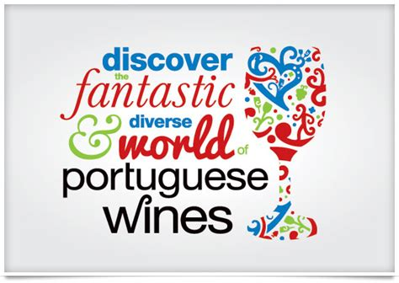
The Diversity and Uniqueness Cont.
International Recognition: Portuguese wines have earned widespread acclaim and recognition in global markets. The quality, diversity, and distinctiveness of Portuguese varietals, such as Touriga Nacional, Alvarinho, and Baga, have garnered numerous awards and accolades, enhancing Portugal's reputation as a premium wine-producing nation.
Preservation of Tradition: Winemaking in Portugal is often a family affair, with knowledge and techniques passed down through generations. Many wineries prioritize sustainable and traditional practices, preserving biodiversity and maintaining cultural landscapes. This commitment to heritage enhances the authenticity and value of Portuguese wines in the global marketplace.

Slide 10
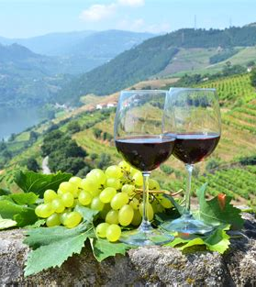
Portuguese Wine Regions
Portugal is home to several key wine regions, each known for unique grape varieties and styles of wine. Here are some of the main wine regions and grape varieties in Portugal:
Wine Regions:
Douro Valley:
  Famous for Port wine production.
  Also produces high-quality red and white table wines.
  Grape varieties: Touriga Nacional, Touriga Franca, Tinta Roriz (Tempranillo), Tinto Cão, and others.

Slide 11
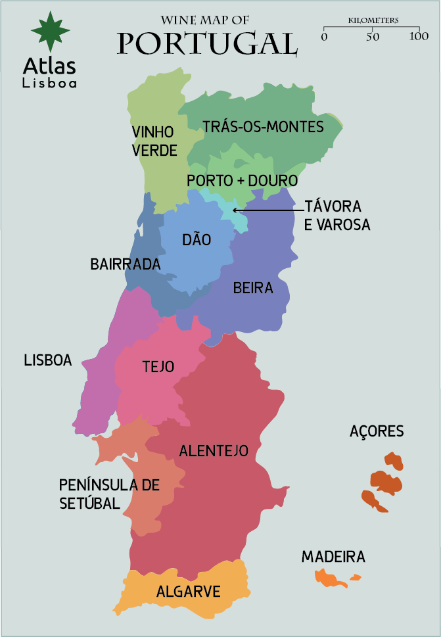
Portuguese Wine Regions Cont.
Vinho Verde:
  Located in the northwest, known for its light, fresh, and sometimes slightly sparkling wines.
  Grape varieties: Alvarinho, Loureiro, Arinto, Trajadura, and others.
Dão:
  Central Portugal region known for elegant and aromatic red wines.
  Grape varieties: Touriga Nacional, Jaen (Mencía), Alfrocheiro, Tinta Roriz (Tempranillo), and others.

Slide 12
Portuguese Wine Regions Cont.
Alentejo:
  Southern Portugal region known for its hot climate and robust red wines.
  Grape varieties: Aragonez (Tempranillo), Trincadeira, Alicante Bouschet, Touriga Nacional, and others.
Bairrada:
  Located in central Portugal, known for both red and sparkling wines.
  Grape varieties: Baga (for red wines), Bical and Maria Gomes (for sparkling and white wines).

Slide 13
Portuguese Wine Regions Cont.
Madeira:
  An archipelago in the Atlantic Ocean, famous for fortified Madeira wines.
  Grape varieties: Sercial, Verdelho, Bual, and Malvasia (Malmsey).
Setúbal Peninsula:
  South of Lisbon, known for sweet and fortified wines.
  Grape varieties: Moscatel de Setúbal (Muscat Blanc à Petits Grains) for sweet wines.

Slide 14
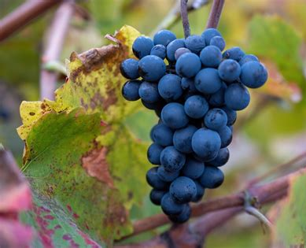
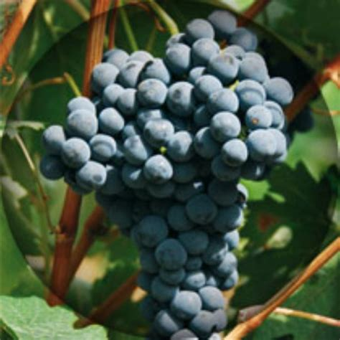
Portuguese Grape Varieties
Touriga Nacional:
  Considered the finest Portuguese grape variety, known for its rich, aromatic red wines. Found primarily in the Douro Valley and Dão.
Touriga Franca:
  Often blended with Touriga Nacional, adds floral and fruit characteristics. Found in the Douro Valley.
Tinta Roriz (Tempranillo):
  Widely planted in Portugal, particularly in the Douro Valley and Dão. Produces structured and aromatic red wines.

Slide 15
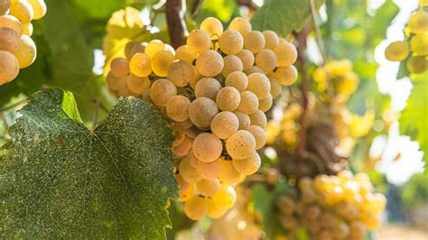
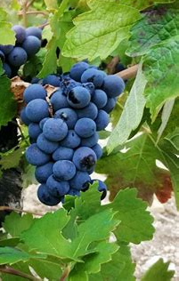
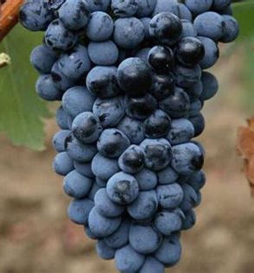
Portuguese Grape Varieties Cont.
Alvarinho:
  Primarily grown in the Vinho Verde region, known for its aromatic and flavorful white wines.
Baga:
  Mainly found in Bairrada, produces tannic and structured red wines with good aging potential.
Arinto:
  A versatile white grape variety used in Vinho Verde, Bairrada, and other regions, known for its high acidity and citrus flavors.

Slide 16
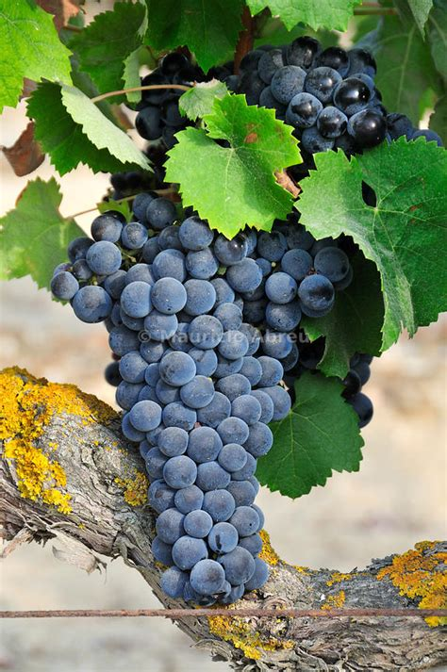
Portuguese Grape Varieties Cont.
Castelão:
  A red grape variety prominent in the Setúbal Peninsula and other southern regions, producing fruity and approachable wines.
These regions and grape varieties showcase the diversity and richness of Portuguese winemaking, offering a wide range of styles from refreshing whites to robust reds and fortified wines. Each region's unique terroir and traditional winemaking techniques contribute to the distinctive character of Portuguese wines.

Slide 17
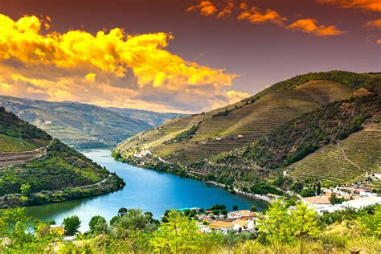
Portugal’s Characteristics and Specialties
Portugal's wine regions are diverse, and each offers unique characteristics and specialties. Here's an overview of notable features for each region:
Douro Valley:
  Specialties: Port wine (fortified wine), Douro DOC wines (red, white, and rosé).
  Characteristics: Steep terraced vineyards along the Douro River, producing intense and complex wines. Red wines often show rich fruit flavors and firm tannins, while whites can be aromatic and mineral-driven.

Slide 18
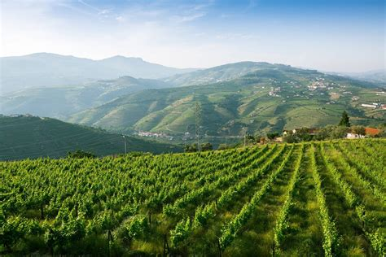
Characteristics and Specialties Cont.
Vinho Verde:
  Specialties: Light, fresh white wines; some lightly sparkling (Vinho Verde Alvarinho).
Characteristics: Lush green landscapes, cool maritime climate, and granitic soils contribute to wines with high acidity, vibrant fruitiness, and sometimes a slight effervescence. Varieties like Alvarinho and Loureiro are prominent.

Slide 19
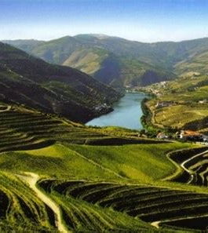
Characteristics and Specialties Cont.
Dão:
  Specialties: Elegant red wines from indigenous grape varieties.
  Characteristics: Granite-based soils and a moderate continental climate yield wines with finesse, balance, and aging potential. Touriga Nacional is a star grape here, contributing to aromatic and structured reds.

Slide 20
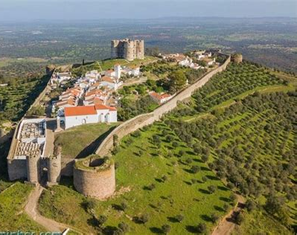
Characteristics and Specialties Cont.
Alentejo:
  Specialties: Full-bodied red wines; increasingly recognized for quality whites.
  Characteristics: Hot, dry climate and rolling plains foster wines with ripe fruit flavors, soft tannins, and often a velvety texture. Aragonez (Tempranillo) and Trincadeira are key red grape varieties, while Antão Vaz and Arinto shine in whites.

Slide 21
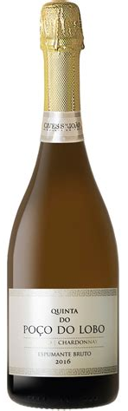
Characteristics and Specialties Cont.
Bairrada:
  Specialties: Baga-based red wines, sparkling wines (Bairrada Espumante).
  Characteristics: Coastal influence moderates the climate, enhancing acidity in wines. Baga produces structured reds with high acidity and potential for aging. The region also excels in traditional method sparkling wines made from Bical and Maria Gomes.

Slide 22
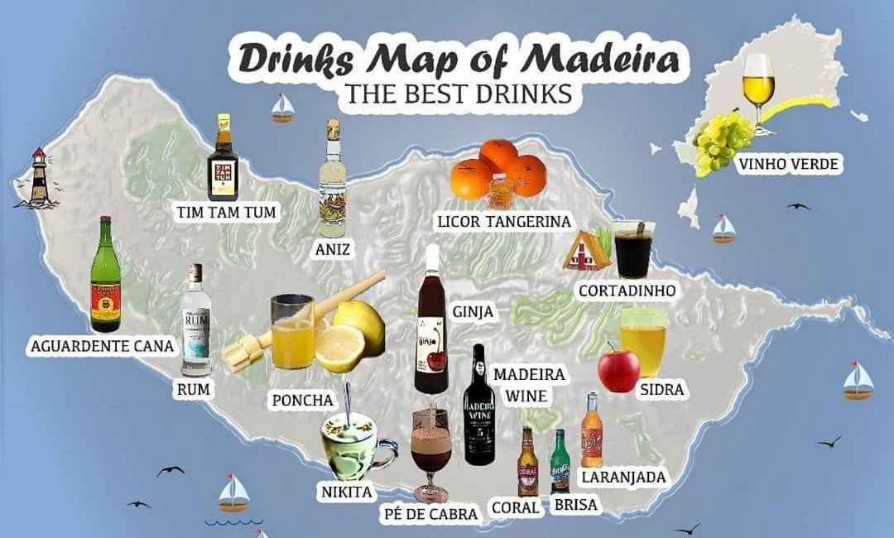
Characteristics and Specialties Cont.
Madeira:
  Specialties: Fortified Madeira wines (dry to sweet styles).
  Characteristics: Volcanic soils and a maritime subtropical climate create unique conditions for aging wines through the estufagem or canteiro methods, resulting in complex and long-lived fortified wines. Styles range from dry Sercial to sweet Malmsey (Malvasia).

Slide 23
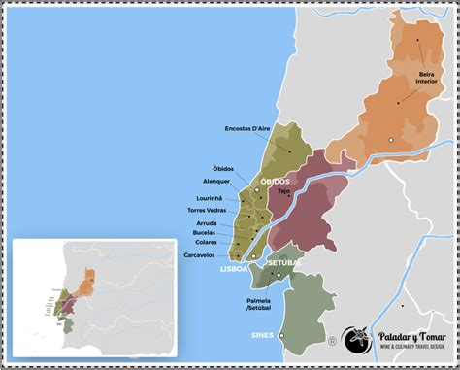
Characteristics and Specialties Cont.
Setúbal Peninsula:
  Specialties: Moscatel de Setúbal (sweet Muscat wines), fortified wines.
Characteristics: Mediterranean climate influences wines made from Muscat of Alexandria (Moscatel). These wines are known for their intense floral aromas, sweetness balanced by acidity, and rich, honeyed flavors.
Each of these regions showcases Portugal's diverse terroirs and grape varieties, contributing to a rich tapestry of wines that range from crisp and refreshing whites to robust reds and complex fortified wines. These specialties reflect centuries of winemaking tradition and innovation, making Portuguese wines highly esteemed worldwide.

Slide 24
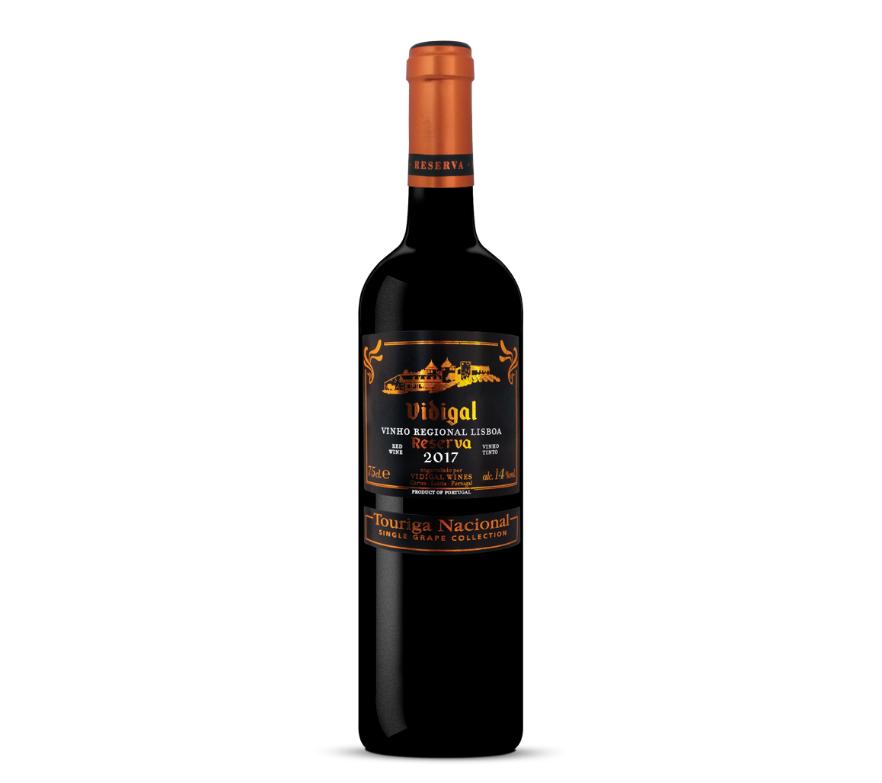
Varieties Unique to Portugal
Portugal is blessed with a plethora of indigenous grape varieties that contribute to the diversity and distinctiveness of its wines. These varieties have adapted to Portugal's varied terroirs and climates, resulting in wines that showcase unique flavors, aromas, and structures. Here's an overview of some key grape varieties that are unique to Portugal:
Touriga Nacional:
  Region: Douro Valley, Dão, and other regions.
  Characteristics: Considered Portugal's finest grape variety, Touriga Nacional produces deeply colored, aromatic red wines with intense floral and berry aromas. The wines are typically full-bodied with firm tannins and excellent aging potential. It's often used in Port blends as well as in high-quality dry red wines.

Slide 25
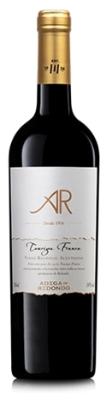
Varieties Unique to Portugal Cont.
Touriga Franca:
  Region: Douro Valley primarily, also found in Dão and other regions.
  Characteristics: A versatile grape known for its deep color, floral aromas, and fruity flavors. It contributes structure and complexity to Port blends, often complementing Touriga Nacional.
  In recent years, it has gained recognition as a standalone varietal in dry red wines.

Slide 26
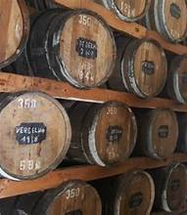
Varieties Unique to Portugal Cont.
Baga:
  Region: Bairrada primarily, also in Dão and other regions.
  Characteristics: Baga produces robust red wines with high acidity, firm tannins, and deep color.
  The wines are known for their potential to age, developing complex flavors of dark fruits, earthiness, and spices.
  Bairrada, is often blended with other local varieties or used in sparkling wines.

Slide 27
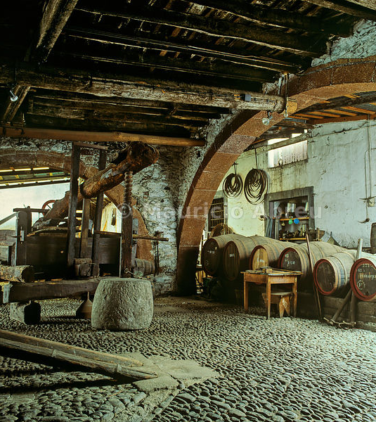
Varieties Unique to Portugal Cont.
Alvarinho (or Albariño):
  Region: Vinho Verde (Monção e Melgaço sub-region), also found in Minho and other regions.
  Characteristics: Known for its aromatic intensity, Alvarinho wines often exhibit notes of peach, citrus, and floral aromas.
  They are crisp, refreshing, and have vibrant acidity, making them ideal for warm climates. Alvarinho from Monção e Melgaço is considered the pinnacle of Portuguese Alvarinho production.

Slide 28
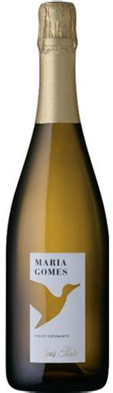
Varieties Unique to Portugal Cont.
Bical:
  Region: Bairrada, also in other regions.
  Characteristics: Bical is a versatile white grape variety that produces wines with good acidity and a range of flavors depending on the terroir. In Bairrada, it's used in sparkling wines (Bairrada Espumante) as well as in still whites, showing citrus, apple, and mineral notes.

Slide 29
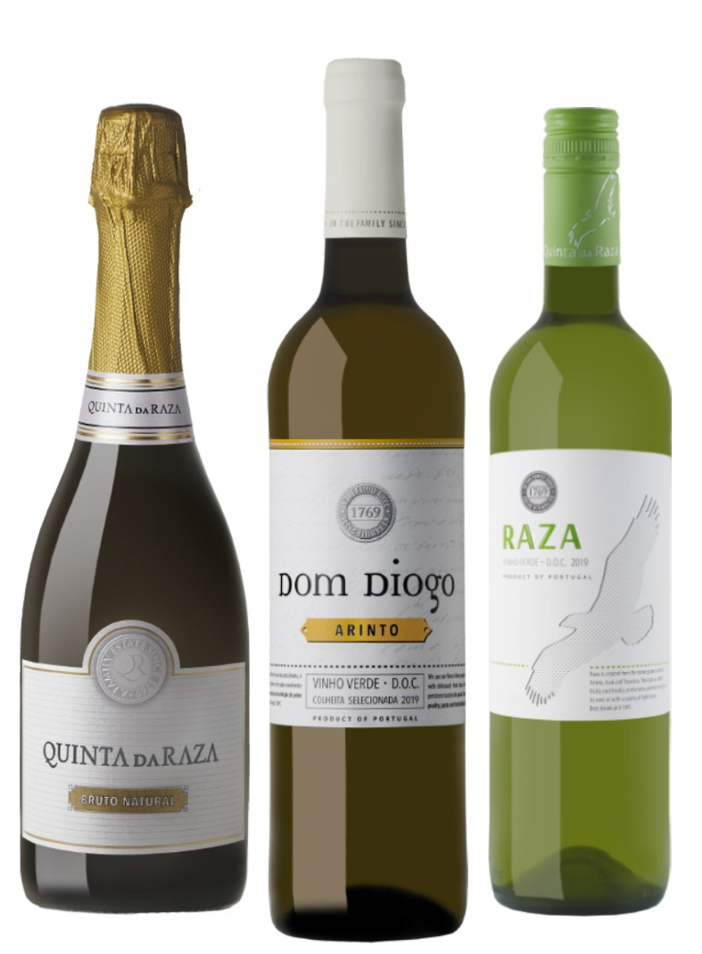
Varieties Unique to Portugal Cont.
Arinto (Pedernã):
  Region: Bucelas, also widely planted in Bairrada, Lisboa, and other regions.
  Characteristics: Arinto is known for its high acidity, which gives the wines a crisp, refreshing character. It typically shows citrus, green apple, and mineral notes, making it suitable for both still and sparkling wines. It's often blended with other varieties or used as a single varietal.

Slide 30
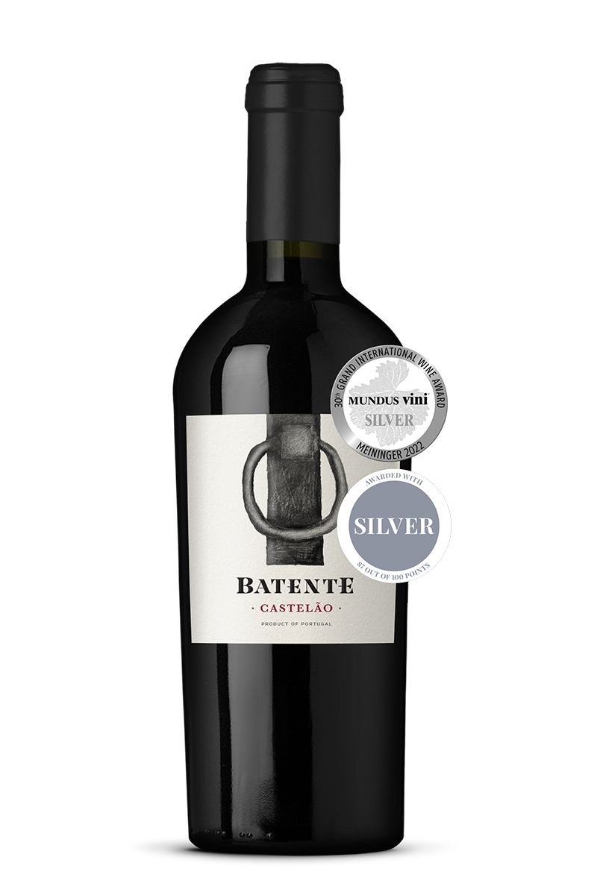
Varieties Unique to Portugal Cont.
Castelão (Periquita):
  Region: Setúbal Peninsula (Palmela), also found in other southern regions.
  Characteristics: Castelão produces fruity red wines with moderate tannins and good acidity. The wines are approachable in their youth and often show flavors of red berries, plums, and spices. It's used in both varietal wines and blends, contributing to the region's fortified and table wines.
These grape varieties, among others like Tinta Roriz (Tempranillo), Trincadeira, and Alicante Bouschet, highlight Portugal's rich viticultural heritage and its commitment to preserving unique indigenous varieties. They play a crucial role in defining the diverse styles and flavors that Portuguese wines offer, from elegant and complex reds to aromatic and refreshing whites, ensuring Portugal's place as a distinctive wine-producing nation on the global stage.

Slide 31
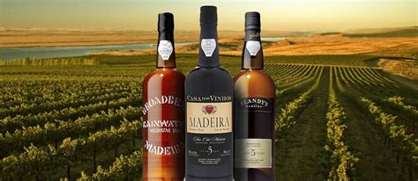
Indigenous Portuguese Varietals
Distinctiveness and Diversity: Indigenous grape varieties contribute to the diversity of Portuguese wines, allowing each region to produce wines with unique flavors, aromas, and textures. Varieties like Touriga Nacional, Alvarinho, and Baga are distinctive to Portugal and offer a wide range of expressions based on their terroir and winemaking techniques.
Adaptation to Terroir: Indigenous grapes have evolved over centuries to thrive in Portugal's varied climates, soils, and landscapes. They have adapted traits that make them well-suited to specific regions, such as high acidity to balance the heat of southern Portugal or resistance to humidity in the coastal regions.

Slide 32
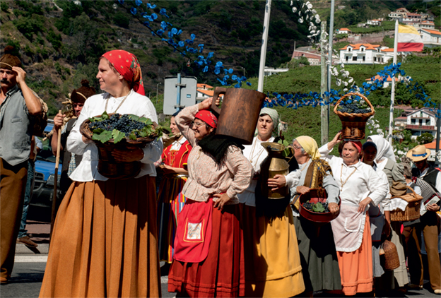
Indigenous Portuguese Varietals Cont.
Cultural Heritage: These grapes are deeply intertwined with Portugal's cultural heritage and winemaking traditions. Many indigenous varieties have been cultivated for generations by local farmers and winemakers, preserving agricultural practices and maintaining biodiversity in vineyards.
Identity and Recognition: Indigenous
grape varieties are integral to the
identity and recognition of Portuguese
wines both domestically and
internationally.
They differentiate Portuguese wines
from those produced in other countries
and contribute to Portugal's reputation
for producing distinctive, high-quality
wines.

Slide 33
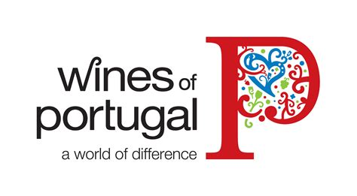
Indigenous Portuguese Varietals Cont.
Sustainability and Resilience: Indigenous grape varieties often require less intervention in the vineyard and winery compared to international varieties. They are naturally adapted to local conditions, which can contribute to sustainable viticulture practices and resilience against climate change challenges.
Market Differentiation: In a competitive global wine market, the use of indigenous grapes allows Portuguese winemakers to offer unique products that stand out and appeal to consumers seeking authentic and distinctive wine experiences. This differentiation can enhance marketability and value.

Slide 34
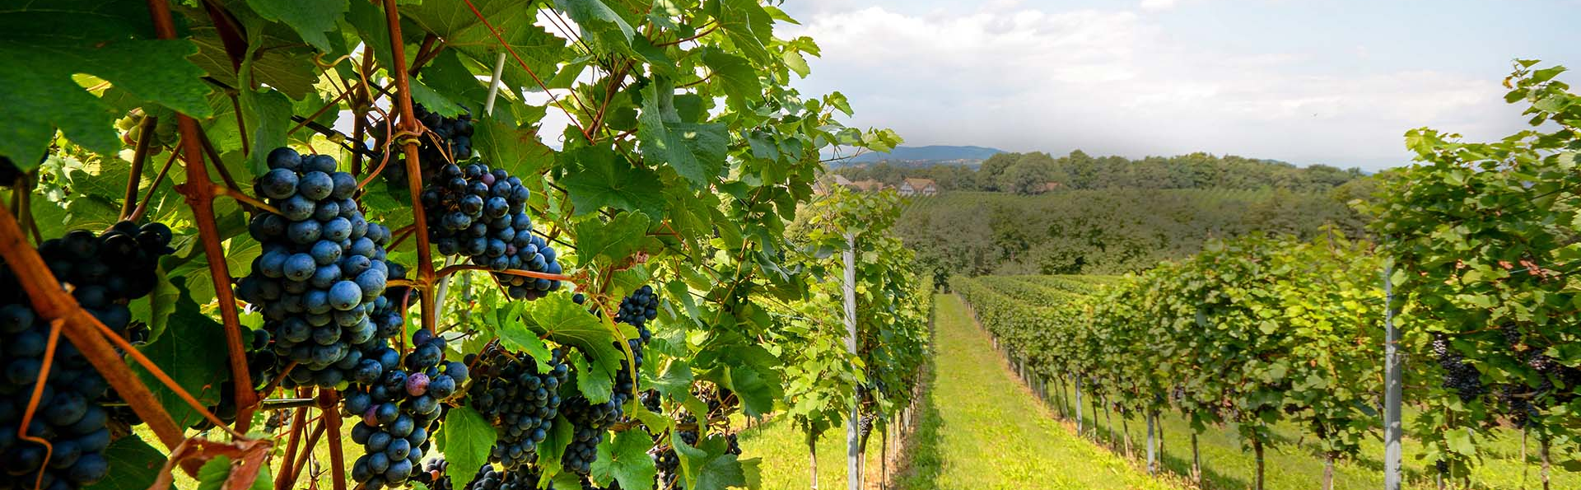
Indigenous Portuguese Varietals Cont.
Overall, the importance of indigenous grape varieties in defining Portuguese wine identity lies in their ability to preserve tradition, showcase regional diversity, and produce wines of exceptional quality that reflect the specific terroir and cultural heritage of Portugal.
They are not just ingredients in winemaking but pillars that support the rich tapestry of Portuguese wine culture and history.

Slide 35
Final Thoughts
Portuguese wine holds significant historical and cultural importance due to its unique production process and storied past.
Portugal offers wines with distinct flavors, ranging from dry to sweet, with varied styles and complexity.
Today, Portuguese wine continues to be cherished for its versatility in cooking and pairing with various dishes, from desserts to savory courses. Their wines offer rich flavors and robust character make it a favorite among wine enthusiasts and collectors worldwide.

Slide 36
Wines of Portugal
I hope you found this presentation about the Wines of Portugal interesting and informative.
If you haven’t already, I hope you all get the opportunity to experience Portuguese wines soon.
Thank you for coming!

Slide 37
Acknowledgement
My seminars are the result of many years of travel experience
combined with many hours of research over the internet.
I would like to acknowledge the many sources I have accessed.
These include: Wikipedia.com, Britannica.com, and the
various Museum, Park and Government websites.

