Slide 1
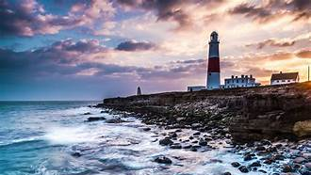
Portland (Weymouth), England Port Guide Presented by Marc Silver

Slide 2
What I Will Cover
My Port Philosophy
Don’t Miss the Ship
Money
Exchanging Money
A Brief History of Portland
Maps
Transportation
Top Attractions & Points of Interest
Local Cuisine & Dining Options
Important Tips & Practical Advice
Conclusion

Slide 3
My Port Philosophy
I have been cruising for over 45 years and have taken over 100 cruises. So, I consider myself an experienced cruiser.
The information I will present is based on those many years of
experience.
When I am on a cruise where the city, I want to visit is not the port city,
I always recommend taking a ship’s tour.
But when I am in a port with multiple attractions nearby and easy to see
on my own - I will do it on my own.
This presentation is not like that.

Slide 4

Don’t Miss the Ship
How to Avoid Missing Your Ship
Pay attention to the time. - Ship time and local time are often different.
Put a return-to-ship reminder on your phone.
Choose excursions wisely.
If a ship-sponsored excursion is late returning to port, the ship will wait for you. If you are on your own???
Be Prepared
Have your Passport, Credit Card, and phone numbers for your ship port agent.
What to Do If You Miss the Ship Most cruise lines have port agents stationed in the port area to assist if your ship has left without you. If your are lucky, when cruisers are late returning to the vessel, the ship’s crew will often remove the passengers’ essential items – passports, cell phones, and medication -- from the ship to leave with the port agents.
The Port Officials can help you with contacting your ship and making necessary travel arrangements.

Slide 5

Money
Englan uses the Euro (€) as its official currency. As of October 2024, the exchange rate between the Euro and the U.S. Dollar (USD) is about 1 EUR = 1.05 USD.
This means U.S. travelers should anticipate slightly higher prices in terms of conversion, but Spain remains a relatively affordable destination compared to many other Western European countries.
When exchanging money, it’s best to avoid doing so at the port exchange kiosks, as they tend to have higher fees and less favorable rates.
Instead, consider using ATMs to withdraw Euros directly, as they often offer better rates. Additionally, credit and debit cards are widely accepted throughout Alicante, though having some cash on hand is always a good idea for smaller purchases or tips.

Slide 6
Exchanging Money
When exchanging money, it’s best to avoid doing so at the port exchange kiosks, as they tend to have higher fees and less favorable rates.
Instead, consider using ATMs to withdraw Euros directly, as they often offer better rates.
Additionally, credit and debit cards are widely accepted throughout Englan, though having some cash on hand is always a good idea for smaller purchases.

Slide 7
A Brief History of Portland
Portland is a tied island in Dorset, connected to the mainland by Chesil Beach.
Inhabited since the Stone Age, it became famous for its limestone quarries, supplying stone for St. Paul's Cathedral and the UN headquarters.
The island developed as a naval base from the 16th century, with Portland Harbour becoming a major Royal Navy facility.
Today it's known for sailing, hosting Olympic events in 2012.

Slide 8
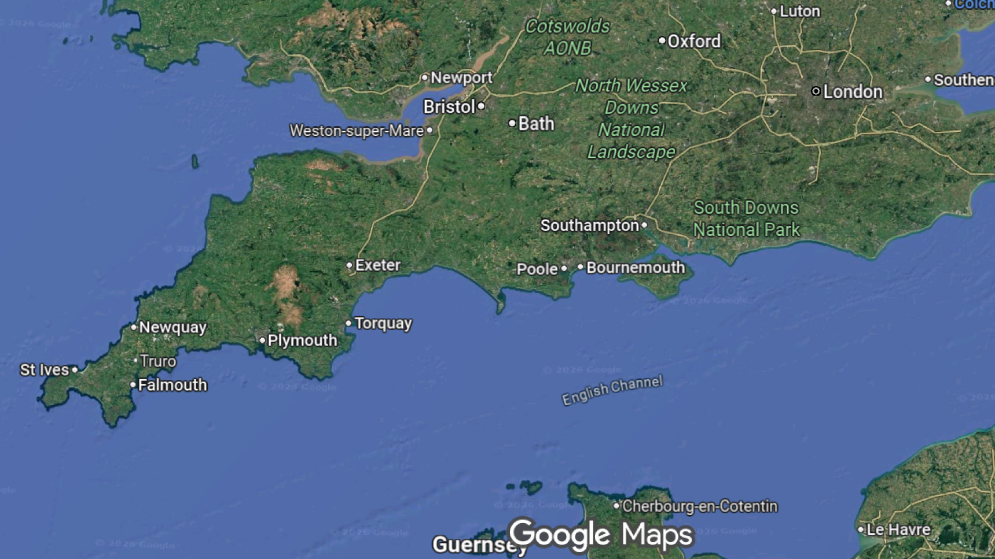

Slide 9
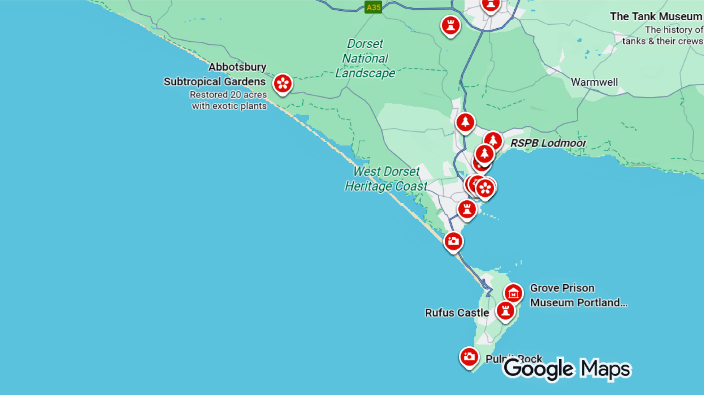
Cruiseship Terminal

Slide 10
Transportation
Here's what you need to know about transportation around Portland and the surrounding area:
From the Cruise Port
Portland Port is relatively isolated, so you'll need transport to reach most attractions. Taxis are usually available at the port, and some cruise lines offer shuttle buses to Weymouth town center (about 3 miles away).
Local Buses
First Bus operates regular services connecting Portland with Weymouth. The main routes are the 1 and 501, running frequently throughout the day. Buses connect Portland Bill, Fortuneswell, and other island locations with Weymouth's town center and train station. Fares are reasonable, and day passes offer good value for multiple journeys.
Short journeys (like Portland to Weymouth): approximately £2-£3
Longer journeys within the area: around £3-£4

Slide 11
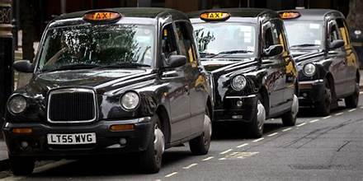
Transportation
Taxis
Several local taxi companies serve the area. It's worth booking in advance, especially on cruise ship days. T
axis can take you anywhere on the island or to nearby attractions like Durdle Door.
I recommend asking for rates before getting into the cab.

Slide 12

Transportation
Car Rental
Rental cars are available in Weymouth if you want flexibility to explore the Dorset coast. The roads on Portland are narrow and winding, but manageable.
Parking can be limited at popular spots like Portland Bill.
Remember if you are from the States, they drive on the other side of the street in the UK.

Slide 13
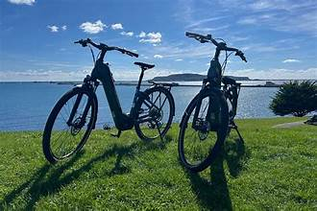
Transportation
Walking & Cycling
Portland is compact and walkable if you're reasonably fit, though hilly in places.
The South West Coast Path offers spectacular walking routes.
Bike rentals are available in Weymouth for exploring the flatter coastal paths.

Slide 14
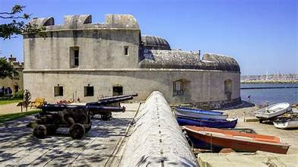
Top Attractions & Points of Interest
Portland Castle
This is a well-preserved Tudor fortress built by Henry VIII in the 1540s, offering harbor views and historical exhibits.
It's just minutes from the port.

Slide 15
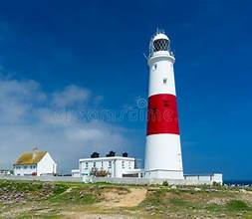
Top Attractions & Points of Interest
Portland Bill Lighthouse
The iconic lighthouse at the island's southern tip features a visitor center and stunning coastal views.
You can climb to the top for panoramic vistas of the English Channel.

Slide 16
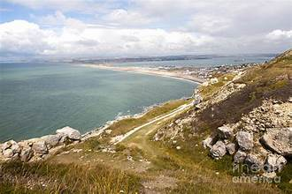
Top Attractions & Points of Interest
Chesil Beach
This remarkable 18-mile pebble beach connects Portland to the mainland.
It's a natural wonder and part of the Jurassic Coast World Heritage Site.

Slide 17
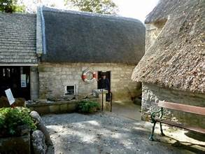
Top Attractions & Points of Interest
Portland Museum
Located in charming cottages, it showcases the island's maritime history, stone quarrying heritage, and local life.

Slide 18

Top Attractions & Points of Interest
Tout Quarry Sculpture Park
A fascinating outdoor gallery where artists have carved sculptures directly into the abandoned quarry faces, blending art with industrial heritage.

Slide 19
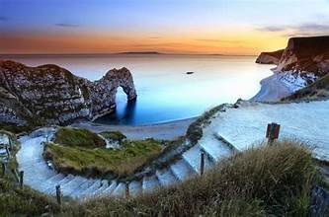
Top Attractions & Points of Interest
Durdle Door & Lulworth Cove
Located about 30 minutes East of Portland.
These are among England's most photographed natural landmarks - a limestone arch and a perfect circular bay on the Jurassic Coast.

Slide 20
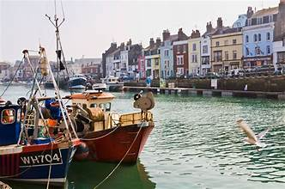
Top Attractions & Points of Interest
Weymouth
The neighboring seaside town offers a Georgian harbor, sandy beach, and charming old town, all within 15 minutes of the port.
The island's compact size makes most attractions easily accessible during a cruise stop.

Slide 21
Local Cuisine & Dining Options
Weymouth offers excellent fresh seafood, being a working fishing port. Try locally caught crab, lobster, and fish from harborside restaurants and traditional fish and chip shops along the esplanade.
The Old Harbor area features cozy pubs serving Dorset ales and classic British fare like Dorset knob biscuits and Blue Vinny cheese.
For casual dining, enjoy ice cream parlors and cafés along the beach. Weymouth's restaurants range from budget-friendly to upscale, with many emphasizing locally sourced Dorset produce and coastal specialties.

Slide 22
Important Tips & Practical Advice
Wear comfortable walking shoes for Portland's hilly terrain and coastal paths. Weather changes quickly, so bring layers and waterproofs.
Most attractions accept cards, but carry some cash for smaller vendors.
Check return shuttle times to avoid missing your ship's departure.

Slide 23
Thanks For Coming
If you have any more questions, please ask.
I will do my best to answer them for you.
Have a great visit in Le Havre!

