Slide 1

Portland Australia Presented by Marc Silver

Slide 2
What I Will Cover
My Port Philosophy
Don’t Miss the Ship
Money
About Portland
Maps
Portland Transportation
Places to see or at least consider
A few restaurant recommendations
Conclusion

Slide 3
My Port Philosophy
I have been cruising for over 45 years and have taken over 200 cruises. So, I consider myself an experienced cruiser.
The information I will present is based on those many years of
Experience.
When I am on a cruise where the city, I want to visit is not the port city,
I always recommend taking a ship’s tour.
But when I am in a port with multiple attractions nearby and easy to see
on my own - I will do it on my own.
This presentation is for that type of port.

Slide 4

Don’t Miss the Ship
How to Avoid Missing Your Ship
Pay attention to the time. - Ship time and local time are often different.
Put a return-to-ship reminder on your phone.
Choose excursions wisely.
If a ship-sponsored excursion is late returning to port, the ship will wait for you. If you are on your own???
Be Prepared
Have your Passport, Credit Card, and phone numbers for your ship port agent.
What to Do If You Miss the Ship
Most cruise lines have port agents stationed in the port area to assist if your ship has left without you.
If your are lucky, when cruisers are late returning to the vessel, the ship’s crew will often remove the passengers’ essential items – passports, cell phones, and medication -- from the ship to leave with the port agents.
The Port Officials can help you with contacting your ship and making necessary travel arrangements.

Slide 5
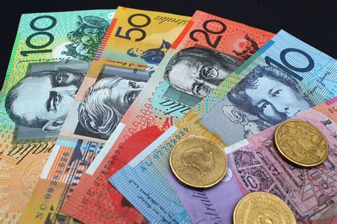
Money
The currency for Portland is the Australian Dollar.
The conversion at the rate is $1.48 AUD to $1.00 U.S.
Or $1 AUD $.67 U.S.

Slide 6
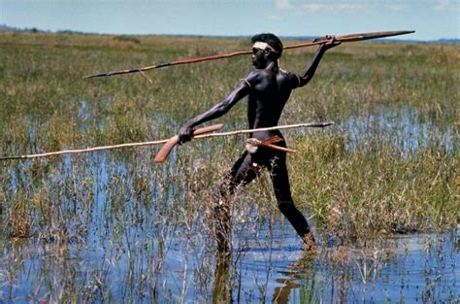
Historical Portland
Aboriginal heritage
The Gunditjmara, an Aboriginal Australian people, are the traditional owners of much of south-west Victoria, including what is now Portland, having lived there for thousands of years.
They are today renowned for their early aquaculture development at nearby Lake Condah.
Physical remains such as the weirs and fish traps are to be found in the Budj Bim heritage areas.
The Gunditjmara were a settled people, living in small circular weather-proof stone huts about 3 ft 3 in high, grouped as villages, often around eel traps and aquaculture ponds.
On just 2.5 acres of Allambie Farm, archaeologists have discovered the remains of 160 house sites.

Slide 7
Historical Portland
19th century European settlement Portland was named in 1800 by the British navigator James Grant, who sailed in the Lady Nelson along the Victorian coast. "I also distinguished the Bay by the name of Portland Bay, in honor of His Grace the Duke of Portland", wrote Grant. The bay, the only deep sea port between Adelaide and Melbourne, offers a sheltered anchorage against the often wild weather of Bass Strait.

Slide 8
About Portland
The city of Portland is the oldest European settlement in the state of Victoria.
It's a pleasant little city, easily accessible on foot.
It's been an important deep-water port for the past 150 years, first as a whaling/fishing port, then sheep and wool.
Now it is home to the third largest aluminum smelter in Australia and exports aluminum ingots, mountains of wood chips and mineral sand, primarily to Asia. We have a layer of brown sawdust on the deck to attest to the wood chip exports.

Slide 9
About Portland
Originally founded by Edward Henty in 1834 (though the Aborigines were here millennia before).
There are more than 200 historical buildings in town that date from the 19th century.
Most of these buildings are constructed of dark bluestone a marked contrast to the golden sandstone seen in Tasmania.
Victorian bluestone is a basalt, quarried locally and one of the most common building materials of the 1850s during the Victorian Gold Rush.
Take a historic walk through town, and admire these sturdy, built-to-last buildings.
Most are still in use. The English Gothic style St. Stephens Anglican church and the old Town Hall were particularly impressive.

Slide 10
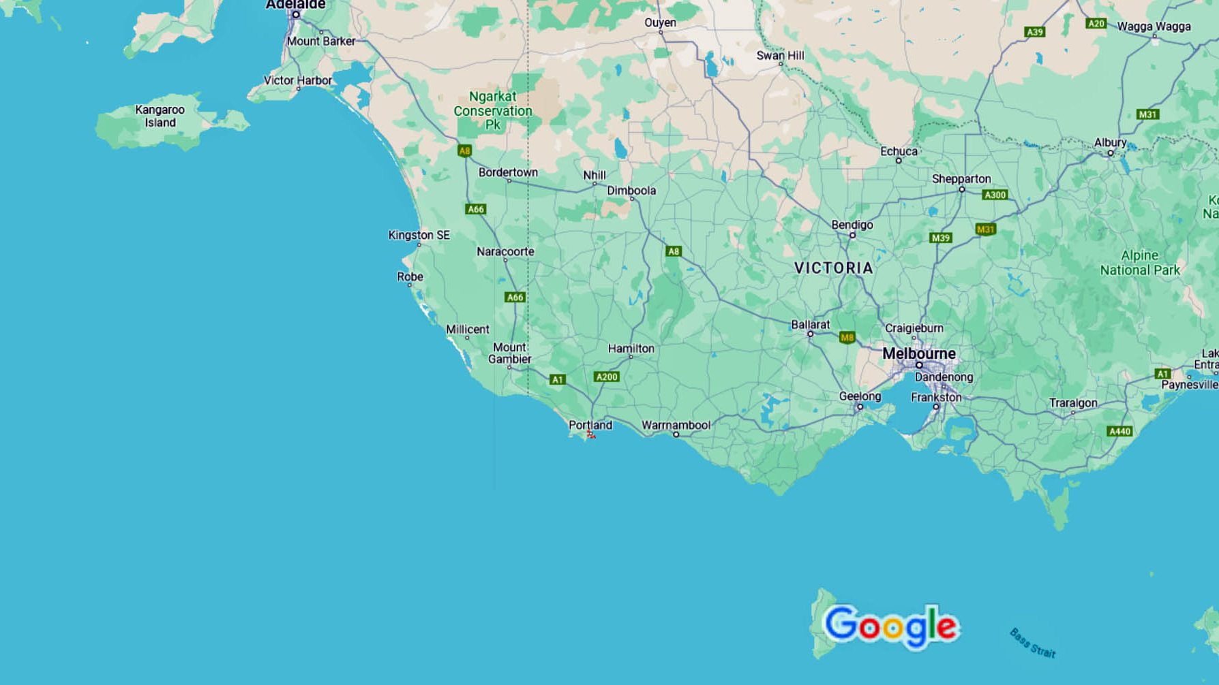
Portland

Slide 11
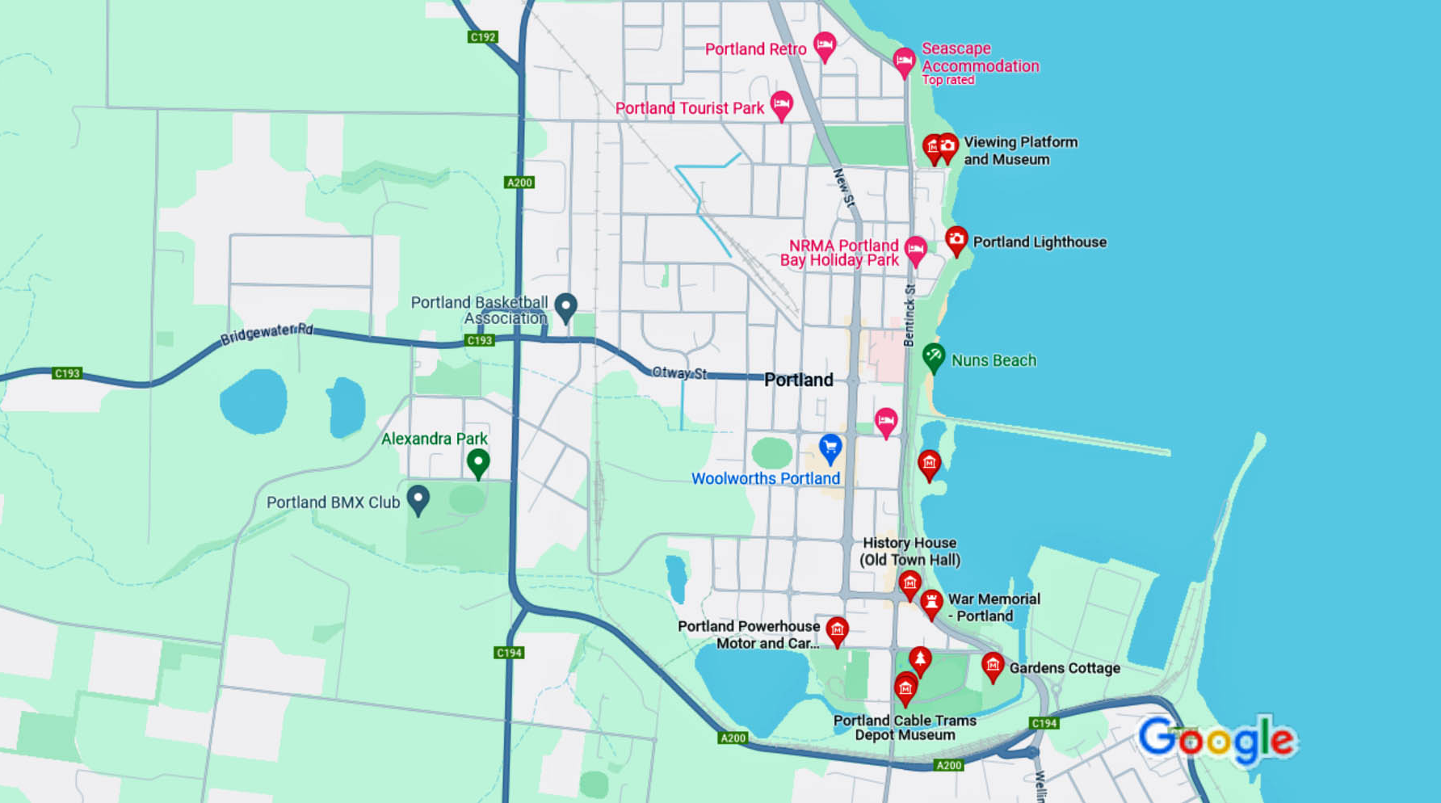
Map of Portland
Cruise Dock

Slide 12
Portland Transit System
Portland has one of the most comprehensive and user-friendly public transit systems I have experienced.
Portland has buses, trams and trains.
Full Fare: $5.30
Senior / Child: $2.65
If you plan to travel outside the main core of the city, consider asking about a “myki Pass”.

Slide 13
City Circle Tram
The City Circle Tram is a free and convenient way to see the sights of central Portland and the Docklands. Plus, you can experience a ride on one of the city's much loved heritage trams.
An audio commentary provides details of city landmarks and major attractions such as the City Museum, Parliament House, Docklands, Federation Square, Portland Aquarium and the Princess Theatre.
The City Circle Tram also links with other tram, train and bus routes around Portland.
To catch the City Circle Tram, simply wait at any tram stop along the City Circle Tram route. These tram stops are specially marked with a City Circle sign. Trams run every 12 minutes.

Slide 14
City Circle Tram

Slide 15
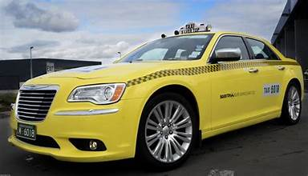
Portland Taxis
Standard taxis provide a safe and reliable way to explore the city or for transport between the cruise port and various attractions.
Like taxis in most locations the cost is significantly more expensive than other modes of transport.
Fares are regulated by the government. Taxi drivers across Victoria are now required to use the meter.
Rideshare is very popular in Portland with several operators to choose from including Uber, Didi, OLA, and Shebah.
Shebah uses women drivers who only pick up women and children.

Slide 16
Promenade
Beacon Cove Promenade is about 500 metres long and is part of a longer waterfront trail.
Developed between 1996 and 2006 to improve on the utilitarian waterfront scene that used to greet visitors to the piers.
Modern waterfront apartments with unimpeded water views were built, and the public land was landscaped to provide nice places to sit and stroll on sunny days. You'll see dog-walkers, strolling couples, joggers and cyclists anytime you care to visit in good weather. It feels like a resort and quite different from the rest of Portland.
People can traverse a nicely landscaped area with palm trees, seating, food outlets and the tram terminus.
From Beacon Cove the tram ride (number 109) to the city is surprisingly quick, less than 15 minutes usually. I recommend Beacon Cove for a low cost, quick excursion from the bayside to the city.

Slide 17
Princes Pier
Princes Pier is a 580-meter-long iconic Portland landmark that has recently been restored and is a great place to take an evening stroll and watch the sunset.
Opened in 1951, the pier was able to hold some of the biggest mail ships and steamers back in the day. Over the years, the pier played a key role in both commerce and defense.
Some of the activities that you can enjoy at the pier include walking, jogging or cycling along the foreshore, playing sports along the beach as well as taking photos around the pier.
Fishing is permitted along the pier, with a variety of fish including trevally and bream available in the morning and snapper appearing in the evening.

Slide 18
Garden City Reserve
Garden City Reserve is a must-visit recreational park in Port Portland.
It is one of the largest parks in the area and offers a range of activities such as cycling, soccer, dog walking, trugo games, picnics, and play in the playground. The park is easily accessible from all street frontages and has an extensive shared path network.
The playground at Garden City Reserve is located at the corner of Beacon Rd, Crichton Avenue, and Tucker Avenue.
It features a large play structure designed like a dragon, as well as a flying fox, tea-cup spinner, chain walking bridge, and natural play elements. There are swing sets for all ages, an all-abilities bird nest swing, a wide wave slide, and toadstool wooden play sculptures.

Slide 19
SEA LIFE Portland Aquarium
SEA LIFE Portland Aquarium is one of Portland’s top attractions for families.
Located in the heart of Portland CBD on the banks of the Yarra River, SEA LIFE Portland Aquarium is home to thousands of sea critters spread across 12 different areas.
It’s an attraction where fun and learning go hand in hand with daily shark and ray feedings and animal presentations.
In total, there are over 10,000 animals on display.
Adults: $49.50
Children 5 -12: $36.00
Children <5 - FREE
There are discount tickets available online.
https://www.visitsealife.com/Portland/tickets-passes/

Slide 20
Queen Victoria Market
The historic Portland market has been in operation since 1878 and is now spread over two city blocks.
Allow yourself some time, grab a coffee to go and peruse the stalls.
Besides the fresh produce market, there is an indoor deli, outdoor general merchandise market and several permanent stores around the QVM perimeter.

Slide 21
Old Portland Gaol
The Old Portland Jail is a must-see when city sightseeing Portland. The jail operated from 1842 until 1929 as a prison and where criminals who had been sentenced to death were hanged, including the (in)famous Ned Kelly.
The Old Portland Gaol is one of the most popular museums in Portland – and a ticket is required to enter.
Visitors interested in learning about Australia’s most notorious criminals and exploring the prison cells should book a ticket in advance on line.
Adults: $38.00 – Senior $30.00
Children 5 -15: $22.00
Children <5 - FREE

Slide 22
Carlton Gardens & Royal Exhibition Building
One of the most beautiful places in Portland, the Carlton Gardens is the next stop on our tour. Designated a park in 1839, the 64 acres are perfect for a stroll, rest or picnic.
Aim for the center of the park and the Royal Exhibition Building. Built in 1880 for the Portland International Exhibition, it was also the site of the first official opening of Australian Parliament in 1901.
It was actually set to be demolished, but was saved and remodeled in the late 1990s. In 2004, it received UNESCO World Heritage status.
Admission Fee: Adults $15, Children <16 Free

Slide 23
Parliament House
The Parliament House is a regular stop on all Portland CBD Tours. Built between 1856 and 1930, the Parliament House is where both houses of Victoria’s Parliament – the Legislative Assembly and Legislative Council – still meet today.
The interior can be seen by guided tour on non-sitting days or from the public gallery when Parliament is in session – both options are free!

Slide 24
Chinatown
Chinatown is easily identified by ornately painted gates and hanging lanterns, walk the length of Chinatown.
Like so many foreigners, the Chinese were also drawn to Portland in the 1850’s by the prospect of finding gold. Land was purchased by many Chinese people along Little Bourke and the thriving Chinatown remains today with a bevy of Asian restaurants and shops.
Among the many places and things to eat in Portland, Dumplings in Chinatown are a must-try! Feasted at the no-frills, budget-friendly Shanghai Dumpling House – which is open for lunch and dinner.

Slide 25
Bourke Street Mall
The Bourke Street Mall is a retail mecca that includes everything from high end shops like Tiffany’s) to the basics like Target, to the flagship store of the Australian department store chain Myer.
With wide sidewalks, there is plenty of room for Portland street performers to entertain those less interested in shopping.

Slide 26
Royal Arcade Portland
Often included on Portland Tours, the Royal Arcade is a quaint covered shopping street that has been around since 1869.
The lane is filled with top-end stores and posh cafes.
Don’t miss the statues of Gog and Magog, two mythical creatures guarding Gaunt’s Clock since 1892, that stand above the entrance.

Slide 27
St. Paul’s Cathedral
The first stone of St. Paul’s Cathedral, a gothic-style church, was laid in 1880, but the spires weren’t completed until 1933.
The gorgeous interior includes original baptismal fonts and an 1891 organ.
Guests can use the descriptive brochures provided at the back of the church to complete an informative self-guided tour of the cathedral.

Slide 28
Portland Skydeck
The Eureka Tower is visible from all over the city. When you stand at the base of the Eureka Tower and look up at the 975-foot-tall building it seems to go on forever.
The top 10 levels are golden in appearance because the glass is gold.
The 24-carat gold-plated windows are a nod to Portland’s historic gold rush of the 1850s.

Slide 30
Restaurants in Portland
There are a lot of excellent restaurants in Portland even though none have a Michelin Star. Here are some recommendations:
For those of you that just like good food, you can’t go wrong just about anywhere you go.
GOOD EATING

Slide 31
Conclusion
Portland is a beautiful City with a rich history and numerous attractions. Regardless of what you're looking for, Portland has something for everyone.
I hope this presentation will help when we visit Portland!

Slide 32
Thanks For Coming
If you have any more questions, please ask.
I will do my best to answer them for you.
Have a great visit to Portland!

Slide 33
Acknowledgement
My seminars are the result of many years of travel experience combined with many hours of research over the internet.
I would like to acknowledge the many source I have accessed.
These include: Wikipedia.com, Britannica.com, and the various Museum, Park and Government websites.

