Slide 1

Port Of Spain Trinidad a Tobago Presented by Marc Silver

Slide 2
What I Will Cover
My Port Philosophy
Don’t Miss the Ship
Money of Trinidad
About Port Of Spain
Area Map of Port Of Spain
Map of Port Of Spain
Port Of Spain Transportation
Places to see or at least consider
Conclusion

Slide 3
My Port Philosophy
I have been cruising for over 45 years and have taken over 100 cruises. So, I consider myself an experienced cruiser.
The information I will present is based on those many years of
experience.
When I am on a cruise where the city, I want to visit is not the port city,
I always recommend taking a ship’s tour.
But when I am in a port with multiple attractions nearby and easy to see
on my own - I will do it on my own.
This presentation is not like that.

Slide 4

Don’t Miss the Ship
How to Avoid Missing Your Ship
Pay attention to the time. - Ship time and local time are often different.
Put a return-to-ship reminder on your phone.
Choose excursions wisely.
If a ship-sponsored excursion is late returning to port, the ship will wait for you. If you are on your own.
Be Prepared
Have your Passport, Credit Card, and phone numbers for your ship port agent.
What to Do If You Miss the Ship Most cruise lines have port agents stationed in the port area to assist if your ship has left without you. If your are lucky, when cruisers are late returning to the vessel, the ship’s crew will often remove the passengers’ essential items – passports, cell phones, and medication -- from the ship to leave with the port agents.
The Port Officials can help you with contacting your ship and making necessary travel arrangements.

Slide 5
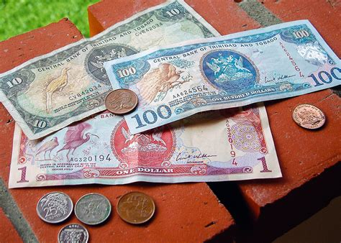
Trinidadian Money
1.00 US Dollar = .7857871 Trinidadian Dollars
1 TTD = 0.147367 USD

Slide 6
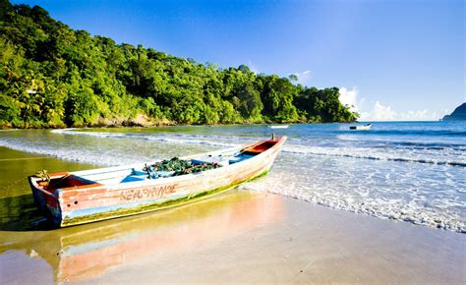
About Port Of Spain
Trinidad and Tobago are an exercise in beautiful contradiction. In Trinidad, pristine mangrove swamps and rainforested hills sit side by side with smoke-belching oil refineries and industrial estates.
Tobago has everything you’d expect from a Caribbean island, with palm trees and white sand beaches still relatively unchanged by the tourist industry.
Combined, this twin-island republic offers unparalleled birdwatching; first-class diving; and luxuriant rainforests perfect for hiking and waterfall swimming.
Then there's the electric nightlife and a fabulous Carnival, easily the biggest and best of the region’s annual blowouts. And thanks to the legacy of TnT's melting-pot population, the cuisine is a foodie’s dream, from sensational curries to the freshest of fish.

Slide 7
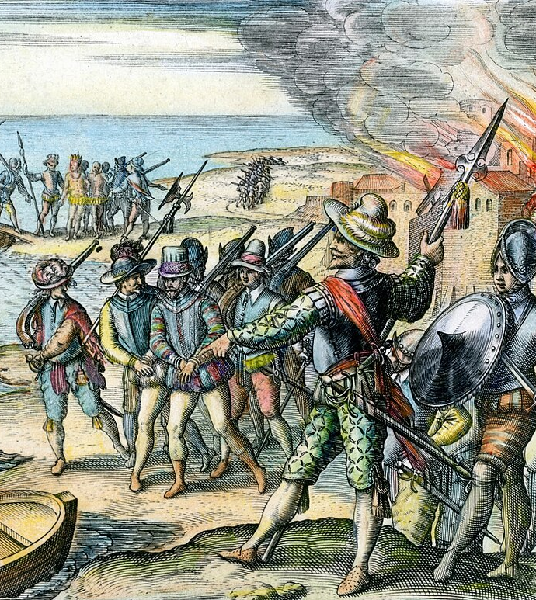
Trinidad’s History
The island of Trinidad was inhabited for centuries by Indigenous peoples before becoming a colony in the Spanish Empire, following the arrival of Christopher Columbus, in 1498. The Spanish surrendered the island to the British in 1797.
The islands' sugar industry grew dramatically with the importation of slaves which continued until the emancipation of the slaves in 1834.
Manpower was replaced with the importation of contract laborers from India between 1845 and 1917, which boosted sugar production as well as the cocoa industry. The discovery of oil in Trinidad in 1910 added another important export.
Trinidad and Tobago obtained independence in 1962, becoming a republic in 1976. Today the country is one of the most prosperous in the Caribbean thanks largely to petroleum and tourism, mostly in Tobago, it is targeted for expansion and is growing.

Slide 8
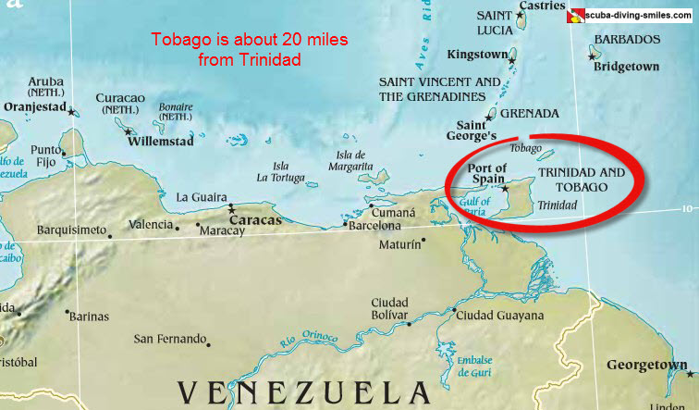

Slide 9
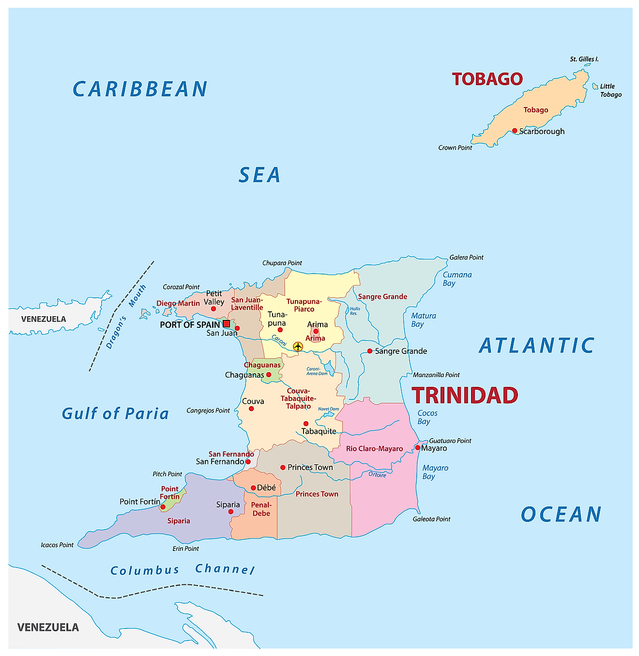
Map of Trinidad

Slide 10
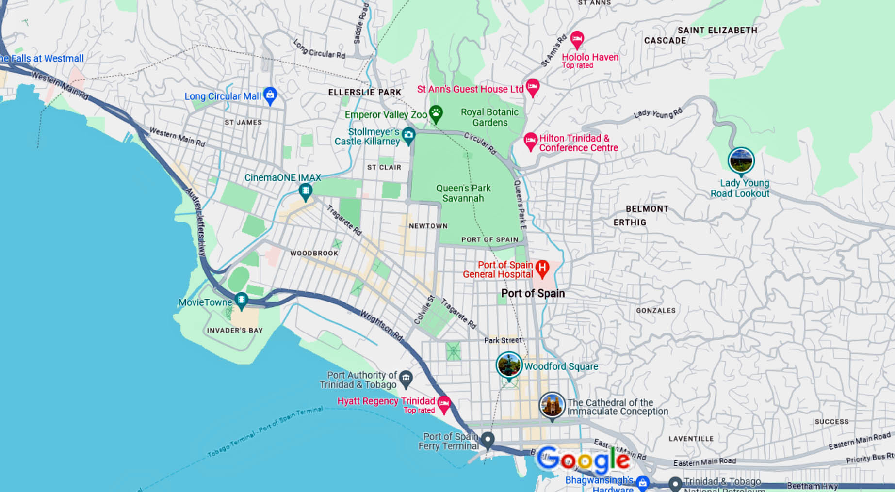
Port Of Spain

Slide 11
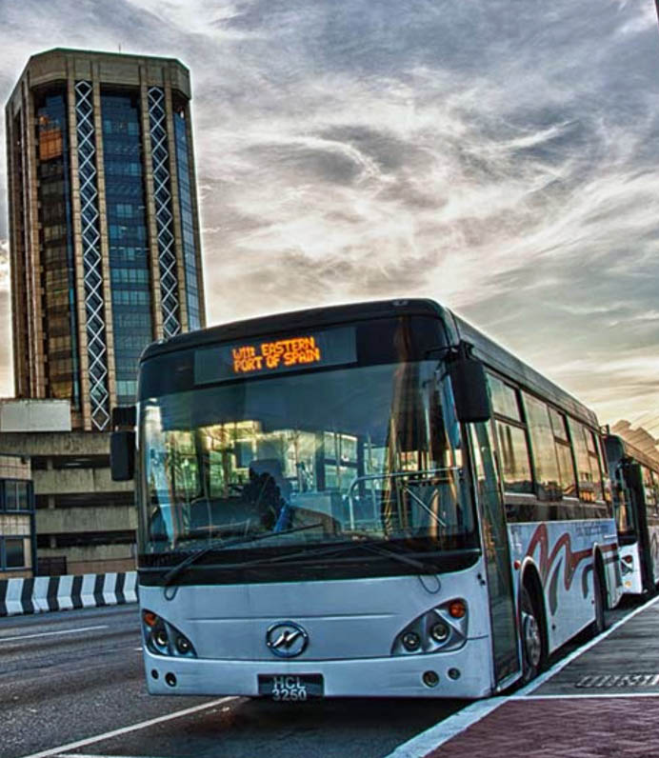
Port Of Spain Transportation
The Public Transportation Services Corporation (PTSC) operates scheduled bus services (TT$2–12) alongside privately operated, unscheduled maxi and route taxis (TT$2–15). Get around for TT$2.50
With our Port-of-Spain All Stop service you can get around at an affordable price. To us, that is less than $.30.
On December 2nd, 1964, the Government decided that public ownership of the bus transport industry should take effect from January 1st, 1965.

Slide 12
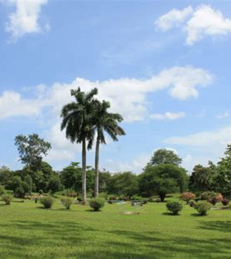
Queens Park Savannah
Queen’s Park Savannah is a large open space that separates downtown Port of Spain from the more upmarket parts of the city.
It was created by forward-thinking town planners in the early 1800s and now gives Port of Spain some much-needed breathing space.
Despite the traffic that constantly moves around the perimeter of the park, inside the space is surprisingly calm and restful. Lovely old trees give welcome respite from the fierce heat of the sun.
You may also see groups of people playing impromptu games of cricket. It is a lovely spot to walk for a while.

Slide 13
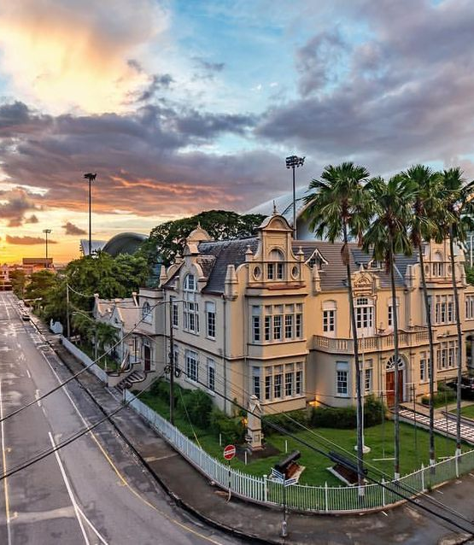
National Museum and Art Gallery
Located on the south side of Queens Park the Museum is housed in a gabled building constructed in the 1890s as part of the celebrations for Queen Victoria’s Diamond Jubilee. The National Museum and Art Gallery has an extensive collection, covering everything from early Amerindian history to the technology of the modern-day oil industry.
Although much of the labeling is outdated and there are no interactive exhibits you would expect to see in a modern museum, it is still worth a visit.
You will get an essential overview of Trinidad and Tobago’s history and culture.

Slide 14
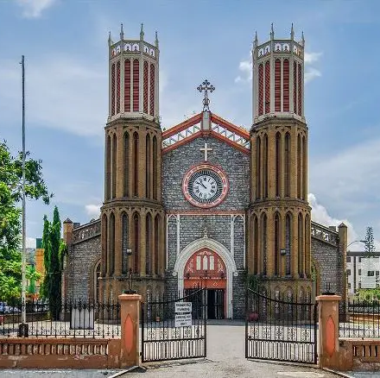
The Cathedral of the Immaculate Conception
The Cathedral is located less than a mile east of the cruise port.
The imposing twin-towered Gothic Roman Catholic Cathedral of the Immaculate Conception is located at the eastern end of Independence Square.
It took sixteen years to build and was completed in 1836. Its ironwork frame was shipped from England and the limestone wall blocks were quarried locally in Laventille.
Sixteen stained-glass windows depicting Trinidad and Tobago’s many ethnic groups were added during a restoration project in the 1980s.

Slide 15
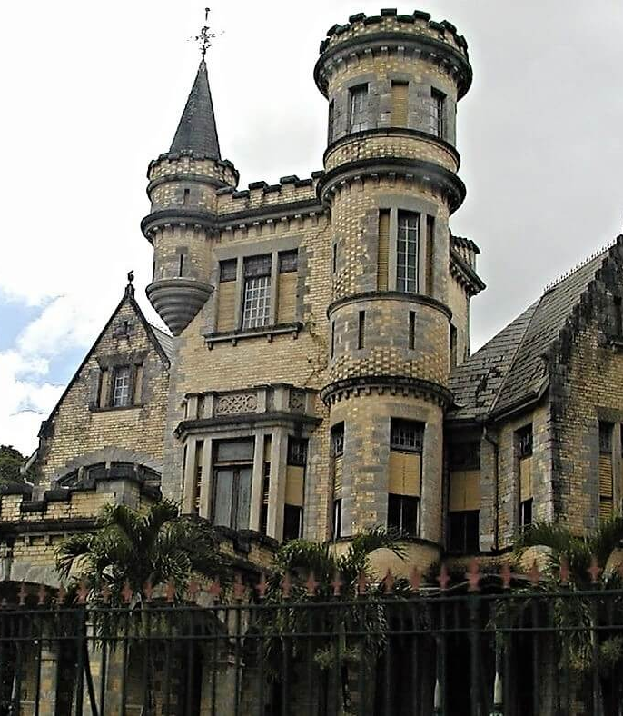
The Magnificent Seven
Along one side of the savannah is a row of mansions built by rival plantation owners in the early years of the twentieth century.
Each man tried to outdo his neighbors in the grandeur of his design. The resulting buildings, ‘The Magnificent Seven’, have had a chequered history.
Three are still in use today. The others have fallen into a state of disrepair although some are in the process of being restored. None are open to the public.
The most outlandish of the seven is Killarney, a fairy-tale castle complete with turrets and spires.

Slide 16

Angostura Distillery
Whether or not you’re a fan of Trinidad’s famous bitters, a tour of the Angostura distillery is well worth doing.
You need to book in advance by calling or e-mailing the distillery directly. They only run tours if they have 10 people or more, so it’s best to contact them as early as possible so that they can put you together with others who want to visit.
You will learn all about the fascinating history of Angostura Bitters and you’ll get to taste some delicious rums.

Slide 17
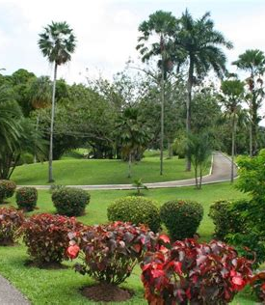
Botanical Gardens
The Botanical Garden’s beautiful grounds are well worth your time to visit.
The gardens were established in 1818 by Governor Woodford and the botanist David Lockhart.
The collection of more than 700 trees is one of the oldest in the western hemisphere and provides welcome shade from the heat of the sun.
There are well-laid-out paths to help you explore the gardens.
There is also an interesting cemetery where you can see the crumbling gravestones of many of Trinidad’s governors.

Slide 18
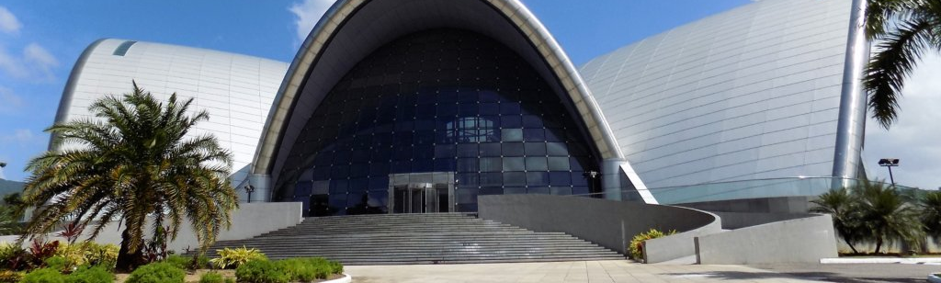
National Academy for Performing Arts
The futuristic National Academy for Performing Arts (NAPA) building with its arcs of steel and glass looks somewhat out of place amongst the colonial buildings that surround it near Queen’s Park Savannah.
Admire it because you can’t go in! It was closed down by health and safety inspectors in 2014 as parts of the building were deemed to be dangerous.

Slide 19
Conclusion
Port Of Spain is a beautiful City with a rich history and numerous attractions. Regardless of what you're looking for, Port Of Spain has something for everyone.
I hope this presentation will help when we visit Port Of Spain!

Slide 20
Thanks For Coming
If you have any more questions, please ask.
I will do my best to answer them for you.
Have a great visit in Port Of Spain !

