Slide 1

Port Douglas Australia Presented by Marc Silver

Slide 2
What I Will Cover
My Port Philosophy
Don’t Miss the Ship
Money
About Port Douglas
Area Map of Port Douglas
Map of Port Douglas
Port Douglas Transportation
Places to see or at least consider
A few restaurant recommendations
Conclusion

Slide 3
My Port Philosophy
I have been cruising for over 45 years and have taken over 200 cruises. So, I consider myself an experienced cruiser.
The information I will present is based on those many years of
experience.
When I am on a cruise where the city, I want to visit is not the port city,
I always recommend taking a ship’s tour.
But when I am in a port with multiple attractions nearby and easy to see
on my own - I will do it on my own.
This presentation is for that type of port.

Slide 4

Don’t Miss the Ship
How to Avoid Missing Your Ship
Pay attention to the time. - Ship time and local time are often different.
Put a return-to-ship reminder on your phone.
Choose excursions wisely.
If a ship-sponsored excursion is late returning to port, the ship will wait for you. If you are on your own???
Be Prepared
Have your Passport, Credit Card, and phone numbers for your ship port agent.
What to Do If You Miss the Ship Most cruise lines have port agents stationed in the port area to assist if your ship has left without you. If your are lucky, when cruisers are late returning to the vessel, the ship’s crew will often remove the passengers’ essential items – passports, cell phones, and medication -- from the ship to leave with the port agents.
The Port Officials can help you with contacting your ship and making necessary travel arrangements.

Slide 5

Money
The currency for Port Douglas is the Australian Dollar.
The conversion at the rate is $1.48 AUD to $1.00 U.S.
Or $1 AUD $.67 U.S.

Slide 6
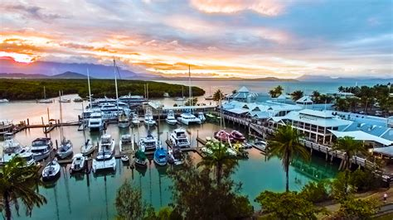
About Port Douglas
Port Douglas is the ideal place for exploring some of Austrailias pristine rainforests and of course the Great Barrier Reef.
The laidback tropical town of Port Douglas is the gateway to two UNESCO World Heritage-listed natural wonders, the Great Barrier Reef and the expanses of the Daintree Rainforest.
It’s also a popular resort destination in its own right, with the tree-fringed sands of Four Mile Beach stretching down the bay and a walkable compact town center.
You can also see Superyachts from around the world berth at Port Douglas’s marina, where tour boats depart nearby coral cays and expeditions to spectacular diving spots on the outer reefs.

Slide 7
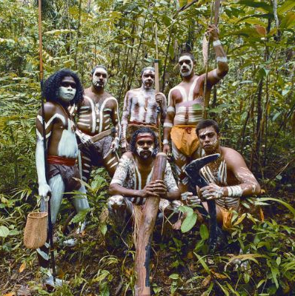
Historical Port Douglas
The town has a rich history, dating back to the early 1870s, when it was first established.
Before the Europeans arrived, the land now known as the Kuku Yalanji people occupied Port Douglas.
These indigenous Australians were hunter-gatherers whose presence in the area dates back over 60,000 years.
The Kuku Yalanji people have a deep connection with the land, and their culture and traditions are still practiced and celebrated in the region today.

Slide 8
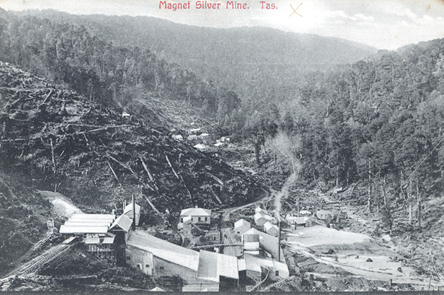
Historical Port Douglas Cont.
European Establishment of Port Douglas
In 1877, the settlers established Port Douglas as a port town primarily to cater to the growing mining industry in the nearby region.
They named the town after John Douglas, a former Premier of Queensland.
Initially, Port Douglas bustled with activity, featuring lively streets and a thriving economy.

Slide 9
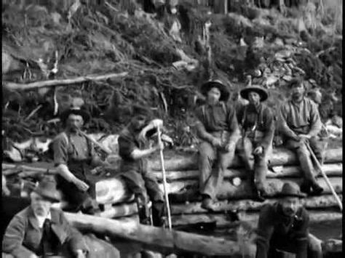
Historical Port Douglas
The Gold Rush
During the late 1800s, Port Douglas experienced the Palmer River gold rush, leading to a massive influx of people. The gold rush brought with it a period of unprecedented prosperity, and the town experienced rapid growth in population and infrastructure.
The period between the 1880s and the early 1900s was known as the boom times, and Port Douglas was at the forefront of the economic and social changes sweeping through Australia.
While Port Douglas flourished, other areas of Australia were being abandoned.
Palmer River gold miners

Slide 10
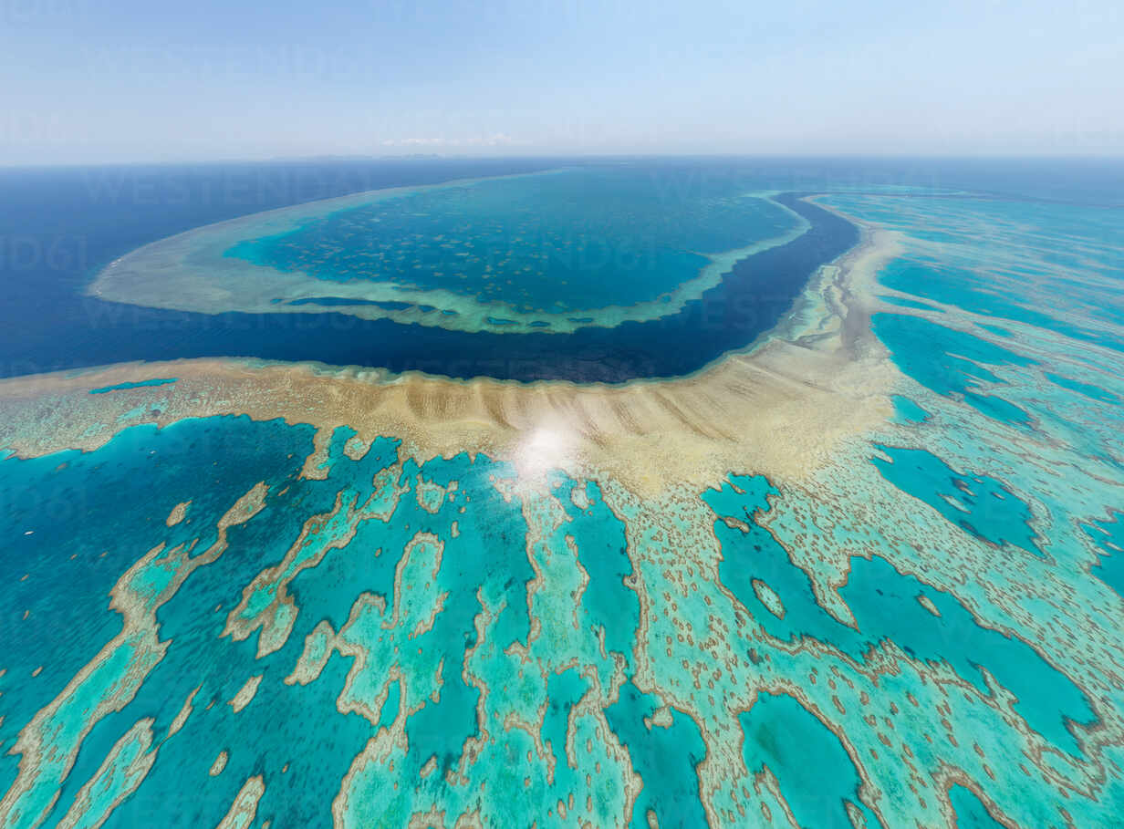
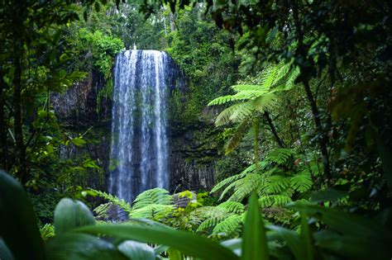
Historical Port Douglas
The Rise of Tourism
In the late 20th century, Port Douglas experienced a resurgence fueled by its stunning natural beauty and the rise of tourism in Australia.
The town’s proximity to the Great Barrier Reef and the Daintree Rainforest, two of Australia’s most popular tourist destinations, made it an attractive location for visitors.
Today, Port Douglas is a thriving tourist town with a vibrant local community and a strong economy.

Slide 11
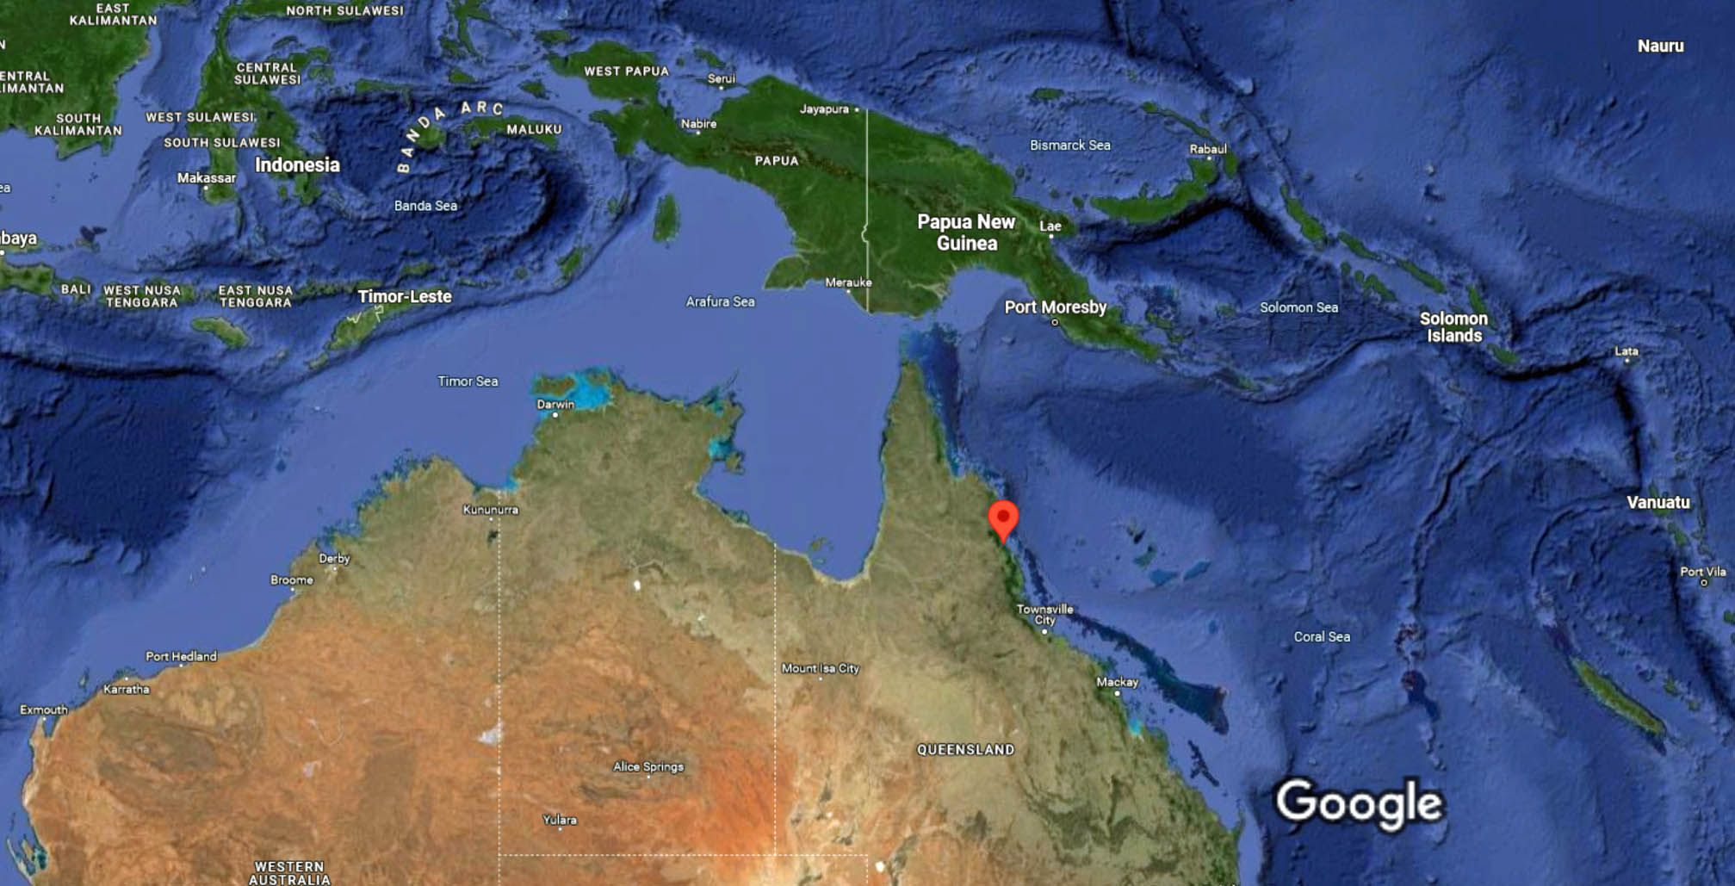
Australia
Port Douglas

Slide 12
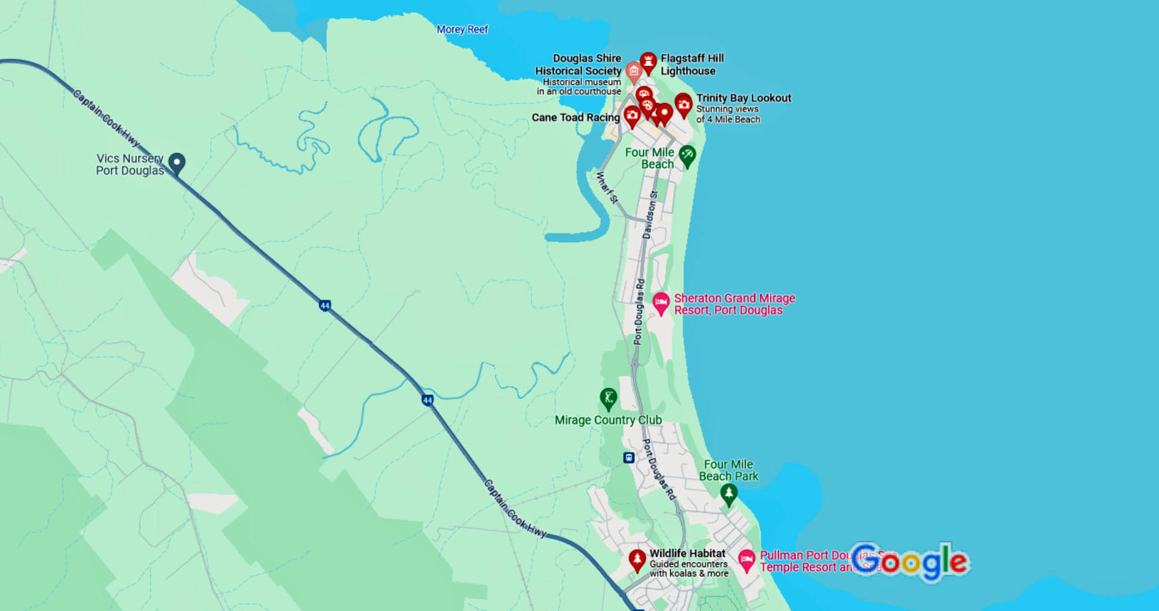
Port Douglas

Slide 13
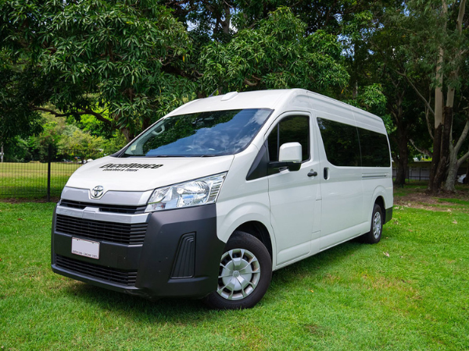
Port Douglas Trasportation
Excellence Coaches offers local shuttles for tourists who want to save extra money on transport. They run throughout Port Douglas area.
They offer transportation between the various attractions in Port Douglas.
1 Day UNLIMITED
Adults $22
Child <12 $11
Child <3 Free
Port Douglas does have Uber, Lyft, Didi, Ola, and other rideshares available.

Slide 14

Port Douglas Taxis
Standard taxis provide a safe and reliable way to explore the city or for transport between the cruise port and various attractions.
Like taxis in most locations the cost is significantly more expensive than other modes of transport.

Slide 15
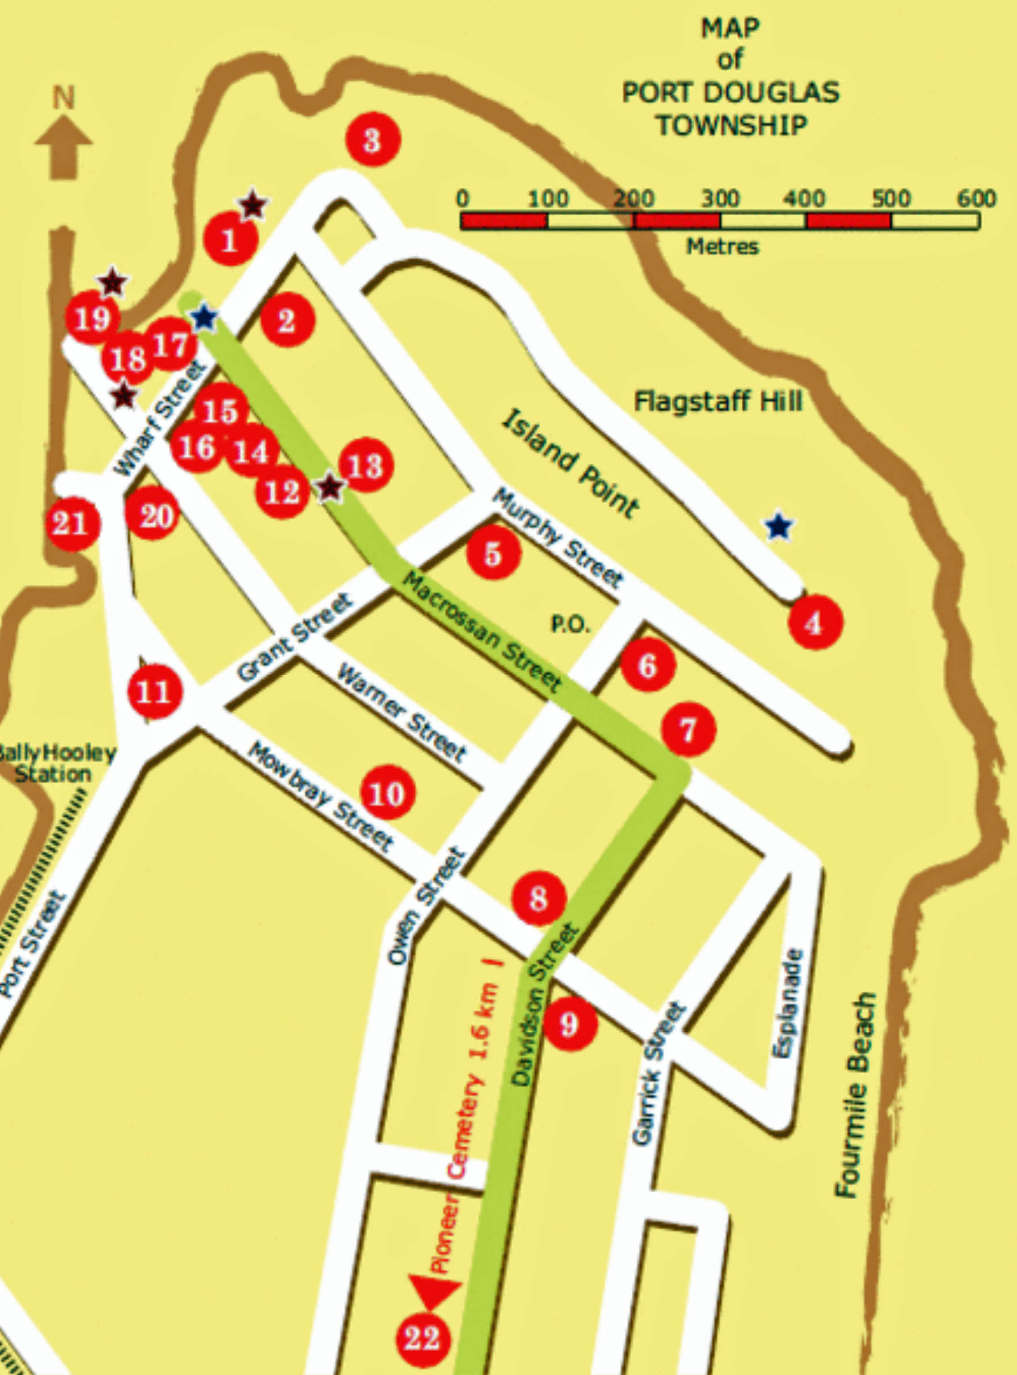
Port Douglas on Foot
Port Douglas is a very small town and easily walkable.
You can easily tour all the interesting points and historic buildings in Port Douglas in less than 3 hours.
1. Former 1879 Port Douglas Court House
2. St. Andrew's Anglican Church
3. Former Flagstaff Hill Lighthouse
4. Flagstaff Hill Lookout & signal Flagstaff
5. St. Mary's Catholic Church
6. Former 1879 State School no. 334
7. Rutherford's Corner
8. The Red Road (Davidson Street)
9. Former Port Douglas Hospital
10. Former Mossman Court House
11. Faugh-a-Ballagh Loco & Carriage
12. Bank of News South Wales (site)
13. Exchange Hotel & Carstens' Memorial
14. North Australian Hotel (central Hotel)
15. Buchanan's Family Hotel
16. Ramsay Store (site)
17. Waterfront Precinct (site)
18. St. Mary's by the Sea
19. Douglas Shire Council "Sugar" Wharf
20. Caledonian Hotel (site)
21. Douglas Divisional Board Wharf
22. Port Douglas Pioneer Cemetery

Slide 16
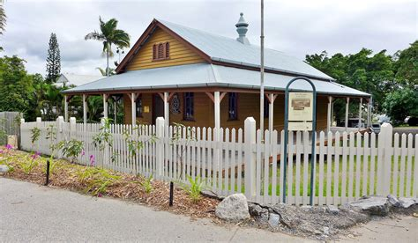
Douglas Shire Historical Society
The Museum displays interesting artifacts from the founding of Port Douglas and the surrounding area.
The Douglas Shire runs along the eastern coast of Far North Queensland from just north of Cairns, near Wangetti, to the Bloomfield River, south of Cooktown.
VISIT THE MUSEUM
25 Wharf St, Port Douglas QLD 4871
Open Tuesdays, Thursdays, Saturdays and Sundays 10am-1pm
Admission $3, Children and Students Free

Slide 17
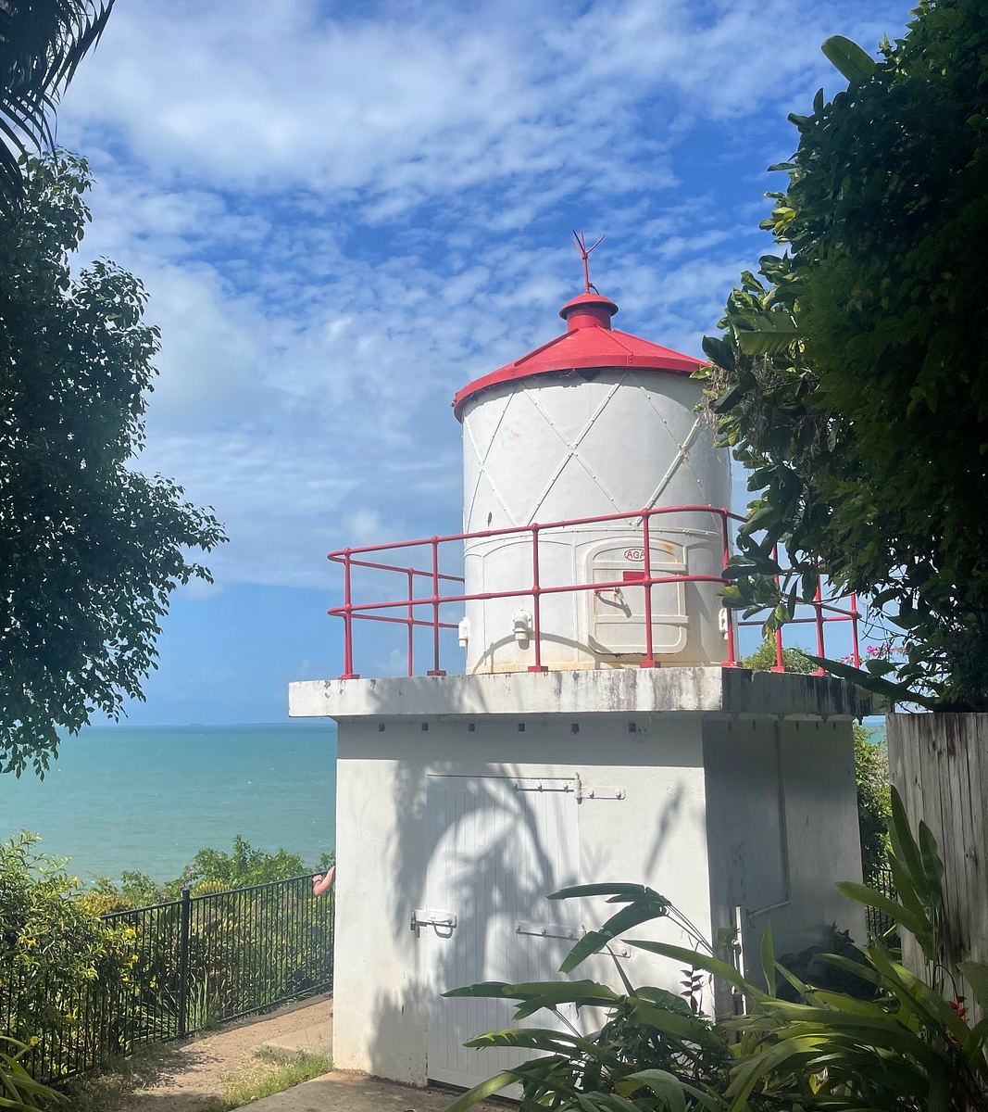
Flagstaff Hill Lighthouse
If you need a picture worth framing look no further than the Flagstaff Hill Lookout.
Located at the summit of Island Point Road, it is an easy walk, to the lookout viewing area.
From here you will witness sweeping, majestic views of Four Mile Beach to the south and the rainforest-clad mountain ranges beyond.

Slide 18
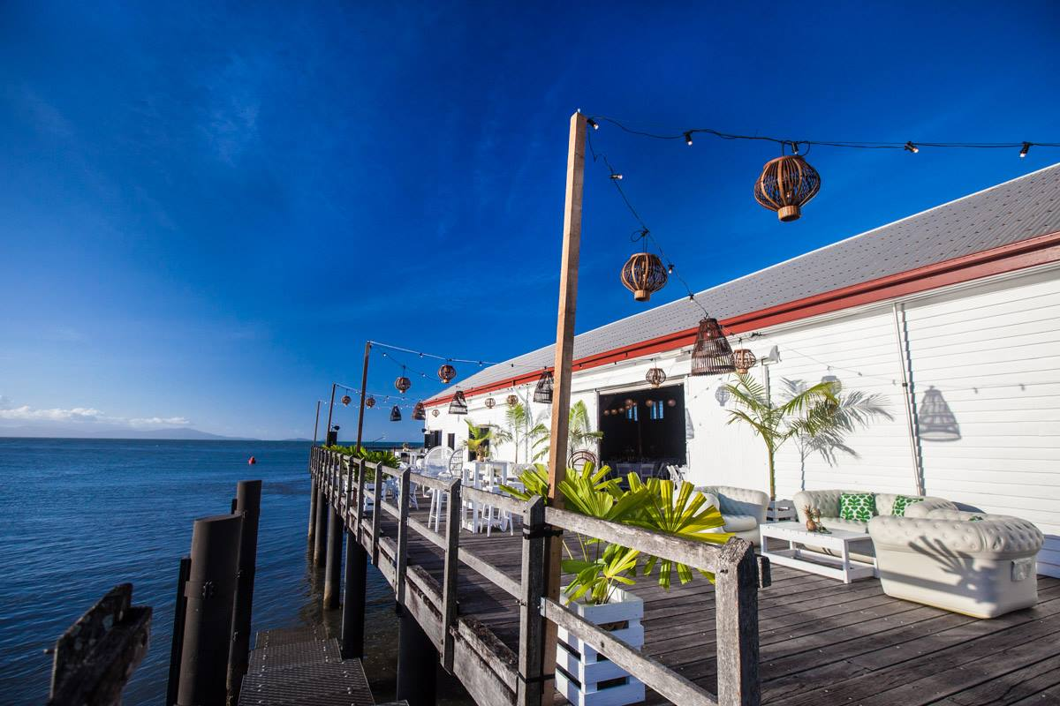
Port Douglas Sugar Wharf
Built in 1904 by the Douglas Shire Council, the historic, heritage listed building was once used for the mooring of ships and loading of sugar (Hence the name).
Flash forward 75 years and the popular white shed was home to well known diver Ben Cropp and his ‘Shipwreck Museum’.
The Sugar Wharf, Port Douglas was placed on the Queensland Heritage Register in 1992.

Slide 19
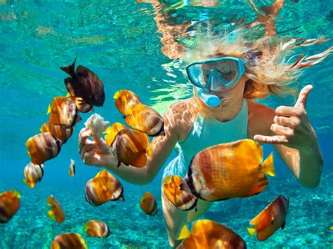
Snorkeling
Several companies offer a 2 -3 Hour Snorkeling Tour to Low Isles Reef .
This adventure takes travelers on a speedy boat ride to this protected UNESCO World Heritage Site, where they can encounter tropical fish, vibrant coral, and majestic turtles.
You will dive with a knowledgeable guide, capable of answering any questions.
Snorkeling gear is provided.
Prices range from $100 to $150.

Slide 20
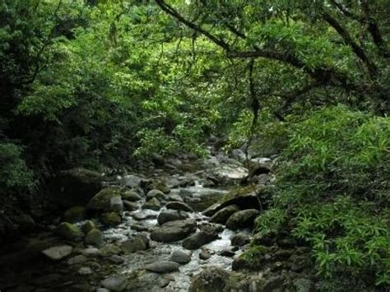
Mossman Gorge
Over millions of years, the Mossman River has carved out a steep-sided gorge through the southern part of the Daintree National Park, and you can walk through this amazing place just 15 minutes drive from Freestyle Resort.
Take the shuttle bus from the Mossman Gorge Centre to the start of the Baral Marrjanga Boardwalk, which has views of the river and the mountains beyond.
Continue over the Rex Creek suspension bridge and you’ll find the Rainforest Circuit Track, a fairly easy 2.4km loop through the magnificent forest.
If you want to ask questions, join one of the Dreamtime Walks, where indigenous guides will take you along private trails, and share their generations of local knowledge.

Slide 21
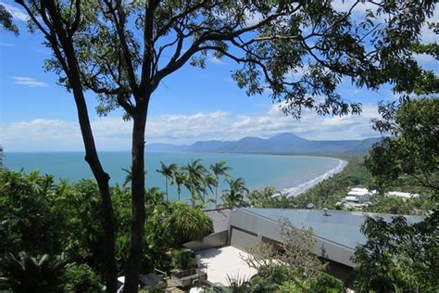
Flagstaff Hill
Port Douglas’s newest walking trail hugs the stunning stretch of coastline between Four Mile Beach and Rex Smeal Park.
It’s a winding, track with several sets of stone steps, and it offers incredible views of the Coral Sea right along its 1.5km length – including a couple of viewing platforms built out over the water.
From Freestyle Resort, head down to the Esplanade then take the steps that rise up from the north end of the beach.
After a short climb, there’s a detour off to the left to Flagstaff Hill Lookout. Come back down and carry on to Little Cove.
You can finish the loop by meandering back up Macrossan Street.

Slide 22
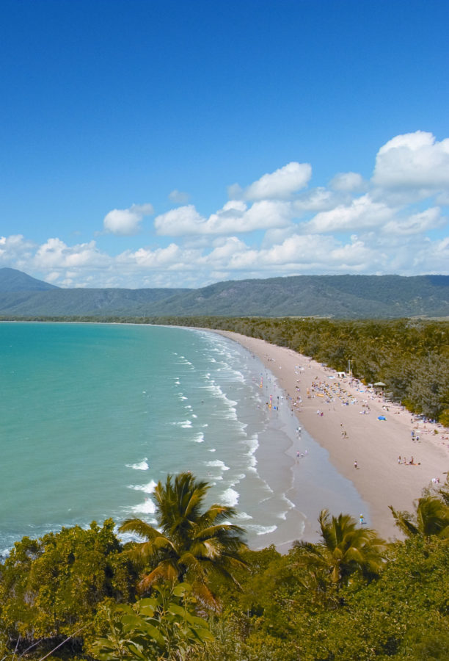
Four Mile Beach
Venture along the Flagstaff Hill Walking Trail down to Four Mile Beach and walk the plank (or viewing platform) and take in the 180-degree views to the Coral Sea, Low Isles and Snapper Island to the north.
Four Mile Beach is one of the world’s most photographed beaches.
Four Mile Beach begins at a rocky headland that opens up to four uninterrupted kilometers of palm-lined, creamy colored sand, and the vast expanse of the sparkling Coral Sea.
You can walk all the way south to the mangroves of the Mowbray River.

Slide 23
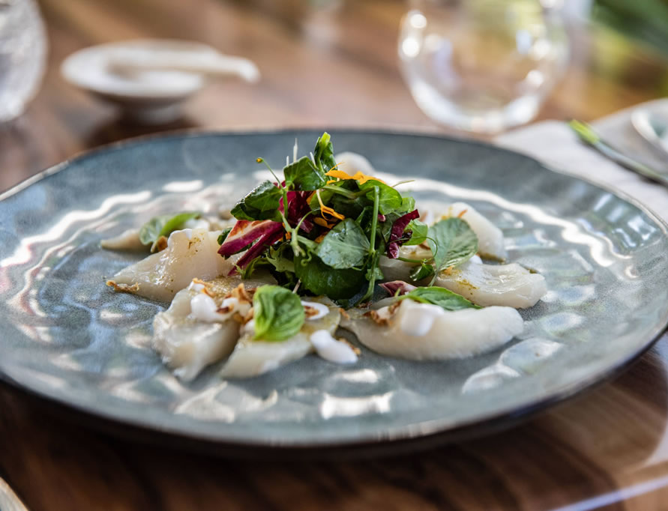
Restaurants in Port Douglas
There are a lot of excellent restaurants in Port Douglas.
Here are some recommendations:
Cafe Fresq $$ - $$$, Cafe, Healthy, Australian
Wrasse & Roe $$$$, Seafood, Australian, Vegetarian
N17 Burger Co $, Quick Bites, American, Vegetarian
Melaleuca Port Douglas $$$$, Seafood, Healthy, Australian
Salsa Bar & Grill $$ - $$$, Seafood, International, Australian
Epicurean Port Douglas $$ - $$$, Healthy, Wine Bar, Gluten Free
Watergate Restaurant & Lounge Bar $$$$, Bar, Vegetarian Friendly, Vegan
The Little Larder Port Douglas $$ - $$$, Healthy, Australian, Vegetarian
Seabean Tapas Bar Restaurant $$ - $$$, Mediterranean, European, Spanish
Nautilus Restaurant $$$$, Contemporary, Australian, Vegetarian

Slide 24
Conclusion
Port Douglas is a beautiful City with a rich history and numerous attractions. Regardless of what you're looking for, Port Douglas has something for everyone.
I hope this presentation will help when we visit Port Douglas!

Slide 25
Thanks For Coming
If you have any more questions, please ask.
I will do my best to answer them for you.
Have a great visit to Port Douglas!

Slide 26
Acknowledgement
My seminars are the result of many years of travel experience combined with many hours of research over the internet.
I would like to acknowledge the many source I have accessed.
These include: Wikipedia.com, Britannica.com, Trip Advisor and the various Museum, Park and Government websites.
7/22/2024

