Slide 1

Women in Piracy Presented by Marc Silver

Slide 2
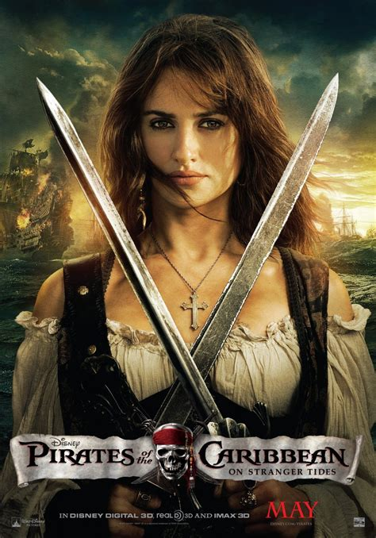
Women of the High Seas
I will make a not-so-large leap and assume everyone here has seen at least one of the Pirates of the Caribbean movies starring Johnny Depp and Keira Knightley.
This series was, of course, a fantasy, but it did portray one reality: there were female pirates. While Elizabeth Swann's character might seem like Hollywood fiction, her story draws inspiration from real women who sailed, fought, and commanded on the high seas.
While Pirates of the Caribbean might be a fantasy, it hints at a reality: women were indeed pirates. Their stories, more compelling than any Hollywood script, are what we’ll explore today.

Slide 3
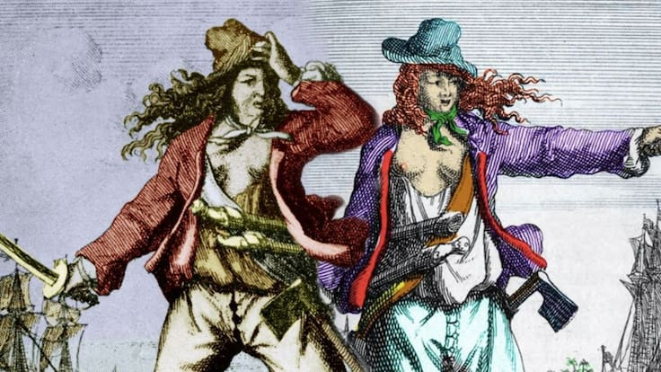
The Historical Context
Picture this: a stormy night off the coast of Jamaica in 1720.
A British naval vessel closes in on a pirate ship, expecting an easy capture. Instead, they’re met by two fierce fighters—Anne Bonny and Mary Read—cutlasses drawn, daring anyone to board.
This scene wasn’t a Hollywood invention; it’s recorded in history.
Women turned to piracy for many reasons—poverty, the lure of adventure, escape from societal constraints, or simply the promise of fortune and freedom.
In a world where women had few legal rights and limited economic opportunities, piracy offered a rare chance to carve their own path.
But with this freedom came enormous risk. Discovery could lead to execution, and life at sea was as brutal as it was liberating.

Slide 4
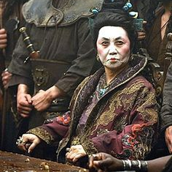
The Historical Context
Women’s lives in piracy weren’t limited to sword fights and sea battles. Some took on supporting roles just as crucial—working as smugglers, money launderers, or fences. Others used taverns or brothels as fronts for pirate intelligence networks.
In a world where women had few legal rights and limited economic opportunities, piracy offered a rare chance to carve their own path. But with this freedom came enormous risk.
Discovery could lead to execution, and life at sea was as brutal as it was liberating.
The lives of women in piracy weren’t limited to sword fights and sea battles. Some women took on supporting roles that were just as crucial. They worked as smugglers, money launderers, and fences, managing the stolen booty. Others used their positions in taverns and brothels as fronts for pirate intelligence networks, gathering information about ship movements and potential targets.

Slide 5
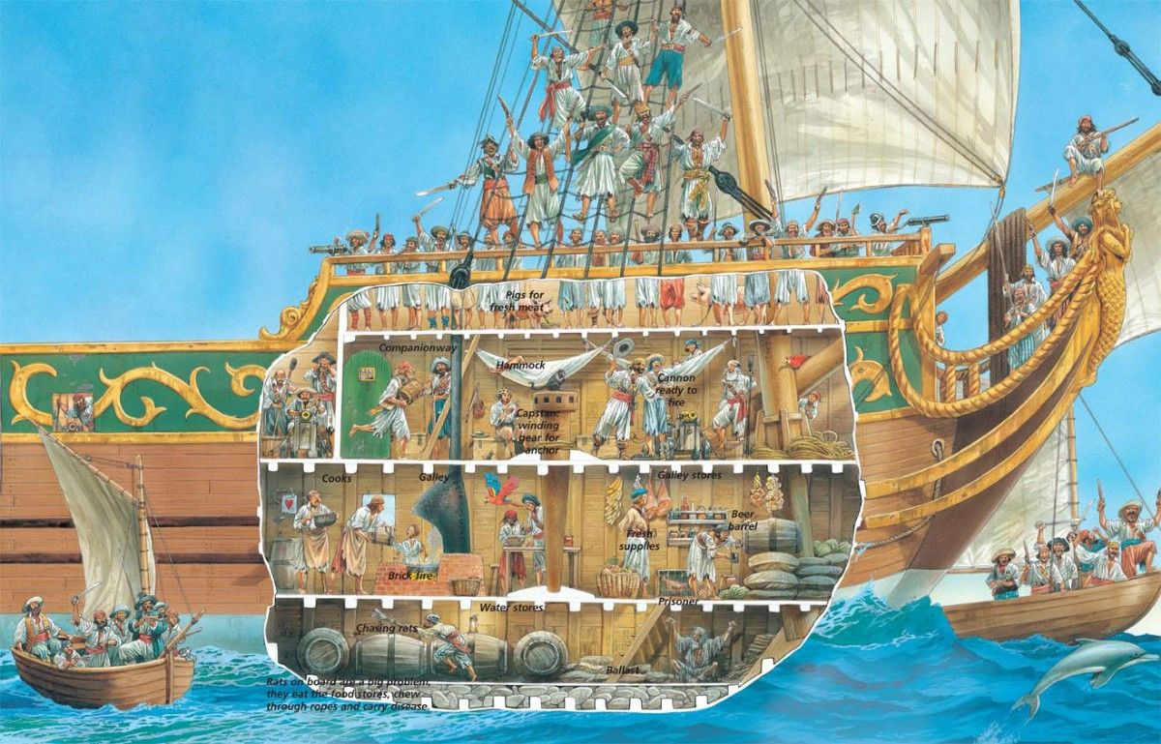
Life Aboard a Pirate Ship
Life aboard a pirate ship was anything but glamorous.
Food often consisted of hardtack infested with weevils, and water quickly turned brackish. Quarters were cramped, tempers often ran high, and disease was a constant threat.
For women who disguised themselves as men, like Mary Read, maintaining their cover was an added challenge.
Despite these difficulties, female pirates earned respect through their skill, bravery, and sheer determination.
Pirate crews valued ability over appearance—if you could fight, strategize, or navigate, you belonged.

Slide 6
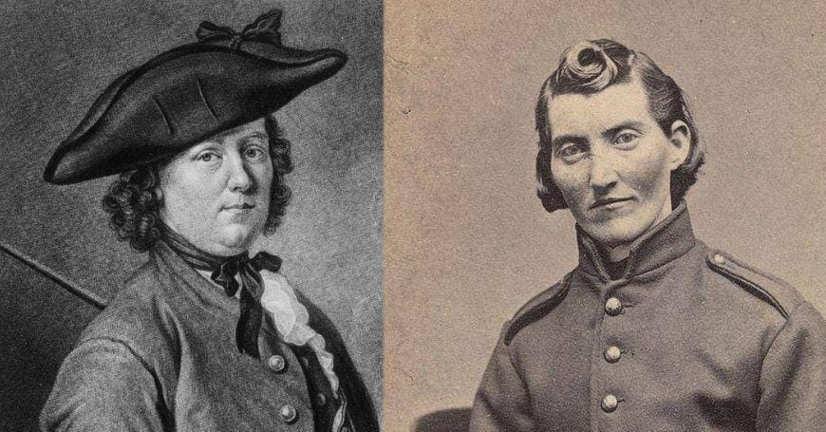
The Golden Age of Piracy
The Golden Age of Piracy (1650–1730) produced iconic figures like Anne Bonny and Mary Read, but it also saw the emergence of lesser-known female pirates who played pivotal roles.
Around forty women are documented as active pirates during this time, though many more likely went unrecorded.
Some women disguised themselves as men to join crews, while others took on operational roles from ports and coastal towns.
Even in a male-dominated world, women proved themselves capable fighters and strategic thinkers.
Pirate crews valued skill over gender, and those who could wield a cutlass, fire a pistol, or command a ship earned respect, regardless of societal norms.

Slide 7
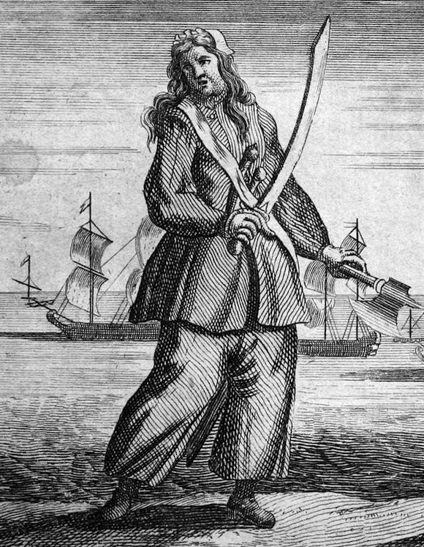
Anne Bonny: The Firebrand of the Caribbean
Born around 1700, Anne Bonny grew up in a tumultuous environment that seemed to foreshadow her rebellious future. In her early twenties, she left her husband for the pirate captain Calico Jack Rackham, joining his crew disguised as a man.
Bonny quickly gained a reputation for her fierce temperament and combat skills.
Her partnership with Mary Read, another disguised female pirate, only added to her legendary status.
The two shared the deck of Calico Jack Rackham’s ship, a rare and significant alliance that showcased their mutual courage and skill in combat.
Both were eventually captured in 1720, though Bonny's ultimate fate remains shrouded in mystery. Her story remains a powerful testament to defiance and survival in a male-dominated world.

Slide 8
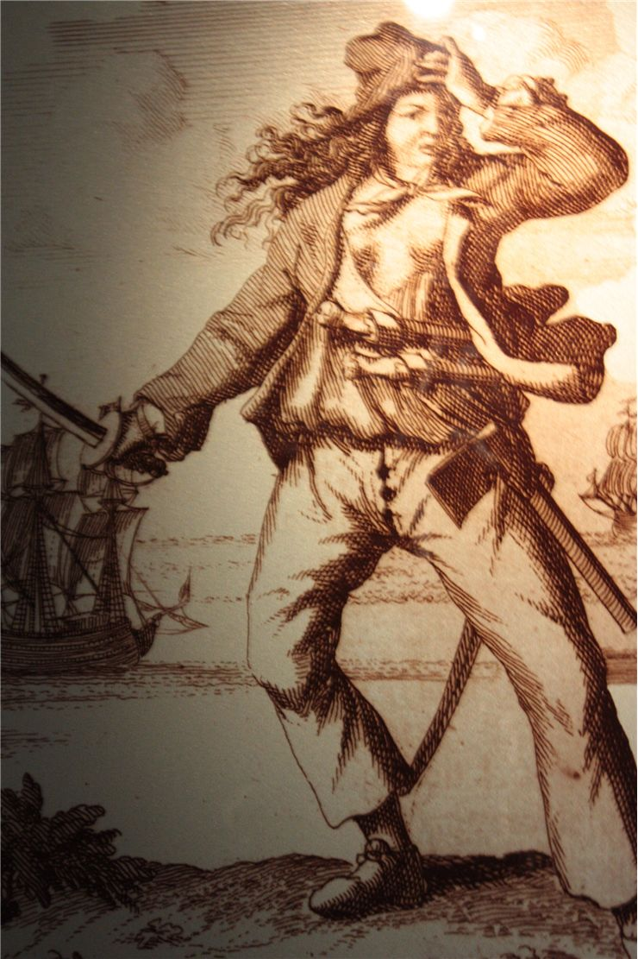
Mary Read: The Reluctant Rebel
Unlike Bonny, Mary Read’s life was marked by tragedy from the start. Born illegitimate in England around 1690, she was disguised as a boy to secure an inheritance.
This early deception paved the way for her later life aboard ships and, ultimately, among pirates.
Known for her bravery, Read reportedly saved Calico Jack’s ship from capture on multiple occasions.
Her life ended tragically in prison in 1721, where she died of fever. Her story—equal parts resilience and rebellion—continues to inspire.

Slide 9
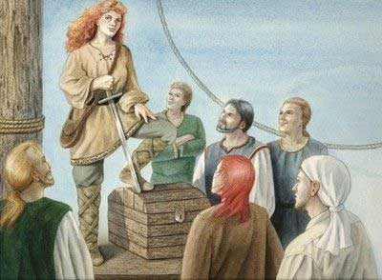
Lesser-Known Female Pirates
Beyond Bonny and Read, many women left their mark on piracy.
Neel Cuyper took a different approach to piracy. Disguised as a man early in her career aboard Dutch merchant ships, she later revealed her identity and established a pirate-friendly resort in Labadee Bay, Haiti.
This hub became a safe haven for pirates, providing rest, trade, and critical intelligence.
Ingela Gathenhielm of Sweden demonstrated that piracy wasn’t just about swordplay.
After her husband’s death, she turned his privateering venture into a sophisticated operation, managing fleets, negotiating with governments, and creating intricate networks for selling stolen goods.

Slide 10
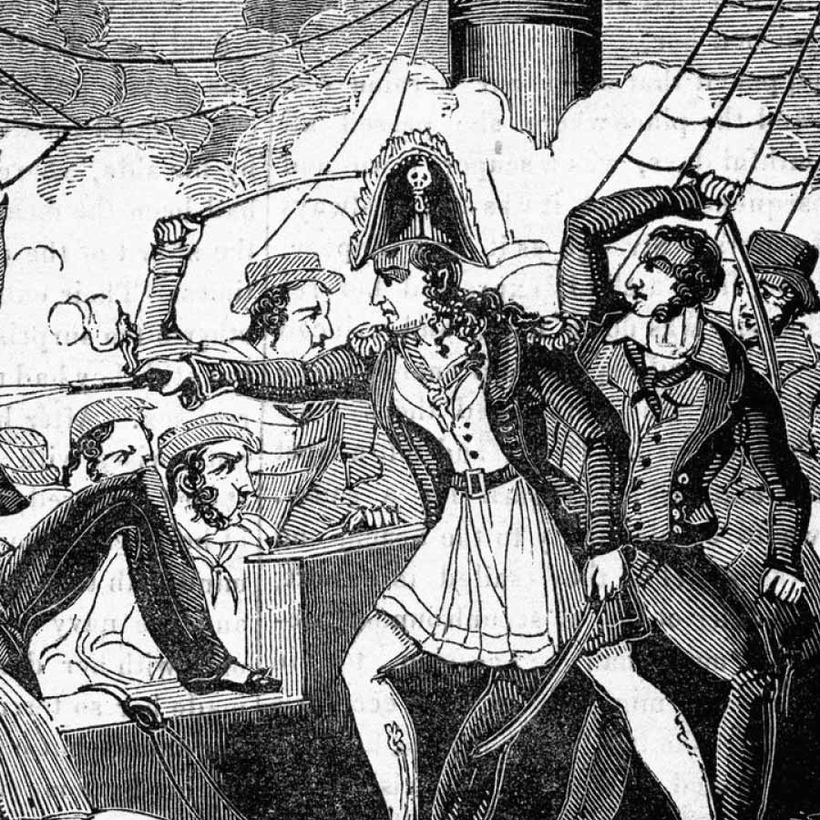
The Role of Myth and Legend
Some female pirates exist in the gray area between fact and fiction.
Charlotte de Berry is one such figure. Legend describes her as a woman who disguised herself as a man to follow her lover into naval service.
Her dramatic tale includes revenge, adventure, and eventual tragedy, making her a symbol of defiance against oppression.
Jacquotte Delahaye, often referred to as “Back from the Dead Red,” reportedly faked her death to escape capture and later reclaimed her role as a pirate leader.
While historians question the veracity of her story, it reflects the allure and resilience associated with women in piracy.

Slide 11
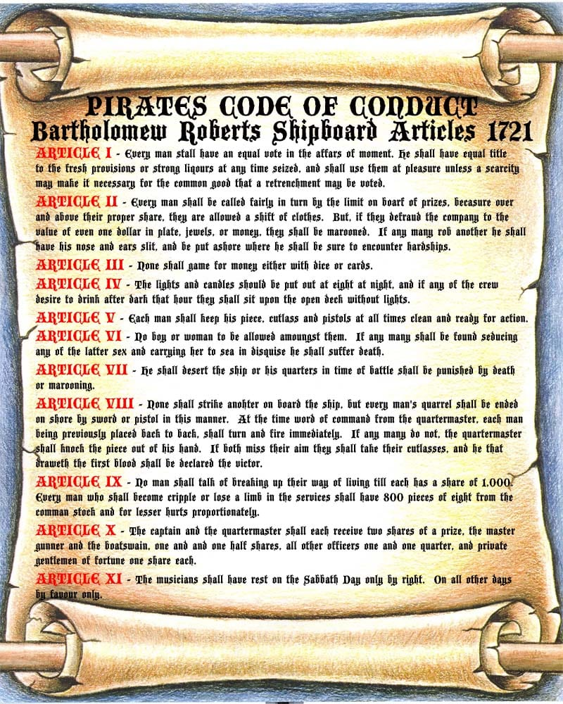
Pirate Codes and Conduct
One of the most fascinating aspects of piracy was the code of conduct many crews followed.
While pirate codes varied depending on the time and region, they all aimed to maintain order and discipline among a notoriously unruly group.
In the Caribbean, pirate codes emphasized equality and democracy. Crews voted on key decisions, divided loot based on rank and contribution, and provided compensation for injuries sustained in battle.
Punishments for breaking the rules, such as theft or desertion, ranged from marooning to execution.

Slide 12
Women Pirates Beyond the Golden Age
Piracy didn’t end with the Golden Age.
Zheng Yi Sao, also known as Ching Shih, commanded over 300 ships and 70,000 pirates in the 19th century.
Her intelligence network, strict code of conduct, and political acumen made her one of history’s most successful pirates.

Slide 13
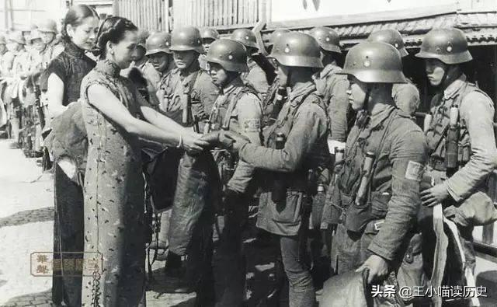
Women Pirates Beyond the Golden Age
In the 20th century, Huang Bamei commanded thousands of pirates, blending traditional piracy with modern technologies.
Huang Bamei (黄八妹) was born around 1906 on Pingtan Island in Fujian province, she initially led a group of pirates along China's southeastern coast. However, during the Second Sino-Japanese War (1937-1945), she transformed her pirate fleet into a guerrilla force fighting against Japanese invaders.
Her fleet utilized speedboats and firearms, adapting to changing maritime challenges
Working with both the Chinese Nationalist government (KMT) and the Americans, Huang commanded hundreds of fighters and conducted raids against Japanese positions. She became known for her military prowess and earned the nickname "The Queen of the Pirates." The KMT government officially recognized her contributions by giving her the rank of colonel.

Slide 14
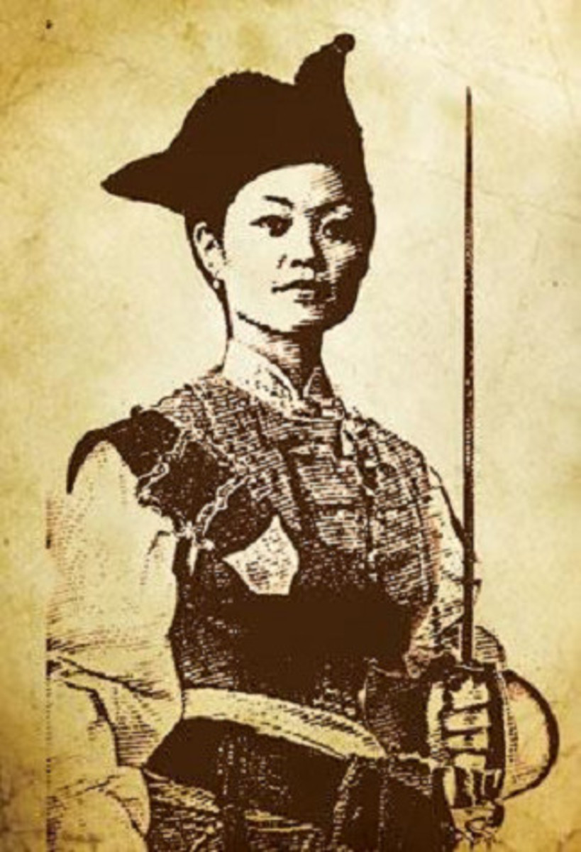
Pirate Codes and Conduct
In contrast, Zheng Yi Sao’s code in the South China Sea was far more rigid and centralized.
As the commander of a fleet of over 300 ships, she maintained absolute authority. Her code imposed severe punishments, such as execution for disobedience or theft from the fleet.
It also addressed the treatment of women, requiring respect for female captives and strict rules for their release or integration into the crew.
This level of discipline ensured the loyalty and efficiency of her vast network, enabling her to command one of history’s most formidable pirate empires.
Zheng Yi Sao

Slide 15
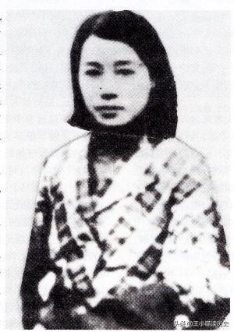
Modern Female Involvement
Even today, women play critical roles in piracy, particularly in regions like Somalia, where piracy has adapted to modern challenges.
Women often operate behind the scenes, handling logistics, financial operations, and recruitment.
They manage supply chains, ensuring pirates have food, fuel, and weapons, and maintain safe houses for crews to regroup.
Some serve as financial masterminds, laundering ransom money through intricate networks. Their roles are pivotal, enabling the continuation of these operations.
While they’re less likely to wield weapons, their influence on modern piracy mirrors the strategic roles of historical figures like Zheng Yi Sao and Huang Bamei.
Huang Bamei

Slide 16
Women in Piracy
Women played fascinating roles in the Golden Age of Piracy, defying societal norms and carving out their own legacies. Anne Bonny and Mary Read, two of the most iconic female pirates, sailed alongside Calico Jack Rackham, disguising themselves as men to join his crew. Renowned for their combat skills and bravery, they became legends, though neither ever captained a ship.
While Bonny and Read are well-known, other women like Neel Cuyper also left their mark. Cuyper began disguised as a man on Dutch merchant ships but eventually earned a place among pirates. After her true identity was discovered, she established a pirate-friendly resort in Labadee Bay, Haiti. Similarly, Ingela Gathenhielm of Sweden managed her late husband’s privateering ventures, becoming a rare female leader in maritime operations.
Some stories blur the line between history and legend. Figures like Charlotte de Berry and Jacquotte Delahaye, though likely fictional, reflect the allure of female pirates in popular imagination. From daring escapes to complex alliances, these women’s lives reveal a rich, untold dimension of piracy, proving that the high seas were not solely the domain of men.

Slide 17
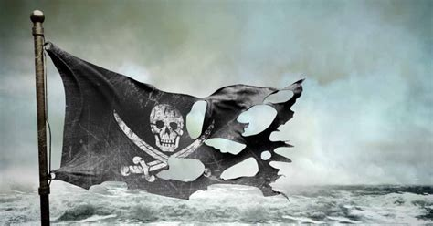
Women in Piracy: A Broader View
Don’t think for a moment that women only appeared during the Golden Age of Piracy.
Historical records document female pirates throughout the ages, commanding fleets, leading raids, and shaping maritime history.
From Zheng Yi Sao’s empire to Anne Bonny’s daring exploits, these stories challenge our assumptions about gender roles on the high seas.
Their legacy isn’t just about swords and treasure—it’s about resilience, defiance, and the human spirit’s determination to chart its own course.

Slide 18
Final Thoughts: Women on the High Seas
Interestingly, while Anne Bonny and Mary Read never captained their own ships, they demonstrated remarkable leadership and bravery as crew members, becoming iconic figures in piracy.
Among the women mentioned, only Ingela Gathenhielm could be considered a leader in maritime ventures, overseeing privateering operations after her husband’s death.
This distinction highlights the varied ways women navigated the high seas, whether through direct combat, cunning, or managing complex operations.
The lives of these women—whether well-documented or shrouded in legend—offer a glimpse into the diverse roles women played in piracy.
Figures like Anne Bonny and Mary Read remind us of the boldness and defiance that characterized this era, while lesser-known pirates like Neel Cuyper and Ingela Gathenhielm reveal the varied paths women took in a world dominated by men.
From violent ends to peaceful retirements, these stories capture the complexities of gender, opportunity, and survival during the Golden Age of Piracy. Together, they paint a richer, more nuanced picture of maritime history, where women were not merely passengers but active participants in shaping the high seas.

Slide 19
References
Cordingly, David. Under the Black Flag: The Romance and the Reality of Life Among the Pirates. Random House, 1995.
Druett, Joan. She Captains: Heroines and Hellions of the Sea. Simon & Schuster, 2000.
Konstam, Angus. Pirates: The Complete History from 1300 BC to the Present Day. Osprey Publishing, 2008.
Rediker, Marcus. Villains of All Nations: Atlantic Pirates in the Golden Age. Beacon Press, 2004.
Starkey, David J. Pirates and Markets: Evidence from History. Boydell Press, 2001.
Primary source references, including trial records from Virginia (1729) and accounts of privateering in 18th-century Sweden, were used to verify historical details about Mary Critchett and Ingela Gathenhielm.

