Slide 1
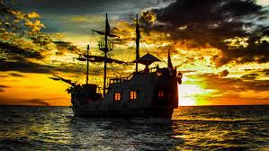
Pirates of the Caribbean Part 2 From Privateers to Pirates Presented By Marc Silver

Slide 2
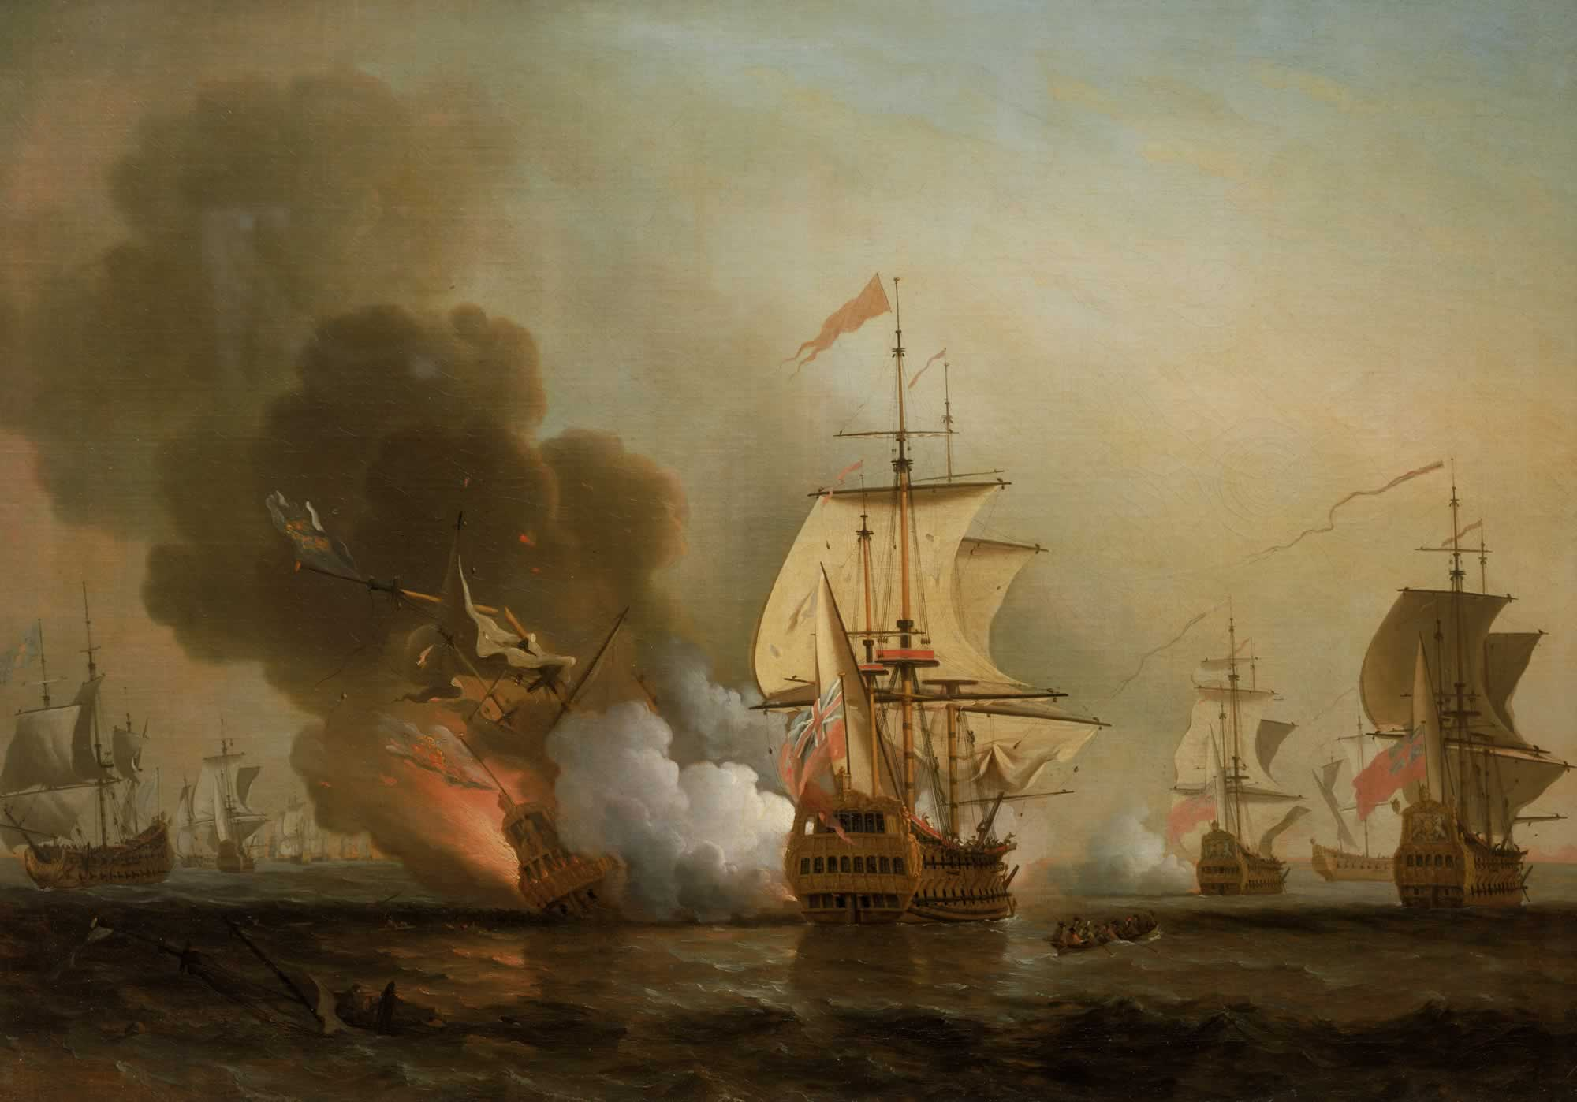
Piracy’s Decline
Decline of Piracy (1730-1750)
By the early 18th century, the golden age of piracy was waning.
Multiple factors contributed to its decline, including heightened naval enforcement, technological advancements, and shifting economic realities.
This decline was not abrupt but the culmination of deliberate efforts by colonial powers to restore order on the seas.

Slide 3
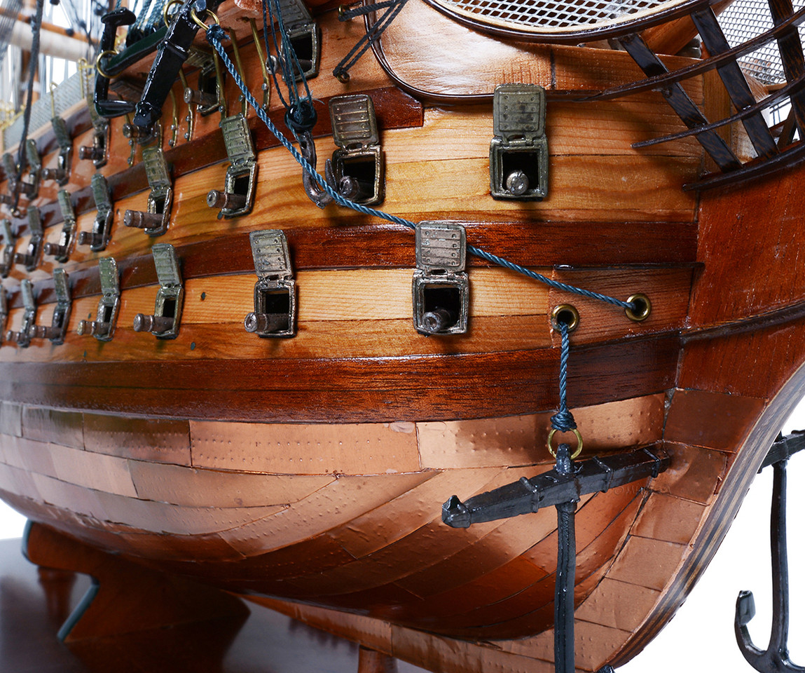
Piracy’s Decline
Factors Behind the Decline
The decline of piracy in the mid-18th century was driven by:
Advances in Naval Technology: Copper-bottomed ships, improved navigation tools, and longer-range cannons.
Economic Shifts: Growing insurance markets, larger merchant fleets, and expanded trade routes.
Increased Enforcement: Efforts like Woodes Rogers’ reforms and coordinated naval patrols.

Slide 4
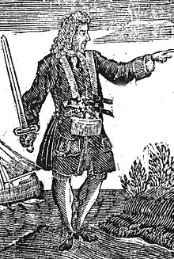
Piracy’s Decline
Improved Naval Enforcement
Colonial powers deployed better-equipped ships, with increased naval patrols targeting pirate strongholds.
Woodes Rogers and Nassau: Governor Woodes Rogers transformed Nassau from a pirate haven into a secure colony.
He offered pardons to pirates willing to surrender and aggressively pursued holdouts.
The British Royal Navy's coordinated maritime strategies systematically dismantled pirate networks, making oceanic trade routes progressively safer for merchant vessels.

Slide 5
Piracy’s Decline
Economic Shifts
Diversified trade routes made piracy less viable, reducing high-value targets in the Caribbean.
Growing insurance markets mitigated financial losses from pirate attacks.
Expanding colonial economies offered more stable and lucrative opportunities for sailors, diminishing the appeal of piracy.
Symbolic Decline
Public executions of notorious pirates like Blackbeard (1718) and Charles Vane (1721) sent a clear message.
By 1730, pirate attacks had dropped by 90%, and by 1750, the era was effectively over.

Slide 6
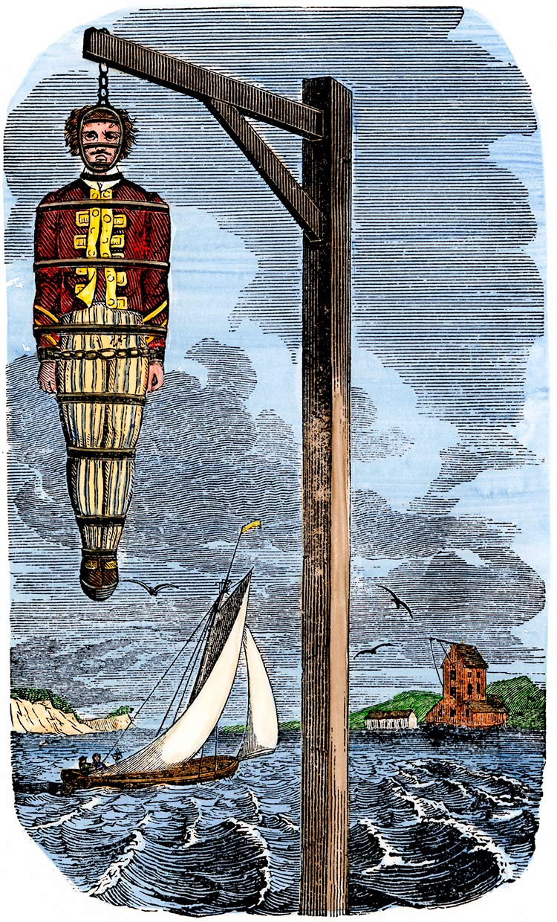
Impact of Piracy
Even after its decline, piracy left an enduring cultural imprint. Pirates became symbols of rebellion, freedom, and defiance against authority, influencing multiple aspects of history and culture.
Maritime Law
Symbolic Decline
The public executions of infamous pirates like Blackbeard in 1718 and Charles Vane in 1721 served as stark warnings. These high-profile deaths marked the beginning of piracy’s end in the Caribbean.
By 1730, pirate attacks had dropped by 90%, and by 1750, the era was effectively over.

Slide 7

Piracy’s Decline
The Cultural Impact of Piracy
Even after its decline, piracy left an indelible cultural imprint. Pirates became enduring symbols of rebellion, freedom, and resistance to authority.
Maritime Law
The chaos caused by piracy spurred international cooperation, leading to clearer maritime laws and more sophisticated naval strategies.
Nations cooperated to establish clearer rules for trade and naval enforcement.

Slide 8

Piracy’s Decline
Caribbean Culture
Pirates played a role in shaping the cultural tapestry of the Caribbean. The blending of European, African, and Indigenous influences is evident in regional cuisine, folklore, and music. Pirate myths often weave into local stories, contributing to a vibrant oral tradition.
Pop Culture
Pirates played a role in shaping the cultural tapestry of the Caribbean. The blending of European, African, and Indigenous influences is evident in regional cuisine, folklore, and music. Pirate myths often weave into local stories, contributing to a vibrant oral tradition.

Slide 9
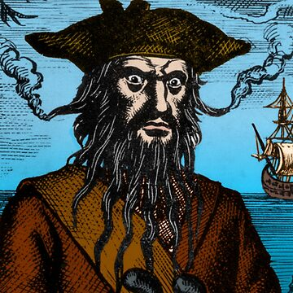
Piracy’s Decline
Notable Final Figures of Piracy
The decline of piracy was marked by the capture or death of several key figures:
Edward "Blackbeard" Teach and Bartholomew "Black Bart" Roberts. Blackbeard (c. 1680-1718) was a master of theatrics, famous for weaving lit fuses into his beard to create a terrifying, smoke-wreathed appearance.
Operating along North America's east coast and the Caribbean, he relied more on intimidation than violence, most notably during his 1718 Charleston harbor blockade. He met his end that year at Ocracoke Inlet, fighting Lieutenant Robert Maynard's forces with legendary resilience.
Roberts (1682-1722), though a reluctant pirate initially, became the era's most successful buccaneer. Unlike his contemporaries, he was known for sobriety and discipline, preferring tea to rum and enforcing strict shipboard rules. His operations spanned from the Americas to West Africa, where he eventually fell in battle against the Royal Navy.

Slide 10
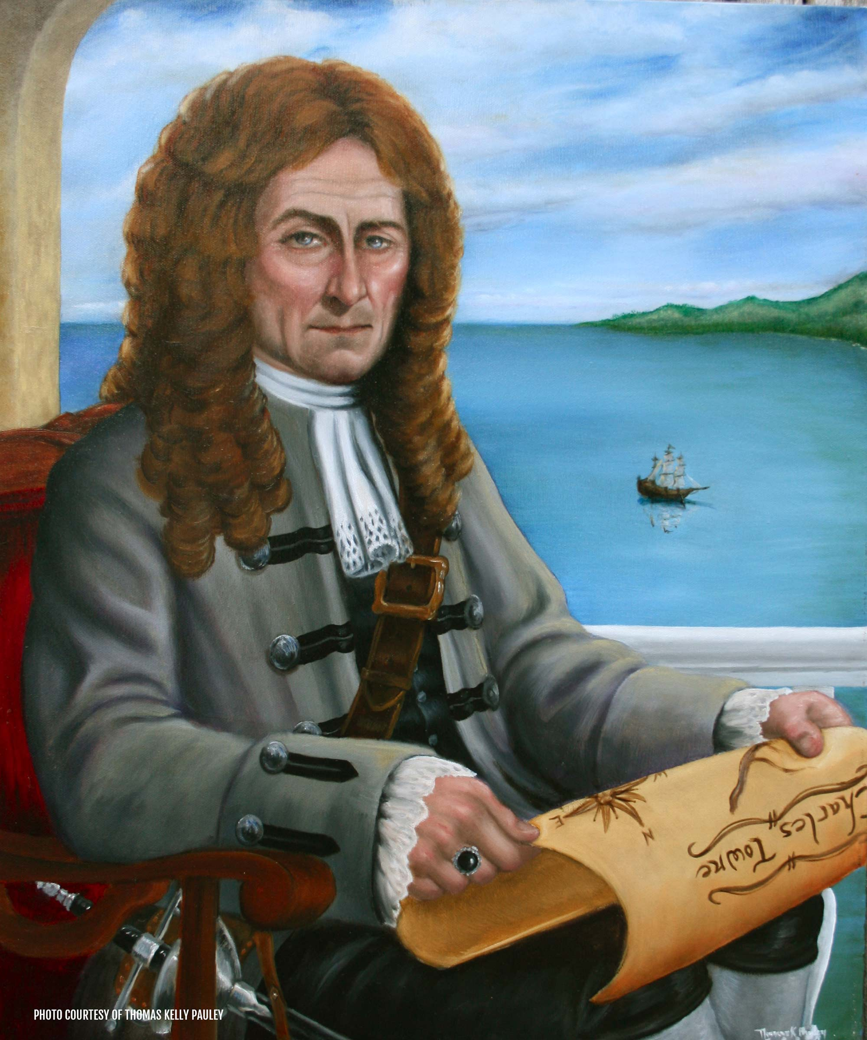
Piracy’s Decline
Stede Bonnet (1688-1718) Known as the "Gentleman Pirate," Bonnet's story is unique among pirates. He was a wealthy Barbadian sugar plantation owner and retired British army major who inexplicably turned to piracy in 1717.
Unlike most pirates, he actually purchased his first ship, the Revenge, rather than stealing it. His lack of sailing experience led him to initially partner with Blackbeard, who effectively took command of Bonnet's ship while keeping him on as a "guest."
Bonnet's career was marked by periods of both success and remarkable ineptitude.
He sometimes operated under a legitimate commission as a privateer, but returned to outright piracy. His end came after he was captured near Cape Fear River. During his trial in Charleston, South Carolina, his former status as a gentleman worked against him - the judge found it particularly offensive that someone of his education and standing would turn to piracy. He was hanged in Charleston on December 10, 1718.

Slide 11
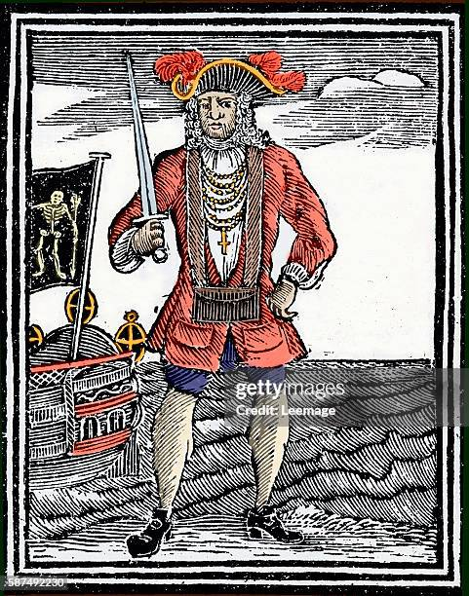
Piracy’s Decline
Bartholomew "Black Bart" Roberts (1682-1722) Perhaps the most successful pirate of the "Golden Age," Roberts was initially a reluctant pirate, forced into service when his merchant vessel was captured.
However, he quickly embraced the life and proved to be an exceptional naval tactician. Unlike many of his contemporaries, Roberts was known for his sobriety and discipline - he preferred tea to rum and enforced strict rules about gambling and fighting aboard his ships.
His fleet operated across a vast area, from the Americas to West Africa. Roberts was innovative in his tactics, using tall ships that could outrun military vessels and developing sophisticated systems for managing his growing fleet.
He was particularly known for his elegant dress style and his strict personal code - he enforced a prohibition on women and gambling, and gave his crew regular rest periods. aboard his, held regular religious services
His death came in 1722 during a battle with the Royal Navy off the coast of Africa.

Slide 12
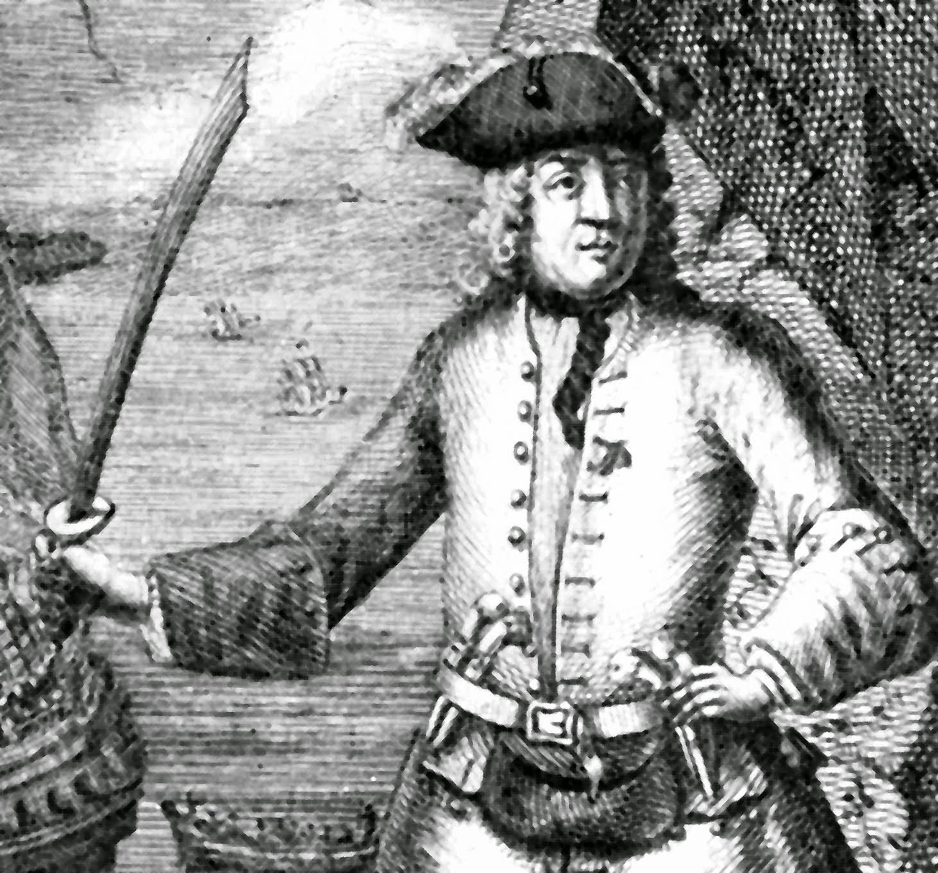
Piracy’s Decline
The Most Successful Pirate
Henry Avery (c 1659–1696 or 1699), also known as "Long Ben," was a notorious English pirate who became one of the most successful maritime criminals in history.
In 1695, he pulled off the most profitable single pirate raid ever, capturing the Mughal ship Ganj-i-Sawai near the coast of India and seizing treasure worth approximately £600,000 (around $100 million today). This extraordinary heist made him extremely wealthy and infamous throughout the maritime world.
Avery's cunning enabled him to evade capture despite extensive international manhunts, becoming a legendary figure in pirate folklore.
After his massive Indian Ocean raid, he disappeared from historical records, with many theories about his ultimate fate.
His incredible success inspired numerous fictional pirate characters and became a benchmark for maritime criminal achievement during the Golden Age of Piracy.

Slide 13
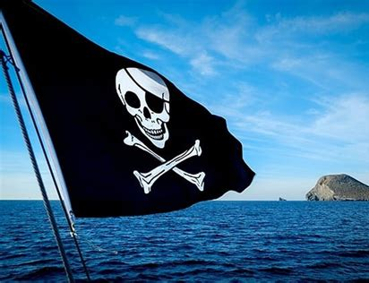
Piracy’s Decline
These figures are fascinating not just for their actions, but for how they reflected different aspects of pirate society - from Blackbeard's theatrical intimidation to Roberts' disciplined professionalism to Bonnet's unlikely career change.
Each one contributed to the complex tapestry of pirate history that continues to fascinate us today.
These enduring legends, while embellished, capture the intrigue and romance of piracy that continues to captivate imaginations today.

Slide 14
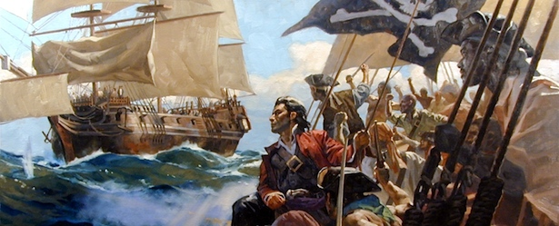
Final Thoughts
The decline of Caribbean piracy marked the end of a chaotic yet transformative era.
Pirates were more than criminals; they were products of their time, reshaping maritime history and challenging colonial powers.
Their defiance of authority and pursuit of freedom left an indelible mark on global culture.
From the democratic principles aboard their ships to their integration with Indigenous peoples, pirates symbolized both rebellion and community.
Their enduring stories of adventure and independence remind us of the human desire to break free from constraints, a theme that continues to inspire and captivate audiences across generations.

Slide 15
Citations & References
Cordingly, David. Under the Black Flag: The Romance and Reality of Life Among the Pirates. Random House, 1995.
Earle, Peter. The Pirate Wars. Thomas Dunne Books, 2003.
Rediker, Marcus. Villains of All Nations: Atlantic Pirates in the Golden Age. Beacon Press, 2004.
Johnson, Charles. A General History of the Pyrates. 1724.
Exquemelin, Alexander O. The Buccaneers of America. 1678.
National Archives. "Letters of Marque." https://www.nationalarchives.gov.uk
Smithsonian Institution. "Pirate Archaeology." https://www.si.edu
Defoe, Daniel (writing as Capt. Charles Johnson). "A General History of the Pyrates." Edited by Manuel Schonhorn. Dover Publications, 1972/1999.
Note: This article synthesizes research from various historical sources. Efforts have been made to ensure accuracy, but some details may vary across accounts

