Slide 1
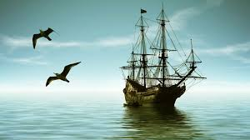
Pirates of the Caribbean Part 1 From Privateers to Pirates Presented By Marc Silver

Slide 2
What We Will Cover
Introduction
Overview of the Age of Pirates
History of Pirate Age in the Caribbean
Regions of Pirate Activity
The Cultural Impact of Piracy
Notable Pirates Through the Ages
The Pirate Economy
The Decline of Caribbean Piracy
Final Thoughts
Citations & References

Slide 3
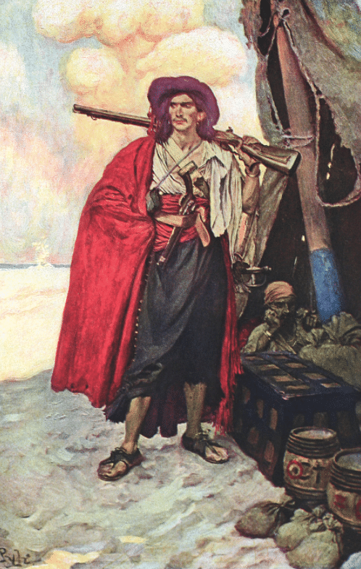
Rogues, Rebels, and Riches
The Caribbean's Maritime Outlaws
Pirates of the Caribbean were far more than the caricatured swashbucklers of Hollywood fame. They were a product of their time, driven by the shifting tides of colonial politics, economic warfare, and a quest for survival.
These rogues and rebels operated at the intersection of legality and defiance, often blurring the line between state-sanctioned privateers and outright criminals.
This golden age of piracy, spanning from the mid-17th to the early 18th century, was rooted in the fierce competition between European powers.
As Spain sought to monopolize the wealth of the Americas, other nations, most notably England, France, and the Netherlands—sought to disrupt their grip by employing privateers.
Over time, many privateers turned pirate, trading their letters of marque for the freedom to plunder without allegiance.

Slide 4
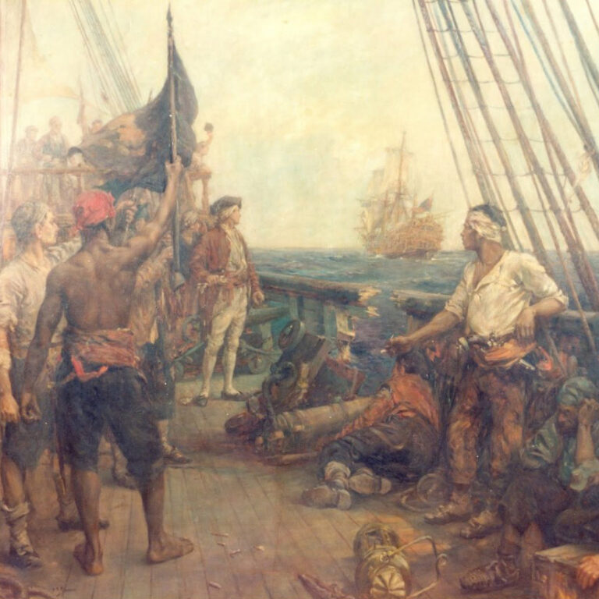
Rogues, Rebels, and Riches
Pirates also forged their own societal norms, creating a world that defied the rigid hierarchies of colonial life. Ships often operated democratically, with captains elected by the crew and loot distributed equitably.
In some cases, pirates embraced principles that resembled early forms of workers' rights and social equity, offering compensation for injuries and shared decision-making.
Culturally, these maritime outlaws left an indelible mark on the Caribbean.
The blending of European, African, and Indigenous influences within pirate society reflected the diversity of the region.

Slide 5
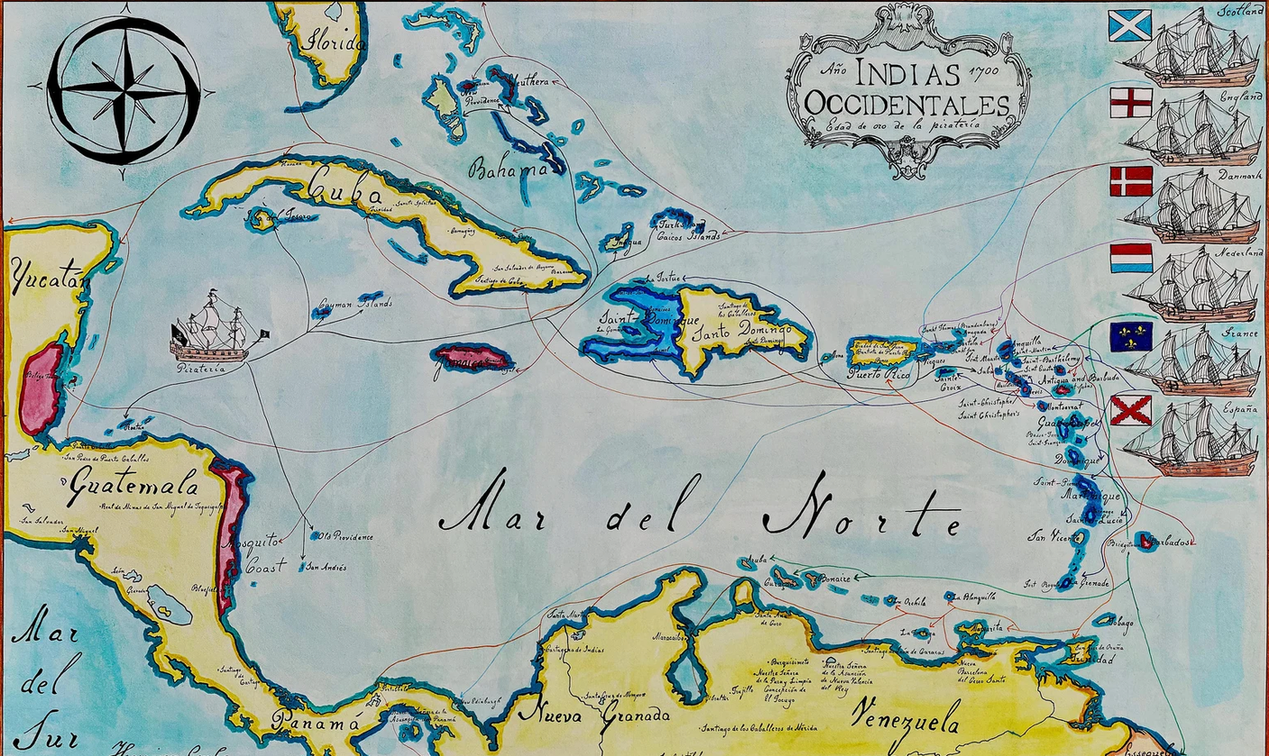
Rogues, Rebels, and Riches
Tales of their daring exploits, coupled with the remnants of their presence in ports like Nassau and Tortuga, continue to captivate imaginations and contribute to the rich tapestry of Caribbean history.
The Caribbean’s golden age of piracy (1650-1730) has long been romanticized, thanks to Hollywood blockbusters and swashbuckling legends. But the reality of these maritime outlaws reveals a far more complex story.
Pirates were not just lawless rogues; they were shaped by colonial politics, economic warfare, and survival in unforgiving conditions.
My talk will delve into the nuanced world of Caribbean piracy, exploring its origins, cultural impact, famous figures, and eventual decline.

Slide 6
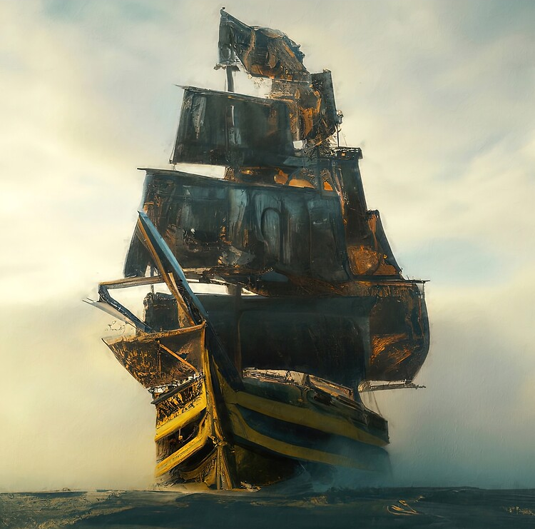
The Dawn of Caribbean Piracy
The story begins with the Spanish conquest of the Americas in the early 1500s. As Spanish galleons laden with gold and silver crossed the Atlantic, they attracted opportunistic raiders from rival European nations.
Initially, these raiders were privateers - legally sanctioned pirates operating under "letters of marque" from their governments. This distinction between privateers and outright pirates would blur significantly over time.

Slide 7
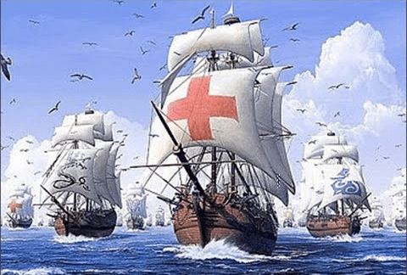
Overview of the Age of Pirates
The Age of Piracy in the Caribbean emerged in the early 1500s as the Spanish Empire began transporting vast wealth from the Americas to Europe.
Spanish treasure fleets, laden with gold, silver, and other riches, became irresistible targets for raiders.
Early privateers, like Sir Francis Drake, operated with government approval through "letters of marque," blurring the line between sanctioned privateering and outright piracy.
Over time, many privateers turned rogue, perpetuating their exploits even after their commissions expired.

Slide 8
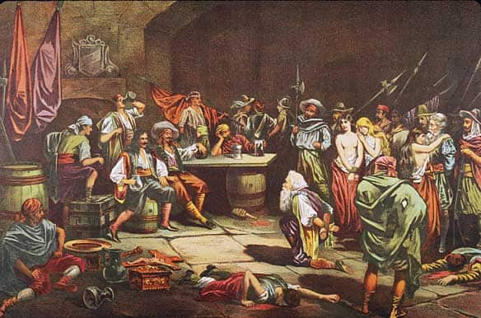
Overview of the Age of Pirates
The Caribbean’s geography made it a haven for piracy. Its numerous islands, hidden coves, and labyrinthine trade routes provided perfect conditions for ambushes and escapes. The inability of colonial powers to effectively police these waters allowed pirate enclaves to flourish.
Meanwhile, thriving black markets ensured a steady demand for stolen goods, making piracy a lucrative enterprise.
Pirates were not just plunderers; they disrupted colonial economies and influenced maritime law. Their activities weakened Spain’s dominance in the New World, while fostering a rebellious spirit that shaped the region's identity.

Slide 9
History of Pirate Age in the Caribbean
Early Period (1500-1650)
The Early Period of Caribbean piracy began in the wake of Spanish colonization in the Americas. With vast quantities of gold and silver being extracted from the New World, the Spanish Empire established treasure fleets to transport these riches back to Europe. These heavily laden ships became irresistible targets for opportunistic raiders.
1521: The first recorded pirate attack in the Caribbean occurred. This set the stage for centuries of maritime conflict as other European powers sought to disrupt Spain's dominance.
1566: Spain introduced a treasure fleet system, organizing ships into convoys that followed predictable routes. While this provided some protection, it also made their paths easier for pirates to anticipate.
1573: Sir Francis Drake’s daring raid on Panama became legendary. He seized a treasure haul valued at the modern equivalent of $37 million, showcasing how privateers, sanctioned by their governments, could strike significant blows against Spanish wealth.
During this period, privateering blurred the lines between piracy and legitimate warfare. Nations like England and France issued "letters of marque," allowing private ships to attack Spanish vessels under the guise of patriotic duty. Figures like Drake and John Hawkins epitomized this early phase of piracy, combining naval strategy with economic warfare.

Slide 10
History of Pirate Age in the Caribbean
Golden Age of Piracy (1650–1730)
The Golden Age of Piracy marked the height of pirate activity in the Caribbean, driven by a mix of geopolitical turmoil and economic opportunity. The weakening of Spain’s empire, coupled with the rise of competing colonial powers like England, France, and the Netherlands, created a perfect storm for piracy.
1655: The English captured Jamaica, turning it into a major base for privateers and pirates. Port Royal, in particular, became infamous for its lawlessness and wealth.
1695: Pirate activity peaked, with an estimated 2,400 active pirates operating across the Caribbean. Their operations disrupted trade routes and sapped colonial economies.
1717: The pirate stronghold of Nassau in the Bahamas reached its zenith, housing around 1,000 pirates. Nassau’s lawlessness and strategic location made it a hub for raids and smuggling.
Pirates during this era operated with unprecedented freedom, taking advantage of political fragmentation and underfunded colonial navies. They targeted not only treasure ships but also merchant vessels carrying goods like sugar, spices, and rum. Pirate crews were often diverse, comprising individuals from various nationalities, social classes, and even escaped slaves, creating an egalitarian society distinct from the rigid hierarchies of the time.
These two periods reflect the evolving nature of piracy, from state-sanctioned privateering in the early 1500s to the unchecked lawlessness of the Golden Age. Each era shaped the Caribbean’s maritime history and cultural identity in profound ways.

Slide 11
History of Pirate Age in the Caribbean
Decline of Piracy (1730–1750)
By the early 18th century, the golden age of piracy in the Caribbean was nearing its end. Several factors contributed to the decline, including coordinated military efforts, advancements in naval technology, and economic changes that made piracy less viable.
1718 Woodes Rogers reforms Nassau: Woodes Rogers, a former privateer turned governor, was appointed to restore order in Nassau, a notorious pirate haven in the Bahamas. With the backing of the British Crown, Rogers implemented strict anti-piracy measures, including granting royal pardons to pirates who surrendered. Many former pirates accepted these pardons, while others were captured or executed, significantly weakening Nassau's pirate population.
1724 The last major Caribbean pirate fleet disbands: By this time, piracy had become increasingly dangerous and unprofitable. Coordinated naval patrols, particularly by the British Royal Navy, disrupted pirate operations. The capture and execution of high-profile pirates, such as "Blackbeard" Edward Teach in 1718, sent a clear message that piracy would no longer be tolerated.
1730 Pirate attacks drop by 90% from their peak: The combined effect of naval enforcement, fortified trade routes, and the decline of pirate strongholds led to a sharp decrease in pirate activity. Many pirates abandoned their illicit trade, while others were driven out or captured. By 1730, piracy in the Caribbean was largely suppressed, with only sporadic attacks reported.

Slide 12
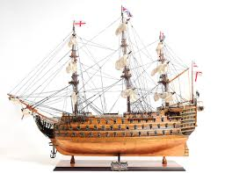
Factors Behind the Decline
Improved Naval Enforcement:
The British, French, and Spanish navies deployed larger, faster ships equipped with advanced weaponry to patrol trade routes effectively.
Copper-bottomed ships introduced in the 1760s further enhanced durability and speed, although the decline had largely occurred by then.
Economic Shifts:
Insurance markets expanded, enabling merchants to recover losses from pirate attacks.
Trade routes diversified and increased, making it harder for pirates to intercept ships.
Legal and Social Reforms:
Governments offered pardons to pirates willing to abandon their trade.
Colonial governments and naval forces worked together to root out pirate enclaves, depriving them of safe harbors.
Symbolic Decline:
Public executions of infamous pirates like Charles Vane, "Calico Jack" Rackham, and Stede Bonnet served as stark warnings, dampening the allure of piracy.
By 1750, the era of Caribbean piracy was effectively over. The once-dominant pirate fleets had been dismantled, and the Caribbean transformed into a more secure and controlled maritime region. The decline marked the end of an era defined by rebellion, adventure, and lawlessness.

Slide 13
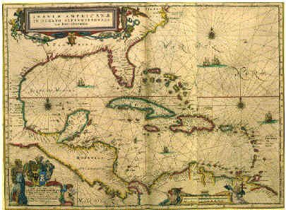
The Spanish Main
The Heart of Pirate Activity
The Spanish Main, a term that originally referred to the mainland coast of Spanish-controlled territories in the Americas, became synonymous with the lucrative hunting grounds for pirates and privateers during the Age of Piracy.
This region stretched from Florida in the north to Venezuela in the south, encompassing vital trade routes and heavily fortified ports.

Slide 14
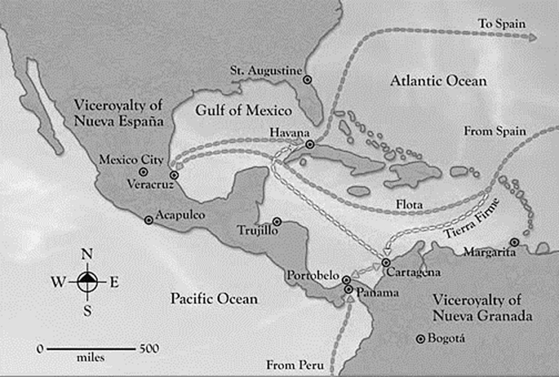
The Spanish Main
Why the Spanish Main Was a Target
Treasure Fleets and Predictable Routes: Spain’s treasure fleets followed regular, predictable schedules and routes to transport gold, silver, and precious commodities from the New World to Europe.
These convoys, while heavily guarded, offered rich rewards for daring attackers.
The Silver Fleet carried vast quantities of silver from Peru and Mexico, making it a prime target.
The Galleons were often laden with other riches, including pearls, emeralds, and spices.

Slide 15
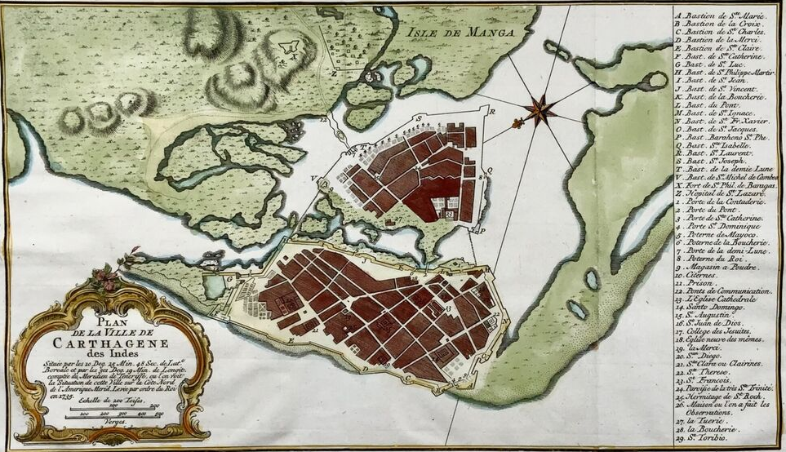
The Spanish Main
Strategic Location:
The Spanish Main was central to Spain’s colonial empire, with major ports like Cartagena, Havana, and Portobelo serving as hubs for transatlantic trade.
Pirates exploited the geography, using nearby islands, hidden coves, and mangroves for ambushes and escape routes.
Wealth of the Spanish Empire:
The Main symbolized Spain’s dominance and wealth in the Americas. Pirates viewed it as the ultimate prize—not just for treasure, but also as a blow to Spanish supremacy.
1754 Cartagena, Colombia

Slide 16
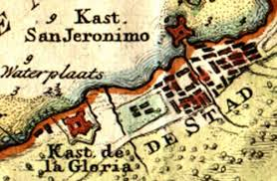
The Spanish Main
Key Pirate Strongholds
Pirates frequently targeted ports and towns along the Spanish Main, and some even used them as bases for operations:
Cartagena: A heavily fortified city known for its gold and emerald trade, it was a frequent target of raiders despite its defenses.
Portobelo: Located on the Isthmus of Panama, this port was a critical point for transferring Peruvian silver across the Atlantic.
Maracaibo: This Venezuelan port was less defended, making it a more accessible target for pirates looking to raid warehouses or capture ships.

Slide 17
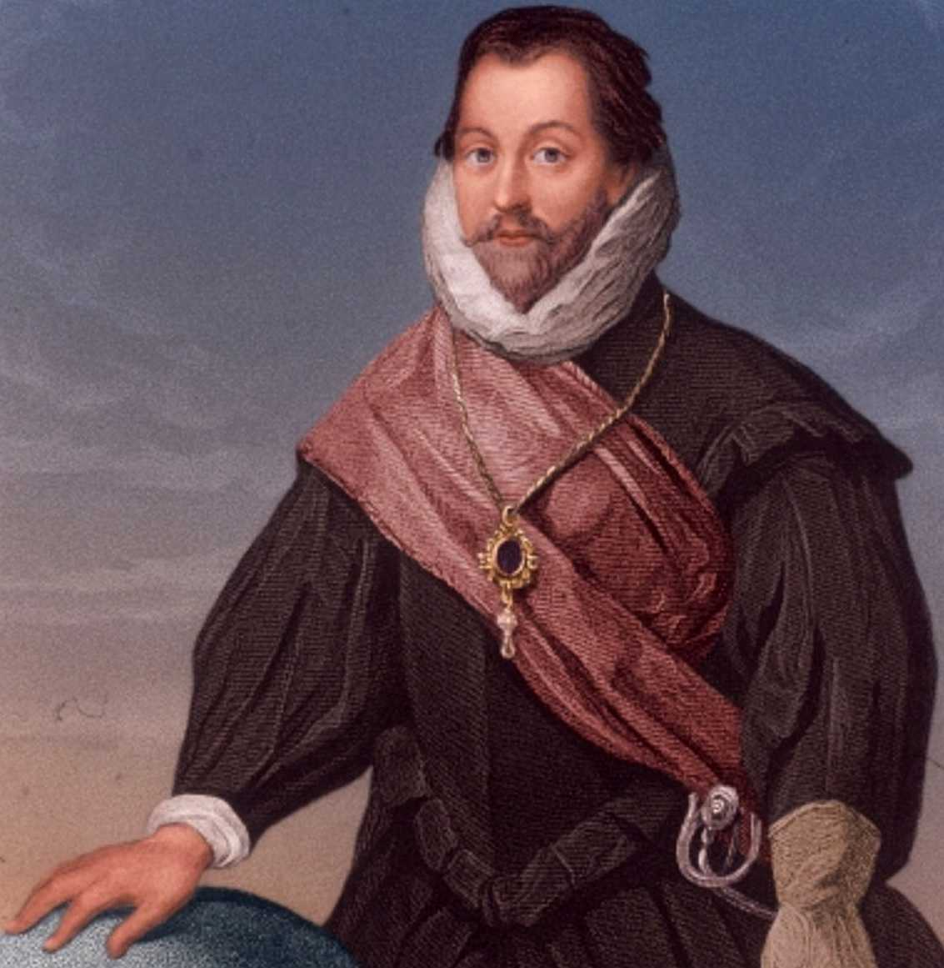
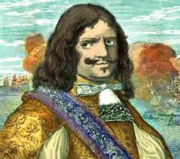
The Spanish Main
Famous Pirate Exploits on the Spanish Main
Francis Drake: One of the most famous privateers, Drake’s 1572 raid on the town of Nombre de Dios near Portobelo netted significant treasure and cemented his reputation.
Henry Morgan: Morgan led numerous raids along the Spanish Main, including a notorious attack on Portobelo in 1668, where his tactics shocked even his contemporaries.

Slide 18
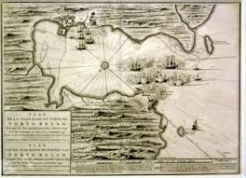
The Spanish Main
Impact on Spanish Dominance
The constant threat of piracy forced Spain to spend vast resources on naval escorts and fortifications. Despite these efforts, the Spanish Main remained a magnet for pirates until the mid-18th century, when enhanced naval patrols and shifting trade routes reduced its strategic importance.
The Spanish Main represents a fascinating chapter in pirate history, a place where danger and opportunity converged, shaping the legends of the Age of Piracy.

Slide 19
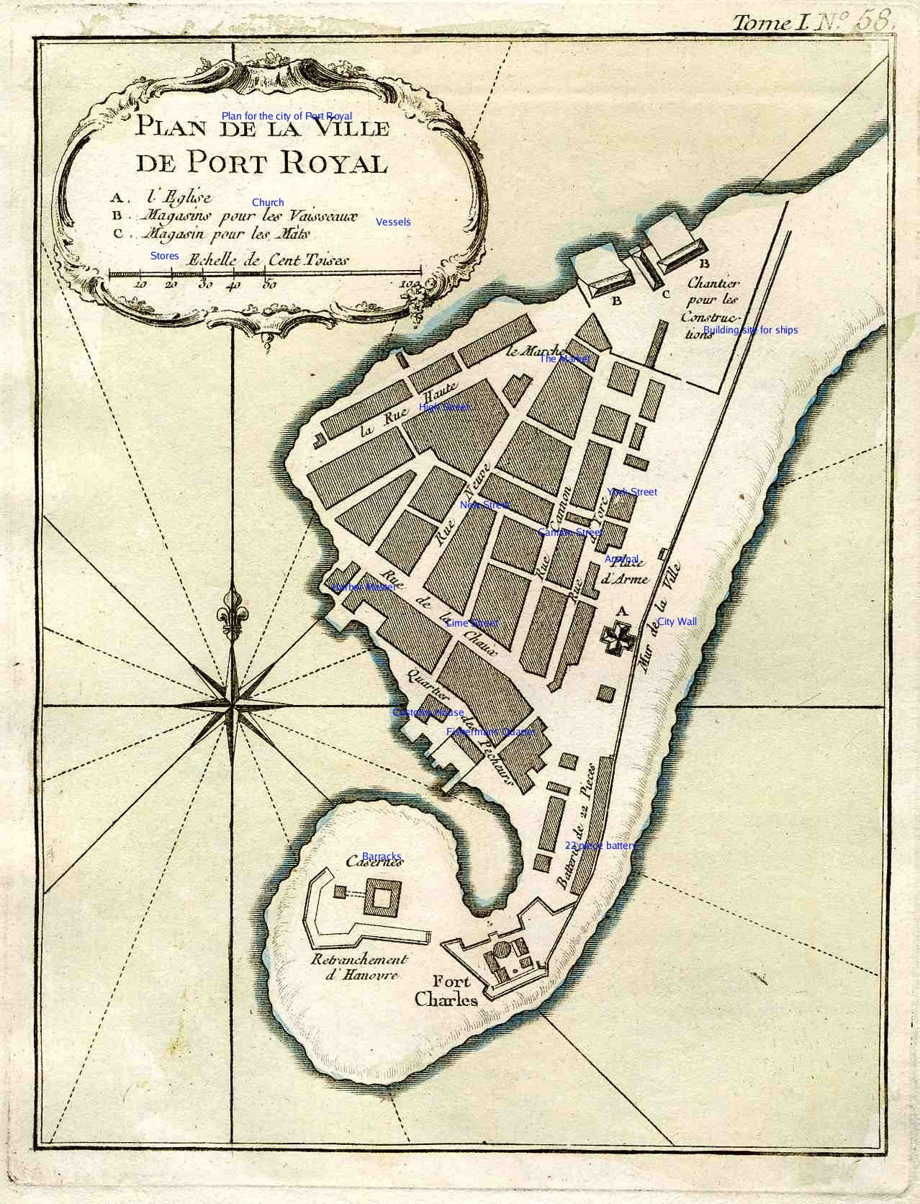
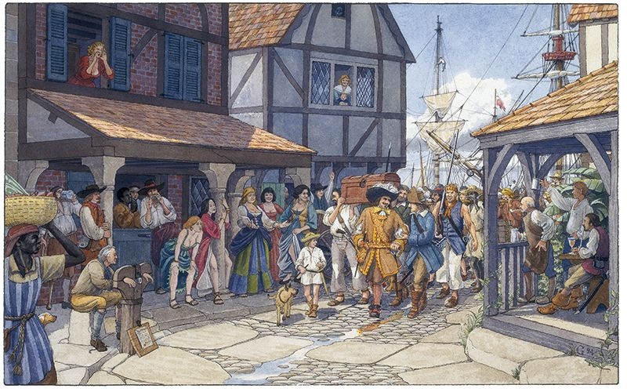
The Spanish Main
Port Royal: The Pirate Capital of the Caribbean
Before its destruction in 1692, Port Royal, located on the southeastern coast of Jamaica, was one of the most infamous and prosperous pirate havens in the Caribbean.
Known as the "wickedest city on Earth," it was a bustling center of commerce, vice, and piracy that attracted adventurers, privateers, and outlaws from around the world.

Slide 20
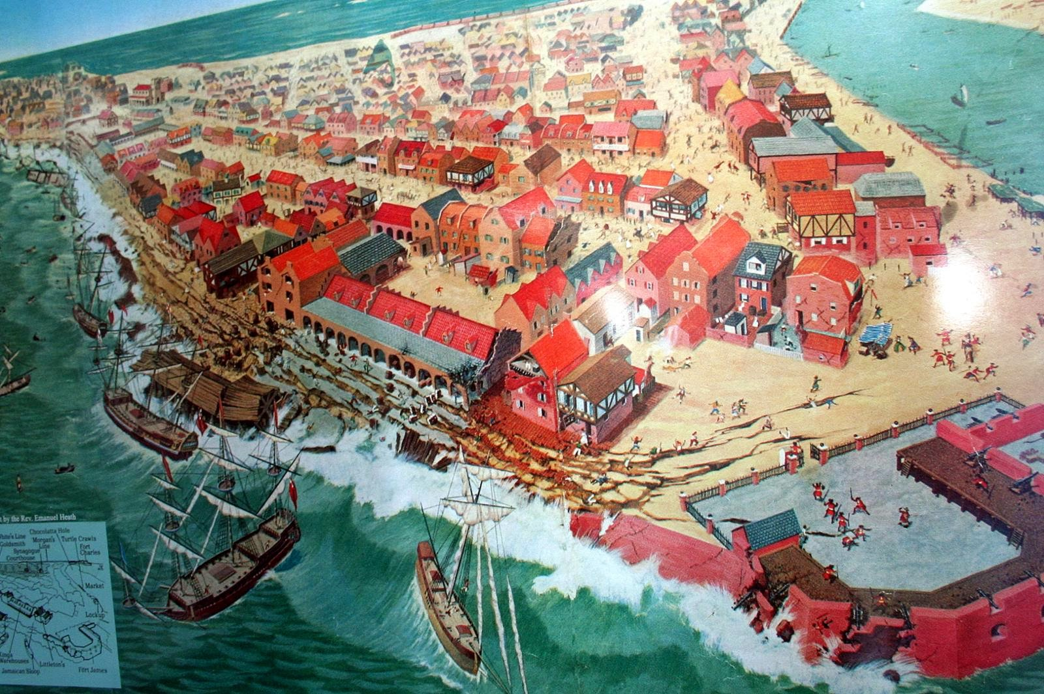
Port Royal’s Rise to Prominence
Strategic Location: Port Royal’s position at the entrance to Kingston Harbor made it an ideal base for pirates and privateers. Its deep-water port could accommodate large ships, and its proximity to major trade routes provided easy access to Spanish treasure fleets and merchant ships.
English Control: After capturing Jamaica from the Spanish in 1655, the English turned Port Royal into a naval stronghold and economic hub. To bolster their position against Spanish forces, the English government encouraged privateers to use the port as a base for raiding Spanish ships and settlements.
Pirate Haven: By the late 1600s, Port Royal was a bustling pirate hub. The town’s economy thrived on the proceeds of plundered gold, silver, and goods. Pirates would return from successful raids and spend their spoils freely in the town’s many taverns, brothels, and gambling houses.

Slide 21
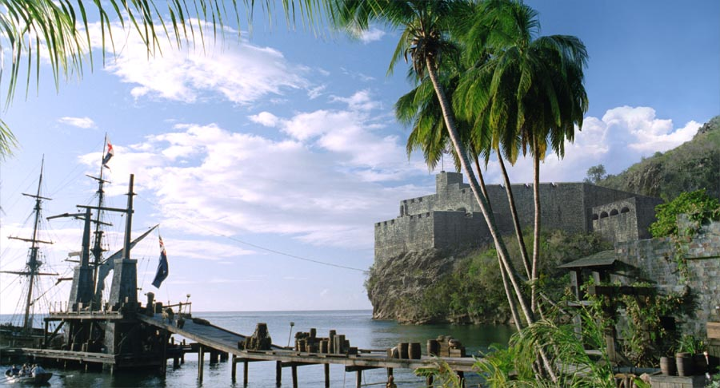
Port Royal’s Rise to Prominence
Life in Port Royal
Wealth and Vice:
At its height, Port Royal’s annual plunder value was estimated at £60,000, an astronomical sum for the time.
The city was home to 213 registered taverns, as well as countless unregistered ones, where rum flowed freely and deals were struck.
Brothels, gambling dens, and markets selling stolen goods contributed to the town’s reputation for lawlessness.

Slide 22
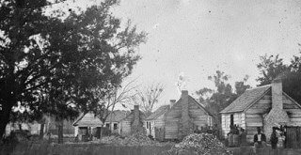
Port Royal’s Rise to Prominence
Diverse Population:
Port Royal was a melting pot of cultures, with English settlers, African slaves, freedmen, and Indigenous people all living and working in the city.
Pirates from various nations, including England, France, and the Netherlands, mingled in the town’s streets, creating a cosmopolitan but volatile environment.
Governance and Lawlessness:
While nominally under English control, Port Royal operated with little oversight. Pirate leaders like Henry Morgan wielded significant influence, often acting as de facto rulers. The town’s officials turned a blind eye to piracy, as it brought wealth and prosperity to the colony.

Slide 23
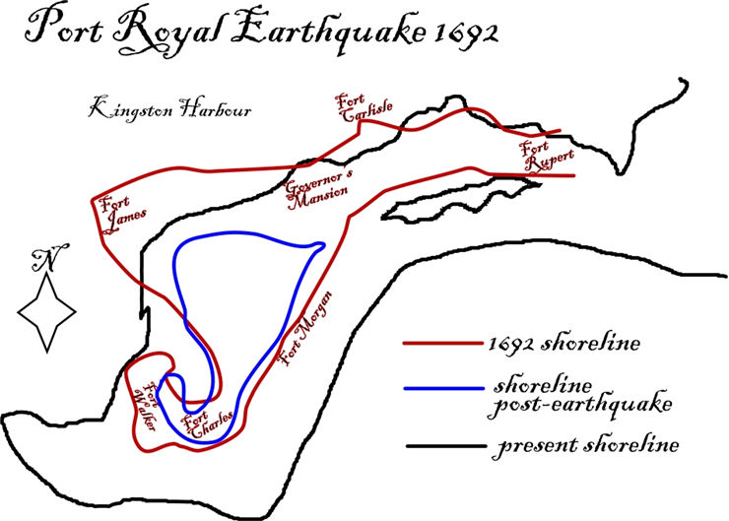
The Spanish Main
Port Royal’s The Earthquake of 1692
Port Royal’s meteoric rise came to an abrupt end on June 7, 1692, when a massive earthquake struck the town.
Extent of the Disaster: Two-thirds of Port Royal sank into the sea as the earthquake caused the sandy soil beneath the town to liquefy. Thousands of people were killed, and much of the city’s wealth was lost.
Aftermath: Survivors relocated to nearby Kingston, and Port Royal never regained its former glory. The earthquake was widely seen as divine retribution for the city’s debauchery.

Slide 24
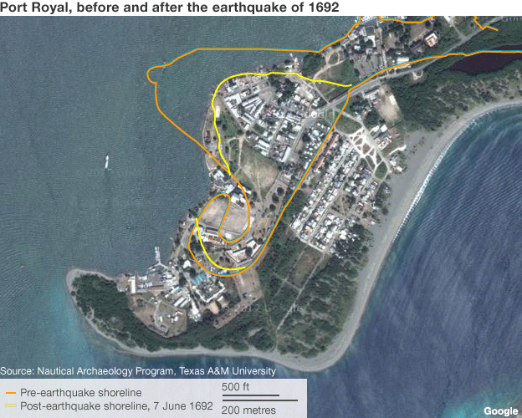
The Spanish Main
Legacy of Port Royal
Today, Port Royal exists as a quiet fishing village, but its pirate-era history remains a source of fascination.
Archaeological excavations have uncovered artifacts from its heyday, offering glimpses into the lives of its inhabitants.
Despite its destruction, Port Royal’s legacy as a center of piracy and excess endures in popular culture, cementing its place in the lore of the Age of Piracy.

Slide 25
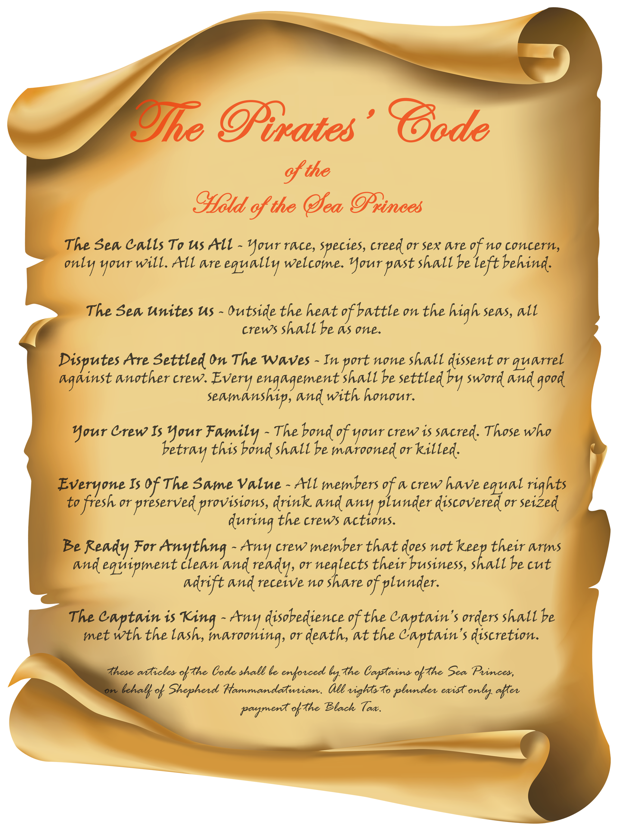
Pirate Codes and Practices
Pirates operated under surprisingly structured systems of governance, particularly aboard their ships.
Unlike the rigid hierarchies of naval or merchant ships, pirate crews adhered to a set of codes that emphasized fairness, mutual benefit, and collective decision-making.
These pirate codes varied from ship to ship but shared common principles that set them apart from the conventional maritime world.

Slide 26
Pirate Codes and Practices
Pay Share:
One of the most significant differences on a pirate ship was the distribution of loot. Pirate crews valued equity, and every member was entitled to a share of the plunder.
How it worked:
The captain typically received a larger share, but it was far less disproportionate than the pay gap on naval vessels, where ordinary sailors received a pittance.
For example, a typical distribution might allot the captain two shares of loot, the quartermaster one and a half shares, and ordinary crew members one share each.
Comparison to naval sailors:
In the British Navy, sailors received wages rather than a share of the spoils, with their share of any prize being as little as 1/500th of the value, compared to pirates’ 1/100th.

Slide 27
Pirate Codes and Practices
Leadership: Pirate crews had a unique approach to leadership, emphasizing collective power over authoritarian rule.
Elected Captains: Pirate captains were chosen by the crew and could be deposed if their leadership was deemed ineffective. Unlike naval captains, whose authority was absolute and often hereditary, pirate captains were accountable to their crew.
Quartermasters: The quartermaster was often considered second-in-command and served as a mediator and enforcer of the pirate code. They handled disputes, distributed loot, and ensured the captain did not abuse their authority.
Democratic Decision-Making: Major decisions, such as whether to attack a ship or where to sail, were often made collectively through a vote. This system ensured that every crew member had a voice in the ship’s operations.

Slide 28
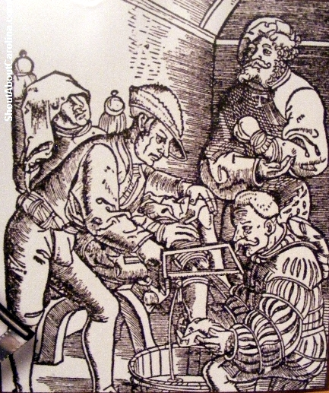
Pirate Codes and Practices
Medical Care: Pirate ships provided better medical care than most naval or merchant vessels, reflecting their pragmatic approach to maintaining a healthy and effective crew.
Guaranteed Treatment: Pirates who were injured in battle or during raids were entitled to care, with funds from the ship’s treasury often used to pay for medical supplies or surgeons.
Compensation for Injuries: Crew members who suffered severe injuries were often compensated financially. For example, the loss of a limb might entitle a pirate to additional shares of loot or a fixed payment. This system incentivized loyalty and reduced the risk of mutiny.
Skilled Surgeons: Some pirate ships employed surgeons or sought their services in port, ensuring that injuries and illnesses were treated promptly.

Slide 29
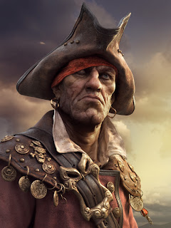
Pirate Codes and Practices
Why These Practices Worked
These codes fostered loyalty, discipline, and efficiency among pirate crews. By ensuring fair treatment and a voice in decisions, pirate leaders reduced the likelihood of mutiny and maintained a cohesive, motivated crew.
In contrast, the harsh conditions and meager rewards of naval and merchant ships often bred resentment and desertion.
Pirates’ egalitarian principles, though born of necessity, were revolutionary for their time and remain a fascinating aspect of their legacy.
These practices contributed to the enduring romanticism of piracy as a rebellious and surprisingly progressive way of life.

Slide 30
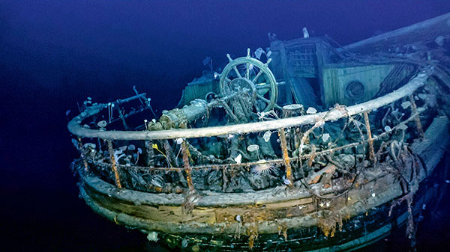
Pirate Codes and Practices
The Economics of Piracy
Pirates’ wealth came from treasure, trade goods, and commodities, with an average haul valued at £12,000.
Using historical inflation rates, this figure typically converts to an equivalent value in the millions of pounds today. £12,000 in the 1700s could equate to around £2 million to £3 million today, depending on the specific year and context of the economic activity (based on Bank of England inflation calculators and historical indices).
Archaeological studies reveal:
62 shipwrecks containing pirate loot.
Investment patterns: 45% on personal expenses, 30% on business ventures, 15% buried as treasure, and only 10% shared among crew.

Slide 31

Indigenous Alliances
Pirates and the Taíno
During the Age of Piracy, Indigenous alliances, particularly with the Taíno people of the Caribbean, played a significant role in the success of pirate activities.
These alliances were born out of shared opposition to Spanish colonization, mutual economic benefit, and the need for survival in a hostile environment.
Shared Opposition to Spain:
The Taíno, among the first Indigenous groups encountered by European colonizers, suffered immense exploitation and violence at the hands of the Spanish. By the time piracy began to rise in the 16th century, the Taíno had every reason to oppose Spanish dominance.
Pirates, frequently targeting Spanish treasure fleets and settlements, became natural allies for Indigenous groups eager to undermine their colonizers.

Slide 32
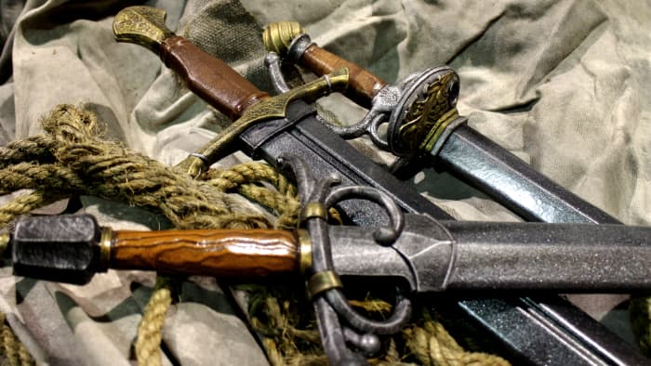
Indigenous Alliances
Mutual Benefit:
Pirates gained valuable local knowledge from the Taíno, such as safe harbors, hidden coves, and inland routes for evading capture.
The Taíno benefited from access to European goods such as metal tools, weapons, and textiles brought by pirates, which were often traded for food, water, and shelter.
How the Alliances Worked
Trade and Resource Sharing: Pirates relied on the Taíno for fresh provisions, such as cassava bread, fruits, and fish, as well as shelter during their travels.
In return, pirates supplied the Taíno with goods they had looted, like knives, mirrors, and firearms.

Slide 33
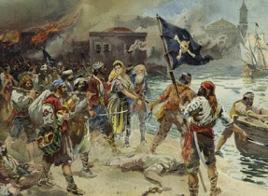
Indigenous Alliances
Military Alliances:
The Taíno often joined forces with pirates in raids on Spanish settlements.
Their knowledge of the terrain made them invaluable scouts and guides.
In some cases, Taíno warriors fought alongside pirates in skirmishes, combining their skills in guerrilla tactics with the pirates’ firepower.
Navigation Techniques:
Indigenous knowledge of currents, winds, and local geography proved critical for pirates navigating the complex waterways of the Caribbean. The Taíno’s expertise helped pirates locate obscure passages, avoid hazards, and evade Spanish naval patrols.

Slide 34
Indigenous Alliances
Cultural Exchange and Legacy
Shared Knowledge:
The relationship wasn’t one-sided. Pirates adopted Taíno techniques for fishing, building shelters, and even some sailing practices. The Taíno, in turn, incorporated European goods into their daily lives.
Resistance Movements:
These alliances symbolized broader resistance to colonial oppression, with pirates and the Taíno working together to destabilize Spanish control over the Caribbean.
End of the Alliance:
As Spanish dominance waned and piracy declined, these alliances faded.
However, their impact on pirate strategies and their defiance of colonial powers left a lasting legacy in Caribbean history.

Slide 35
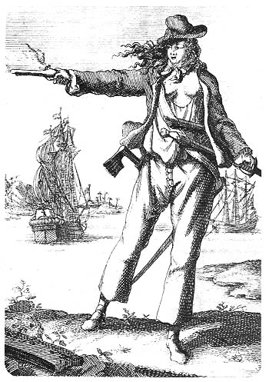
Women in Piracy
Women in a Man’s World
Life at sea was harsh and dangerous, and societal conventions largely barred women from such roles.
However, some women broke through these barriers, often disguising themselves as men to join pirate crews.
Once aboard, they earned respect by proving their mettle in battle and daily shipboard life.

Slide 36
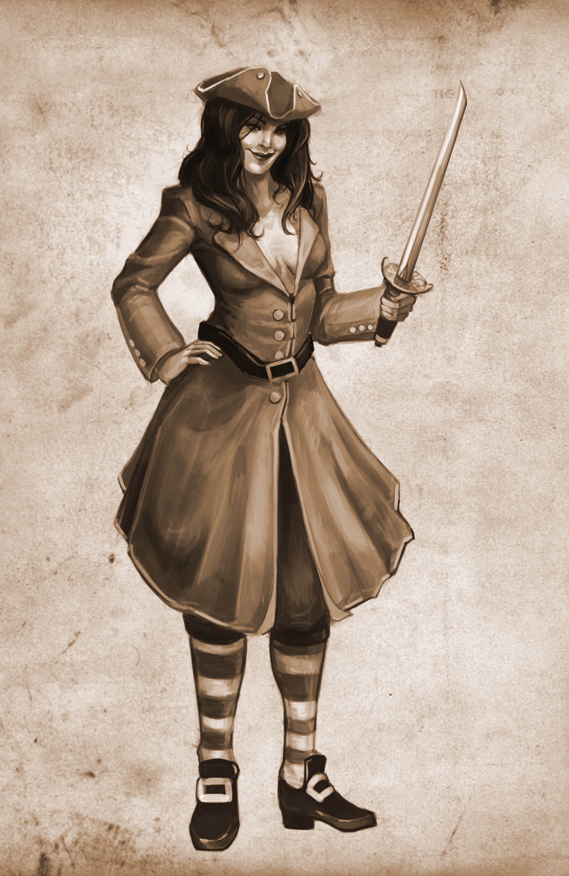
Women in Piracy
Anne Bonny: The Fiery Rebel
Early Life: Anne Bonny, born in Ireland around 1698, moved to the Caribbean with her family as a child. Her rebellious streak became apparent early, and she eventually left her husband to join the pirate Calico Jack Rackham.
Role in Piracy: Bonny fought alongside Rackham’s crew, participating in raids and battles. She was known for her ferocity and fearlessness, earning the respect of her male counterparts. Witnesses at her trial testified to her skill with weapons, describing her as fighting “with pistol and cutlass as fiercely as any man.”
Capture and Legacy: In 1720, Rackham’s crew was captured, and Bonny was tried for piracy. While sentenced to death, her execution was delayed due to her pregnancy, and her ultimate fate remains a mystery.

Slide 37
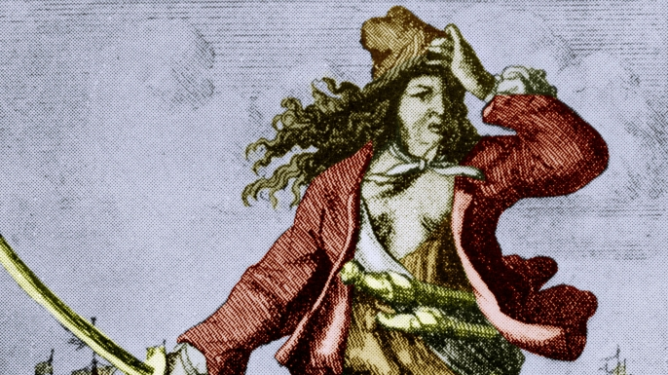
Women in Piracy
Mary Read: The Soldier Turned Pirate
Early Life: Born in England around 1685, Mary Read also disguised herself as a man to gain opportunities unavailable to women. She served as a soldier in various European armies before turning to piracy.
Pirate Career: Read joined Calico Jack’s crew and formed a close bond with Anne Bonny. Her military background made her an asset in combat, and she was known for her bravery and tactical acumen.
Capture and Death: Like Bonny, Read was captured in 1720. She died in prison of illness before her execution could be carried out.

Slide 38

Women in Piracy
One of the most fascinating aspects of pirate history is the presence of women who defied societal norms to pursue lives at sea. The stories of these female pirates, whether historical or legendary, highlight the complex relationship between gender and maritime life in the Age of Sail.
Charlotte de Berry and Jacquotte Delahaye, though likely fictional, exemplify common themes in female pirate lore – tales of women who gained power through cunning, courage, and strategic use of gender disguise.
Unlike her legendary counterparts, Neel Cuyper's story is rooted in historical record. After serving on Dutch merchant vessels disguised as a man, she was captured and recruited by pirates. Following her discovery as a woman, Cuyper established a haven for pirates at Labadee, Haiti. Her reign as the "Queen of Labadee Bay" came to a violent end during a joint English-Spanish raid in 1695.

Slide 39
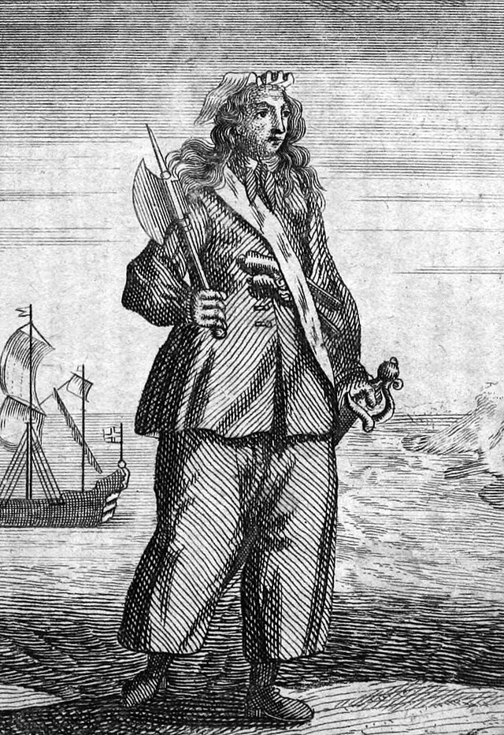
Women in Piracy
Challenges and Triumphs
Disguises: Many women disguised themselves as men to join pirate crews, as pirate codes often prohibited women on board, fearing they would bring bad luck or cause conflict. However, once their true identities were revealed, those who proved their worth were often accepted.
Equality on Pirate Ships: Pirate crews valued competence over gender, offering women who demonstrated skill and courage a degree of equality rarely seen in society at large.
Mary Read 1720

Slide 40
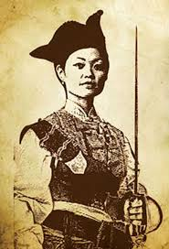
Women in Piracy
Other Notable Women in Piracy
Rachel Wall: Often considered the first American female pirate, Rachel Wall operated off the coast of New England in the late 18th century. She was eventually captured and executed in 1789.
Ching Shih: Though not in the Caribbean, Ching Shih was a Chinese pirate leader who commanded one of the largest pirate fleets in history, showcasing the global presence of women in piracy.
Cultural Impact
Women like Anne Bonny and Mary Read became legends, inspiring countless books, films, and folklore. Their stories challenged the notion of piracy as exclusively male and highlighted the potential for women to succeed in unconventional roles through sheer determination and skill.
Their legacies endure as symbols of defiance, strength, and equality in one of history’s most rugged and lawless professions.

Slide 41
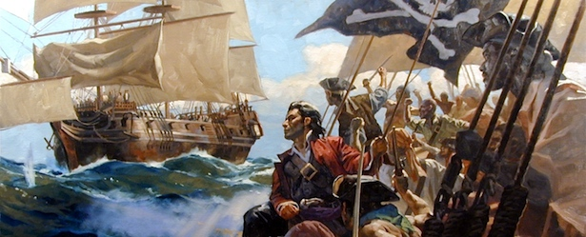
Final Thoughts
The decline of Caribbean piracy marked the end of a chaotic yet transformative era.
Pirates were more than criminals; they were products of their time, reshaping maritime history and challenging colonial powers.
Their defiance of authority and pursuit of freedom left an indelible mark on global culture.
From the democratic principles aboard their ships to their integration with Indigenous peoples, pirates symbolized both rebellion and community.
Their enduring stories of adventure and independence remind us of the human desire to break free from constraints, a theme that continues to inspire and captivate audiences across generations.

Slide 42
Citations & References
Cordingly, David. Under the Black Flag: The Romance and Reality of Life Among the Pirates. Random House, 1995.
Earle, Peter. The Pirate Wars. Thomas Dunne Books, 2003.
Rediker, Marcus. Villains of All Nations: Atlantic Pirates in the Golden Age. Beacon Press, 2004.
Johnson, Charles. A General History of the Pyrates. 1724.
Exquemelin, Alexander O. The Buccaneers of America. 1678.
National Archives. "Letters of Marque." https://www.nationalarchives.gov.uk
Smithsonian Institution. "Pirate Archaeology." https://www.si.edu
Defoe, Daniel (writing as Capt. Charles Johnson). "A General History of the Pyrates." Edited by Manuel Schonhorn. Dover Publications, 1972/1999.
Note: This article synthesizes research from various historical sources. Efforts have been made to ensure accuracy, but some details may vary across accounts

