Slide 1


Piraeus, Greece
Port Presentation
Presented by
Marc Silver

Slide 2
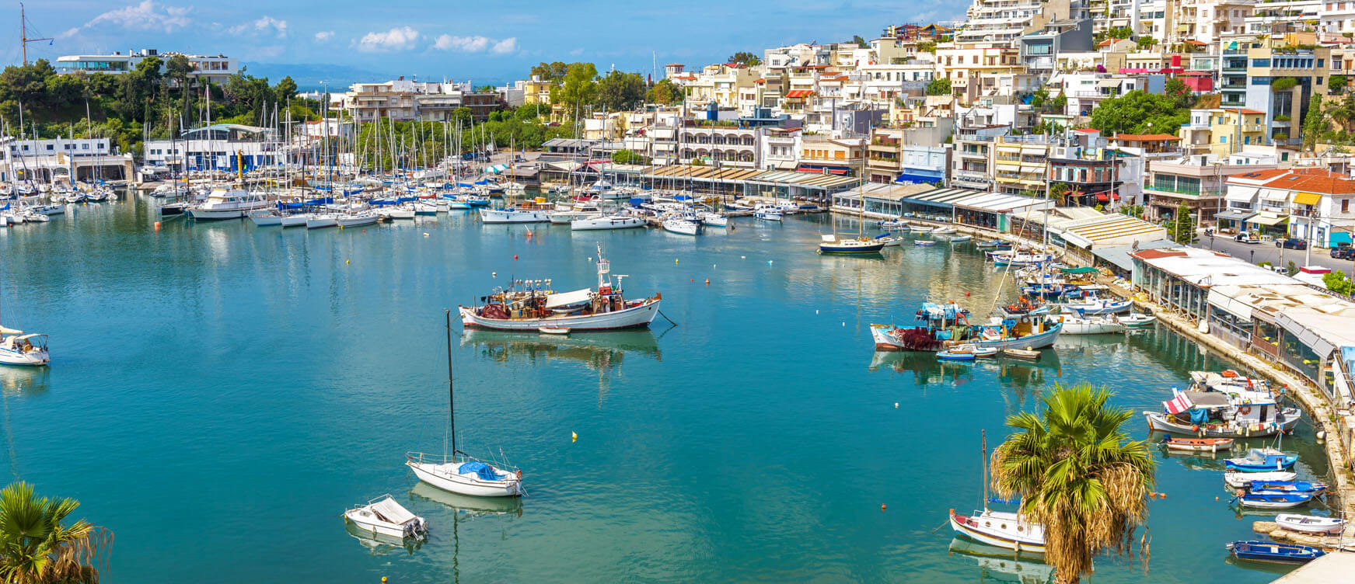
Piraeus Greece
Piraeus is a port city within the Athens urban area ("Greater Athens"), in the Attica region of Greece. It is located eight kilometres (5 mi) southwest of Athens' city centre, along the east coast of
the Saronic Gulf.
Total population is 448,997. In 2011 Piraeus had a population of 163,688, making it the fifth largest municipality in Greece. Piraeus has a long recorded history, dating back to ancient Greece. The city was founded in the early 5th century BC,

Slide 3
What I Will Cover
History of Port of Piraeus
A few interesting facts about Piraeus.
My Port Philosophy
Don’t Miss the Ship
Money
Where is the Tourist Office?
Map of Piraeus
Places to see or at least consider
A few restaurant recomendations
Best way to get around Piraeus
Hop On Hop Off

Slide 4
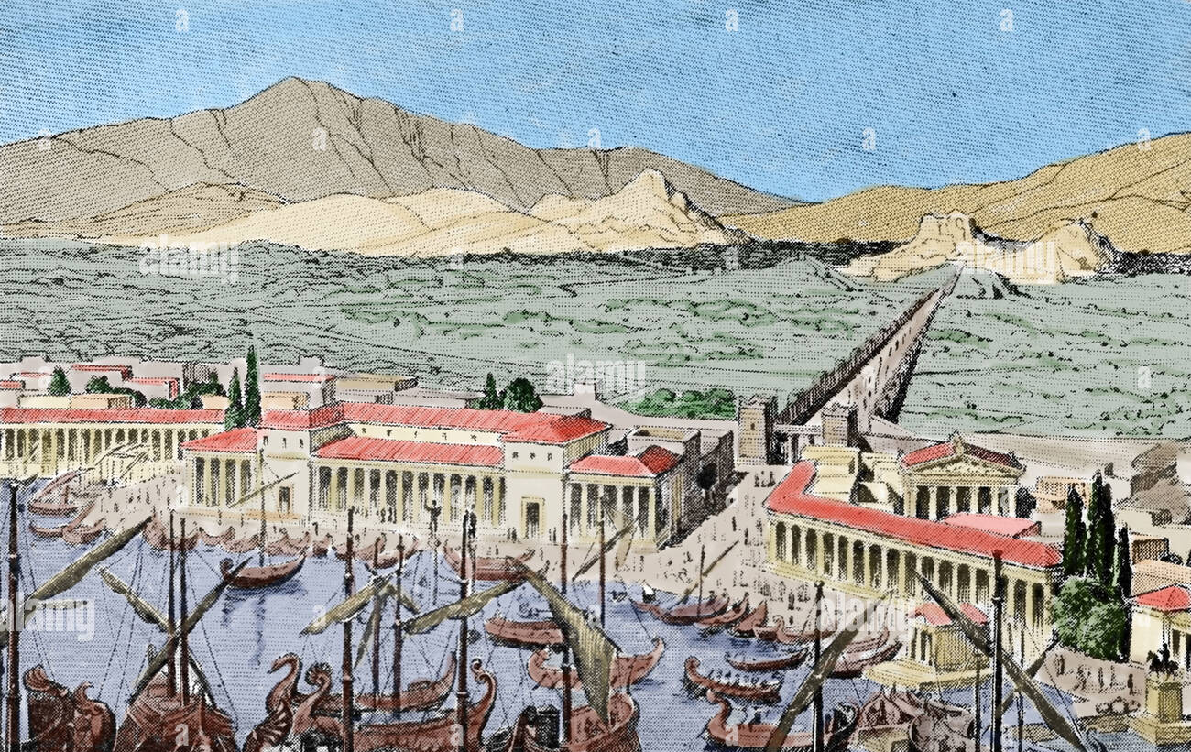
Piraeus Greece Early History
In the 7th and 6th centuries bce the Athenians used Phaleron Bay for mooring, since the present port was separated from the mainland by marshes. The Athenian statesman Themistocles persuaded his colleagues about 493 bce to fortify and use Piraeus for the new
Athenian fleet, though its fortifications were not completed until after 479. Soon after 460 the Long Walls from the base of Munychia to Athens were built, thereby ensuring communications between Athens and its port in the event of a siege. The street pattern of modern Piraeus still approximates the rectangular grid designed for the new town by the architect Hippodamus of Miletus.

Slide 5
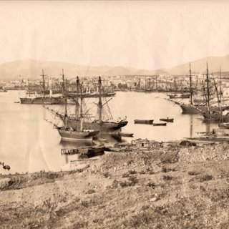
Piraeus Greece Later History
The Spartans captured Piraeus at the close of the Peloponnesian War and demolished the Long Walls and the port’s fortifications in 404. They were rebuilt under the Athenian leader Conon in 393 bce. In 86 bce the Roman commander Lucius Cornelius Sulla destroyed
the city, and it was insignificant from that time until its revival after 1834, when Athens became the capital of newly independent Greece. In 1854–59, following the Crimean War, Piraeus was occupied by the Anglo-French fleet to forestall Greek expansionist intentions. Piraeus was bombed by the Germans in 1941 during World War II.

Slide 6
My Port Philosophy
I have been cruising for over 43 years and taken over 100 cruises. So I consider myself an experienced cruiser.
I always like to see how other people live.
When I am on a cruise where the city I want to visit is not the port city, I always recommend taking a ship’s tour.
But when I am in a port where many things are nearby and easy to see on my own - I will do it on my own.
This presentation is for that type of port.

Slide 7
Don’t Miss the Ship
How to Avoid Missing Your Ship
Pay attention to the time. - Ship time and local time are often different.
Put a return to ship reminder on your phone.
Choose excursions wisely.
If a ship-sponsored excursion is late returning to port for, the ship will wait for you. If you are on your own???
Be Prepared
Have your Passport, Credit Card and phone numbers for your ship port agent.
What to Do If You Miss the Ship Most cruise lines have port agents stationed in the port area to assist if your ship has left without you. If your lucky, when cruisers are late returning to the vessel, the ship's crew will often remove the passengers' essential items -- passports, cell phones and medication -- from the ship to leave with the port agents.
The Port Officials can help you with contacting your ship and making necessary travel arrangements.

Slide 8
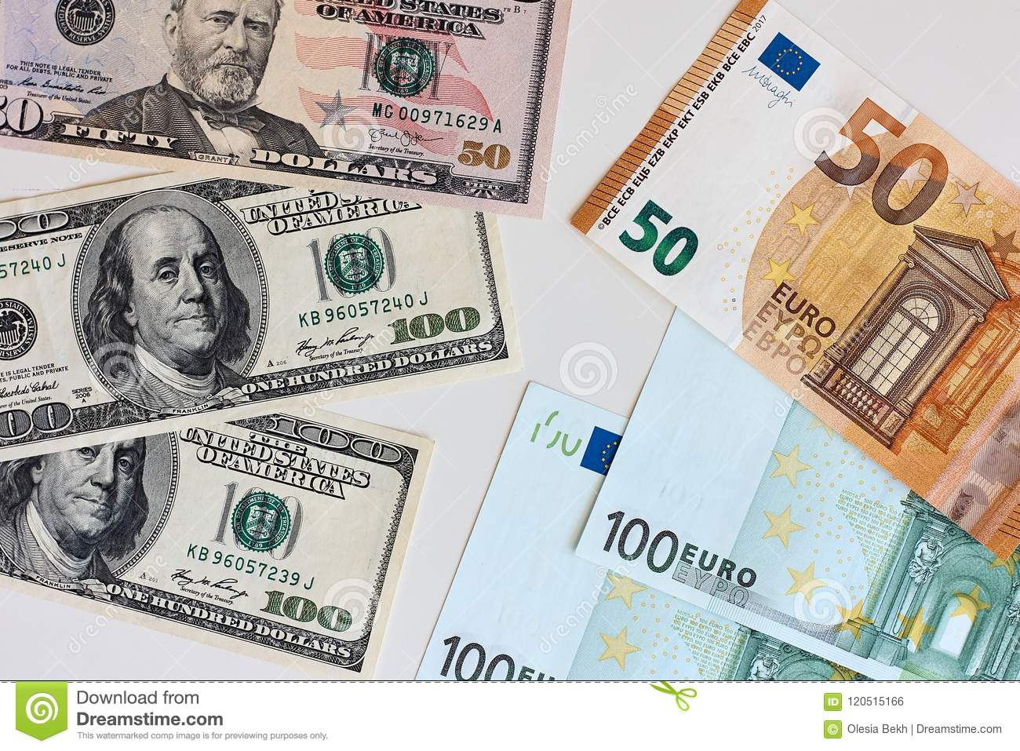
Money
The euro is the official currency of 20 European Union countries which collectively make up the euro area, also known as the eurozone.
Official Exchange is €1 to $1.079 US

Slide 9
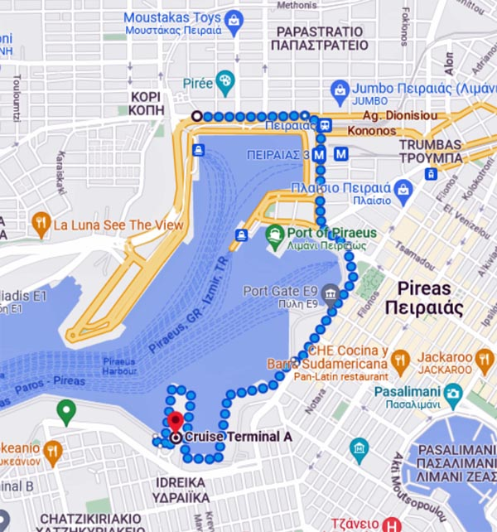
Tourist Office
Tourism Office provides a tourist information service and attention to the city's visitors.
Regretably it is over a 37 minute (2.9 km) walk to get there.
Akti Kondili 56, Pireas 185 45, Greece

Slide 10
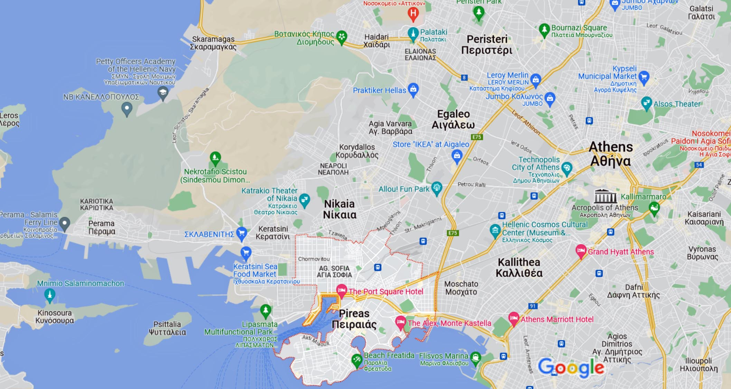
Map Of Piraeus/Athens

Slide 11
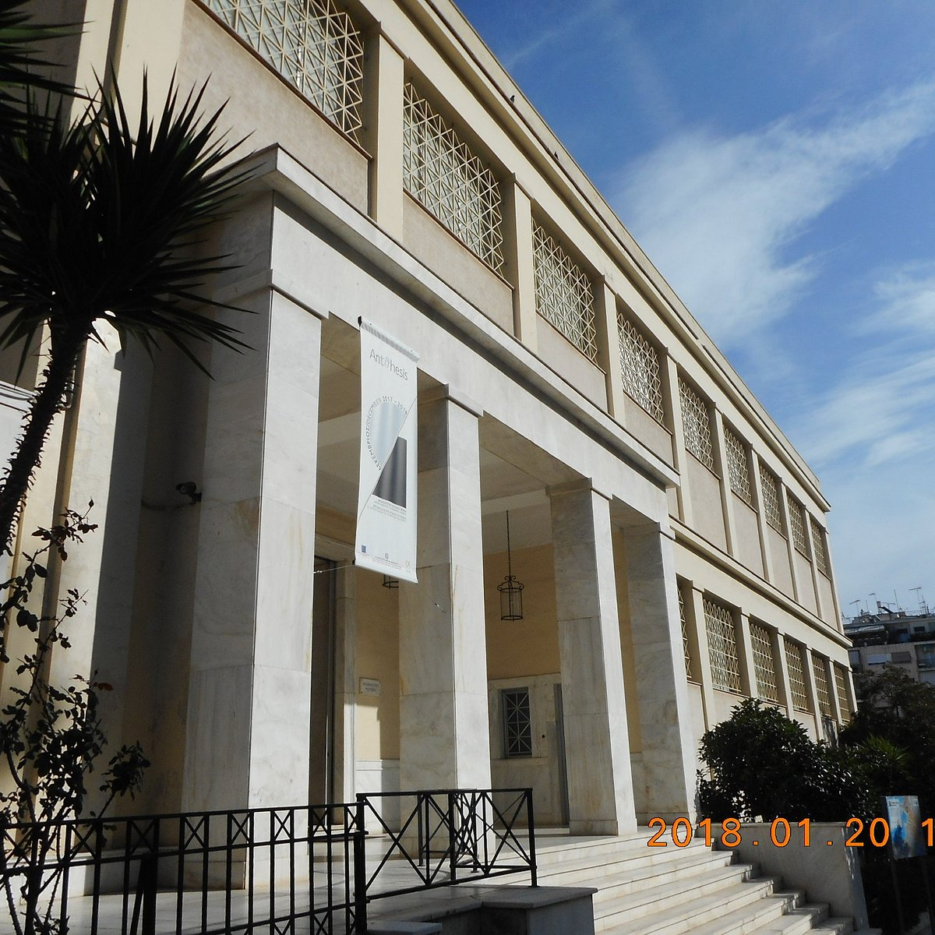
Archaeological Museum of Piraeus
The Archaeological Museum of Piraeus is located near the port of Zea. Its permanent exhibition includes finds mainly from the wider area of the city and the southern coast of Attica. The museum’s collection covers a period spanning from the Mycenaean era until the Roman times and recomposes the history of ancient Piraeus, an important trading center of the Eastern Mediterranean.
Admission Price: €4

Slide 12
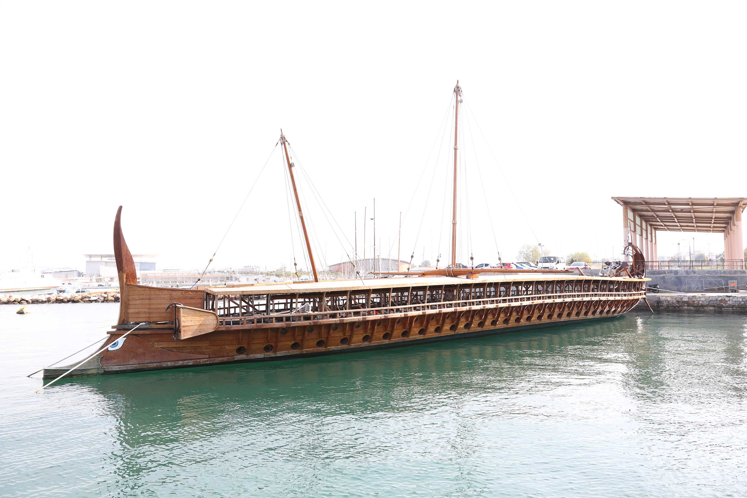
Hellenic Maritime Museum
The Hellenic Maritime Museum was founded in 1949 and since 1971 has been located in the yacht harbor of Zea, where the boat houses of the Athenian navy were in ancient times. At the Maritime Museum visitors can see around two thousand objects, exhibited so as to bring to life the Greek maritime tradition in a chronological order. The exhibits include models of ancient and modern ships, paintings by some of the greatest Greek marine artists of the 19th and 20th centuries, guns, medals, nautical instruments, presenting the maritime history of the Greeks from the
prehistoric era to ancient years,
the Byzantine period, the Balkan
wars, the two World Wars until
the present time.

Slide 13
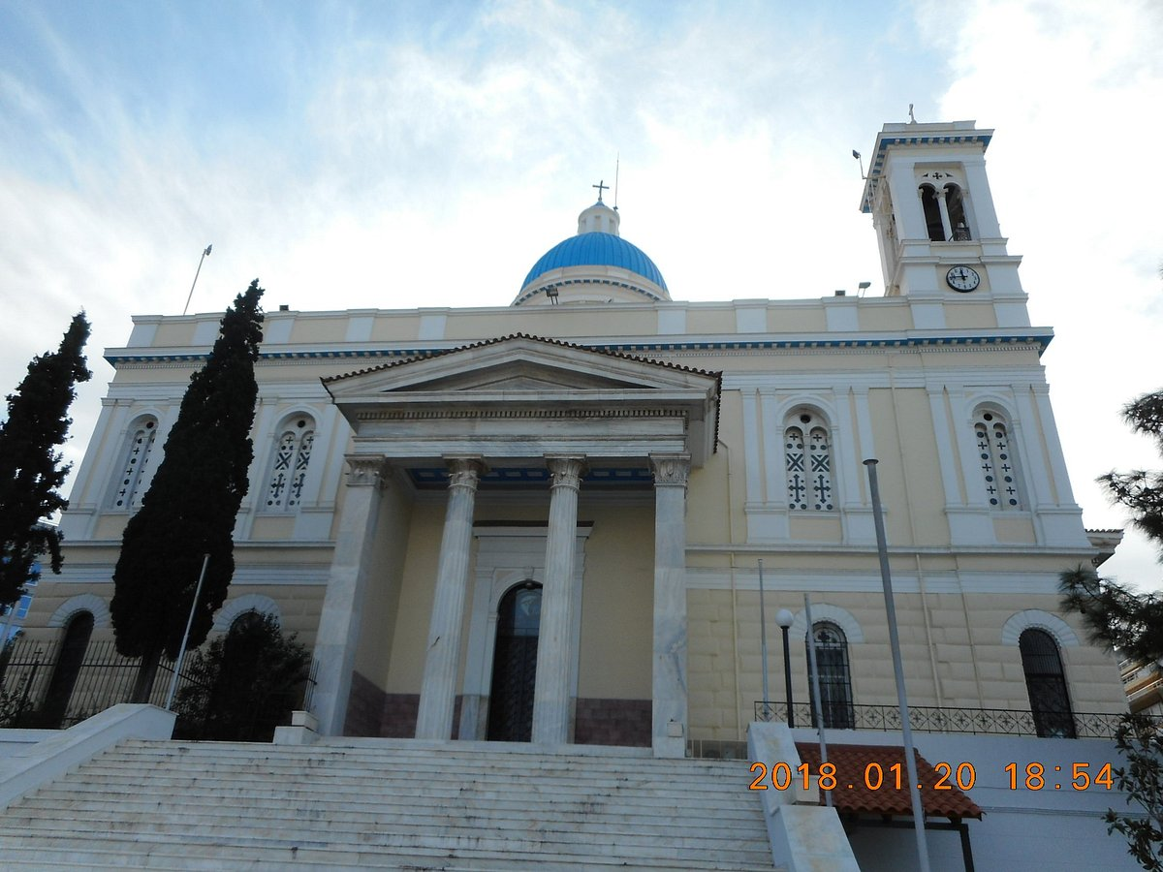
Church of Saint Nicholas
The Greek Orthodox Church of Saint Nicholas is located close to the harbour in the port city of Athens. It is dedicated to the patron saint of Greece, who is also the protector of sailors and seamen.

Slide 14
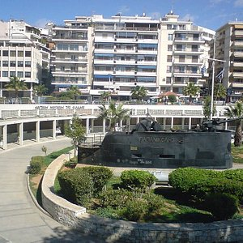
Museum of Olympiacos
Olympiacos was founded in 1925 in Piraeus and is the largest multi-athletic organization in Greece and one of the largest in the world, with activities in 17 different competitive departments. The Museum is in the Football Stadium and opens on Tuesday-Thursday-Friday-Saturday 10:00-18:00, Wednesday 12:00-20:00 and Sunday 10:00-16:00. On matchdays it closes 2 hours before
kick-off. Tours of the Museum and
the Stadium George Karaiskakis
are available, for groups and
individual visitors after booking.
General admission fee €5

Slide 15
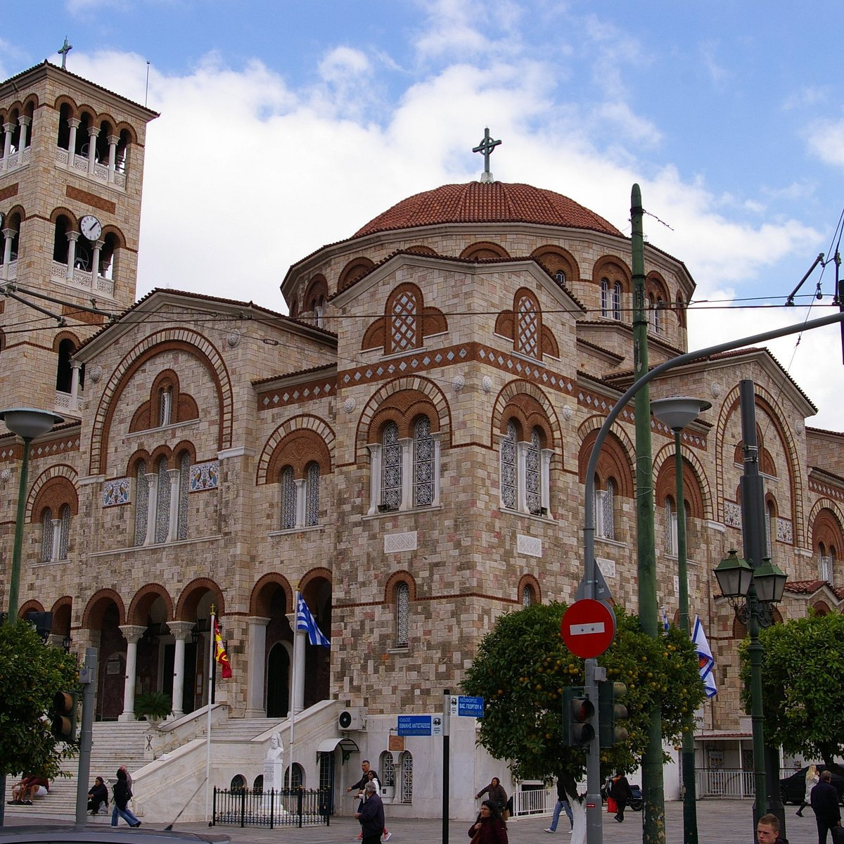
Ieros Naos Agia Triada
The church is built in the Byzantine architectural cruciform style with three domes. The main church is flanked by two smaller domed chapels, one of which is dedicated to the Life-Giving Spring and the other to Saint John the Theologian. The main church is dedicated to the Holy Trinity and the church has a narthex at the front set at
right angles to the main aisle. There are two large Doric-style columns and one smaller, Corinthian-style column on either side of the main entrance.

Slide 16
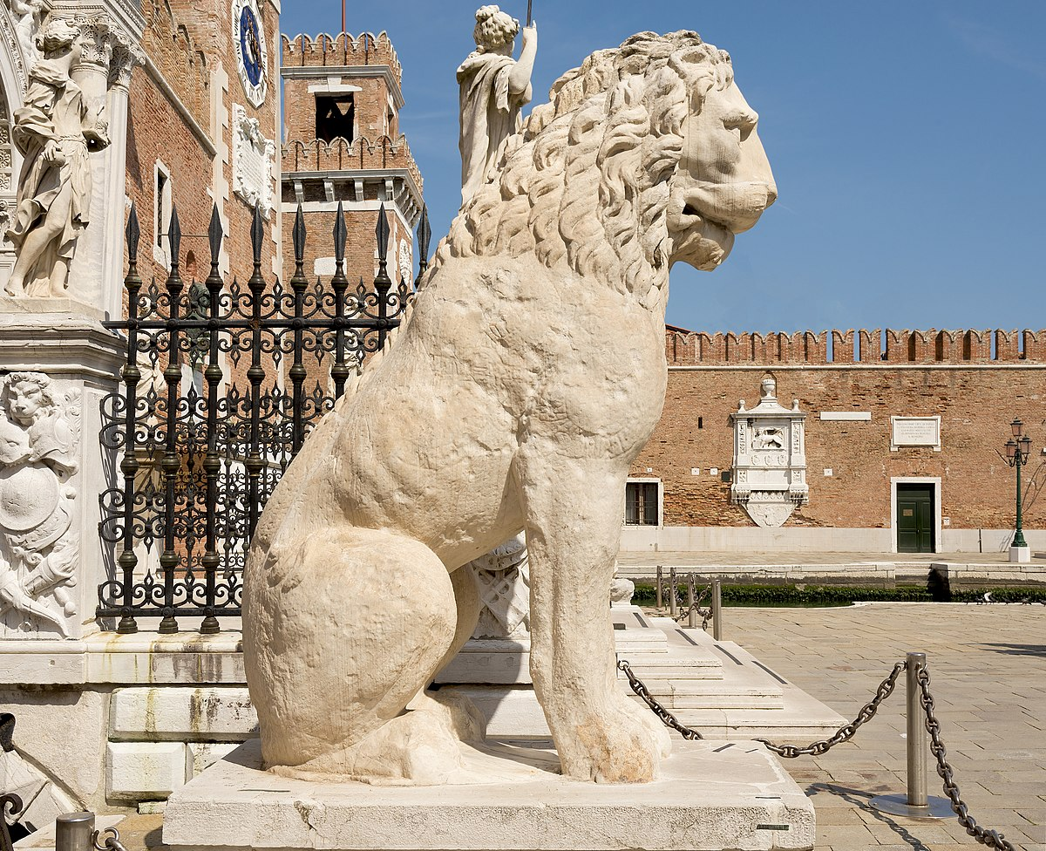
Piraeus Lion
The lion was originally sculpted in about 360 BC, and became a famous landmark in Piraeus, having stood there since the 1st or 2nd century AD. Its prominence was such that the port eventually became referred to in Italian as Porto Leone
("Lion Port") as the port's original name ceased to be used. It is depicted in a sitting pose, with a hollow throat and the mark of a pipe (now lost) running down its back; this suggests that it was at some point used as a fountain.

Slide 17
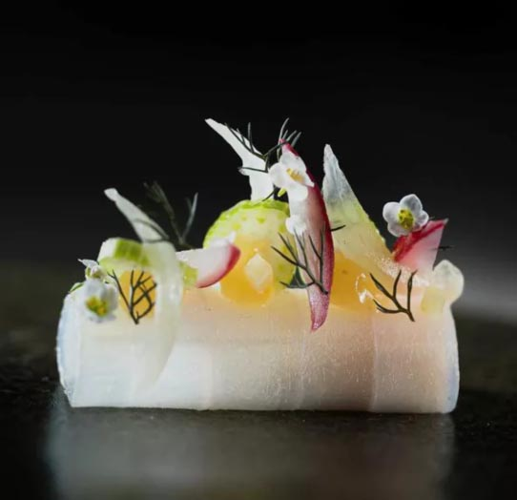
Home to Amazing Restaurants
You will need to go to Athens to visit a Michelin star restaurants. Many of us on the ship are foodies, so naturally we’re always on the hunt to eat at the most exclusive spots anytime we travel.
Here are a few of the Michelin Star to consider.
Soil - 5 Ferekidou Street, Athens, €€€€ · Greek, Contemporary
Pelagos - 40 Apollonos Street, Athens, €€€€ · Contemporary, Mediterranean
Varoulko Seaside - 54-56 Koumoundourou Coast, Athens, €€€ · Seafood
VERi TABLE - 8 Angelou Sikelianou Street, Athens, €€€ · French
Cerdo Negro 1985 - 5 Vitonos Street, Athens, €€ · Mediterranean, Fusion
Athénée - 9 Voukourestiou Street, Athens, €€ · Modern
Oikeîo - 15 Ploutarchou Street, Athens, € · Greek
For those of you that just like good food, you can’t go wrong just about anywhere you go in Piraeus. After all this is Greece! GOOD EATING

Slide 18
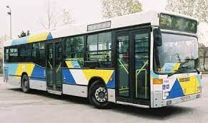
Getting Around
There are three means of transportation to get from Piraeus Port to the city centre of Athens; taxi rides, convenient bus rides and a reliable system of metros. The Piraeus port taxi ride will take about 25 minutes and will cost approximately 25€ under normal traffic conditions. The 40 bus will take you to the city centre of
Athens in 50 minutes, and costs 1.40€. Tickets can be purchased at ticket machines near every major stop,

Slide 19
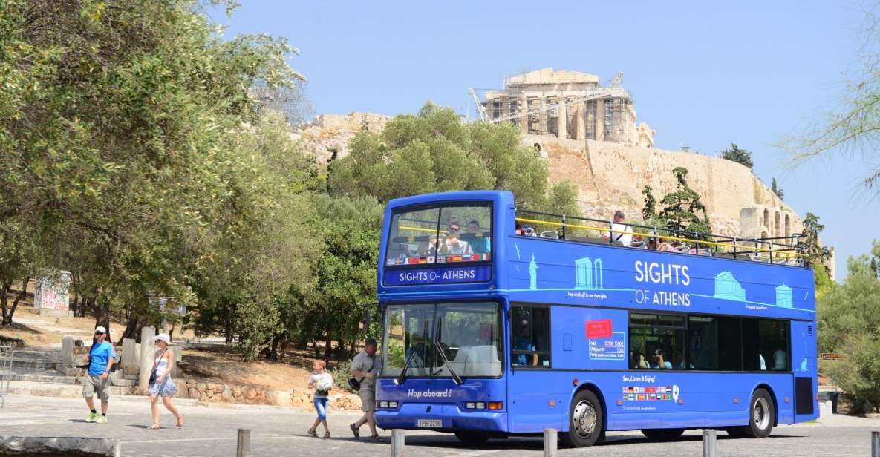
Hop on – Hop Off
Discover Athens, the Port of Piraeus, and the coastline of the Athenian Riviera at your own pace with a hop-on and hop-off ticket for 4 different bus lines. See the sites of the ancient capital, relax on the beach at Agios Kosmas and much more. Hop on and off as often as you like on 4 different bus lines
Make the most of your vacation with stops at all the major sights in Athens.
All day tickets cost € 23.

Slide 20
Thanks For Coming
If you have any more questions, Please ask.
I will do my best to answer them for you.
Have a great visit in Piraeus !

