Slide 1
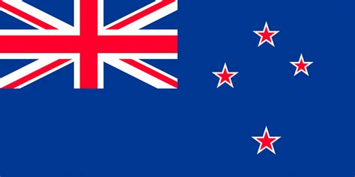
Picton Australia Presented by Marc Silver

Slide 2
What I Will Cover
My Port Philosophy
Don’t Miss the Ship
Money
About Picton
Area Map of Picton
Map of Picton
Picton Transportation
Places to see or at least consider
A few restaurant recommendations
Conclusion

Slide 3
My Port Philosophy
I have been cruising for over 45 years and have taken over 200 cruises. So, I consider myself an experienced cruiser.
The information I will present is based on those many years of
experience.
When I am on a cruise where the city, I want to visit is not the port city,
I always recommend taking a ship’s tour.
But when I am in a port with multiple attractions nearby and easy to see
on my own - I will do it on my own.
This presentation is for that type of port.

Slide 4

Don’t Miss the Ship
How to Avoid Missing Your Ship
Pay attention to the time. - Ship time and local time are often different.
Put a return-to-ship reminder on your phone.
Choose excursions wisely.
If a ship-sponsored excursion is late returning to port, the ship will wait for you. If you are on your own???
Be Prepared
Have your Passport, Credit Card, and phone numbers for your ship port agent.
What to Do If You Miss the Ship Most cruise lines have port agents stationed in the port area to assist if your ship has left without you. If your are lucky, when cruisers are late returning to the vessel, the ship’s crew will often remove the passengers’ essential items – passports, cell phones, and medication -- from the ship to leave with the port agents.
The Port Officials can help you with contacting your ship and making necessary travel arrangements.

Slide 5
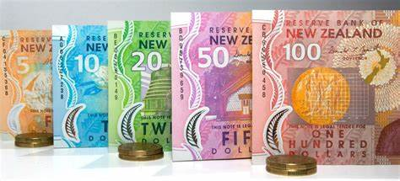
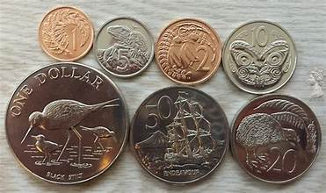
Money
The currency for Auckland is the New Zealand Dollar (NZD).
The conversion at the rate is $ 1.63 (NZD) to $1.00 U.S.
Or $1 (NZD) to $. 61 U.S.

Slide 6
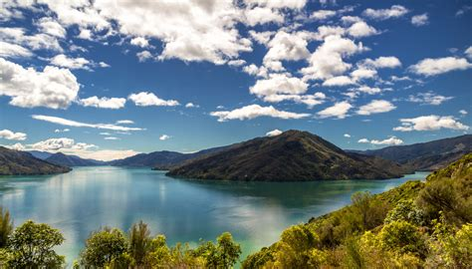
About Picton
Picton is famous for being the gateway to the stunning Marlborough Sounds. Nestled in the heart of the Marlborough Sounds, Waitohi / Picton is the base for exploring, with Queen Charlotte Sound being one of New Zealand’s most beautiful water landscapes.
The Marlborough Sounds make up one fifth of New Zealand’s entire coastline (almost 1,544 square miles) and they are without doubt New Zealand’s most popular and sheltered waterways for boating and kayaking.
Picton is Marlborough’s second-largest town, with a population of 4,790 (as at June 2021).
Impressively set in upper Queen Charlotte Sound, in the inlet known as Picton Harbor. The harbor is flanked by two headlands, Wedge Point and the Snout, and comprises two inlets, Picton Harbor proper and Shakespeare Bay.

Slide 7
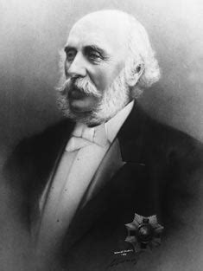
Historical Picton
The town is on the site of the Te Āti Awa settlement of Waitohi, which was established by migrants from Taranaki on the North Island in 1828.
In March 1850 the site was bought from Te Āti Awa, who moved to neighboring Waikawa Bay, which is still a Māori center today. A town was surveyed but most section buyers were speculative, anticipating a road between Waitohi and the Wairau.
In 1859 the province of Marlborough was established. Governor Thomas Gore Browne renamed the town Picton, and named Mabel Island in Picton Harbor after his daughter. Settler Thomas Allport farmed the island named after him for some years.

Slide 8
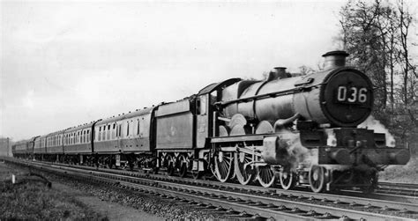
Historical Picton Cont.
The railway connected Picton and Blenheim in 1875; Picton gained a borough (town) council in 1876, but it was Blenheim which grew – with 3,222 residents in 1900 compared to Picton’s 875.
Picton’s population increased to 1,361 in 1911, probably on account of the freezing works, which opened in 1900 (and remained the town’s biggest employer until its closure in 1983).
It wasn’t until 1956 that the population passed 2,000 people.

Slide 9
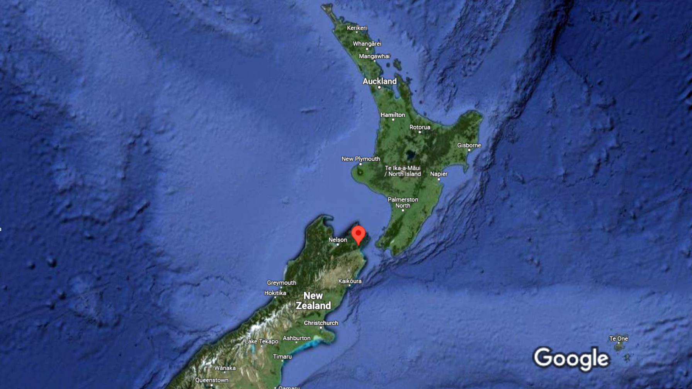
Area Map
Picton

Slide 10
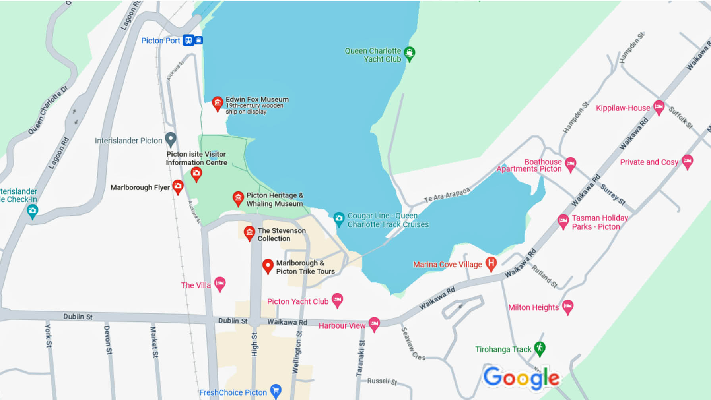
Map of Picton

Slide 11
Picton Buses
Picton has one of the most comprehensive and user-friendly public transport Pay with cash in exact change.
One Way ticket start at $2.30 and go to $7.50 depending upon distance.
Daily Ticket Fares
Regional Excursion Daily Ticket (RED) – Provides eligible concession card holders with unlimited daily travel within our network for just $2.50.

Slide 12
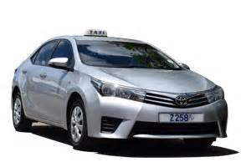
Picton Taxis
Standard taxis provide a safe and reliable way to explore the city or for transport between the cruise port and various attractions.
Like taxis in most locations the cost is significantly more expensive than other modes of transport.
You can also arrange car service in advance with Uber or Lyft in Picton. Request a ride anytime up to 90 days ahead.

Slide 13
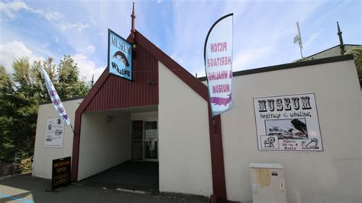
Picton Heritage & Whaling Museum
The Picton Heritage and Whaling Museum overlooks the Picton Foreshore and Queen Charlotte Sound and contains historical collections from Picton (Waitohi) and the Sounds dating back to the 1700s.
From early Mäori settlement to the area’s whaling history, there’s a lot to unpack at this fascinating museum.
Exhibit tell the story of the families who lived here and how Picton came to be.
The museum is open most days between 10am and 3pm.
$10.00 per Adult
$3.00 per Student
$1.00 per Child

Slide 14
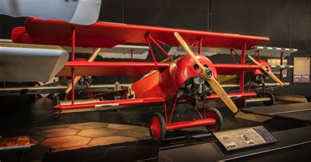
Omaka Aviation Heritage Centre
Omaka Aviation Heritage Centre is run by The New Zealand Aviation Museum Trust and although some objects are owned by the Trust, many of the aircraft and memorabilia are on loan from private individuals, who generously offer them for public display.
It began when a group of enthusiasts imported two Chinese Nanchang trainers and established the Marlborough Warbirds Association.
The sound of the Nanchang's radial engines was heard over Blenheim drawing curious spectators and, increasingly, other heritage aircraft.
As well as aircraft, there are the smaller items; letters, logbooks, clothing, photographs that help convey the human stories and give the machines their relevance to history.
Adult (15 yrs+) $30.00
Child (5-14 yrs) $12.00
Infant (under 5) Free

Slide 15
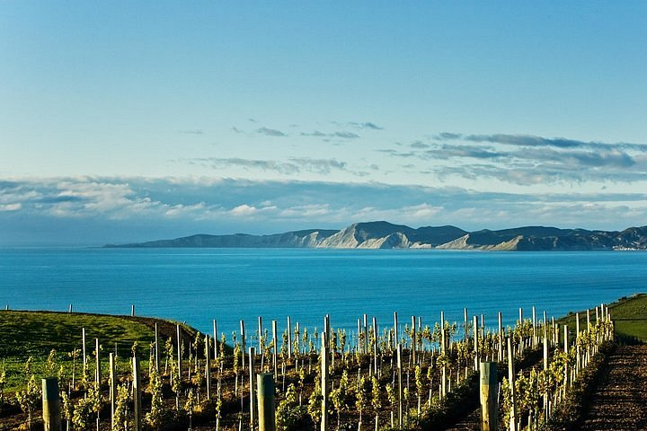
Wine Tasting
There are several local wine tour operators with a a range of excursions to suit your style of tour.
Small group tours or private half or full day tours with you own personal guide can be arranged.
All tour companies guarantee to get you back to your ship on time, but I recommend confirming your return time and include plenty of buffer time as well.
The Marlborough region has several craft beer breweries that can be visited as part of your tour. All cellar doors can post wine purchased by you overseas if required.
½ day Wine Tasting tours start at around $170 and go up from there.

Slide 16
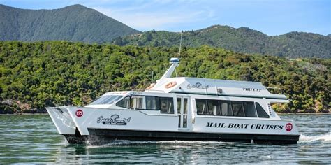
Motuara Island Bird Sanctuary
New Zealand is home to some fascinating native birds. Many of which can be seen on the pest-free Motuara Island.
An hour’s walk takes you up to a stunning viewpoint across the Queen Charlotte Sound. Look out for marine wildlife such as dolphins on a cruise out to the wildlife mecca of Motuara Island.
This pest-free island in the Queen Charlotte Sound is a bird haven with a short walk past watering holes (a huge attraction for birds) and to a stunning lookout over the sounds.
The island is home to endangered birds like the saddleback, king shag, little blue penguin and kiwi bird. Visit the island with Beachcomber Cruises.

Slide 17
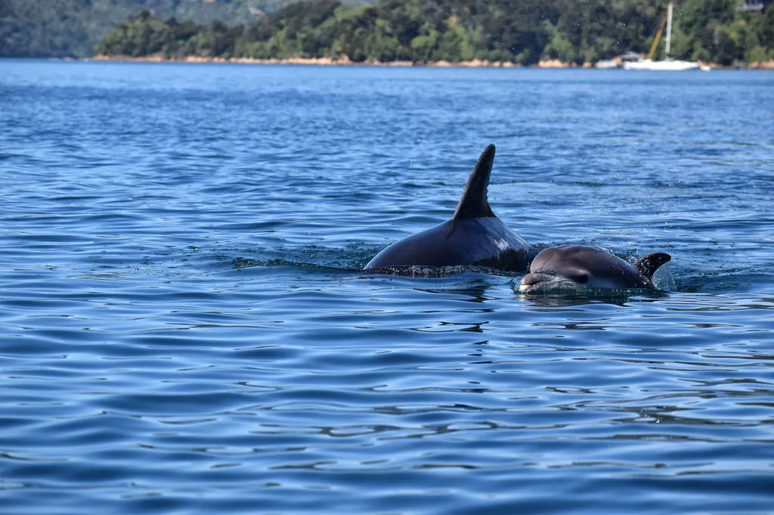
Eco Cruise Excursions
Experience wild dolphins, see endangered birds up close and much much more on a wildlife cruise of the Marlborough Sounds.
Get up close to nature, swim with the Dolphins and visiting a predator free bird sanctuary island are just a few of the activities you can do in the area before returning to your cruise ship.
Adults: $149
Children 5 -15: $75
Children < 5 - FREE

Slide 18
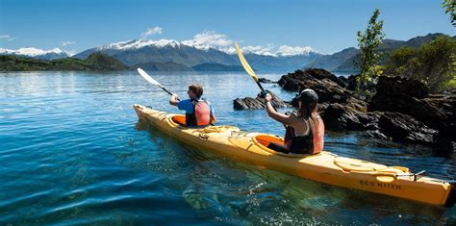
Sea Kayak
The Marlborough Sounds is perfect for sea kayaking even if it is your first time or you have kayaked before your in for a treat with calm, sheltered bays with an abundance of wildlife on offer.
From half day to full day guided tours with the assurance of returning you back to your cruise ship well before departure. Tour prices start at $110pp
You can also rent sea kayaks from Marlborough Sounds Adventure Company in the harbor.
Double Kayak Hire Rate
Half day Rental: $40 Day Rental: $70

Slide 19
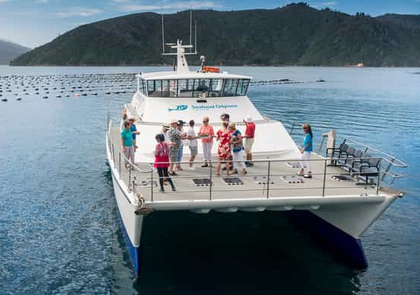
Marlborough Sounds Cruises
Ideal for cruise ship visitors to experience half and full day cruises of the Marlborough Sounds.
Seafood Odyssea Cruises offers a cruise through Queen Charlotte Sound, where you will sample local seafood such as salmon, and Green lip mussels, including Marlborough sauvignon blanc for the definitive wine/food pairing.
Discover the natural beauty while relaxing aboard a well-appointed catamaran.
Learn about this fascinating industry in the Marlborough Sounds from the knowledgeable crew.
Keep an eye out for local wildlife including seals, dolphins and birds.
Return transport to your ship in Picton.
Adult: $125
Child: $60 (5-15 years)
Child: Free (0-4 years)
Departure 1.00pm
Return 4.00pm

Slide 20
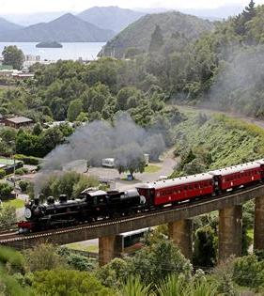
Steam Train Tour
Take a steam train ride from a bygone era. The WWI Memorial steam locomotive was built in 1915.
Departure is from Picton Railway Station which is conveniently located across the road from the cruise ship shuttle drop off point.
Disembark at Blenheim Station and enjoy at two and a half hours at leisure to explore Blenheim town center, a typical rural New Zealand township with a large variety of shops, gourmet cafes and restaurants.
The Steam Train will then depart Blenheim for the return journey to Picton (approx. 90-minutes) where you can spend more time at your leisure until you board your shuttle back to the cruise ship.

Slide 21
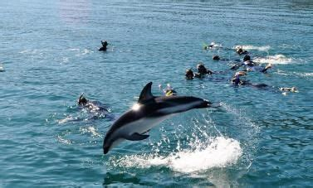
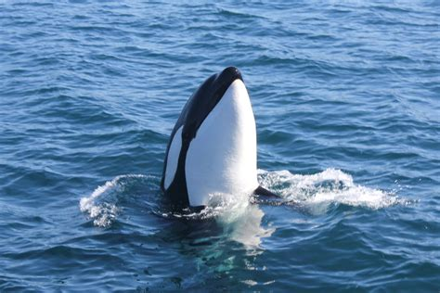
Swim with Bottlenose Dolphins
Join a dolphin swim & viewing cruise in the sheltered calm waters of the scenic Marlborough Sounds.
With luck you will see Dusky, Bottlenose, Common, Orca and the rare Hector’s dolphins that frequent this amazing area.
Swim with dolphins and view them in their underwater world. This is an adventure experience of a lifetime and one that you’ll never forget.
Cruise Calm Sheltered Waters of Queen Charlotte Sound, while you listen to informative commentary from the crew about these amazing animals.
Complimentary Tea, Coffee, Hot Chocolate and Biscuits.
Adult: $199 (16+ years) Child: $175 (12 – 15 years) Infant: N/A

Slide 22
Restaurants in Picton
There are a lot of excellent restaurants in Hokkaido. Especially for seafood.
Here are some recommendations: Restaurants in Picton :

Slide 23
Conclusion
Marlborough is a beautiful City with a rich history and numerous attractions. Regardless of what you're looking for, Marlborough has something for everyone.
I hope this presentation will help when we visit Pitcon!

Slide 24
Thanks For Coming
If you have any more questions, please ask.
I will do my best to answer them for you.
Have a great visit to Marlborough!

Slide 25
Acknowledgement
My seminars are the result of many years of travel experience combined with many hours of research over the internet.
I would like to acknowledge the many source I have accessed.
These include: Wikipedia.com, Britannica.com, and the various Museum, Park and Government websites.

