Slide 1
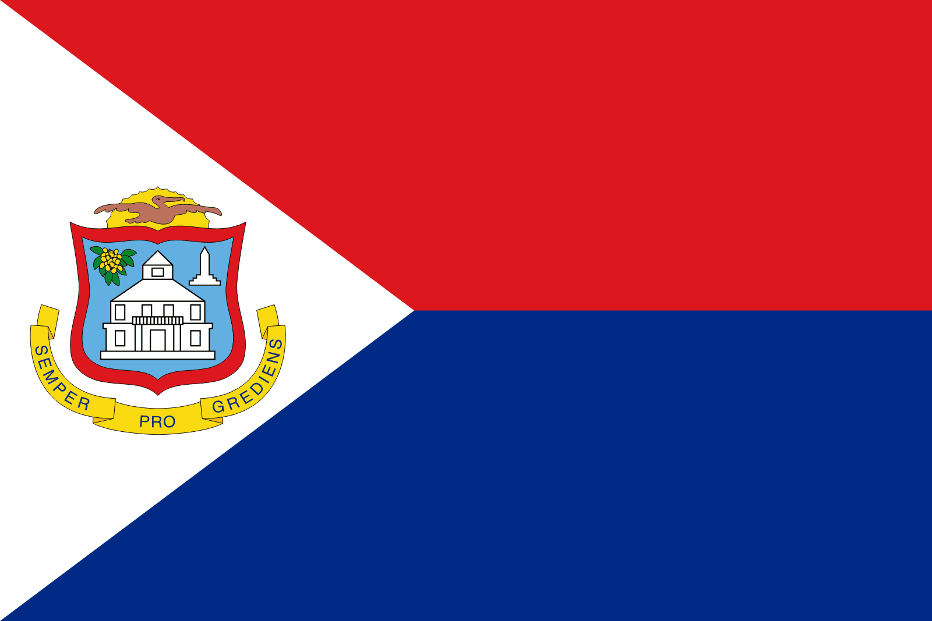
Philipsburg, Sint Maarten Presented by Marc Silver

Slide 2
What I Will Cover
My Port Philosophy
Don’t Miss the Ship
Money
About Philipsburg, Sint Maarten
Area Map of Sint Maarten
Map of Philipsburg
Philipsburg Transportation
Places to see or at least consider
A few restaurant recommendations
Conclusion

Slide 3
My Port Philosophy
I have been cruising for over 45 years and have taken over 200 cruises. So, I consider myself an experienced cruiser.
The information I will present is based on those many years of
experience.
When I am on a cruise where the city, I want to visit is not the port city,
I always recommend taking a ship’s tour.
But when I am in a port with multiple attractions nearby and easy to see
on my own - I will do it on my own.
This presentation is for that type of port.

Slide 4

Don’t Miss the Ship
How to Avoid Missing Your Ship
Pay attention to the time. - Ship time and local time are often different.
Put a return-to-ship reminder on your phone.
Choose excursions wisely.
If a ship-sponsored excursion is late returning to port, the ship will wait for you. If you are on your own.
Be Prepared
Have your Passport, Credit Card, and phone numbers for your ship port agent.
What to Do If You Miss the Ship Most cruise lines have port agents stationed in the port area to assist if your ship has left without you. If your are lucky, when cruisers are late returning to the vessel, the ship’s crew will often remove the passengers’ essential items – passports, cell phones, and medication -- from the ship to leave with the port agents.
The Port Officials can help you with contacting your ship and making necessary travel arrangements.

Slide 5
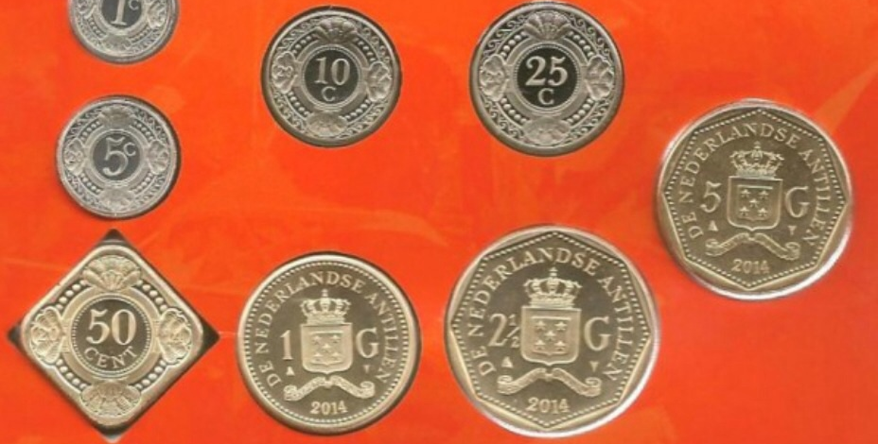
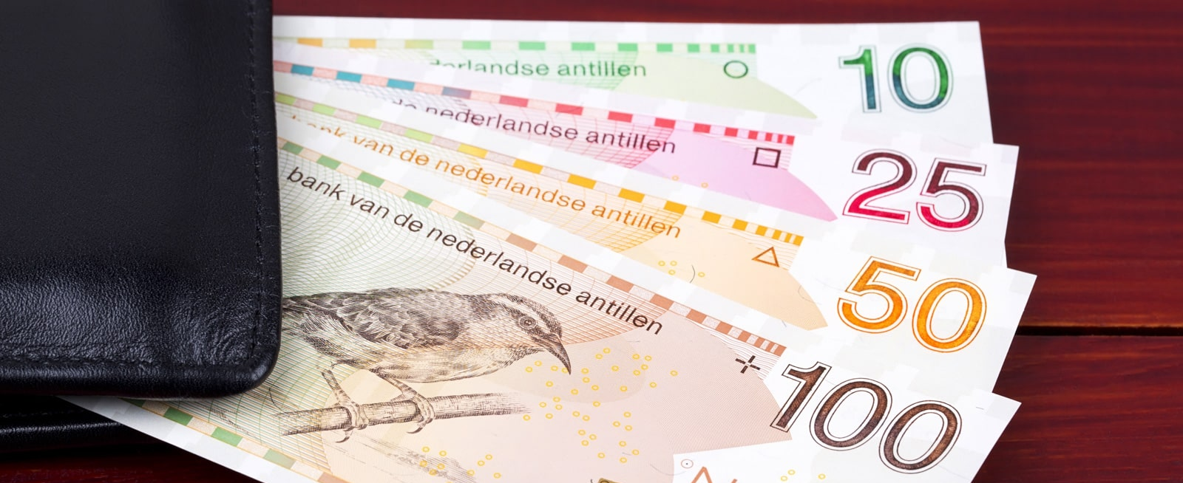
Money
The official currency of Sint Maarten (country code: SX) is the Netherlands Antillean guilder, with symbol ƒ and currency code ANG.
United States (USD) | 1 USD = 1.81 ANG
Europe (EUR) | 1 EUR = 1.93 ANG

Slide 6
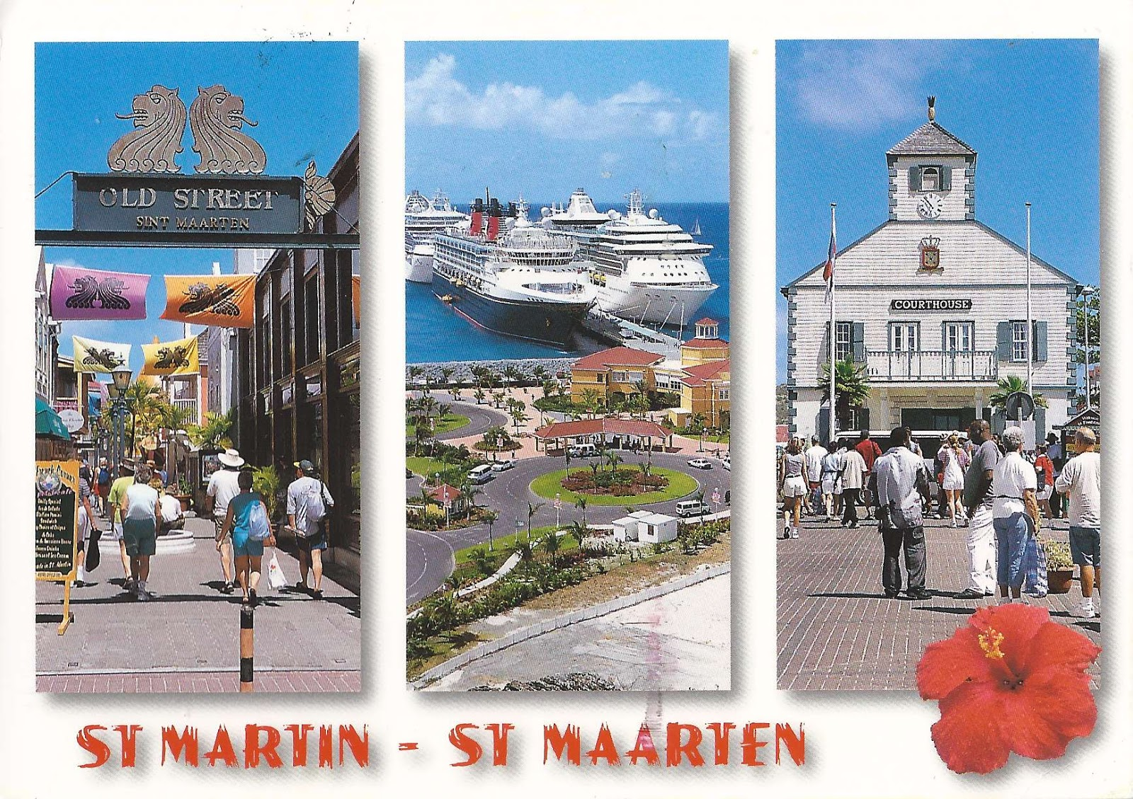
About Philipsburg, Sint Maarten
Philipsburg, the capital of Dutch St. Maarten, fills a narrow stretch of land between Great Bay and the Great Salt Pond. Founded in 1763 by John Philips, a Scottish captain in the Dutch navy, it soon became a bustling center of international trade. Today it is as bustling as ever, with lively shopping streets, cafés, and hotels.
St. Maarten, or Sint Maarten, a vibrant Caribbean island, is a unique destination where European flair meets tropical charm. Divided between the Netherlands and France, it's the smallest inhabited island in the world shared by two nations. This dual nationality contributes to the island's diverse culture, cuisine, and architecture, making it an intriguing spot for cruisers and tourists alike.

Slide 7
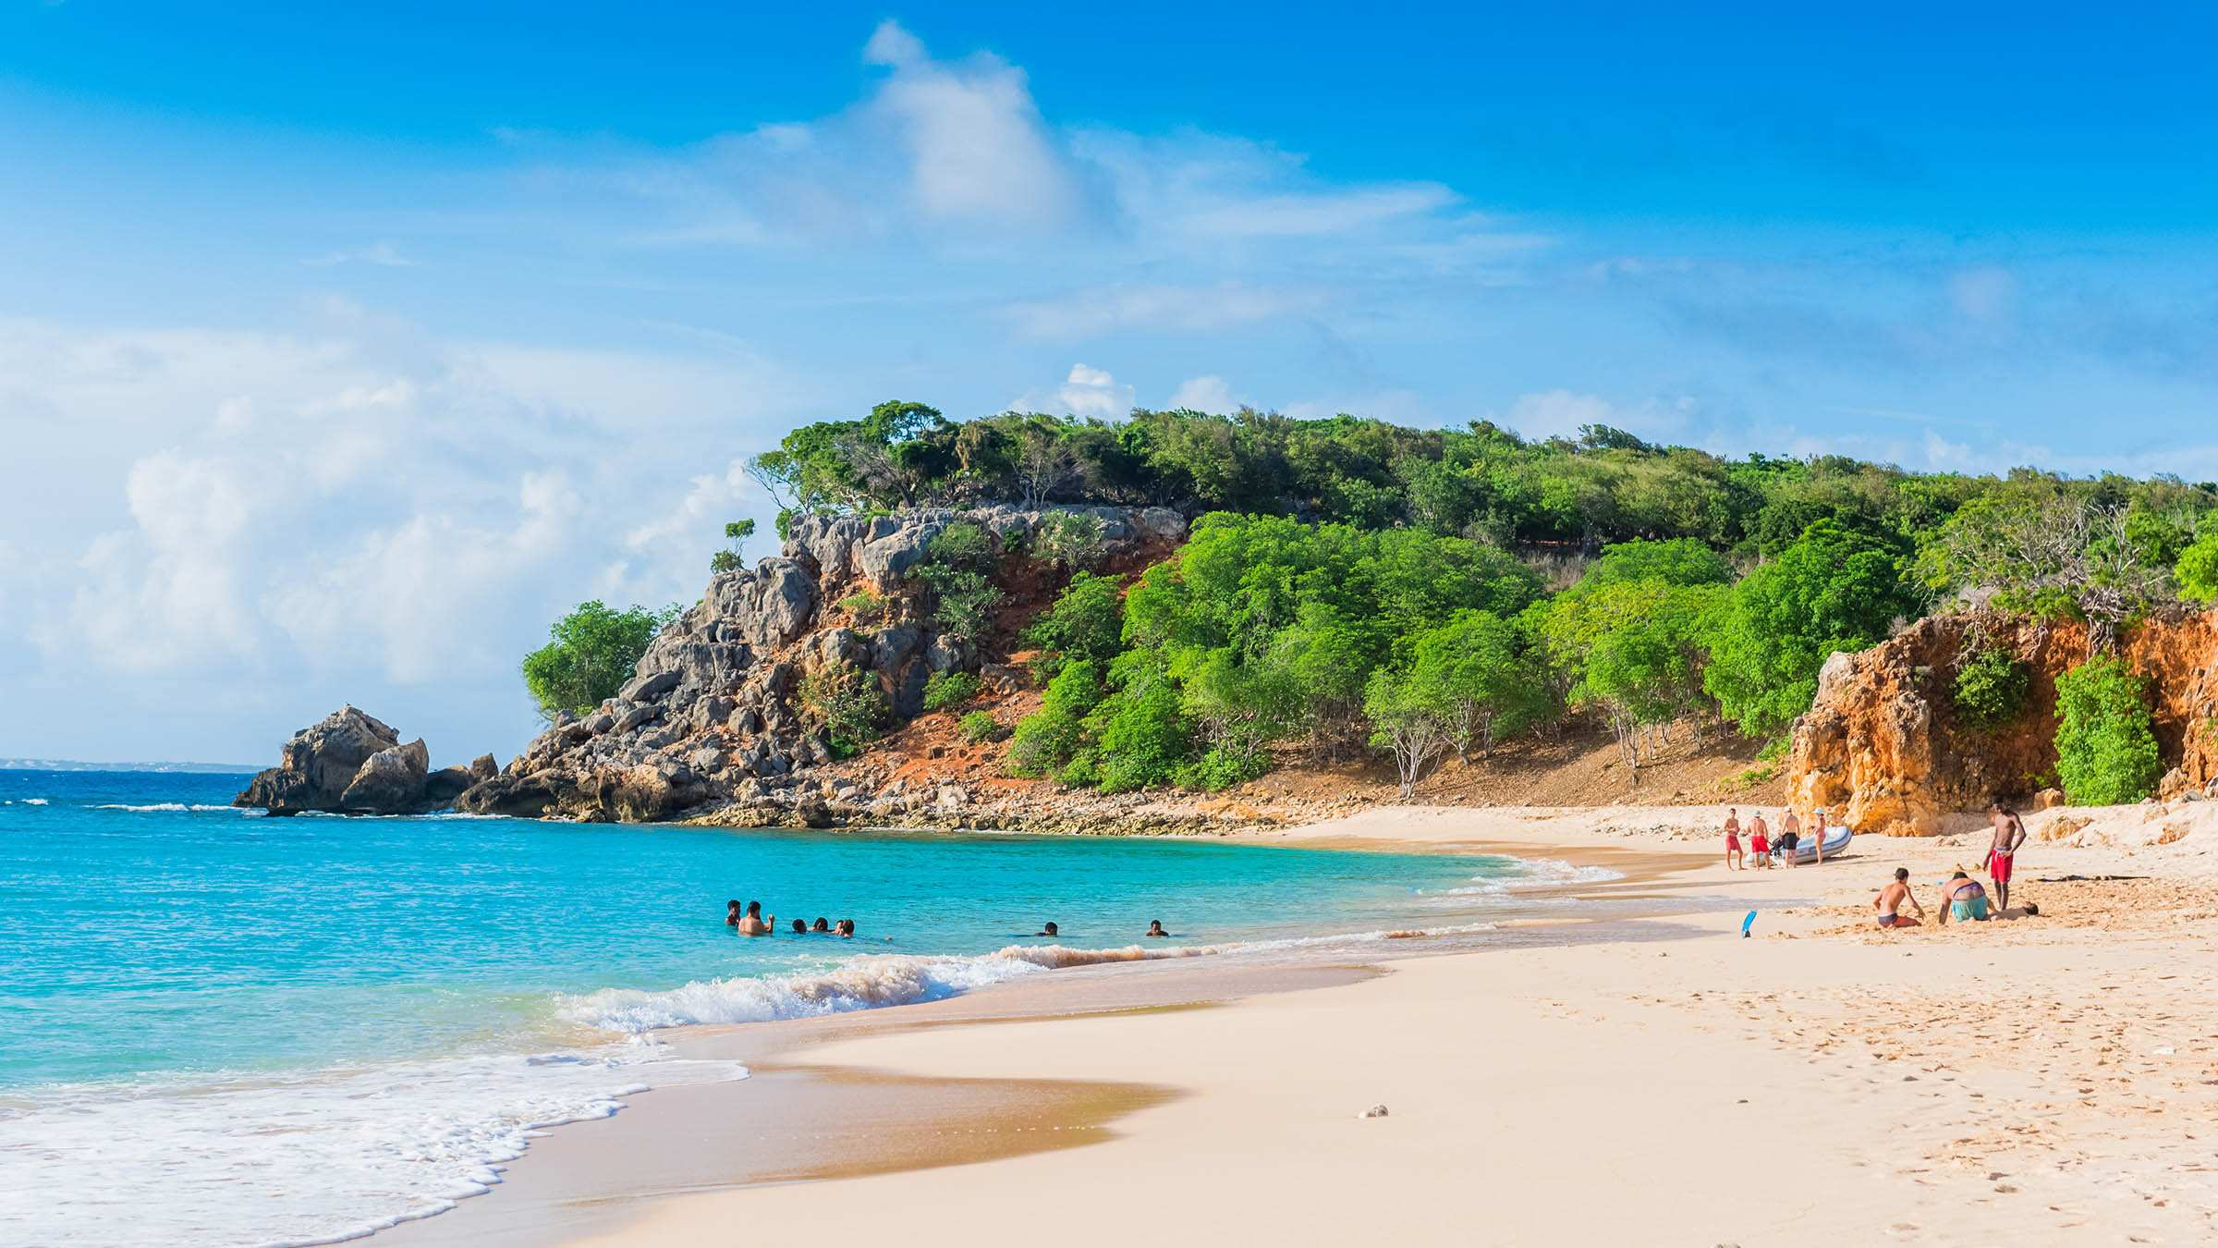
French Side of St. Martin
On the French side of the island, the Euro is the official currency, but the US Dollar is widely accepted and often preferred.
The French side of St. Martin is a wonderful place to visit. You can find luxury and seclusion on its sandy beaches. There’s also great food and wine at the various restaurants on this delightful island. You can also enjoy swimming and snorkeling in the blue clear waters of the Caribbean beaches around this lovely island.
Marigot is the capital of the French side in Saint Martin, it’s a small village like area full of great restaurants cafés bars and boutiques. Marigot is a port town and is also the main port of the French side of the island.
There are also nude beaches on the French side of the island.

Slide 8
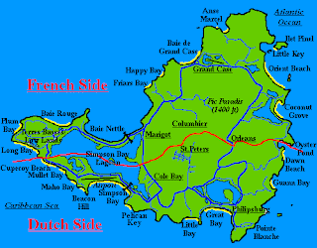
Map of Sint Maarten

Slide 9
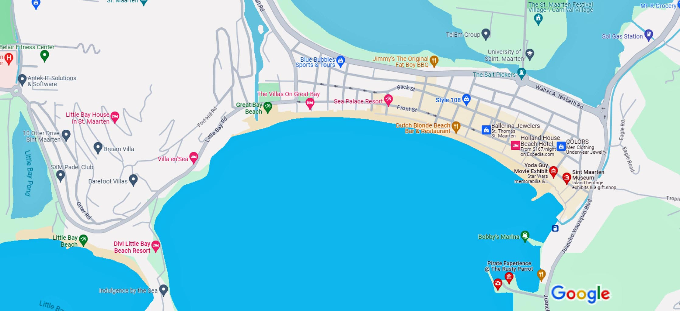
Map of Philipsburg

Slide 10
Philipsburg Buses
The bus system in St. Maarten is an efficient and cost-effective way for visitors to explore the island.
Different from public transport systems found in many countries, St. Maarten’s buses are more informal. They are typically small vans rather than large buses and do not operate on a set schedule.
Buses run frequently and cover most of the island, making them a reliable option for getting around.
You can identify these buses by the sign in their front window indicating their destination. an excellent way to navigate St. Maarten. It's advisable to have small change ready for the fare and to ask the driver about the final destination and stops to ensure you’re headed in the right direction.

Slide 11
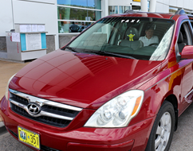
St. Maarten Taxis
Taxis in St. Maarten are a prominent and convenient mode of transportation for visitors, especially those arriving by cruise. They are readily available at the cruise pier.
Taxis in St. Maarten operate with fixed rates to specific destinations, which means there's no metered fare system. This approach provides passengers with the assurance of knowing the cost upfront. The taxi drivers are generally friendly and knowledgeable about the island, often doubling as informal tour guides.
Here are some standard rates from the cruise port:
To Anse Marcel: $45
To Dawn Beach: $25
To Grand Case: $35
To Maho: $30
To Marigot: $30
To Philipsburg center: $10
To Sandy Ground: $35

Slide 12
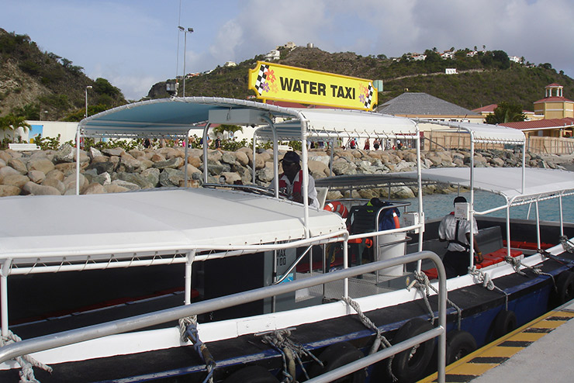
Water Taxis
The water taxi system in St. Maarten is a popular and efficient means of transportation, especially favored by tourists for its convenience and scenic route.
The water taxis primarily operate between the cruise ship terminal and downtown Philipsburg, providing easy access to the heart of the city's shopping and dining areas.
This mode of transport is not only quick but also offers a picturesque view of the coastline, making the journey part of the St. Maarten experience.
Departing from the cruise terminal, the water taxis are frequent, ensuring that visitors don’t have to wait long for a ride. The cost of a water taxi ride is quite reasonable, with round-trip fares typically around $7, offering a cost-effective option for travelers. One-way trips are usually priced at about $5

Slide 13
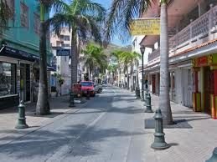
Front Street
The port itself offers a range of amenities and is a short walk or a quick taxi ride from the bustling Front Street, renowned for its duty-free shopping. Front Street's most prominent landmark is the Courthouse, built in 1793. A grand white wooden structure topped with a cupola, it now serves as St. Maarten's courthouse. Also on Front Street is the Museum,
which gives visitors an excellent introduction to local history. Among the artifacts on display are pottery from the island's original inhabitants, the Arawaks, and cargo salvaged from a British ship that sank off the coast in 1801.
Walking Front Street you can explore a variety of shops selling everything from luxury goods to local crafts.

Slide 14
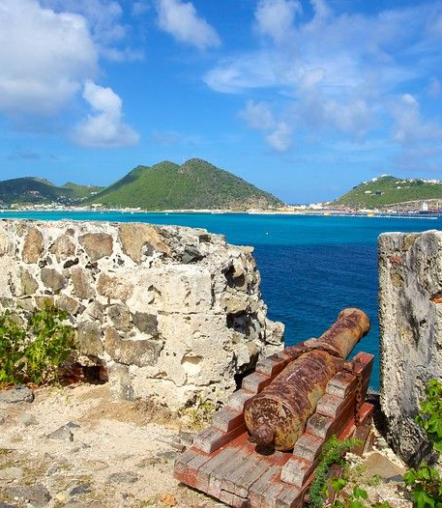
Two Historic Forts
Two historic forts bear witness to St. Maarten's history.
Fort Amsterdam, built in 1631 on a peninsula, was the first Dutch military outpost in the Caribbean. The fort was soon captured by the Spanish, who made it their most important bastion east of Puerto Rico. The Spanish abandoned the fort in 1648, and since then it has remained in Dutch hands.
Fort Louis is an 18th-century former French military fort that was built during the reign of King Louis XVI of France. Fort Louis was completed in 1789 to protect warehouses of the Marigot harbor which stored locally produced sugarcane, coffee, rum, and salt from Dutch and British pirates.

Slide 15
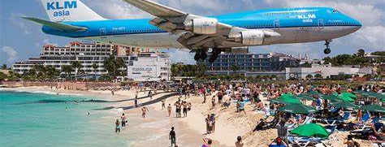
Maho Beach, located near the Princess Juliana International Airport, is famous for its unique experience of watching planes fly at a very close-range overhead as they land. This beach is around 11 km from the cruise port, a journey of about 20 minutes by taxi.
Its popularity stems from the thrill of plane-spotting, making it a unique shore excursion option, and one of the most popular beaches in the world.
Maho Beach

Slide 16
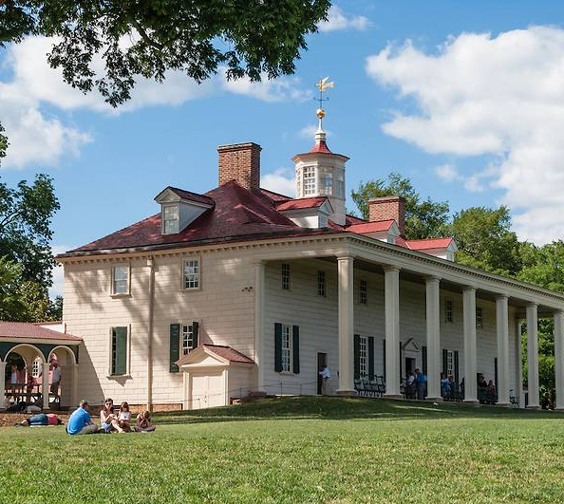
Mount Vernon Plantation
Mount Vernon Plantation was originally established in the 18th century for growing corn, sugar, tobacco, coffee, cotton, and spices that were exported to Europe.
The Mount Vernon Plantation was first set up in 1786 and has been carefully preserved throughout the years under different owners from Britain, St. Barts, the USA, and St. Martin.

Slide 17
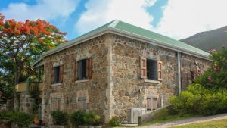
Emilio Wilson Estate
The Emilio Wilson Estate is a historical site in St. Maarten that was formerly a sugar plantation. The Emilio Wilson Estate also served as a home to the first governor of Sint Maarten. The estate was eventually purchased by Emilio Wilson, whom the property is named after.
The Emilio Wilson Estate is important to the people of St. Maarten as it represents the ancestry of the former slaves who worked on the plantation.
A historical, cultural, educational, and recreational park was established on the estate which was in line with Emilio Wilson’s vision for the land to be kept in its original state.
The Estate features antique colonial rock walls, historical artifacts, and caves that served as shelters during the hurricanes in St. Maarten.

Slide 18
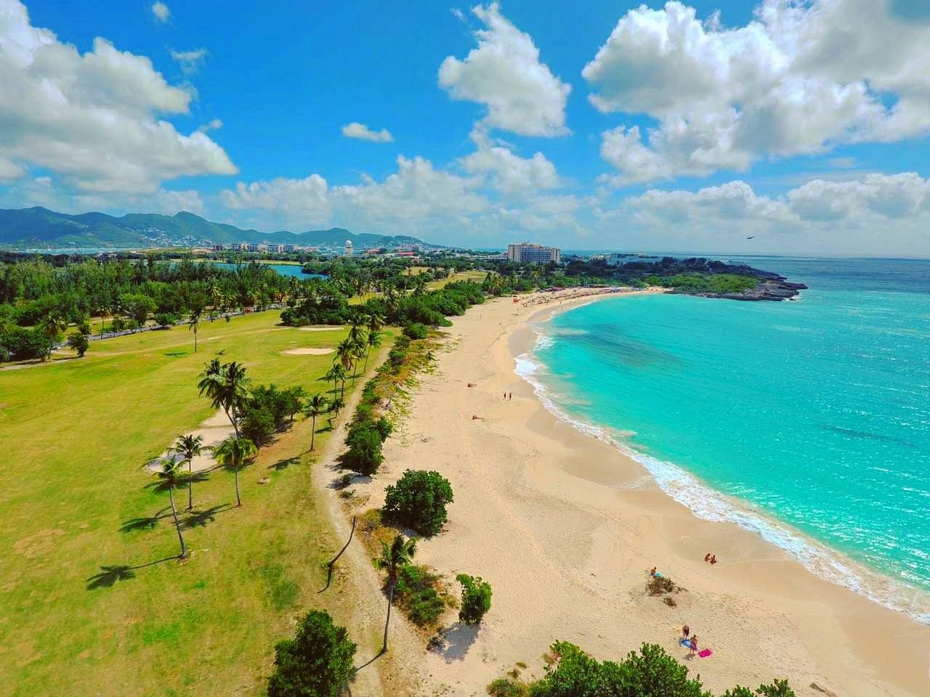
Mullet Bay Beach, situated in the southwest of the island, is about 9 miles from the cruise port, and a 30-minute drive.
Mullet Bay Beach
The beach is known for its calm, aquamarine waters, and soft sandy shores.
It's a favorite for both relaxation and water sports and is equipped with amenities like beach bars and restaurants.

Slide 19
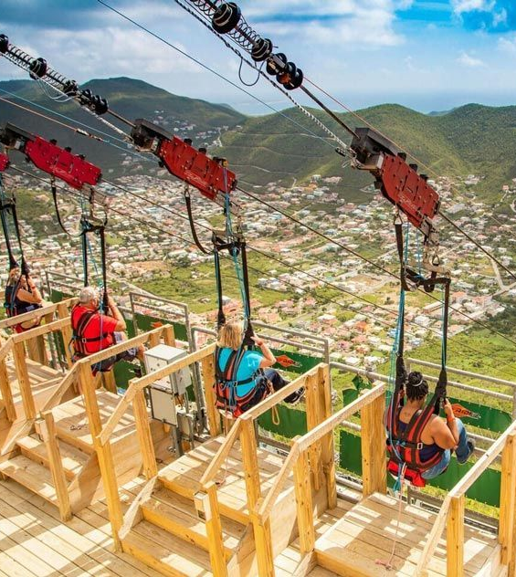
Zip Lining
ROCKLAND ESTATE.
Rainforest Adventures creates unique and memorable experiences that inspire a sustainable use of the environment and an appreciation of the local culture while positively impacting our communities.
Rockland Estate is an eco–adventure park that recognizes the ecological, cultural, and historical value of the site.
Fly, ride, slide, - do it all! This package combines: the Flying Dutchman, the Sentry Hill Zip Line, and the Schooner Ride. $159/person

Slide 20
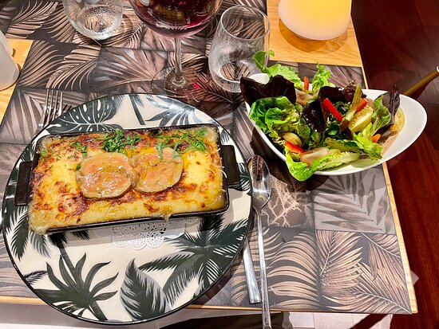
Restaurants
There are a lot of excellent restaurants in Philipsburg. Especially for Caribbean and seafood.
Here are some recommendations:
Bold Buddha $$ - $$$ American, Steakhouse, Caribbean, Front St 49, Philipsburg
Lazy Lizard St. Maarten $$ - $$, Caribbean, Bar, Vegetarian 5 Front Street, Philipsburg
Le Bistronome Sxm $$ - $$$ French, Caribbean, European 34 Bd De Grande Case
Lazy Lizard St. Maarten $$-$$$ Caribbean, Bar, Vegetarian, 5 Front Street, Philipsburg
Dutch Blonde Beach Bar $$-$$$ Caribbean, Dutch Bar, Boardwalk 79, Philipsburg
Dirty Sanchez Crew Bar $ Pub. Front Street 43 K, Board Walk, Philipsburg
For those of you who just like good food, you can’t go wrong just about anywhere you go in Sint Maarten.
GOOD EATING

Slide 21
Conclusion
Philipsburg is a beautiful City with a rich history and numerous attractions. Regardless of what you're looking for, Philipsburg has something for everyone.
I hope this presentation will help when we visit Philipsburg!

Slide 22
Thanks For Coming
If you have any more questions, please ask.
I will do my best to answer them for you.
Have a great visit to Philipsburg !

