Slide 1
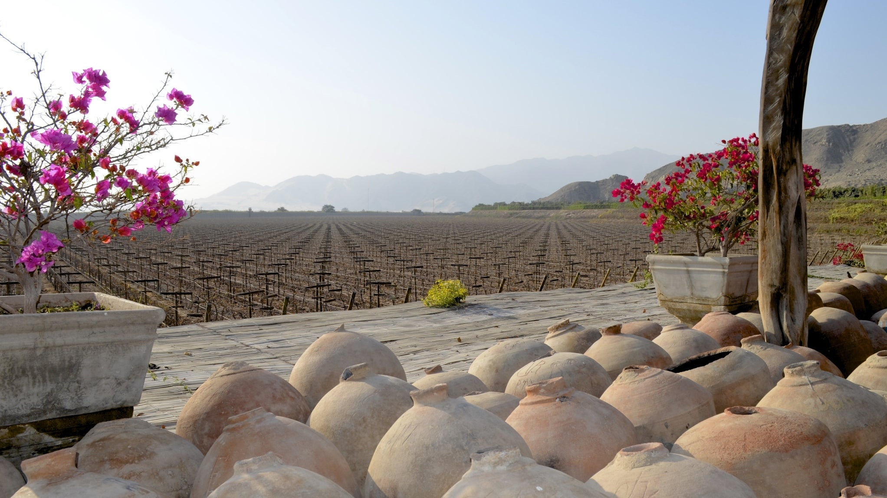
An Introduction to
Wine in Peru
Presented by
Marc Silver

Slide 2
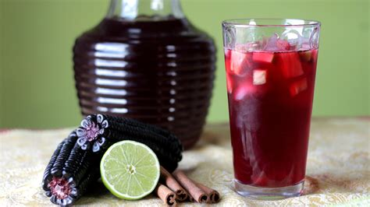
History of Peru’s Wine
Early Andean Alcoholic Traditions: The Foundations of Agriculture
Before the introduction of European grapevines, the indigenous Andean cultures, such as the Moche, Nazca, and Wari, cultivated a variety of crops and were skilled in fermentation.
They produced chicha, a traditional alcoholic drink
made from fermented maize, as well as other fruit
based beverages. These cultures developed sophisticated farming techniques, including terracing and irrigation, which would later influence the
cultivation of vineyards when the Spanish arrived.
While grapes were not part of the Andean agricultural landscape, these early civilizations laid the agricultural and technological groundwork that would later support the introduction of viticulture.

Slide 3
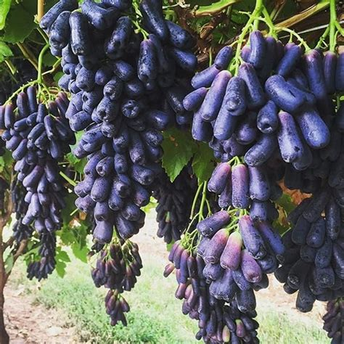
Colonial Influence
The Arrival of European Grapes
The introduction of Vitis vinifera to Peru by Spanish colonists in the 16th century marked the beginning of the country’s winemaking journey.
These European vines thrived in the arid, sunny conditions of southern Peru, particularly around the Ica region.
By the mid-1500s, Peru had become a key wine-producing colony in the Americas, contributing to the establishment of New World winemaking.
Vitis vinifera

Slide 4
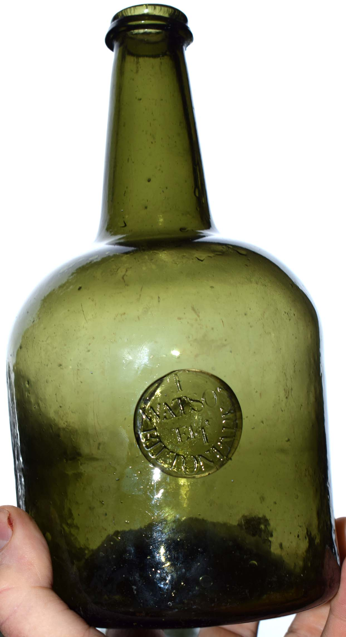
History of Peru’s Wine
1700s: The Colonial Expansion
By the 18th century, the Peruvian wine industry began to grow in response to increased demand for wine and Pisco.
The Spanish colonial government promoted viticulture in Peru to meet
the needs of both the local population and Spanish settlers.
Wineries started expanding their production, focusing not only on
domestic consumption but also on exports to other Spanish colonies.
Key Developments: The introduction of irrigation techniques allowed
for better vineyard management in arid regions.
Grapes like Muscat and Quebranta were cultivated more extensively,
laying the foundation for future winemaking.

Slide 5
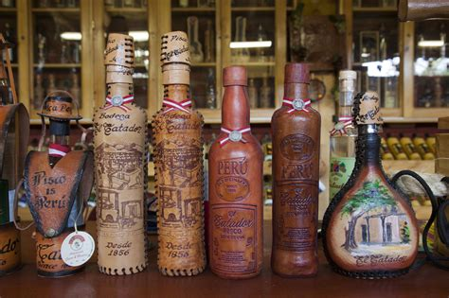
History of Peru’s Wine
1800s: The Rise of Pisco
The 19th century saw a significant shift in the focus of Peruvian viticulture towards Pisco production. As the demand for Pisco grew, especially in the United States and Europe, many vineyards shifted their focus to producing this traditional grape spirit rather than still wines.
Key Developments: The establishment of regulations for Pisco production, including the designation of certain grape varieties and production methods, solidified its importance to Peru's economy.
This period also marked the growth of large estates that began to dominate the wine and Pisco markets.

Slide 6
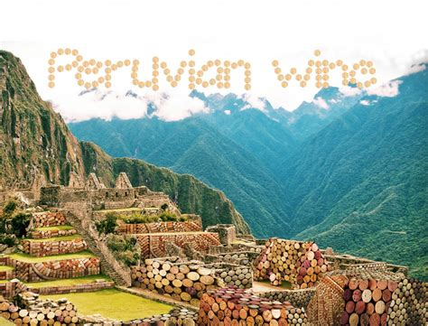
History of Peru’s Wine
1990s: Modernization and Globalization
The 1990s brought a wave of modernization to the Peruvian wine industry. Entrepreneurs and international investors began to see the potential of Peruvian viticulture, leading to new investment in technology and vineyard practices.
Key Developments: The introduction of
international grape varieties, such as Cabernet
Sauvignon, Merlot, and Malbec, allowed
winemakers to diversify their offerings.
The increased focus on terroir led to the
identification of specific vineyard sites that
would enhance the quality of wines produced.

Slide 7
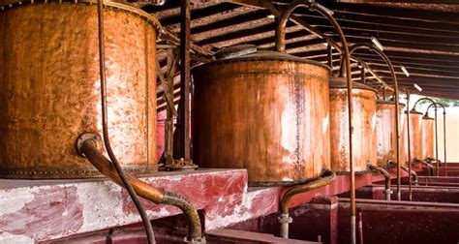
History of Peru’s Wine
2000s to Present: A Bright Future
In recent years, Peruvian wine has continued to gain international acclaim. With a focus on sustainability and organic practices, many wineries are now producing wines that reflect the unique terroir of their regions.
Key Developments: The recognition of Peru as a distinct wine-producing country, along with an increase in wine tourism, has boosted interest in local wines. Notable wineries are now showcasing their products at international exhibitions, further solidifying Peru's place in the global wine landscape.
Innovations: Modern winemaking techniques, including temperature-controlled fermentation and the use of French and American oak barrels, have improved the consistency and quality of Peruvian wines.

Slide 8
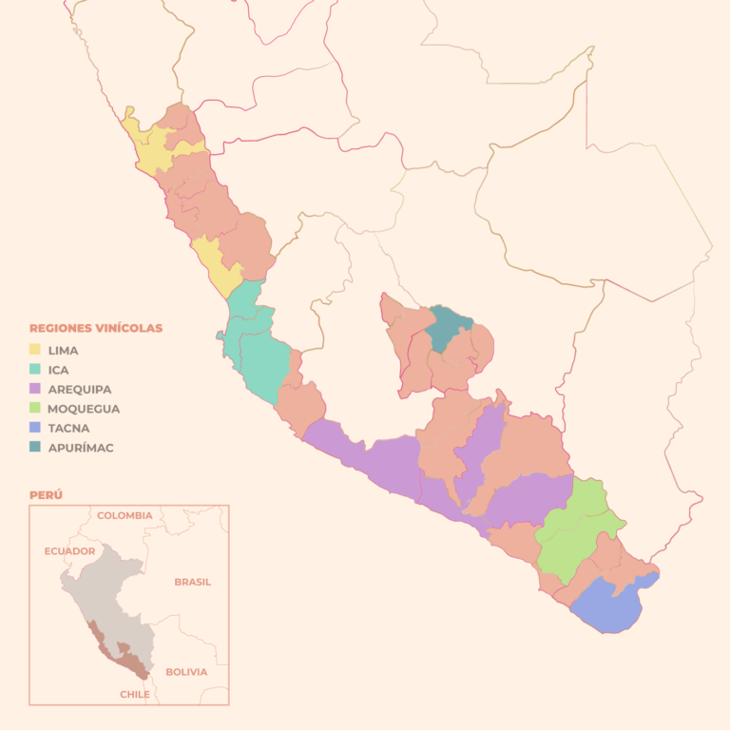
Wine Regions in Peru
Peru’s wine production is largely centered in its southern coastal and highland regions.
The country’s unique combination of intense sunlight, dry conditions, and varied altitudes makes it a surprisingly diverse environment for viticulture.
Here, we’ll rank and explore the most important wine regions in Peru, diving into their specific terroirs and grape varieties.

Slide 9
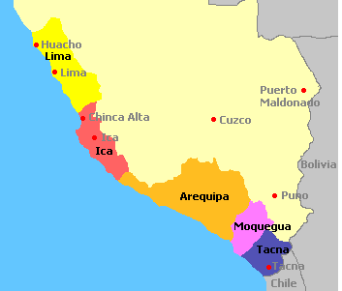
Wine Regions
Ica
As the heart of Peru’s wine industry, Ica is by far the largest and most significant wine-producing region. Located about 300 km south of Lima, Ica’s climate is perfect for viticulture, with hot, sunny days and cool nights. This large diurnal temperature shift is ideal for developing flavor complexity in grapes. Ica is also home to some of Peru’s most notable wineries and is known for both wine and Pisco production.
Terroir: The region's sandy soils, low rainfall, and near
constant sunlight make it ideal for ripening grapes. Its dry desert
climate means winemakers have full control over water use
through irrigation, allowing for consistent grape quality year after
year.
Predominant Grape Varieties: Quebranta (primarily used for
Pisco), Muscat, Albilla, and Tannat. The heat of the region brings
out ripe, fruity characteristics in these grapes, particularly in red
wines like Malbec and Tannat.

Slide 10
Wine Regions
Arequipa
Sitting at a higher altitude than Ica, Arequipa offers a dramatically different environment for grape growing. The volcanic soils here, coupled with the cooler temperatures at altitude, create wines with distinct minerality and freshness.
Terroir: The volcanic origins of the soil add a
unique mineral character to the wines, and the
higher altitude (up to 2,000 meters) slows the
ripening process, which helps to preserve acidity
and intensify flavors.
Predominant Grape Varieties: Tannat, Syrah, and
Sauvignon Blanc. Tannat, in particular, thrives in
this region’s cooler climate and produces structured
, tannic wines with great aging potential.

Slide 11
Wine Regions
Moquegua
Though much smaller in terms of production, Moquegua has garnered attention for its high-quality wines. This southern region’s cool climate and proximity to the Andes give it an advantage when it comes to crafting elegant, well-structured wines.
Terroir: High-altitude vineyards (around 1,500 meters)
and a mix of clay and sandy soils make for complex
wines with a strong sense of place.
Predominant Grape Varieties: Malbec and Cabernet
Sauvignon. The cooler temperatures allow these grapes
to ripen more slowly, leading to wines with more
nuanced flavors.

Slide 12
Wine Regions
Lima
Though Lima is not a major wine-producing region today, it has historical significance as one of the first places where Spanish settlers planted grapevines in Peru. The area’s coastal location means cooler temperatures, and a few wineries are still operating here, producing boutique wines.
Terroir: Coastal influences and cooler temperatures lead
to fresher, lighter wines. The proximity to the ocean also
imparts a slight salinity to the wines, adding an
interesting layer of complexity.
Predominant Grape Varieties: Muscat and Albilla for
whites, and some experimentation with reds like Syrah
and Cabernet Sauvignon.

Slide 13
Wine Regions
Tacna
A rising star in Peru’s wine scene, Tacna is located near the border with Chile and benefits from both high-altitude vineyards and a unique microclimate. Though production is still limited, the quality of the wines emerging from this region is promising.
Terroir: Tacna’s high-altitude vineyards, cool nights,
and volcanic soils provide a perfect setting for
developing concentrated wines with great aging
potential.
Predominant Grape Varieties: Tannat and Cabernet
Sauvignon dominate, with recent experimentation in
Syrah and Petit Verdot.

Slide 14
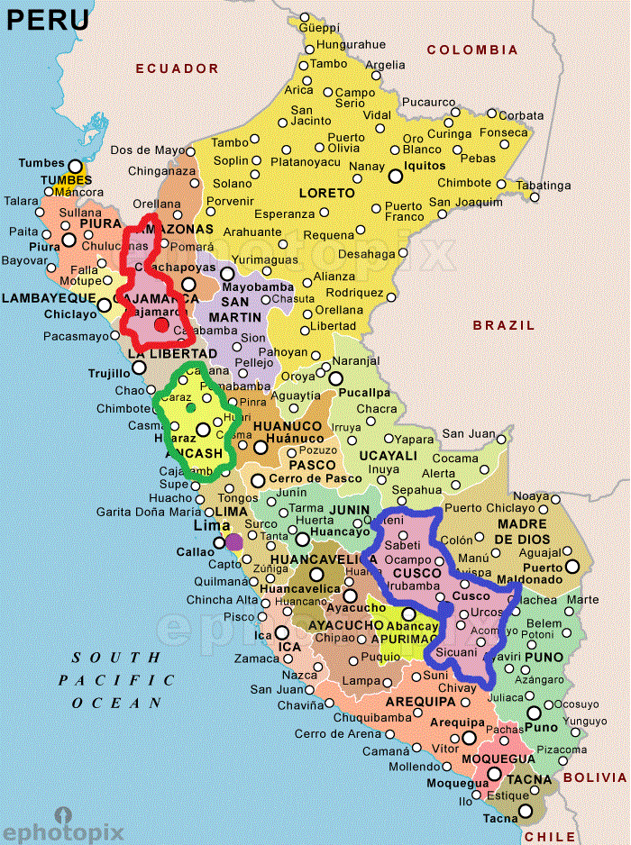
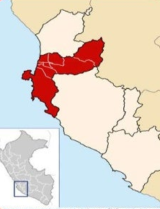
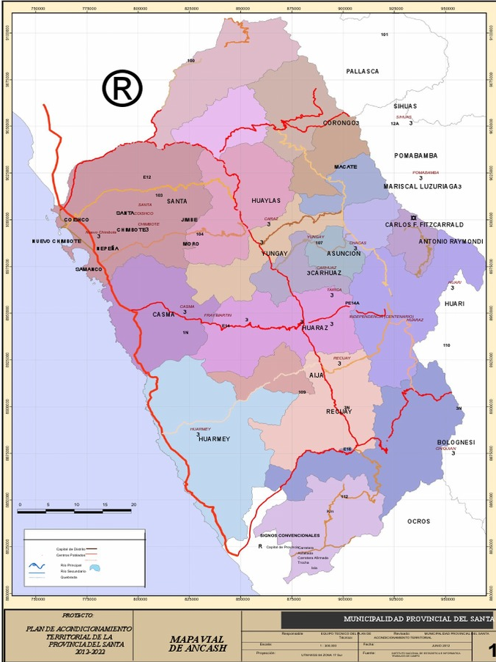
Wine Regions
Other Lesser Regions
While smaller in production, regions like Pisco, Ancash, and Cajamarca are home to vineyards experimenting with different grape varieties.
These areas often produce wines for local consumption rather than international markets but contribute to Peru's growing diversity of wine styles.
Pisco
Ancash

Slide 15
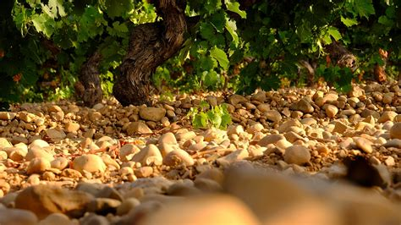
Peru’s Unique Terroir
Peru’s terroir is unique in that its wine regions stretch across vastly different environments, from coastal deserts to high-altitude valleys near the Andes. This geographical diversity, combined with volcanic soils, makes Peru a fascinating place for wine production. Some key factors shaping the character of Peruvian wines include:
Volcanic Soils: Regions like Arequipa and Tacna benefit from
the volcanic origin of their soils, which impart a minerality to
the wines. This can add complexity and structure, especially to
red varietals like Tannat and Malbec.
High Altitude: Many of Peru’s wine regions are located at altitudes ranging from 500 to over 2,000 meters. The cooler temperatures at these elevations slow down the ripening process, allowing grapes to develop more concentrated flavors while maintaining high acidity. This is particularly true for Arequipa and Moquegua.

Slide 16
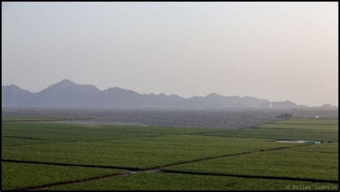
Peru’s Unique Terroir
Coastal Influence: In regions like Lima, proximity to the Pacific Ocean brings cool breezes that help regulate temperatures, resulting in wines that are fresher and lighter, with a saline note that can be particularly intriguing in whites.
Dry Climates and Irrigation: Much of Peru’s wine production takes place in desert regions, where rainfall is minimal.
This means winemakers have to rely on irrigation systems, often using techniques adapted from ancient Andean practices.
The control over water levels allows for consistent grape quality, year after year.

Slide 17
Peru’s Major Varietals
Peru’s Major Varietals and Their Characteristics
Peru’s winemaking landscape is a vibrant tapestry woven from both indigenous and international grape varieties.
As winemakers across the country embrace the unique terroirs of their regions, they are crafting wines that reflect the diverse climates, soils, and altitudes that characterize Peru's varied geography. This fusion of traditional Andean practices with modern viticultural techniques has led to a burgeoning wine industry that is both exciting and dynamic.
In this exploration of Peru’s major varietals, we will delve into the distinct flavor profiles and characteristics of the grapes that thrive in this South American gem. Each varietal offers a unique glimpse into the terroir from which it hails, showcasing the skill and creativity of the winemakers.
We'll also highlight ideal food pairings, providing insights into how these wines can elevate your dining experience. So, whether you're a seasoned sommelier or a curious newcomer, let’s dive into the major grape varieties that are shaping Peru's wine scene and discover the delightful flavors they bring to the table.

Slide 18
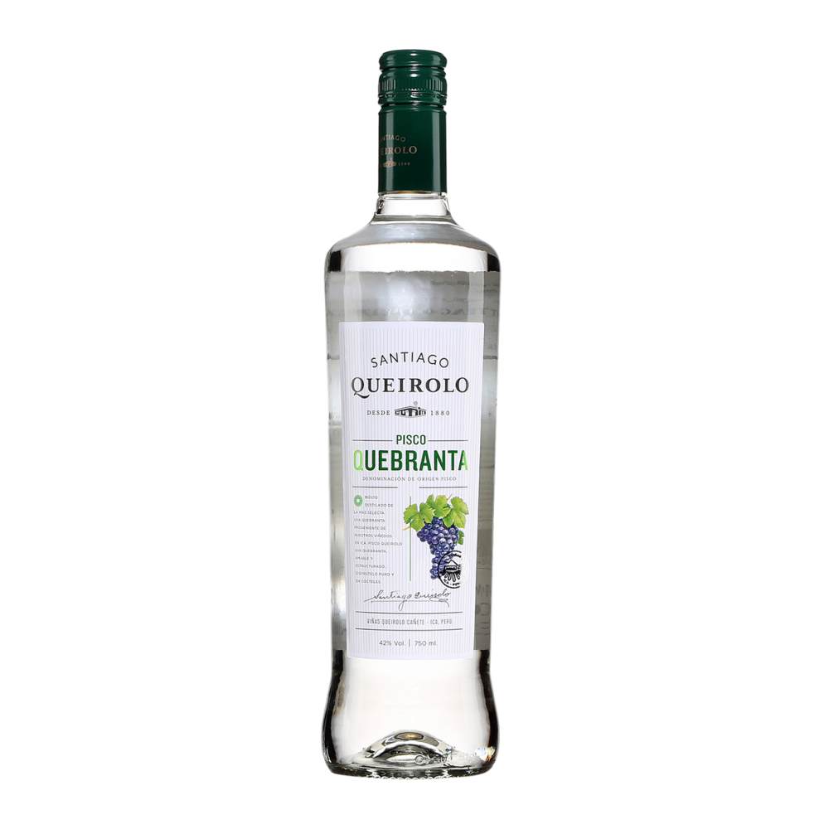
Peru’s Major Varietals
Quebranta
Quebranta is perhaps the most famous grape variety in Peru, primarily known for its use in producing Pisco. However, it is also used to make still wines with a unique personality.
Tasting Notes: Wines made from Quebranta are typically robust, with intense fruity aromas like ripe plum and black cherry. On the palate, they can be slightly rustic with earthy and herbal undertones. Expect a medium body with moderate acidity, making them versatile for pairing.
Food Pairing: Quebranta pairs well with hearty dishes like beef stew, grilled meats, or even a Peruvian lomo saltado. Its fruit-forward nature also makes it a good match for dishes with rich sauces.

Slide 19
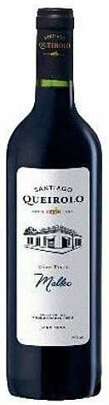
Peru’s Major Varietals
Malbec
Malbec, a star varietal in neighboring Argentina, is also gaining popularity in Peru, particularly in regions like Moquegua and Ica.
Tasting Notes: Malbec from Peru tends to be fruit-forward, with rich flavors of black cherry, plum, and blueberry. There’s often a smoky or earthy note, which gives it added complexity. Compared to Argentine Malbecs, Peruvian versions can have a slightly leaner profile due to the cooler growing conditions in some regions.
Food Pairing: Malbec pairs well with grilled meats, hearty pasta dishes, and anything smoky, like barbecued ribs. Its fruitiness also makes it a good match for chocolate-based desserts.

Slide 20
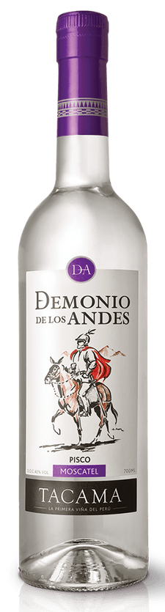
Peru’s Major Varietals
Muscat
Muscat (or Moscatel) is widely grown in Peru, both for Pisco production and for making aromatic white wines. This grape is known for its intense perfume and floral qualities.
Tasting Notes: Muscat wines are highly aromatic, with scents of orange blossom, honeysuckle, and ripe stone fruits like apricot and peach. The palate is often fruity with a slight sweetness, even in dry versions. It’s a wine that drinks easily and appeals to those who love bright, fragrant wines.
Food Pairing: Muscat pairs beautifully with spicy foods, making it an excellent choice for dishes like ceviche or Thai cuisine. Its floral nature also makes it great for sipping on its own or with fruit-based desserts.

Slide 21
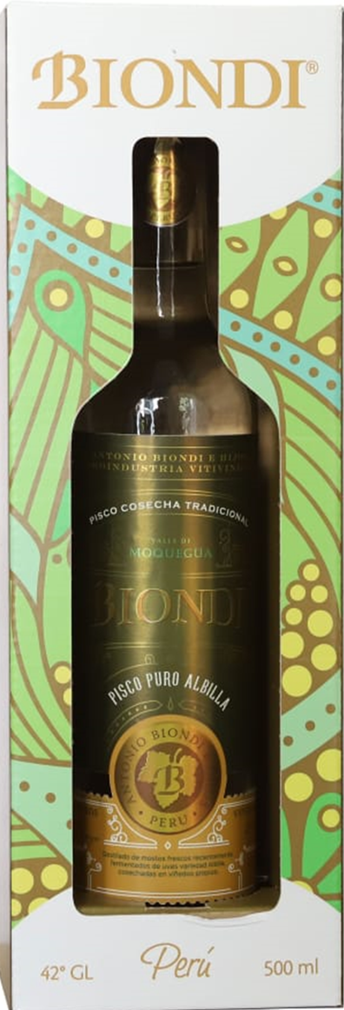
Peru’s Major Varietals
Albilla
Albilla is another white grape variety used both for winemaking and Pisco production. It’s known for producing fresh, aromatic wines that are perfect for warm climates.
Tasting Notes: Albilla wines tend to be light and crisp, with notes of citrus, green apple, and a hint of minerality. They are refreshing and easy-drinking, with bright acidity that keeps them lively on the palate.
Food Pairing: Albilla pairs wonderfully with light, fresh dishes such as seafood, salads, and white fish. Its crispness also makes it a great wine to enjoy with soft cheeses or as an aperitif on a sunny afternoon.

Slide 22
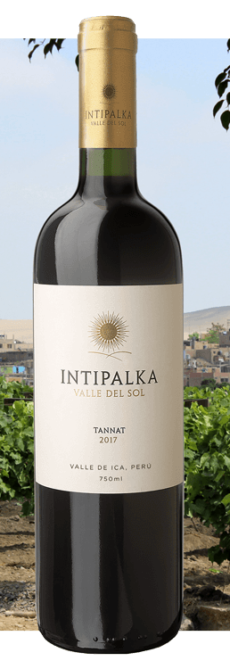
Peru’s Major Varietals
Tannat
Tannat is a bold red grape that has found a new home in Peru, particularly in regions like Arequipa and Tacna. Originally from France, Tannat thrives in the cooler, high-altitude vineyards of southern Peru.
Tasting Notes: Tannat is known for its intense tannic structure, making it a full-bodied, powerful wine. Expect flavors of black currant, plum, and blackberry, with underlying notes of leather, tobacco, and earth. Its high tannins give it excellent aging potential.
Food Pairing: Tannat’s robust structure pairs best with equally strong flavors—think roasted meats, lamb chops, or rich stews. It also pairs wonderfully with hard cheeses like aged Manchego.

Slide 23
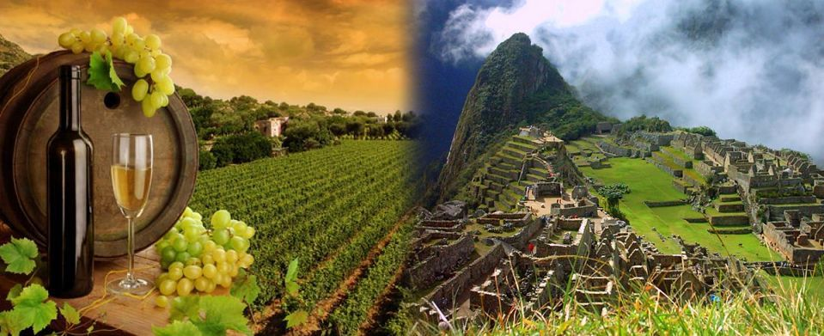
Notable Wineries in Peru
Now that we’ve explored the grape varieties, let’s look at some of the standout wineries that are putting Peruvian wine on the map.
These wineries are known for their dedication to quality and innovation, producing wines that showcase the unique terroir of the country.

Slide 24
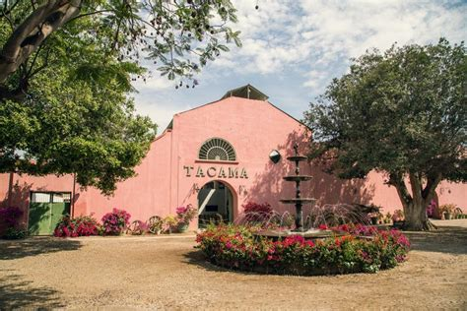
Notable Wineries
Tacama (Ica)
Tacama is the oldest winery in South America, founded
in 1540, and it remains one of Peru’s most prestigious
wine producers. Situated in the Ica Valley, Tacama
combines centuries of tradition with modern winemaking
techniques to create wines that are both timeless and
cutting-edge.
Notable Wines: Tacama produces a wide range of
wines, but their Tannat and Gran Tinto are particularly celebrated. The Gran Tinto is a blend of Tannat, Petit Verdot, and Malbec, offering a rich, full-bodied experience with dark fruit flavors and hints of spice.
Awards: Tacama has won numerous awards, including gold medals at the Concours Mondial de Bruxelles for their red blends and Pisco.

Slide 25
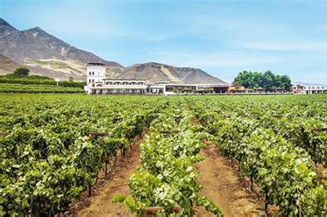
Notable Wineries
Viña Queirolo (Ica)
Viña Queirolo is a family-owned winery that has been making wine since 1880. Their vineyards in the Ica Valley produce a range of wines, from affordable everyday bottles to premium wines that showcase the region’s best grapes.
Notable Wines: Their Intipalka line is particularly well-regarded, with the Malbec and Tannat being standouts. The Intipalka Malbec is noted for its balance of fruit and spice, while the Tannat is bold and structured, perfect for aging.
Awards: Viña Queirolo’s wines have earned recognition at international wine competitions, including the Decanter World Wine Awards.

Slide 26
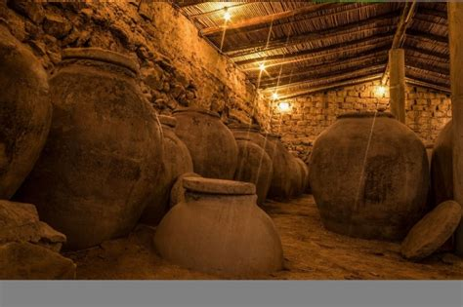
Notable Wineries
Bodega Murga (Arequipa)
Bodega Murga is located in the high-altitude region
of Arequipa, where the volcanic soils create wines
with unique minerality. Though a smaller producer,
they have garnered attention for their quality and
attention to detail.
Notable Wines: Their flagship wine is a Syrah
that reflects the cool, high-altitude terroir of Arequipa. The wine is peppery, with dark fruit flavors and a mineral edge that makes it distinct.
Awards: Bodega Murga’s Syrah has received accolades from regional wine competitions and is gaining a reputation for its elegance and complexity.

Slide 27
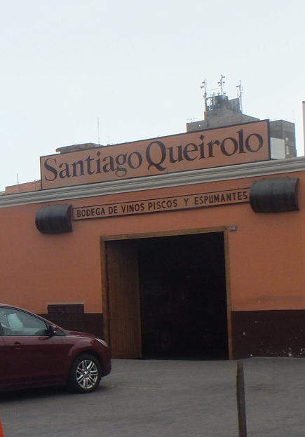
Notable Wineries
Santiago Queirolo (Lima)
Located near Lima, Santiago Queirolo is one of the country’s most iconic wine brands, with a focus on both Pisco and wine production. Their vineyards stretch across several regions, allowing them to experiment with different grapes and terroirs.
Notable Wines: Their Cabernet Sauvignon is particularly noteworthy, offering a bold, structured wine with notes of cassis, black pepper, and tobacco. It’s a classic example of Peruvian winemaking at its best.
Awards: Santiago Queirolo has won medals at both national and international competitions for their Cabernet Sauvignon and Pisco.

Slide 28
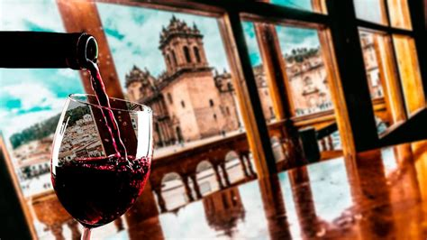
Final Thoughts
Peru’s wine industry is still emerging on the global stage, but it has a rich, fascinating history and a unique terroir that set it apart from other South American wine-producing countries. From the sun-soaked vineyards of Ica to the volcanic slopes of Arequipa, each region offers something distinct, whether it’s the bold reds of Tannat or sweetness of Muscat.
What makes Peruvian wine especially exciting is the blend of
ancient Andean agricultural traditions with modern winemaking
techniques. The same spirit of innovation and adaptation that
allowed early civilizations to thrive in the rugged Andean
landscape is alive in Peru’s vineyards today, as winemakers
work to perfect their craft and share it with the world.
Whether you’re sipping a mineral-driven Syrah from Arequipa or a fruit-forward Malbec from Moquegua, one thing is clear: Peru is a wine region that deserves more attention, and for adventurous wine lovers, it offers a world of flavors waiting to be discovered.

Slide 29
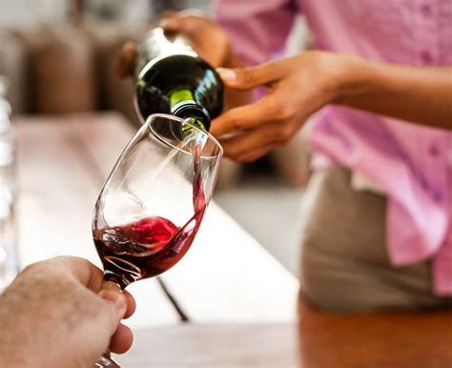
Conclusion
Peru may be better known for its Pisco, but its wine scene is steadily gaining momentum. With a rich historical background, diverse terroirs, and a range of grape varieties that express the country's unique geography, Peruvian wine is on the cusp of international recognition.
The dedication of winemakers, both old and new, to producing high-quality wines means that we can expect great things from this country in the years to come.
For wine enthusiasts seeking something new and distinctive, Peruvian wine offers an exciting opportunity to explore flavors shaped by high altitudes, volcanic soils, and a proud winemaking heritage.
With wineries like Tacama and Viña Queirolo leading the charge, there’s no better time to explore the diverse and delicious wines of Peru.

Slide 30
Acknowledgement
My seminars are the result of many years of experience combined with many hours of research over the internet.
I would like to acknowledge the many source I have accessed.
These include Wine Spectator, Wine Enthusiast, BKWine Magazine, Wine & Spirits Magazine, American Vineyard Magazine, The Grapevine Magazine, Wikipedia.com, Britannica.com, and the
various Government websites.

Slide 31
Citations and References
Castillo, Santiago. "The History of Winemaking in Peru". Wine Today Magazine, 2023.
Pérez, Valeria. "Peruvian Wine Regions and Their Unique Terroir". Vinotéca Journal, Vol. 42, Issue 3, 2022.
Santos, Juan. "Grape Varieties in Peru: A Growing Industry" - Decanter, 2021.
Tacama Winery Official Website - tacama.com.pe. Retrieved October 2024.
Viña Queirolo - A Tradition of Excellence. Vinaqueirolo.pe. Accessed October 2024.

