Slide 1
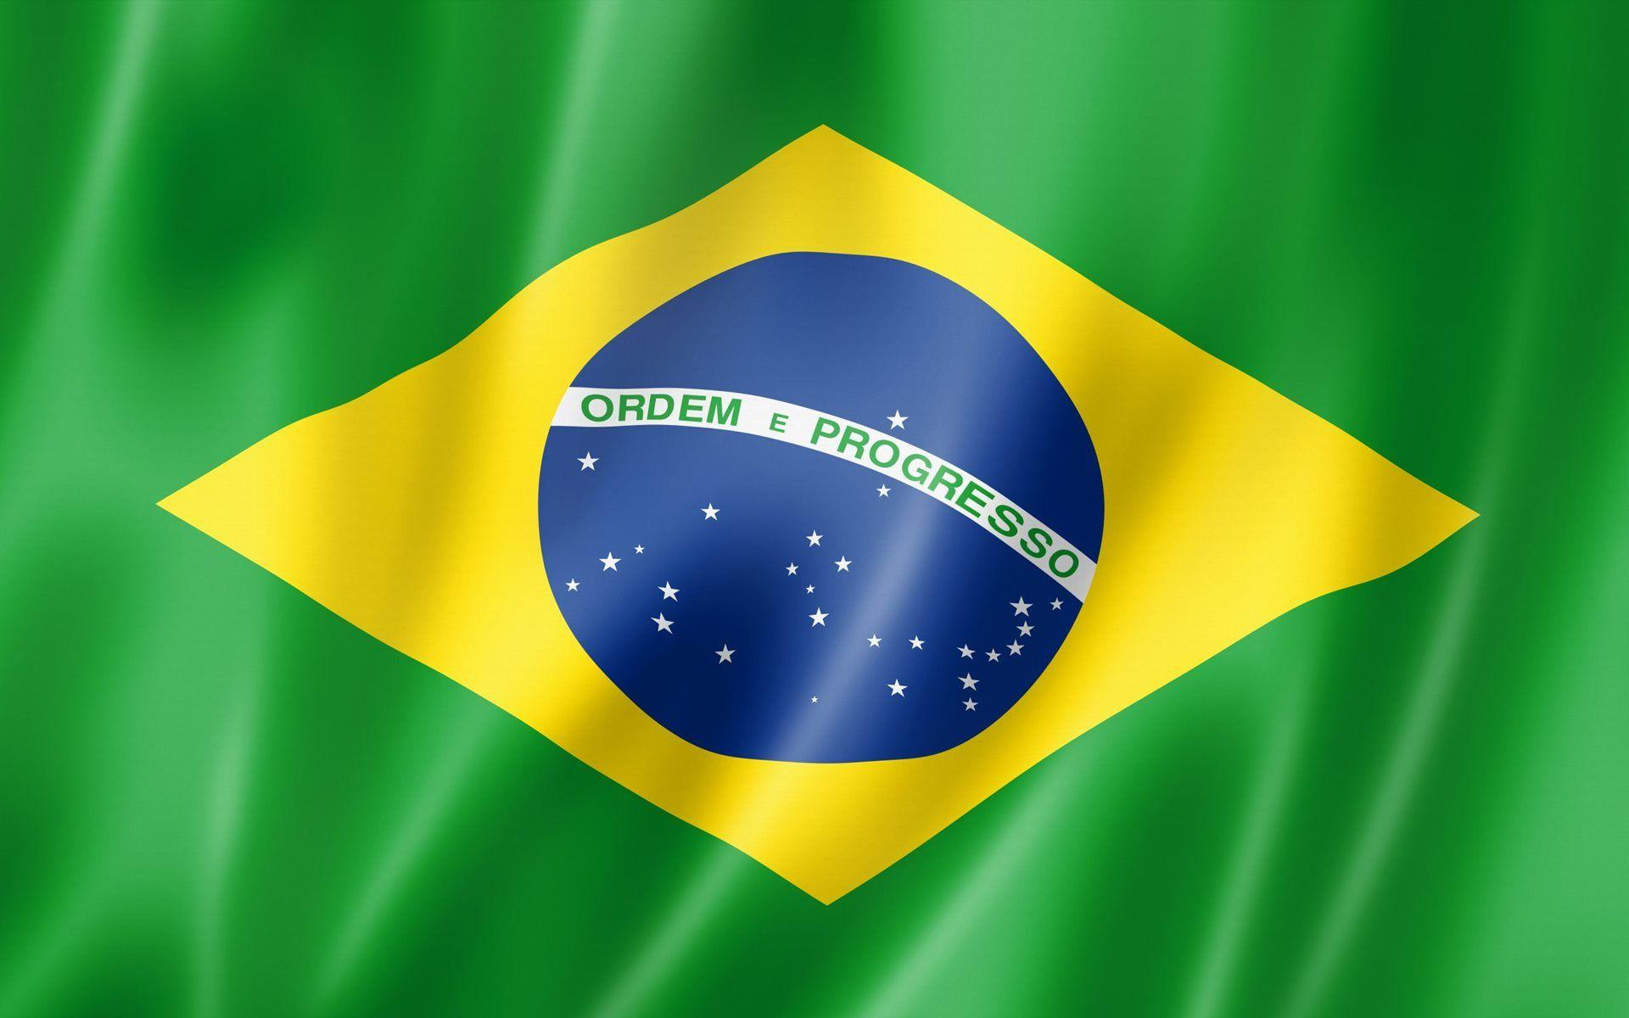
Parintins, Brazil
Presented by
Marc Silver

Slide 2
What I Will Cover
My Port Philosophy
Don’t Miss the Ship
Money
About Parintins
Parintins History
Area Map of Parintins
Map of Parintins
Parintins Transportation
Places to see or at least consider
A few restaurant recommendations
Conclusion

Slide 3
My Port Philosophy
I have been cruising for over 44 years and have taken over 200 cruises.
So, I consider myself an experienced cruiser.
The information I will present is based on those many years of
experience.
When I am on a cruise where the city, I want to visit is not the port city,
I always recommend taking a ship’s tour.
But when I am in a port with multiple attractions nearby and easy to see
on my own -
I will do it on my own.
This presentation is not like that.

Slide 4

Don’t Miss the Ship
How to Avoid Missing Your Ship
Pay attention to the time. - Ship time and local time are
often different.
Put a return-to-ship reminder on your phone.
Choose excursions wisely.
If a ship-sponsored excursion is late returning to port, the
ship will wait for you. If you are on your own.
Be Prepared
Have your Passport, Credit Card, and phone numbers for
your ship port agent.
What to Do If You Miss the Ship
Most cruise lines have port agents stationed in the port area to assist if your ship has left without you. If your are lucky, when cruisers are late returning to the vessel, the ship’s crew will often remove the passengers’ essential items – passports, cell phones, and medication -- from the ship to leave with the port agents.
The Port Officials can help you with contacting your ship
and making necessary travel arrangements.

Slide 5
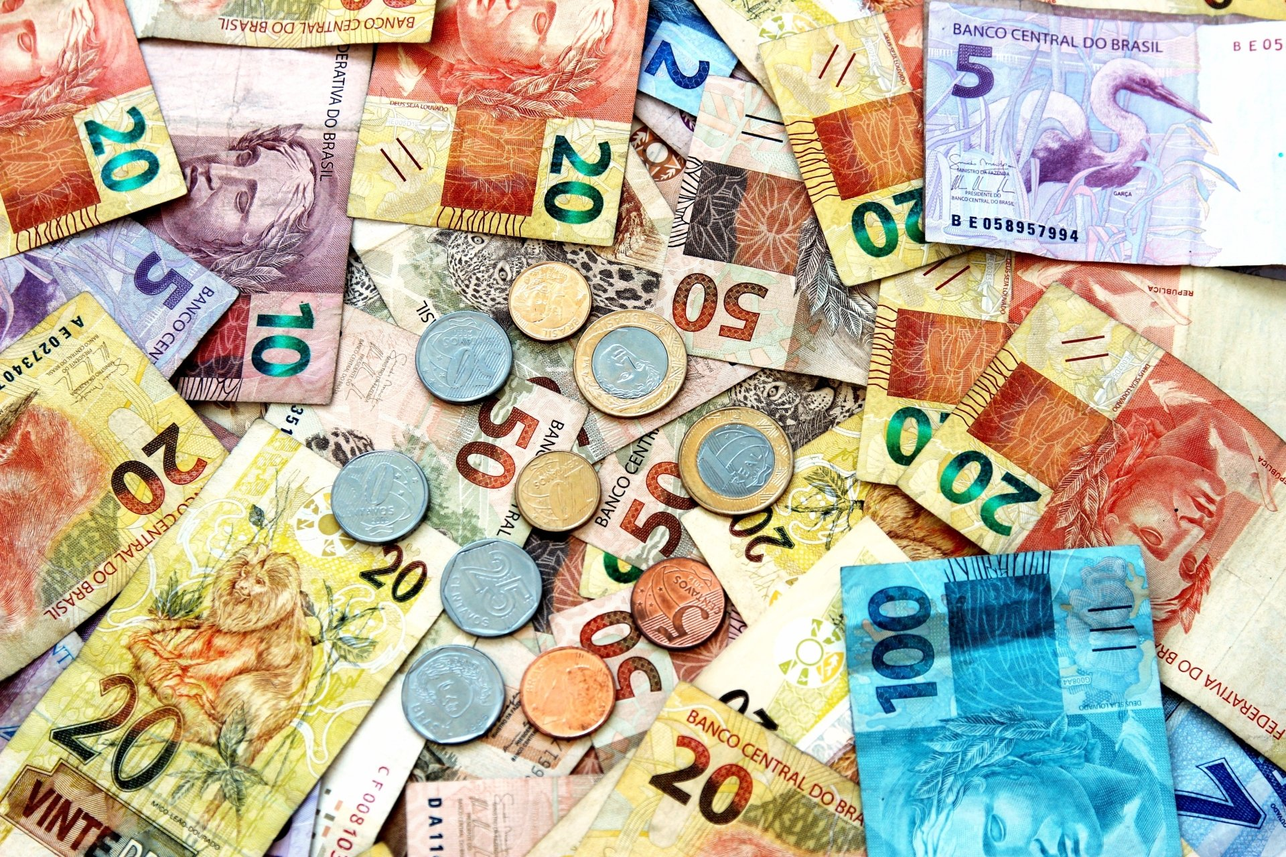
Money
The Brazilian Real
The official exchange rate is:
$1.00 US = 4.9310457 Real
1.00 Brazilian Real = 0.2028 US Dollars

Slide 6
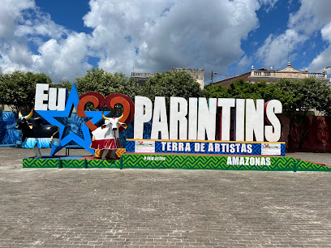
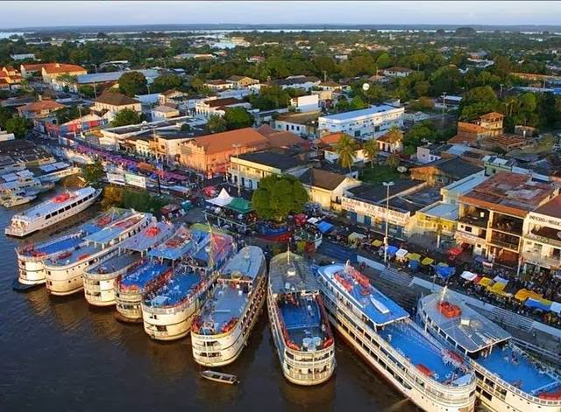
About Parintins, Brazil
Parintins is a municipality in the far east of the Amazonas state of Brazil. It is part of a microregion also named Parintins.
There are no bridges or roads that connect the city-island of Parintins to the rest of the world. This remote city in the Amazon is 228 miles N.E. of Manaus, the capital of Brazil’s Amazonas state.
Parintins is home to thousands of low-income and Indigenous Brazilians. Its position along the Amazon River makes it dependent on commodities and resources from other parts of the country.

Slide 7
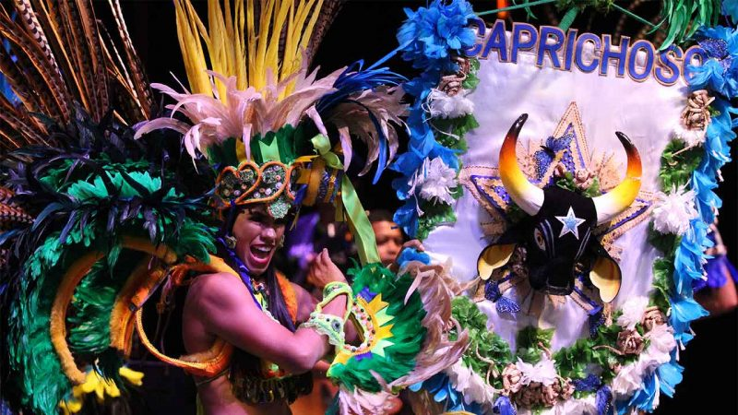
Parintins, Brazil History
Parintins was originally inhabited by indigenous peoples. José Gonçalves da Fonseca discovered the area in 1749 while exploring the Amazon River.
The town was founded in 1796, by José Pedro Cordovil. Queen Maria of Portugal gave him the island as a gift. He founded a cocoa tree farm.
In July 1833 the village was transformed into a parish, with the name of the parish of Nossa Senhora do Carmo of Tupinambarana.
On 14 March 1853 the installation of the city was renamed for Parintins in 1880, honoring to the name of the tribe that inhabited the place before your foundation.
Today the city is best known for the BOI BUMBA Folklore Festival celebrating a local legend about a resurrected ox.

Slide 8
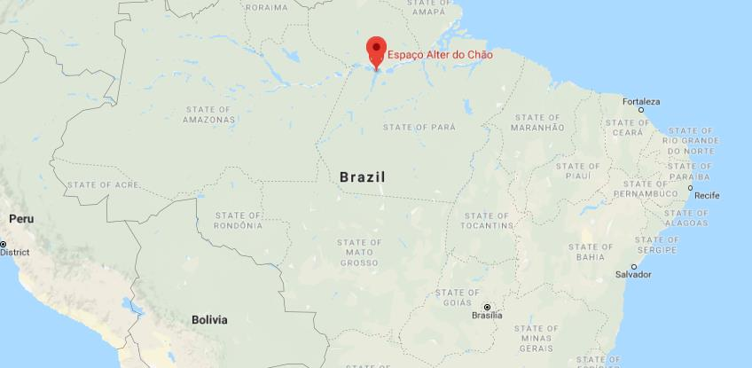
Area Map of Parintins, Brazil

Slide 9
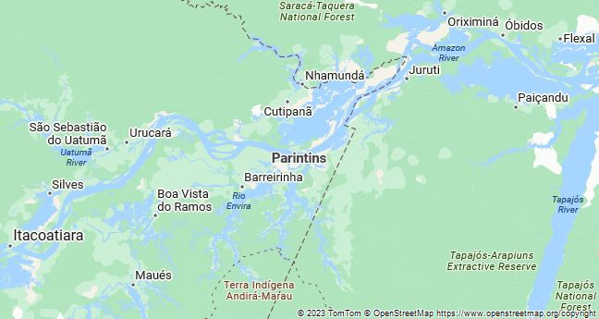
Map of Parintins

Slide 10
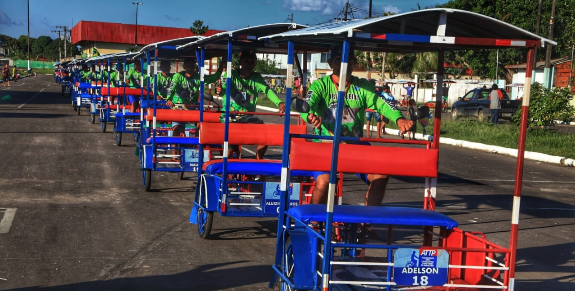
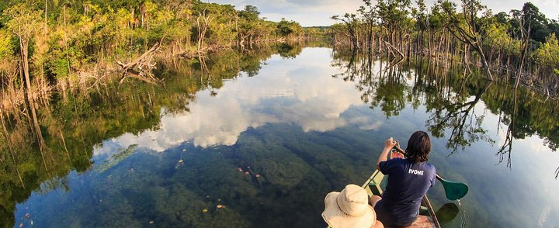
Parintins, Brazil Transportation
Parintins is small enough to walk around.
The entire city is only about 3 miles by 1 mile in size.
For very little money you can hire a pedicab to show you around town, or a canoe or fishing boat to show you around the area from the water.

Slide 11
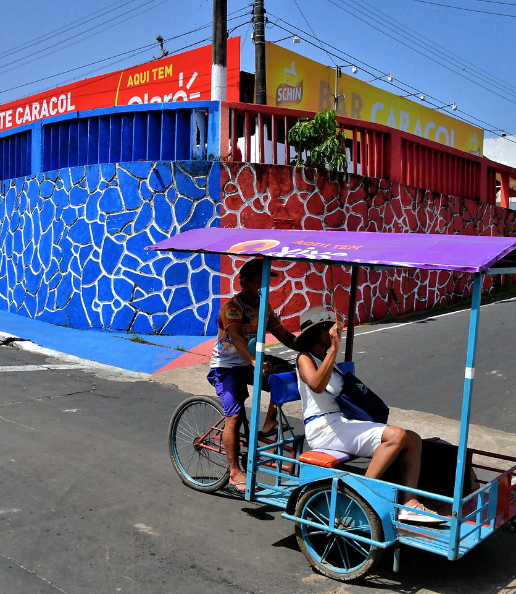
Pedicab in Parintins
Parintins is not large so it can be explored on foot. But the places to see are not clustered together nor easy to find. And it will be hot.
The average daily high is 90°F with a relative humidity of 81%.
The best option for sightseeing is aboard a pedicab. Plenty of eager drivers will greet you at the terminal. Agree on a duration, bargain for the best rate, and then sit back while you get peddled around town.
Notice the red and blue wall in the background. These are the predominant colors in Parintins.

Slide 12
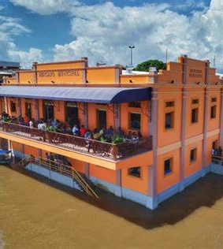
Parintins Market
With a panoramic view of the Amazon, the Leopoldo Neves Municipal Market, in Parintins, displays the history, architecture, and flavors of regional cuisine.
Inaugurated in 1937, the market was reopened on May 27, 2019, when it turned 82 years old after extensive renovation.
Meeting point for locals and tourists, the historic building considered one of the most imposing in the city, has gained modern architecture, without losing its traditional features.
The space is known for vegetables, meat, fish, restaurants, snack bars, handicrafts, fruit shops and bars.

Slide 13
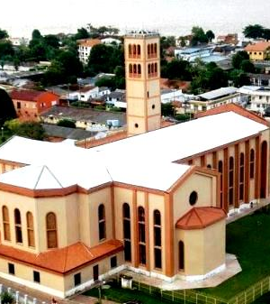
N S DO CARMO CATHEDRA
The church is a little bit of a walk from the port, especially with the heat of Brazil.
The official name is the Cathedral of Our Lady of Carmo and is the largest structure in town. Its simple design adds to its beauty.
It is easy to find the church as it has a high tower with Mary overlooking the Amazon River and watching over the city.
The Stations of the Cross are beautiful paintings. On the front altar, there is an image of Our Lady of Carmo.

Slide 14
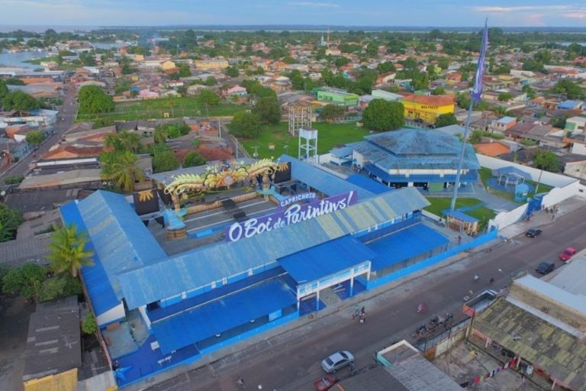
CURRAL DO BOI CAPRICHOSO
Consider taking a pedicab to tour the town and be sure to see the practice stage for the “Blue” team better known as the “Caprichoso” team for the BOI BUMBA Folklore Festival.
The CURRAL DO BOI CAPRICHOSO is an interesting facility worth seeing. Be sure and go inside and see the trophies that the Caprichoso have won throughout the years.

Slide 15
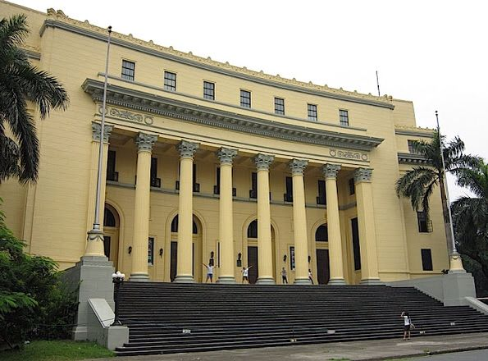
Cine- da Paz Theater
The theater is located about a ¼ mile Southwest of the cruise terminal at Av. Amazonas 2300. This is a beautiful building well worth a visit.

Slide 16
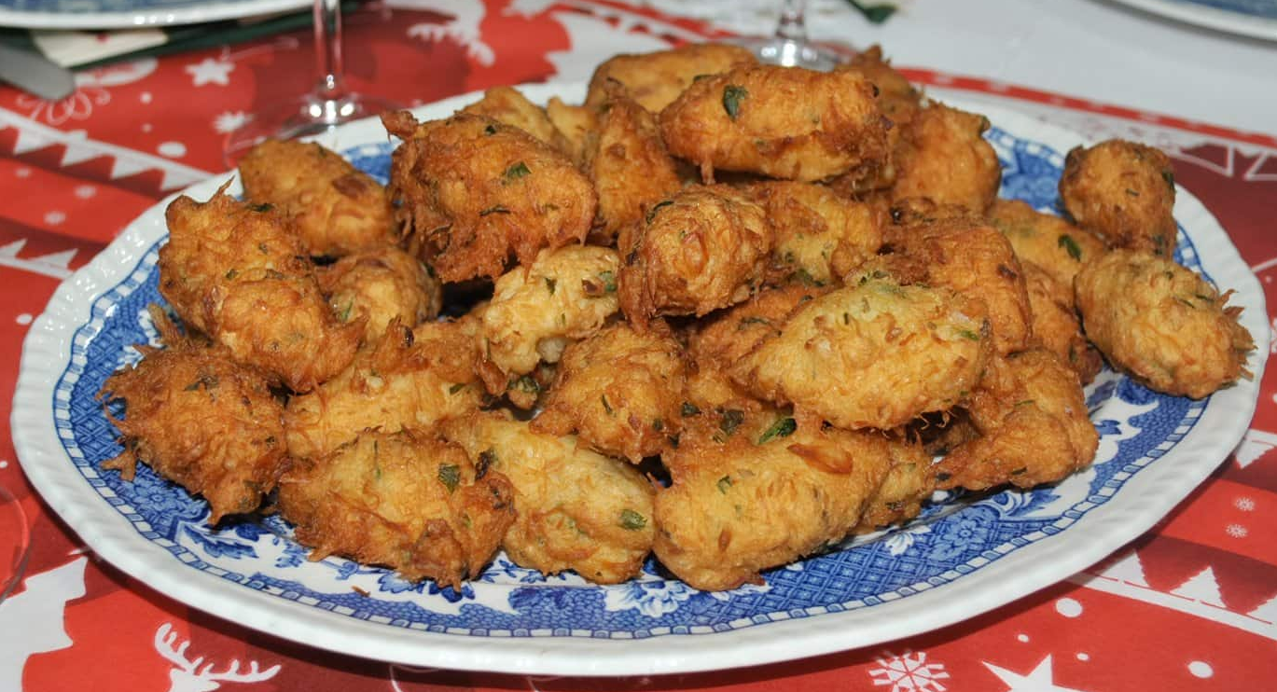
Street Food
Brazilian street food is a real highlight of a trip to this evocative and eclectic country. Considering this is a place that excels at soccer, jiu-jitsu, and samba, it shouldn’t be too surprising that Brazilian food also draws its flavors from a vast fusion of influences.
The country’s population is impressively diverse, including people of European, Amerindian, African, Levantine, and East Asian descent. This rich blend is reflected in the vast array of flavors to be found in its food.
Bolinhos de Bacalhau (fried cod cakes)
A delicious reminder of Brazil’s European heritage

Slide 17
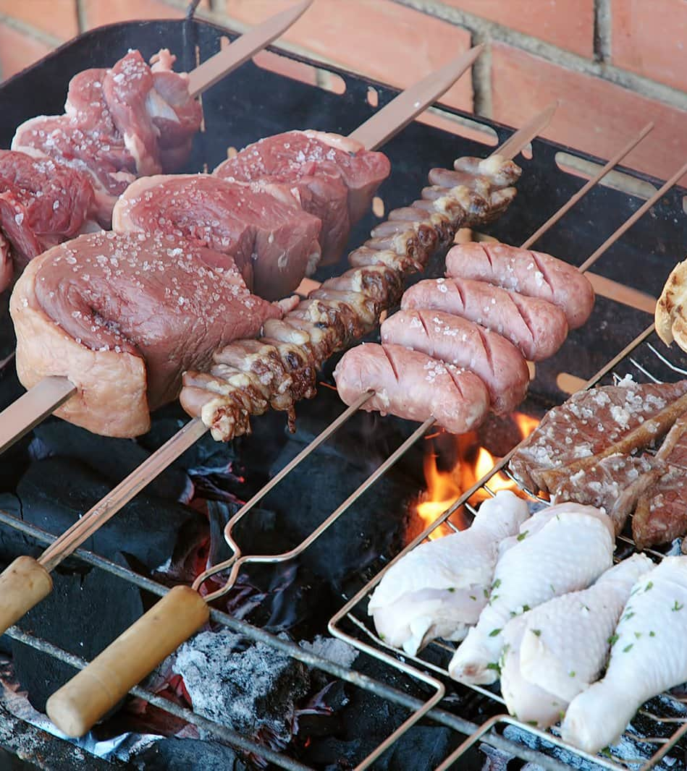
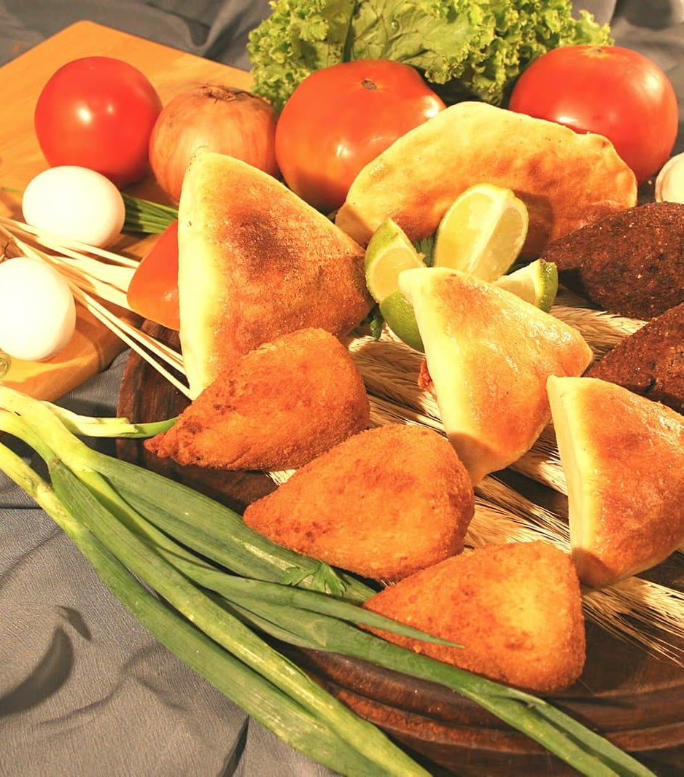

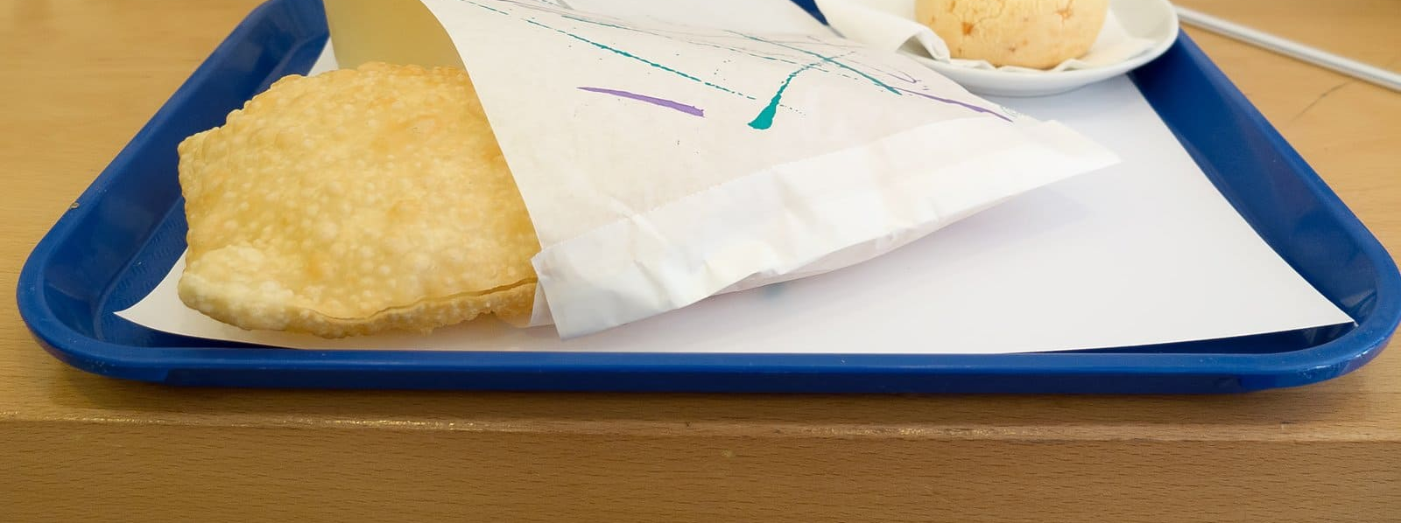
Street Food
Picanha (barbecued beef)
Kibe (meat patties)
Brigadeiros (chocolate balls)
Pastel de queijo (deep-fried cheese pastry)

Slide 18
Thanks For Coming
If you have any more questions, please ask.
I will do my best to answer them for you.
Have a great visit to Parintins!

