Slide 1

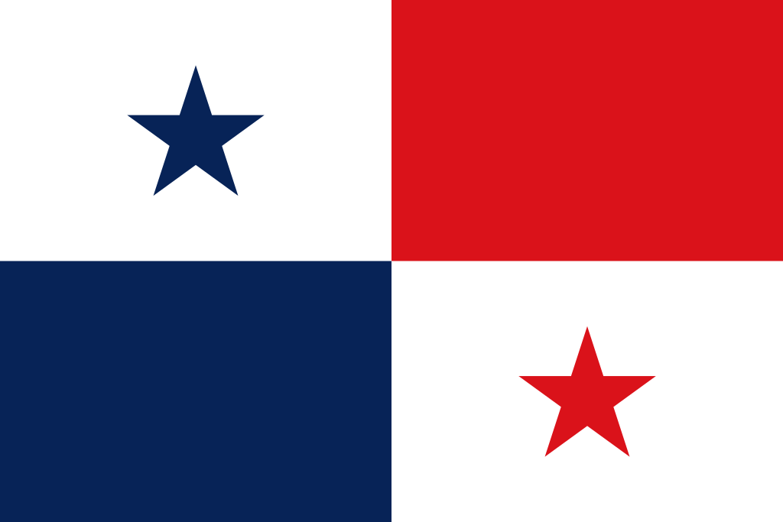
Panama City, Panama Presented by fellow Cruiser Marc Silver

Slide 2
What I Will Cover
My Port Philosophy
Don’t Miss the Ship
Money
About Panama City, Panama
History of Panama City, Panama
Transportation
Points of Interest
Places to see or at least consider
A few restaurant recommendations
Conclusion

Slide 3
My Port Philosophy
I have been cruising for over 45 years and have taken over 100 cruises. So, I consider myself an experienced cruiser.
The information I will present is based on those many years of
experience.
When I am on a cruise where the city, I want to visit is not the port city,
I always recommend taking a ship’s tour.
But when I am in a port with multiple attractions nearby and easy to see
on my own - I will do it on my own.
This presentation is for that type of port.

Slide 4
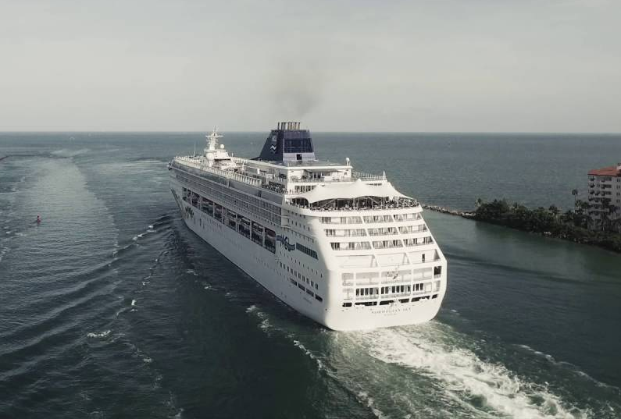
Don’t Miss the Ship
How to Avoid Missing Your Ship
Pay attention to the time. - Ship time and local time are often different.
Put a return-to-ship reminder on your phone.
Choose excursions wisely.
If a ship-sponsored excursion is late returning to port for, the ship will wait for you. If you are on your own???
Be Prepared
Have your Passport, Credit Card and phone numbers for your ship port agent.
What to Do If You Miss the Ship Most cruise lines have port agents stationed in the port area to assist if your ship has left without you. If you’re lucky, when cruisers are late returning to the vessel, the ship's crew will often remove the passengers' essential items -- passports, cell phones, and medication -- from the ship to leave with the port agents.
The Port Officials can help you with contacting your ship and making necessary travel arrangements.

Slide 5
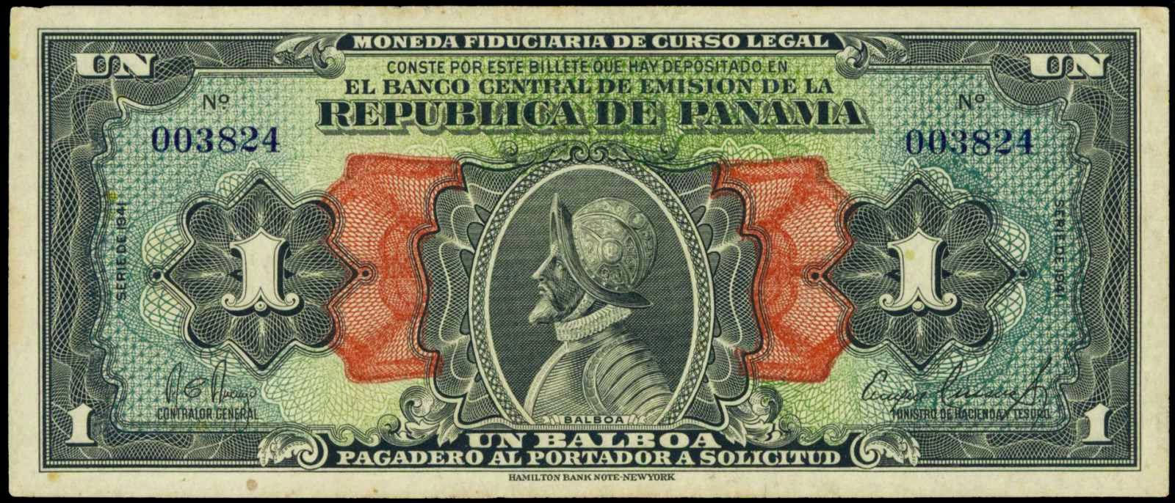
Money
The unit of currency in Panama is the U.S. dollar, but the Panamanian balboa, which is pegged to the dollar at a 1:1 ratio, also circulates in denominations of 5¢, 10¢, 25¢, and 50¢ coins. (U.S. coins are in circulation as well.) Balboa coins are sized similarly to their U.S. counterparts, and travelers will have no trouble identifying their value.

Slide 6
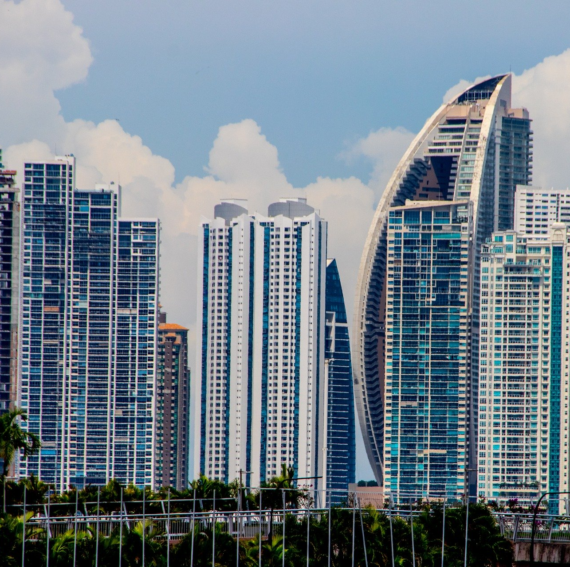
About Panama City
Panama City or Ciudad de Panamá, is the capital of the Republic of Panama.
It is in the east-central part of the country near the Pacific Ocean terminus of the Panama Canal, on the Gulf of Panama. Area city, 38.5 square miles (100 square km). Pop. (2010) city, 430,299; (2010 est.) urban agglomeration, 1,378,000.

Slide 7
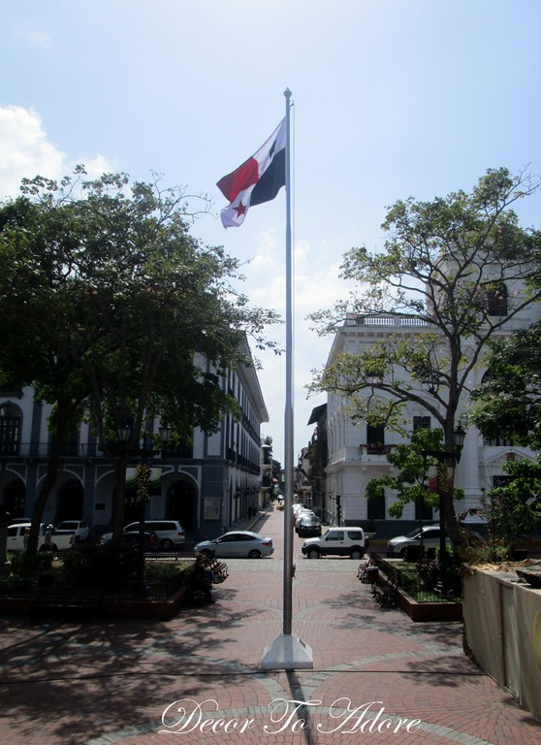
Historical Panama City, Panama
The site of the future city was originally an Indian fishing village; the name Panamá means “many fish.” The old city (Panamá Viejo) was founded in 1519 by Gov. Pedro Arias Dávila and was made the territory seat. From the Andean countries, Gold bullion was shipped northward by sea to Panama City, and from there, it was carried across the isthmus by pack animals to Nombre de Dios or Portobelo on the Caribbean coast for shipment to Spain. The city prospered until the depredations of pirates and privateers curtailed trade. In 1595 Sir Francis Drake tried unsuccessfully to send a force across the isthmus to sack old Panama; in 1671, however, Henry Morgan completely destroyed it. The new city (Panamá Nuevo; now commonly called Casco Viejo, “Old Fortification”) was rebuilt about 5 miles (8 km) southwest of the old site in 1674 by Alonso Mercado de Villacorta, a Spanish conquistador.

Slide 8
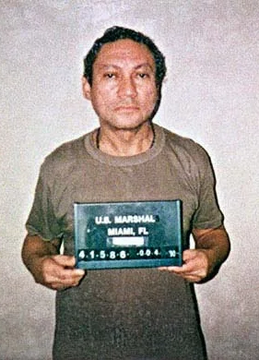
Historical Panama City, Panama
In 1903 independence from Colombia was declared there, and the city was made the national Panamanian capital.
Panama City developed and expanded rapidly with the construction of the canal (1904–14). It became a modern center with cabarets, nightclubs, and banking. The city was the site of Latin American congresses in 1826, 1939, and 1959.
The city’s descendants of West Indian workers, many of whom had emigrated from Jamaica and Barbados to help build the Panama Canal, are also credited with creating a new type of popular music called reggae in Spanish.
Panama City was also the site of the headquarters of Panamanian leader Manuel Noriega. In December 1989 The US invaded Panama to remove Gen. Manuel Noriega,. extraditing him to the U.S. to face charges of drug trafficking and money laundering.

Slide 9
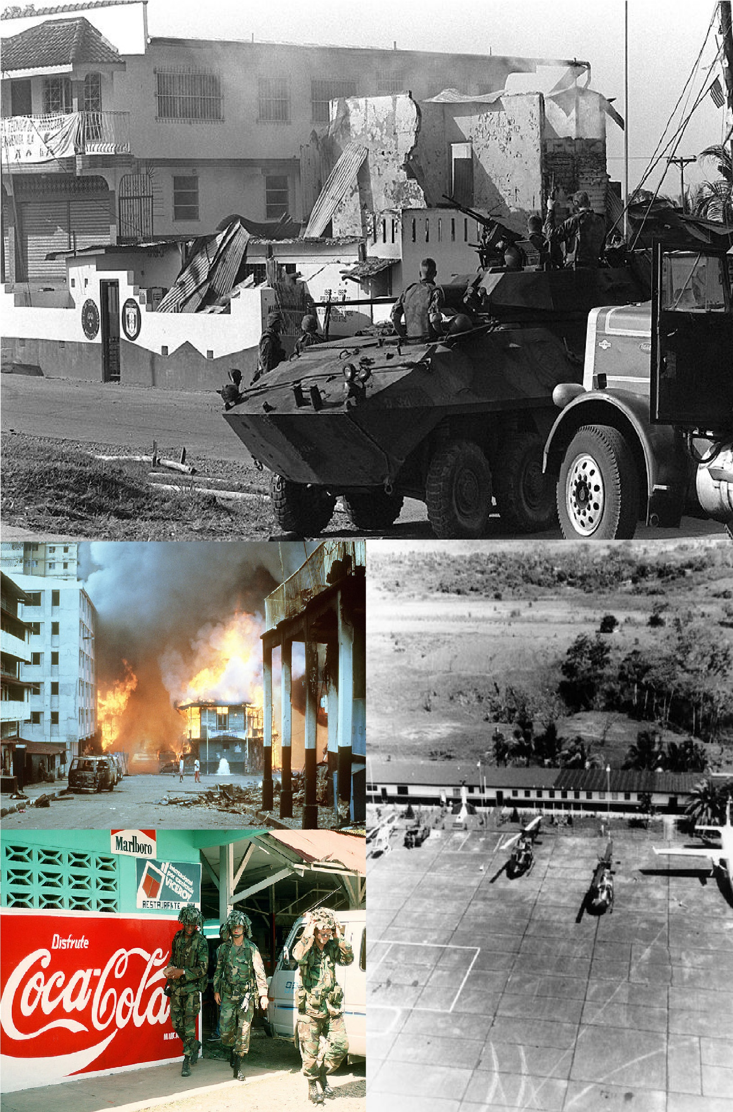
History of Panama City
On July 19, 1990, a group of sixty companies with operations in Panama filed a lawsuit against the U.S. government in Federal District Court in New York City, alleging that the invasion was "done in a tortuous, careless and negligent manner with disregard for the property of innocent Panamanian residents"
After the invasion, US President George H. W. Bush announced a billion dollars in aid to Panama.
Critics argue that about half of the aid was a gift from American taxpayers to American businesses because $400 million consisted of incentives for US businesses to export products to Panama, $150 million was to pay off bank loans and $65 million went to private sector loans and guarantees to US investors.

Slide 10
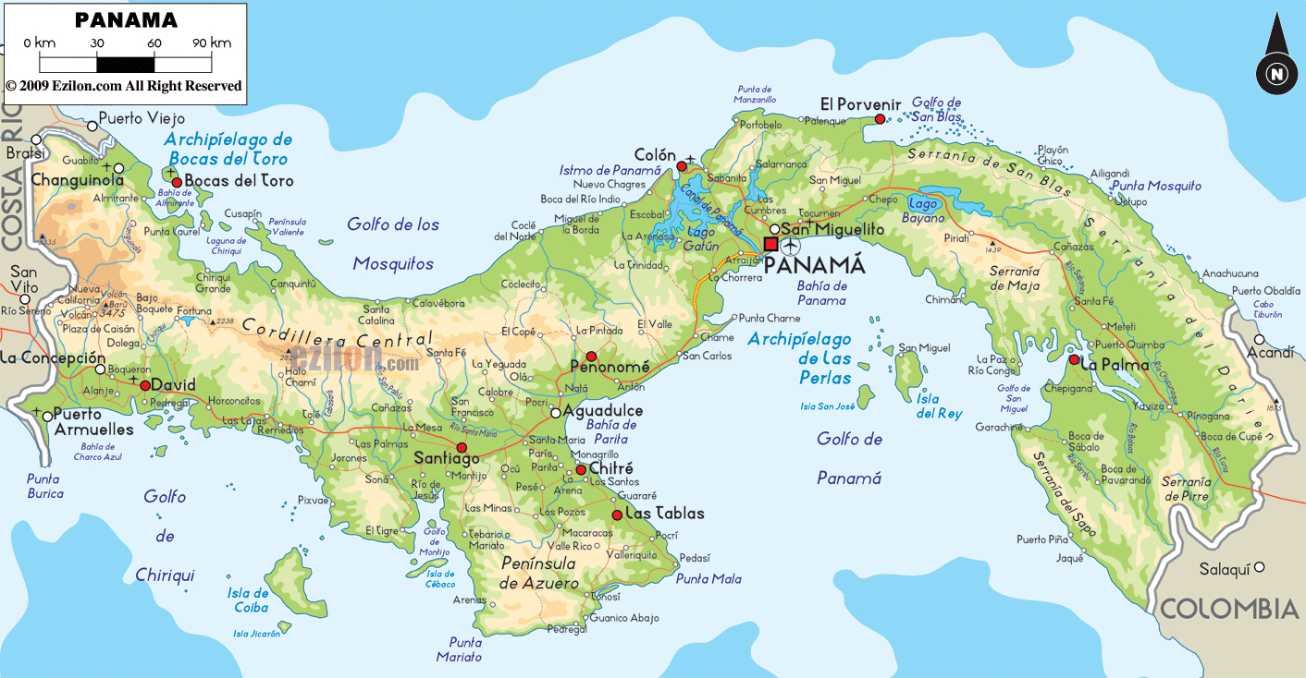
Map of Panama

Slide 11
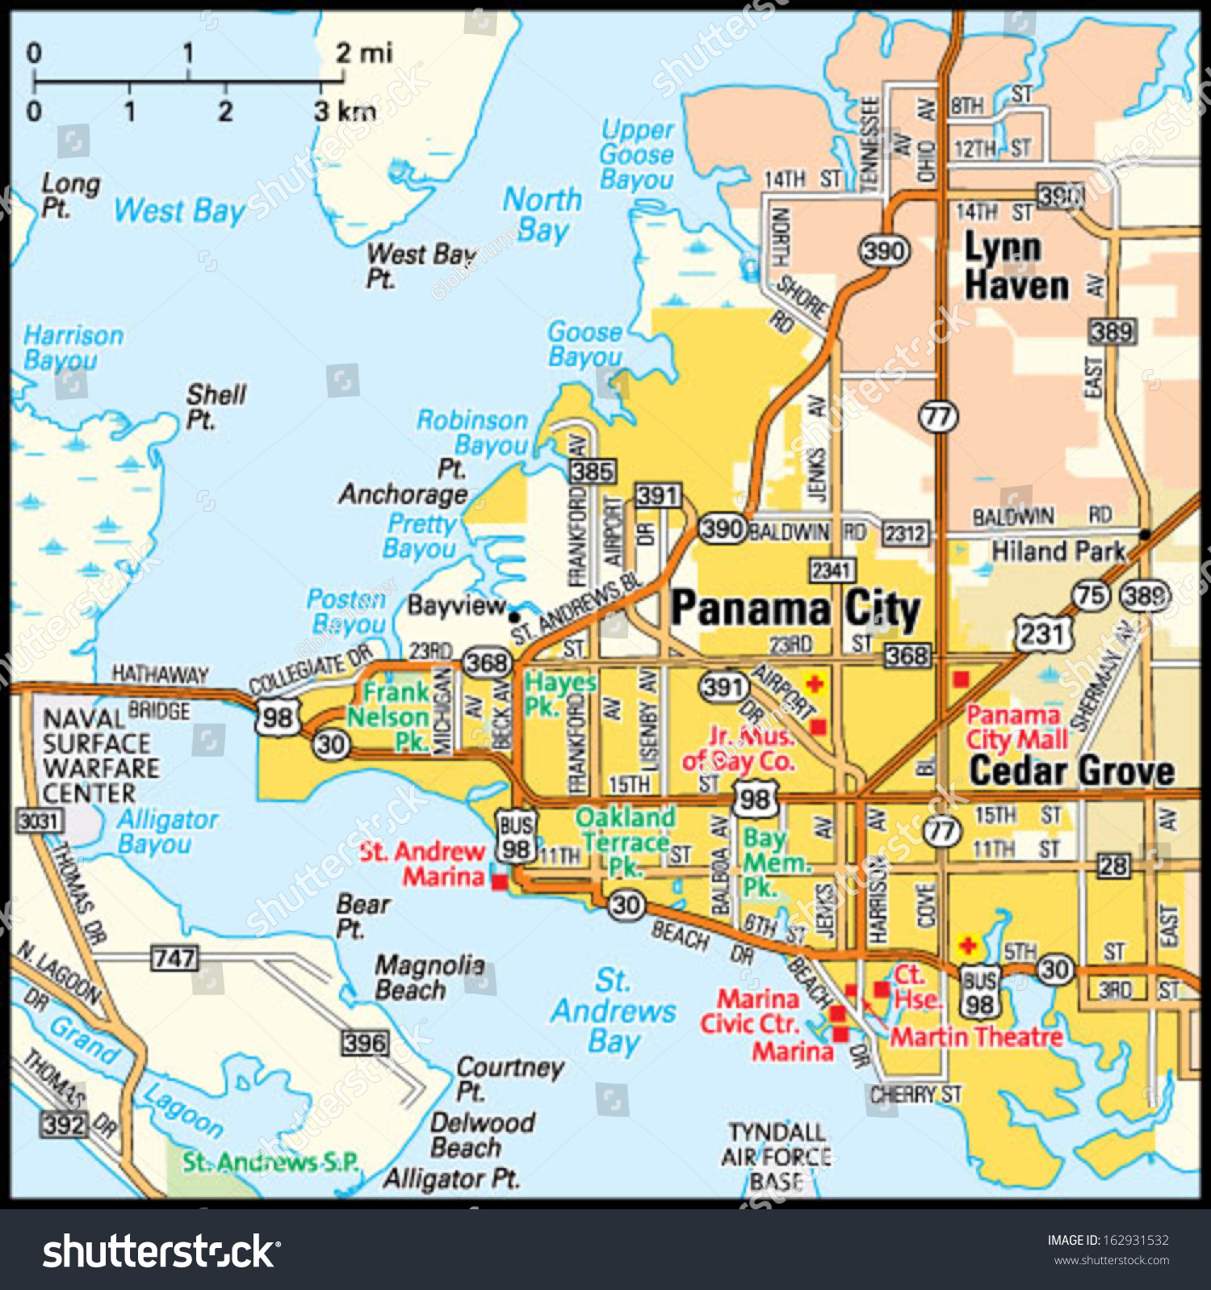
Map of Panama City

Slide 12
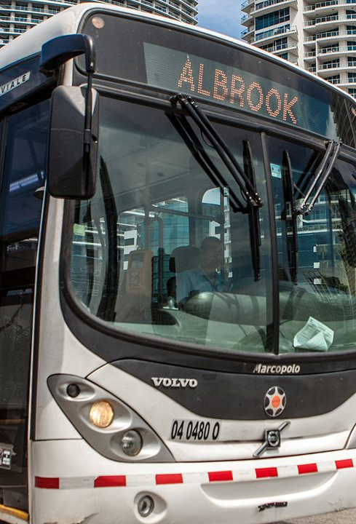
Panama City City Bus
In 2012, Panama City welcomed a new fleet of city buses called Metro Busses. These newly-built buses are clean, air-conditioned, and held to high health and safety standards. To use these buses, a rechargeable bus card (the Tarjeta Metrobus) is needed. This can be bought at Metro Bus kiosks or at most grocery stores. Credit (from 50 cents to $50) is loaded onto the cards.
A Metro Card costs $2, and then you can add however much money you think you’ll need onto the card.
Most city rides cost 25 cents, although the cost is $1.25 if you travel along Corredor Nord or Sur or go to Tocumen International Airport.

Slide 13
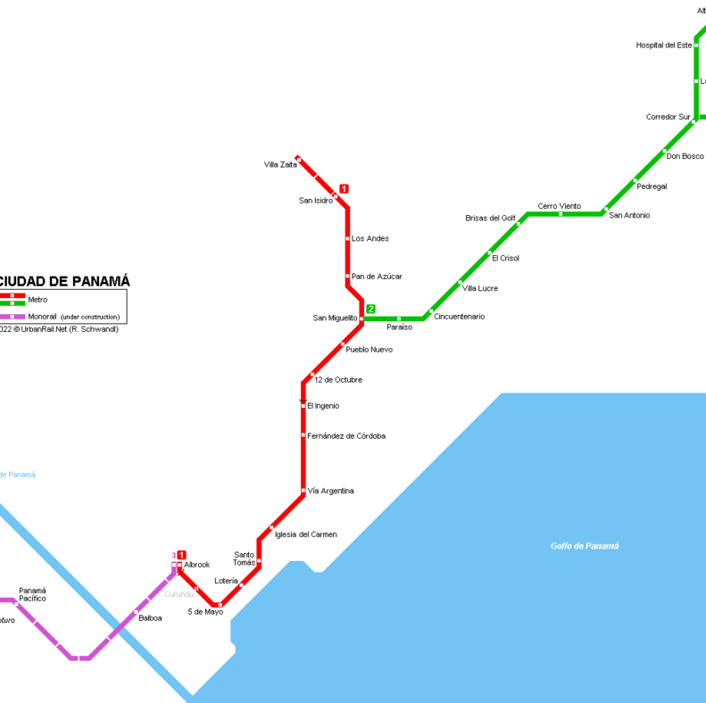
Panama Metro
The Panama Metro is a rapid transit system in Panama City, Panama. It links neighborhoods north and east of the metropolitan area to the city center.
The Metro was built to relieve the traffic congestion between the city and San Miguelito District and to offer commuters a viable alternative to road transport, as the MiBus transit system was suffering multiple issues.
This ticket can be used for one ride on the metro and costs $0.30.

Slide 14
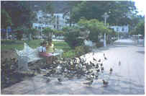
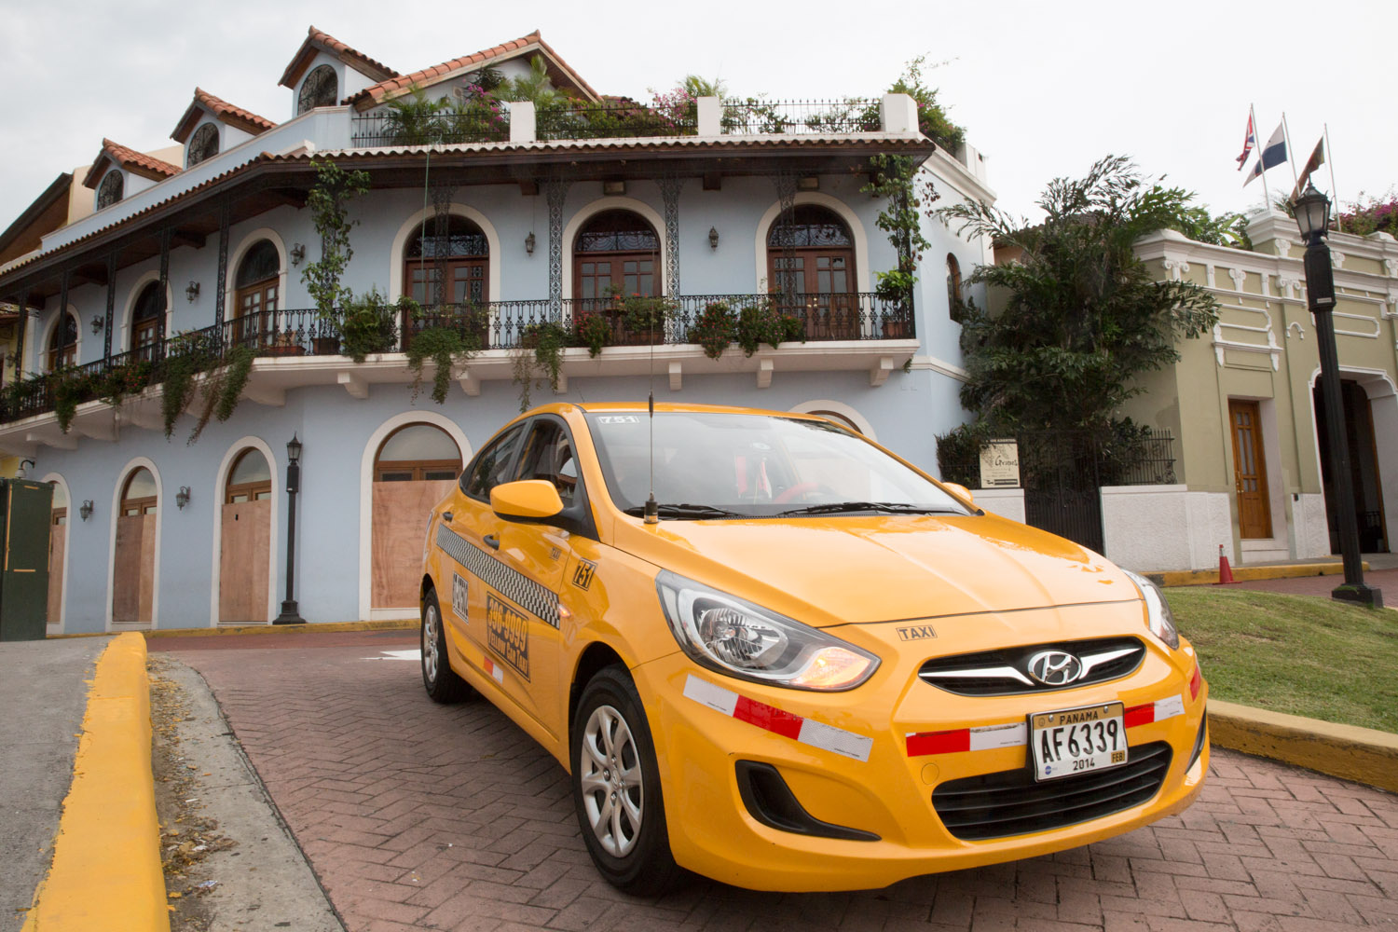
Panama City Taxis
Taxis in Panama City are plentiful. Taxis can be very reasonable, as long as you ask the price BEFORE you get in.
Don’t judge the taxi by its looks.
It may have beaten bodywork and a cracked window. It may have things dangling from the rearview mirror. The music may be so loud that your ears bleed. There maybe stickers all over the windshield. He may drive in a way that seems erratic. This is all normal – he knows what he’s doing. Some speak English. Many don’t.
Negotiate the price before driving off – remember, there’s no meter. If you do take a $4 ride and they ask for $10 at the end, laugh and say, “It costs me $4 every day – look, here’s $5”. They’ll take it, having tried, and anyway, it’s your bad not having set the price before you left. Tipping is not expected for taxi rides. Coming from a country where the meter reads $3.50 as soon as you get in a cab, it feels weird to pay $1.50 for a trip. Round it up and throw in a little extra if you feel like it but don’t feel guilty.

Slide 15
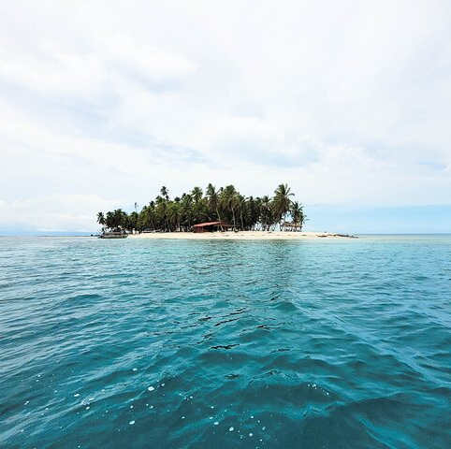
Day Tour in San Blas Islands
The palm-fringed beaches and traditional villages of the San Blas Islands lie just east of Colon along Panama’s Caribbean coast. The tours visit multiple islands in one day such as Aguja, Pelicano, and Perro islands; enjoy fun activities such as swimming, snorkeling, and kayaking; visit a sunken shipwreck; and take a swim in a natural pool.

Slide 16
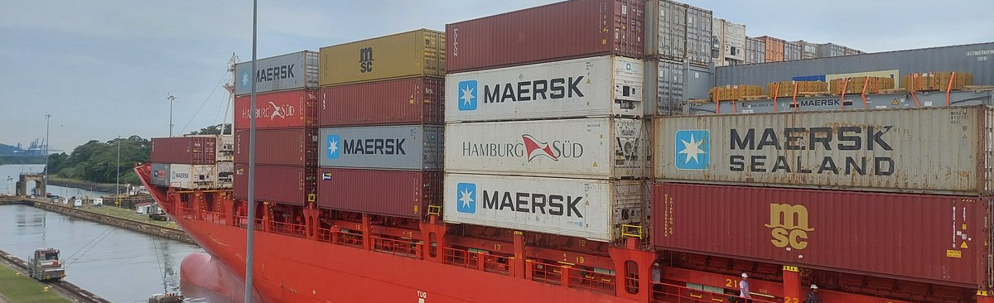
Half Day City and Panama Canal Tour
If you’re a first-time visitor to Panama City, you’ll want to see the must-visit highlights. Try a five-hour Private or Share group tour, that takes you to the atmospheric old town, the engineering marvel of the Panama Canal, and the sweeping Amador Causeway, with its great views of the city. If you’re short on time or on a quick shore excursion, this convenient tour makes the most of your time.

Slide 17
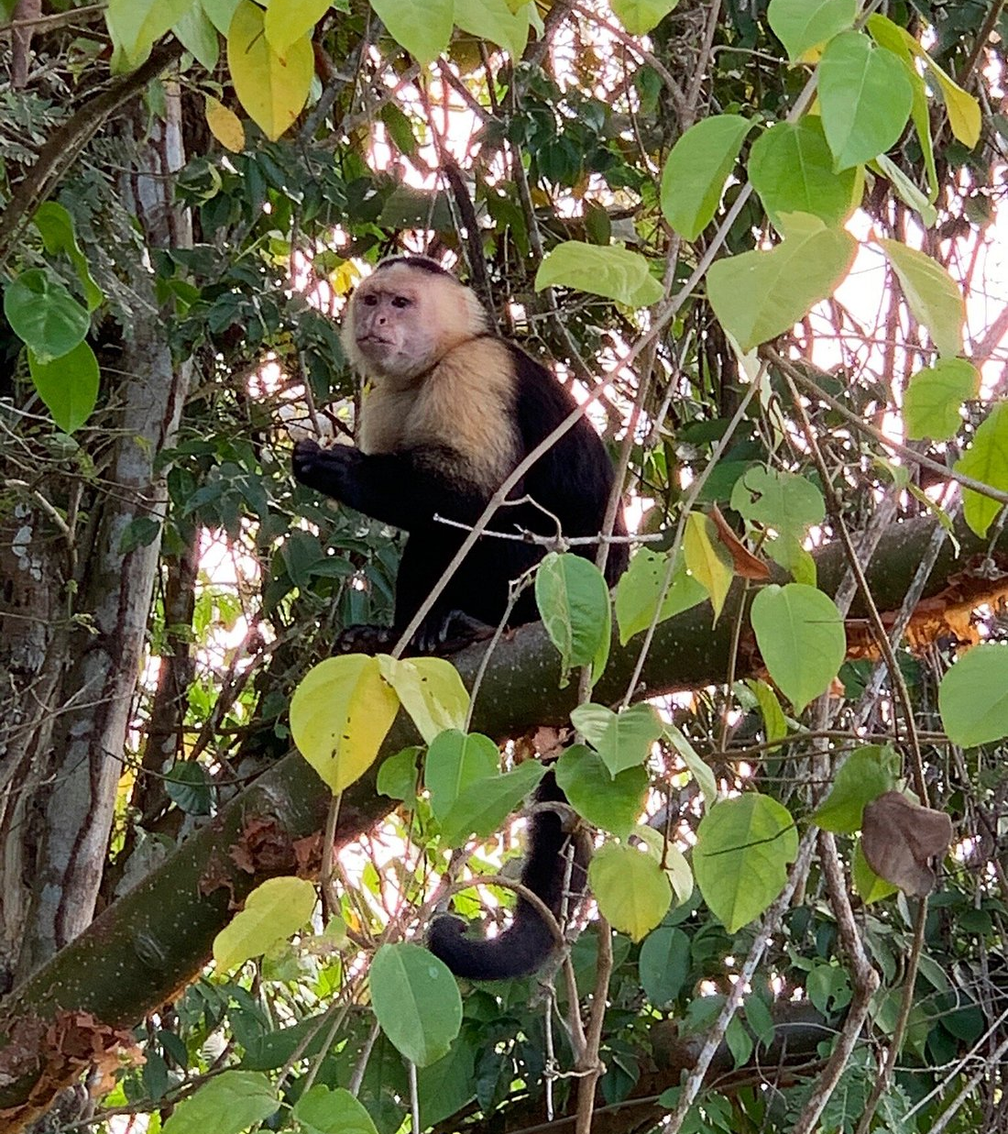
Monkey Island
Monkey Island can only be accessed through a tour (usually from Panama City), which can be combined with a visit to the sloth sanctuary, or a rainforest walk. The best time to visit is during the dry season (December to April) when the weather is clear, and the monkeys are the most active.
Check with the Cruise Tour Desk for help.

Slide 18


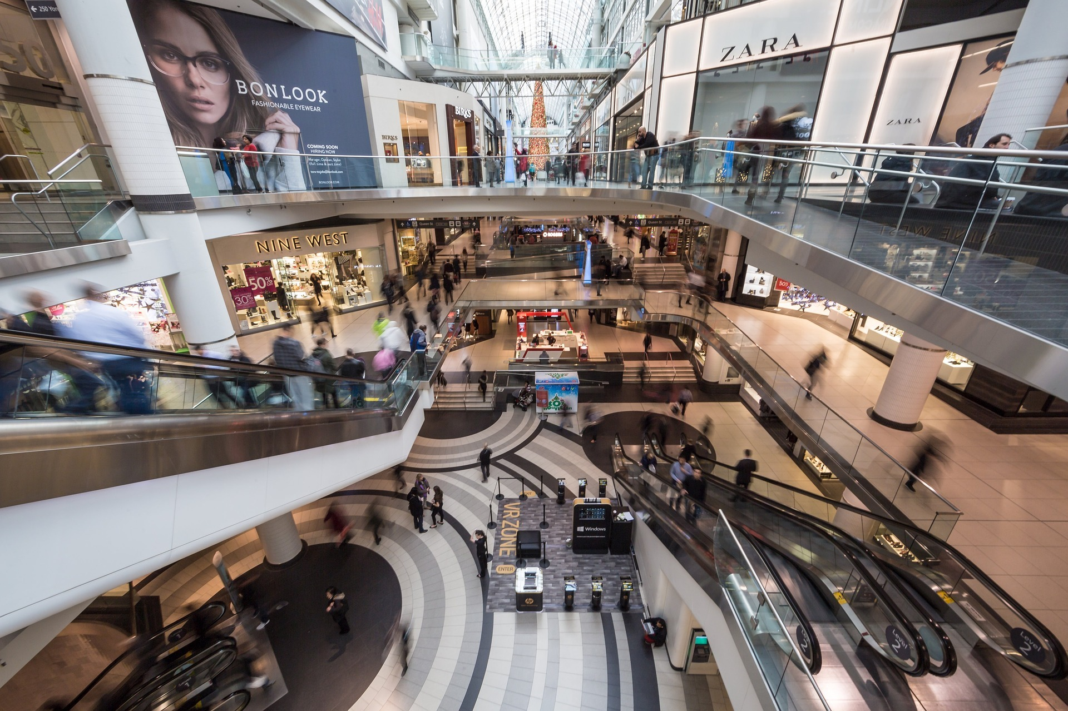
Multiplaza Pacific
Multiplaza Pacific Is an amazing 3-story shopping mall in Panama’s most prestigious neighborhood, Punta Pacifica, on Via Israel.
Multiplaza Pacific is considered the best shopping center in Panama and can be a great starting point for your shopping trip. Here you will find all kinds of American, European, and Latin American brands of clothing, shoes, and accessories, as well as a food court, movie theater, cafes, restaurants, and a nightclub on the outdoor terrace of the top floor.
Hint: Get your green Panama Shopping Card at a special counter, show it in the stores of Multiplaza Mall and get a discount. To get the discount card you must have your passport.
Opening hours: Mon–Sat 10 – 20, Sat 11 – 19, restaurants and bars on the terrace of Las Terrazas open from 11 am to 2 am.

Slide 19
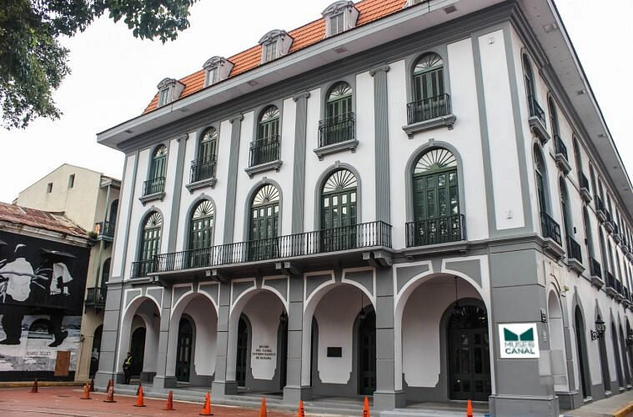
Museo del Canal Interoceánico de Panamá
The Panama Canal Museum is a non-profit institution that promotes and rescues the historical memory of Panama and its Canal, being one of the most important tourist destinations in the country. Its objective is to contribute to the formation of the community by facilitating cultural experiences that promote its integral development.
Signs are in Spanish, but English-speaking guides and audio guides (US$5) are available.

Slide 20
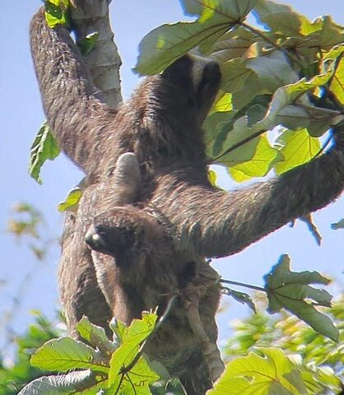
Panama Canal Boat Safari & Jungle Walk
The manmade lakes, islands, and tropical rainforests along the Panama Canal are renowned for their biodiversity. On this eco cruise, sail along a scenic stretch of the Panama Canal and Gatún Lake; visit Monkey Island; and look out for wildlife such as monkeys, iguanas, crocodiles, and exotic birds.

Slide 21
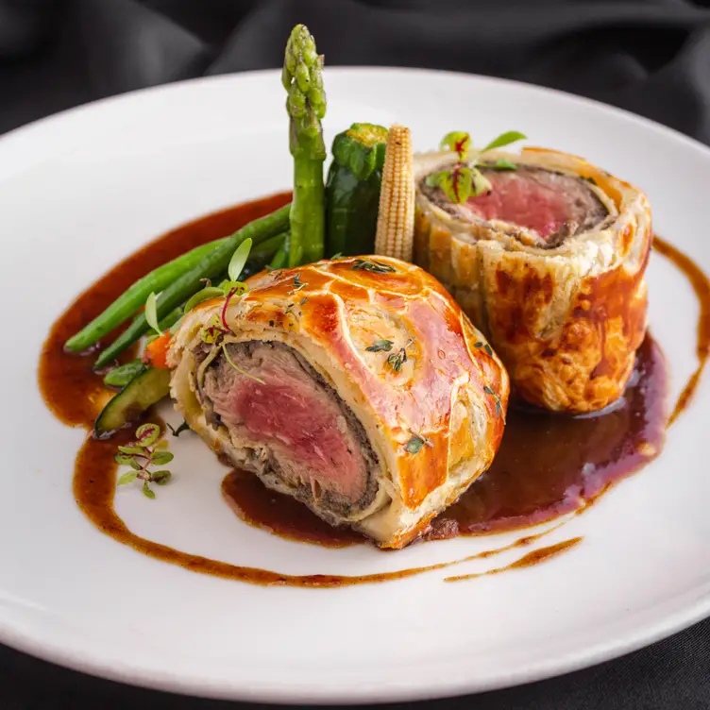
Panama City Restaurants
Panama City has many excellent restaurants. Many of us on the ship are foodies, so naturally, we’re always on the hunt to eat at the most exclusive spots anytime we travel.
Here are a few of the best restaurants to consider in downtown Panama City. La Boucherie $$$$ French, International Grill
Via Israel Restaurant en La Terrazas Del Multiplaza Mall, Panama City
Caliope Steakhouse $$$$ International fusion 57th Street Obarrio, Panama City 0807 Panama
Azahar Panama $$$$ Seafood, International, Sushi
Avenida Balboa Ph Yoo Panama, Piso 7, Panama City
Assisi Restaurant $$ - $$$ Italian,Bar,Pizza
Calle 71 Este Corner Avenue 5C Sur San Francisco, Panama City
Chèvre Panama $$$$ Italian,French, Pizza
Calle 72 San Francisco Casa 81, Panama City
Concolon Panamanian Street Food Café $ Central American, Vegetarían
Calle San Lucas, Panama City
For those of you who just like good food, you can’t go wrong just about anywhere you go in Panama City.
GOOD EATING

Slide 22
Conclusion
Panama City is a beautiful City with a rich history and numerous attractions. Whether you're looking for stunning beaches, historic sites, or unique attractions, Panama City has something for everyone.
I hope this presentation will help when we visit Panama City!

Slide 23
Thanks For Coming
If you have any more questions, please ask.
I will do my best to answer them for you.
Have a great visit in Panama City!

