Slide 1
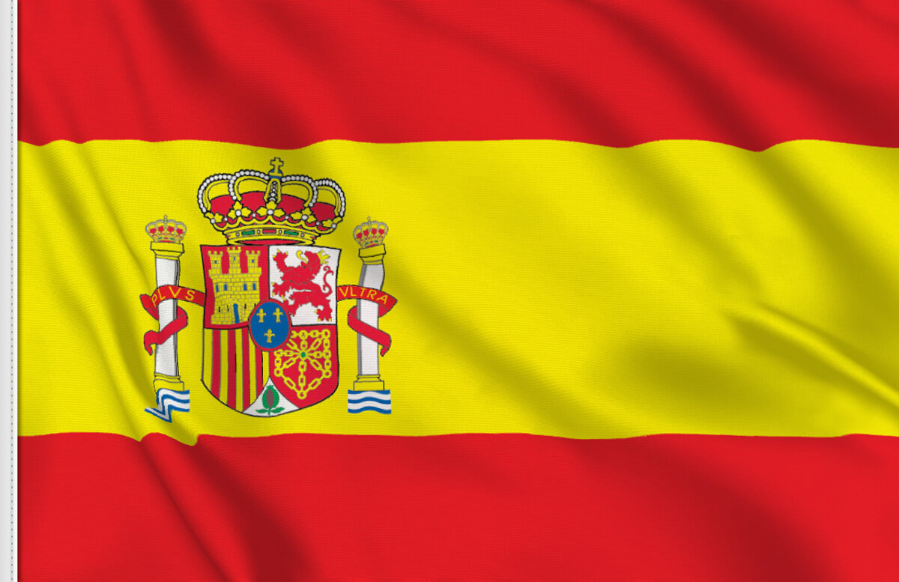
Palma de Mallorca Spain
Cruise Travel Guide
Port Presentation
Presented by
Marc Silver

Slide 2
What I Will Cover
My Port Philosophy
Don’t Miss the Ship
Money
Introduction to Palma de Mallorca
A Cruise Traveler’s Guide
History of Palma de Mallorca
Maps
Getting Around
Tourist Office?
Important Tips & Practical Advice
Attractions & Points of Interest.
A few restaurant recommendations
Final Thoughts

Slide 3
My Port Philosophy
I have been cruising for over 45 years and have taken over 100 cruises.
I consider myself an experienced cruiser.
The information I will present is based on those many years of experience.
When I am on a cruise where the city I want to visit is not the port city, I always recommend taking a ship’s tour.
But when I am in a port with multiple attractions nearby and easy to see on my own - I will do it on my own.
This presentation is for that type of port.

Slide 4
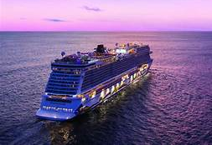
Don’t Miss the Ship
How to Avoid Missing Your Ship:
Pay attention to the time. - Ship time and local
time are often different.
Put a return-to-ship reminder on your phone.
Choose excursions wisely:
If a ship-sponsored excursion is late returning
to port, the ship will wait, but not for excursions
taken on your own.
Be Prepared:
Have your Passport, Credit Card, and phone numbers for the ship port agent.
What to Do If You Miss the Ship:
Most cruise lines have port agents stationed in the port area to assist if your ship has left without you. Sometimes, when cruisers are late returning to the vessel, the ship's crew may remove the passengers' essential items -- passports, cell phones, and medication -- from the ship to leave with the port agents.
The Port Officials can help you with contacting your ship
and making necessary travel arrangements.

Slide 5

Money
Spain uses the Euro (€) as its official currency.
As of October 2024, the exchange rate between
the Euro and the U.S. Dollar (USD) is about
1 EUR = 1.05 USD.
This means U.S. travelers should anticipate
slightly higher prices in terms of conversion,
but Spain remains a relatively affordable
destination compared to many other Western European countries.
When exchanging money, it’s best to avoid doing so at the port exchange kiosks, as they tend to have higher fees and less favorable rates.
Instead, consider using ATMs to withdraw Euros directly, as they often offer better rates. Additionally, credit and debit cards are widely accepted throughout Palma de Mallorca, though having some cash on hand is always a good idea for smaller purchases or tips.

Slide 6
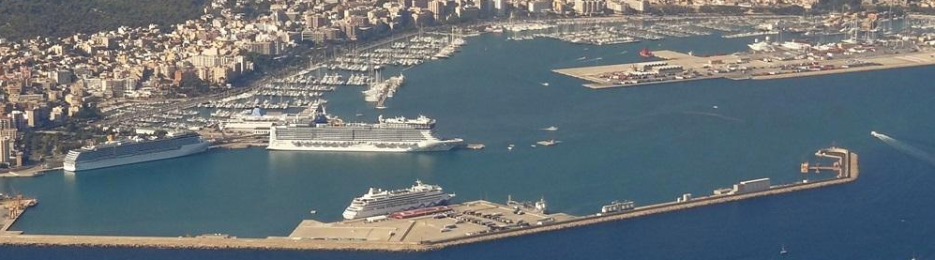
A Cruise Traveler’s Guide to
Palma de Mallorca
Palma, the capital of the beautiful island of Majorca (Mallorca) in Spain’s Balearic Islands, is a cruise destination rich with history, culture, and Mediterranean beauty.
It offers a perfect blend of historic architecture, stunning beaches, and vibrant culinary experiences, making it a must-visit stop for cruise travelers. Whether you have a few hours or a full day to explore, this guide will help you make the most of your time in Palma.
NCL Dock

Slide 7
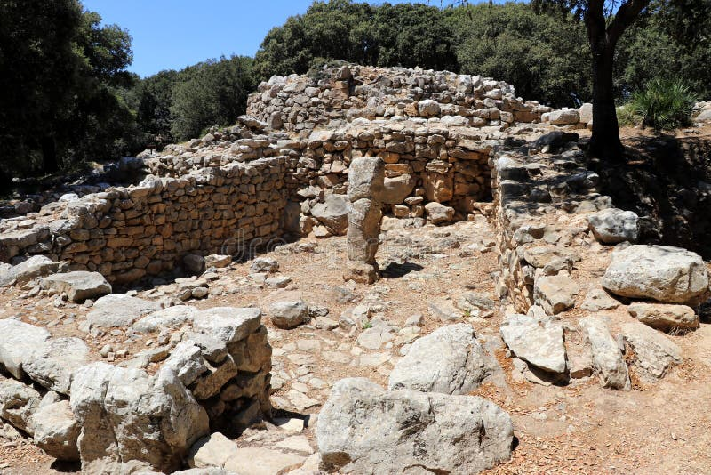
Palma de Mallorca’s History
From Ancient Roots to Modern Glamour
Palma's history is as rich and varied as the cultures that have left their mark on the island.
Originally inhabited by the Talaiotic people during the Bronze Age (3300 to 1200 BC), Majorca's strategic position in the Mediterranean made it a coveted prize for many civilizations.
The Romans conquered the island in 123 BC, founding the city of Palmera, which eventually
grew into modern-day Palma.
Remnants of Roman architecture
can still be seen in the form of
ruins scattered across the city.
There are numerous ancient ruins
scattered around the region to
explore.

Slide 8
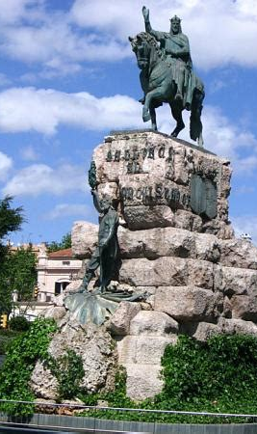
The History of Palma de Mallorca
After the fall of the Roman Empire, Palma fell under Byzantine rule before being conquered by the Moors in the 10th century.
During this period, the city flourished as a bustling port, and many of its architectural treasures, including the Arab Baths (Banys Àrabs), date back to this era.

Slide 9
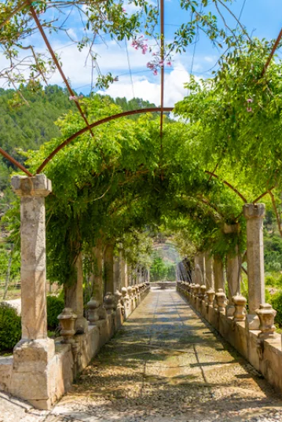
The History of Palma de Mallorca
In 1229, King James I of Aragon reconquered the island, bringing Palma under Christian rule.
He initiated the construction of the city's crown jewel, the Gothic-style Cathedral of Santa María (La Seu). The 19th and 20th centuries saw Palma transform into a global tourist hotspot, renowned for its beaches, culture, and glamorous appeal.
Today, the city’s mixture of ancient history and modern luxury makes it a top Mediterranean destination.

Slide 10
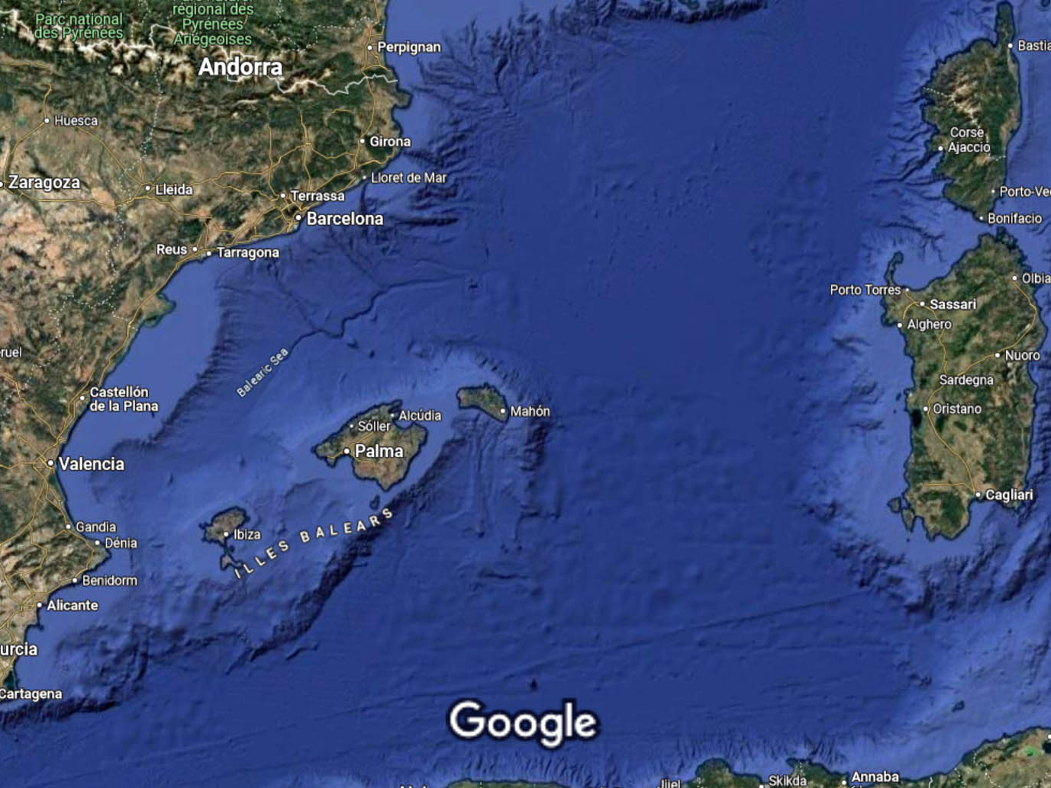
Mallorca
Map

Slide 11
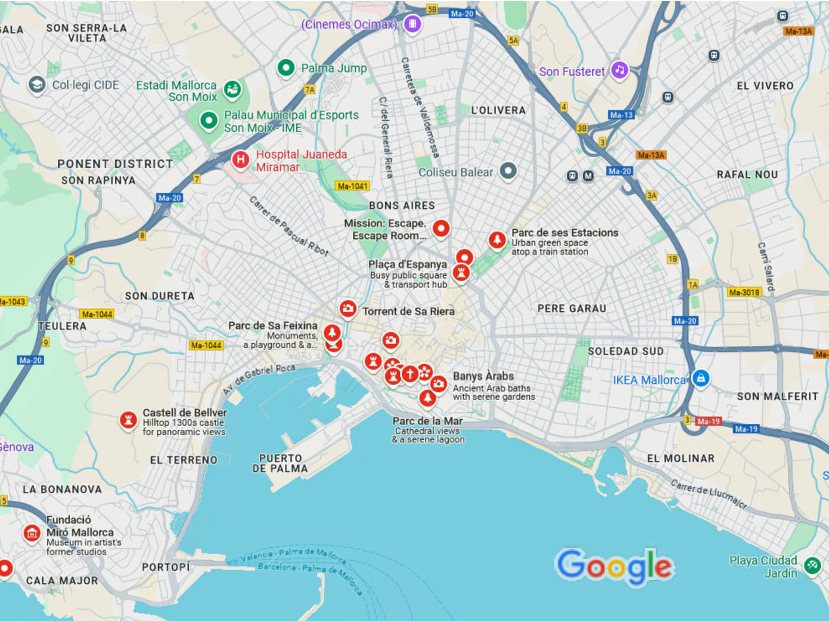
Map Of Palma de Mallorca
Palma

Slide 12
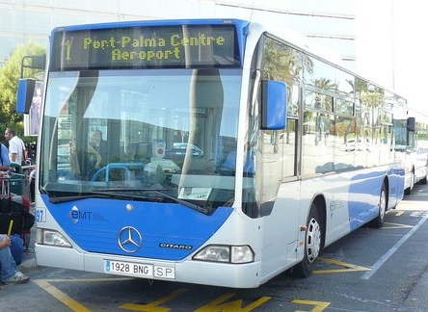
Getting Around Palma de Mallorca
Public Buses
For the most part Palma de Mallorca is an easy city to walk, but for those who want to avoid exercise as much as possible, there are the city buses.
Palma has an efficient public bus system
operated by EMT Palma. Buses are affordable, reliable, and cover the entire city, including popular tourist spots like the Cathedral, Bellver Castle, and the beach.
A single ticket costs around €3, and buses run frequently from the cruise port into the city center. Please note: The walk is long along the pier.
For day trips further afield, intercity buses from TIB can take you to charming towns like Valldemossa or Sóller.

Slide 13
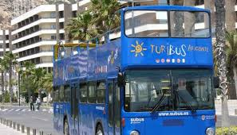
Getting Around Palma de Mallorca
Palma de Mallorca Turibus Bus
A hop-on hop-off bus service in Palma de Mallorca is a perfect break for travelers who want to explore the city at a slower pace.
The double-decker bus guarantees you easy access to your favorite attraction since you are free from the strict schedule and the contrasting multiple languages are provided by the audio narrator.
It offers a convenient way to see the city's highlights, including La Seu Cathedral, Bellver Castle, and the stunning waterfront.
The tour costs around €18 for a 24-hour pass, and the buses have multilingual audio guides that provide insight into Palma's history and culture. Be aware the busses are crowded.

Slide 14
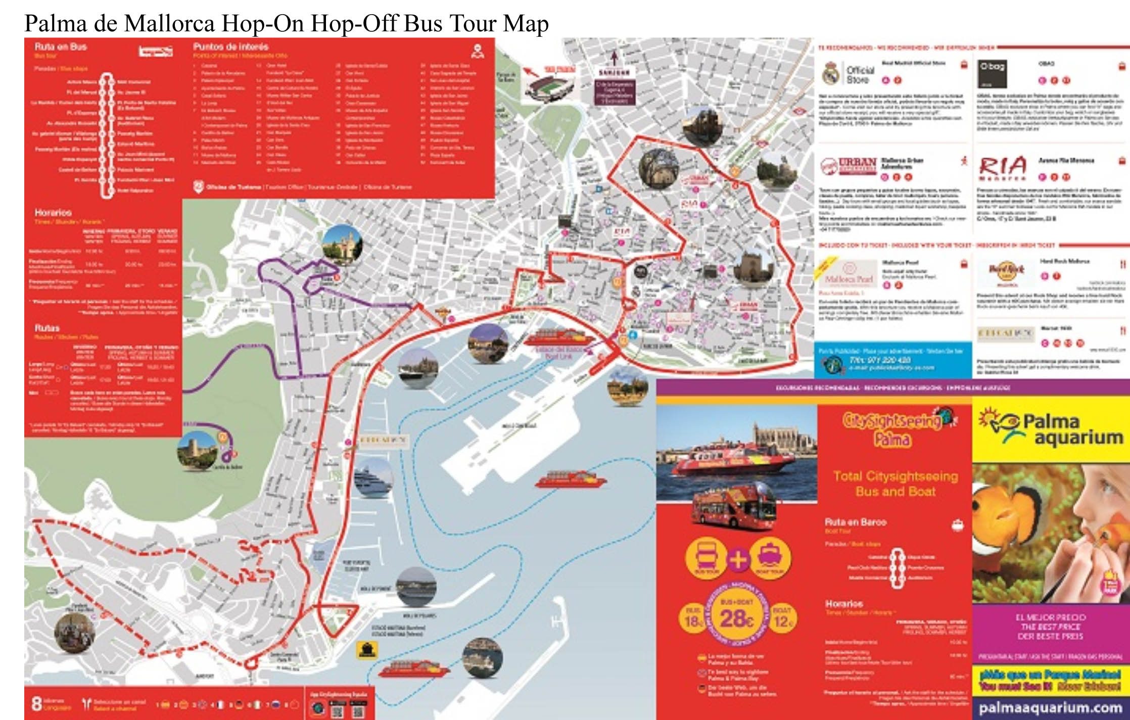

Slide 15

Getting Around Palma de Mallorca
Taxis and Ride-Sharing
Taxis are widely available in Palma and offer a hassle-free way to get around. From the port to the city center, the fare usually ranges from €10 to €15, depending on traffic. Taxis in Palma are safe, metered, and easy to hail.
Uber is not available on the island, but local ride-sharing apps like Cabify offer an alternative, often with set rates that can be more affordable for longer trips.

Slide 16
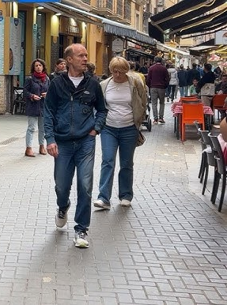
Getting Around Palma de Mallorca
Walking
Palma’s historic center is highly walkable, with narrow cobblestone streets, charming squares, and beautiful landmarks all within close proximity.
Walking allows you to explore at your own pace, discovering hidden gems like quaint cafes, artisan shops, and ancient courtyards.
For those who enjoy exploring on foot, Palma is a paradise.

Slide 17
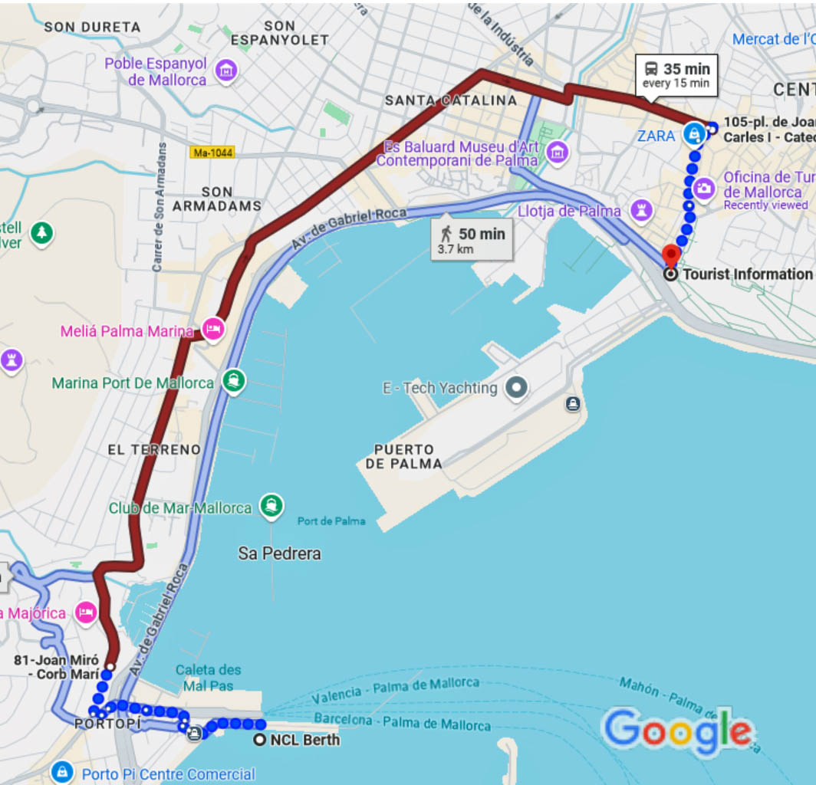
Tourist Office
The Tourism Office provides tourist information service and expertise for the city's visitors.
It is a drive or long bus ride to find the Palma de Mallorca Tourist Center, located in town.
You can pick up pamphlets on places to see throughout Palma de Mallorca as well as getting advice from the associates there.

Slide 18
Important Tips & Practical Advice
Time Needed for Attractions: If you have limited time, prioritize visiting La Seu Cathedral and Bellver Castle. These two landmarks can be explored in about 3-4 hours, leaving you time to stroll around the old town or relax by the beach.
Excursions: While booking excursions through your cruise line can be convenient, Palma is easy to explore independently. Walking tours and bike rentals offer a more intimate experience, and public transportation is affordable and reliable.
Safety and Health Tips: Palma is generally safe, but as with any tourist destination, keep an eye on your belongings in crowded areas. Tap water is safe to drink, but bottled water is widely available if you prefer. Sunscreen is a must, especially during the summer months, and comfortable shoes will make navigating the cobblestone streets easier.

Slide 19
Attractions & Points of Interest
1. Palma de Mallorca Cathedral – La Seu
2. Royal Palace of La Almudaina
3. Parc de la Mar
4. The Mercat de l’Olivar
5. Best boat excursions in Palma de Mallorca
6. The Plaça Mayor
7. Shopping in Palma de Mallorca
8. The Palau March – Bartolomé March Foundation
9. The Arab Baths (Banys Arabs)
10. Must-visit museums in Palma de Mallorca
11. Basilica de Sant Francesc
12. Other plazas to discover in Palma
13. Bellver Castle – Castell de Bellver
14. Fundació Pilar i Joan Miró
15. Palma de Mallorca Aquarium
16. More activities in Palma de Mallorca
Best things to do around Palma de Mallorca
17. Beaches near Palma de Mallorca
18. Soller train – Tren de Sóller
19. The Serra de Tramontana
20. Day trips around Palma

Slide 20
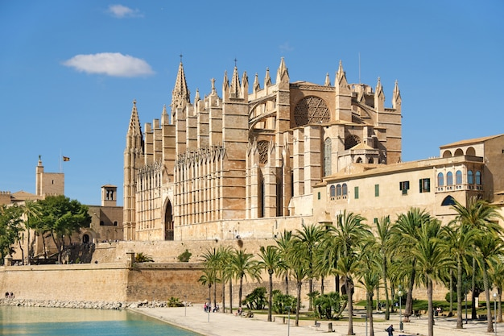
Attractions & Points of Interest
Palma de Mallorca offers a wide variety of
attractions that cater to history buffs, nature
lovers, and culture seekers alike.
La Seu Cathedral (Cathedral of Santa María)
Description: One of the most iconic landmarks
in Spain, Palma’s La Seu Cathedral dominates
the city’s skyline. Built between 1300 and 1601,
it is the second-largest cathedral in Spain after Seville’s.
One of Spain’s most iconic Gothic cathedrals, La Seu dominates Palma’s skyline. Built on the site of a former mosque, its intricate architecture and stunning rose window are awe-inspiring. Inside, you’ll find works by famous artists like Antoni Gaudí and Miquel Barceló.
Admission: €8 for adults, free for children under 12
Operating Hours: 10 AM - 5:15 PM (hours may vary depending on the season)
Tips: Visit early in the morning to avoid the crowds, and don’t miss the views of the sea from the terrace.

Slide 21
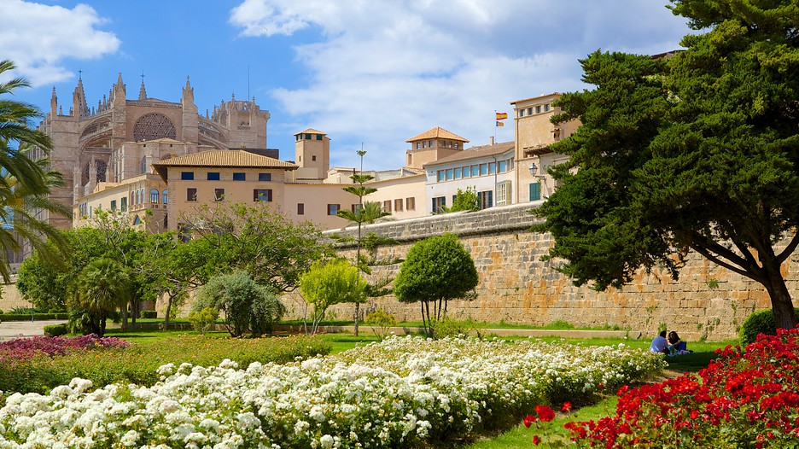
Attractions & Points of Interest
Parc de la Mar
Located beside Palma’s iconic landmarks—the majestic La Seu Cathedral and the Royal Palace of Almudaina—Parc de la Mar is a picturesque green space that merges history with nature.
One of the park's highlights is its expansive artificial lake, which mirrors the grandeur of the cathedral, especially at sunset, creating a captivating backdrop for photos.
The park offers scenic views of the city's coastline, making it ideal for leisurely strolls along the seafront, where visitors can enjoy the calm ambiance while taking in the beauty of Palma’s skyline. .

Slide 22
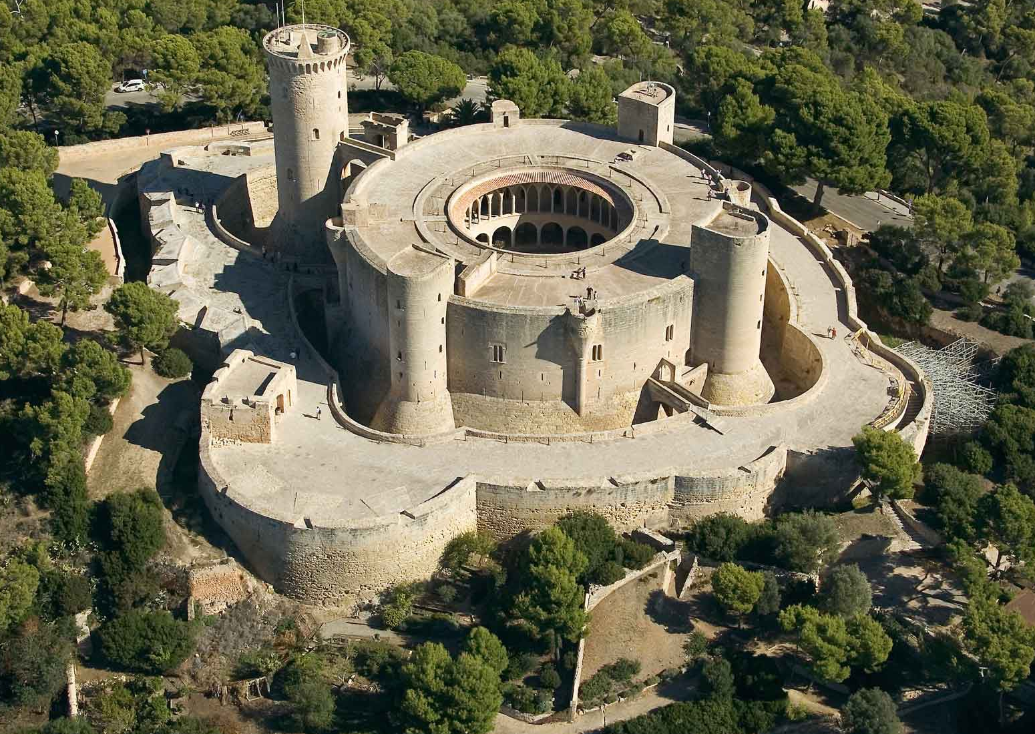
Bellver Castle
Bellver Castle
Description: This 14th-century
circular castle is perched on a
hill overlooking Palma.
Originally a royal residence, it
now houses the city’s history
museum. Its unique design and
panoramic views make it a
popular stop.
Admission: €4 for adults, €2 for students and seniors, free on Sundays
Operating Hours: 10 AM - 7 PM (closed on Mondays)
Tips: Wear comfortable shoes for the climb up the hill, or take a taxi to the entrance.

Slide 23
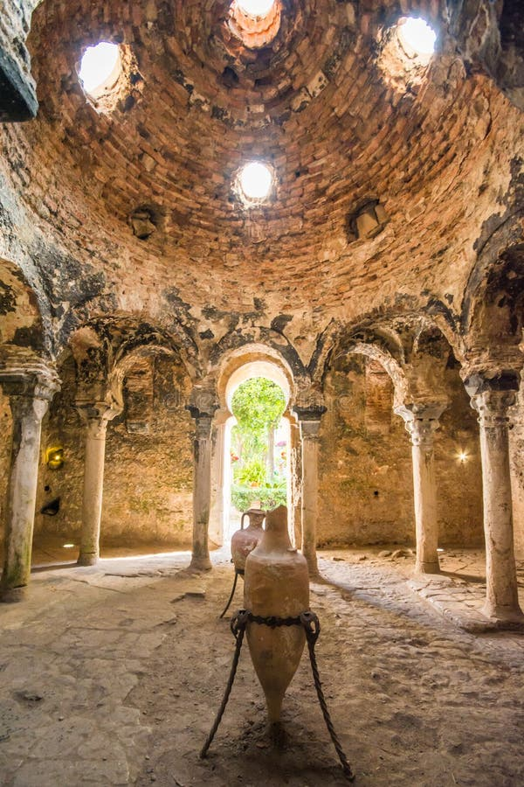
Banys Àrabs (Arab Baths)
Banys Àrabs (Arab Baths)
Description: For a glimpse into Mallorca’s Moorish past, visit the Banys Arabs, or Arab Baths.
These 11th-century baths are one of the few
remaining traces of Muslim rule on the island.
The small, photogenic site features a preserved
room with a domed ceiling supported by arches
and columns.
Admission: €3 for adults
Operating Hours: 9:30 AM - 8 PM
Tips: The site is small, so it’s best combined
with a walking tour of the old town.

Slide 24
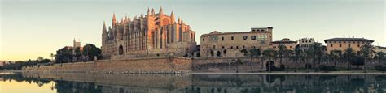
Paseo Marítimo
Paseo Marítimo
Description: Palma’s stunning seaside promenade stretches for miles along the harbor. It's lined with restaurants, bars, and cafes, offering plenty of spots to relax and enjoy views of the Mediterranean. It’s perfect for an evening stroll or bike ride.
Admission: Free
Tips: Visit at sunset for the best views.

Slide 25
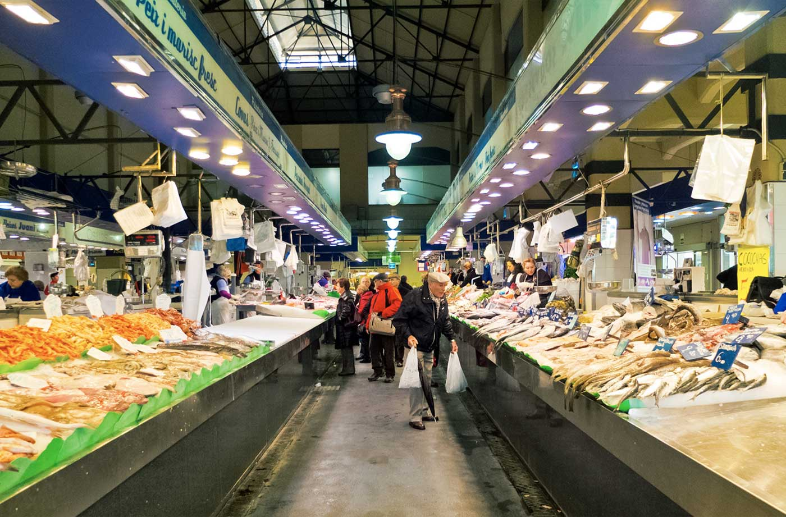
Mercat de l'Olivar
Mercat de l'Olivar
For a taste of local life, visit the Mercat de
l’Olivar, Palma’s largest food market.
With an array of fresh produce, cheeses,
seafood, and local delicacies, it's a great
spot to sample authentic Mallorcan cuisine.
Don’t miss the chance to try sobrasada, a
traditional cured pork sausage unique to the Balearic Islands.
Also try a local delicacies like sobrasada (a cured sausage) and ensaimada (a spiral pastry).
Practical Information:
Open daily from 7:00 AM to 3:00 PM (closed Sundays)
Admission: Free
Operating Hours: 7 AM - 2:30 PM (closed Sundays)
Tips: Arrive early to sample the freshest offerings, and don’t hesitate to try the tapas bars located inside the market.

Slide 26
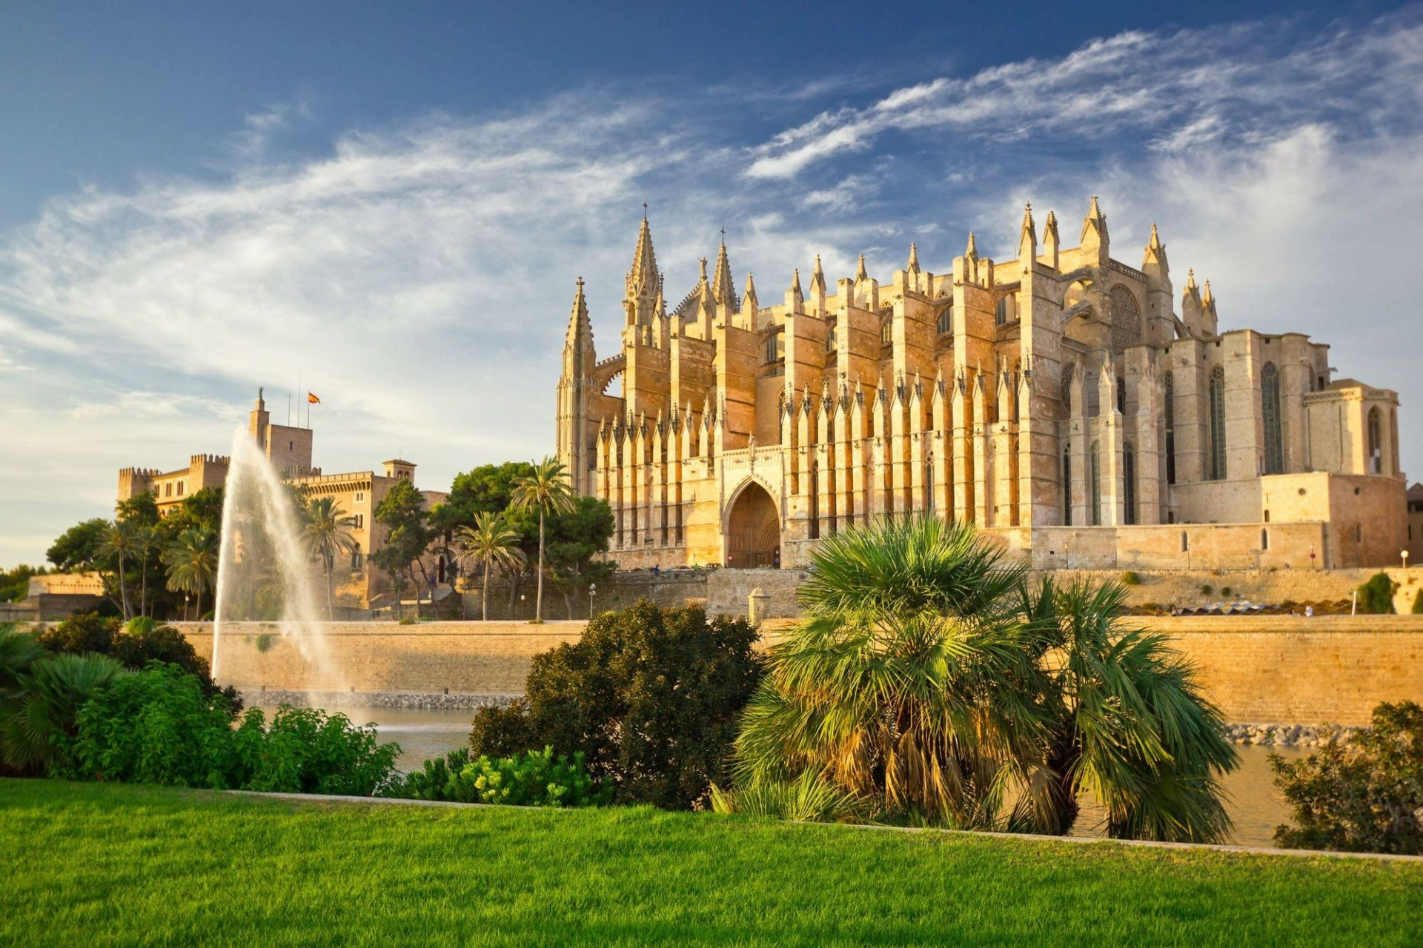
Catedral-Basílica de Santa María de Mallorca
The first historical documents relating to the building of the Cathedral date from 1230. Bishop Pere de Morella consecrated the altar stone of the main altar. And during the reign of King James II (1276–1311), construction of the building we know today began.
Around the second half of the 13th century, new stonework started being laid in the chevet.
This is integrated into the Royal Chapel and preserves the space intended for the tombs of the monarchs from the Mallorcan royal family. It is known as the Chapel of the Holy Trinity.
At the start of the 20th century the architect Antoni Gaudí adapted the inner space of the Cathedral to meet the new liturgical and pastoral requirements

Slide 27
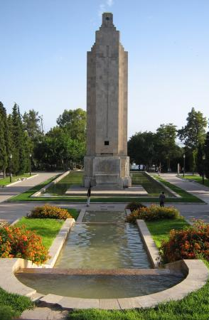
Parc de Sa Feixina
Parc de Sa Feixina is a delightful urban oasis, offering a range of attractions for visitors of all ages.
The park's playground is a favorite among local families, featuring two large towers connected by hanging bridges, along with slides and swings that provide plenty of fun for children.
In addition to the play area, the park is home to several stone monuments, including an obelisk, and peaceful fountains that add to its tranquil charm.
The sight of ducks paddling through the fountains' water jets adds to the serene atmosphere, making Parc de Sa Feixina a perfect spot to unwind and enjoy the outdoors.

Slide 28
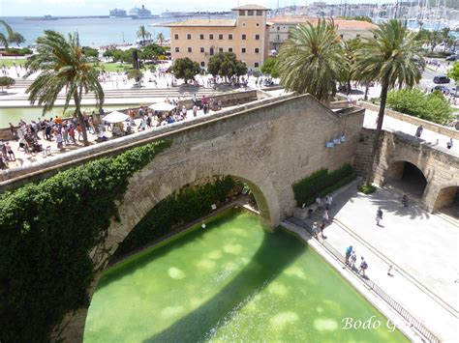
Arc de sa Drassana
The Arc de sa Drassana is a grand historical arch that stands as one of the few remaining links to Palma's Arab heritage.
Dominated by the imposing Palau de l'Almudaina, the arch once served as the seaward entrance to the palace and nearby shipyards during the Arab rule of the island.
The Riera, Palma’s now-diverted river, flowed along what is currently the Passeig d'es Born, and the sea reached the city walls.
The Arc de sa Drassana was strategically positioned at this maritime gateway, connecting the Arab palace complex with the bustling shipyards.
Today, it remains a striking reminder of the city's ancient past, and Palma's storied history.

Slide 29
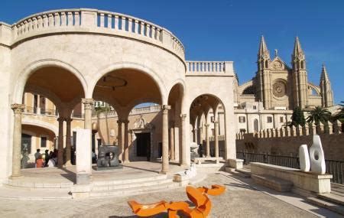
Palau March Museum
Once the residence of one of Mallorca’s
wealthiest families, the Palau March
Museum now houses an eclectic
collection of art, including sculptures
by Rodin and Dali, rare 14th-century
maps, and a magnificent 18th-century nativity scene with over 1,000 figurines.
One of the rooms houses more than a thousand painted and costumed works, while the Sala del Libro (Book Room) contains manuscripts, incunabula and codices, as well as a unique collection of nautical charts from the 14th to the 15th centuries.
Admission is only: €3.80 Children under 12 Free

Slide 30
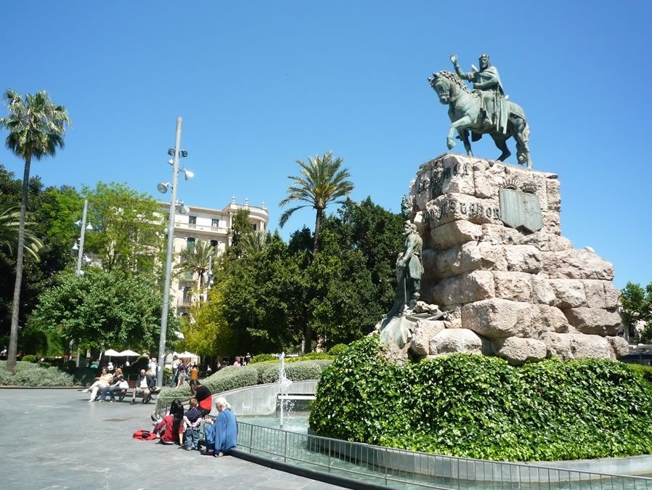
Plaça d'Espanya
Plaça d'Espanya in Palma de Mallorca is a lively central hub, serving as a key transportation point with access to trains, buses, and the metro.
It’s known for its statue of King Jaume I, commemorating his reconquest of the island in 1229.
Surrounded by shops, cafés, and the nearby Parc de les Estacions, the square is a popular meeting spot and gateway to exploring both the historic and modern parts of the city.

Slide 31
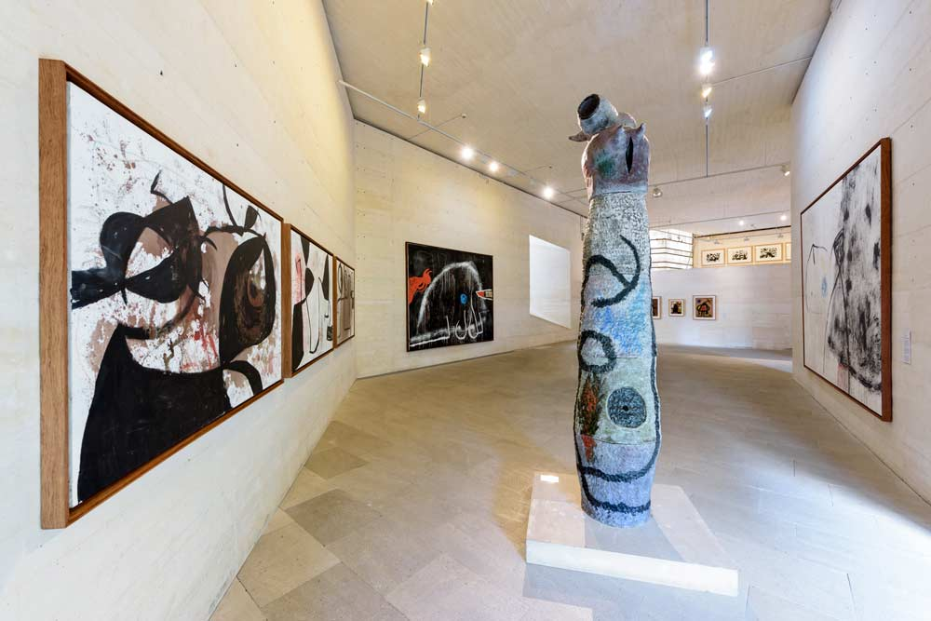
Fundació Miró Mallorca
Fundació Miró Mallorca is a cultural
treasure in Palma dedicated to the life
and art of Joan Miró.
The foundation includes three key
buildings: Miró's studio, Son Boter,
and the Moneo Building, showcasing
both his creative process and completed
works within a blend of modern and
traditional architecture.
Surrounded by beautiful Mediterranean gardens, the foundation invites visitors to relax and appreciate the natural landscape that inspired Miró’s vibrant creations.
It is a dynamic space that celebrates the connection between nature and creativity, reflecting the essence of Miró’s artistic vision. For more details, visit their official site.
Admission fees: Adults: €10, Students and seniors: €7
There are also reduced fees for guided tours which add €1 to the general admission, making it €11 in total.

Slide 32
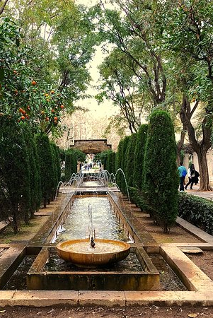
S'Hort del Rei
S'Hort del Rei originally established in the medieval period as part of the Almudaina Palace grounds.
It flourished during the reign of King James II in the early 14th century, featuring lush fruit trees, vibrant flowers, and even animal husbandry.
The garden underwent significant changes in the 19th century as the area was redeveloped.
Today, S'Hort del Rei is a peaceful retreat in the heart of the city, where visitors can enjoy its beautiful landscaping and sculptures.
Notable features include a swan pond and various art pieces, such as the bronze statue “Foner” by Llorenc Rossello and a marble sculpture by Josep Maria Subirachs.

Slide 33
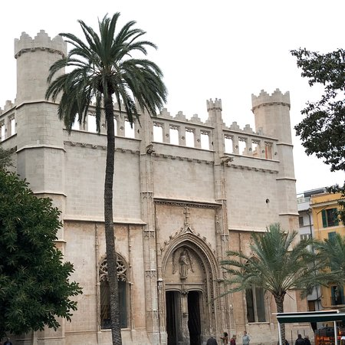
Llotja de Palma
Llotja de Palma, or Sa Llotja, is a magnificent
Gothic building in Palma de Mallorca, designed
by architect Guillem Sagrera and constructed
between 1426 and 1447.
Originally a trading exchange, it played a
crucial role in the city’s maritime commerce
during its golden age.
The building features impressive architectural details, including intricate carvings and soaring arches, which reflect its historical significance and grandeur.
Today, Llotja de Palma serves as a cultural center, hosting temporary art exhibitions that showcase both local and international talent.
Visitors can explore its spacious central hall and admire the elegant columns, making it a key attraction for history and architecture enthusiasts​.

Slide 34
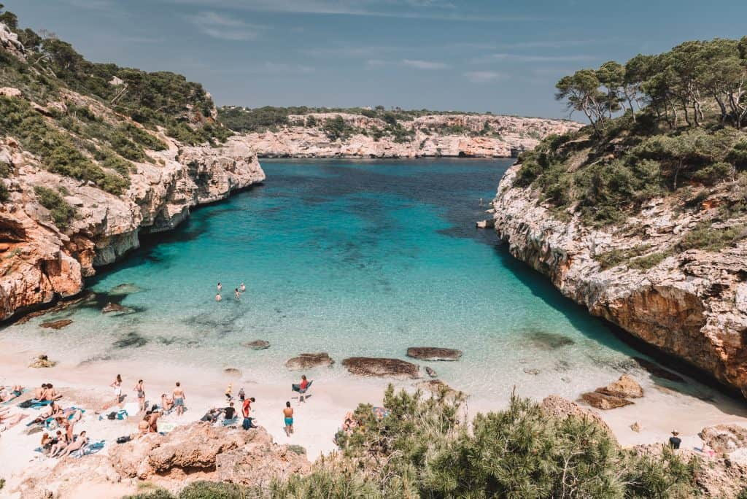
Beaches Near Palma
Beaches Near Palma
Palma’s proximity to the sea means that several beaches are just a short trip from the city center.
While not as wild as other parts of the island, Can Pere Antoni Beach offers a convenient spot to cool off after exploring the city.
For a more idyllic experience, head west to Cala Major or Illetes beaches, or east to S’Arenal, known for its lively promenade lined with restaurants and bars.

Slide 35
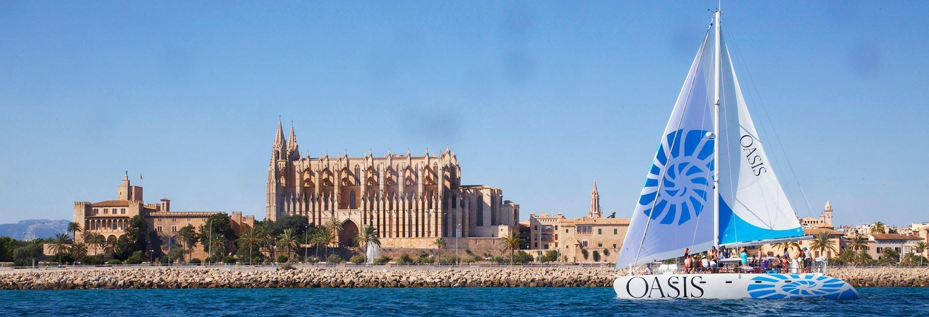
Unique Experiences in Palma
Catamaran and Boat Excursions
One of the most memorable activities for visitors is a boat excursion around Palma Bay.
Choose from catamaran cruises with swimming stops at secluded coves like Cala Vella or opt for a sunset cruise with music and drinks onboard.

Slide 36
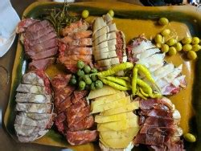
Home to Amazing Restaurants
Palma’s culinary scene is a delight for foodies, offering a wide range of options from traditional Mallorcan dishes to international gourmet cuisine. Here’s a guide to dining in Palma:
Traditional Dishes
Pa amb oli: A simple but delicious
Mallorcan dish made with rustic bread |
rubbed with ripe tomatoes and topped with
olive oil, cheese, ham, or sobrasada.
Frito Mallorquín: A flavorful stir-fry of
lamb or pork, mixed with vegetables and potatoes, seasoned with local herbs.
Ensaimada: A sweet pastry typically enjoyed for breakfast or as a dessert. Try it plain or filled with cream or cabello de ángel (pumpkin jam).

Slide 37
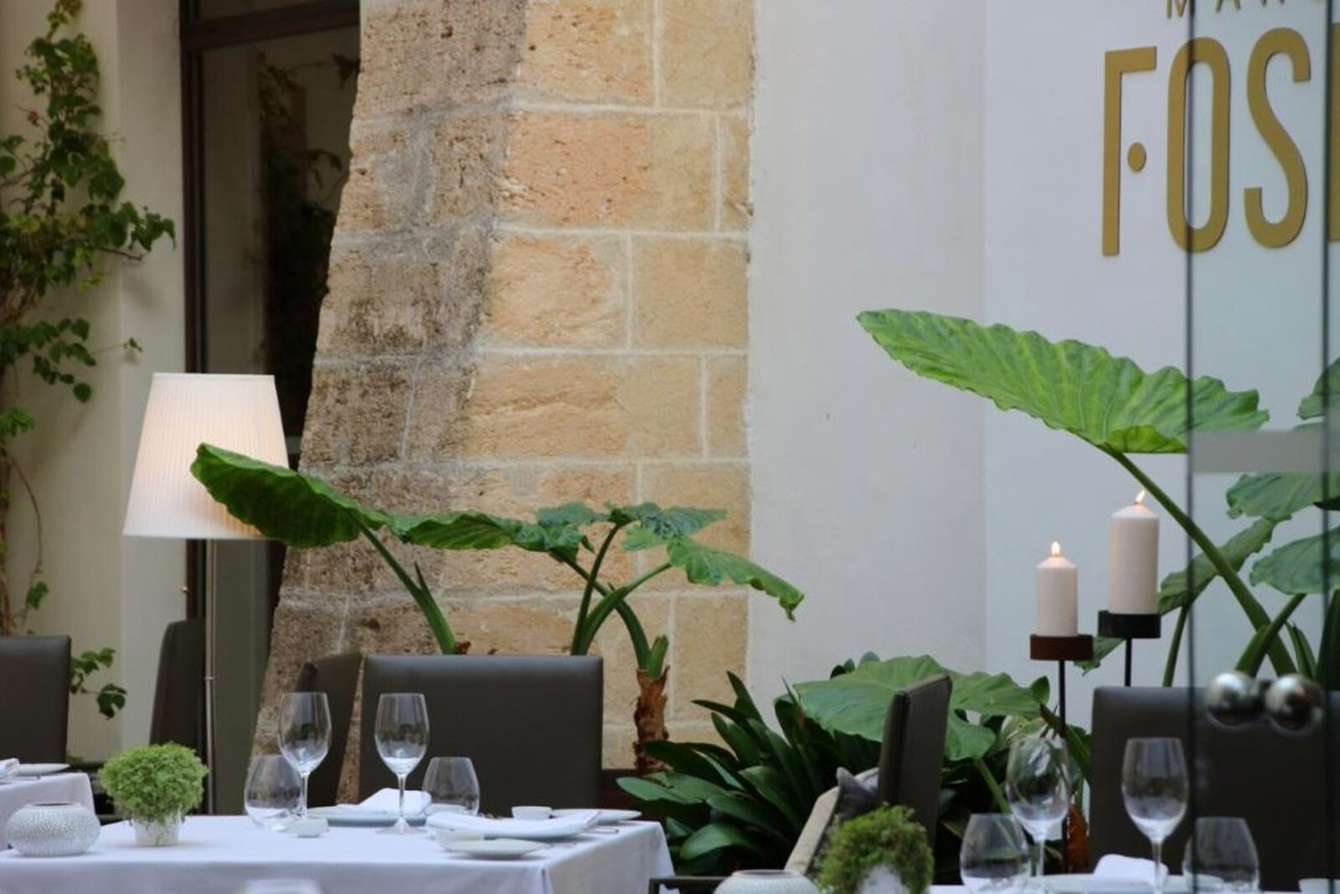
Home to Amazing Restaurants
Best Spots to Eat
Ca'n Joan de S'Aigo: One of the oldest cafes in
Palma, this is the go-to spot for an authentic
ensaimada and a cup of thick hot chocolate.
Marc Fosh: A Michelin-starred restaurant offering
modern Mediterranean cuisine in the heart of Palma.
Ideal for those seeking a high-end dining experience.
La Rosa Vermutería: A charming tapas bar offering
traditional Spanish vermouth and delicious tapas in a laid-back setting.
Tips for Choosing Authentic vs. Tourist Dining
To avoid tourist traps, look for restaurants that are filled with locals, especially during lunchtime. Many authentic restaurants offer a menú del día (daily set menu), which is a great way to sample traditional dishes at a reasonable price.
Vegetarian/Vegan Options
Palma has a growing number of vegetarian and vegan-friendly restaurants. Spots like Bon Lloc, the island’s first vegetarian restaurant, and Compost Vegano offer creative, plant-based dishes made with locally sourced ingredients.

Slide 38
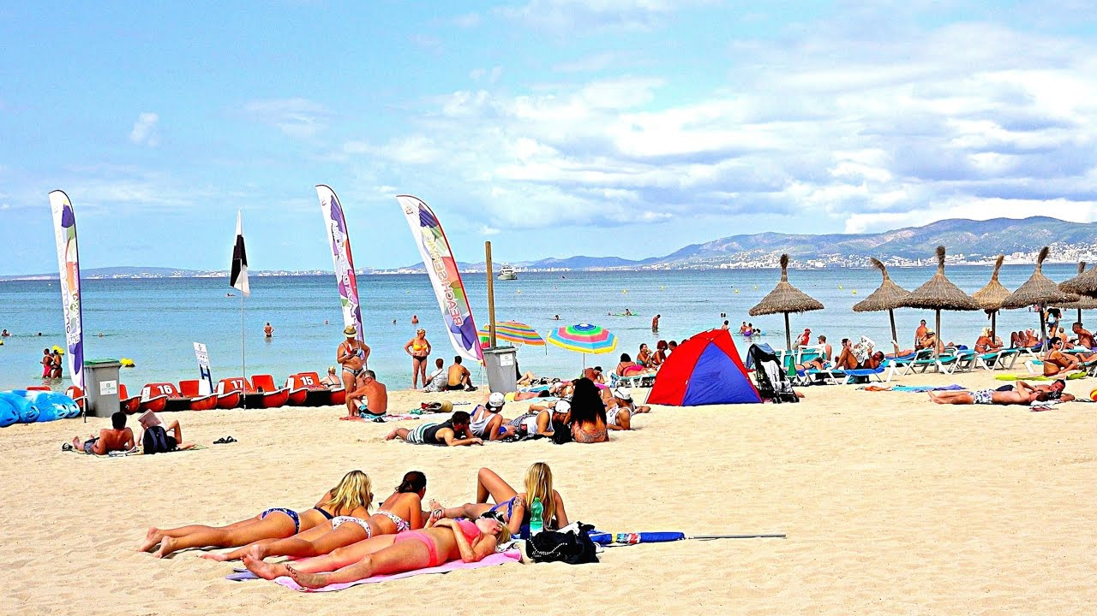
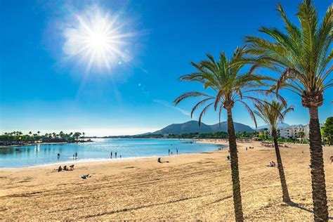
Final Thoughts
Palma de Mallorca is a vibrant city that effortlessly combines history, culture, and modernity.
Whether you’re exploring its Gothic cathedrals, lounging on the beach, or savoring the local cuisine, there’s something for every traveler to enjoy.
With this guide in hand, you’ll be able to make the most of your cruise stop and experience the best that Palma has to offer.

Slide 39
Thanks For Coming
If you have any more questions, Please ask.
I will do my best to answer them for you.
Have a great visit in Palma de Mallorca!

Slide 40
References
EMT Palma Official Website for public transport information
Palma City Sightseeing Website for Hop-On Hop-Off Bus details
La Seu Cathedral Official Website for hours and admission fees
Bellver Castle Official Website for ticket information
XE.com for up-to-date currency exchange rates
Various restaurant websites for dining recommendations
Palma Cathedral (La Seu): Official website
Royal Palace of La Almudaina: Spanish National Heritage
Mercat de l’Olivar: Palma City Council
Palma Aquarium: Official website
Tren de Sóller: Soller Train Official Website

