Slide 1
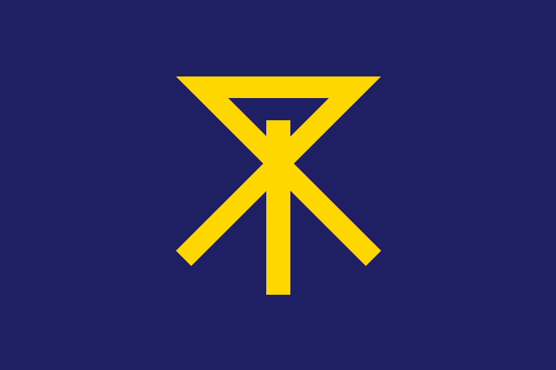
Osaka, Japan Presented by: Fellow Passenger Marc Silver

Slide 2
What I Will Cover
My Port Philosophy
Don’t Miss the Ship
Money
About Osaka, Japan
Osaka History
City Map
City Pass
Points of Interest
Places to see or at least consider
A few restaurant recommendations
Conclusion

Slide 3
My Port Philosophy
I have been cruising for over 45 years and have taken over 100 cruises. So, I consider myself an experienced cruiser.
The information I will present is based on those many years of
experience.
When I am on a cruise where the city, I want to visit is not the port city,
I always recommend taking a ship’s tour.
But when I am in a port with multiple attractions nearby and easy to see
on my own - I will do it on my own.
This presentation is for that type of port.

Slide 4

Don’t Miss the Ship
How to Avoid Missing Your Ship
Pay attention to the time. - Ship time and local time are often different.
Put a return-to-ship reminder on your phone.
Choose excursions wisely.
If a ship-sponsored excursion is late returning to port, the ship will wait for you. If you are on your own???
Be Prepared
Have your Passport, Credit Card, and phone numbers for your ship port agent.
What to Do If You Miss the Ship Most cruise lines have port agents stationed in the port area to assist if your ship has left without you. If your are lucky, when cruisers are late returning to the vessel, the ship’s crew will often remove the passengers’ essential items – passports, cell phones, and medication -- from the ship to leave with the port agents.
The Port Officials can help you with contacting your ship and making necessary travel arrangements.

Slide 5
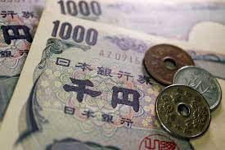
Money
The Yen is the official currency of Japan
Official Exchange is 100 Yen is 72 cents US
Or 142.15 Yen to the US Dollar

Slide 6
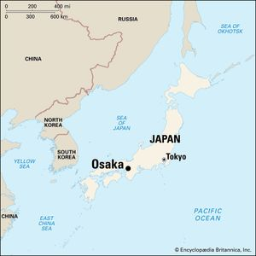
About Osaka
Ōsaka, city and capital of Ōsaka fu, south-central
Honshu, Japan. The city, together with its neighbor-
ing city Kōbe and nearby Kyōto, are the centers of
the Keihanshin Industrial Zone, the second-largest
urban and industrial areas in Japan.
Ōsaka Bay lies at the eastern end of the Inland Sea,
on the delta of the Yodo River. Its metropolitan area is spread over the deltas and into the alluvial uplands of the Yodo,
Yamato, and other rivers. Kōbe lies on the northwestern shore of Ōsaka Bay, about 20 miles (30 km) west of Ōsaka. The climate is temperate, with cool winters and hot, humid summers; annual rainfall is about 54”.

Slide 7

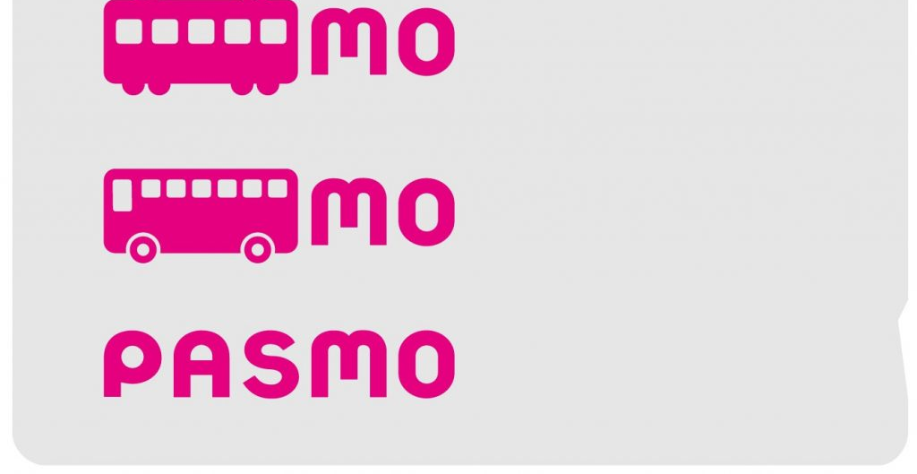
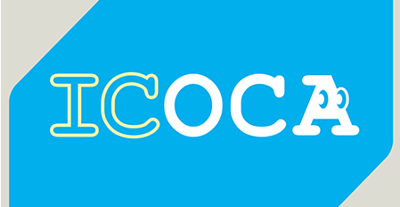
PASMO, Suica, & ICOCA Cards
The PASMO, Suica, and ICOCA Cards are e-money IC cards that can be used for travel and shopping across Japan.
Cashless fare payment
Use it for shopping
No waiting for change
Get special privileges
Apple phone users can also link with all three cards.
PASMO refunds - If you no longer need your PASMO, it can be refunded. Suica and ICOA cards do not offer refunds.

Slide 8
Osaka’s History
In the Jōmon period (7,000 BCE), Osaka was mostly submerged by the Seto Inland Sea, and the small Uemachi-daichi plateau, located in the southern part of the city called Uehonmachi area consisted of a peninsula with an inland sea in the east. It is considered one of the first places where inhabitants of Japan settled, both for the favorable geological conditions, rich in fresh water and lush vegetation, and because it was in a position difficult to attack from a military point of view. By the Kofun period, Osaka developed into a hub port connecting the region to the western part of Japan. The port of Naniwa-tsu was established and became the most important in Japan.
In 645, Emperor Kōtoku built his Naniwa Nagara-Toyosaki Palace in what is now Osaka, making it the capital of Japan. The city now known as Osaka was at this time referred to as Naniwa, and this name and derivations of it are still in use for districts in central Osaka. 8/21/2024

Slide 9
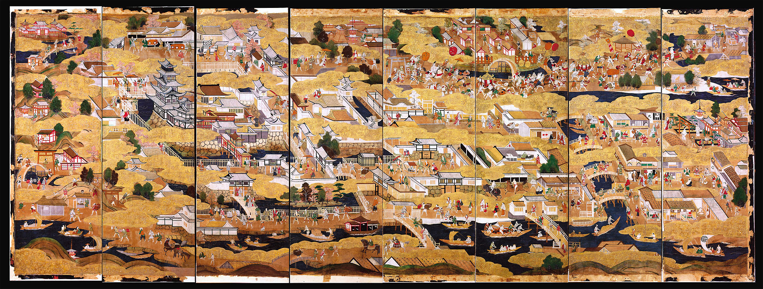
The Sumiyoshi-matsuri in the 16th century

Slide 10
Osaka’s History
In 1496, Jōdo Shinshū Buddhists established their headquarters in the heavily fortified Ishiyama Hongan-ji, located directly on the site of the old Naniwa Imperial Palace. Oda Nobunaga began a decade-long siege campaign on the temple in 1570 which ultimately resulted in the surrender of the monks and subsequent razing of the temple. Toyotomi Hideyoshi constructed Osaka Castle in its place in 1583. Osaka Castle played a pivotal role in the Siege of Osaka (1614–1615).
With the enormous changes that characterized the country after the Meiji Restoration (1868), and the relocation of the capital from Kyoto to Tokyo, Osaka entered a period of decline. From being the capital of the economy and finance, it became a predominantly industrial center.

Slide 11
Osaka’s History
The plan to reorganize Osaka and its province into a metropolis like Tokyo met with stiff opposition in some municipalities, particularly the highly populated Sakai. He then fell back on a project that included the suppression of the 24 wards of Osaka, thus dividing the city into 5 new special districts with a status similar to that of the 23 Special wards of Tokyo.
The referendum of May 17, 2015, called in Osaka for the approval of this project saw a narrow victory of no, and consequently, Hashimoto announced his withdrawal from politics.

Slide 12
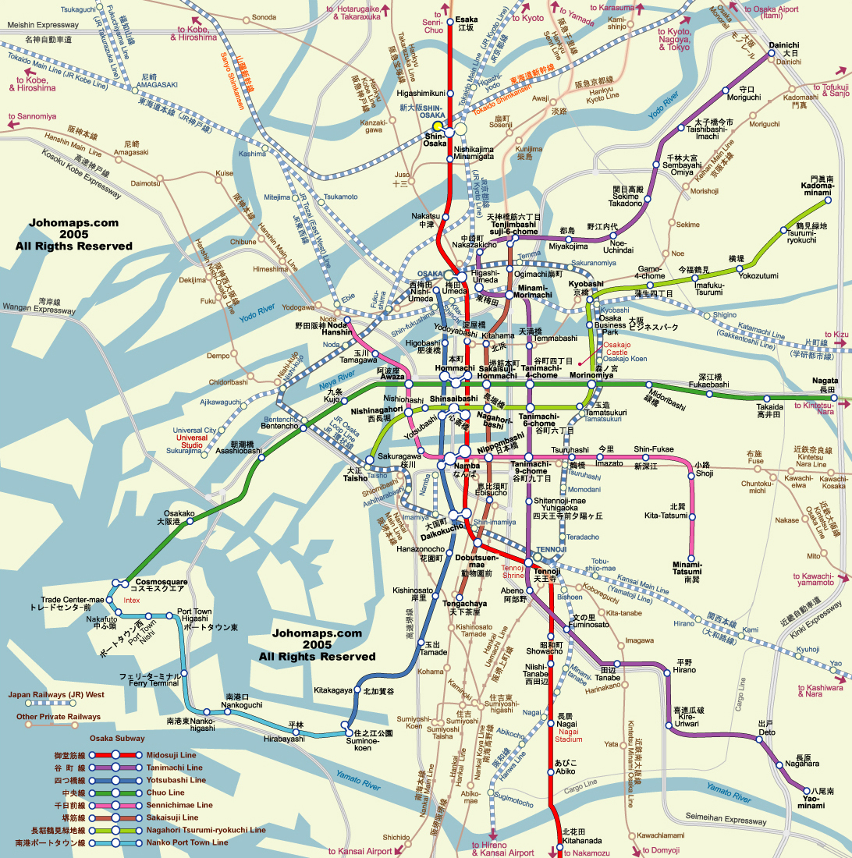
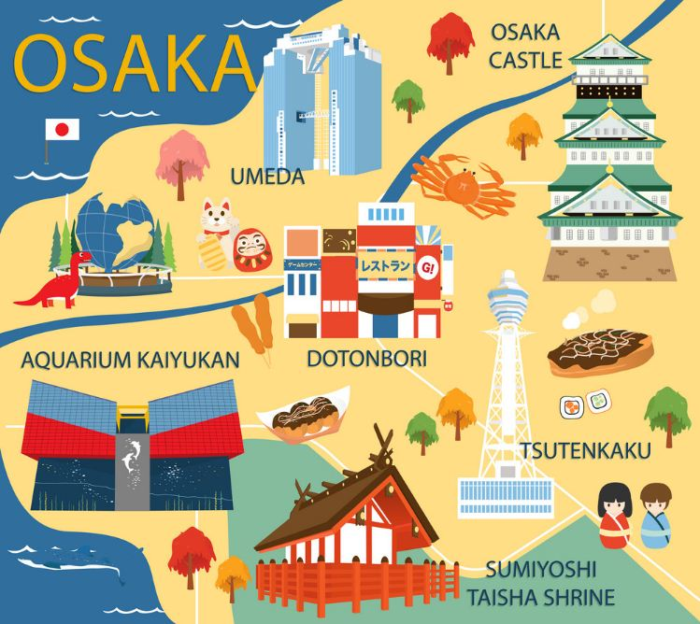
Osaka City Map

Slide 13
Osaka E-Pass Card Day Pass 2,800yen You can enter more than 20 facilities for free once at each place when you present the QR code at the counter of the facilities.
Sakishima Cosmo Tower Observatory *800 yen
Osaka Suijyo Bus Aqua-Liner *1,600 yen
Entrepreneurial Museum of Challenge and Innovation *300 yen
Peace Osaka (Osaka International Peace Center) *250 yen
Tsutenkaku Tower(Observation deck) *900 yen
Shitennoji Temple (Chushingaran, Hombo Garden) *300 yen
OSAKA WHEEL (The largest Ferris wheel in Japan) *1,000 yen
Dotombori Museum Namikiza *600yen
Kaiyodo Hobbyland *1,000 yen
Natural Hot Spring Hinata no Yu *850yen
KUCHU-TEIEN OBSERVATORY *1500 yen
Koji Kinutani Tenku Art Museum *1000 yen
HEP FIVE Ferris Wheel *600 yen
Osaka Museum of Housing and Living *600 yen
Nakanoshima River Cruise *1500 yen
Tombori River Cruise *1200 yen
TOMBORI River JAZZ Boat *2000 yen
Kamigata Ukiyoe Museum *700 yen
WONDER CRUISE *1200 yen
GLION MUSEUM *1200 yen
Cruise Ship Santa Maria Day Cruise *1600 yen
LEGOLAND® Discovery Center Osaka Entry with discounted price (2,300 yen

Slide 14
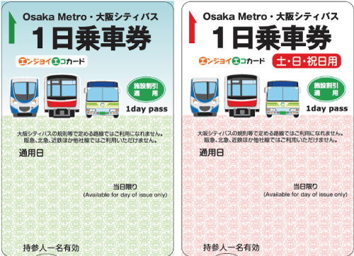
Osaka 1-Day Pass - Enjoy Eco Card
The Enjoy Eco Card is a one-day all-you-can-ride ticket for Osaka Metro, and Osaka City Bus, and also includes discounts for tourist locations within the city. It costs 820 yen for adults (or 620 yen on weekends and holidays), and 310 yen for children.
Except for buses for IKEA Tsuruhama and Universal Studios Japan
Includes discount benefits presented at about 30 tourist facilities in Osaka City! (*Limited to the day of use)
There is no expiration date.
These 1 Day Passes may not be available!

Slide 15
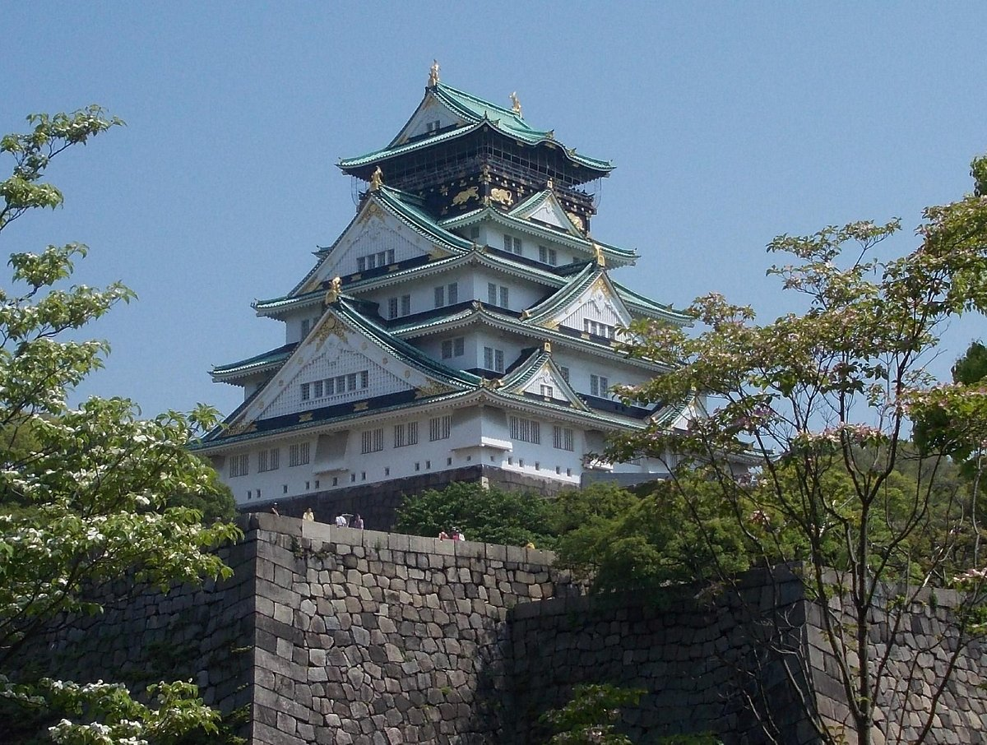
Osaka Castle Park
Once the largest castle in Japan when originally built in the 1580s, this castle has an observation platform with city views and a history museum that uses holograms, 3D pictures, and other technologies to describe the history of the castle and the period during which it was built.
Admission is 600 Yen

Slide 16
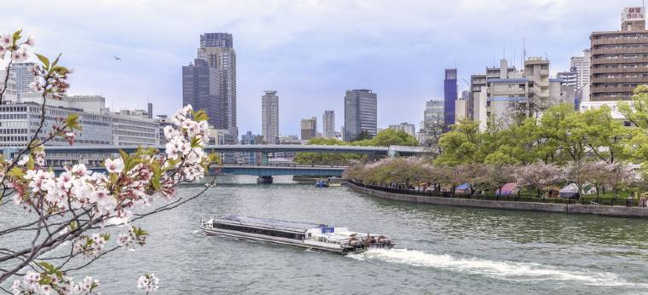
Aqualiner
Water bus with multiple boarding points offering scenic cruises of the Okawa River. A sightseeing boat to view the water capital of Osaka from the river. From Osaka Castle to Osaka City Central Public Hall and the retro buildings of Kitahama, this 40-minute ride will tour through famous landmarks and historic sites that spread out along the waterside.
Enjoy relaxing onboard with some
drinks, snacks and ice cream that
are sold on the boat.
Adult Fare: 2,000 yen
850 yen for children

Slide 17
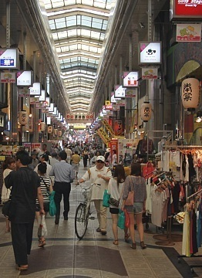
Explore Tenma District
Tenma District is known for its shrine and shopping arcade.
Tenma is a neighborhood to the east of Osaka's Kita district. The area is best known for being the home of Osaka Tenmangu Shrine, from which the neighborhood got its name and the Tenjinbashi-suji shopping street. The area is also renowned for its bustling nightlife quarter.
Tenjinbashi-suji Shopping Street claims to be the longest in Japan. The covered arcade stretches more than two kilometers, starting approximately from Tenjimbashi-suji Rokuchome Subway Station and leading south until close to the Tenjinbashi Bridge.
The shopping street has a neighborhood atmosphere and is where locals shop for goods such as groceries, clothes, shoes, books, medicine, snacks, and sundries. Prices for fashion products are relatively low in return for average quality. There are also many eateries and cafes.

Slide 18
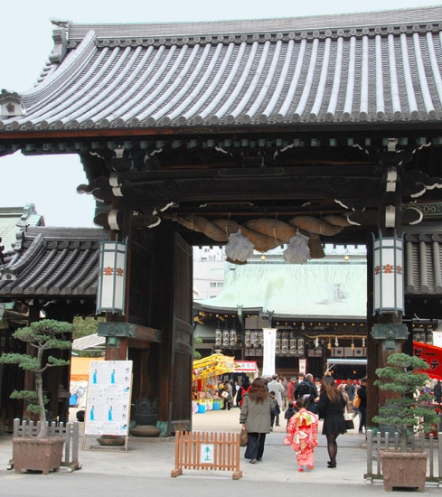
Osaka Tenmangu Shrine
The shrine, founded in the 10th century, is one of the most important of hundreds of shrines across Japan that are devoted to Tenjin, the Shinto deity of scholarship, who in turn has been associated with the Heian Period scholar Sugawara Michizane. Osaka Tenmangu Shrine has been destroyed by fire a number of times during its history, and its current main hall (honden) and main gate date back to 1845.
Osaka Tenmangu is famous for its festival, the Tenjin Matsuri, which is held annually on July 24 and 25 and is ranked as one of Japan's top three festivals besides Kyoto's Gion Matsuri and Tokyo's Kanda Matsuri.

Slide 19

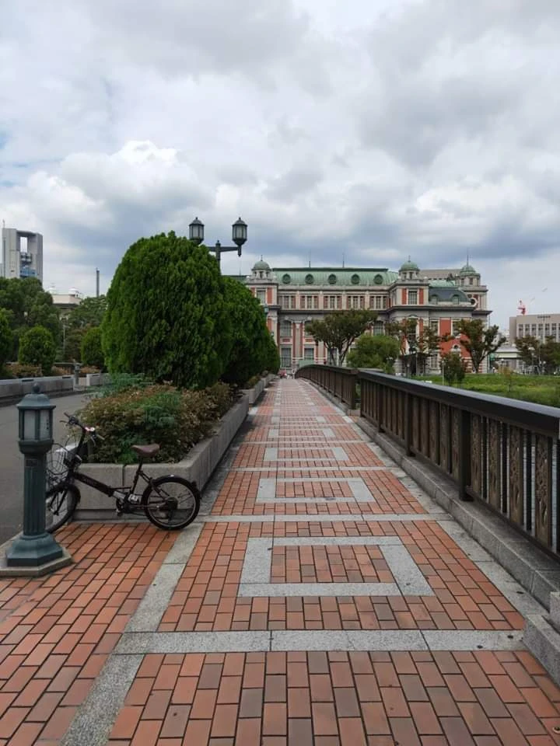
Tombori River Walk
Over 30 stores and restaurants have been built to face the Tombori Riverwalk, making the most of the waterside scenery. One of them is the Dotombori Branch Store of Don Quijote Company, a chain of discount stores, whose building has a giant Ferris wheel. In addition, a boat pier has been completed near the building, where the popular Dotombori River Cruise lines depart and arrive. Since the launch of Aqua Metropolis Osaka festivals, more attention has been focused on waterfront areas in Osaka; it is now expected that more events will be held, and more open-air cafes established along the Riverwalk. Visit the Tombori Riverwalk website to check the event schedule and come enjoy various events and meals along the Dotombori Riverfront. A resting place close to Dotonbori's business district. It offers a stunning view of downtown Osaka. With water, the neighborhood becomes a very vibrant place, and there is an endless flow of people at night.

Slide 20
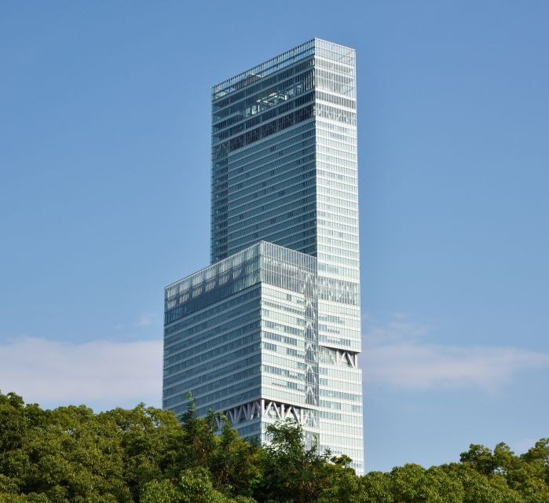
Harukas 300 Observation Deck
Get stunning views of Osaka from Abeno Harukas 300 observatory deck and consider upgrading your ticket to include a Helicopter tour around Japan's tallest building for spectacular views.
Enjoy sweeping views of Osaka at the height of 300 meters from the Harukas 300 observatory.
Take a stroll in the Sky Garden which features a wooden deck or get your fix of caffeine in the cafe on the same floor.
Addmission ¥500

Slide 21
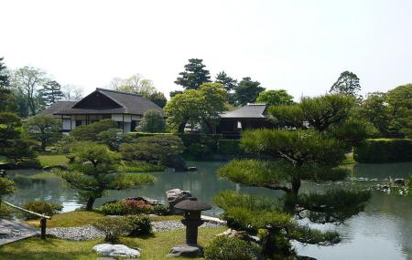
Katsura Imperial Villa
The grounds of this 17th-century imperial villa feature a scenic classical garden with teahouses. Katsura Imperial Villa, Japanese Katsura Rikyū, group of buildings located in the southwest suburbs of Kyōto, Japan. The complex was originally built as a princely estate in the early 17th century and lies on the bank of the Katsura River, which supplies the water for its ponds and streams. The estate covers an area of about 16 acres. In 1590 it was given to Prince Toshihito, the younger brother of the emperor, who developed the estate until his death in 1629. In the following years, it was completed in substantially its present form by his son, Prince Toshitada, who built an addition to the main section, two more tea pavilions, and much of the garden’s stonework.
Admission Prices Adults 1000 Yen

Slide 22
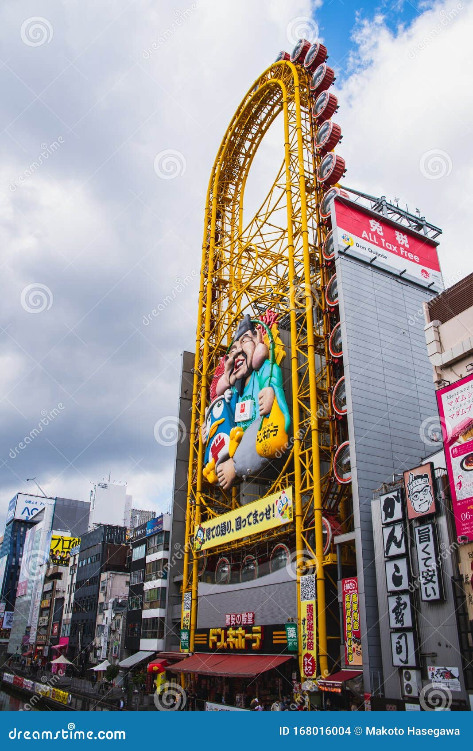
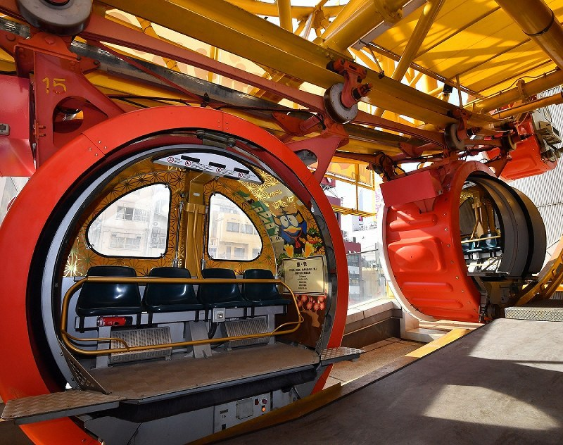
Ebisu Tower Ferris Wheel
Ebisu Tower is the world's first oval Ferris wheel that rotates in about 15 minutes. It is also the first time in the world that a four-seater gondola rotates horizontally.
600 yen / 1 person
Gondola capacity: 4 people.
Present your Osaka Tour Pass card ticket and get 100 yen off the regular pass

Slide 23
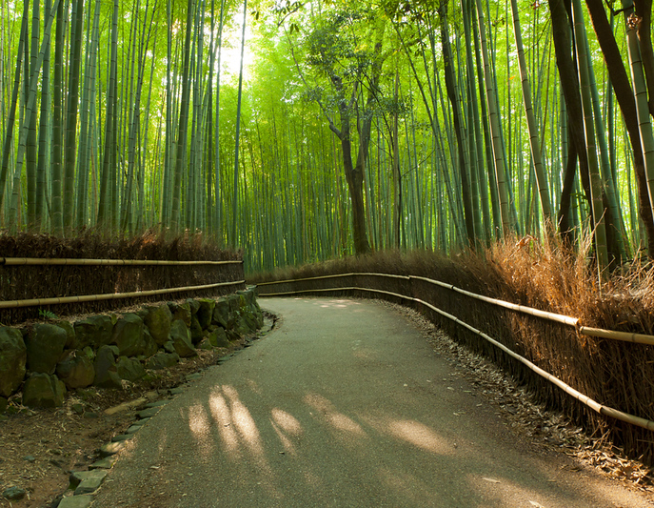
Arashiyama Bamboo Grove
Scenic location showcasing a host of monkeys, bamboo forest & and water vistas. The Arashiyama Bamboo Grove is one of Kyoto’s top sights and for good reason: standing amid these soaring stalks of bamboo is like being in another world.
You’ve probably seen pictures of the Arashiyama Bamboo Grove – along with the torii tunnels of Fushimi-Inari-Taisha Shrine and Kinkaku-ji Temple, it’s one of the most photographed sights in the city. But no picture can capture the feeling of standing in the midst of this sprawling bamboo grove – the whole thing has a palpable sense of grandeur that is quite unlike that of any normal forest we know of.

Slide 24
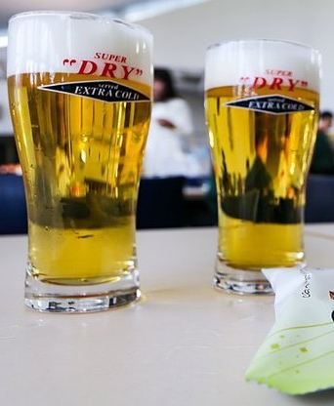
Asahi Beer Suita Brewery
Asahi is one of Japan's top four beer producers and has its roots in Osaka. Its most well-known and internationally recognized product is Asahi Super Dry, a very light, crisp lager, which was launched in 1987. The Suita Factory Asahi Beer Suita Kōjō) in Osaka is the company's first brewery, built in 1891.
Brewery tours are offered at the Suita Factory which lasts about 90 minutes and includes a tasting session. Most tours are conducted in Japanese, while multilingual audio guides are available for download to one's mobile device. English tours are held only on selected days.
The grounds, about a ten-minute walk from Suita Station on the JR Kyoto Line
Brewery tours cost 1000 yen

Slide 25
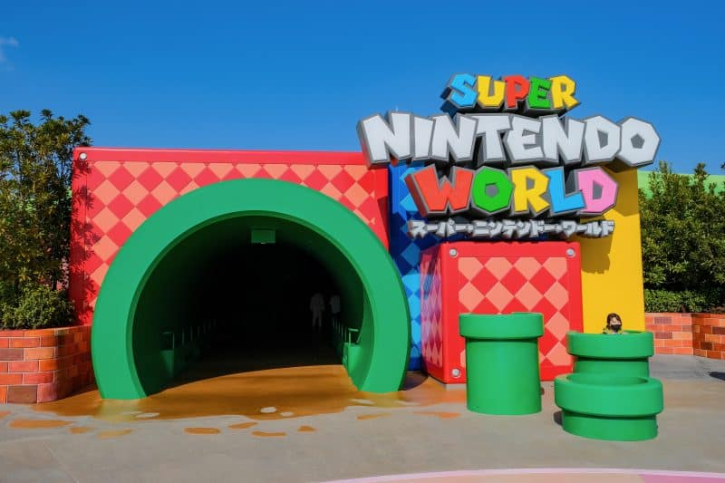
Universal Studios / Super Nintendo World
Universal Studios Japan’s hugely popular Super Nintendo World opened in March 2021 and is still drawing in huge crowds. But be prepared if you plan to visit because the Osaka theme park’s must-visit extension still requires a special area ticket along with the usual entry pass. Jump into the
Nintendo Universe brought to life like never
before! Enjoy the world's first SUPER NINTENDO
WORLD! Experience Mario Kart and other
Nintendo games as state-of-the-art,
interactive attractions that seamlessly
connect to create an innovative and
immersive theme park experience.
Addmission ¥8,600

Slide 26
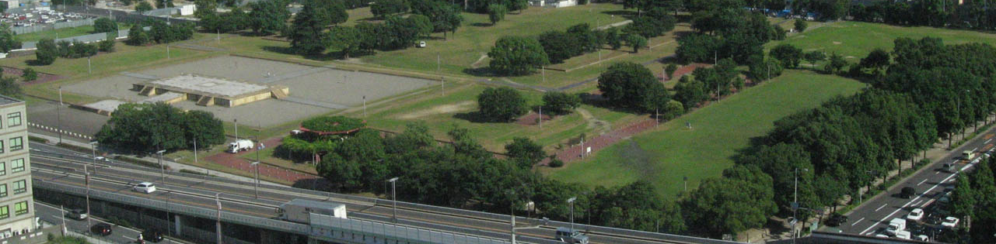
Naniwa Nagara-Toyosaki Palace
Naniwa Nagara-Toyosaki Palace is a historical palace which was located in present-day central Osaka City, Japan. The palace of this period is also sometimes referred to as the Former Naniwa Palace to contrast it with the Naniwa Palace built in the same location in 744 AD.
Construction of the palace was completed in 652 AD. The palace stood for 34 years before being destroyed by fire in 686 AD.

Slide 27
Osaka Michelin Star Restaurants
Osaka has several Michelin-starred restaurants. Many of us on the ship are foodies, so naturally, we’re always on the hunt to eat at the most exclusive spots anytime we travel.
Here are a few of the Michelin Star Restaurants to consider.
Kashiwaya Osaka Senriyama - 2-5-18 Senriyamanishi, Suita, Osaka, ¥¥¥¥ · Japanese
Ichiju Nisai Ueno Minoten - 2-5 Minokoen, Mino, Osaka, ¥¥¥ · Japanese
Point - 2-17-47 Uenohigashi, Toyonaka, Osaka, ¥¥¥ · French
Shunsaiten Tsuchiya - 41-4 Toyotsucho, Suita, Osaka, ¥¥¥ · Tempura
Kamigatachuka SHINTANI - 1-4-21 Nakazaki, Kita-ku, Osaka, ¥¥¥ · Chinese
L'angolo - 1-12-1 Tenjimbashi, Kita-ku, Osaka, ¥¥ · European
Sushi Marumine- 6-2-20 Tenjimbashi, Kita-ku, Osaka, ¥¥ · Sushi
Jizakeya Iwatsuki - 4-6-19 Tenjimbashi, Kita-ku, Osaka, ¥¥ · Izakaya
Soba Takama - 7-12-14 Tenjimbashi, Kita-ku, Osaka, ¥ · Soba
For those of you that just like good food, you can’t go wrong just about anywhere you go in Osaka.
GOOD EATING

Slide 28
Conclusion
Osaka is a beautiful City with a rich history and numerous attractions. Whether you're looking for stunning beaches, historic sites, or unique attractions, Osaka has something for everyone.
I hope this presentation will help when we visit Osaka!

Slide 29
Thanks For Coming
If you have any more questions, please ask.
I will do my best to answer them for you.
Have a great visit in Osaka!

