Slide 1
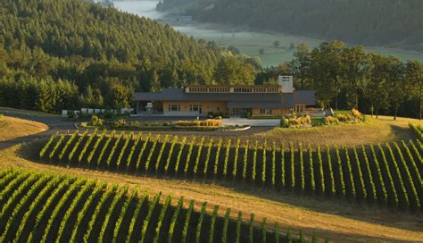
The Wines of Oregon A Deep Dive into History, Terroir, and Wineries Presented by Marc Silver

Slide 2
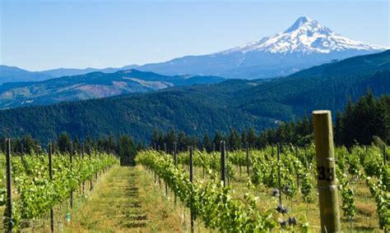
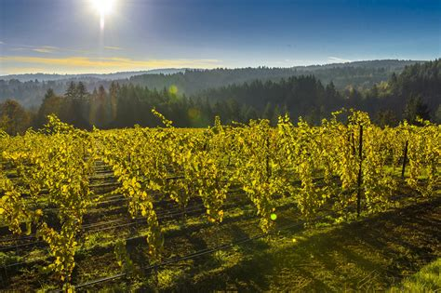
The Wine of Washington
Oregon has become a prominent name in the world of wine, gaining recognition for its high-quality varietals, unique terroir, and a focus on sustainable practices.
Though relatively young in the history of winemaking, Oregon has developed a distinctive wine culture shaped by its climate, geography, and innovative winemakers.
This presentation explores Oregon’s wine history, key wine regions, top varietals, terroir, and the most influential wineries driving the state’s wine renaissance.

Slide 3
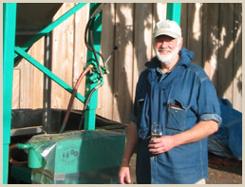
A Brief History of Oregon Wine
Oregon's winemaking history dates back to the 19th century, but it wasn’t until the 1960s that modern viticulture began in earnest.
Early pioneers like David Lett of The Eyrie Vineyards, who planted the first Pinot Noir vines in the Willamette Valley in 1965, set the stage for Oregon's future.
These winemakers recognized that the state's cool climate was ideal for producing high-quality, cool-climate wines similar to those of Burgundy, France.
The hard work paid off when Eyrie’s 1975 South Block Reserve Pinot Noir out scored all but a handful of prestigious Burgundies in the 1979 Gault/Millau “Wine Olympics” in Paris.
The same result was achieved in 1980 at the Drouhin tasting in Burgundy. Now Lett, Eyrie Vineyards, and the entire Oregon wine industry had achieved international acclaim. Since then Eyrie Vineyards wines have become well known for their long cellar life.

Slide 4
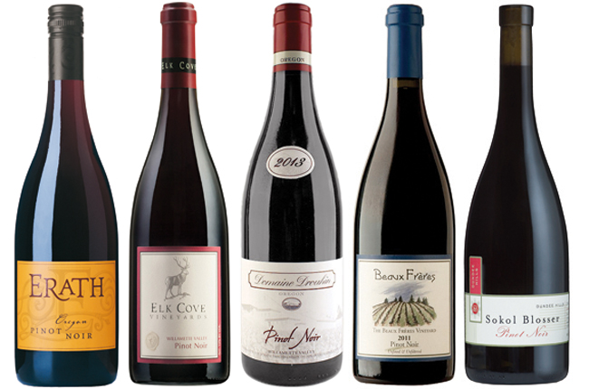
A Brief History of Oregon Wine
By the 1980s, Oregon wines, particularly Pinot Noir, began to earn international acclaim, notably when a 1975 Eyrie Vineyards Pinot Noir placed in the top ten at the prestigious 1979 Wine Olympics in Paris.
This global recognition attracted more winemakers to the state, and by the 1990s, Oregon was firmly established as one of America’s premier wine-producing regions.
Today, Oregon boasts over 1,000 wineries and 21 recognized American Viticultural Areas (AVAs), producing a wide range of wines while maintaining a commitment to sustainable and organic farming.

Slide 5
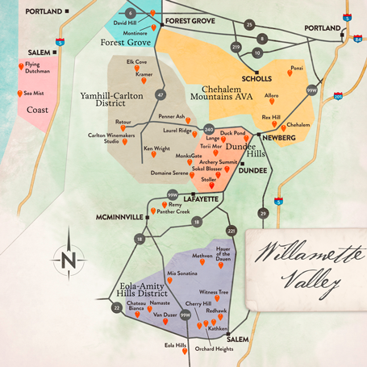
Key Wine Regions of Oregon
Oregon’s wine regions are diverse, thanks to its varied geography and climates. The state is home to several distinct AVAs, each with unique terroirs and specialties.
Willamette Valley AVA
The Willamette Valley is the heart of Oregon’s wine industry and the largest AVA in the state, accounting for over 70% of Oregon's vineyards.
Located between the Cascade Mountains to the east and the Coast Range to the west, this cool-climate region is renowned for producing world-class Pinot Noir.
The area’s volcanic soils and moderate rainfall create the perfect conditions for growing this finicky grape, leading to elegant, balanced wines with complex flavors & bright acidity.

Slide 6
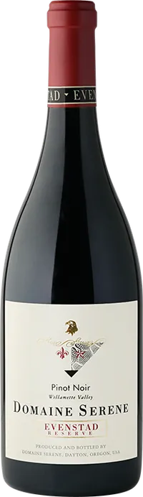
Top Wineries in Willamette Valley
Domaine Serene: Known for its award-winning Pinot Noirs, Domaine Serene has been a leading winery in the region since the late 1980s.
The Eyrie Vineyards: A pioneer in Oregon winemaking, Eyrie’s wines are still considered benchmarks for Oregon Pinot Noir and Chardonnay. The Eyrie Vineyards 2019 Daphne Pinot Noir was awarded 97 points by Wine Spectator.
Sokol Blosser: This family-owned winery focuses on organic farming and produces high-quality Pinot Noir, as well as other varietals like Muller Thurgau, Pinot Gris, Riesling and Rosé. 10 of their 17 vineyard blocks are Pinot Noir but they are also renown for their other varietals.

Slide 7
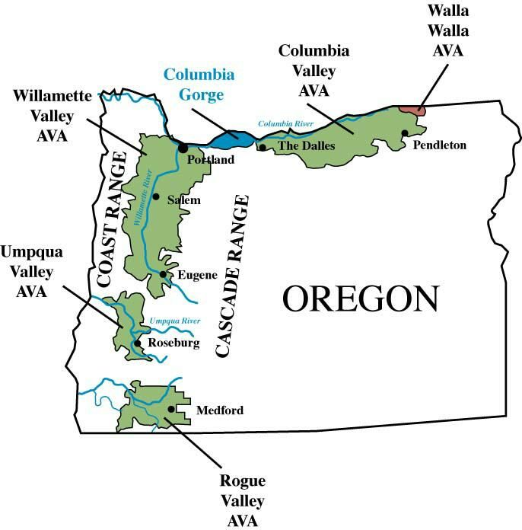
Rogue Valley AVA
Located in Southern Oregon, just inland from the coast, the Rogue Valley AVA experiences a warmer, more Mediterranean-like climate compared to the Willamette Valley.
This makes it ideal for producing a broader range of varietals, including Syrah, Cabernet Sauvignon, and Merlot, in addition to Pinot Noir.
The region's diverse microclimates and soils contribute to wines with rich, bold flavors and smooth textures.
Rogue Valley is also home to Oregon’s first official winery founded by Peter Britt in 1873.
Britt was an early gold rush settler to the region who began growing grapes as early 1852, before opening the doors to his Valley View Winery. While the exact location of the original winery is unknown, it is believed to have been in Jacksonville,

Slide 8
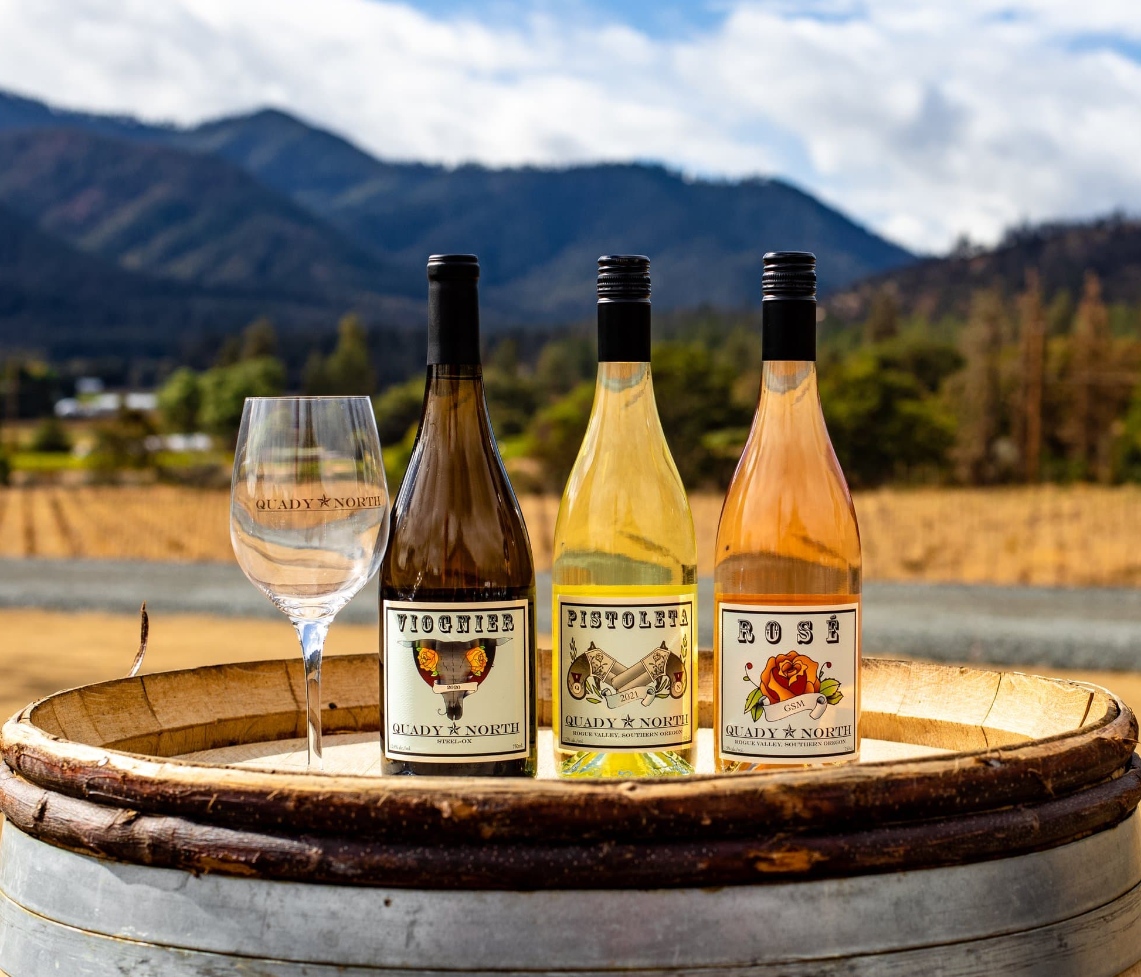
Top Wineries in Rogue Valley
Del Rio Vineyards: Del Rio is known for its robust red wines, especially Cabernet Sauvignon and Syrah. Oregon is not just the place to taste Pinot Noir, Del Riois a good example and produces some excellent full-bodied reds.
Troon Vineyard: Specializing in biodynamic farming, Troon produces distinctive wines such as Zinfandel, Vermentino, and Malbec.
Quady North: Focused on Rhône varietals like Syrah and Viognier, Quady North is a standout in the Rogue Valley for its rich, fruit-forward wines.
The climate, with warm days punctuated by afternoon winds and cool nights, reminded Herb Quady of Southern France, and he was convinced that Rhone varieties would thrive here.

Slide 9
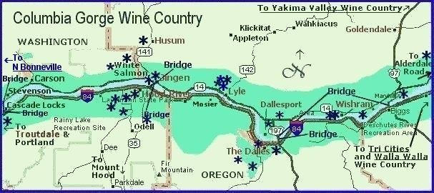
Columbia Gorge AVA
Stretching along the Columbia River, this AVA is unique due to its diverse microclimates, allowing for the production of both cool-climate and warm-climate wines.
The western side of the AVA is cooler and wetter, ideal for Riesling, Chardonnay, and Pinot Noir, while the eastern side is warmer and drier, making it suitable for Cabernet Sauvignon, Syrah, and Zinfandel.
Designated: 2004 Total Size: 191,000 acres Acreage Under Vine: Total vineyard acreage: 950 Top Varieties: Chardonnay, Pinot Noir Soils: Silt loam

Slide 10
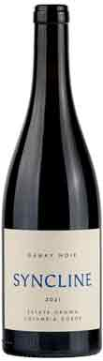
Top Wineries in Columbia Gorge
Syncline Winery: Known for Rhône varietals and Chardonnay, Syncline is a small, family-owned winery that focuses on sustainability and natural winemaking.
They have built a strong reputation as a creative, limited-production, autonomous estate winery with a vision of creating world-class wines while maintaining biodynamic estate vineyards, green building practices, and innovative wine growing.
Analemma Wines: This winery is praised for its sparkling wines and biodynamic approach to viticulture.
The Pines 1852: With a history dating back to the 19th century, The Pines is known for producing rich, fruit-driven wines, particularly Zinfandel.

Slide 11
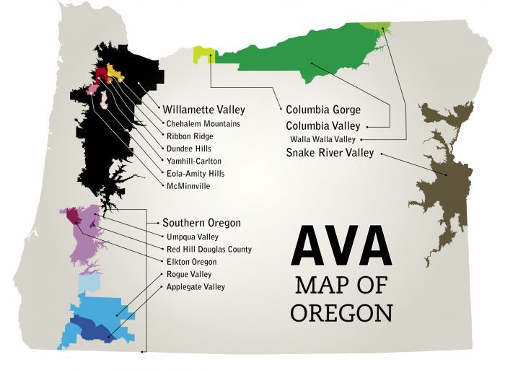
Umpqua Valley AVA
The Umpqua Valley is one of the state’s most diverse wine regions, with a wide range of varietals thriving in its varied climates.
The valley benefits from the convergence of cool marine air from the coast and warmer temperatures from the inland.
This results in the successful cultivation of grapes like Pinot Noir, Tempranillo, and Syrah.

Slide 12
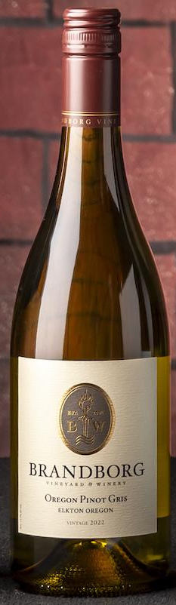
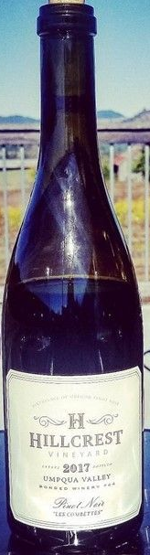
Top Wineries in Umpqua Valley
HillCrest Vineyard: Oregon’s oldest estate winery and the birthplace of Oregon Pinot Noir, HillCrest produces small-batch wines with a focus on traditional European winemaking techniques.
Abacela: A trailblazer in planting Tempranillo in Oregon, Abacela has set the standard for this Spanish varietal in the U.S. As the pioneers of American Tempranillo and other lesser-known varieties, we have been coined an icon of innovation in Southern Oregon's Umpqua Valley since 1995.
Brandborg Vineyard & Winery: Located near the coastal range, Brandborg produces high-quality Pinot Noir and Gewürztraminer.

Slide 13
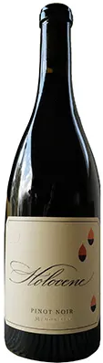
Signature Varietals of Oregon
While Oregon is most famous for its Pinot Noir, the state produces a wide variety of wines, benefiting from its diverse climates.
Jim Gordon, senior tasting editor at Wine Enthusiast. Commented, “Over the past several decades, Willamette Valley has become known as one of the very best places to grow and make Pinot Noir in the U.S.,”
It’s often compared to Burgundy more than to California.
Pinot Noir: Oregon’s most celebrated varietal, known for its finesse, elegance, and complexity. The cool climate of the Willamette Valley is particularly suited to producing Pinot Noir with bright acidity, red fruit, and earthy undertones.
Holocene Memorialis Pinot Noir 2022
97 points Wine Enthusiast

Slide 14
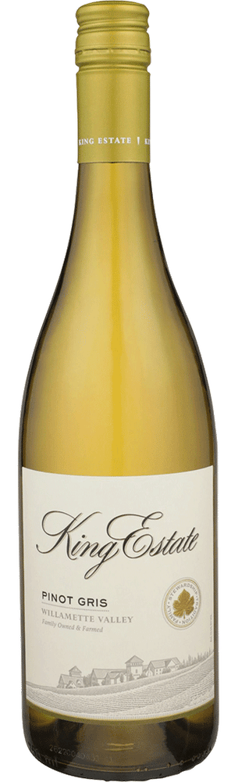
Signature Varietals of Oregon
Pinot Gris: Oregon’s second most-planted grape, producing fresh, vibrant wines with silvery straw color.
Pure aromas and flavors of tart peach, cashew nougat, white flower, and lime zest with a silky, vibrant, fruity medium-to-full body and a graceful, complex, long finish displaying notes of tangerine, Honeycrisp apple, and almond skin with no oak flavor.
A Oregon Pinot Gris that is bright and crisp, pairs well with antipasto or shellfish.

Slide 15
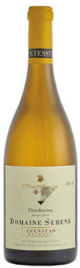
Signature Varietals of Oregon
: Initially overshadowed by Pinot Noir, Chardonnay has gained prominence in Oregon, particularly in the Willamette Valley, where winemakers are producing mineral-driven, Burgundian-style Chardonnays.
Chardonnay is full of mineral and citrus notes. It’s “steely,” and is reminiscent of Chablis with a touch of saline and muted oak treatment. The fruit suggests Bosc pear and apricot with a hint of cream.
Chardonnay with bright acidity, pairs well with herb roasted chicken and grilled salmon are just a couple of the possibilities.

Slide 16

Signature Varietals of Oregon
Syrah: Southern Oregon, especially the Rogue Valley, has become a hotbed for Syrah, producing bold, full-bodied wines with notes of black fruit, pepper, and spice.
Syrah is typically bold and full-bodied, with aromatic notes of smoke, black fruit with pepper spice. Stylistically, it can be round and fruity, or dense and tannic with brisk acidity, moderate-to-high alcohol levels (13–14.5%) and firm tannins.
Syrah/Shiraz has a deep ruby-red to purple hue because it’s made with red-skinned grapes. When youthful, wines can be inky and opaque. The color is generally darker than Cabernet Sauvignon. Syrah color can change with age, as it can lose pigmentation and concentration while taking on garnet tones.

Slide 17
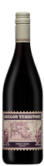
Signature Varietals of Oregon
Tempranillo: Umpqua Valley is leading the way in the production of Tempranillo, with wines that showcase deep fruit flavors, balanced tannins, and earthy notes.
The aroma profiles of Tempranillo wines can vary depending on factors such as the region, winemaking techniques, and aging, but generally, they exhibit the following aroma profiles:
Red and Black Fruits: strawberry, raspberry, cherry, plum.
Floral Notes: violet, rose petals; and Herbal/Earthy Notes of Tobacco, leather and dill.
Secondary Aroma Profile: The secondary aromas develop during fermentation and are influenced by the yeast strains and fermentation conditions.
These aromas can include: Spicy Notes of black pepper, clove and cinnamon.
Baked/Roasted Notes of coffee, chocolate, vanilla (from oak aging); and
Dried Fruit Notes: raisin, fig, prune.
It pairs well with Roast meat, Ribs, and pulled pork.

Slide 18
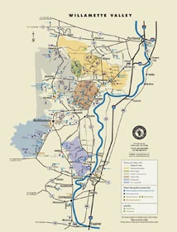
Oregon’s Terroir
A Confluence of Geography and Climate
Oregon’s unique terroir is the result of a combination of factors: its latitude, diverse soil types, and climatic influences from the Pacific Ocean.
The state’s location at 45° latitude, similar to Burgundy in France, means it receives plenty of sunlight during the growing season while maintaining cool temperatures, which helps preserve acidity in the grapes.

Slide 19
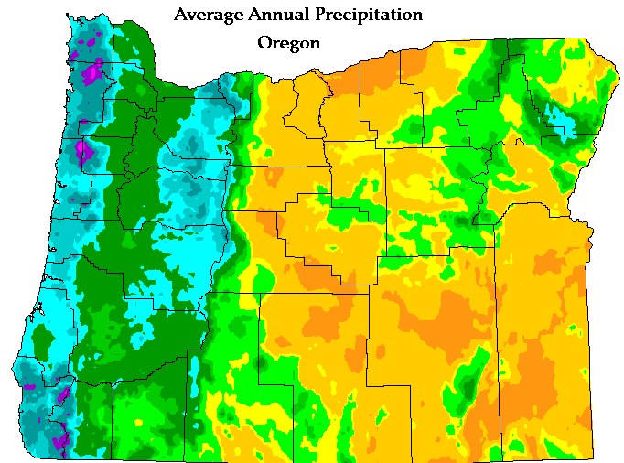
Oregon’s Terroir:
A Confluence of Geography and Climate
Soil types vary significantly across the state. In the Willamette Valley, volcanic Jory soils provide excellent drainage, which is crucial for growing Pinot Noir. Meanwhile, the southern AVAs like Rogue Valley and Umpqua Valley have more diverse soils, ranging from sandy loams to river sediment, each contributing to the distinctiveness of their wines.
Additionally, the Pacific Ocean plays a critical role in moderating temperatures, particularly in the Willamette Valley.
The cooling marine breezes help prevent over-ripening, allowing grapes to develop slowly and retain their vibrant acidity and fresh flavors.

Slide 20
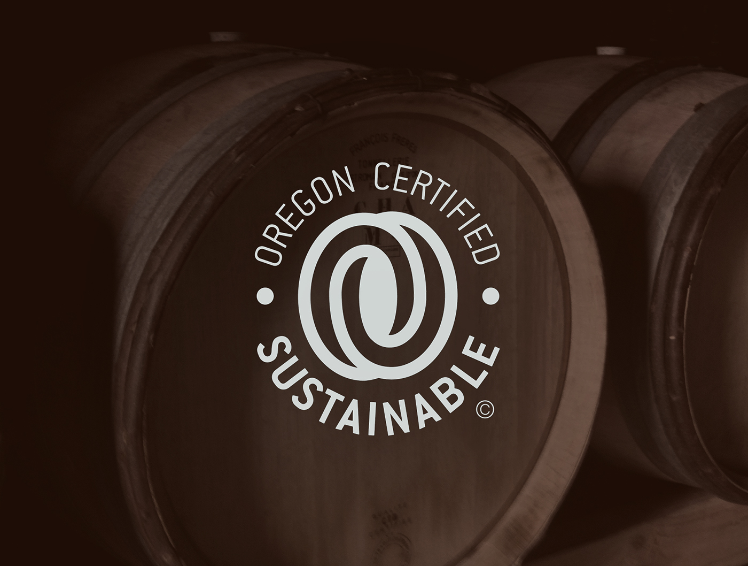
Sustainable and Organic Winemaking Practices
Oregon has earned a reputation not only for the quality of its wines but also for its commitment to sustainable, organic, and biodynamic farming practices.
Many of the state’s vineyards are certified organic or biodynamic, with an emphasis on preserving the environment and promoting biodiversity in the vineyards.
This commitment to sustainability is reflected in the wines, which often showcase a sense of place and a connection to the land.

Slide 21
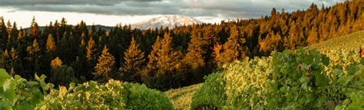
Conclusion
Oregon's rise as a world-class wine region is a testament to its pioneering spirit, diverse terroirs, and the passion of its winemakers.
Whether you are drawn to the elegance of Willamette Valley Pinot Noir, the boldness of Rogue Valley Syrah, or the innovation of Umpqua Valley Tempranillo, Oregon offers something for every wine enthusiast.
With a focus on sustainability and a dedication to crafting wines that express the unique qualities of their terroir, Oregon is undoubtedly a key player on the global wine stage.

Slide 22
Acknowledgement
My seminars are the result of many years of experience combined with many hours of research over the internet.
I would like to acknowledge the many source I have accessed.
These include Wine Spectator, Wine Enthusiast, BKWine Magazine, Wine & Spirits Magazine, American Vineyard Magazine, The Grapevine Magazine, Wikipedia.com, Britannica.com, and the various Government websites.

Slide 23
References
Robinson, Jancis. The Oxford Companion to Wine, 4th ed., Oxford University Press, 2015.
“Oregon Wine History,” Oregon Wine Board, https://www.oregonwine.org/press/history/
"Willamette Valley AVA," Wine Enthusiast, https://www.winemag.com/region/willamette-valley-ava/
"Southern Oregon Wines," Wine Spectator, https://www.winespectator.com/articles/southern-oregon

