Slide 1

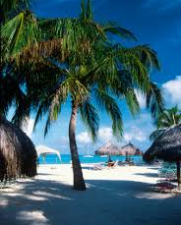



Oranjestad, Aruba
Presented by
Fellow Cruiser
Marc Silver

Slide 2
What I Will Cover
My Port Philosophy
Don’t Miss the Ship
Money
Aruba’s History
Aruba’s Today
Map of Aruba
Map of Oranjestad
Oranjestad Transportation
Places to see or at least consider
A few restaurant recommendations
Conclusion

Slide 3
My Port Philosophy
I have been cruising for over 45 years and have taken over 100 cruises.
So, I consider myself an experienced cruiser.
The information I will present is based on those many years of
experience.
When I am on a cruise where the city, I want to visit is not the port city,
I always recommend taking a ship’s tour.
But when I am in a port with multiple attractions nearby and easy to
see on my own - I will do it on my own.
This presentation is for that type of port.

Slide 4

Don’t Miss the Ship
How to Avoid Missing Your Ship
Pay attention to the time. - Ship time and local time are
often different.
Put a return-to-ship reminder on your phone.
Choose excursions wisely.
If a ship-sponsored excursion is late returning to port, the
ship will wait for you. If you are on your own.
Be Prepared
Have your Passport, Credit Card, and phone numbers for
your ship port agent.
What to Do If You Miss the Ship
Most cruise lines have port agents stationed in the port area to assist if your ship has left without you. If your are lucky, when cruisers are late returning to the vessel, the ship’s crew will often remove the passengers’ essential items – passports, cell phones, and medication -- from the ship to leave with the port agents.
The Port Officials can help you with contacting your ship
and making necessary travel arrangements.

Slide 5
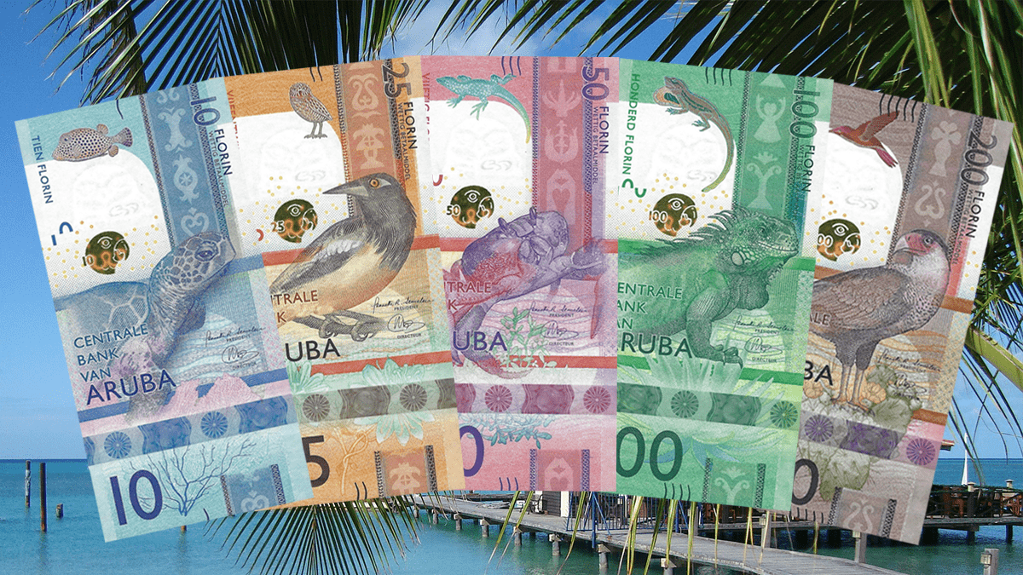
Aruba Money
The currency on the island is the Aruba Florin.
You can exchange U.S. dollars, but it isn’t necessary. Using American money in Aruba is common and widely accepted. You may receive Aruba currency as change.
The Aruba currency exchange
rate for U.S. dollars is Afl 1.77
for cash and Afl 1.78 for
traveler’s checks.
Most places however use the
rate of Afl 1.75, many
restaurants and shops use the
exchange rate of Afl 1.80.

Slide 6
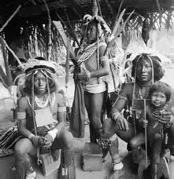
Aruba’s History
The first known inhabitants of the island of Aruba were the Caiquetio Indians of the Arawak tribe from Venezuela.
During the Pre-Ceramic period, 2500 BC - 1000 AD, this seminomadic tribe fished, hunted, and gathered food, depending mostly on the sea for survival. They created tools out of roughly flaked stones and shells and lived in small family groups in the coastal areas known today as Malmok and Palm Beach.

Slide 7
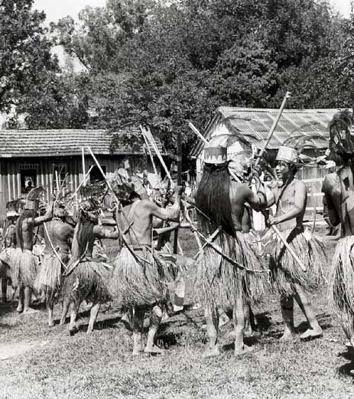
Aruba’s History Cont.
At the beginning of the Ceramic period, 1000 - 1515 AD, these Indians established five large villages and started producing corn and yucca. Scaled-down versions of two of these Amerindian villages, as well as a representation of an Amerindian dwelling, can be seen at the Archaeological Museum of Aruba.
The museum also houses the remains of ceramic urns, coarse pottery, and jewelry made by the Caquetios, with some of the artifact fragments dating back to 1000 AD.

Slide 8
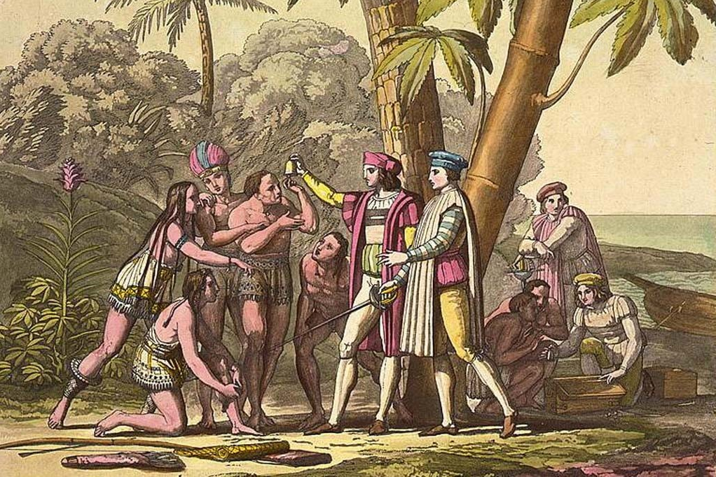
Aruba’s History Cont.
In 1499, Spanish explorer Alonso de Ojeda discovered Aruba, kicking off the colonization of the island by the Spanish. Due to the relatively low rainfall on the island, the colonizers did not believe that Aruba was a good place for
plantations or crop growing.
In 1513, the Spaniards enslaved many
of the Caquetio Indians and sent
them to Hispaniola to work on
plantations and in mines.
Some Indians returned to Aruba in
1515 and were recruited as laborers
for cattle and horse breeding
operations.
Aruba stayed under Spanish control for 137 years.

Slide 9
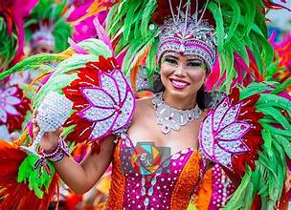
Aruba’s History Cont.
Because of Aruba’s strategic location, the Dutch occupied the island in 1636 to protect their salt supply from the South American mainland while also ensuring a naval base in the Caribbean during their Eighty Years’ War with Spain.
The Dutch recruited the Caquetio people to build farms and raise cattle for meat that
would be sold and shipped to other islands.
During the Napoleonic Wars, the British invaded and took control of Aruba, but the Netherlands took it back in 1816.
Aruba officially became part of the Netherlands Antilles in 1845.

Slide 10
Aruba Today
In 1986, Aruba became a constituent country within the Kingdom of the Netherlands and acquired the formal name the Country of Aruba.
Situated in the southern part of the Caribbean Sea, Aruba is located approximately 18 miles north of the Venezuelan peninsula of Paraguaná and 50 miles northwest of Curaçao.
Aruba measures 20 miles long by 6 miles at its widest
Alongside Bonaire and Curaçao, Aruba forms a group called the ABC islands.
Oranjestad is the capital of Aruba.
In contrast to much of the Caribbean, Aruba has a dry climate with an arid xeric landscape

Slide 11
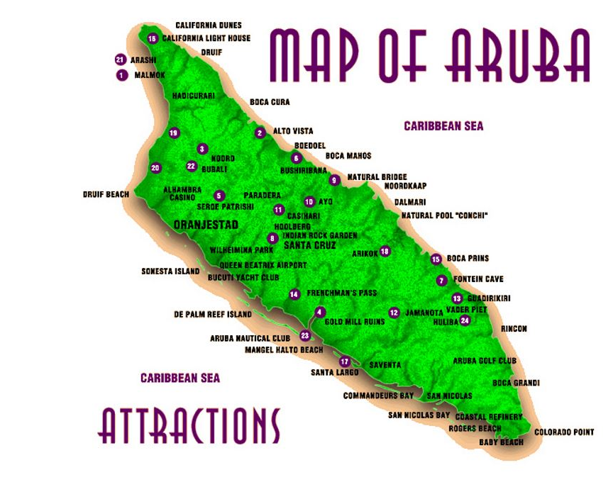
Area
Map of Aruba

Slide 12
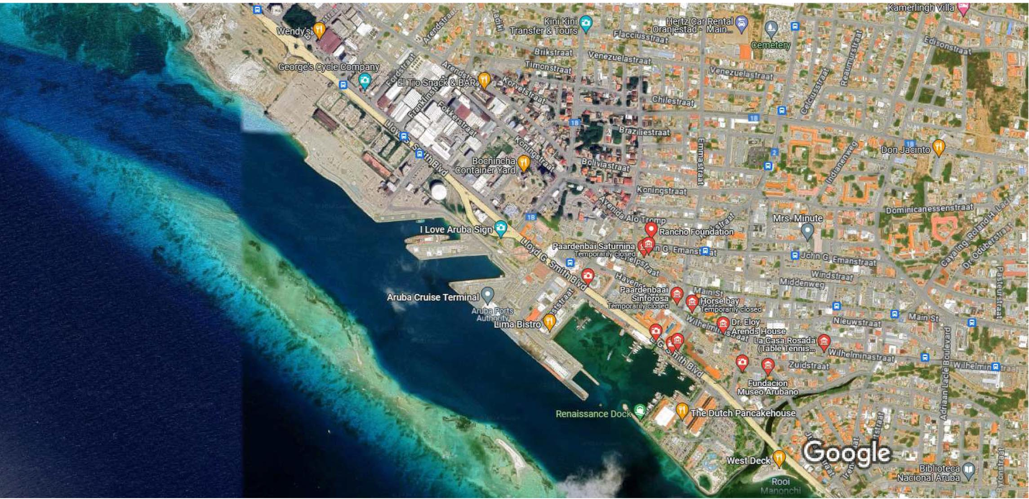
Map of Oranjestad

Slide 13
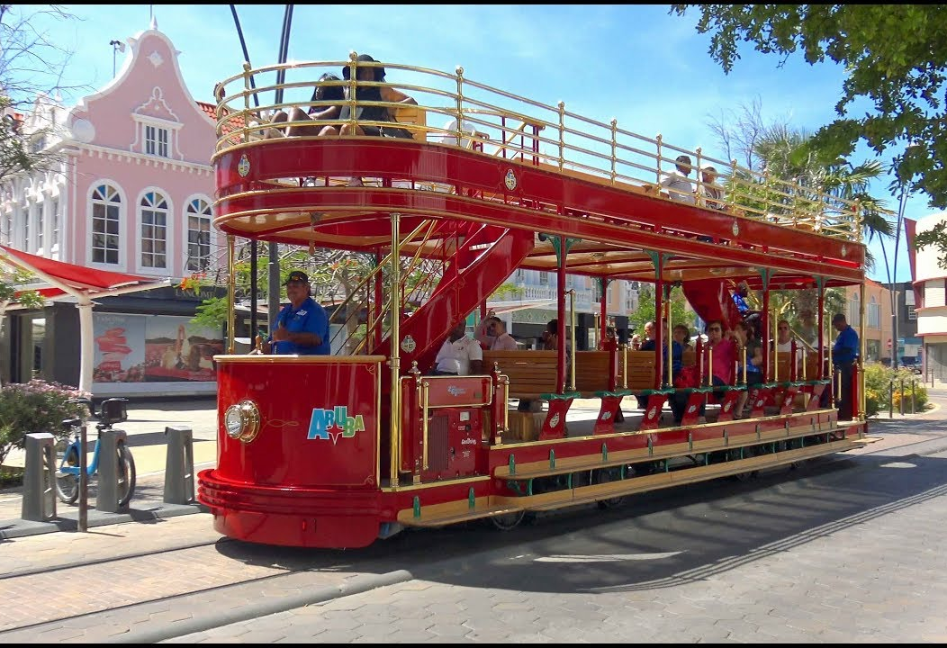
Oranjestad Trolley
One of Aruba's transportation options appealing to cruise ship passengers is the downtown streetcar/trolley. The trolleys offer free transportation to and from the main street downtown area in a loop.
The streetcars can be boarded right outside the cruise port's main gate. There is hop-on/hop-off access from nine stops.
The double-decker will allow passengers
to experience the downtown area with
360-degree views.
Stops include the House of Parliament,
Archaeological Museum, Fort Zoutman
Historical Museum, the Protestant Church,
Mainstreet, and more.
Aruba is the only island with a free trolley..

Slide 14
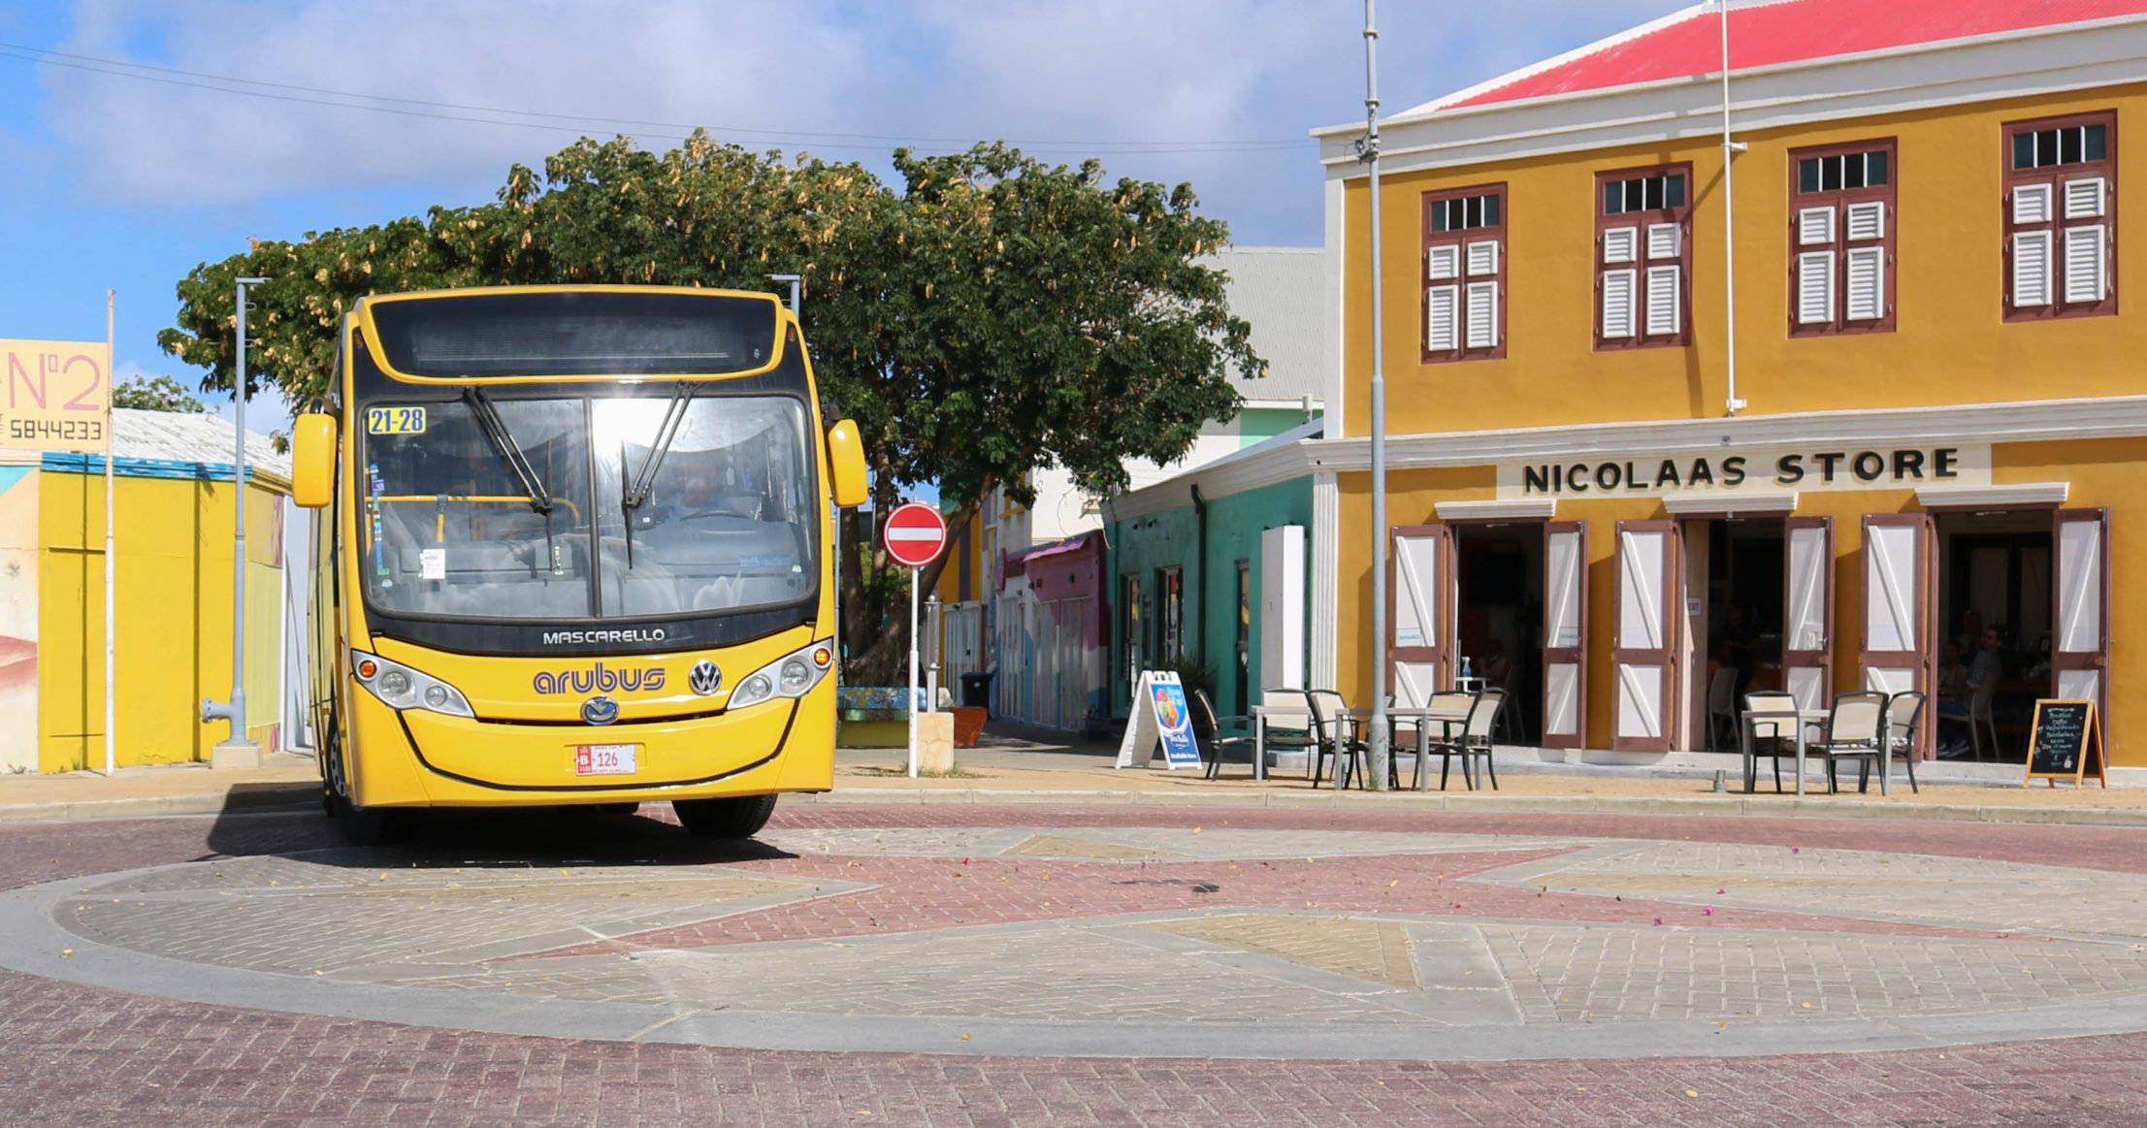
Oranjestad Buses
Arubus N.V. is the major public transportation of Aruba owned by the Government of Aruba.
The main objective is the daily transportation of passengers throughout Aruba. Buses depart from the main stations, located in Oranjestad and San Nicolas, but they also have a lot of stops throughout the various bus routes.
Single Trip
$2.60 or AWG 4.50
Retour Card
$5.00 or AWG 8.75
Day Pass
$10.00or AWG17.50

Slide 15
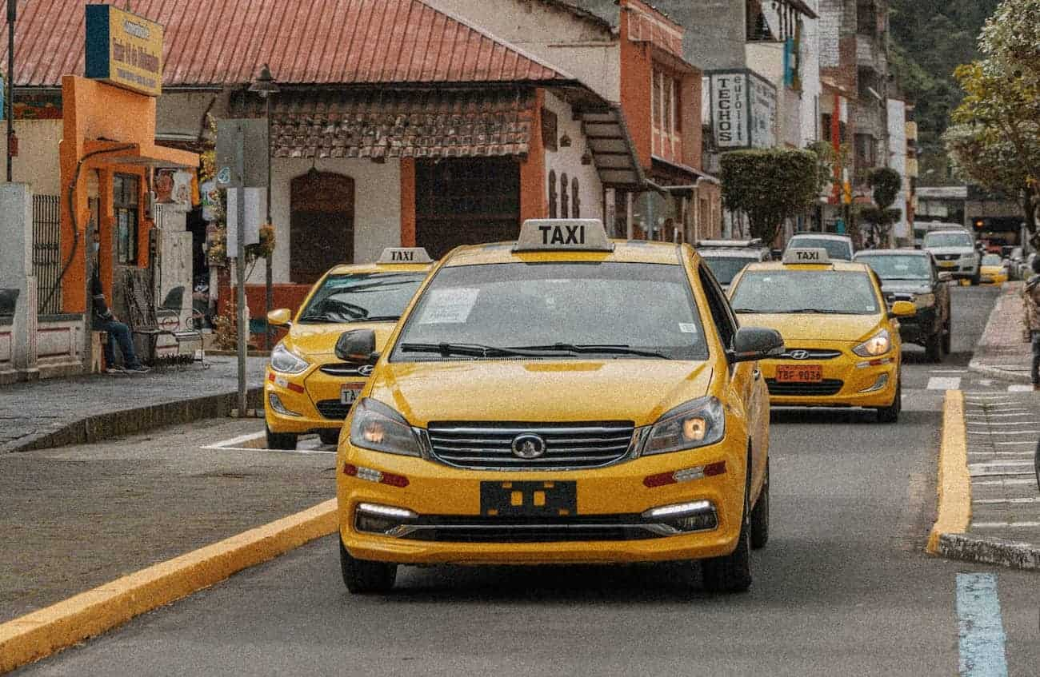
Oranjestad Transportation
Taxis in Aruba are plentiful. Taxis can be very reasonable, as long as you ask the price BEFORE you get in.
Fares are fixed by zones; rates for trips in town and to more distant points should be posted at local hotels.
Taxis in Aruba do not have meters since rates are based on destination rather than mileage and are set by the Aruba Department of Public Traffic and have a maximum capacity of 5 passengers per taxi.
All prices are in USD.
On Sundays, official holidays and from 11 PM
till 7AM additional charges to the regular rates
apply.
Make sure you have small change. Taxis will not
carry change so they can keep yours.
You do not have to tip taxi drivers. Tipping is
accepted but not expected by the driver.
Also, They don’t open doors or help you in or out.

Slide 16
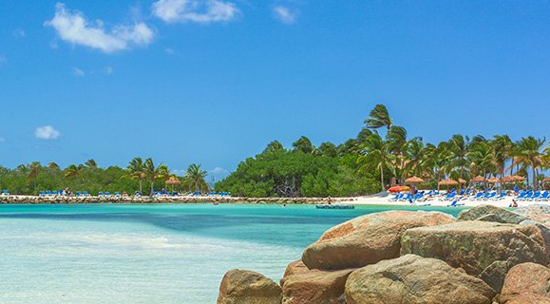
Oranjestad Tour Companies
Several independent tour companies in Aruba offer various tours of the island. They cover just about any activity and interest you may have. You can contact any of them online or just wait and see what is offered when you disembark in Oranjestad.
Below are some examples with approximate prices:
Barcelo Beach Resort Day Pass ($109.99)
Catamaran Sail, Shipwreck Snorkel & Open Bar ($59.99)
Palm Beach Parasailing ($64.99)
Private Highlights Sightseeing ($54.99)
North Coast UTV Adventure ($214.99)
Beginner SCUBA Diving ($114.99)
Private Open-Air Bus & Beach ($59.99)
Private Off the Beaten Path Sightseeing ($59.99)
Buggy Highlights & Beach Break ($239.99)
Island Sightseeing ($49.99)

Slide 17
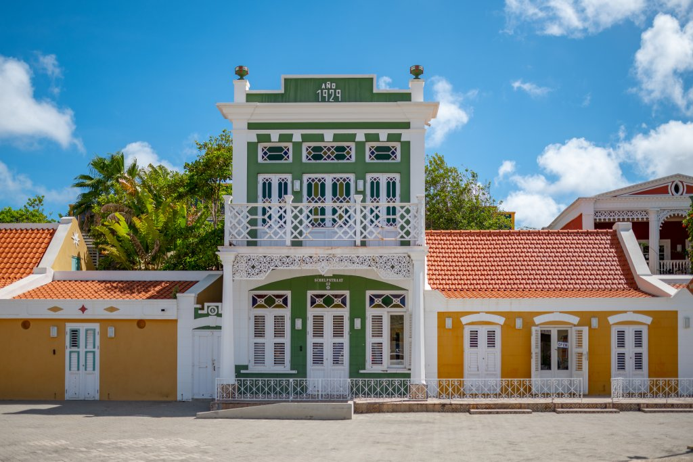
National Archeological Museum
For a look deep into Aruba’s past, check out the National Archeological Museum that’s housed in the former home of the Ecury family.
Indigenous artifacts dating from as far back as 2500 BC are carefully preserved in the museum’s collections and give visitors a glimpse into the world of the people who lived on the island before European settlers arrived a few hundred years ago.
The museum also contains an exhibition of contemporary island artists who use historical themes in their pieces, and the large cistern used by the Ecury family to store rainwater collected from the roof of the house.
Hours are Tuesday to Friday from 10 a.m. to 5 p.m., Saturday and Sunday 10 a.m. to 2 p.m. The NAMA is located in downtown Oranjestad. Free entrance.

Slide 18
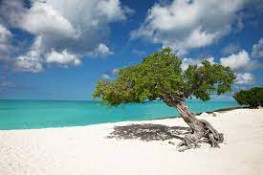
Eagle Beach
Eagle Beach is a beach and neighborhood of Oranjestad, Aruba. The area is famous for its many low-rise resorts and wide public beaches. It has soft white sand and has been rated one of the best beaches in the world.
You won't find many food and drink kiosks along this beach, though a few resorts offer formal restaurants. If you want to dine nearby, head to the Alhambra Mall in front of Manchebo Beach Resort & Spa.
Along the much narrower strip of sand, you'll find the resorts located directly across the street from the beach like Amsterdam Manor Beach Resort, La Cabana Beach Resort, Eagle Aruba Resort & Casino, and the Embassy Suites by Hilton Aruba Resort, which opened in 2023.

Slide 19
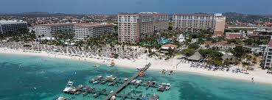
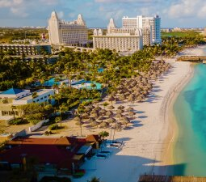
Palm Beach
Located on the west side of the island, Palm Beach offers white sands and calm waters for excellent swimming conditions.
This area is known as the high-rise strip due to all the tall tower hotels lining its shores. The beach is book-ended by The Ritz-Carlton, Aruba, and the Divi Aruba Phoenix Beach Resort, with many big brand hotels in between, including the Aruba Marriott Resort & Stellaris Casino, the Hilton Aruba Resort & Casino, and the Hyatt Regency.

Slide 20
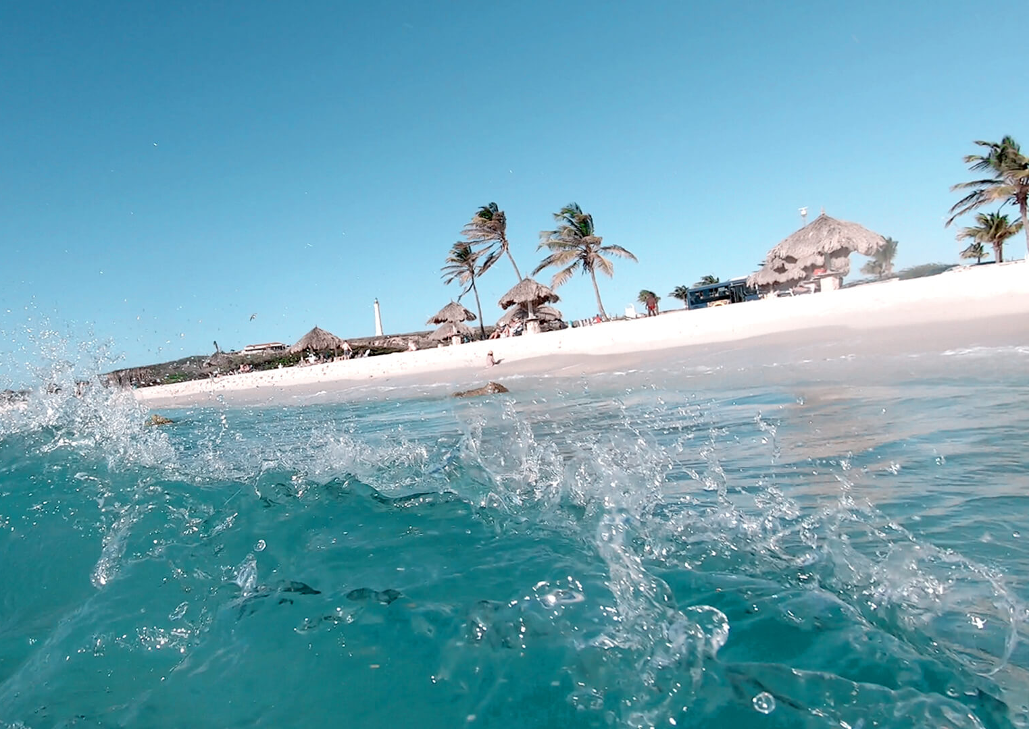
Arashi Beach
Arashi (or Arasji) is a settlement and beach on the northwestern tip of Aruba, in the Noord district. It is close to Malmok, Kudarebe, and the California Lighthouse.
The beach is popular for swimming and snorkeling. This quiet and secluded beach is known not only for its excellent snorkeling but a variety of water activities including windsurfing, scuba diving, deep-sea fishing, swimming, and sailing.

Slide 21
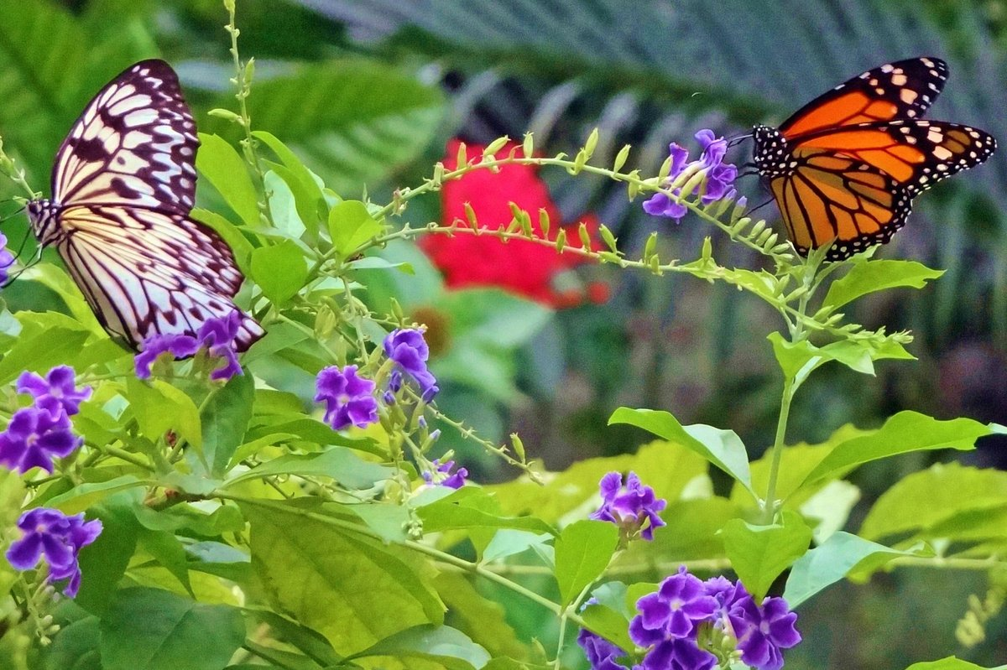
The Butterfly Farm
You will walk through a lush tropical rainforest amidst flowers, trees, ponds, and a trickling waterfall with butterflies flying overhead and all around you in their natural paradise.
This is a dream come true for butterfly enthusiasts. Within a large meshed enclosure, you can see hundreds of real exotic butterflies flying freely, a beautiful display of the most spectacular species from all over the world.
Entry is $16 ($13 for seniors)

Slide 22
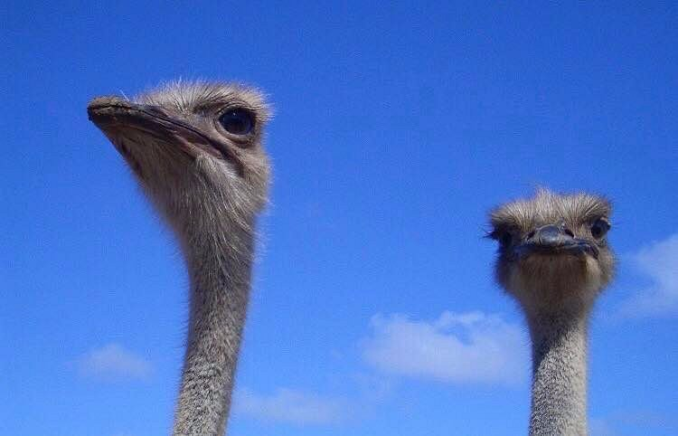
Aruba Ostrich Farm
The farm’s guided tours are both informative and interactive. A knowledgeable guide will first introduce the adult emus and ostriches.
You will learn about the ostrich’s amazing speed as well as other defense mechanisms it uses against predators.
Mating, rearing, and feeding habits will both surprise and amuse you.
You will even have the opportunity to hand-feed the not-so-shy creatures. Just watch out! Ostriches are ALWAYS hungry, and if you have
food in your hands, you may quickly find yourself
surrounded by a herd of curious critters.
The tour with a visit to the incubator, hatchery, and
special pens for young ostriches and emus. You will
also learn some interesting facts about ostrich eggs
as well as the incredible growth rate of young
ostriches.
Tours fees: $14 per adult, $7 per child

Slide 23
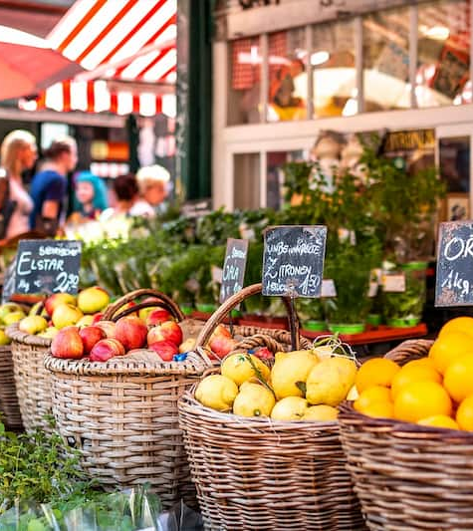
The Local Market Aruba
Want to get a feel of the Aruban culture; The Local Market is the place to be! Located right in front of the Valero Boulevard gas station by the cruise terminal, the market is open
Traditional Dutch-style market stalls fill up the marketplace with vendors offering a huge selection of products at bargain prices.
With 40 buzzing stalls—all with permanent coverings to shield them from the elements—it’s an ideal spot to find locally made items and affordable Aruban souvenirs.
The owners entice local creators to showcase their wares there, so you’ll find unique items like sand art, wood carvings, oil paintings, seashell jewelry, and all manner of cool handmade keepsakes.
You’ll also find excellent local fare on-site, including BBQ and fresh fruit shakes, and there’s free parking as well.

Slide 24
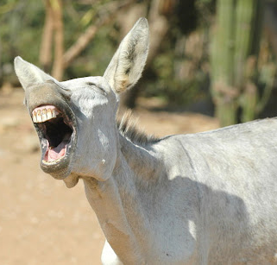
Donkey Sanctuary
Located on the outskirts of Oranjestad in Santa Cruz, the Aruban Donkey Sanctuary is worth the trek.
The sanctuary is run by a non-profit organization dedicated to saving the island’s population of donkeys, which used to be a main source of transportation. Purchase a feed cup at the sanctuary or bring your supply of carrots and apples.
There is no admission fee. No ticket is needed. However, donations are very much welcome!

Slide 25
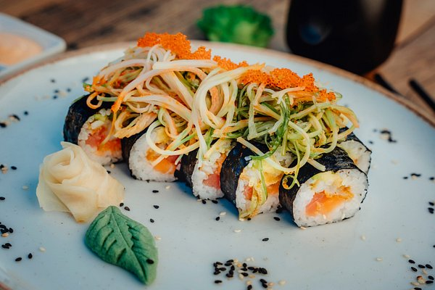
Restaurants
There are a lot of excellent restaurants in Oranjestad. Especially for Caribbean Seafood.
Here are some recommendations:
The Flying Fishbone $$$$ French Caribbean Seafood Savaneta 344, Savaneta Aruba
The West Deck $$ - $$$ American Caribbean Bar At the Governors Bay Linear Park, Oranjestad
Wacky Wahoo’s $$ - $$$ Caribbean Healthy Vegetarian-Friendly Palm Beach 33B, Noord
Ocean Z Restaurant $$$$ Caribbean Seafood International L.G. Smith Boulevard 526, Noord
Aqua Grill $$$$ Caribbean Seafood Dining bars J.E. Irausquin Blvd. 374, Palm - Eagle Beach
Atardi $$$$ Seafood International Contemporary Aruba Marriott Resort & Stellaris Casino, Eagle Beach
Zeerovers $ Quick Bites Caribbean Seafood Savaneta 270, Savaneta
Indo $ Asian Indonesian Vegetarian Friendly Noord 17, Noord
Restaurant Nusa $$ - $$$ Asian Indonesian Vegetarian Friendly
Kerkstraat 4, Oranjesta
For those of you who just like good food, I am sure you will enjoy Oranjestad

Slide 26
Conclusion
Oranjestad is a beautiful City with a rich history and numerous attractions. Regardless of what you're looking for, Oranjestad has something for everyone.
I hope this presentation will help when we visit Oranjestad!

Slide 27
Thanks For Coming
If you have any more questions, please ask.
I will do my best to answer them for you.
Have a great visit to Oranjestad!

