Slide 1


Olympia

Slide 2
What I Will Cover
Hop On – Hop Off
Getting Around
Places to see or at least consider
Conclusion
My Port Philosophy
Don’t Miss the Ship
Money
About Olympia
Map of Greece
Map of Olympia
Near by Destinations

Slide 3
My Port Philosophy
I have been cruising for over 43 years and have taken over 100 cruises.
So I consider myself an experienced cruiser.
The information I will present is based on those many years of
experience.
When I am on a cruise where the city I want to visit is not the port city,
I always recommend taking a ship’s tour.
But when I am in a port with multiple attractions nearby and easy to see
on my own -
I will do it on my own.
This presentation is not like that.

Slide 4
Don’t Miss the Ship
How to Avoid Missing Your Ship
Pay attention to the time. - Ship time and local time are often different.
Put a return to ship reminder on your phone.
Choose excursions wisely.
If a ship-sponsored excursion is late returning to port for, the ship will wait
for you. If you are on your own???
Be Prepared
Have your Passport, Credit Card and phone numbers for your ship port agent.
What to Do If You Miss the Ship
Most cruise lines have port agents stationed in the port area to assist if your ship has left without you. If your lucky, when cruisers are late returning to the vessel, the ship's crew will often remove the passengers' essential items -- passports, cell phones and medication -- from the ship to leave with the port agents.
The Port Officials can help you with contacting your ship
and making necessary travel arrangements.

Slide 5
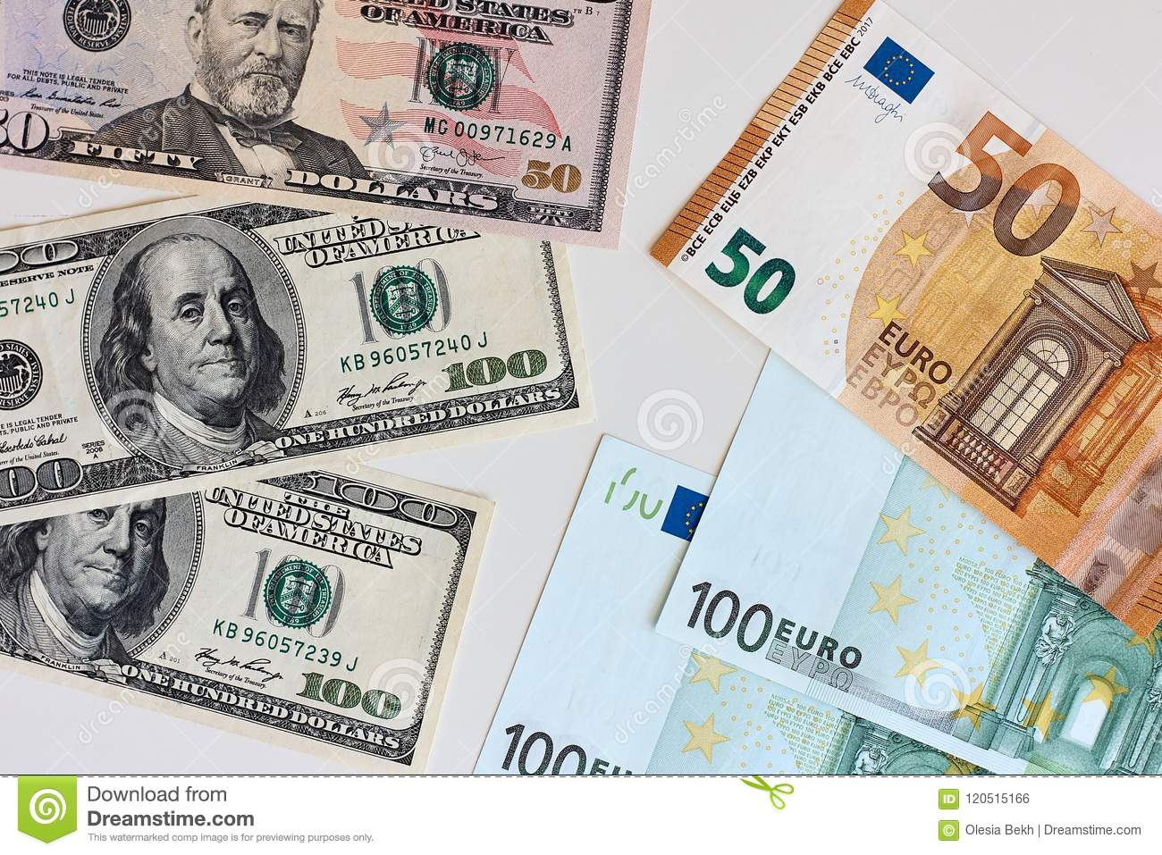
Money
The euro is the official currency of 20 European Union countries which collectively make up the euro area, also known as the euro-zone
Official Exchange is $1.079 US to €1

Slide 6
About Olympia
Olympia was an ancient Greek sanctuary site dedicated to the worship of Zeus located in the western Peloponnese. The Pan-Hellenic Olympic Games were held at the site in honor of Zeus every four years from 776 BCE to 393 CE. Olympia is listed by UNESCO as a World Heritage Site.
The first large building at the famous ancient sanctuary site was the Heraion, a temple dedicated to Hera built around 650-600 BCE. In the 5th century BCE the sanctuary reached its peak of prosperity, and the massive 6 x 13 column Temple of Zeus was completed in 457 BCE in order to house a huge ivory and gold statue of the leader of the Olympian gods. Designed by Libon of Elis, the Doric temple was the biggest in Greece at the time.

Slide 7
About Olympia
Sporting events were originally associated with funeral rituals, for example, the funeral games instigated by Achilles in honour of Patroklos in Homer's Iliad. Some mythological accounts credit Zeus with beginning the Games to celebrate his victory over Kronos; other accounts state Pelops began them in honor of Oinomaos. In any case, sport, a healthy body, and a competitive spirit were a large part of Greek education, so it is hardly surprising that organized athletic competitions would at some point be created.
The first Olympic Games were held in 776 BCE at the first full moon after the summer solstice. The winner of the first and only event, the stadion foot-race (one length of the stadium track, 600 feet or 192 m), was Koroibos of Elis, and from then on every victor was recorded and each Olympiad was named after them, thus giving us the first accurate chronology of the Greek world.
Over time other events were added to the Games such as longer foot-races, wrestling, boxing, chariot racing, discus, javelin, jumping, and the pentathlon.

Slide 8
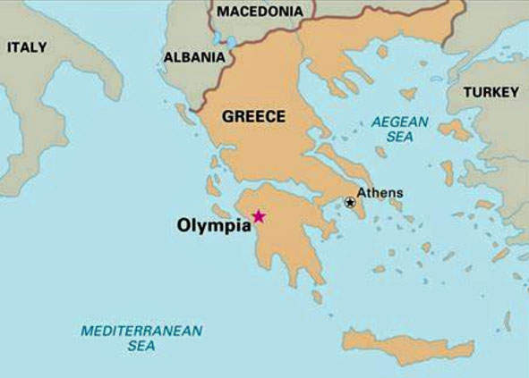
Map of Greece

Slide 9
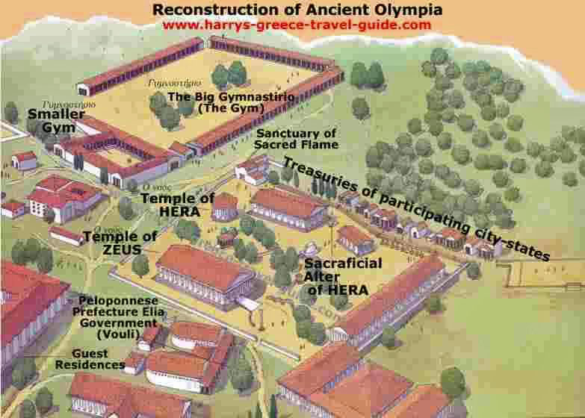
Map of Olympia

Slide 10
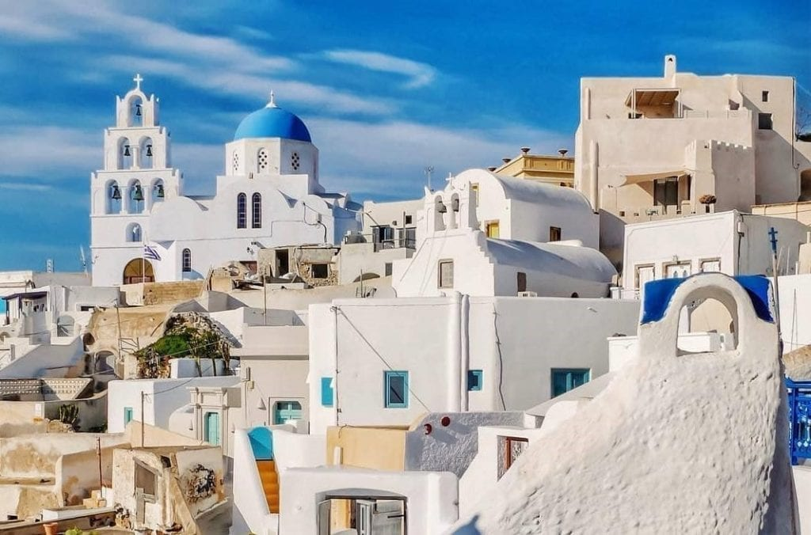
Nearby Desinations
Olympia is located close to many other locations of the Peloponnese that you might want to visit. Especially if you have your own private vehicle, you should not miss the chance to go on a small road trip and have a taste of the surrounding area! Among others, some of the most popular spots nearby are the following:
Pyrgos: 21,3 km
Katakolo: 32,2 km – Our Port
Amaliada: 37,7 km
Ancient Ilida: 44 km
Andritsaina: 44,2 km
Pyrgos:

Slide 11
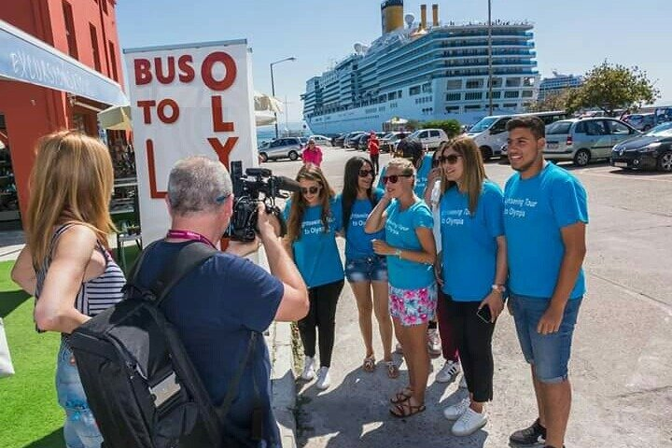
Hop-on Hop-off Bus
Drive through the scenic and beautiful landscape of the Peloponnese Peninsula to reach the birthplace of the Olympic Games. Admire the emblematic temples and athletic facilities and feel the era of the ancient classical period. Visit the modern Village of Olympia for shopping, traditional Greek food, and refreshments. Save time and money with our fast drive to Olympia. For your convenience and comfort departure is just a two-minute walk outside the cruise Terminal of Katakolo.
From €20 per person

Slide 12
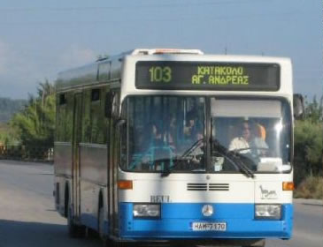
Getting Around
For the more adventurous, you do have other options.
Train
In case you prefer a train for your transfers, there is a special line that departs from the port of Katakolo and carries out routes to the ancient site of Olympia. You can find further information on www.trainose.gr
Bus
Katakolon to Ancient Olympia via Pyrgos
Ticket Cost: € 3.9 Euro Estimate Time: 75 min

Slide 13
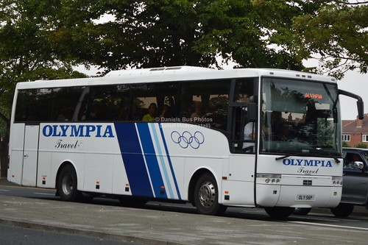
Olympia Transport Tickets
The public transport system in
Olympia offers various kinds of
electronic tickets, monthly and
yearly travel cards that are easily
rechargeable. The price of transport
tickets in Olympia are cheaper than
most other European cities.
The following tickets are valid for
the city’s public buses, trolleybuses,
metro, tram and commuter trains.
90-minute ticket: € 1.20 (US$ 1.30)
24-hour ticket: € 4.10 (US$ 4.50)

Slide 14
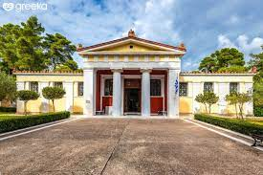
Archaeological Museum
Olympia's Archaeological Museum has some of the most
significant exhibitions of the ancient world displaying
the long history of the Sanctuary of Zeus and the Olympic
Games, as well as artwork date back thousands of years.
The Museum, which houses finds from the excavation of the Sanctuary of Zeus, is one of the most important museums of Greece. The exhibition also contains great masterpieces from the long history of the Olympic Games' birthplace and thousands of years of art. The exhibits are displayed in chronological and thematic order from Prehistoric down to Roman times.
Admission: 12 €

Slide 15
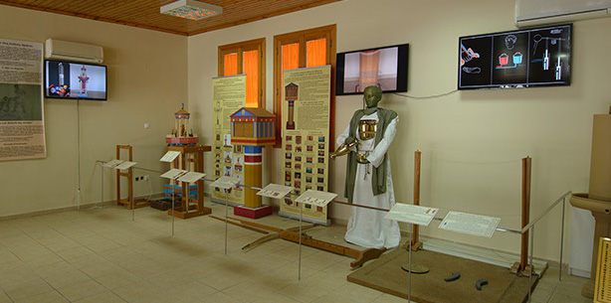
Archimedes Museum
This unique museum in the center of Ancient Olympia is dedicated to one of the greatest mind of all time! Reconstructed inventions of Archimedes and his time. Interactive replicas of the ancient Greek world.
The exhibits are accompanied by rich audio-visual material (in Greek and English), such as explanatory labels and giant p posters with a lot of information, detailed diagrams, photos and complete bibliographical references.
Admission: 9 €

Slide 16
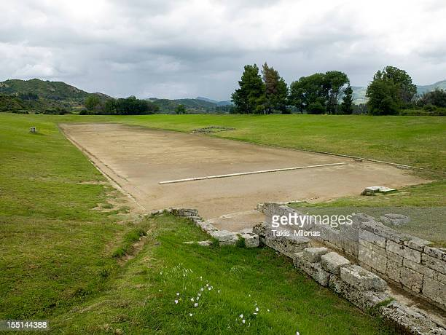
Ancient Stadium
The Ancient Stadium of Olympia: The stadium of Ancient Olympia was a holy place for the ancient Greeks, where all the sports activities were held dedicated to the god Zeus. Originally, the stadium was constructed in such a manner that spectators could view the events from the slopes of Mount Cronion. But the stadium was gradually moved further east, and eventually, it was placed outside the temple of Zeus.
The stadium had a seating capacity of 20,000 spectators and almost all seats were made of mud.

Slide 17
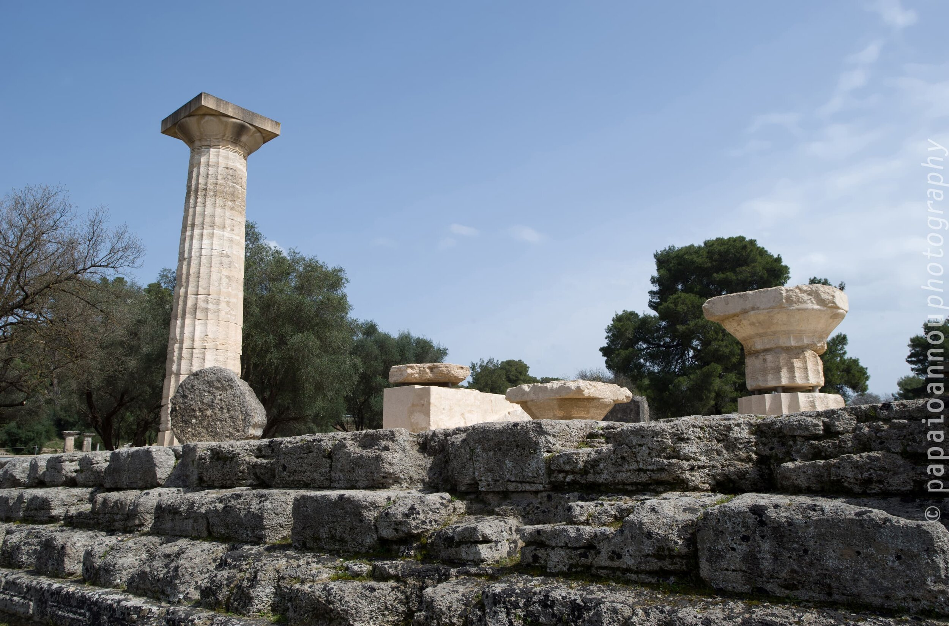
Temple of Zeus
Olympia Temple of Zeus: The ruined Temple of Zeus that stands today in the archaeological site of Olympia was built to honor the chief of the gods. It was probably constructed around 470 B.C when the ancient Olympic Games were at their peak. In fact, there is an interesting
story behind the construction of this temple.
In 470 B.C, there was a war between Elis
and Pisa, two neighboring powers in the area
of Olympia. Finally, Elean was defeated, and
as a penalty, the town gave the funds for
building a magnificent temple right outside
the stadium of Olympia.

Slide 18
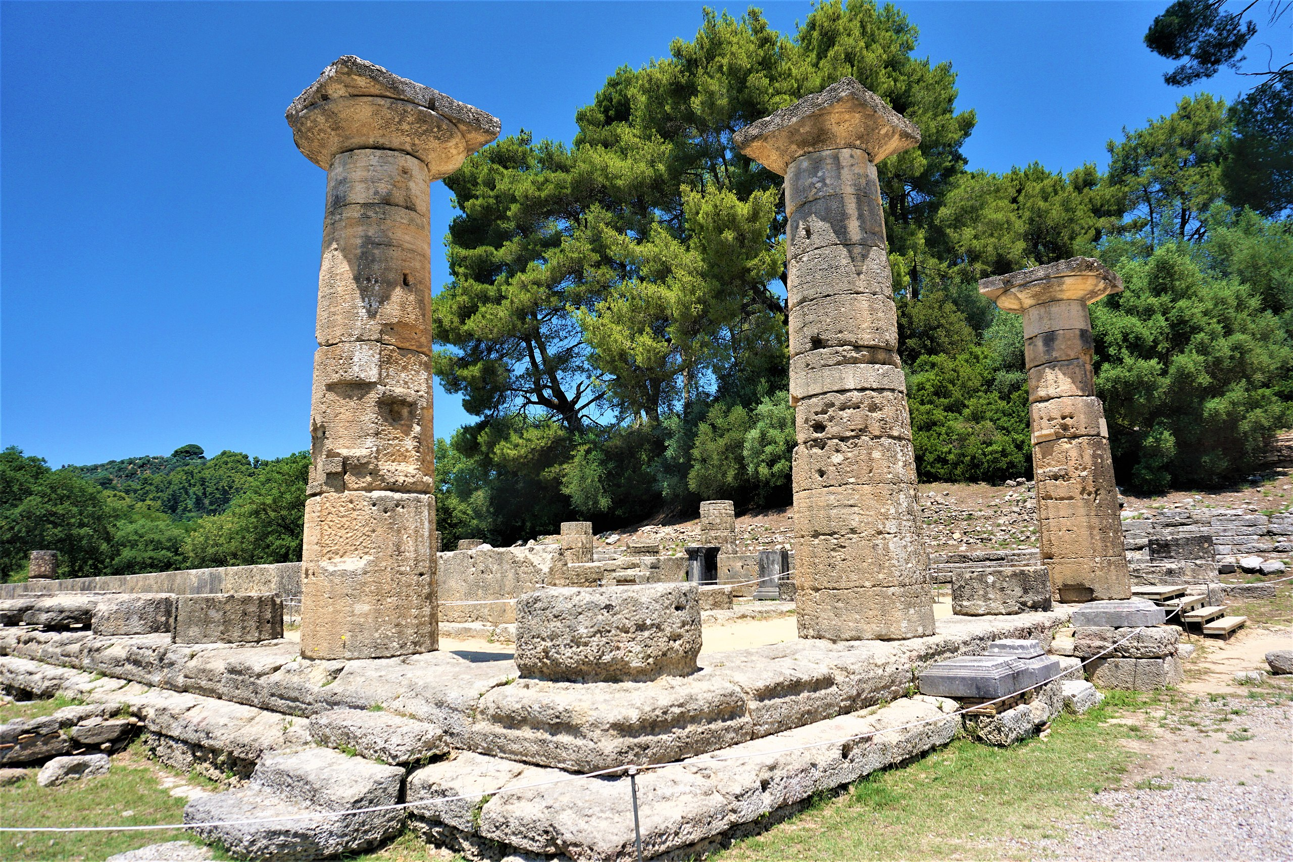
The Temple of Hera
The temple of goddess Hera in Ancient Olympia was originally a temple for both Zeus and Hera. In the 7th century, this temple was built of wood, but eventually, the wood was replaced by stone. One of the oldest monuments in Greece, the Temple of Hera became solely dedicated to the goddess when the great Temple of Zeus was constructed nearby.

Slide 19
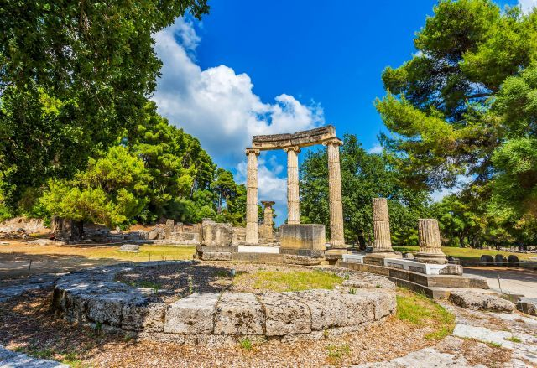
Philippeion
The Philippieion, the only circular building inside the Altis, is one of the finest examples of ancient Greek architecture. Located west of the temple of Hera, it was dedicated to Zeus by Philip II of Macedon.

Slide 20
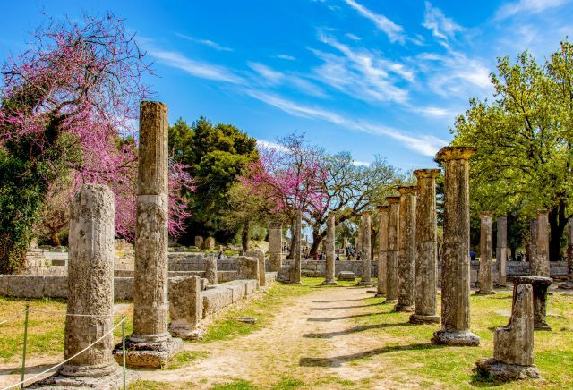
Palaestra
The Palaestra is situated west of the Altis enclosure, near the Kladeos River. Built-in the third century BC as part of the gymnasium complex, it was used to practice boxing, wrestling and jumping.

Slide 21
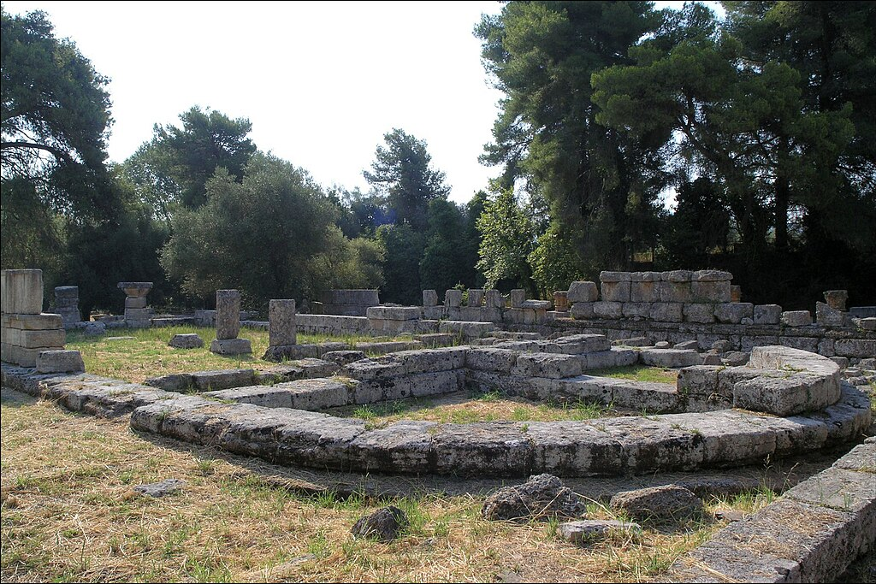
Bouleuterion
The Bouleuterion (Council House) of Ancient Olympia was a building inside the archaeological site of Olympia. A bouleuterion was an assembly house for local legislatures and other meetings.
Building complex comprising two main buildings, a square room, and a stoa. The edifices were erected south of the Temple of Zeus and date back to the 6th - 4th Century BC.

Slide 22
Conclusion
Olympia is a beautiful City with a rich history and numerous attractions. Regardless of what you're looking for, Olympia has something for everyone.
I hope this presentation will help when we visit Olympia!

Slide 23
Thanks For Coming
If you have any more questions, please ask.
I will do my best to answer them for you.
Have a great visit in Olympia !

