Slide 1
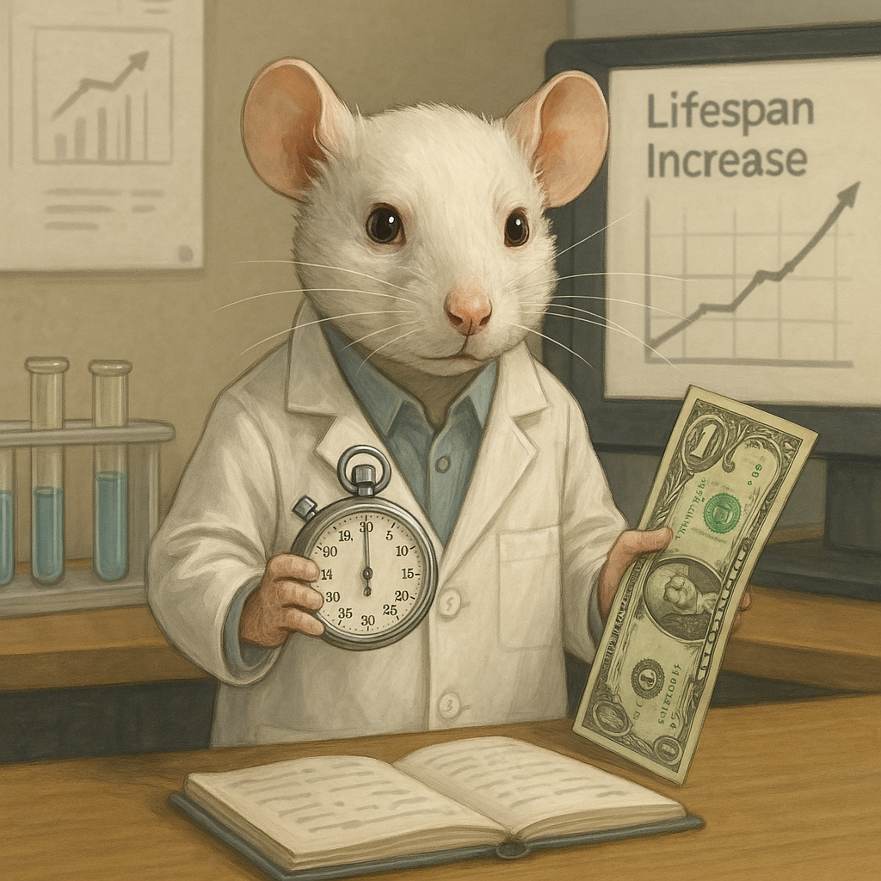
Of Mice, Money, and Getting Old Presented by: Marc Silver
Idioms About Animals, Aging, and Being Broke

Slide 2
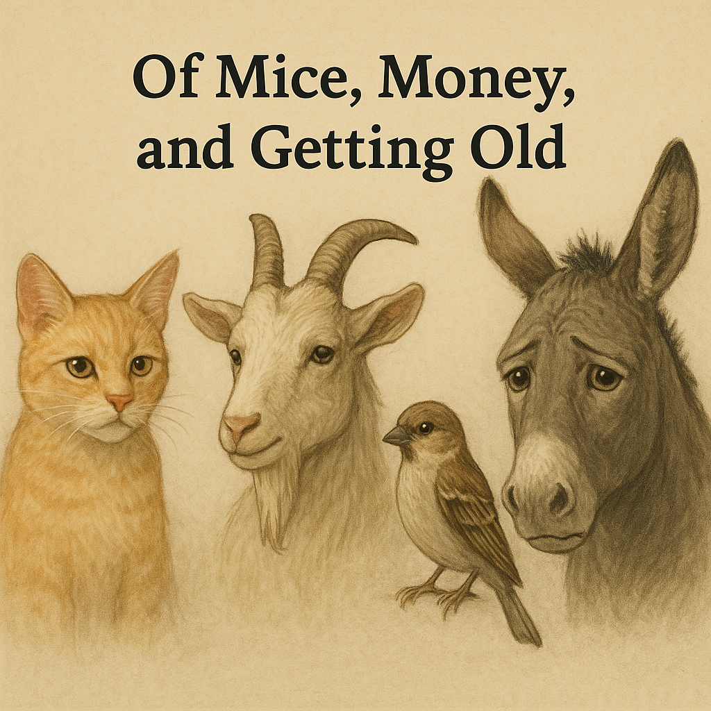
Idioms About Animals, Aging, and Being Broke
What do cats, goats, sparrows, and donkeys have in common?
They all show up in idioms that reveal how we feel about life’s harder truths—getting older, losing money, and making a fool of ourselves along the way.
So whether you’re broke, gray, or just trying to avoid looking like a bewildered chicken, these global expressions have something to say.
Notes:
They’ve all been enlisted to reflect the human condition — from foolish to funny, stubborn to sad.

Slide 3
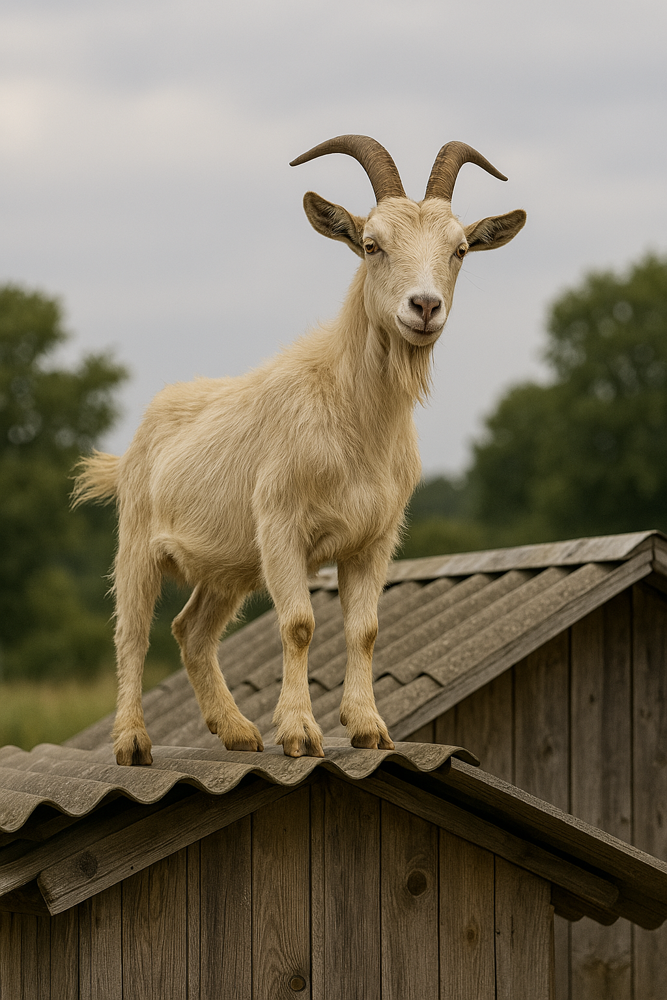
Animal Idioms Because Humans Can’t Take All the Blame
Spain: “Estar como una cabra” – “To be like a goat.”
It means: You’re wild, unpredictable, maybe a little nuts. The goat’s to blame, not you.
Notes:
In Spain, calling someone a goat means they’re a bit wild or offbeat — but harmless. It’s not you acting crazy, it’s the goat.

Slide 4
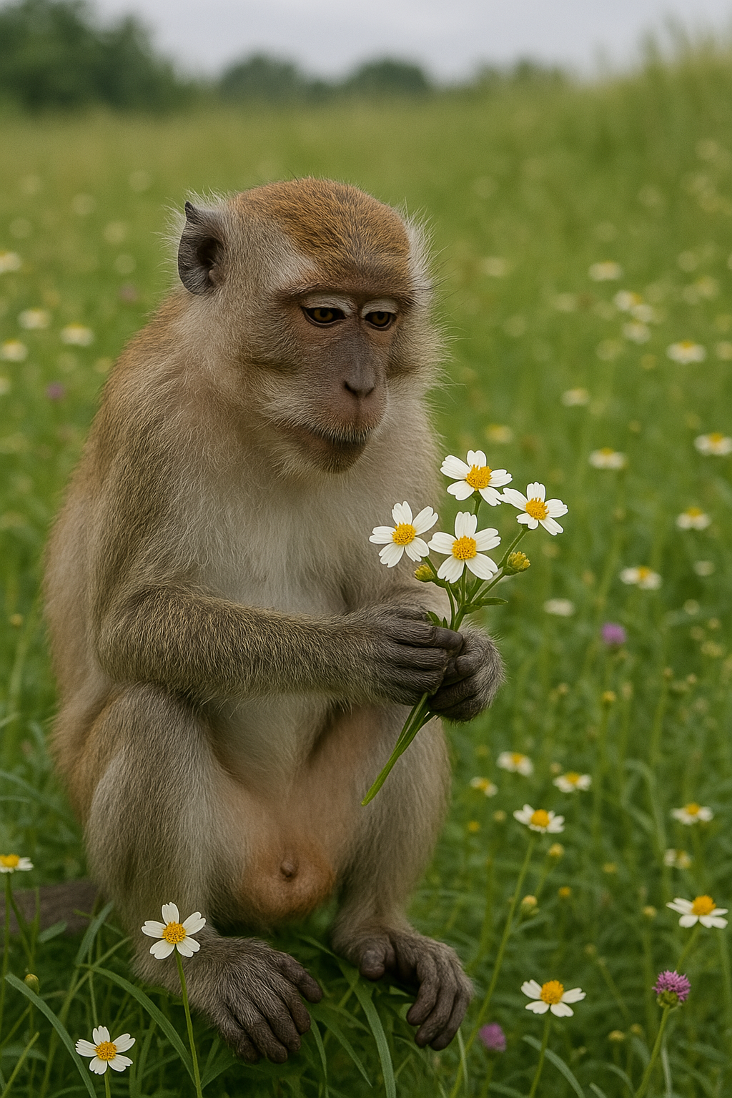
Animal Idioms Because Humans Can’t Take All the Blame
Malaysia: “Seperti kera mendapat bunga” – “Like a monkey getting flowers.”
Having something beautiful but not knowing what to do with it. Clueless appreciation at its finest.
Notes:
This one’s about being totally out of your depth — like handing a bouquet to a monkey. It’s admiration without understanding.

Slide 5
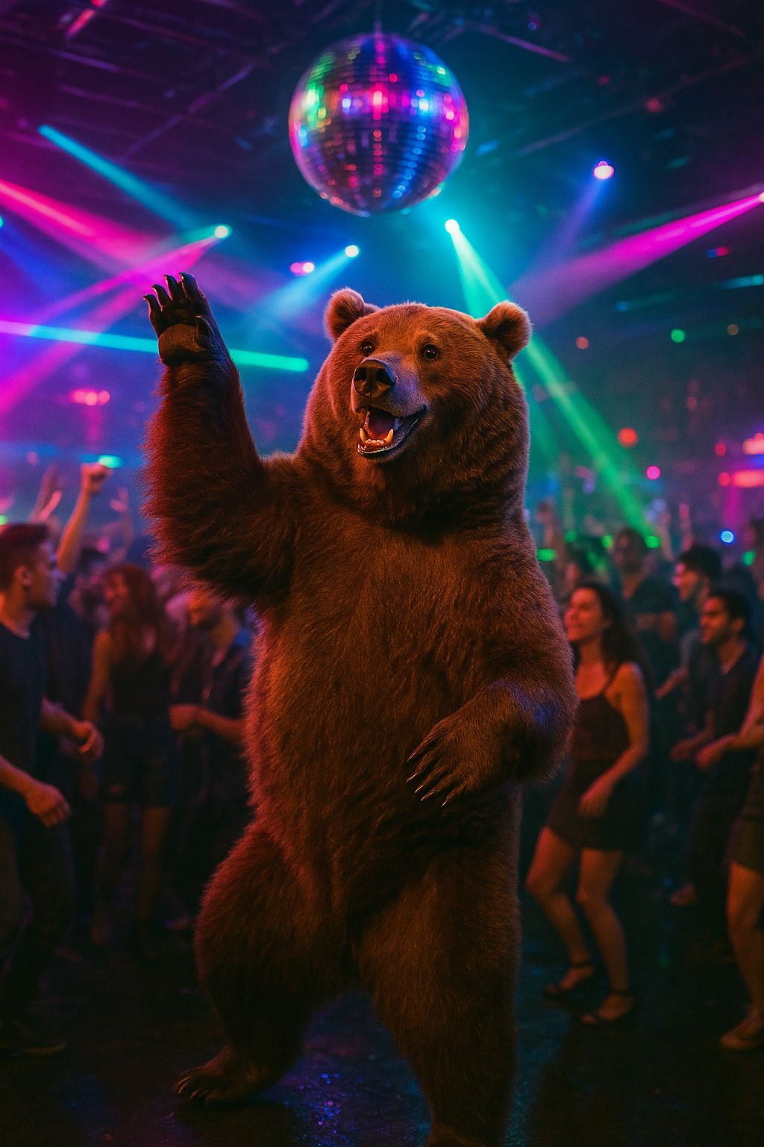
Animal Idioms Because Humans Can’t Take All the Blame
Germany: “Da steppt der Bär” – “That’s where the bear dances.”
That’s the place to be. It’s hopping. The party is so good, even bears can’t help but break into a jig.
Notes:
In Germany, if the bear's dancing, you’ve found the hotspot. It's their way of saying, “This party’s alive.” When even the bear can’t sit still, you know it’s good.

Slide 6
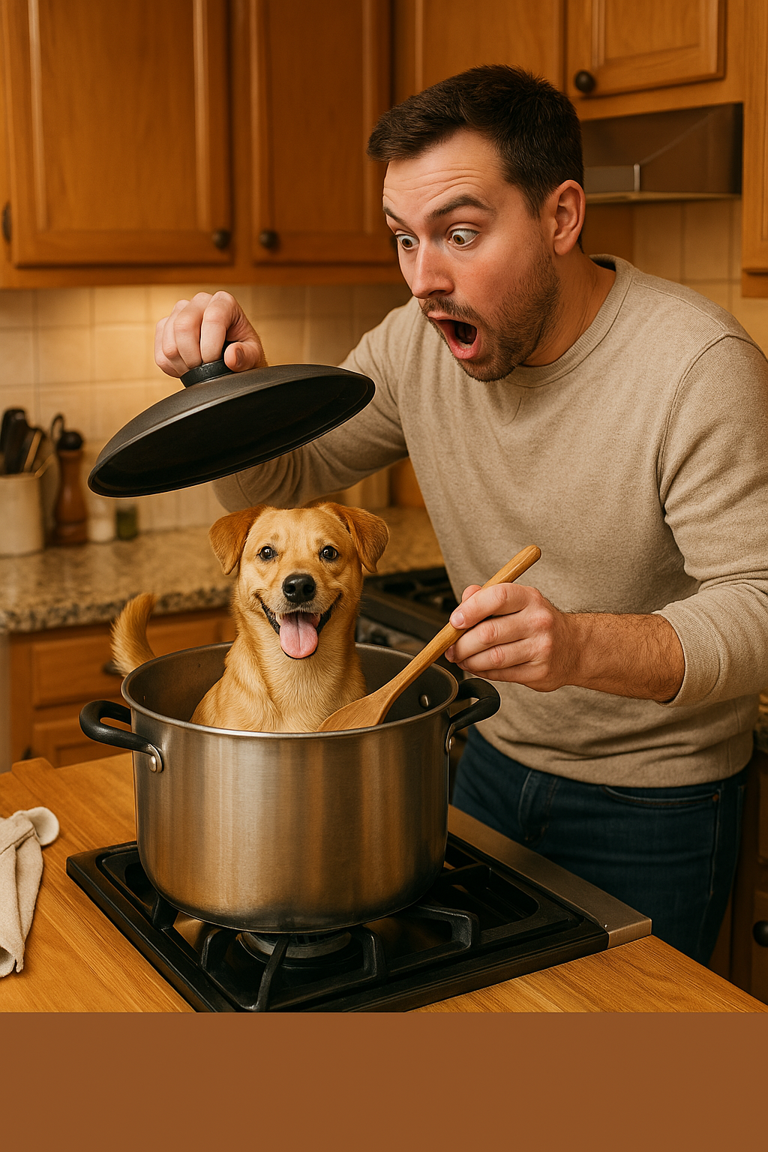
Animal Idioms Because Humans Can’t Take All the Blame
Netherlands: “Hij doet alsof hij de hond in de pot gevonden heeft” – “He acts like he found the dog in the cooking pot.”
Disappointed too late. Used when someone misses out and shows up after the action’s over.
Notes:
This one’s for the person who shows up late and acts shocked there’s nothing left — like finding the dog in the stew pot and wondering where dinner went.

Slide 7
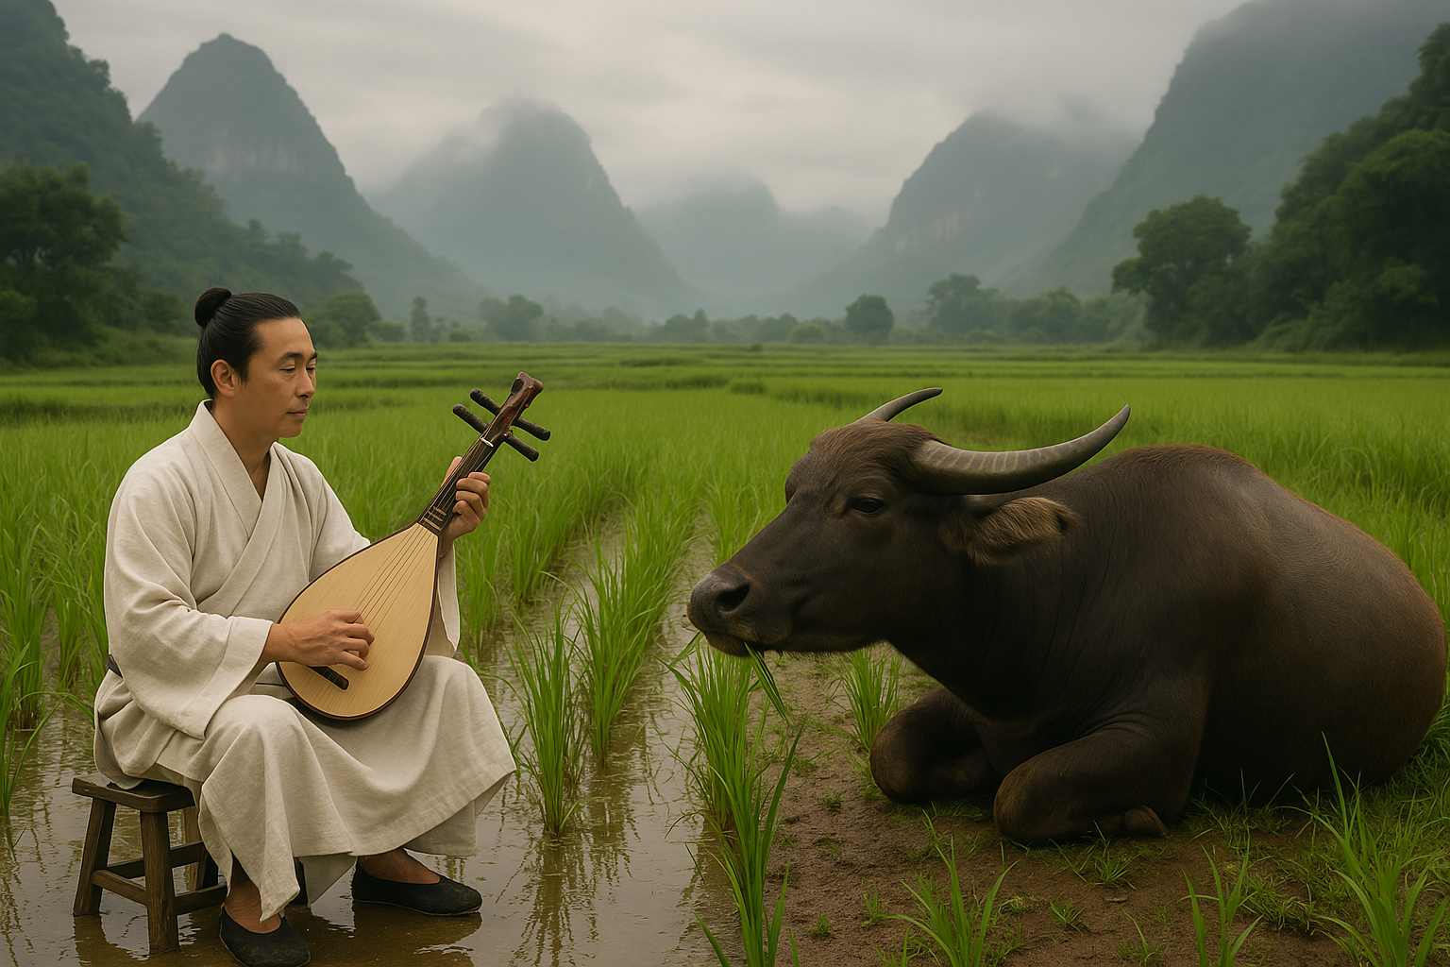
Animal Idioms Because Humans Can’t Take All the Blame
China: “对牛弹琴” (duì niú tán qín) – “Playing a lute to a cow.”
Trying to impress or explain something to someone who just doesn’t get it. Think: arguing logic with a rock.
Notes:
This is China’s poetic way of saying, “You’re wasting your breath.” You can play your heart out, but the cow’s not clapping.

Slide 8
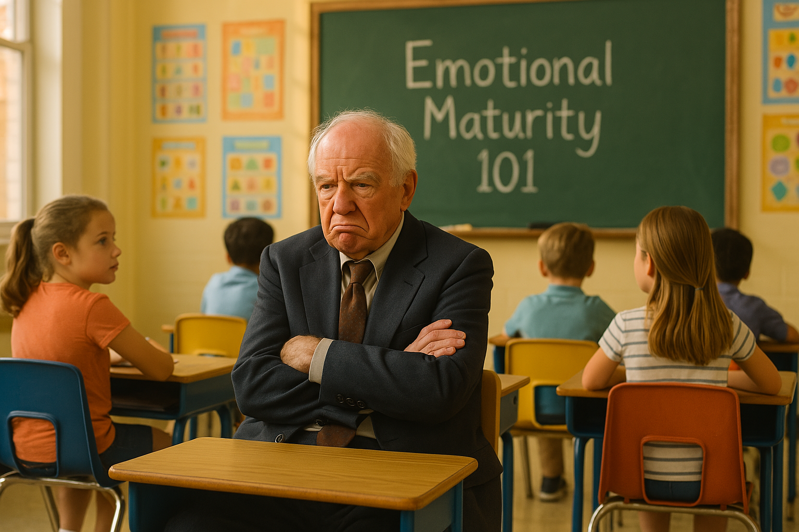
Aging Idioms Gray Hair, Sharp Tongues, and Worn-Out Legs
Arabic:” قلبه وقع في رجليه “Old in age, small in mind.”
Getting older doesn’t guarantee wisdom. A cautionary phrase for the cranky elder who forgot to grow up.
Notes:
This one’s a jab at elders who’ve aged on the outside but stayed immature inside. It's a reminder: wisdom isn’t automatic — you still have to earn it.

Slide 9

Aging Idioms Gray Hair, Sharp Tongues, and Worn-Out Legs
Italian: “Essere nella terza età” – “To be in the third age.”
A graceful way to describe elderhood. Less about decline, more about entering a final act—with wisdom and retirement discounts.
Notes:
The Italians don’t say you’re old — they say you’ve entered your third age. It’s not an ending, it’s a new chapter, ideally with more wisdom and better wine.

Slide 10

Aging Idioms Gray Hair, Sharp Tongues, and Worn-Out Legs
French: “Il n’a plus toute sa tête” – “He no longer has all his head.”
A gentle nudge at forgetfulness or mental decline. Often said with a shrug and a sigh.
Notes:
This is the French way of saying someone’s slipping a bit upstairs — softly, with affection. It’s less judgment, more resigned empathy... and maybe a little wine.

Slide 11
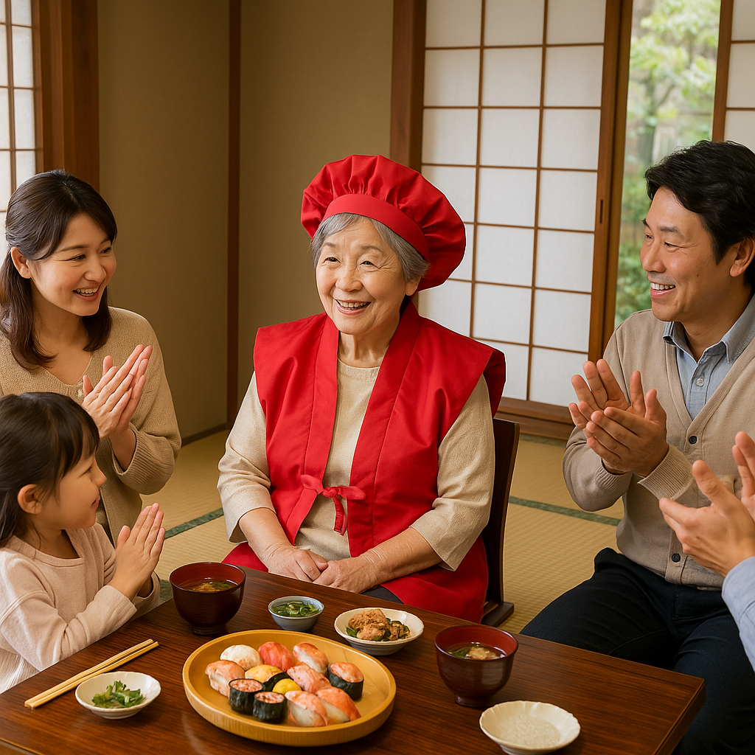
Aging Idioms Gray Hair, Sharp Tongues, and Worn-Out Legs
Japanese: “還暦” (Kanreki) – Refers to turning 60, symbolizing a return to the zodiac sign of your birth.
Not just getting older—coming full circle. Celebrated, not dreaded.
Notes:
In Japan, turning 60 is a rebirth — not a decline. You’ve completed the zodiac cycle and get to start fresh. It’s celebrated with red clothes, family, and respect.

Slide 12
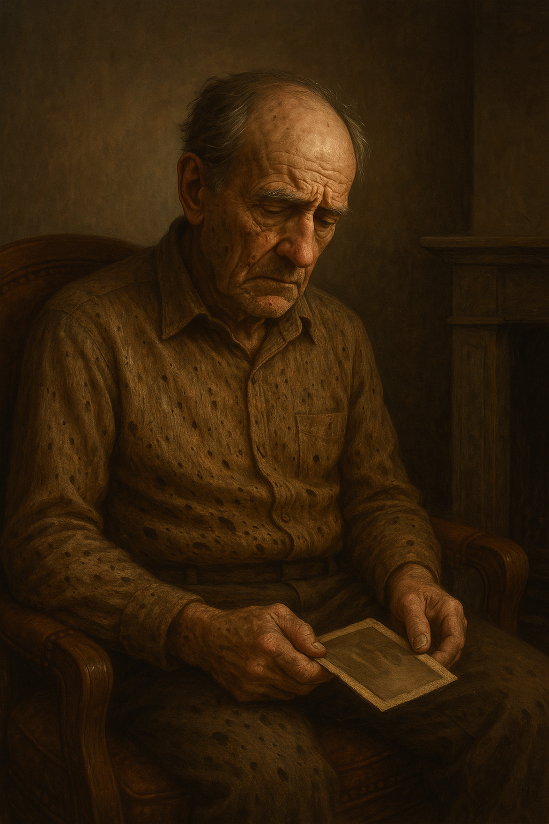
Aging Idioms Gray Hair, Sharp Tongues, and Worn-Out Legs
Greek: “Τον έφαγε το σαράκι” – “He was eaten by the woodworm.”
Used to describe someone consumed by worry or bitterness with age. Slowly gnawed from the inside out.
Notes:
This is a haunting Greek image of someone slowly eaten away by regret or worry — not all at once, just bit by bit, until there's nothing solid left.

Slide 13
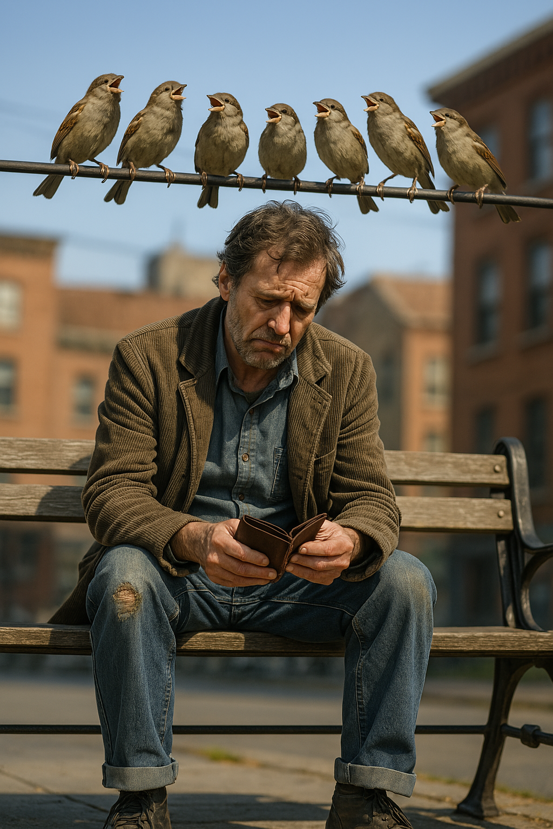
Broke Idioms When the Wallet Echoes
Hungary: “Még a verebek is kiröhögik” – “Even the sparrows laugh at you.”
So poor it’s public knowledge—and the wildlife’s mocking you.
Notes:
In Hungary, when you’re broke, even the birds are in on the joke. It's poverty so obvious, the sparrows can’t help but laugh.

Slide 14
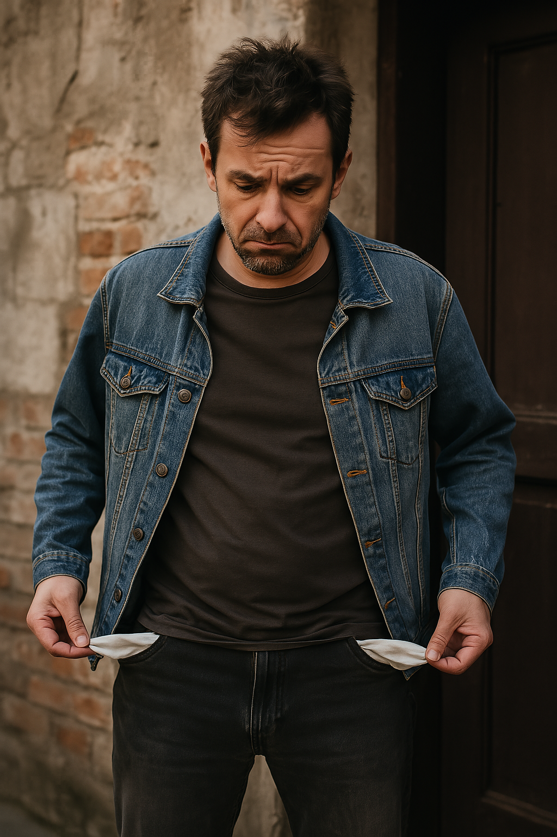
Broke Idioms When the Wallet Echoes
Portuguese: “Nem um tostão furado” – “Not even a rusty coin.”
Completely broke. Not a cent. Not even one worth throwing away.
Notes:
This is rock-bottom broke — not even enough for a coin that’s too rusty to spend. You’ve got pockets, just no purpose for them.

Slide 15
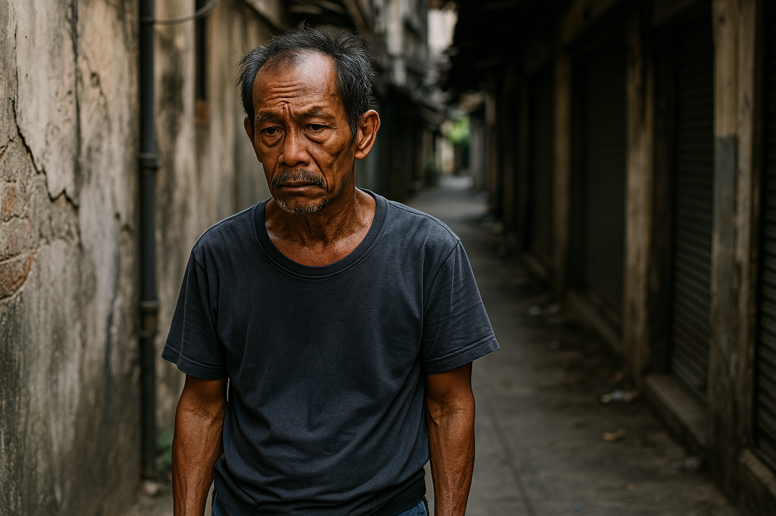
Broke Idioms When the Wallet Echoes
Thai: “จนตรอก” (Jon-trok) – “Trapped in an alley.”
No options. No way out. Used when someone’s hit financial rock bottom.
Notes:
In Thai, being broke feels like being cornered — no exits, no backup. Just you, the walls, and nowhere to go.

Slide 16
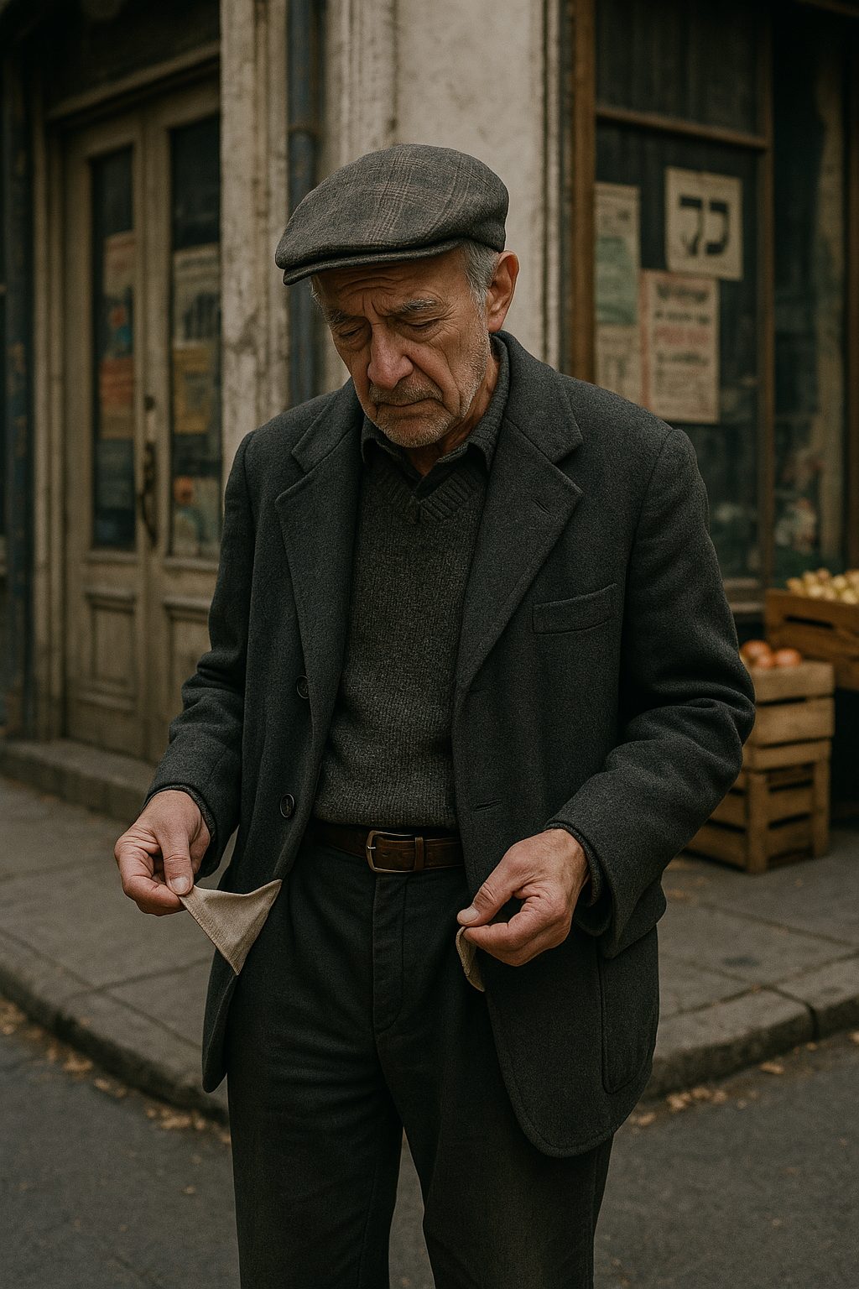
Broke Idioms When the Wallet Echoes
Yiddish: “Er hot kein Groshn nit” – “He doesn’t have a penny.”
Said with the universal tone of someone checking their pockets and coming up empty.
Notes:
It’s classic Yiddish understatement — broke, yes, but said with a shrug, maybe a joke, and always a touch of dignity.

Slide 17

Broke Idioms When the Wallet Echoes
Romanian: “A face foamea cu stil” – “To starve with style.”
No money, but still keeping up appearances. Think lipstick and bare foot.
Notes:
This is about holding your head high even when your wallet’s empty. You may be broke, but you’re not giving up on elegance — just shoes.

Slide 18
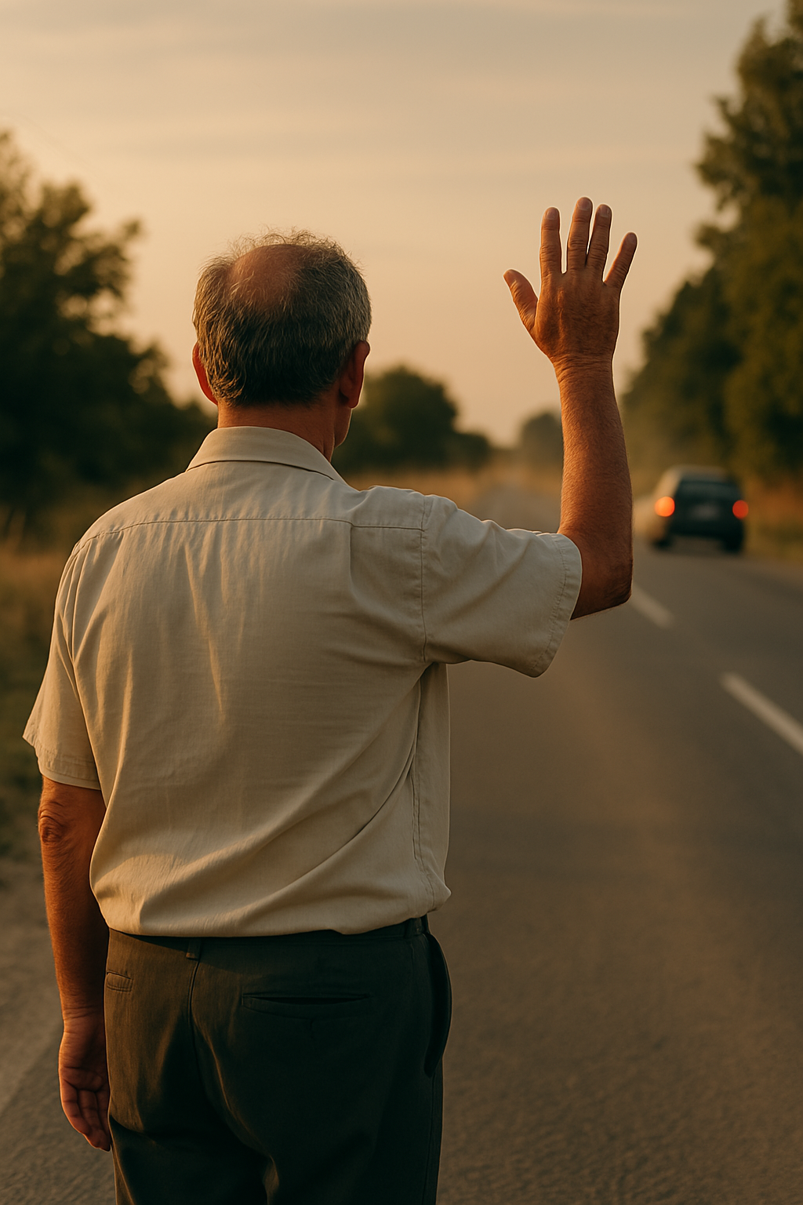
Broke Idioms When the Wallet Echoes
Brazil (Portuguese): “Ficar com a mão abanando” – “To be left waving your hand.”
Used when you walk away with nothing—no deal, no cash, not even a thank-you.
Notes:
In Brazil, if you're left waving your hand, you’ve got nothing. Not a deal, not a dime — not even the courtesy of being let down gently.

Slide 19
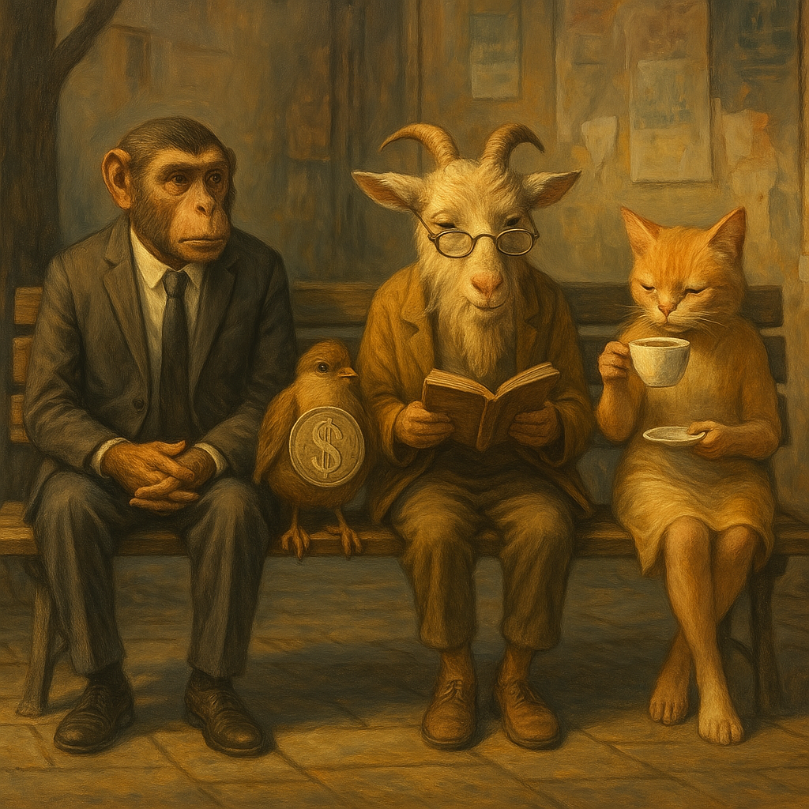
Final Thoughts Fur, Wrinkles, and Empty Pockets
Across languages, animals do the talking when people won’t.
Age is respected, mocked, or quietly mourned. And being broke? That’s a universal joke we’re all invited to laugh at—often through our teeth.
These idioms reveal the soft belly of everyday life. We laugh, we age, we misplace our money—and still find a way to turn it all into poetry.

Slide 20
Next Time
Idioms about fear, bravery, and foolishness.
(Spoiler: In the Czech Republic, when you’re terrified, you’ve got a hamster in your stomach.)

Slide 21
Thanks for Coming!
What

