Slide 1
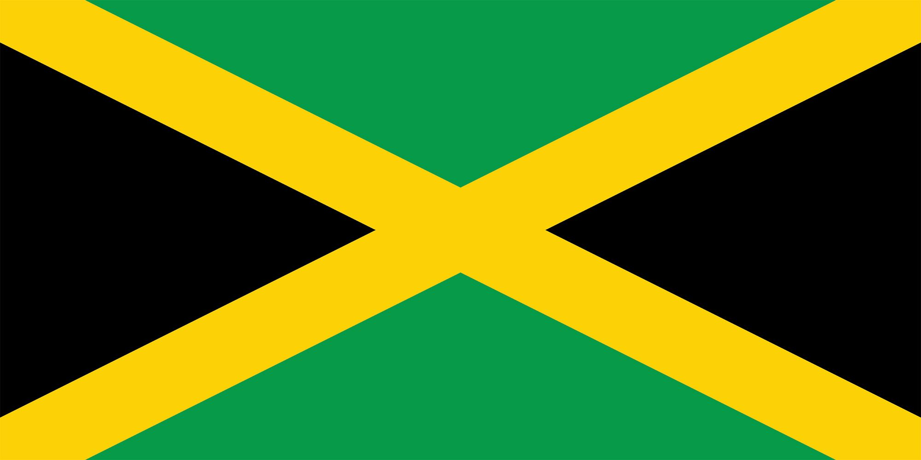
Ocho Rios Jamaica Presented by Marc Silver

Slide 2
What I Will Cover
My Port Philosophy
Don’t Miss the Ship
Money
About Ocho Rios, Jamaica
Area Map of Jamaica
Map of Ocho Rios
Ocho Rios Transportation
Places to see or at least consider
A few restaurant recommendations
Conclusion

Slide 3
My Port Philosophy
I have been cruising for over 45 years and have taken over 100 cruises. So, I consider myself an experienced cruiser.
The information I will present is based on those many years of
experience.
When I am on a cruise where the city, I want to visit is not the port city,
I always recommend taking a ship’s tour.
But when I am in a port with multiple attractions nearby and easy to see
on my own - I will do it on my own.
This presentation is for that type of port.

Slide 4

Don’t Miss the Ship
How to Avoid Missing Your Ship
Pay attention to the time. - Ship time and local time are often different.
Put a return-to-ship reminder on your phone.
Choose excursions wisely.
If a ship-sponsored excursion is late returning to port, the ship will wait for you. If you are on your own???
Be Prepared
Have your Passport, Credit Card, and phone numbers for your ship port agent.
What to Do If You Miss the Ship Most cruise lines have port agents stationed in the port area to assist if your ship has left without you. If your are lucky, when cruisers are late returning to the vessel, the ship’s crew will often remove the passengers’ essential items – passports, cell phones, and medication -- from the ship to leave with the port agents.
The Port Officials can help you with contacting your ship and making necessary travel arrangements.

Slide 5

Money
The Jamaican Dollar is the official currency of Jamaica
The official Exchange is 155.06 Jamaican Dollars for $1 US Dollar.
The Jamaican Dollar symbol is JMD

Slide 6
About Ocho Rios
Ocho Rios (Spanish for "Eight Rivers") is one of Jamacia’s most beautiful resort areas. Beginning as a sleepy fishing village, Ocho Rios has seen explosive growth in recent decades to become a popular tourist destination featuring duty-free shopping, a cruise-ship terminal, world-renowned tourist attractions, and several beaches and acclaimed resorts.
In addition to being a port of call for cruise ships, Ocho Rios also hosts cargo ships at the Reynolds Pier for the exportation of sugar, limestone, and in the past, bauxite.
The estimated population of the town in 2011 was 16,671, which is nearly 10% of the total population of St. Ann. The town is served by both Sangster International Airport (97 km west of Ocho Rios) and Ian Fleming International Airport (17 km east of Ocho Rios). Scuba diving and other water sports are offered in the town's vicinity.

Slide 7
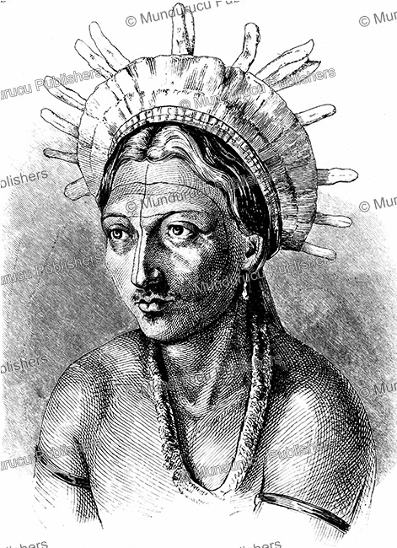
Jamaican Natives
Ocho Rios was originally settled by a tribe of Arawak people, who had settled in Jamaica around 1,000 BCE and called the land Xamayca, meaning land of wood and water.
The Caribbean Island of Jamaica was inhabited in approximately 600 AD by the Redware people, often associated with redware pottery,
After Christopher Columbus landed in 1494 he claimed the island for Spain, Ocho Rios was named Las Chorreras, meaning rapid rivers.
The Spanish enslaved the Arawak, who were ravaged further by diseases that the Spanish brought with them. By 1602, the Arawak-speaking Taino tribes were extinct.
However, some of the Taino escaped into the forested mountains of the interior, where they mixed with runaway African slaves, and survived free from first Spanish, and then English, rule.

Slide 8
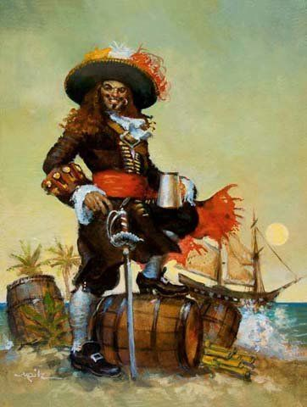
Jamaican Early Settlements
In 1655, the English invaded Jamaica and defeated the Spanish. Some African enslaved people took advantage of the political turmoil and escaped to the island's interior mountains, forming independent communities that became known as the Maroons.
Meanwhile, on the coast, the English built the settlement of Port Royal, a base of operations where piracy flourished as so many European rebels had been rejected from their countries to serve sentences on the seas.
Captain Henry Morgan, a Welsh plantation owner and privateer, raided settlements and shipping bases from Port Royal, earning him his reputation as one of the richest pirates in the Caribbean.

Slide 9
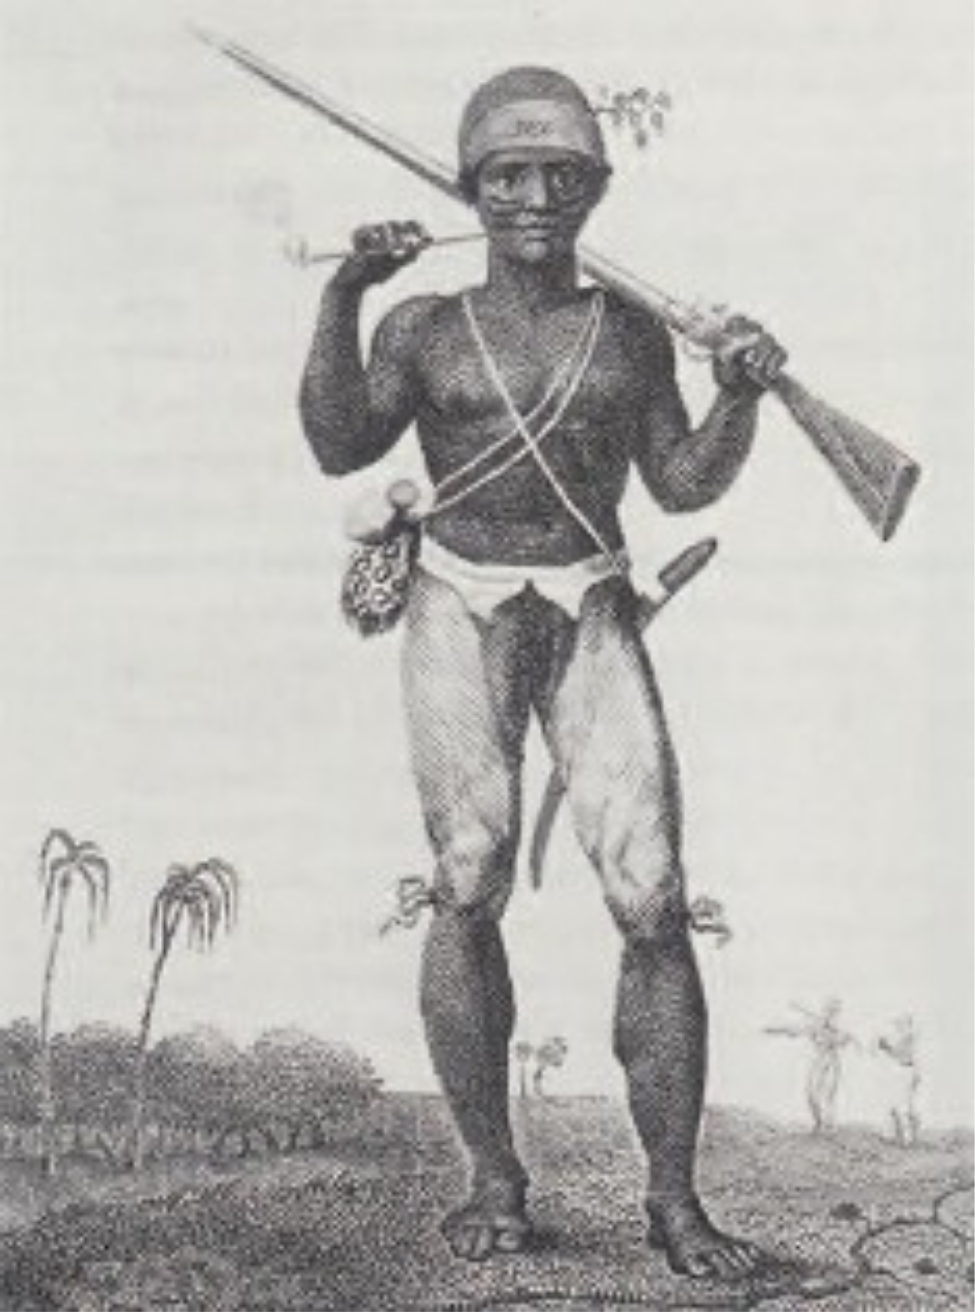
Jamaican Colonization
In the 18th century, sugar cane replaced piracy as British Jamaica's main source of income. The sugar industry was labor-intensive, and the British brought hundreds of thousands of enslaved black Africans to the island. By 1850, the black and mulatto Jamaican population outnumbered the white population by a ratio of twenty to one.
Enslaved Jamaicans mounted over a dozen major uprisings during the 18th century, including Tacky's Revolt in 1760. There were also periodic skirmishes between the British and the mountain communities of the Jamaican Maroons, culminating in the First Maroon War of the 1730s and the Second Maroon War of 1795–1796

Slide 10
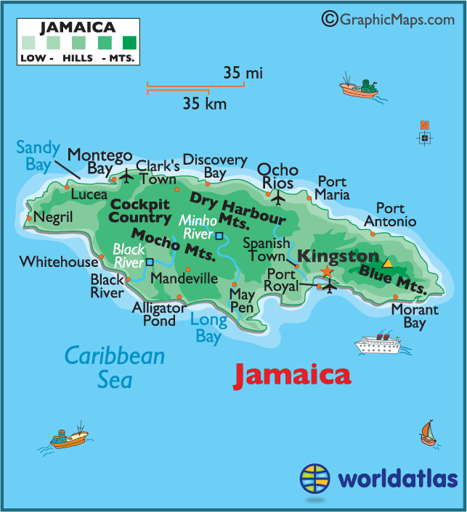
Map of Jamaica

Slide 11
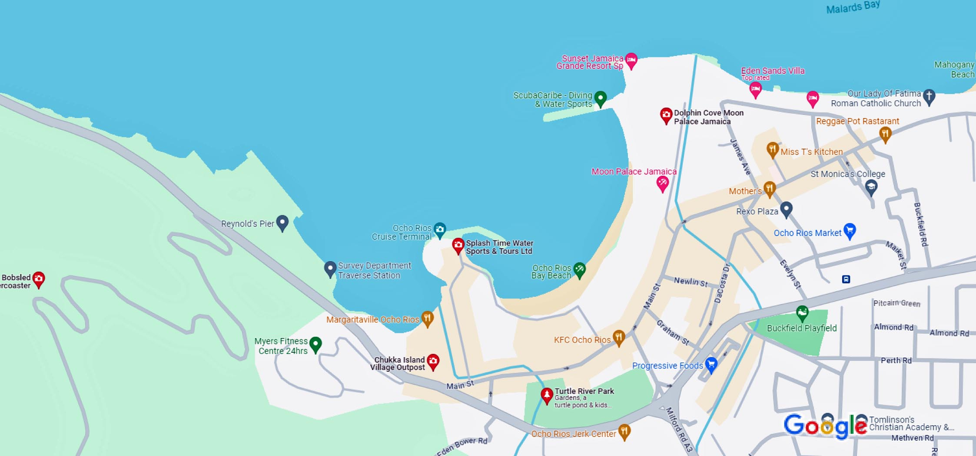
Map of Ocho Rios

Slide 12
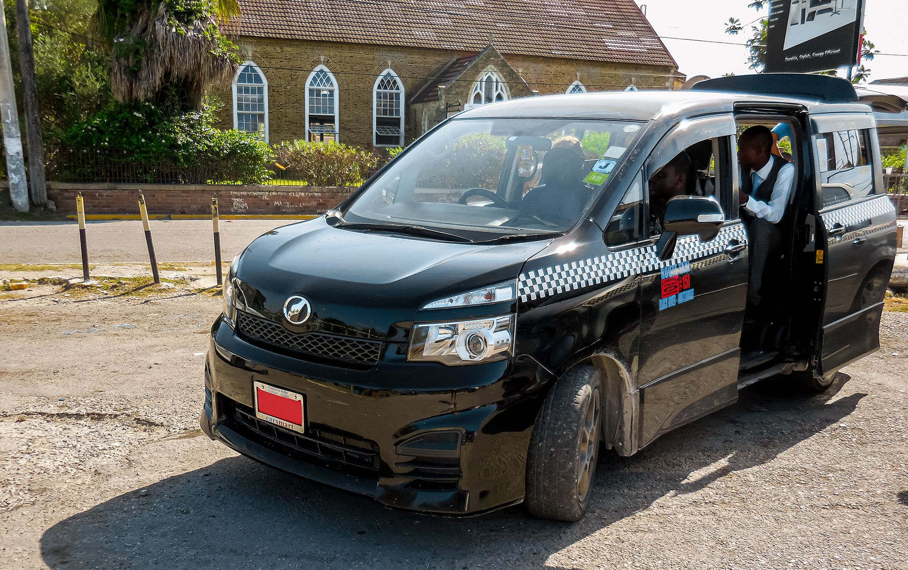
Ocho Rios Taxis
Getting around Jamaica by taxi is very easy. Private taxis are provided for visitors to Jamaica, while Route Taxis are designed for locals and operate similarly to buses with specific routes they travel. These drivers are only licensed to drive in a specific area. These taxis can stop anywhere to pick up and drop off passengers and usually carry multiple people at any time.
You can tell a taxi by its Red license Plate. Also, their route will be shown on the side of the taxi.
The prices are set by the government. Typically, $1 or $2 US.
Because the Route Taxis make more money the more people they carry, often they will over pack the car. If the Taxi is packed just wait for another.
Chartered Route Taxi, means you will be the only passengers but you need to agree to a price before getting in the taxi. They will then post a Chartered Sign in the window.
The Mini Route Buses run from city to city. Prices run between $3 and $6 US depending upon the distance.

Slide 13

Ocho Rios Tourist Taxis
You can Recognize a tourist taxi by its Red license plate, and they will have the name of their company on the front and back of the taxi. All tourist taxis must’ to be less than 5 years old and in good condition. They are also all air-conditioned and insured.
JUTA, are private taxis that primarily due tours for tourists. They are knowledgeable and drive much safer than the Route Taxis. A tour could run $200 US for an all-day tour but realize the taxi expenses could run as high as $150 for fuel, license fees, maintenance, and commission fees.
If you do take a taxi tour, and had a great time, remember to tip your driver.

Slide 14
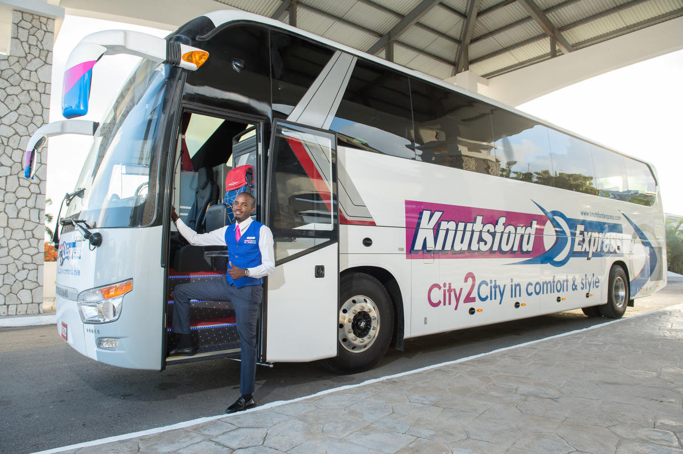
Knutford Express
Knutford Express is a luxury passenger and courier transportation company offering safe, reliable, comfortable, and cost-effective scheduled services.
They offer scheduled services from convenient locations on Jamaica's north and south coasts Passengers can traverse the island to points in Portland, St. Mary, Manchester, Negril, Trelawny and Kingston in spacious, air-conditioned coaches.
Most tickets run $10 to $30 US. Chances are you won’t use this service, but I hope this is good information.
If you want to travel from Ocho Rios to Negril this bus makes sense, otherwise, a Route Taxi is a better choice.

Slide 15
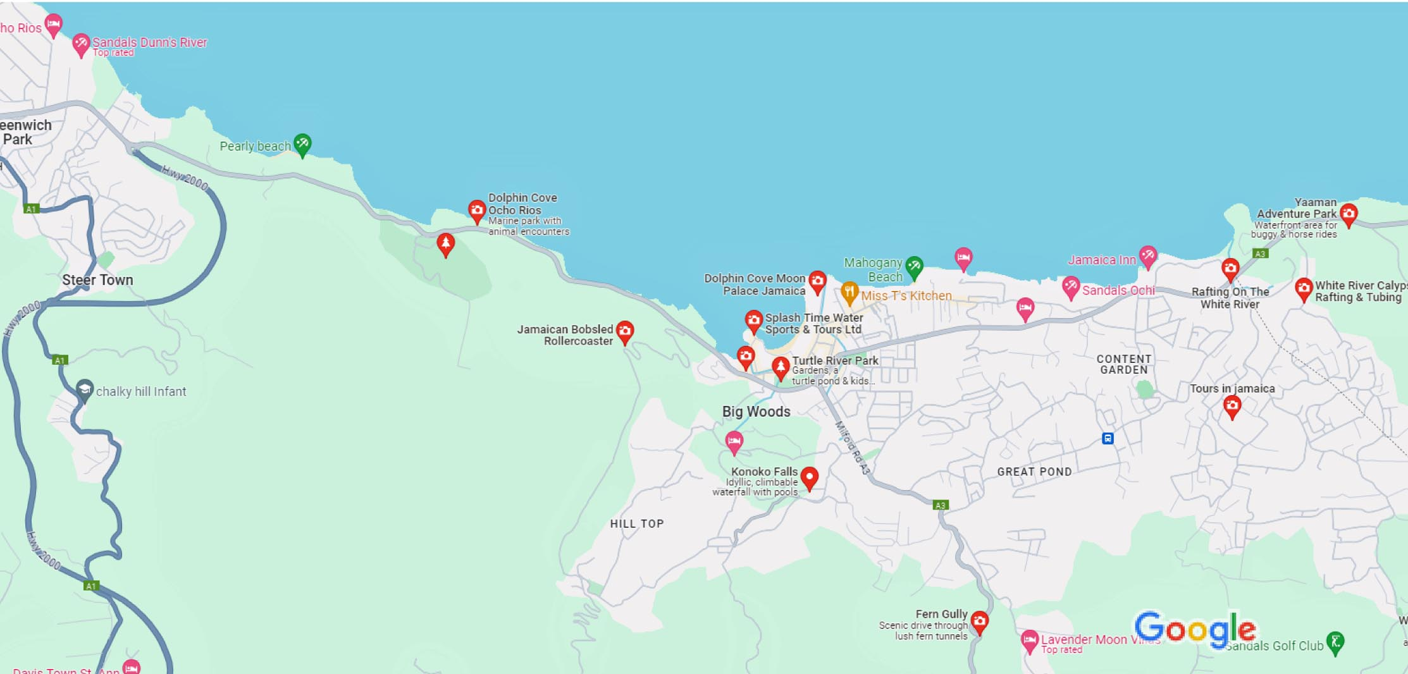
Map of Local Attractions

Slide 16
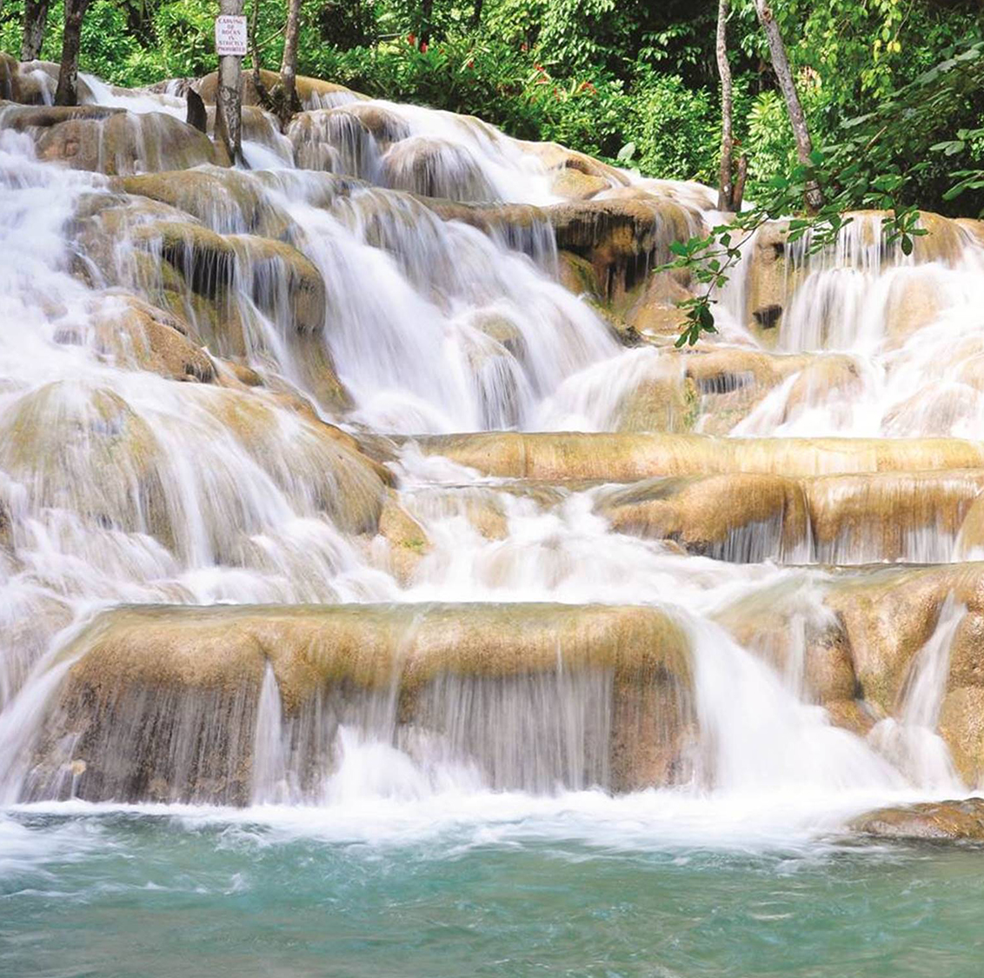
Dunn's River Falls
On my first visit to Jamaica, I climbed Dunn’s River Falls. It is 180 feet high and 600 feet long, and the waterfalls are naturally terraced like giant natural stairs. Even in the heat of Summer, the Falls are refreshingly cold.
Climbing the waterfalls is a popular tourist activity and is normally performed with the help of tour guides from the park. It takes about 1-1.5 hours to climb with short breaks for photographs taken by your guide. There are also stairs alongside the falls for those who do not want to get wet or are unable to manage the rocky, uneven terrain of the actual waterfall.
The falls are bordered by lush, green vegetation that shades the area from the sun and keeps the area, and climbers, cool. The climb can be relatively hard but with help from your guide, it is much easier.

Slide 17
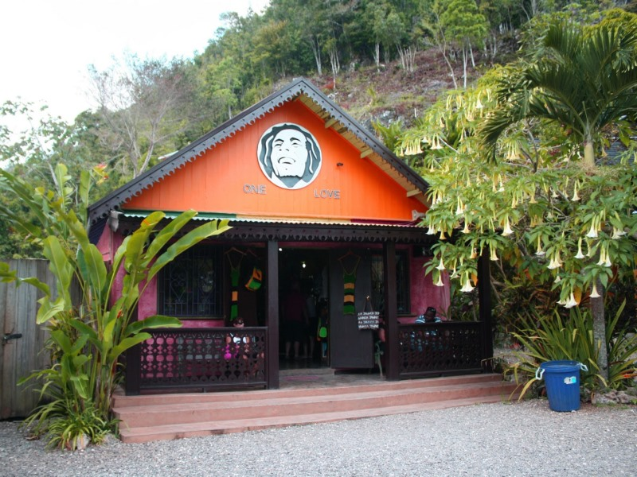
Nine Mile Village
Located about 30 miles from the cruise terminal is Nine Mile Village. Located in Saint Ann Parish, this is the birthplace and final resting place for Reggae icon Bob Marley.
This fact has made the area tremendously popular with music fans, and you can do a guided tour of the local museum and the mausoleum where the popular musician was buried.
The tour offers an opportunity to learn about the Rastafarian religion and the life of Bob Marley.
You can either book a tour here through the ship or find one on shore. These packages cost about $100 to $150 per person and often include, ziplining or river tubing. Plan on spending about six hours, so plan on using most of the day for the activity.
Local tours can cost as little as $50 to $80 per person.

Slide 18
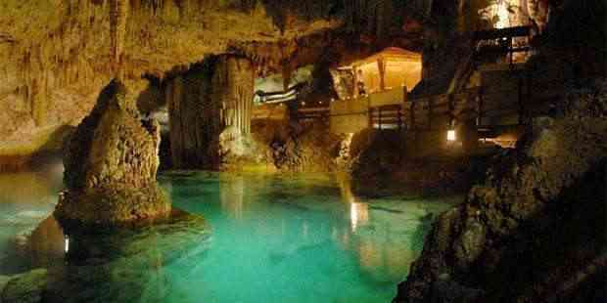
Green Grotto Caves
20 miles west of the port is a speleologist’s dream at Green Grotto Caves. The Caves are surrounded by thick vegetation and are supplied with pristine waters flowing from its secret depths. Its rich history can be identified with diverse groups of people including its first inhabitants, the Arawak Indians who used the caves. Proof of this is evident in the multiple fragments of pottery and artifacts that are unearthed from time to time.
During the 17th century, the English invaded the island of Jamaica and discovered the Green Grotto Caves were used as a hideout for the Spaniards who were being driven out of the country.
In the mid-20th Century, between the two world wars, they were used by smugglers running arms to Cuba. In the latter years during the Second World War, the Government of Jamaica used the entrance of the cave as a storeroom for rum in barrels.
Admission: Adults US$20
Children under 12: US$10

Slide 19
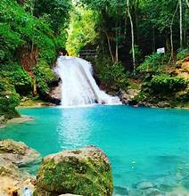
Blue Hole
You will want to check out the famous Blue Hole, also known as the Irie Blue Hole.
This is essentially a group of natural pools fed by waterfalls in the mountains, and the attraction goes by many names. It is not usually as crowded as Dunn’s River Falls, and it is located just about 25 minutes from Ocho Rios.
There are guides, and rope swings, and rivers to cross, and it’s a good idea to wear water shoes to avoid slipping on the rocks during this fun-filled encounter.

Slide 20
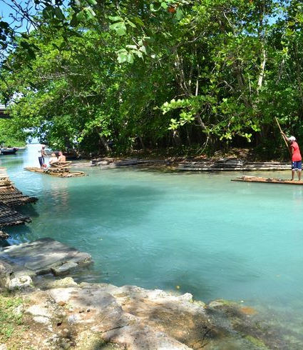
White River
Get up close and personal with the Chukka White River Valley location, offering stunning natural beauty and historic landmarks. The clarity of the water at White River Valley and the consistency of the river flow make it stand out above other locations on the island.
The limestone bedrock filters the river’s water so it remains crystal clear even when there’s flooding. Located in St. Mary, Jamaica, this location is home to beautiful wildlife and an extensive history. With the exciting zipline adventure and thrilling river tubing journey, this location is the perfect piece of paradise when paired with the Blue Hole experience!.

Slide 21
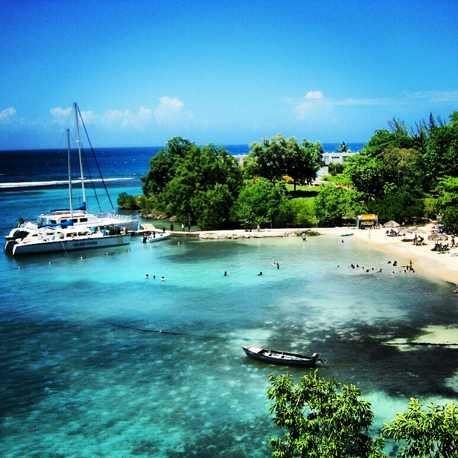
Mahogany Beach
Mahogany Beach in Ocho Rios is loved by both tourists and locals.
It is most lively on the weekend when you can find bustling beach football matches and barbeques filling the air with the scent of delicious foods. The beach is well-maintained, and there is no admission fee.
Mahogany Beach is on the small side, but it is a good spot to relax with family or friends, grab some snacks from the beachside shop, and sink into an amazing beach day. Mahogany Beach is about 1 km from the Ocho Rios town center.

Slide 22
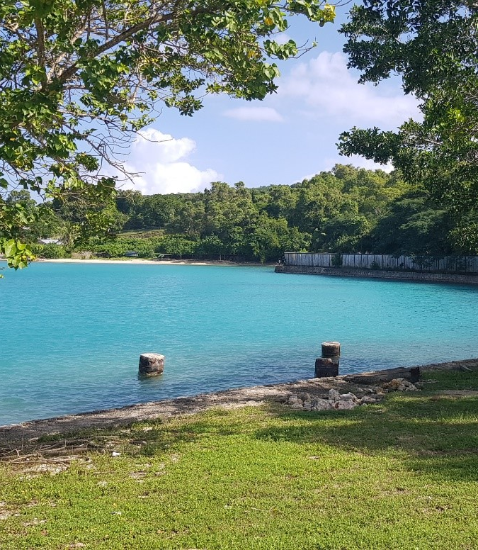
James Bond Beach
Ian Flemming is a household name in Jamaica, as the man behind the creation of the James Bond series is known to have written his novels on the island.
The James Bond Beach, which is near the Goldeneye property, where Flemming put pen to paper for the famous novels, is also featured in the James Bond film ‘Dr. No.’ Although it is not one of the favorite beaches close to Ocho Rios, James Bond Beach is as beautiful on the big screen as it is in real life. While there you can try freshly grilled seafood right on the beach while taking in the sunshine. Take lots of photos to share later, you will have earned the bragging rights!

Slide 23
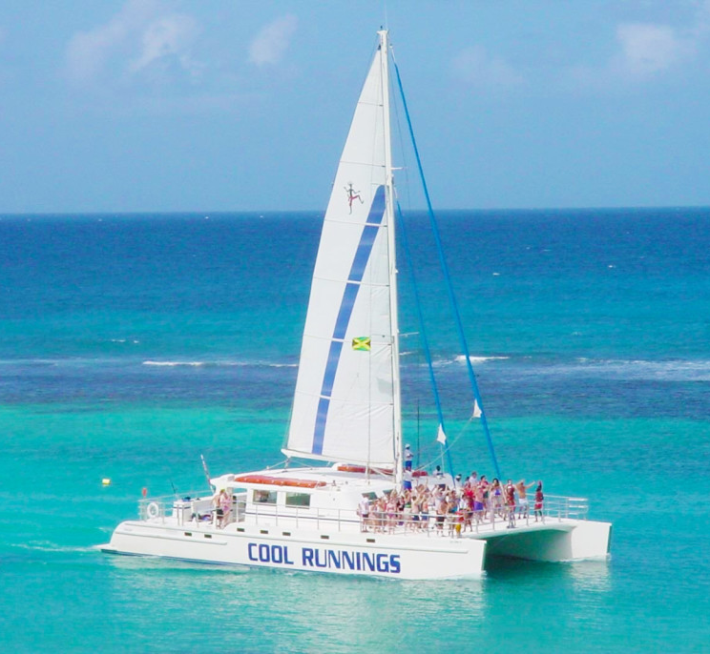
Boat Cruise with Snorkeling
Set sail to one of the Caribbean’s best snorkeling spots filled with brilliantly colored exotic marine life.
Every boat will offer thirst-quenching tropical refreshments, tasty snacks, and music so you can sing at the top of your lungs, and sway to the rhythm of the islands.
I have been on dozens of these excursions and feel they are great fun.
Be sure to bring a towel, sunscreen, swimwear, some cash, a credit card and of course you ship’s card.
,

Slide 24
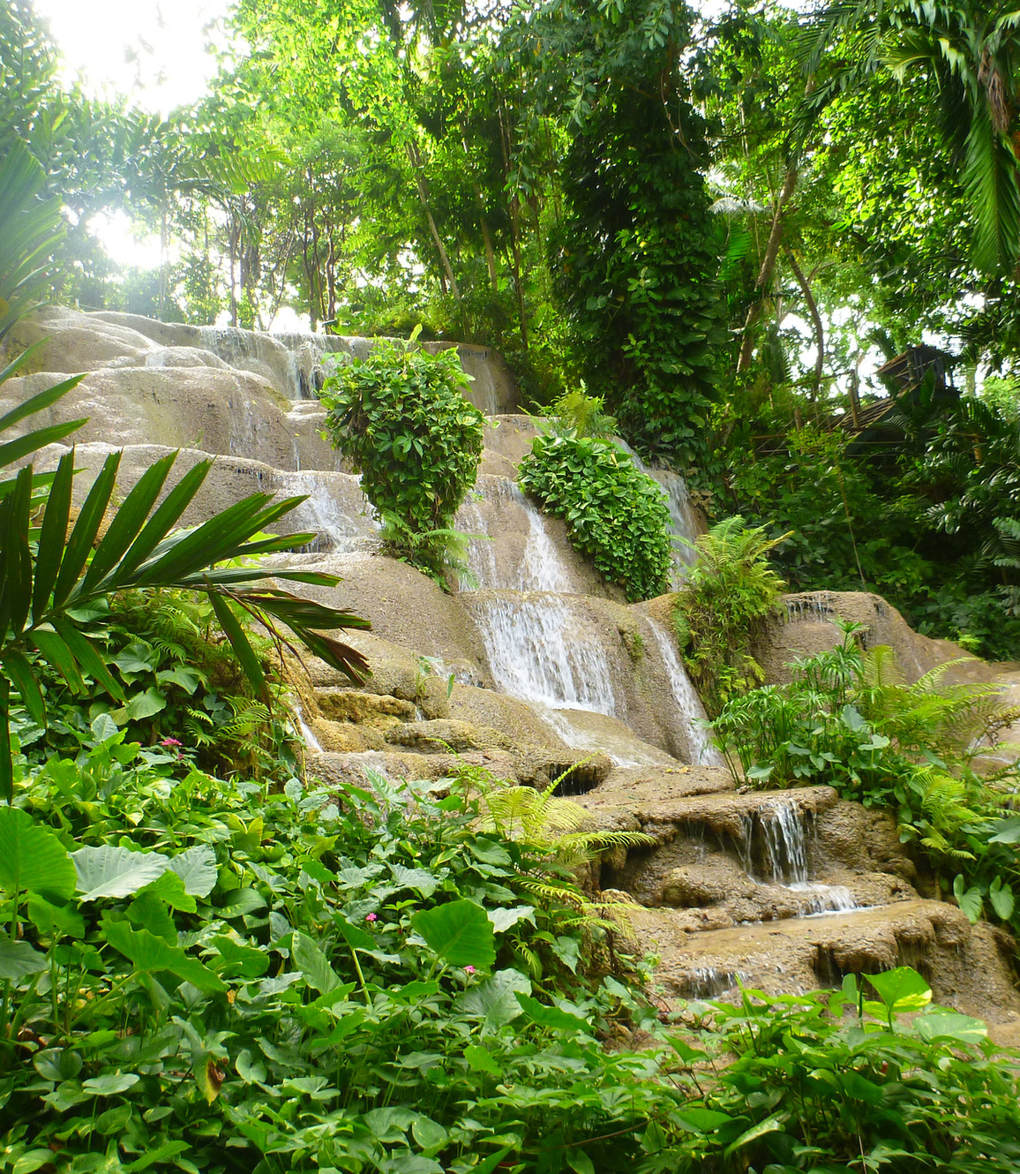
Konoko Falls & Park
Rainforests in Jamaica are peaceful, scenic, and fun. There are so many options when it comes to doing explorations of this nature, but it can be difficult to choose just one.
If you have limited time and want to try a waterfall tour that won’t disappoint, try the Konoko Falls Rainforest Trek. This is one of the more exciting rainforest expeditions on the island where you’ll get a chance to climb a waterfall, visit the botanical gardens, a museum, and a bird aviary, with still enough time for a cooking demo.
The cooking demonstration involves learning how to make tasty jerk meals, and it is the perfect addition to a tour that teaches about Jamaica and fulfills the need for adventure.

Slide 25
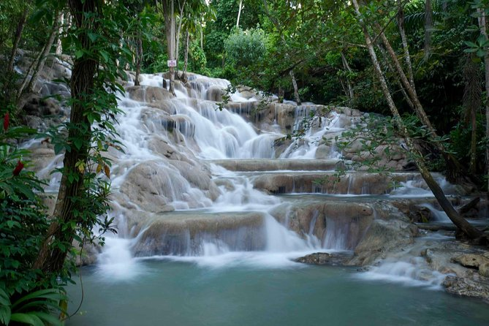
Fern Gully
A former riverbed, it is now possible to walk three miles through the valley in the shadows of magnificent ferns and hardwood trees. Jamaica has more than 500 species of ferns, and you can see at least 300 of them in this dark, shaded gorge almost 3 miles in length.
Until an earthquake around 1907, the gorge was one of the eight flowing rivers of the Ocho Rios area. The river disappeared during the earthquake and the river bed was turned into a paved road.
The dense fern growth appears to have been growing in place since the beginning of time, despite such a recent start.
The trip up Fern Gully is breathtaking. At one time it was a stream that had cut a deep valley in the mountain and over time has been populated with dense rain forest vegetation, including many varieties of ferns, hence the name Fern Gully.

Slide 26
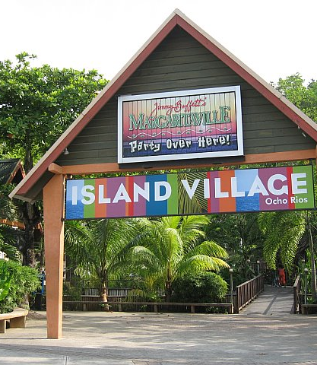
Island Village
Island Village is just minutes south of the Cruise Ship Pier, Island Village offers the perfect mix of retail and entertainment facilities all in one convenient stop.
This picturesque open-air setting incorporating natural spring lagoons and beautiful flowering trees, this complex has the remarkable feeling of being almost at “One With Nature”. It manages to recreate the ambiance of a picturesque Caribbean village setting while at the same time housing retail and entertainment facilities.
Island Village is located on the beach and stays true to its tropical location, gardens, scenic boardwalk, and water features for a relaxed shopping experience.

Slide 27
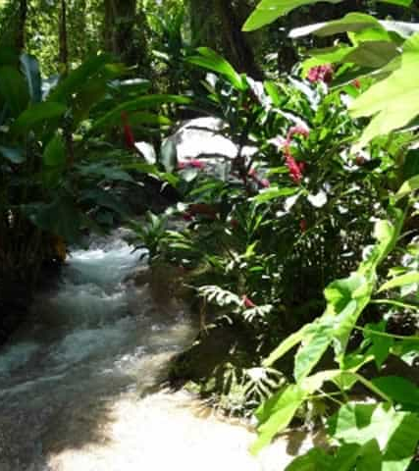
Turtle River Park
Just a 10-minute walk from the pier. You may want to bring along a swimsuit when you go, as the Turtle River Falls and Gardens located in Ocho Rios have 14 waterfalls all in one place. This is a great activity for families with children.
The kids will have a fun time at this attraction which also includes 15 acres of gardens in the mountainside, small pools, hammocks, a koi pond, and an aviary. Your kids can explore this area and have a chance to hand-feed the birds in the aviary as part of the guided tour.
ADMISSION: Adult $20US / Child under 11 $10US

Slide 28
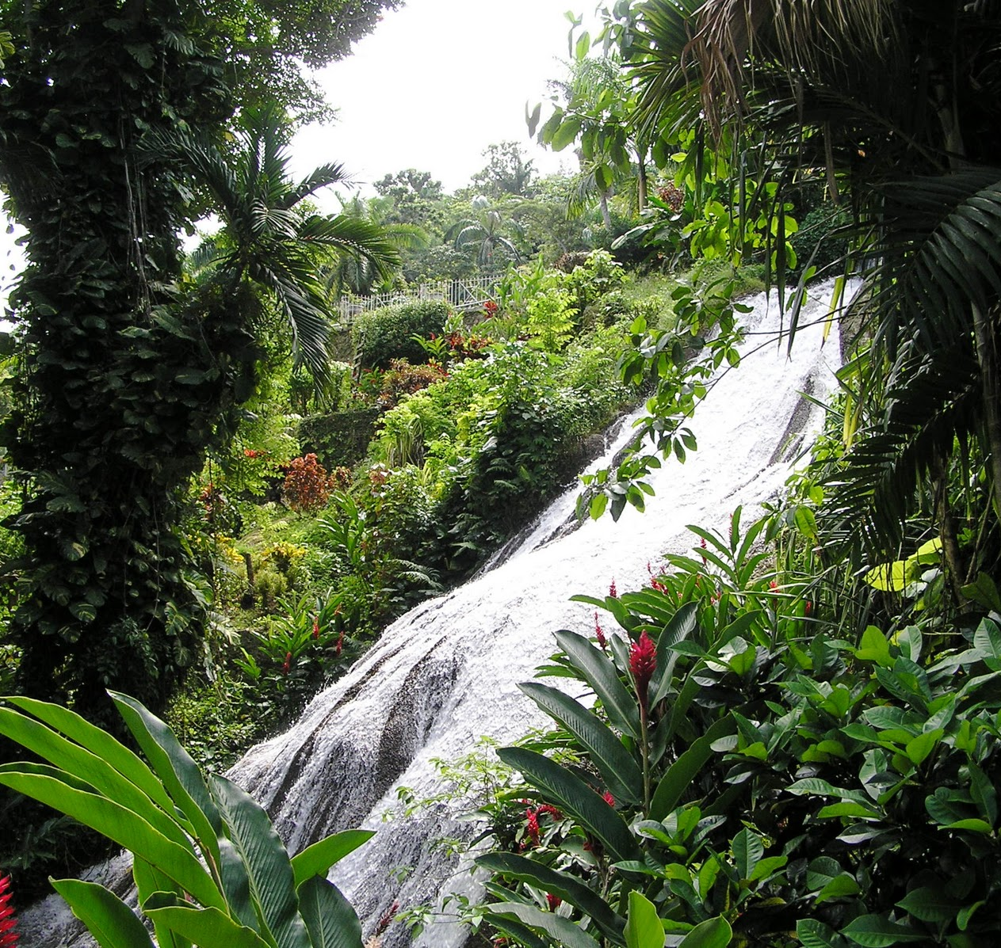
Shaw Park Gardens
Shaw Park Gardens is less than a mile walk up the mountain and is a great place to go if you want to get away from it.
Great place for people who just love being surrounded by trees, plants, and flowers, and who want to find out all they can about the exotic flora and fauna of Jamaica.
Take in views of cascading waterfalls and enjoy the breezy atmosphere. Take lots of photos as you stroll through this 25-acre property with the friendly and well-informed guides.

Slide 29
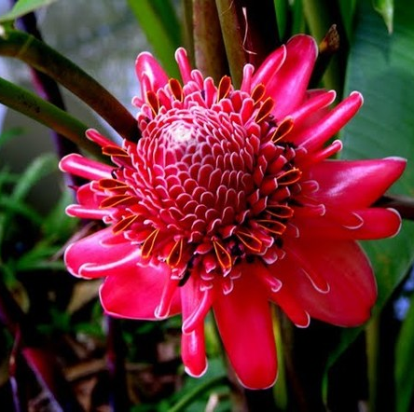
Cranbrook Flower Forest
Located about a half hour up the coast you will find an abundant eco-attraction featuring botanical gardens, rainforest, blue hole, waterfalls, and beautiful tropical flora and fauna.
This beautiful park is a must-see for anyone who wants to experience the lush beauty of Jamaica away from the crowds.
Beautiful examples of croton, ginger, heliconia, bird of paradise, and begonias. The grounds are perfect for a picnic.
Other activities include bird watching, pond fishing, croquet, donkey rides, and volleyball.

Slide 30
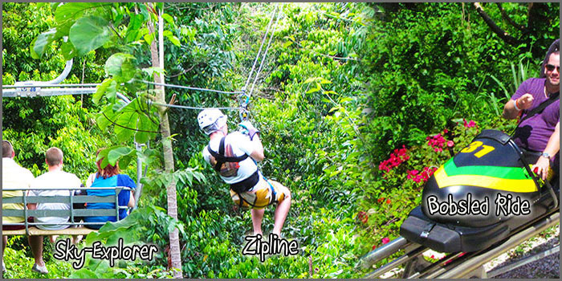
Mystic Mountain
Mystic Mountain is one of the top attractions in Ocho Rios, Jamaica.
There is so much to do there – from zip lining and bobsledding to bird watching.
A great activity to bring the kids. With a name like Mystic Mountain, you’ll have them intrigued before you even get to this location. Once there, you’ll be able to ride up the mountainside on the Sky Explorer, a chairlift that rises over the rainforest.
This affords amazing views of the cruise ship port and the coastline, and once you’re at the top you can go for guided walks, jump in the infinity pool, go ziplining, ride a bobsled down the mountain, or do other fun activities.
My one caveat is you can spend more money here than Disneyland!

Slide 31
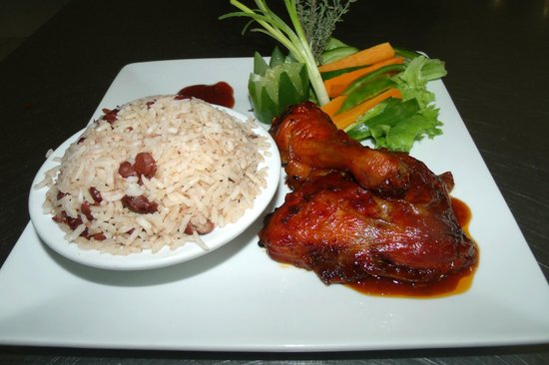
Restaurants
There are a lot of excellent restaurants in Ocho Rios. Especially for seafood.
Here are some recommendations: Bamboo Blu $$ - $$$ Caribbean, Bar, Seafood
Mammee Bay Estate, Mammee Bay Next to Riu Hotel, Ocho Rio
Miss T's Kitchen $$ - $$$ Caribbean, Healthy, Jamaican
65 Main Street, Ocho Rios
Evita's Italian Restaurant $$ - $$$ Italian, Caribbean, Fusion
Eden Bower Rd. Off Da Costa Drive, Ocho Rios
Mom’s $ Caribbean, Jamaican, 7 Evelyn St, Ocho Rios
Oceans On The Ridge $$ - $$$ Caribbean, Bar, Seafood
Shaw Park, Ocho Rios
Bamboo Blu $$ - $$$ Caribbean, Bar, Seafood Mammee Bay Estate, Mammee Bay Next to Riu Hotel, Ocho Rios
I hope you enjoy your culinary adventures in Ocho Rios!

Slide 32
Conclusion
Ocho Rios is a beautiful Area with a rich history and seemingly endless attractions.
Regardless of what you're looking for, Ocho Rios has something for everyone.
I hope this presentation will help when we visit Ocho Rios

Slide 33
Thanks For Coming
If you have any more questions, please ask.
I will do my best to answer them for you.
Have a great visit in Ocho Rios !

