Slide 1
Norway’s History a Time Line
Presented by
Marc Silver

Slide 2
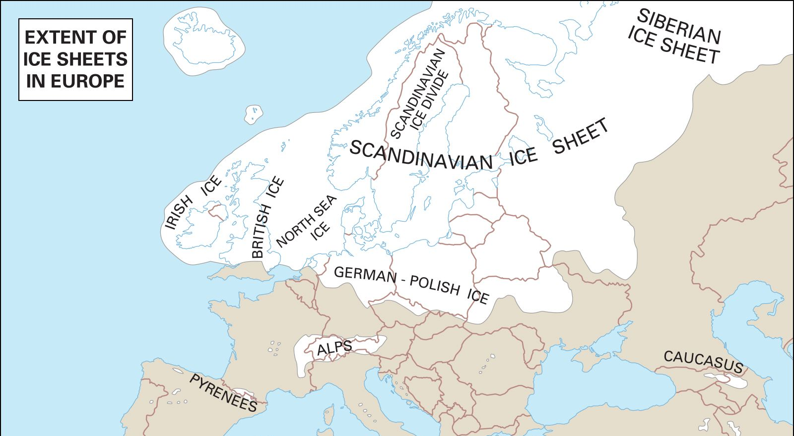
Norway’s Prehistory
Norway's history has long been influenced by both the terrain and the Scandinavian climate. Most of the Scandinavian land mass has been covered by ice at least three times. Here are the key dates we know about:
10000 BCE: Humans arrive in Scandinavia from the first time, attracted to the Norwegian coast by the good conditions for sealing, fishing, and hunting. They arrive from the south, but also from the northeast.
8000 BCE: Nomadic groups begin to settle as the ice recedes along the entire coastline.
4000 BCE: Farming begins along the Oslofjord at the start of the Neolithic period. Tools and techniques arrive from southern Scandinavia.

Slide 3
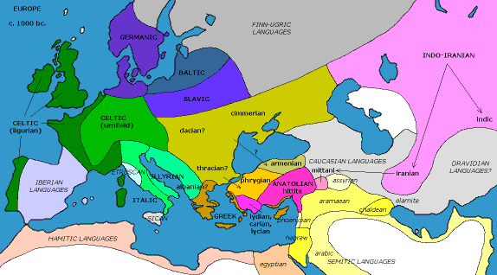
Norway’s Prehistory Cont.
3000 BCE: The era of the fascinating Scandinavian Battle-Axe culture in coastal areas of Norway and Sweden. A recent research study suggested individuals have ancestry from the Pontic–Caspian steppe herders, with components originating from hunter–gatherers and Early Neolithic farmers. This means there was migration into Scandinavia.
2800 BCE: Agriculture and farming modernizes and spreads across the country. Oats, barley, pigs, cattle, sheep and goats are now commonplace.

Slide 4
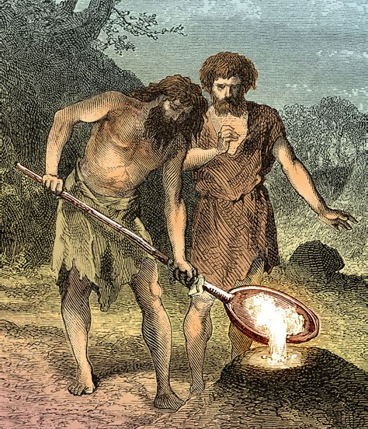
The Bronze Age in Norway
The copper and tin in the bronze from the Bronze Age came from people far away. Globalization was now a thing for the first time. As a maritime society, scholars have suggested this could have been a mini-Viking Age.
1700 BCE: The beginnings of the Early Bronze Age, triggered by the import of both metals and culture from central Europe.
1100 BCE: The transition into the Late Bronze Age. People maintained close trade links with Mycenaean Greece, and became expert metalworkers. The number and density of metal deposits saw wealth develop.

Slide 5
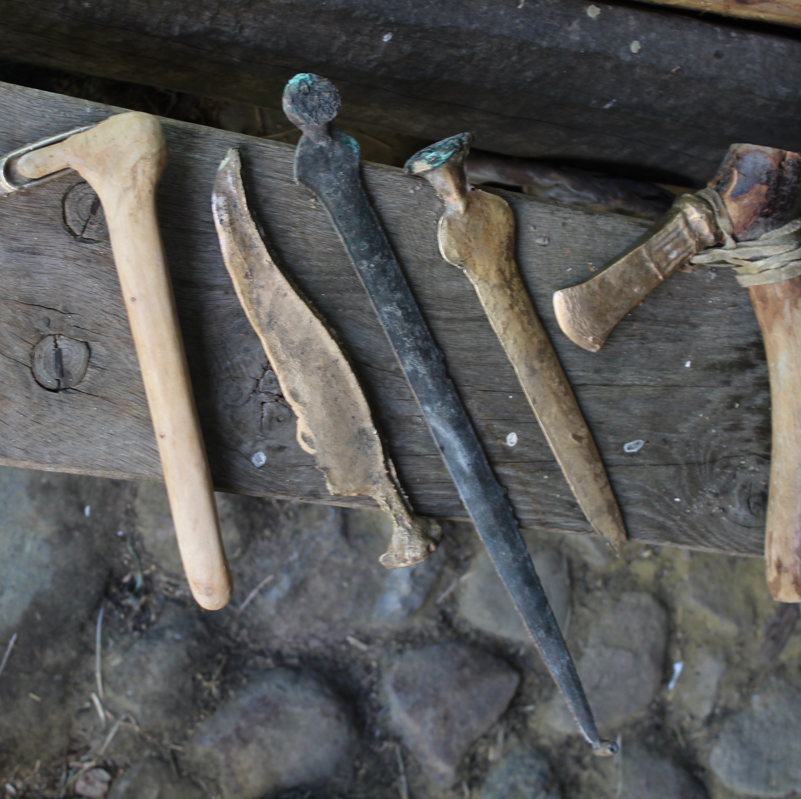
Iron Age in Norway
The transition into the Iron Age is marked by change. A changing climate caused a dramatic change in the flora and fauna leading to migration southwards.
Also, the expansion of Hallstatt culture from the south caused cultural shifts. Northern Iron Age culture was likely spearheaded by speakers of Germanic languages, long before the Viking Age came to the fore.
500 BCE: This period is often referred to as the “Findless Age” due to the lack of archaeological evidence, consistent with a drop in population.

Slide 6
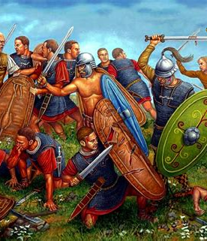
Iron Age in Norway
100 CE: The Roman Empire begin to exert pressure on the Germanic tribes throughout Northern Europe. This period became known as the Roman Iron Age. Significant trade took place, with coins, vessels, glass objects, buckles and weapons all making their way into Scandinavia.
250 CE: Germanic tribes that settled north of the Black Sea begin to influence Scandinavia. For example, the use of runes is seen for the first time. Sami people begin to settle in the north of Scandinavia. How far south they lived is debated.
450 CE: Scandinavians return to the region with silver and gold from the Roman Empire. Trading in such luxury goods begins to increase.
550 CE: Powerful farmers became chieftains and their power increased as other Germanic tribes migrated northwards and local farmers wanted protection.

Slide 7
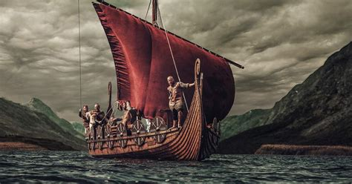
The Viking Age in Norway
An era of exploration and expansion. Yes, they were warriors, but the Norsemen of the time also created social institutions, oversaw the conversion to Christianity and left a big impact on European history.
793: Widely accepted as the “beginning” of the Viking Age, the raid on Lindisfarne was the most notable of the early attacks on the British Isles. According to written sources, “heathen men came and miserably destroyed God’s church on Lindisfarne, with plunder and slaughter.”
830: Norway's Oseberg ship that was discovered near Tønsberg was buried around this time. It's known as the finest artefact to have survived from the era.

Slide 8
The Viking Age in Norway Cont.
872: Icelandic historians believe Harald Fairhair (Harald hårfagre) became the first King of Norway. He is said to have unified Norway following the Battle of Hafrsfjord, commemorated by the famous swords sculpture of Stavanger.
900: Battles continue in Britain over land and power, while Viking sail into France and along the Mediterranean.
981: Expelled from Norway and Iceland, Erik the Red settled in Greenland with 25 ships, people and goods. More than 3,000 Vikings were said to be living on Greenland as farmers at one point. Vikings also discovered Newfoundland after being blown off course on a voyage to Greenland.

Slide 9
The Viking Age in Norway Cont.
995: Olav Tryggvason built the first Christian church in Norway. He would go on to found the city of Trondheim in 997.
1030: Norway's Christian King Olav Haraldsson was defeated in the Battle of Stiklestad. Churches and shrines to Saint Olav were built in his honour across Europe. However, some historians doubt the authenticity of the battle.

Slide 10
The Middle Ages
Many chieftains feared that Christianity would rob them of power, so it took centuries for the new faith to be fully accepted. For many years people adopted both as a form of “insurance policy.” For example, carvings in some of Norway’s oldest stave churches feature figures from Norse mythology.
1100: Population increased drastically. Many farms were divided into smaller plots of land, with some landowners turning over their land to the King or church during tough times.
1130: After almost a century of peace, ambiguous rules of succession led to a civil war.

Slide 11
The Middle Ages
1280: Known as Norway's original ‘golden age', the late 13th and early 14th century was a peaceful time of increasing international relations.
1349: Many communities were entirely wiped out as the Black Death arrived in Norway. The disease killed a third of the population within a year. The subsequent drop in tax income weakened the King so the church became more powerful.
1360: The Hanseatic League took control of a lot of international trade via its establishment in Bergen.

Slide 12
The Scandinavian Unions
1397–1523: The Kalmar Union was a personal union between Norway, Denmark and Sweden – which at the time also included much of modern Finland – under a single crown.
1524–1814: The Kalmar Union dissolved, but Norway remained in a personal union with Denmark. While the crowns were united, the two countries retained their own laws, currencies and militaries.

Slide 13
Norwegian Independence
1814: The signing of the Norwegian constitution at Eidsvoll. However, nationalistic aspirations were frustrated by Sweden's victory in a brief war.
1814–1905: Norway entered a personal union with Sweden. The countries shared a common monarch and conducted a common foreign policy.
1905: Negotiations between the two governments eventually led to full independence. Sweden recognised Norway as an independent constitutional monarchy.

Slide 14
The World Wars
1914-1918: Norway remained technically neutral during World War I, but wielded significant influence through trade and diplomacy.
1940-1945: Norway was occupied by German forces for much of World War II. The country played host to some key moments, including the Battle of Narvik, Operation Claymore and the Heavy Water War.
1952: Oslo hosted the 1952 Winter Olympics. The city put its name forward to show the world they had recovered from the war. In total, 694 athletes from 30 nations participated. Norway won 16 medals, 7 of them gold.

Slide 15
The Oil Age
1966: The first oil exploration well was dug in the North Sea. Oil was discovered within a year, but it was not thought to be economically viable.
1969: Initial oil exploration in the North Sea had proved disappointing until the Ocean Viking discovery. This find in what would become known as the Ekofisk field kick-started a new economic era for Norway.
1972: The Norwegian government creates Statoil, which would later become Equinor. Building up Norwegian competence and participation on the Norwegian continental shelf were the primary aims. The government of Norway remains the largest shareholder today.

