Slide 1
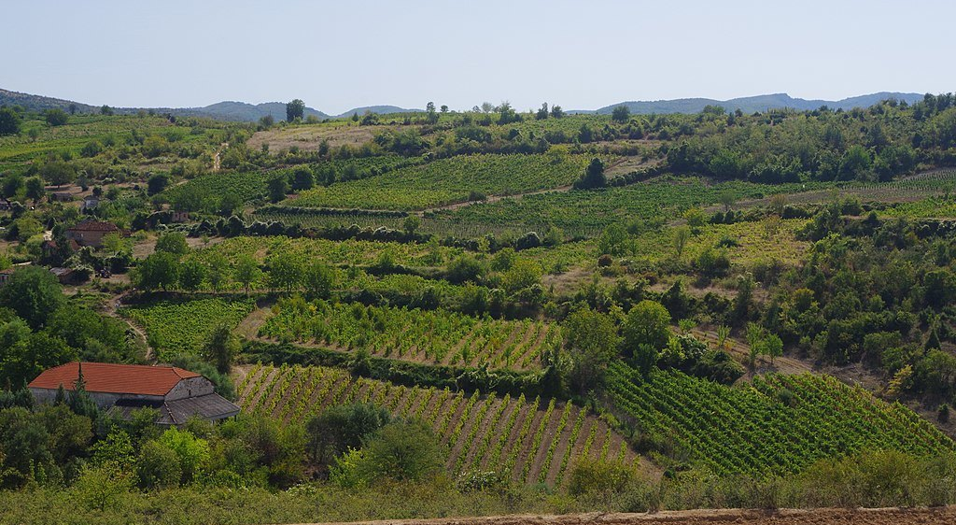
Wine Regions of the World Wines of North Macedonia Presented by Marc Silver

Slide 2
An Introduction to Wine in North Macedonia
Wines of North Macedonia
History of Wine in North Macedonia
North Macedonia’s Wine Classification System
Wine Regions of North Macedonia and Notable Wineries
Lesser-known Wine Regions
North Macedonia’s Unique Terroir
North Macedonia’s Wine Culture and Traditions
Indigenous Grapes and Their Significance
Sustainable Winemaking Practices in North Macedonia
Growing International Reputation
Final Thoughts
References

Slide 3
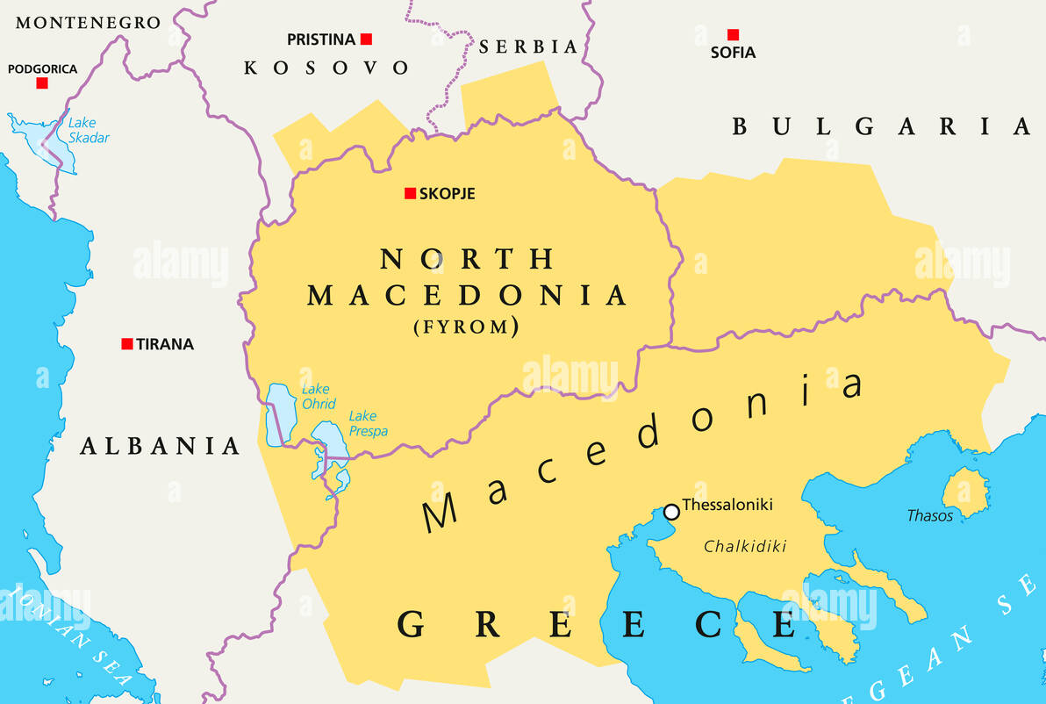
Wines of North Macedonia
Imagine a country where winemaking goes back thousands of years, where every glass tells a story of ancient traditions mingling with modern innovation.
Welcome to North Macedonia, a hidden gem of the Balkans, with a wine culture as rich and varied as its landscapes.
Whether you’re a seasoned wine enthusiast or just starting to explore, North Macedonia's wines are bound to surprise you with their bold flavors and distinct local character.

Slide 4
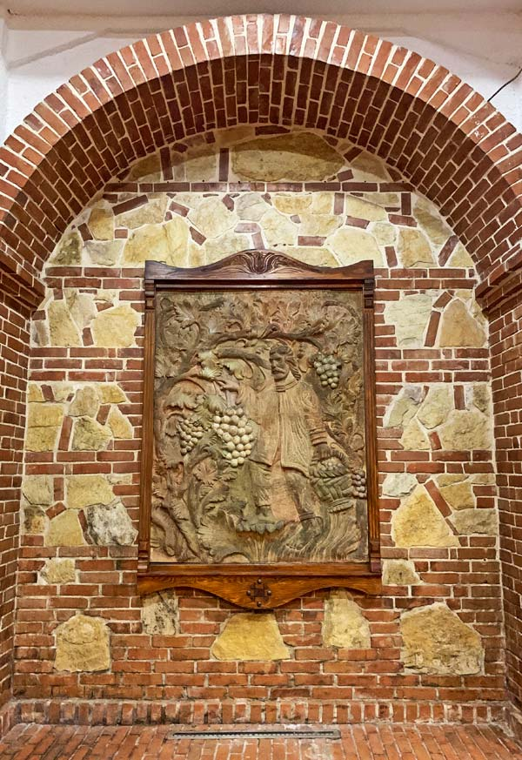
Ancient Beginnings
Picture this: over 4,000 years ago, the early inhabitants of what is now North Macedonia were already busy cultivating grapevines.
These ancient winemakers weren’t just creating a drink; they were crafting a cultural symbol. Wine flowed at celebrations, rituals, and trade gatherings, woven into the very fabric of daily life.
It's amazing to think that we can still savor some of that same spirit today, in each glass of Macedonian wine.

Slide 5

Influence of the Romans and Middle Ages
Fast forward to the Roman era, when wine took on an even greater role.
The Romans, with their well-known love for wine, brought their expertise to the region, refining grape-growing and winemaking techniques.
They laid down vineyards and introduced grape varieties that set the stage for the wines we enjoy today.
Then, during the Middle Ages, the monasteries kept the tradition alive.
Monks, with their devotion to both faith and wine, became the caretakers of this ancient craft, preserving it through times of upheaval.

Slide 6
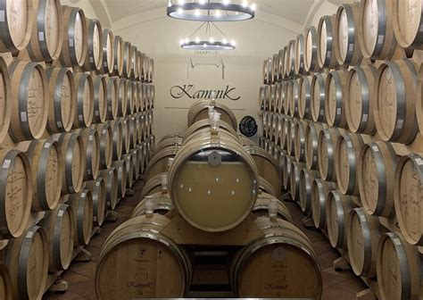
Modern Revitalization and Global Recognition
The road wasn't always easy, centuries of Ottoman rule and the chaos of world wars left their mark. But by the was underway.
After gaining independence, North Mace1990s, a wine renaissance donia’s wine scene began to blossom once more.
Today, it’s not just about quantity; it’s about quality. Smaller, boutique wineries are popping up everywhere, mixing modern techniques with time-honored traditions.
The world is starting to take notice, Macedonian wines are earning a well-deserved spot on the international stage.

Slide 7
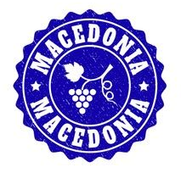
North Macedonia’s Wine Classification System
The country’s classification system might sound a bit formal, but it’s really about guaranteeing quality.
It’s similar to what you’d find in France or Italy, focusing on where the grapes are grown and how the wine is made.
Think of it as a way to make sure you’re getting a true taste of the land, whether it’s a simple table wine or a high-quality bottle from a particular region.

Slide 8
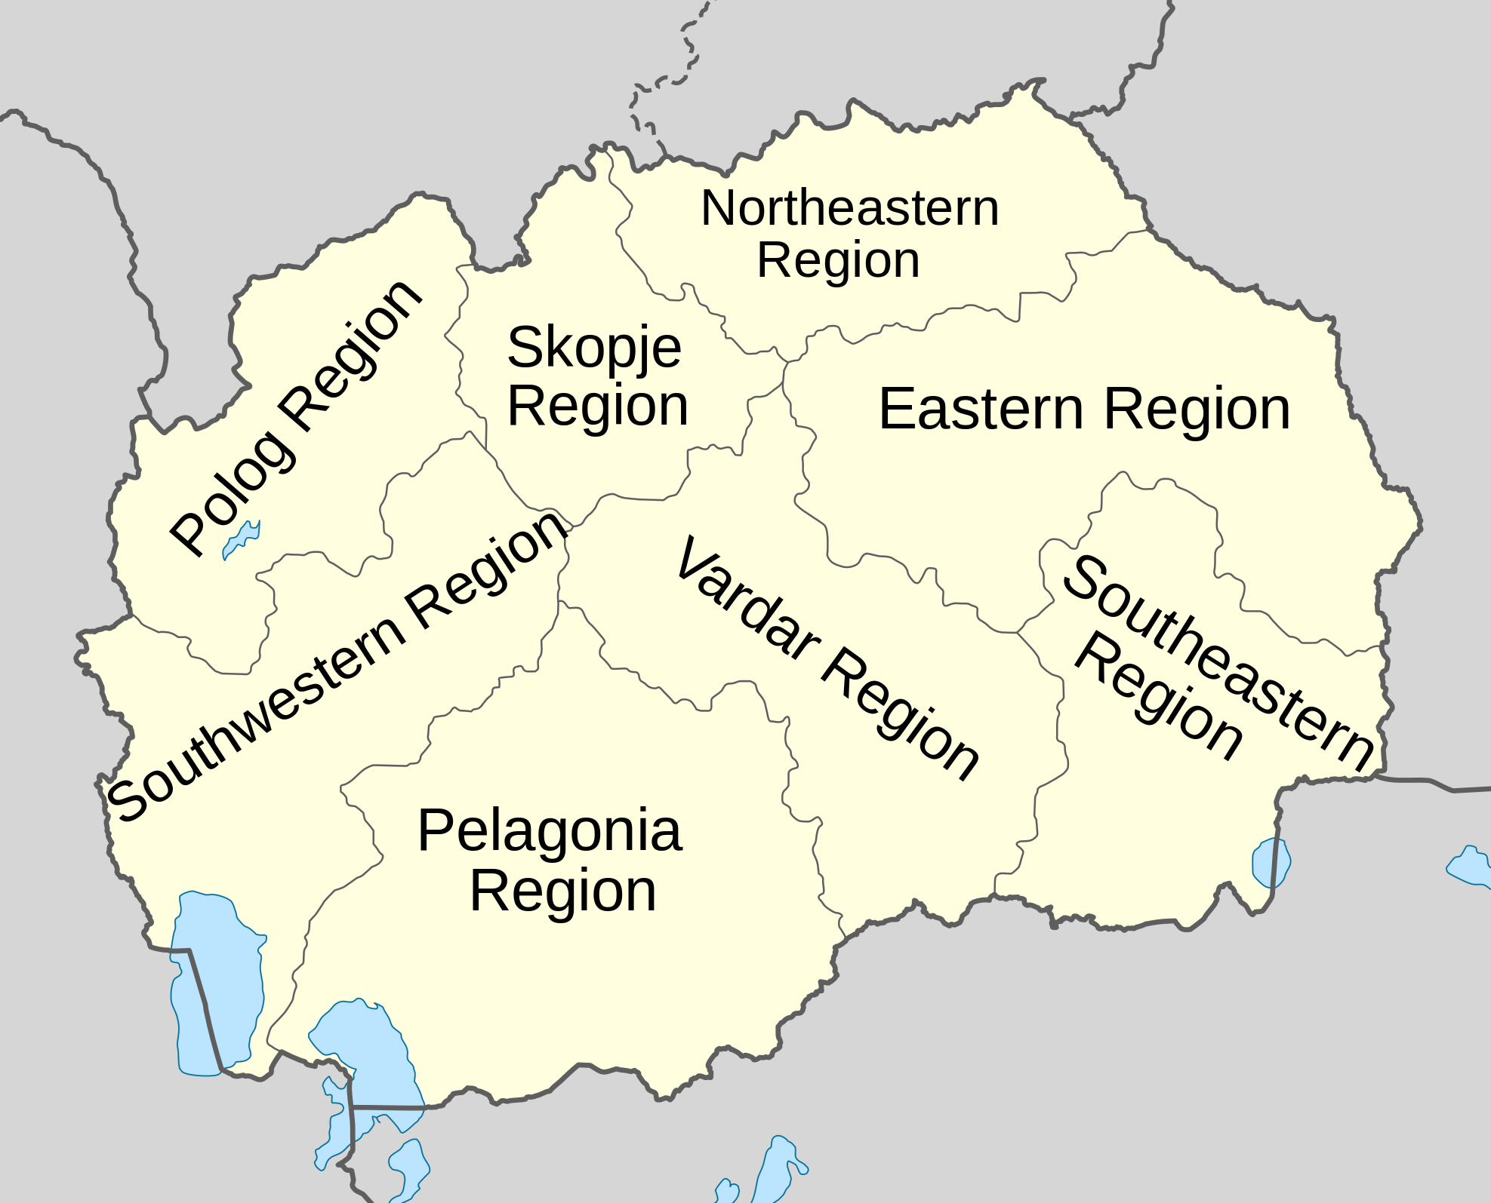
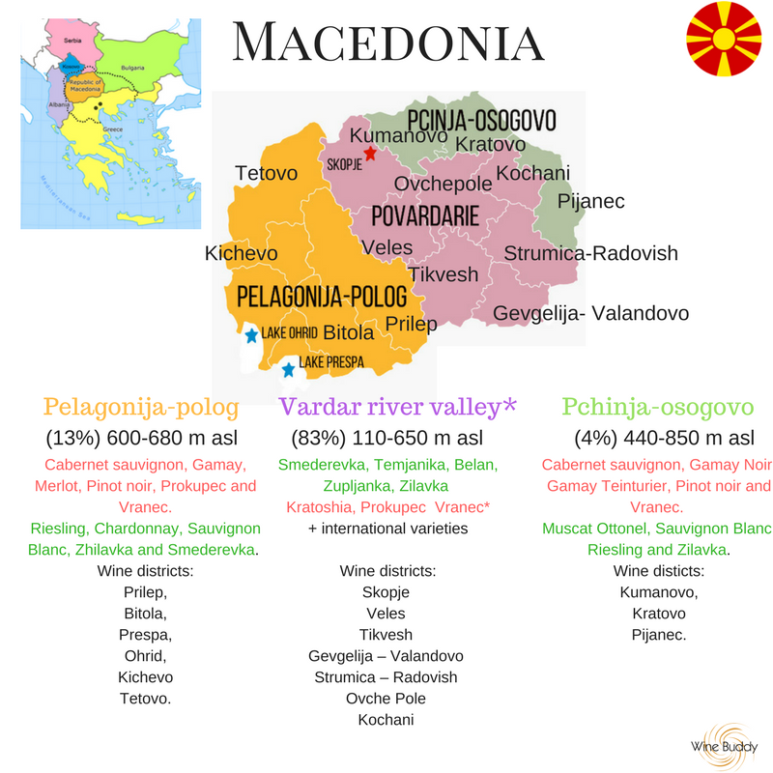
Introduction to North Macedonia’s Wine Regions
If you ever get the chance to visit, you’ll see why wine is such a big deal here.
North Macedonia's wine regions are as diverse as the wines themselves, each with its own distinct landscape, climate, and winemaking traditions.
From the rolling hills and sun-drenched vineyards of the Tikveš region to the river valleys of Povardarie and the cooler, elevated areas around Skopje, there’s something special to discover at every turn.
Let’s take a little tour and explore what makes these regions so unique.

Slide 9
Tikveš Wine Region
The Tikveš Region, often called the "wine heart" of North Macedonia, is the country’s largest and most famous wine-producing area.
Here, endless rows of vines stretch across the warm, Mediterranean-influenced terrain, with hot summers and mild winters creating ideal conditions for bold red wines like Vranec and Kratošija.
Tikveš’s reputation as a top wine destination isn’t just about the quantity it produces but the quality, with many wineries here gaining international recognition for their innovative blends and dedication to tradition.

Slide 10
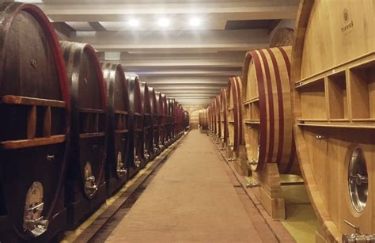

Notable Wineries in Tikveš
Tikveš Winery: This is the big name around here, known for its top-quality Vranec and a long history of winemaking.
They’ve mastered the art of combining tradition with innovation, and it shows.

Slide 11
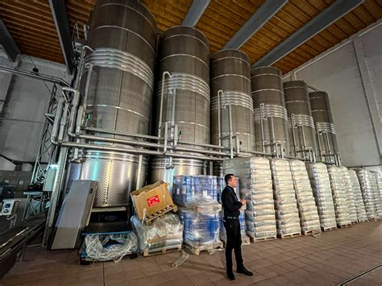
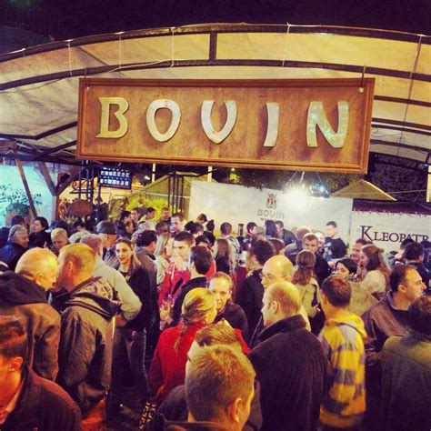

Notable Wineries in Tikveš
Stobi Winery in Tikveš is known for being a bit of a trendsetter, Stobi’s range is impressive. They even have a sparkling Chardonnay that’s become a local favorite.
Also located in Tikveš is Bovin Winery. They are all about organic winemaking.
Their wines are fresh, vibrant, and have a real sense of place.

Slide 12
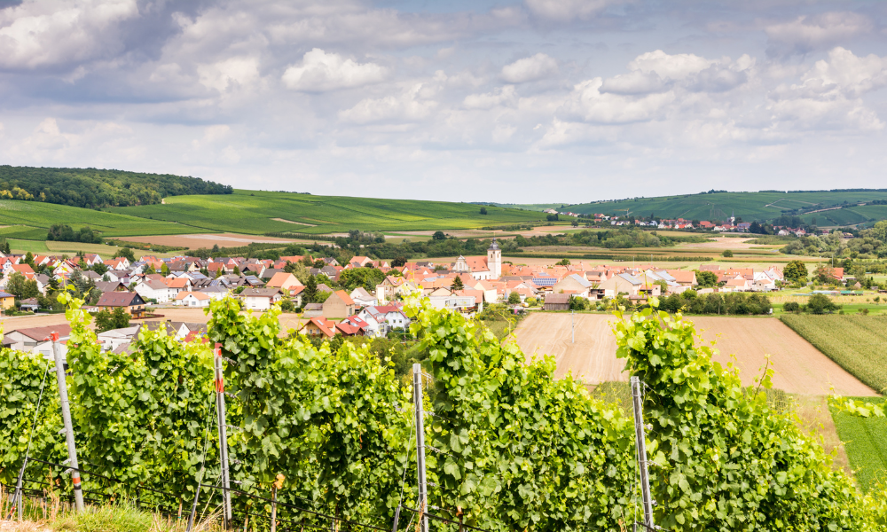
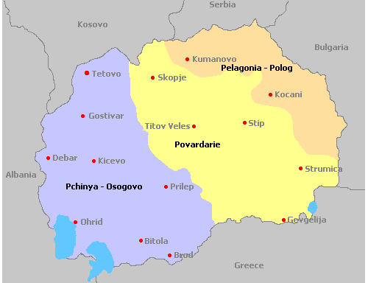
Povardarie Wine Region
Travel northeast to the Povardarie Region, where the mighty Vardar River snakes through vineyards that benefit from cooling breezes and varied soils.
This region is known for its refreshing whites, like Smederevka and Rkaciteli, as well as balanced reds.
The combination of river valleys and gentle slopes provides a diverse microclimate that adds complexity to the wines, making them crisp and lively with a unique minerality.

Slide 13
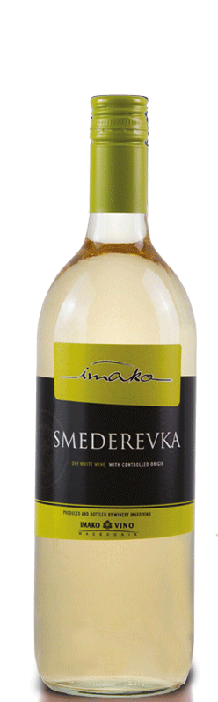
Povardarie Wine Region
Following the Vardar River, Povardarie has a touch of the Mediterranean in its air.
That’s what makes it a great region for crisp white wines, like Smederevka and Chardonnay.
The river’s breeze cools things down a bit, helping to keep the acidity fresh and lively. If you’re after something light and refreshing, this is the place to look.

Slide 14
Skopje Wine Region
Then, there's Skopje, the capital region, where urban wineries are making a name for themselves.
Tucked between limestone-rich hills and overlooked by the majestic Vodno Mountain, Skopje’s vineyards have a special character.
Here, traditional winemaking meets modern techniques, and you’ll find small-scale producers experimenting with indigenous and international varietals.
The wines from Skopje often have a fresh, vibrant profile that reflects the youthful energy of the capital city itself.

Slide 15
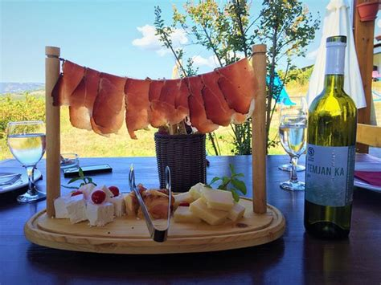
Skopje Wine Region
Surprisingly, the capital region is starting to make a name for itself in wine.
It’s all about innovation here, with urban wineries producing small batches that combine local varietals with international favorites like Merlot.
The limestone-rich soils add a distinct minerality that makes these wines stand out.

Slide 16

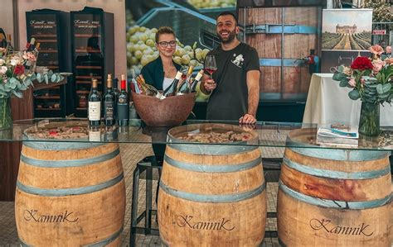
Notable Wineries in Skopje
Chateau Kamnik: In the Skopje region, Kamnik is making waves with their elegant reds and aromatic whites.
They’re committed to sustainability, and it’s reflected in the quality of their wines.

Slide 17
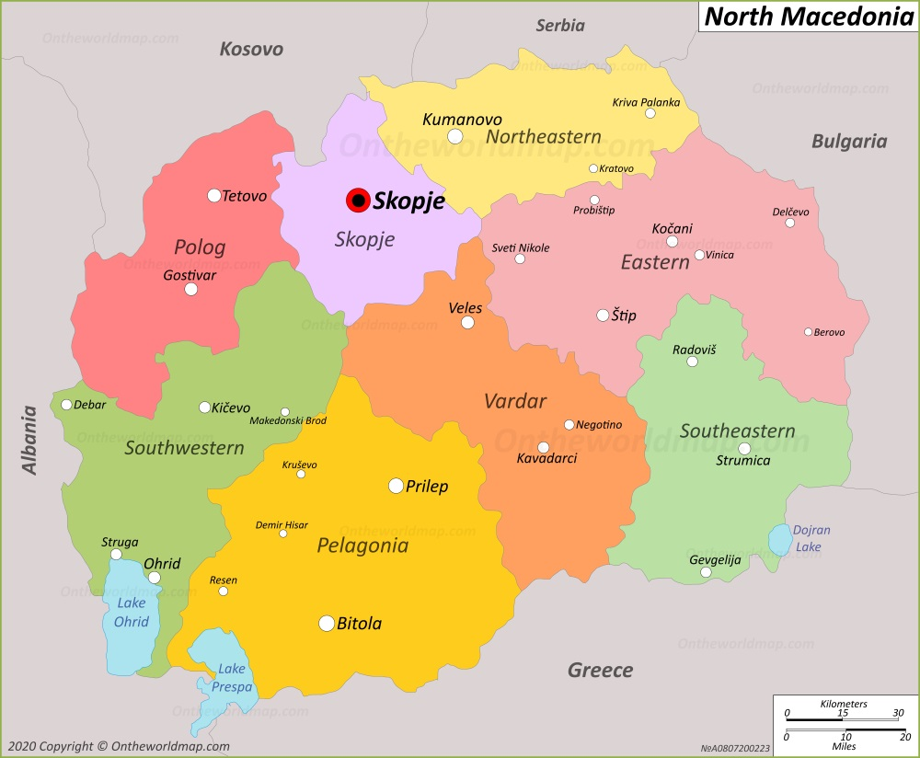
Veles Wine Region
Further south, the Veles Region offers a more boutique wine experience.
It’s a haven for those who appreciate small, family-owned wineries with a passion for organic and biodynamic practices.
Veles’ cooler nights and rocky soils create conditions perfect for elegant, medium-bodied wines with subtle, nuanced flavors.
It’s a place where winemakers blend the past with the present, using traditional methods to craft wines that speak to the land's heritage.

Slide 18
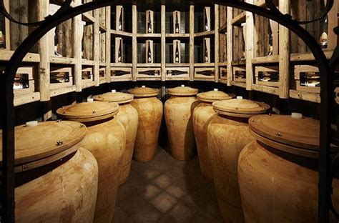
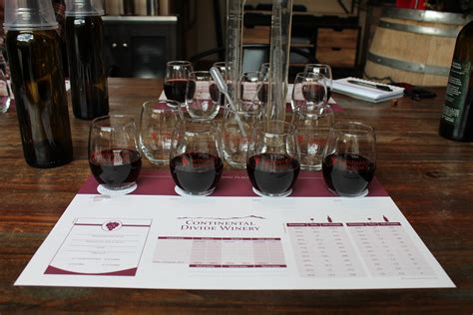
Veles Wine Region
Now, Veles is where things get interesting.
It’s a smaller region, known for its quirky, experimental spirit.
Here, you’ll find winemakers blending ancient practices with the latest trends, often leaning towards organic and biodynamic methods.
Each bottle from Veles has its own personality, and you can taste the creativity that goes into every sip.

Slide 19
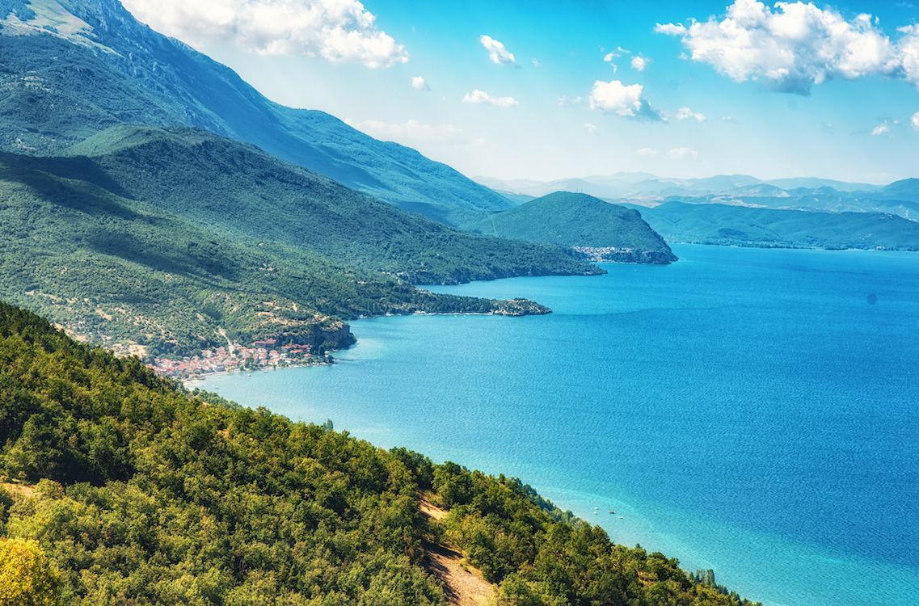
Lesser-known Wine Regions
In addition to these main regions, North Macedonia has several lesser-known wine areas that are worth exploring, like the lakeside vineyards around Ohrid, where grapes grow under the influence of a cooler, more temperate climate.
These hidden gems often focus on preserving ancient grape varieties and artisanal winemaking techniques, offering a rare glimpse into the country’s deep-rooted wine culture.
Each of these regions has its own story to tell, from the soil and climate to the traditions passed down through generations of winemakers.

Slide 20
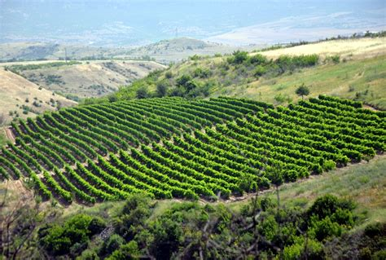
Lesser-known Wine Regions
Together, they make North Macedonia a captivating destination for wine lovers, a place where every glass tells the tale of the land, the people, and the passion that goes into every bottle.
So, if you find yourself wandering the Macedonian countryside, don’t miss the chance to taste your way through these diverse regions, each one offering a unique expression of the country’s vibrant wine scene.
Beyond the big names, there are a handful of tiny regions, each with its own charm. Places like Ohrid, Strumica, and Kumanovo might not be on the main wine route, but they’re worth a detour.
These areas are home to small, family-run vineyards that hold onto the traditions that have been passed down for generations.

Slide 21

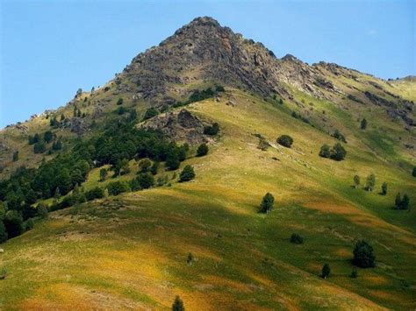
Unique Terroir
It’s hard to sum up the country’s terroir in just a few words.
There’s so much going on, rugged mountains, rolling hills, and fertile plains, each with its own type of soil.
You’ve got limestone and clay in some areas, volcanic touches in others, and alluvial deposits by the rivers.
This mix means that each vineyard produces something truly unique.
The local winemakers know how to play with these differences, choosing the best spots for each varietal.

Slide 22
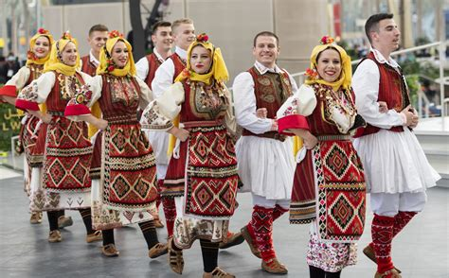
North Macedonia’s Wine Culture and Traditions
Wine festivals are a big deal here, especially in Tikveš, where the Harvest Festival is like one big celebration of everything that makes Macedonian wine so special.
There’s dancing, music, and plenty of wine to go around.
And it's not just about the wine; it’s about coming together, sharing stories, and keeping traditions alive.

Slide 23
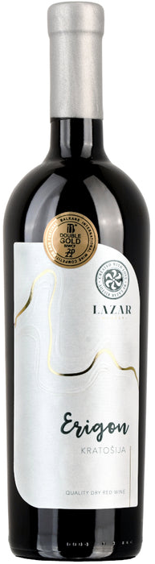
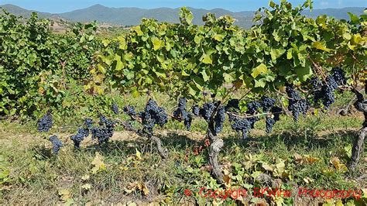
Indigenous Grapes and Their Significance
You can’t explore Macedonian wine without highlighting Vranec, the region’s signature red.
It’s a bold and robust wine, with deep, dark color and intense flavors that demand attention, think of ripe black cherry, juicy plum, and a touch of spice. This grape truly showcases the rich, full-bodied reds that North Macedonia is known for.
Then there’s Kratošija, a grape with an unexpected connection to California’s Zinfandel.
It’s lighter than Vranec, offering bright red fruit notes like raspberry and strawberry, making it an easy-going choice that pairs well with a variety of dishes.

Slide 24
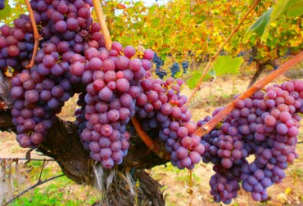
Internationally Recognized Varietals
Alongside the local stars, you’ll find familiar faces like Merlot, Cabernet Sauvignon, and Chardonnay, but there are also some other international favorites that have settled in nicely.
Syrah and Pinot Noir are making waves, often blended with the indigenous varieties to create wines that are both familiar and distinctly Macedonian.
There's something unique about a Chardonnay from the limestone rich soils here, it’s crisp, refreshing, and perfect when paired with fresh seafood.

Slide 25

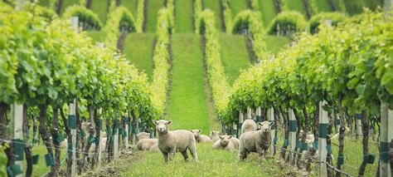
Sustainable Winemaking Practices
Sustainability is catching on in a big way, with more wineries turning to organic and biodynamic methods.
It’s about respecting the land, keeping things as natural as possible, and ensuring that future generations can enjoy the same high-quality wines.
Many wineries are also embracing eco-friendly practices, like using solar power or conserving water, it’s all part of the bigger picture.

Slide 26

North Macedonia’s Growing International Reputation
North Macedonia has steadily been building its presence on the international wine scene, and it’s gaining attention for the quality and diversity of its wines. While historically a country more known for its quantity of wine production rather than its global reach, North Macedonia has been making strides in recent years.
The country's wines have started to receive recognition at international wine competitions, with varieties like Vranec and Kratošija earning top awards.
This has helped elevate North Macedonia's profile, especially among wine enthusiasts who appreciate the balance between indigenous varietals and internationally recognized grapes.

Slide 27
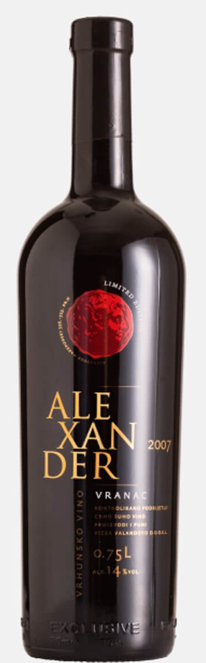
North Macedonia’s Growing International Reputation
The wines produced here are expressive, often highlighting the country's winemaking tradition while also embracing modern techniques.
As the world of wine becomes more globalized, North Macedonia’s wineries have increased their exports to countries across Europe, North America, and even Asia. The country's focus on quality over quantity is resonating with wine lovers who are looking for something distinctive, yet approachable.
There’s also a cultural renaissance happening around Macedonian wine. Wine tourism is growing, with visitors seeking out the wineries in regions like Tikveš, Povardarie, and Vardar Valley to explore the ancient winemaking traditions that date back thousands of years.
These efforts, combined with the increasing quality of wine production, are making North Macedonia a country to watch in the global wine industry.

Slide 28
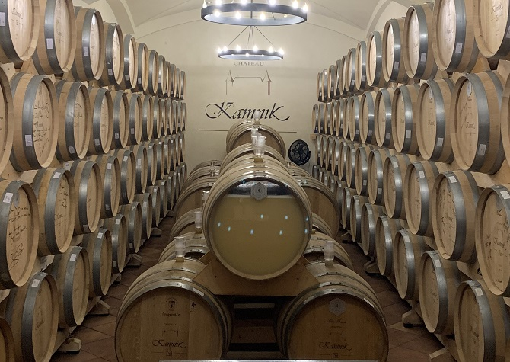
Final Thoughts
North Macedonia’s wine scene is full of surprises. It’s a place where ancient traditions and modern techniques coexist, where each glass tells a story of the land and the people who’ve worked it for centuries.
Whether you’re looking for bold reds, crisp whites, or something in between, Macedonian wines have a way of drawing you in and leaving you wanting more.
So, next time you’re browsing the wine aisle, why not give a bottle from North Macedonia a try? You might just discover a new favorite.
North Macedonia’s rich wine culture, unique terroir, and commitment to sustainable practices make it a fascinating wine destination.

Slide 29
Acknowledgement
My seminars are the result of many years of experience combined with many hours of research over the internet.
I would like to acknowledge the many source I have accessed.
These include Wine Spectator, Wine Enthusiast, BKWine Magazine, Wine & Spirits Magazine, American Vineyard Magazine, The Grapevine Magazine, Wikipedia.com, Britannica.com, and the various Government websites.

Slide 30
Citations and References
North Macedonia's wine scene is steadily growing in both reputation and production. The country benefits from a rich history of viticulture, thanks to its Mediterranean climate and diverse terroirs, especially along the Vardar River Valley. With its favorable climate, winemakers are producing a variety of wines that are gaining attention internationally, particularly red wines like Vranec, and local white varieties such as Temjanika.
The wine industry in North Macedonia is centered around three main regions: the Vardar River Valley, which produces most of the country's wine, followed by the Pelagonija-Polog and Pchinja-Osogovo regions​. Jancis Robinson ​Wine Guide
. The Vardar Valley is especially known for its concentration of vineyards, including in areas like Gevgelija-Valandovo and the famed Tikveš district. Tikveš Winery, one of the largest producers, has become a key player in the region, offering both high-volume wines and more premium, single-vineyard offerings. ​Jancis Robinson.
Besides local varieties, such as the indigenous Kratošija (known internationally as Tribidrag) and the white Temjanika, international varietals like Merlot and Cabernet Sauvignon also thrive here, adding complexity and diversity to the wine portfolio​. Wine Guide
. While the market is currently dominated by larger producers, the presence of small, boutique wineries is on the rise, further enhancing the country's reputation.
This increasing focus on quality over quantity, along with a commitment to modern viticulture and sustainable practices, has placed North Macedonia on the map as a region to watch for wine enthusiasts. With wineries experimenting with more sophisticated winemaking techniques, North Macedonia's wine future looks bright on the international stage. ​Jancis Robinson ​Wine Guide
.

