Slide 1
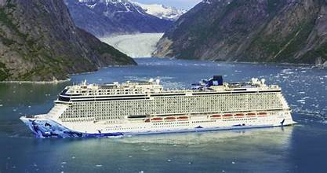
Nome Alaska Cruise Presented by Marc Silver

Slide 2
What I Will Cover
My Port Philosophy
Don’t Miss the Ship
About Valdez
Getting around Valdez
Points of Interest
Places to see or at least consider
Conclusion

Slide 3
My Port Philosophy
I have been cruising for over 45 years and have taken over 100 cruises. So, I consider myself an experienced cruiser.
The information I will present is based on those many years of
experience.
When I am on a cruise where the city, I want to visit is not the port city,
I always recommend taking a ship’s tour.
But when I am in a port with multiple attractions nearby and easy to see
on my own - I will do it on my own.
This presentation is for that type of port.

Slide 4
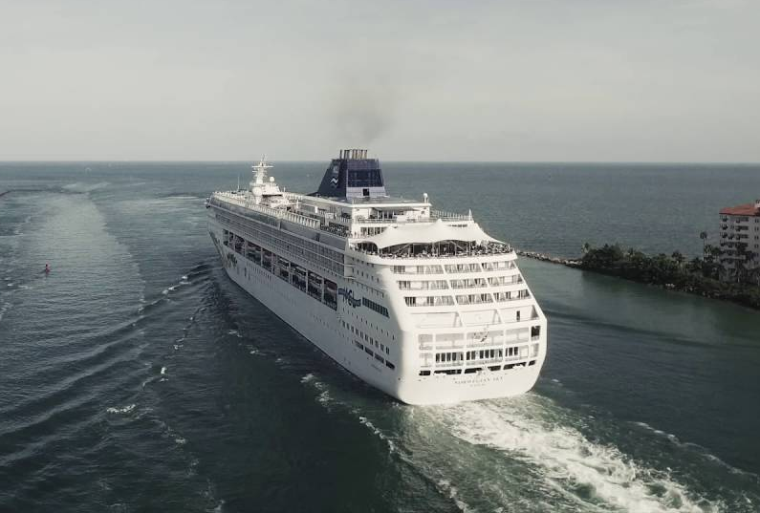
Don’t Miss the Ship
How to Avoid Missing Your Ship
Pay attention to the time. - Ship time and local time are often different.
Put a return-to-ship reminder on your phone.
Choose excursions wisely.
If a ship-sponsored excursion is late returning to port for, the ship will wait for you. If you are on your own???
Be Prepared
Have your Passport, Credit Card and phone numbers for your ship port agent.
What to Do If You Miss the Ship Most cruise lines have port agents stationed in the port area to assist if your ship has left without you. If you’re lucky, when cruisers are late returning to the vessel, the ship's crew will often remove the passengers' essential items -- passports, cell phones, and medication -- from the ship to leave with the port agents.
The Port Officials can help you with contacting your ship and making necessary travel arrangements.

Slide 5
Alaska History
The first human beings arrived in Alaska in about 13,000 BC. At that time Alaska was part of a land bridge that extended across to Siberia. People followed the herds of animals they hunted. Europeans arrived in the area in the 18th century.
In 1741 a Dane called Vitus Bering led a Russian expedition to Alaska. They discovered there was great wealth in Alaska in the form of animal furs. Unfortunately, they also brought diseases to which the native people had no immunity. The British arrived in 1778 when Captain Cook sailed there. (Cook Inlet is named after him). George Vancouver sailed to Alaska in 1794.
Meanwhile, in 1772 the Russians made a settlement at Unalaska. Then in 1784, they made a settlement on Kodiak Island.
However, by the 1860s, the Russians had lost interest in Alaska. Over-hunting had depleted the supply of furs and it was difficult to supply bases such a long way off. So they decided to try and sell Alaska to the Americans. In 1867 US Secretary of State William Henry Seward signed a treaty to buy Alaska for $7.2 million – less than 2 cents an acre. However, it took 6 months to persuade Congress to ratify the treaty. Alaska formally passed to the USA on 18 October 1867.

Slide 6
Alaska History Cont.
The new area was at first called the Department of Alaska. In 1884 it was changed to the District of Alaska. Meanwhile, in 1878 the first cannery opened in Alaska.
In 1880 gold was discovered in Alaska, in Juneau. Then in 1896 gold was discovered in Yukon but the easiest way to reach it was to sail to Skagway in Southeast Alaska. In 1899 gold was discovered in Nome in Northwest Alaska. Another gold rush began in 1902 when gold was discovered near Fairbanks.
In a single decade, the population of Alaska soared. In 1890 the population of Alaska was just over 32,000 but by 1900 it had surpassed 63,000. Then in 1912, Alaska became a territory. Anchorage was founded in 1915 and Denali National Park was created in 1917. The Alaska Railroad was completed in 1923. President Warren G Harding went to Alaska to drive in a golden spike in a ceremony to mark the event.
Women in Alaska were given the right to vote in 1913.

Slide 7
Alaska History Cont.
An Agricultural College and School of Mines opened in 1922. It became the University of Alaska in 1935.
In June 1942 the Japanese bombed Dutch Harbor in the Aleutian Islands. They also took the islands of Kiska and Attu. The Americans landed on Attu on 11 May 1943. By 30 May they had retaken the island. The Japanese abandoned the island of Kiska in August 1943. During the Second World War, military bases were built in Alaska and as a result some Alaskan towns greatly increased in size. Meanwhile, the Alaska Highway was built in 1942.
In 1957 oil was discovered in Alaska at Swanson River, on the Kenai Peninsula. Then on 30 June 1958, the Senate passed the Alaska Statehood Act. On 3 January 1959, Alaska became the 49th state of the union. The first governor of Alaska was William A Egan.
On 9 July 1958, an earthquake in Alaska caused a tsunami 524 tall in Lituya Bay.
Then on 27 March 1964 (Good Friday), Alaska was struck by a devastating earthquake. It measured 9.2 on the Richter Scale making it the most powerful earthquake recorded in North America. It killed 131 people.

Slide 8
Downtown Nome
In 1898 the “three lucky Swedes,” Jafet Lindberg, Erik Lindblom, and John Brynteson, discovered fabulous deposits of gold in Anvil Creek above present-day Nome. Word reached Dawson the next spring, and by fall 10,000 stampeders had arrived and set up tents on the beach, only to have them blown away by a fierce September storm that prompted a migration inland. There, more gold was found; in fact, placer deposits were carried by most streams that emptied into the Bering Sea.

Slide 9
Downtown Nome
In 1925 a diphtheria epidemic required emergency delivery of serum from Nenana, 650 miles overland by dogsled. Through the heroic efforts of mushers and dogs, the serum arrived in time to save many lives. This event is commemorated today in the famous Iditarod Sled Dog Race from Anchorage to Nome. The race takes place every March and turns Nome into a late-winter carnival.

Slide 10
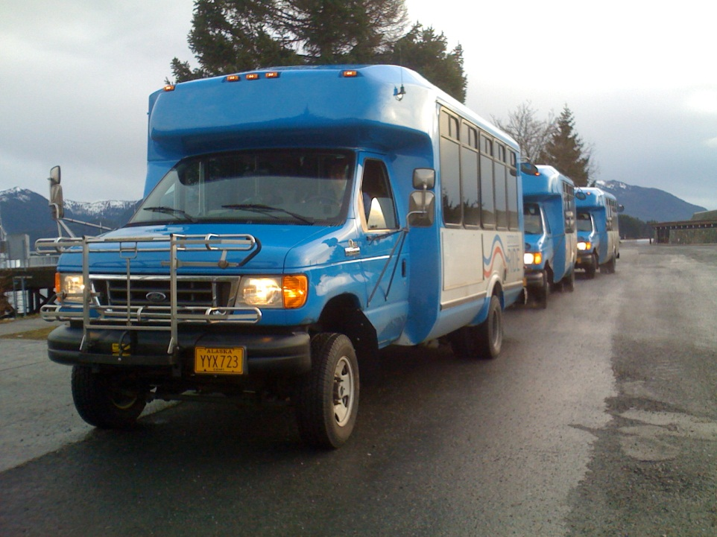
Free Shuttle
Ride the free shuttle to downtown Sitka to experience the many local shops, restaurants, and attractions.
Distance
Cruise Terminal is Located 6 miles from Sitka
Ride Duration
Shuttle Ride is 10-15 minutes to Downtown
Cost
The shuttle is free to all cruise ship passengers
Drop Off/ Pick Up Location
The shuttle drops off at and picks up at Harrigan Centennial Hall in Downtown Sitka.
Frequency
The shuttle departs at least every 15 minutes while your ship is at port.
Last Shuttle
The last shuttle from downtown is 30 minutes prior to your ship all aboard time.

Slide 11
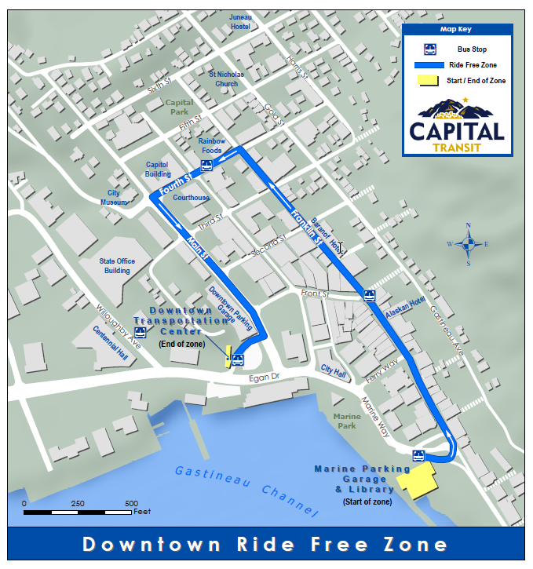
Getting Around Nome
Juneau is compact and easy to navigate.
Most activities and attractions are found within one mile of the boat harbor, so walking, especially along the waterfront path—are feasible.
But the bus system is an excellent choice if you want to get out of the city.
There is also a Ride Free zone downtown.
Cash Fare (One-Way) Exact fare required. Drivers do not make change. Sales tax included. Adult (19+) $2
Youth 18 & younger $1
Children 5 & younger Free

Slide 12
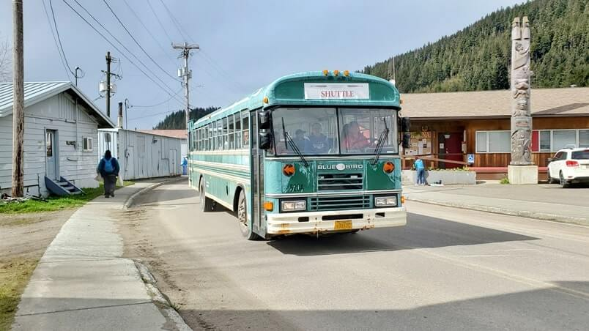
Nome Buses
The path to Hoonah is to the right at the port. It is a flat 1.5-mile walk into town along the ocean.
You will travel past the picturesque Three Rocks. Sit on the bench and spend some time looking into the bay.
You may see Dall’s dolphins jumping through the waves.
Stop by the historic Old Bear Clan Cemetery across the road.
If you’re capable, it is absolutely worth the experience to walk at least one way.
The town is small, so it won’t take too much time to visit, but it is worth the effort.

Slide 13
Nome Walking Map

Slide 14
Bears
Admission:
Adult - $15
Child - $5 (aged 8-18)
Children under 7 Free

Slide 15
Center
Adult: $15 per person Youth (age 5-17): $6 per person Child (age 4 and under): FREE

Slide 16
Museum
The core of the the public in 1897.

Slide 17
About

Slide 18
Museum
Admission Adult: $7 Seniors: $6 Children (12 and under): FREE

Slide 19
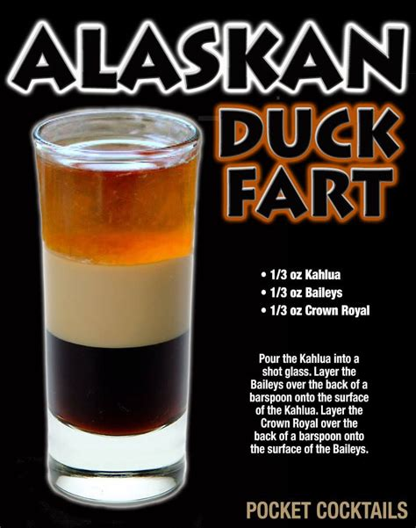
Try a Duck Fart
For those of you that watch the Deadliest Catch, you probably remember Sig Hansen’s favorite drink, The Duck Fart. You can get one at the XXXXX Saloon for $7 a shot.
With a name like that you may have to go ahead and get yourself two of them.
No list of things to do in Nome would be complete without the famous Red Dog Saloon.
A mix of tourists and locals will keep you in good company while you sit back and relax, planning your next inexpensive adventure around town.

Slide 20
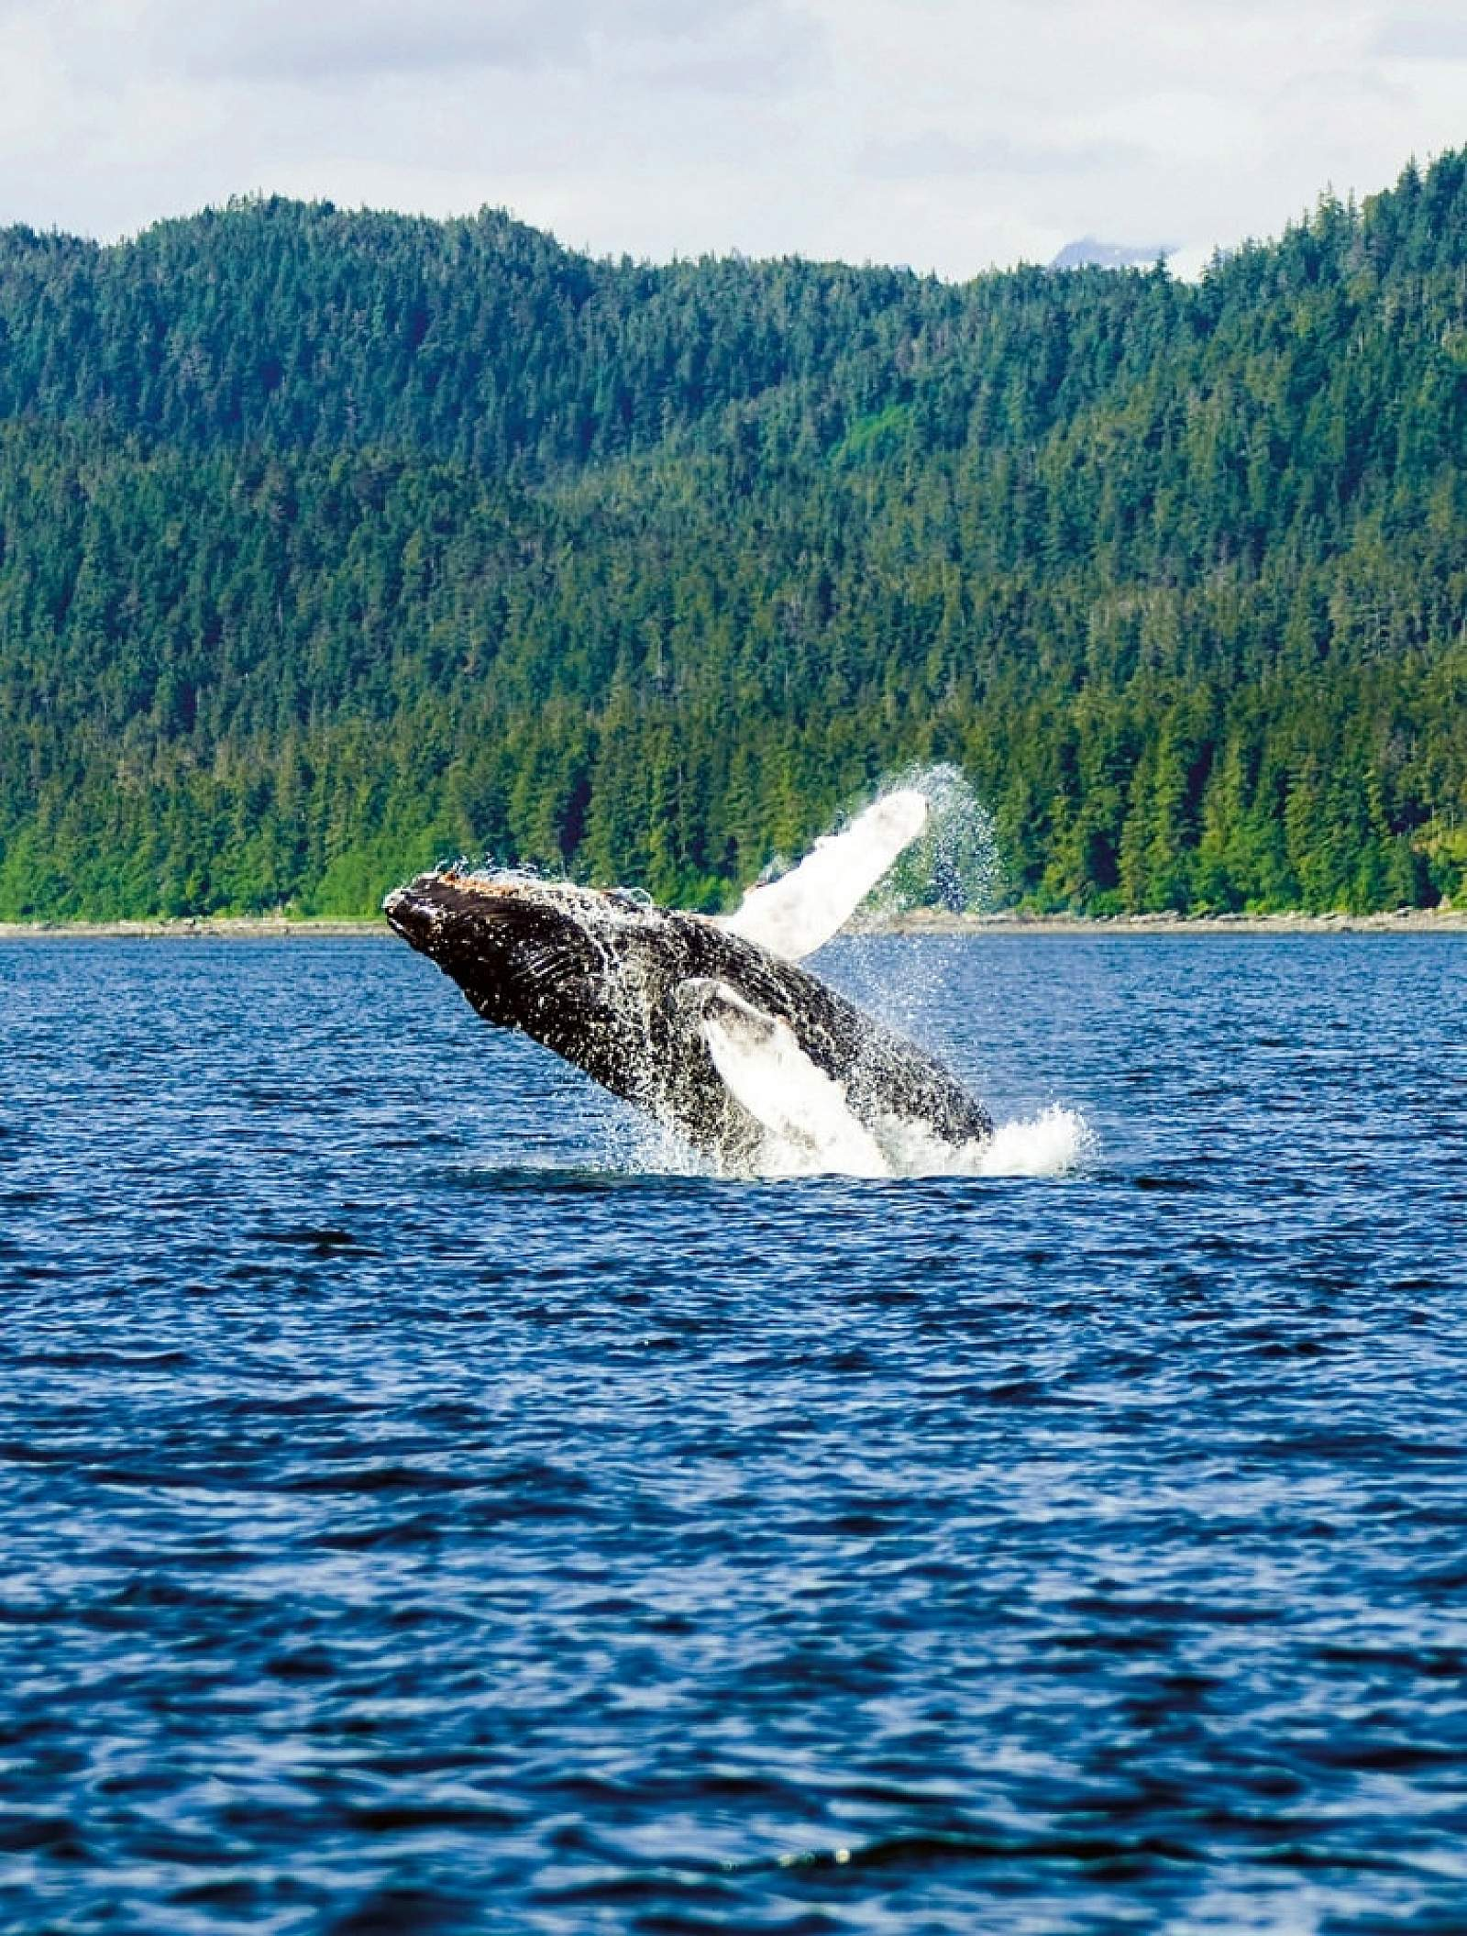
Whale Watching Adventure
There are plenty of whale tours to let you watch the orcas and humpbacks as they breach and spout from the water.
You may also spot sea lions, harbor seals, Dall’s porpoises, bald eagles, bears, blacktail deer, and seabirds during the tour.
Even without binoculars, you’ll have a great view, on clear days, of the forest-surrounded Mendenhall Glacier.
Whale Watching Adventure $189 adult, $139 child (under 12 yrs.)

Slide 21
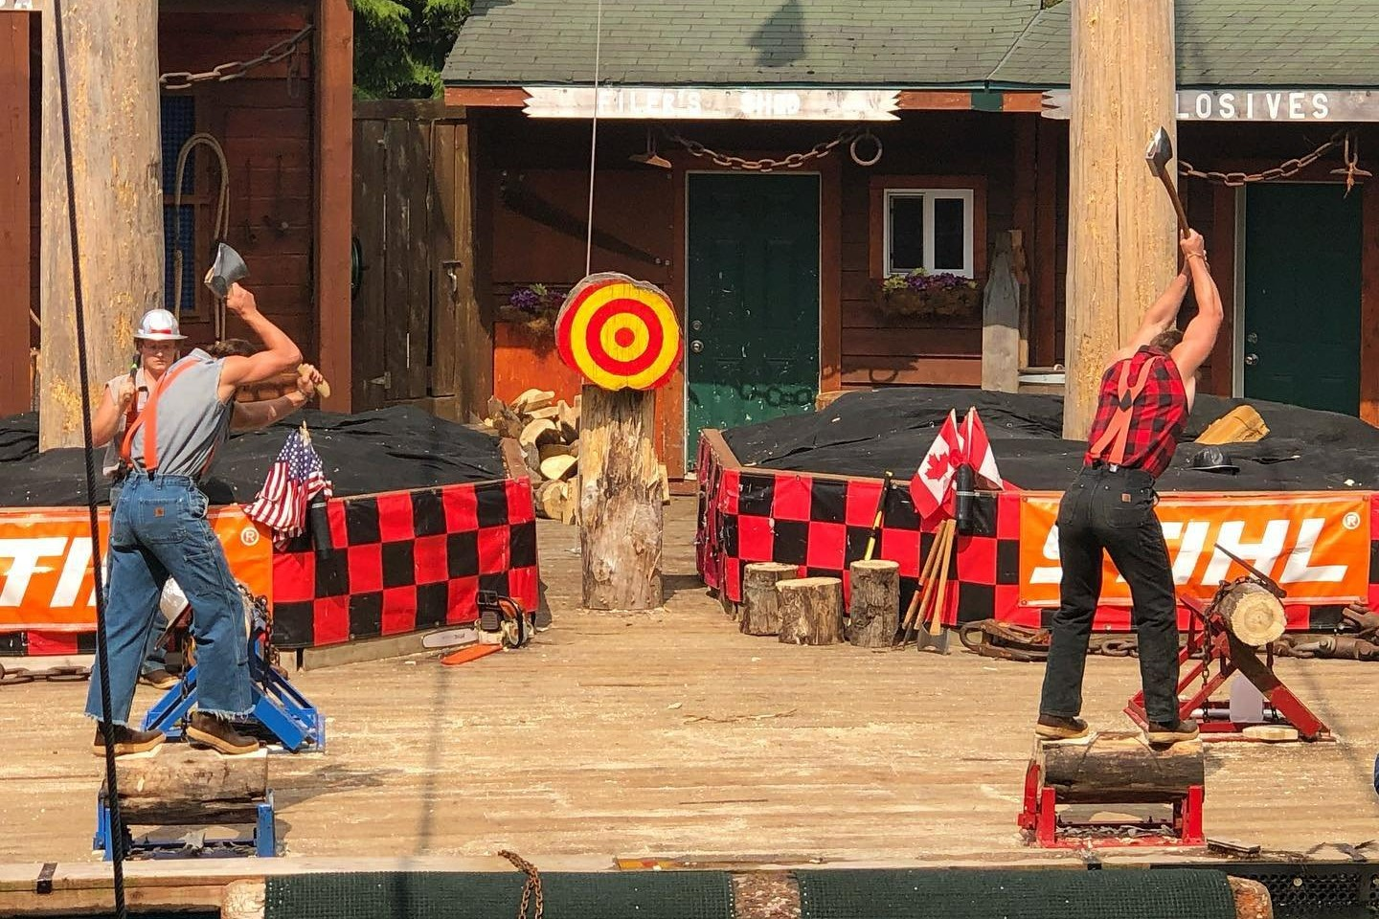
Great Alaskan Lumberjack Show
This show is a staple of Ketchikan and brings guests a thrilling competition of skill and strength that highlights Southeast Alaska’s logging history.
These world champion athletes are sure to impress all ages with 7-pound axes, 6-foot razor-sharp saws, tree-climbing gaffs, and more. The one-hour performance is packed with action. Audience members will be on the edge of their seats as they watch burly lumberjack's freefall from towering trees, scamper across floating logs, and show off their strength as they chop and saw.
Get in on the “axe-tion” with a group of friends and try your own hand at the axe-throwing competition. The lumberjacks meet up with participants after the show and demonstrate the art of the throw in a head-to-head battle. Don’t forget your flannel — you’ll want to look the part when you’re in the boisterous crowd.
The full show is offered three to four times daily, giving guests plenty of opportunities to add it to their schedule.

Slide 22
Conclusion
Nome is a beautiful City with a rich history and numerous attractions. Whether you're looking for stunning views, historic sites, or unique attractions, Nome has something for everyone.
I hope this presentation will help when we visit Nome.

Slide 23
Thanks For Coming
If you have any more questions, please ask.
I will do my best to answer them for you.
Have a great visit in Nome!

Slide 24
Acknowledgement
My seminars are the result of many years of travel experience combined with many hours of research over the internet.
I would like to acknowledge the many source I have accessed.
These include: Wikipedia.com, Britannica.com, Trip Advisor and the various Museum, Park and Government websites.

Slide 25
Acknowledgement
My seminars are the result of many years of travel experience combined with many hours of research over the internet.
I would like to acknowledge the many source I have accessed.
These include: Wikipedia.com, Britannica.com, Trip Advisor and the various Museum, Park and Government websites.

