Slide 1
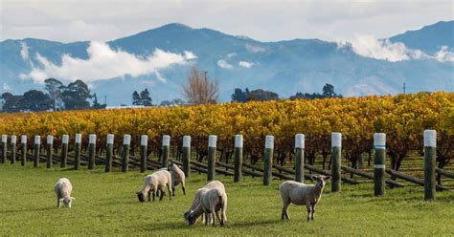
Exploring the Wine Regions of New Zealand A Journey Through Its Wineries Presented by Marc Silver

Slide 2
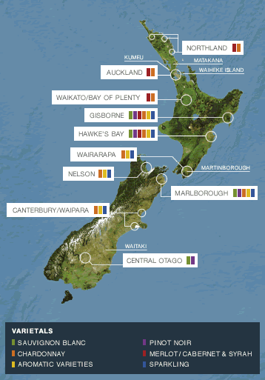
A Journey Through Its Wineries
New Zealand, a remote island nation in the southwestern Pacific Ocean, is renowned for its stunning landscapes, vibrant culture, and increasingly, its world-class wines.
Despite its relatively young wine industry, New Zealand has quickly risen to prominence, producing some exceptionally fine wines recognized globally.
The country's diverse climate and varied terroir have given rise to several distinct wine regions, each with its own unique characteristics.

Slide 3
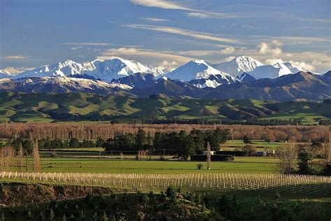
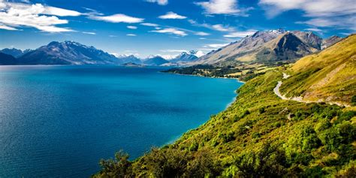
A Journey Through Its Wineries
New Zealand, a country renowned for its breathtaking landscapes, is also home to some of the world's most distinctive and high-quality wines.
From the rolling vineyards of Marlborough to the rugged hills of Central Otago, New Zealand's wine regions offer a diverse range of climates and soils that contribute to the unique character of its wines.
This presentation explores the key wine regions of New Zealand, highlighting what makes them special and what wines they are best known for and some notable wineries.
We’ll also explore the history, key regions, and standout wineries that make New Zealand a must-visit destination for wine enthusiasts.

Slide 4
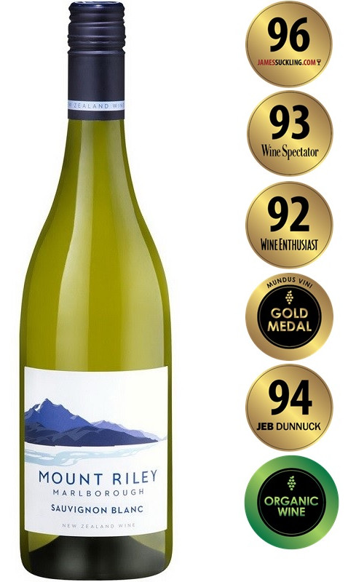
A Brief History of New Zealand Wine
The history of wine in New Zealand is relatively young compared to other renowned wine-producing countries.
The first vines were planted in the early 19th century, but it wasn't until the late 20th century that New Zealand began to establish its reputation on the global wine stage.
The pivotal moment came in the 1980s with the rise of Marlborough Sauvignon Blanc, a variety that quickly gained international acclaim for its vibrant and intense flavors.
This breakthrough put New Zealand on the map as a serious wine producer and sparked interest in its other wine regions and varietals.

Slide 5
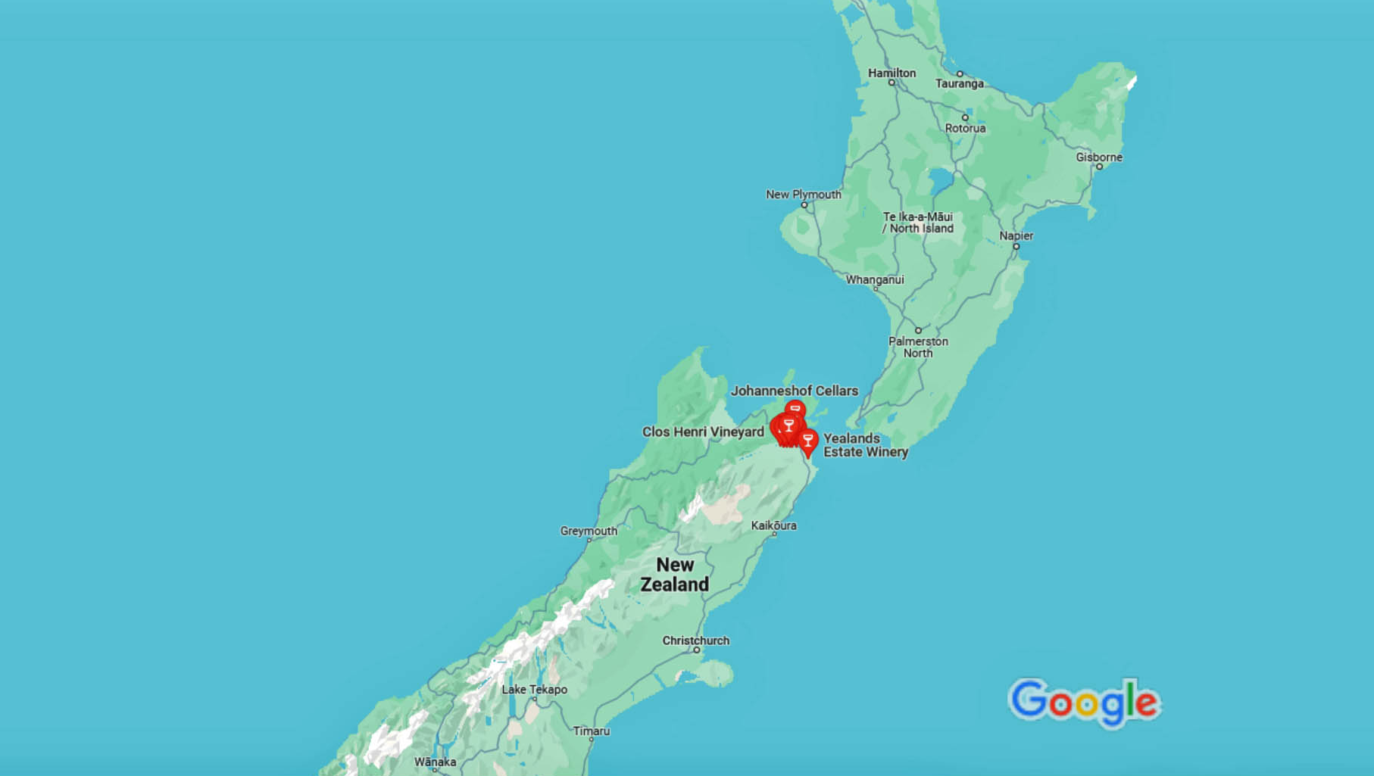
Wine Regions
Marlborough

Slide 6
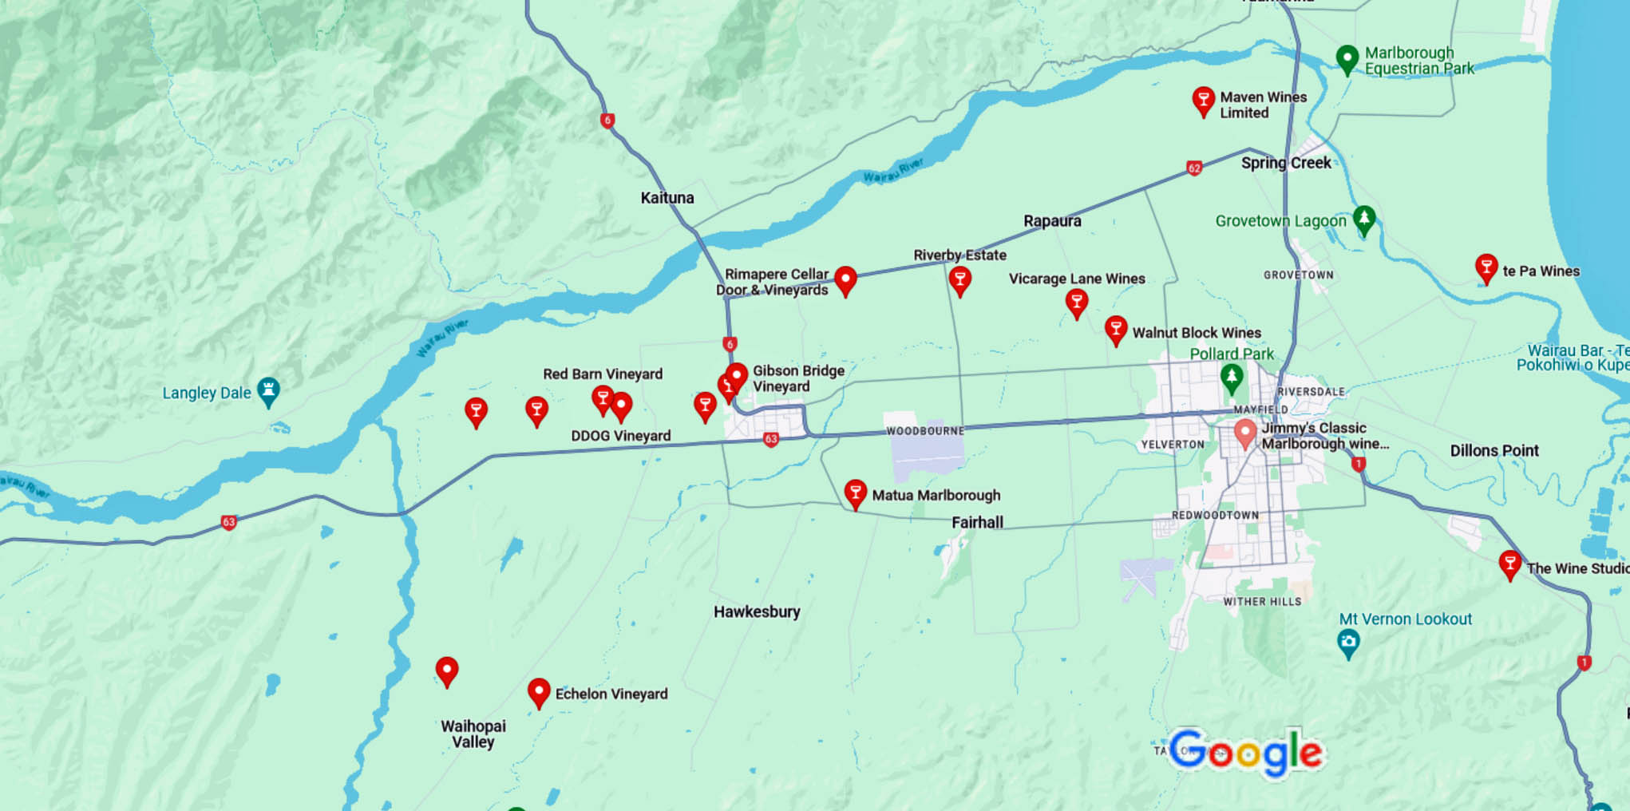
Wine Regions
Marlborough: The Heart of New Zealand Wine
Marlborough, located at the northern tip of the South Island, is the largest and undoubtedly the most famous wine region in New Zealand as well as the largest by production.
Located at the northeastern tip of the South Island, Marlborough enjoys a sunny climate with cool nights, perfect for growing grapes.
The wines from Marlborough are typically characterized by their zesty acidity, tropical fruit flavors, and herbaceous notes.
It is best known for its Sauvignon Blanc, which thrives in the region's cool climate and sunny days. However, the region also produces excellent Chardonnay, Pinot Noir, and sparkling wines.

Slide 7
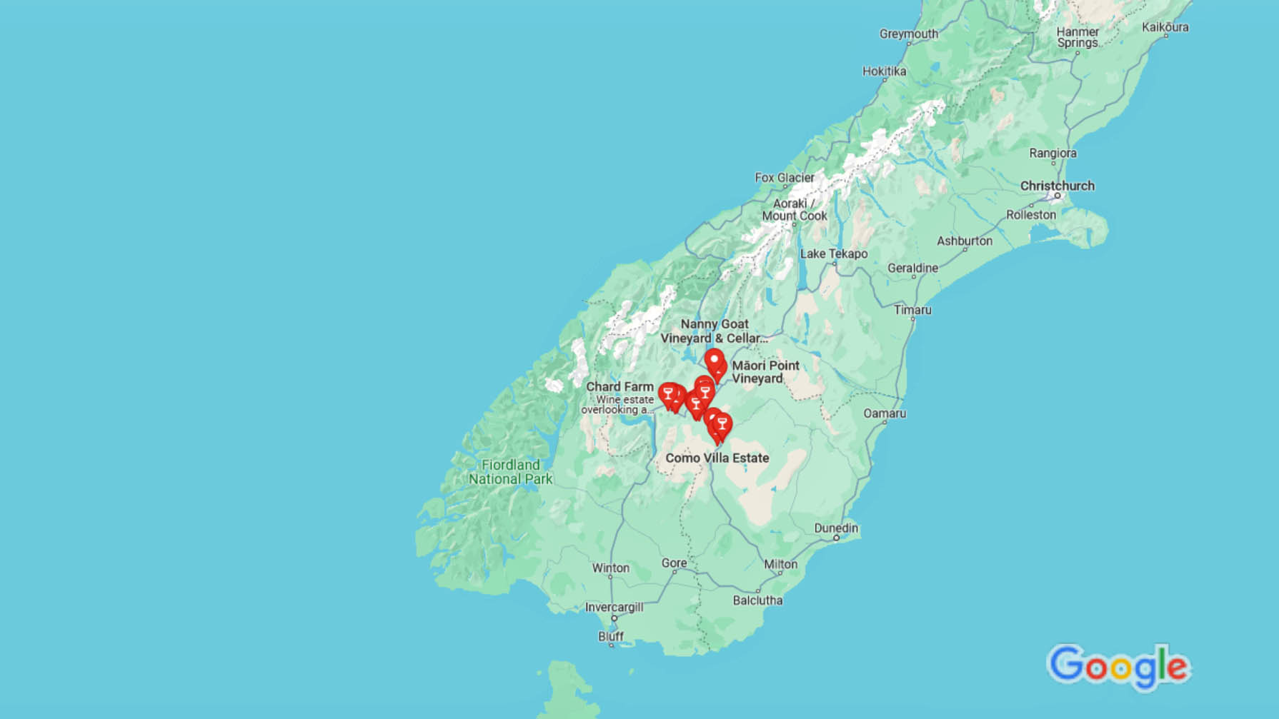
Wine Regions
Central Otago

Slide 8
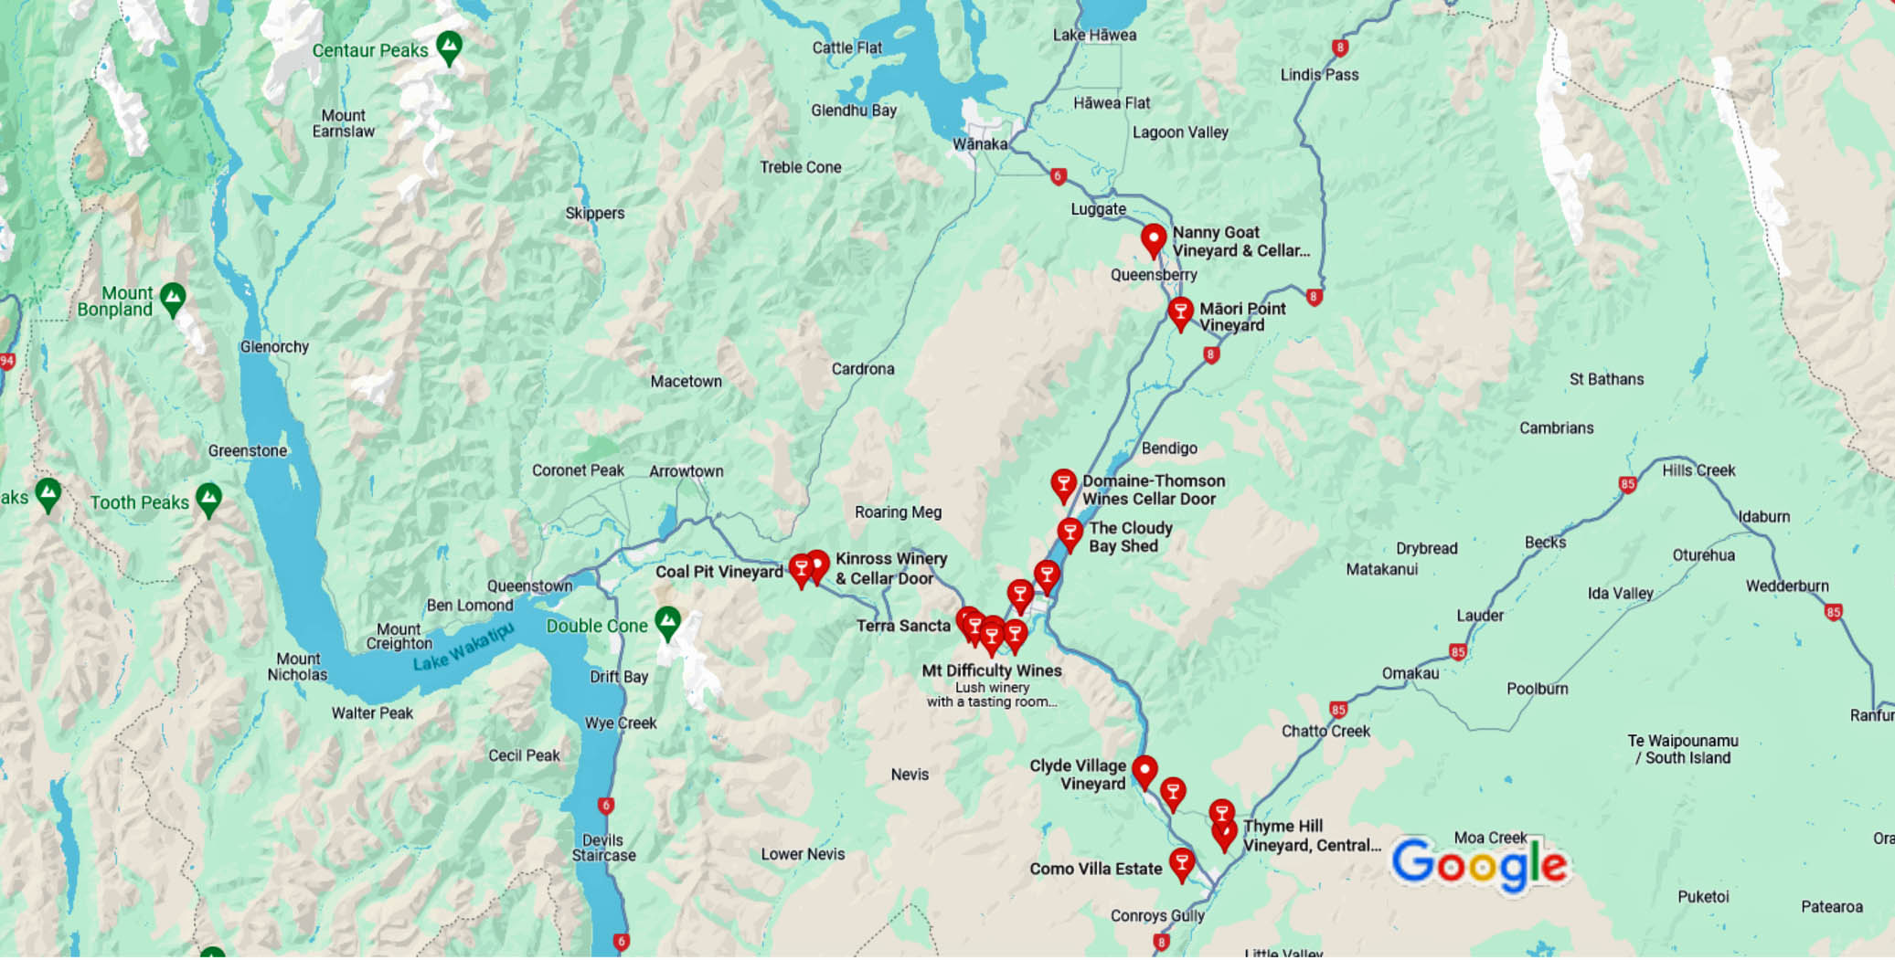
Wine Regions
Central Otago: The Southern Gem
Central Otago, located in the southernmost part of the South Island, is one of the world's most southerly wine regions. Central Otago is the world’s southernmost wine region.
Known for its dramatic landscapes and extreme climate, Central Otago is a challenging yet rewarding place to grow grapes.
It is renowned for its Pinot Noir, which thrives in the cool, dry climate and high-altitude vineyards. and is considered among the best in the world.
The region's dramatic temperature variations result in wines with intense flavors, vibrant acidity, and complex aromatics.
Pinot Noir is characterized by its vibrant red fruit flavors, silky texture, and a hint of spice.
The region also produces excellent Chardonnay, Riesling, and Pinot Gris.
Central Otago's stunning landscapes of rugged mountains and glacial lakes make it a picturesque destination.

Slide 9
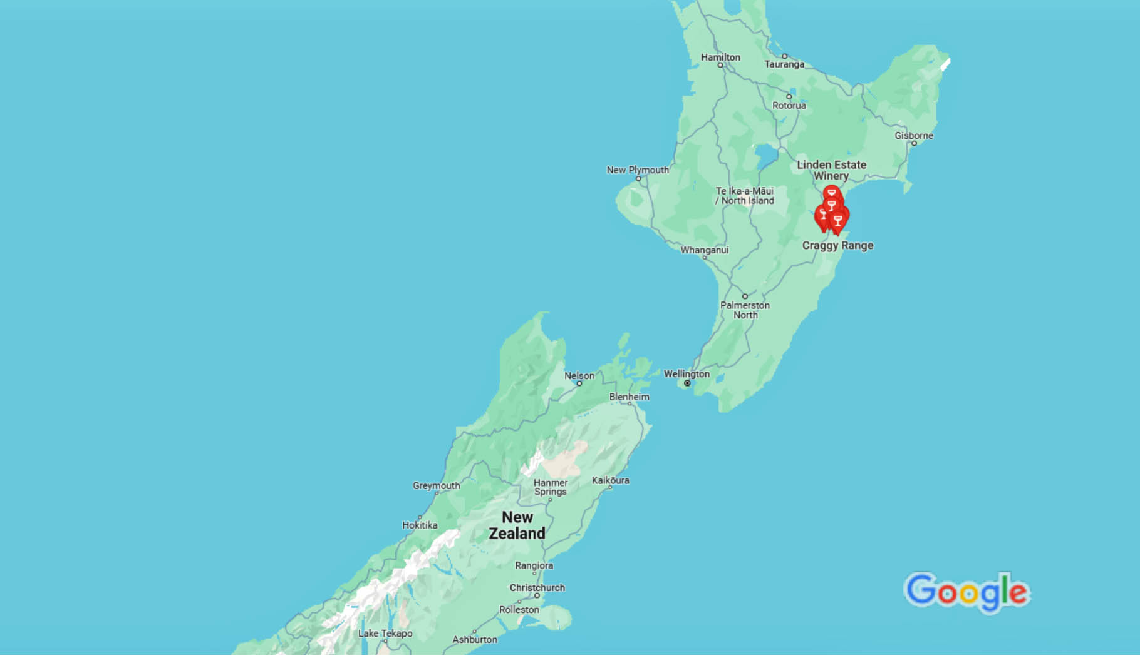
Wine Regions
Hawke’s Bay

Slide 10
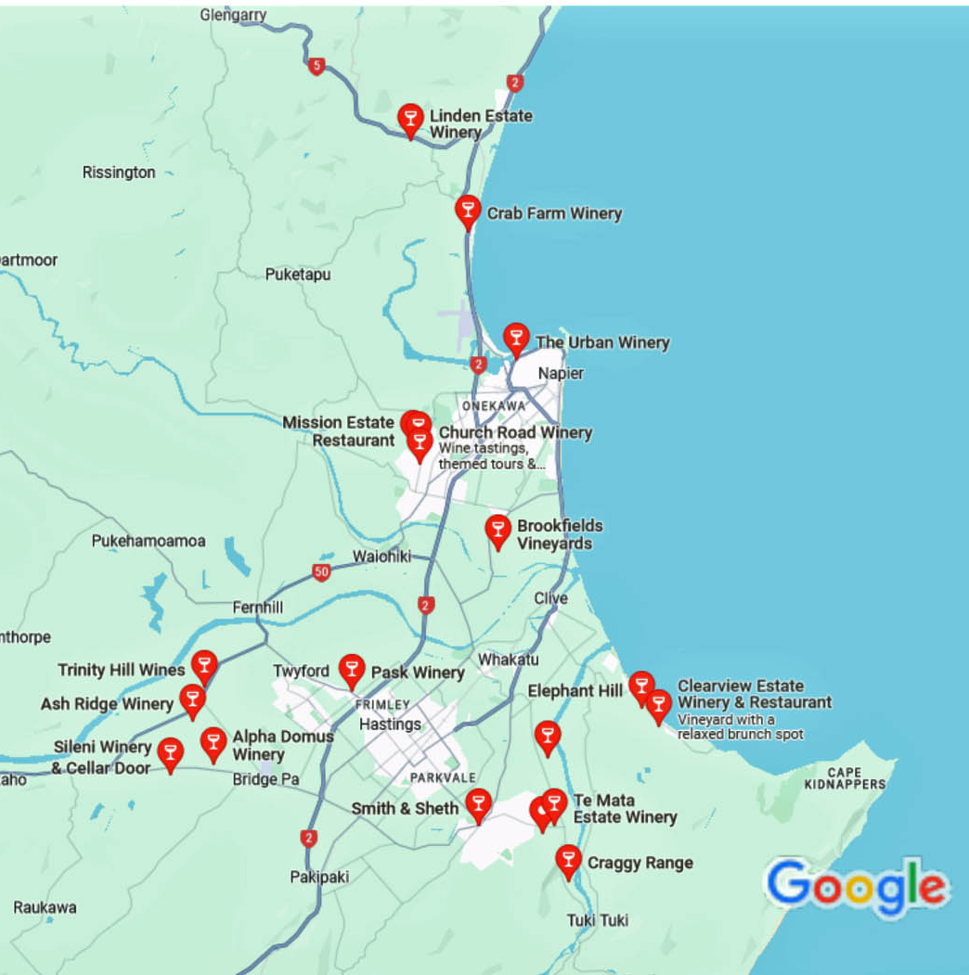
Wine Regions
Hawke’s Bay: The Red Wine Powerhouse
Hawke's Bay, on the east coast of the North Island, is New Zealand’s oldest wine region and the second largest in terms of production.
This area is particularly renowned for its red wines, especially Bordeaux-style blends (Cabernet Sauvignon and Merlot), Syrah, and Chardonnay.
The region’s diverse soils, including gravelly riverbeds and clay loam, contribute to the complexity and richness of its wines.
It’s temperate climate, makes it ideal for ripening red grape varieties. The region's warm climate and diverse soils allow for a wide range of wine styles, from rich, full-bodied reds to elegant, minerally whites.
The Gimblett Gravels sub-region, in particular, is famous for producing some of the country’s most highly regarded red wines.
Hawke's Bay is also a leader in sustainable wine production, with many wineries embracing organic and biodynamic practices.

Slide 11
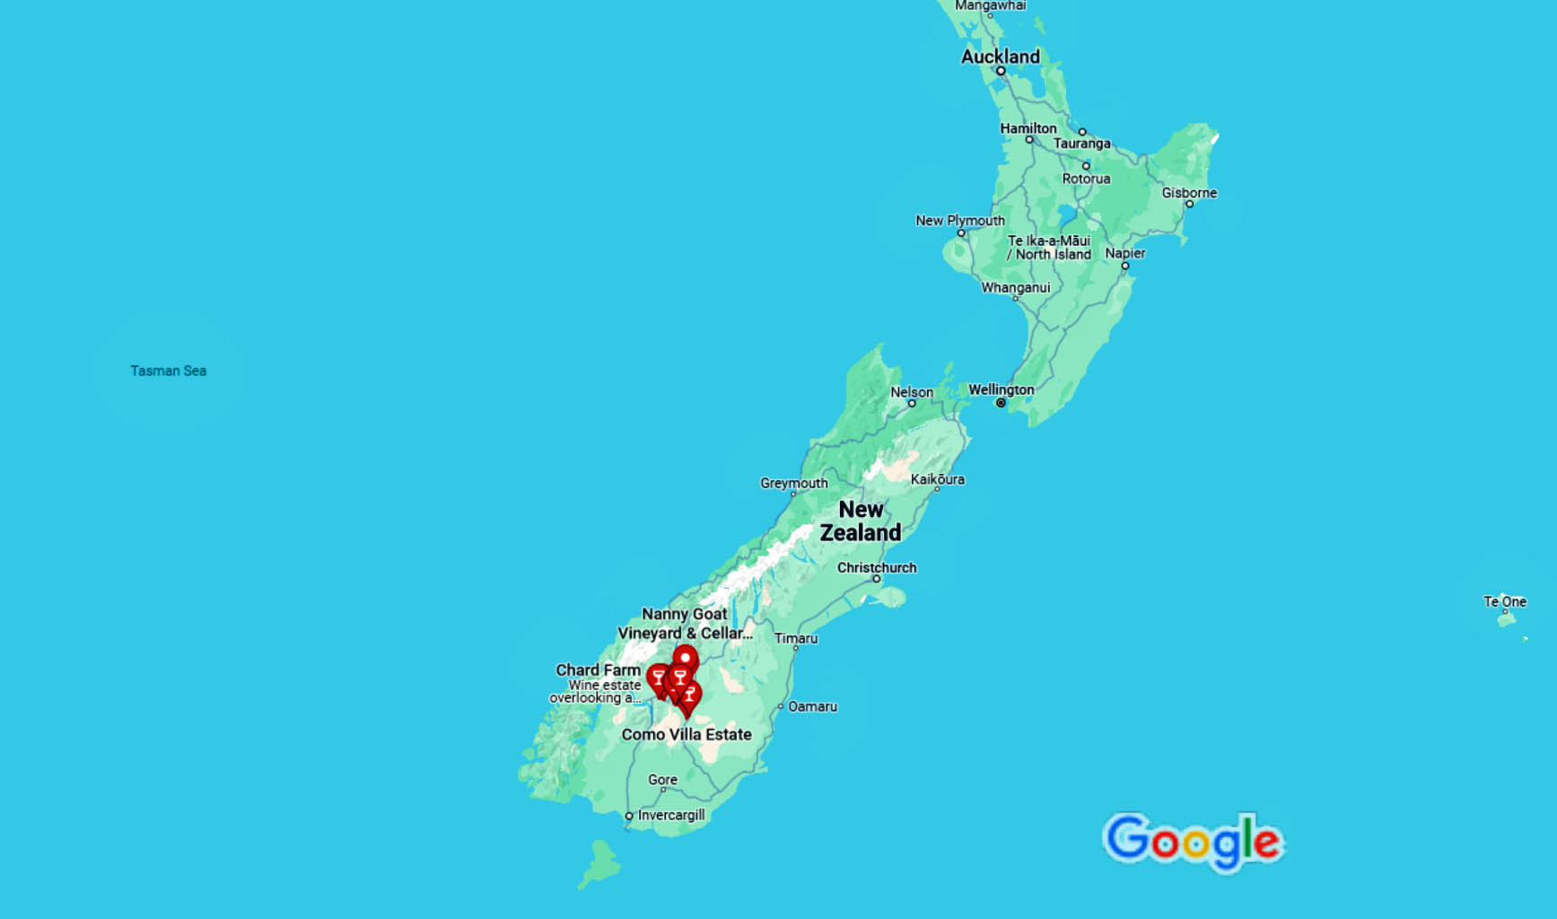
Wine Regions
Central Otago

Slide 12
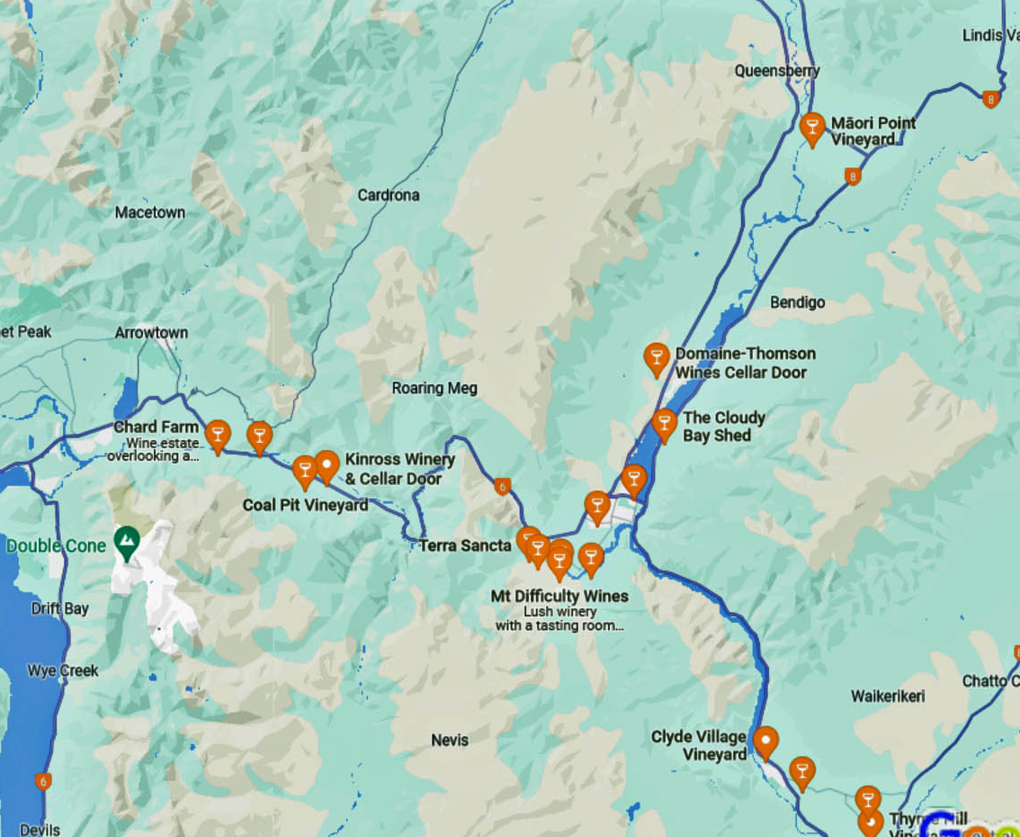
Wine Regions
Central Otago: The Southern Gem
Central Otago, located in the southern part of the South Island, is the world’s southernmost wine region.
Known for its dramatic landscapes and extreme climate, Central Otago is a challenging yet rewarding place to grow grapes.
The region is best known for its Pinot Noir, which thrives in the cool, dry climate and high-altitude vineyards.
Central Otago Pinot Noir is characterized by its vibrant red fruit flavors, silky texture, and a hint of spice. The region also produces excellent Chardonnay, Riesling, and Pinot Gris.

Slide 13
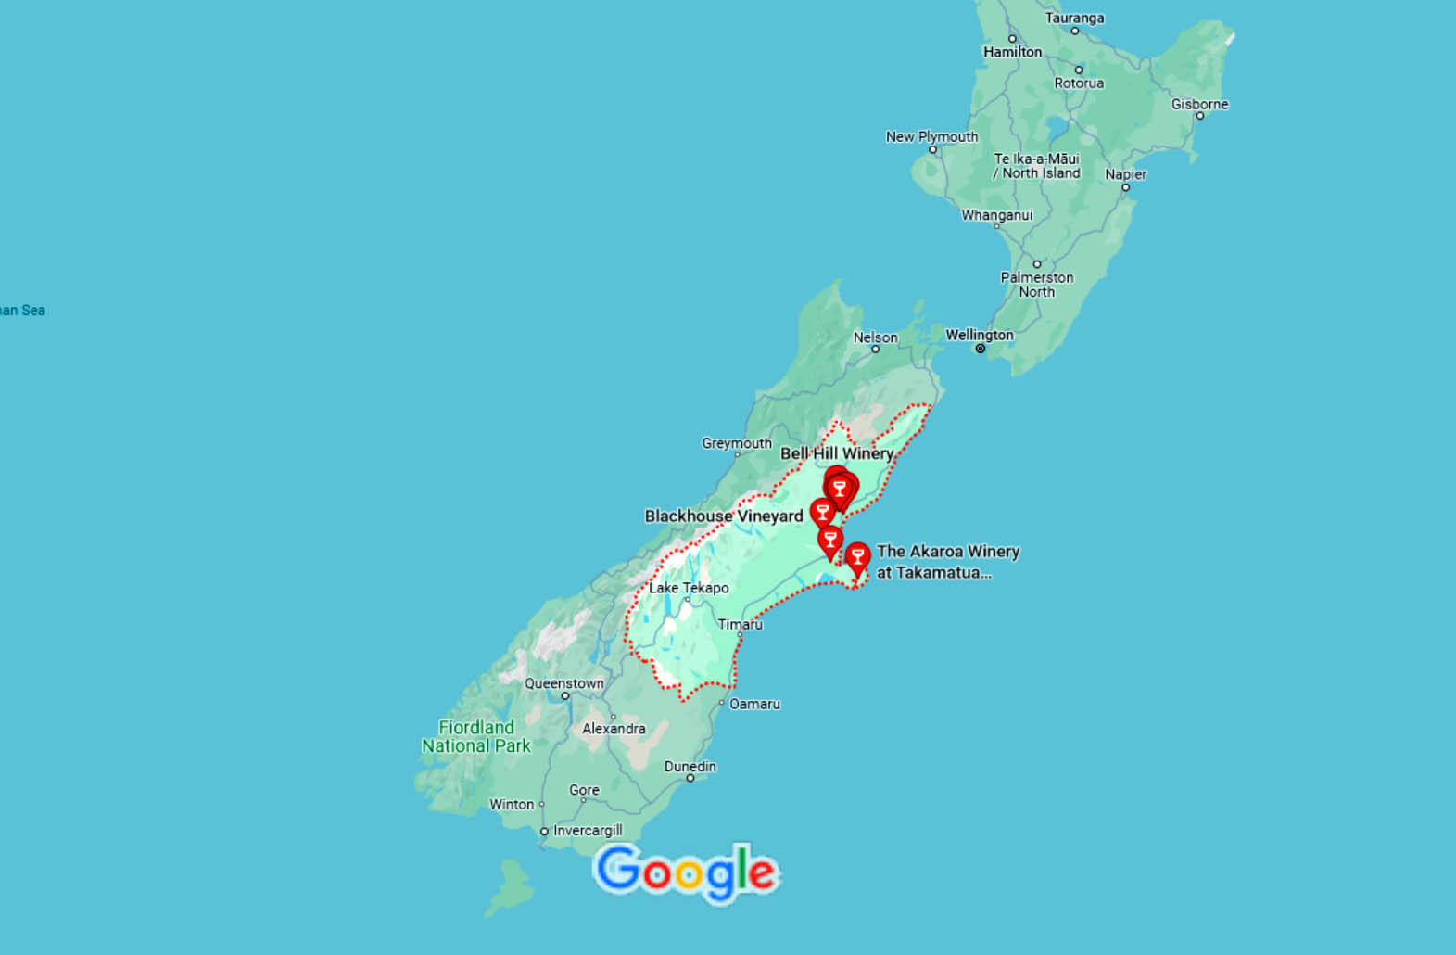
Wine Regions
Canterbury

Slide 14
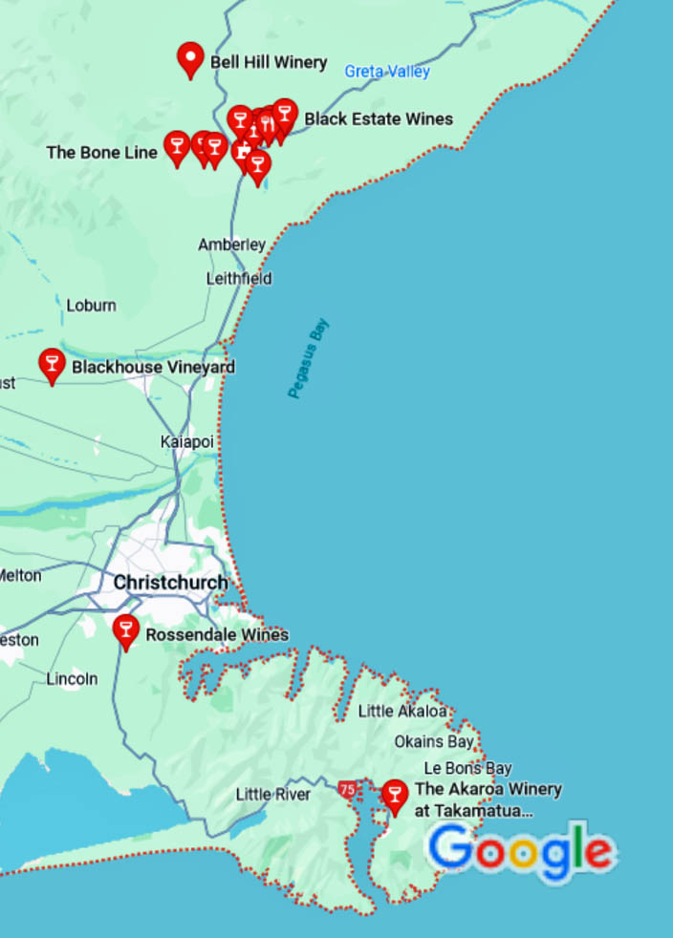
Wine Regions
Canterbury: A Region on the Rise
Canterbury, located on the east coast of the South Island, is a rapidly emerging wine region in New Zealand.
The region’s cool climate and long, dry autumns are ideal for producing elegant, aromatic white wines such as Riesling, Pinot Gris, and Sauvignon Blanc.
Canterbury is also gaining recognition for its Pinot Noir, which is characterized by its bright red fruit flavors and fine acidity.
The Waipara Valley, a sub-region of Canterbury, is particularly renowned for its aromatic whites and Pinot Noir.

Slide 15
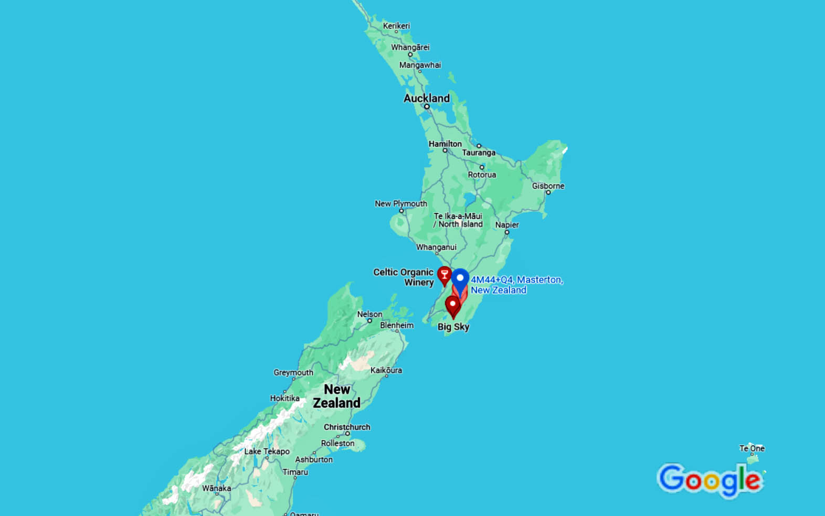
Wine Regions
Wairarapa

Slide 16
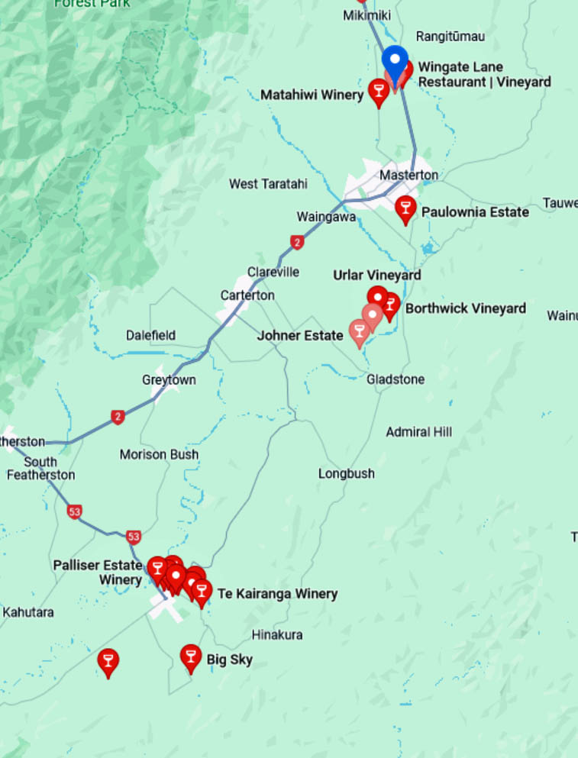
Wine Regions
Wairarapa: The Boutique Region
Wairarapa, located at the southern tip of the North Island, is a small but highly regarded wine region known for its boutique wineries and high- quality Pinot Noir. It’s located just north of Wellington on the North Island, is a small but prestigious wine region.
The region’s cool climate and long growing season allow the grapes to develop complex flavors and elegant structures.
It is best known for its Pinot Noir, which displays dark rich fruit flavors, silky tannins, and earthy undertones.
The region also produces excellent Sauvignon Blanc, Riesling, and Syrah.
Martinborough, a sub-region of Wairarapa, is particularly famous for its premium Pinot Noir.
The region's boutique wineries also produce high-quality Sauvignon Blanc, Chardonnay, and aromatic white varieties.
The charming town of Martinborough, with its cluster of family-owned wineries, is the heart of Wairarapa's wine country.

Slide 17
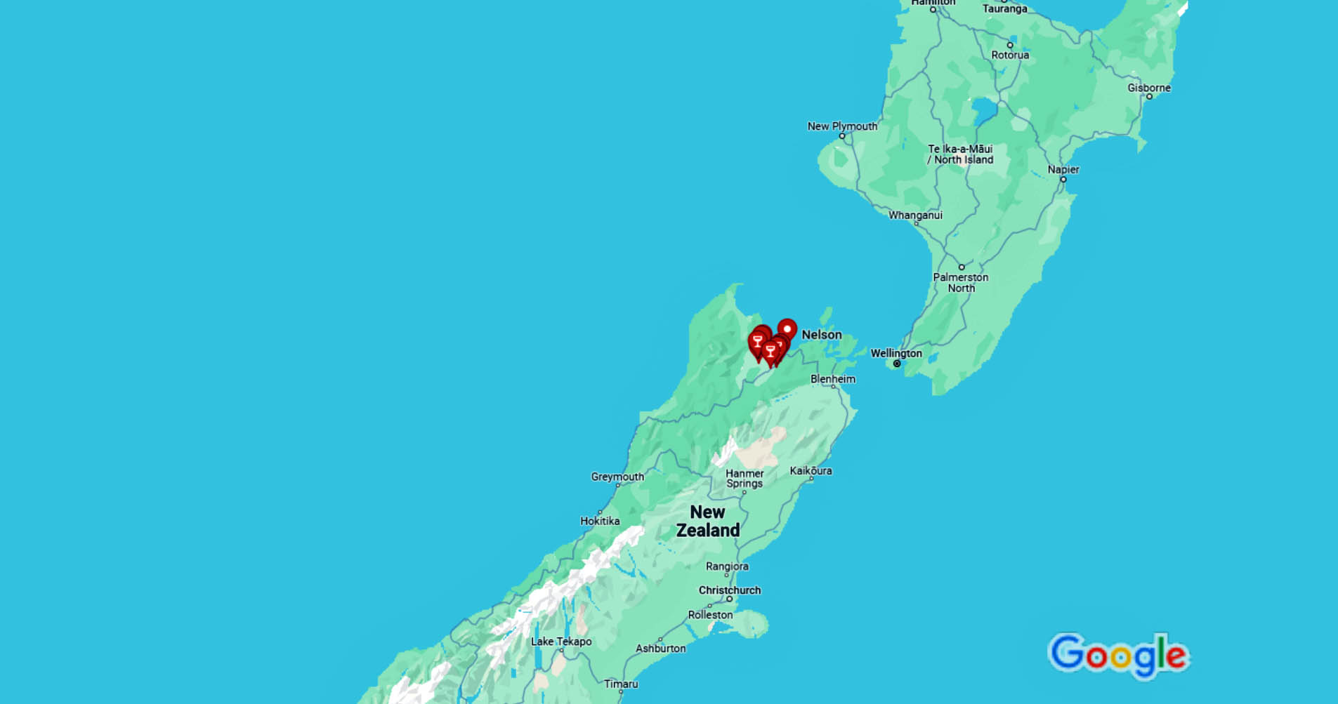
Wine Regions
Nelson

Slide 18
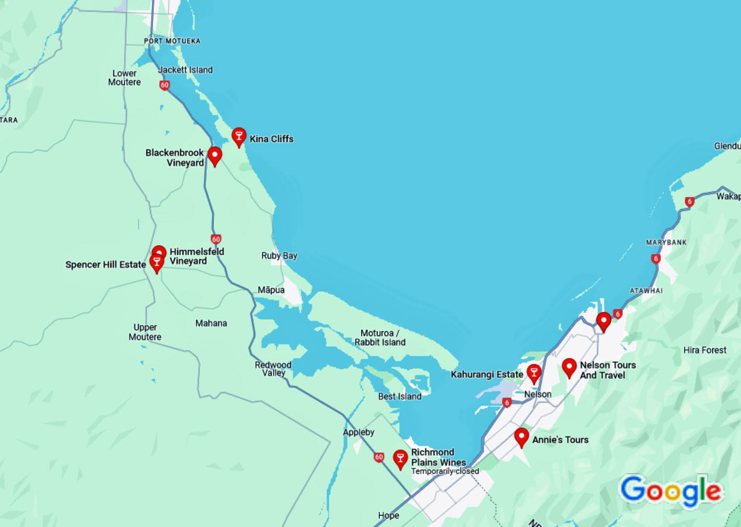
Wine Regions
Nelson: The Artisan Region
Nelson, located at the northern tip of the South Island, is a small but vibrant wine region known for its artisan producers and diverse wine styles.
The region enjoys a sunny, maritime climate, making it ideal for growing a wide range of grape varieties.
Nelson is particularly known for its aromatic whites, including Sauvignon Blanc, Riesling, and Pinot Gris.
The region also produces excellent Chardonnay and Pinot Noir.
Nelson’s winemakers are known for their hands-on, artisanal approach, resulting in wines with a distinct sense of place.

Slide 19
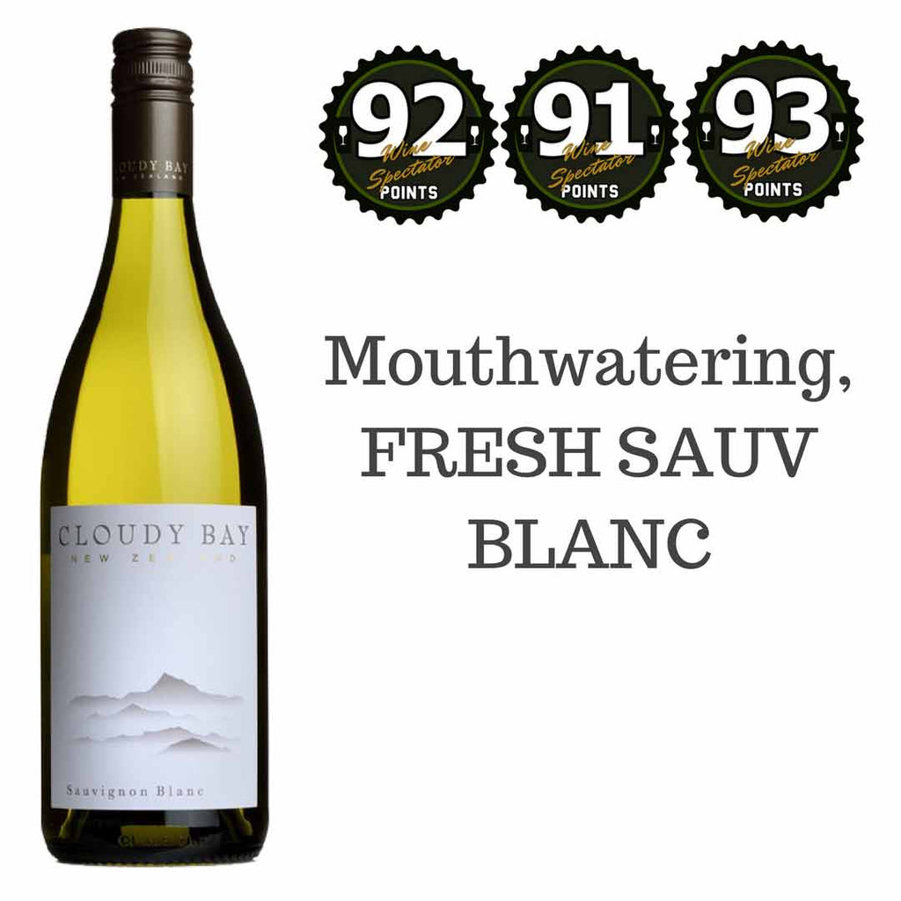
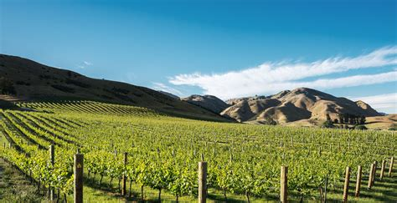
Notable New Zealand Wineries
Cloudy Bay (Marlborough)
Cloudy Bay is perhaps the most famous winery in New Zealand, known for its iconic Sauvignon Blanc that helped put Marlborough on the world wine map.
Established in 1985, Cloudy Bay has become a symbol of New Zealand wine excellence.
In addition to its Sauvignon Blanc, the winery produces outstanding Chardonnay, Pinot Noir, and sparkling wine.
A visit to Cloudy Bay offers a chance to taste these celebrated wines in a stunning setting overlooking the Wairau Valley.

Slide 20
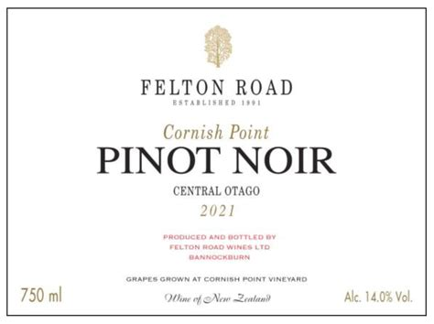
Notable New Zealand Wineries
Felton Road (Central Otago)
Felton Road is a leader in organic and biodynamic winemaking in Central Otago.
The winery is internationally acclaimed for its Pinot Noir, which consistently receives high praise from critics and wine lovers alike.
Felton Road's vineyards are located on the Bannockburn slopes, where the combination of soil, climate, and meticulous viticulture
The winery also produces excellent produces wines of remarkable purity and complexity. Chardonnay and Riesling.

Slide 21
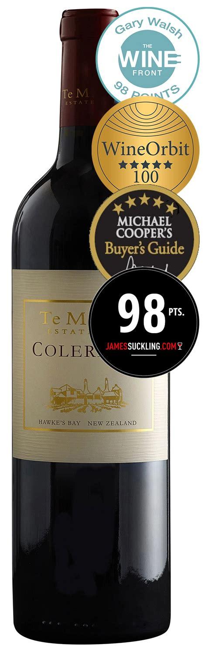
Notable New Zealand Wineries
Te Mata Estate (Hawke's Bay)
Te Mata Estate is one of New Zealand's oldest wineries, with a history dating back to 1896.
It is renowned for its Bordeaux-style blends, particularly the flagship wine "Coleraine," which is widely regarded as one of New Zealand's finest reds.
The estate also produces outstanding Syrah, Chardonnay, and other varietals.
Te Mata's historic winery and picturesque vineyards make it a must-visit destination in Hawke's Bay.

Slide 22
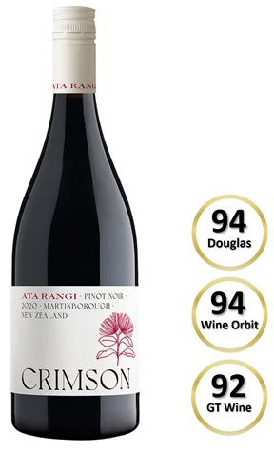
Notable New Zealand Wineries
Ata Rangi (Wairarapa)
Ata Rangi is a small, family-owned winery in Martinborough that has earned a reputation as one of New Zealand's top Pinot Noir producers.
Founded in 1980 by Clive Paton, Ata Rangi has consistently produced wines of exceptional quality and character.
The winery's Pinot Noir is known for its depth, elegance, and aging potential, while its Sauvignon Blanc and Chardonnay are also highly regarded.
Ata Rangi's commitment to sustainable and organic practices further enhances its standing as a leader in New Zealand wine.
Ata Rangi Crimson Pinot Noir 2020

Slide 23
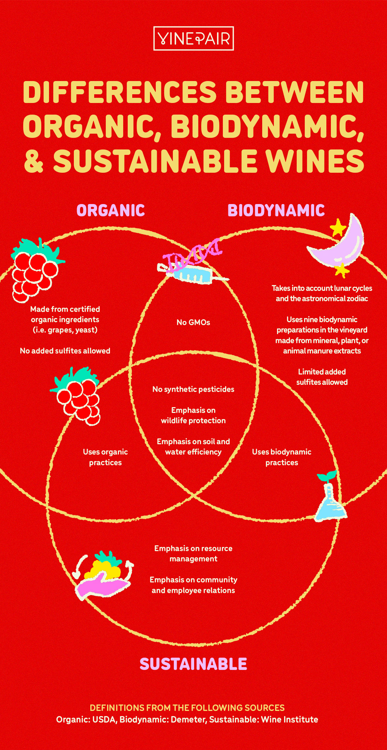
The Future of New Zealand Wine
New Zealand's wine industry continues to evolve, with a growing emphasis on sustainability, innovation, and diversity.
Many wineries are adopting organic and biodynamic practices, reflecting a broader commitment to environmental stewardship.
Additionally, new grape varieties and winemaking techniques are being explored, adding to the country's already impressive range of wine styles.
As New Zealand's wines gain more recognition on the global stage, the country's wine regions are becoming increasingly popular with tourists. Wine tours, tastings, and events offer visitors the opportunity to experience the unique flavors and stunning landscapes that define New Zealand wine.

Slide 24
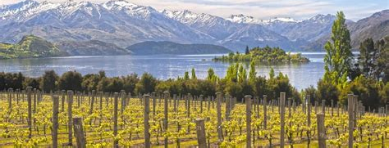
Conclusion
New Zealand’s wine regions are as diverse as the country’s landscapes, offering a wide range of wine styles that reflect the unique terroir of each area.
From the iconic Sauvignon Blanc of Marlborough to the world-class Pinot Noir of Central Otago, New Zealand wines have made their mark on the global stage.
As the industry continues to grow and evolve, these regions will undoubtedly continue to produce wines that captivate and delight wine lovers everywhere.

Slide 25
Wine Regions of New Zealand
I hope you found these facts about New Zealand’s Wine interesting and informative.
Hopefully, you all get the opportunity to visit the beautiful and historic country for yourselves.
Thank you for coming!

Slide 26
Acknowledgement
My seminars are the result of many years of experience combined with many hours of research over the internet.
I would like to acknowledge the many source I have accessed.
These include Wine Spectator, Wine Enthusiast, BKWine Magazine, Wine & Spirits Magazine, American Vineyard Magazine, The Grapevine Magazine, Wikipedia.com, Britannica.com, and the various Government websites.

Slide 27
Resources: Books and Guides
"The World Atlas of Wine" by Hugh Johnson and Jancis Robinson This comprehensive guide provides detailed maps and descriptions of wine regions worldwide, including New Zealand. It’s an essential resource for understanding the geography and terroir of New Zealand’s wine regions.
"The Wine Bible" by Karen MacNeil This book offers an in-depth look at the world’s wine regions, including New Zealand. It’s an excellent resource for both beginners and experienced wine enthusiasts.
"Wine Folly: The Essential Guide to Wine" by Madeline Puckette and Justin Hammack This book provides a visual and easy-to-understand guide to wine, with sections dedicated to New Zealand’s wine regions and grape varieties.

Slide 28
Resources: Websites
New Zealand Winegrowers The official website of New Zealand Winegrowers, the national organization for the country's wine industry. It offers comprehensive information about New Zealand’s wine regions, grape varieties, and wine tourism.
Wine-Searcher This website provides detailed information about New Zealand’s wine regions, including descriptions of the main grape varieties and wine styles produced in each region.
Decanter Magazine Decanter offers articles and reviews on New Zealand wines and regions, providing insights from some of the world’s leading wine critics.

