Slide 1

Naze (Oshima Island), Japan Presented by: Marc Silver

Slide 2
What I Will Cover
My Port Philosophy
Don’t Miss the Ship
Money
About Naze (Oshima Island), Japan
Shima Bus
Places to see or at least consider
A few restaurant recommendations
Conclusion

Slide 3
My Port Philosophy
I have been cruising for over 45 years and have taken over 100 cruises. So, I consider myself an experienced cruiser.
The information I will present is based on those many years of
experience.
When I am on a cruise where the city I want to visit is not the port city,
I always recommend taking a ship’s tour.
But when I am in a port with multiple attractions nearby and easy to see
on my own - I will do it on my own.
This presentation is for that type of port.

Slide 4
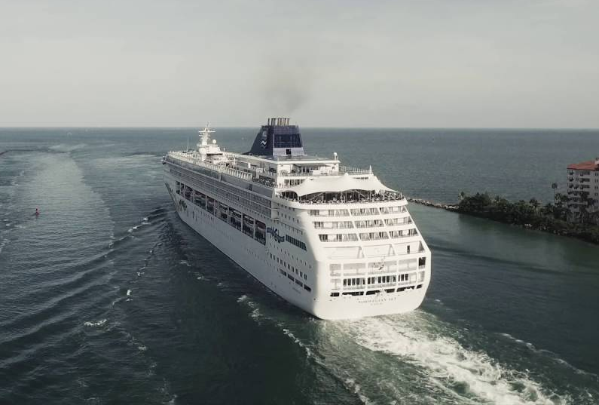
Don’t Miss the Ship
How to Avoid Missing Your Ship
Pay attention to the time. - Ship time and local time are often different.
Put a return-to-ship reminder on your phone.
Choose excursions wisely.
If a ship-sponsored excursion is late returning to port for, the ship will wait for you. If you are on your own???
Be Prepared
Have your Passport, Credit Card and phone numbers for your ship port agent.
What to Do If You Miss the Ship Most cruise lines have port agents stationed in the port area to assist if your ship has left without you. If you’re lucky, when cruisers are late returning to the vessel, the ship's crew will often remove the passengers' essential items -- passports, cell phones, and medication -- from the ship to leave with the port agents.
The Port Officials can help you with contacting your ship and making necessary travel arrangements.

Slide 5
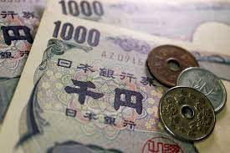
Money
The Yen is the official currency of Japan
Official Exchange is 100 Yen is 72 cents US
Or 142.15 Yen to the US Dollar

Slide 6
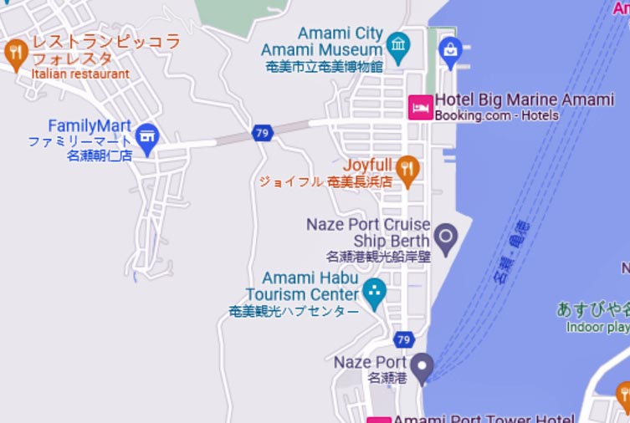
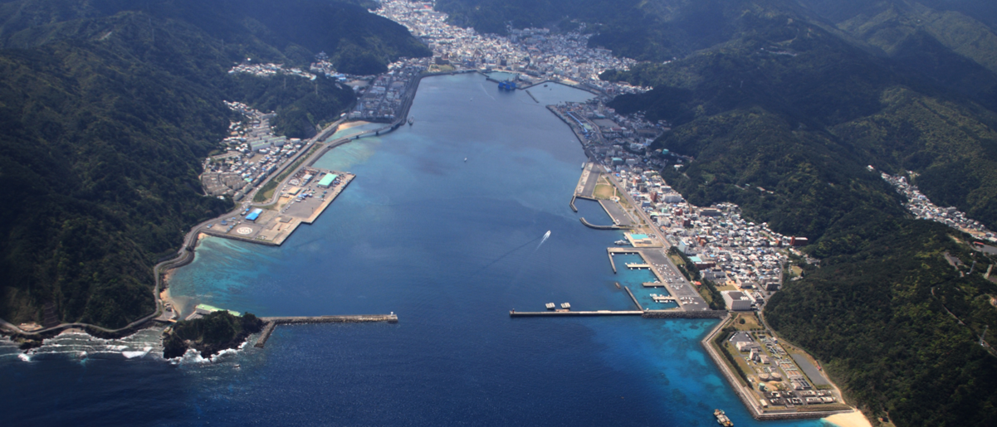
About Naze Japan
Naze in the region of Kagoshima with its 41,365 habitants is a town located in Japan - some 782 mi or ( 1259 km ) South-West of Edo, the country's capital. The village of Naze was established on April 1, 1908. It was elevated to town status on October 1, 1922. As with all of the Amami Islands, the village came under the administration of the United States from July 1, 1946, to December 25, 1953. It was elevated to city status on July 1, 1946. Amami City is closest to the port.

Slide 7

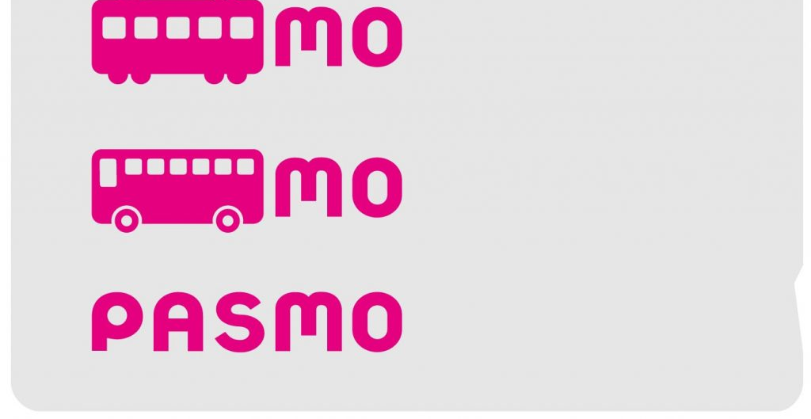

PASMO, Suica, & ICOCA Cards
The PASMO, Suica, and ICOCA Cards are e-money IC cards that can be used for travel and shopping across Japan.
Cashless fare payment
Use it for shopping
No waiting for change
Get special privileges
Apple phone users can also link with all three cards.
PASMO refunds - If you no longer need your PASMO, it can be refunded. Suica and ICOA cards do not offer refunds.

Slide 8
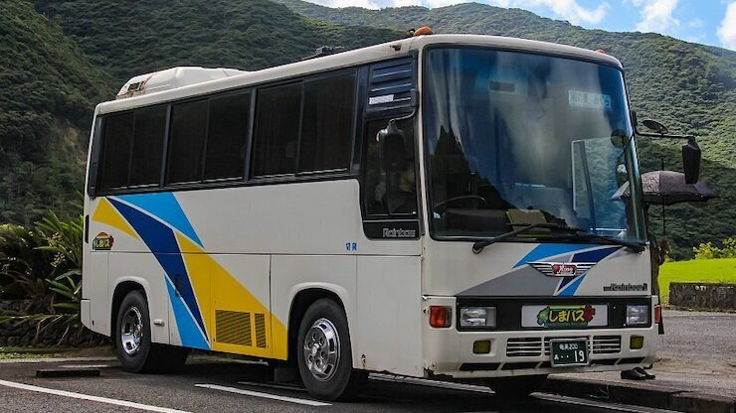
Shima Bus
Amami Oshima is a relatively large island, and it takes around two hours to drive from top to bottom. The island's largest town is Amami City (also referred to as Naze), located on the northern coast near the center of the island.
Public transportation is provided by the Shimabus ("island bus").
Around ten bus routes converge in central Amami City and splinter off to other parts of the island. Bus fares depend on the distance traveled.
You may purchase a 1-day, unlimited travel pass for 2100 Yen.

Slide 9
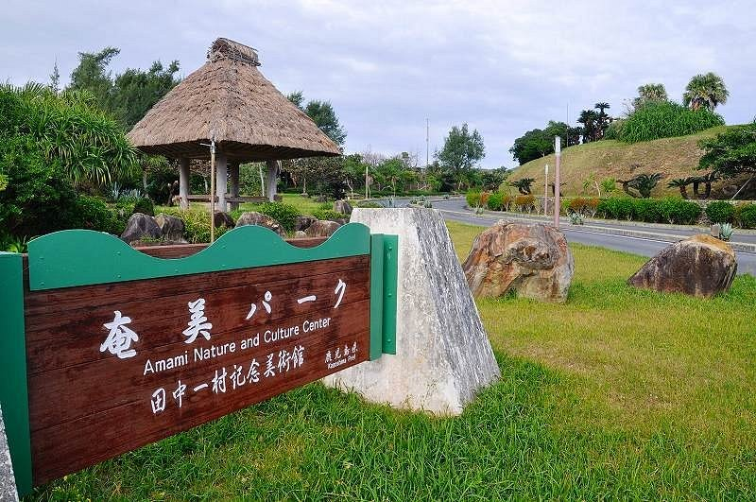
Amami Park
Amami park doesn't just focus on Amami Oshima, it is a multifaceted facility that presents the nature, culture, and history of the Amami Islands. Inside the facility is an art museum with many great works from the master painter Isson Tanaka, who was fascinated by the nature of Amami, are displayed, as well as a garden that recreates the character of Amami's vegetation. You can also enjoy Amami's local dish 'keihan' chicken rice at the restaurant on the second floor.
Admission: Adults ￥620 High school students ￥410 Children ￥310

Slide 10
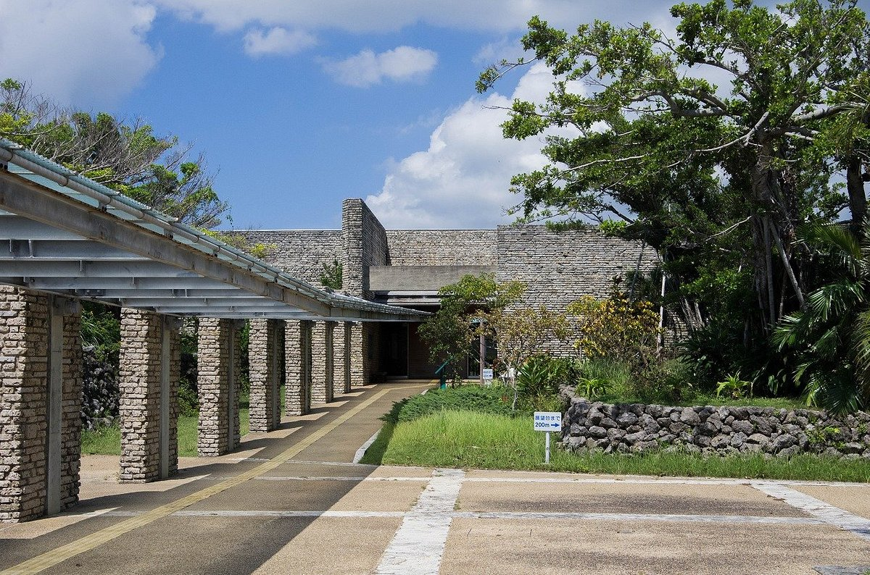
Tanaka Isson Museum
Tanaka Isson Memorial Museum of Art Tanaka is the main attraction at Amami Park in the northeast corner of Amami Oshima, not far from the airport. Dedicated to the popular late artist who lived on Amami Oshima towards the end of his life, the museum showcases art over five rooms with a mixture of permanent and temporary exhibitions from Isson himself and other artists associated with the island.
Admission: ￥520 yen (Tanaka Isson Museum only) ￥3 10 yen (Amami no Sato only) ￥630 yen (Tanaka Isson Museum and Amami no Sato)

Slide 11
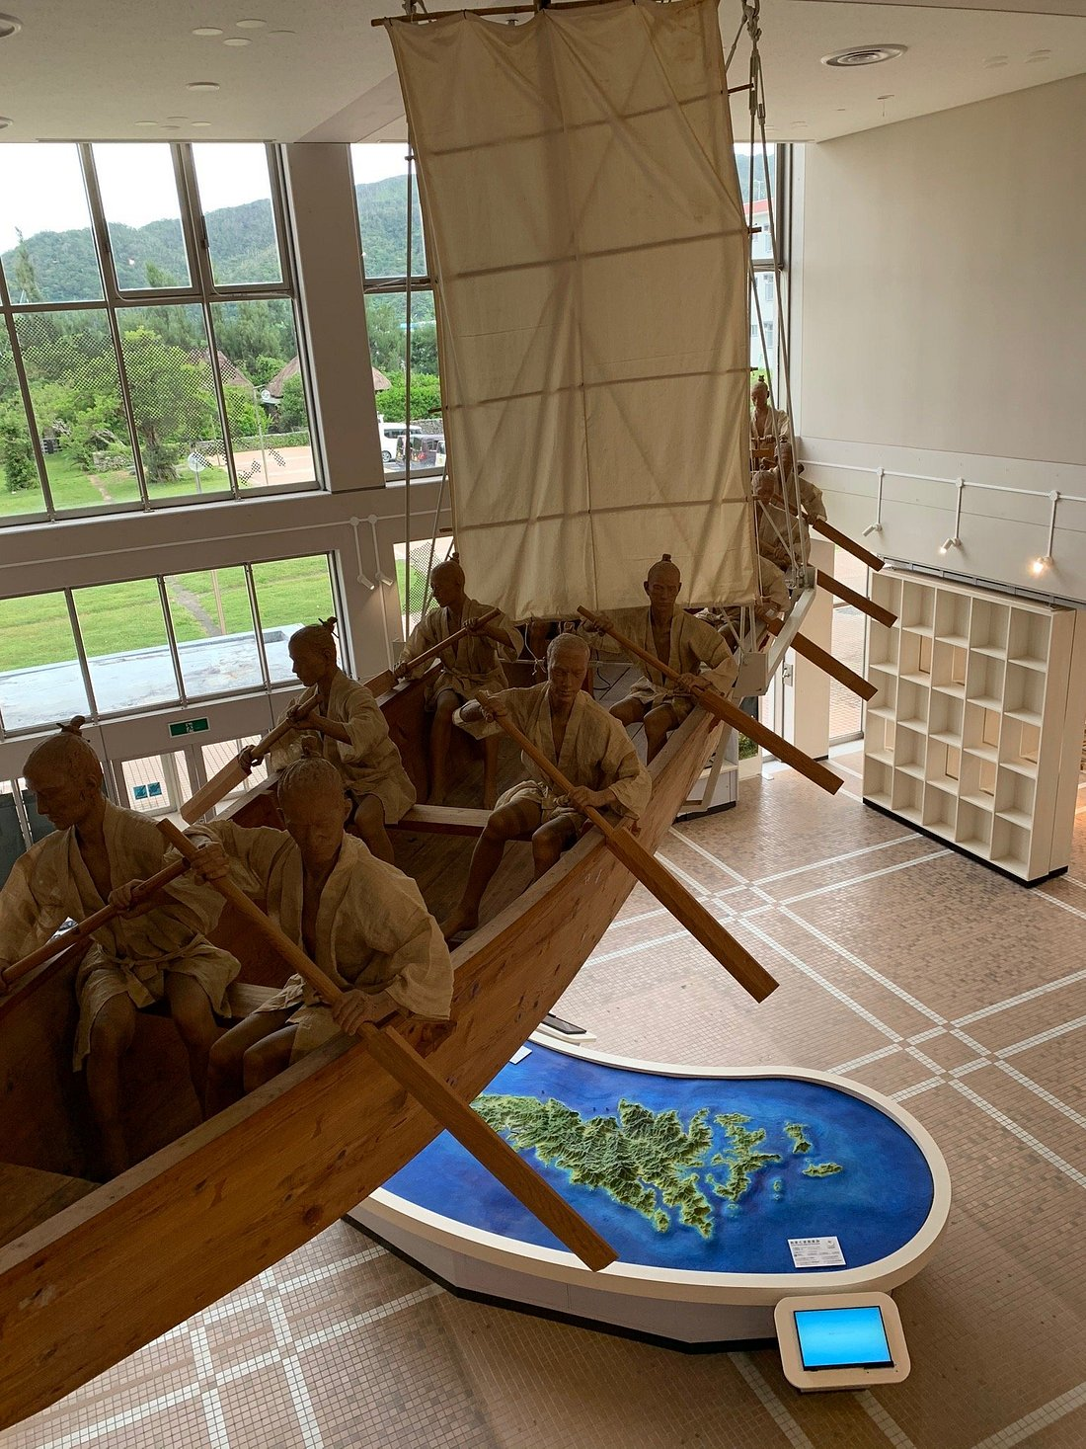
Amami City Amami Museum
Learn about Amami's distinctive history and culture at the Amami Museum, with displays of traditional life, customs, and natural science.
This facility exhibits materials including models and old tools that illustrate Amami's distinctive culture and history as well as the natural environment of the island. This museum offers a great in-depth learning experience about Amami.
Admission Fees
Adult: ¥310 Student: ¥150
Child: ¥100

Slide 12
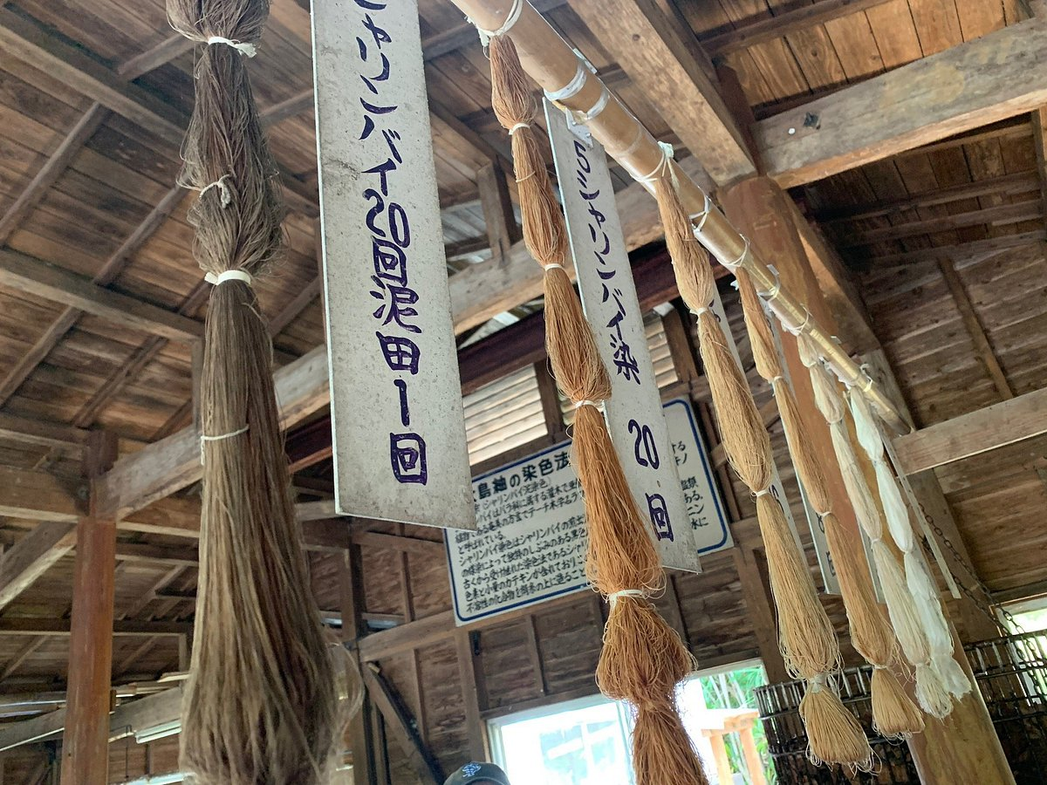
Oshima Tsumugi Museum
Oshima Tsumugi Art Museum is a facility where you can observe the actual manufacturing site of Amami Oshima Tsumugi, which is a special product of Amami Oshima, and experience mud dyeing. Oshima Tsumugi is a silk fabric that originated in Amami Oshima. You can also see the actual weaving scene. Visitors can experience the variety and intricacy of handwoven Authentic Oshima Tsumugi silk fabric and learn more about the rich history of the patterns and art form. Experience the skills and thoughts of the craftsmen for Oshima Tsumugi.
Admission Fees Adult: ¥550 Child: ¥220

Slide 13
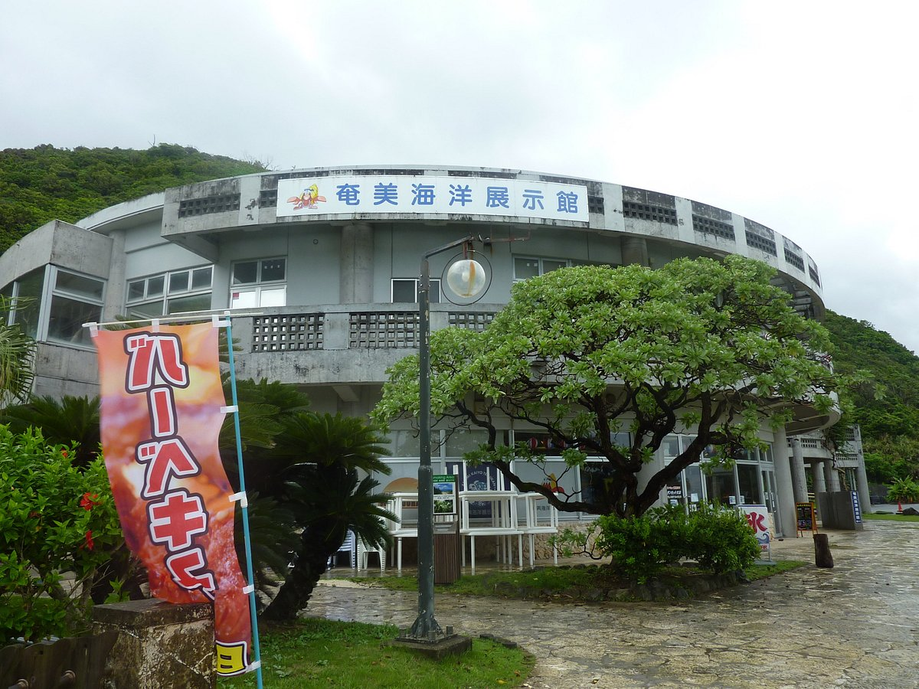
Amami Marine Exhibition Hall
Situated in Ohama Seaside Park, Amami Kaiyo Tenjikan (Maritime Museum) is home to over 100 species of fish, 30 species of coral as well as plants and animals that inhabit Amami's ocean and beach. You can feed the fish and turtles or interact with sea creatures in the Touch Pool. The museum also offers classes for handcrafting items using materials from the ocean of Amami. There is a theater where you can learn about the ocean through videos. This is a fun museum for everyone.
Admission Fees Adult: ¥500 Child: ¥100

Slide 14
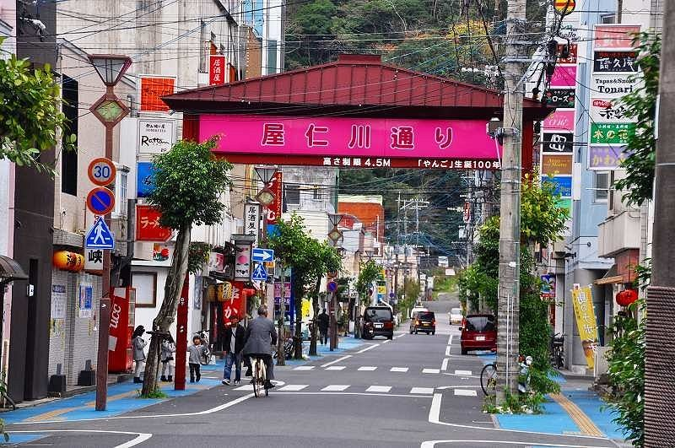
Yanigawa Shopping Street
Yanigawa Shopping Street is a nightlife district located in the bustling Naze City of Amami Oshima Island. The street is lined with about 200 snack bars and izakaya restaurants and is said to be the second largest after Tenmonkan Street in Kagoshima City. The locals have dubbed it "Yango-dori" after the river that used to flow in the area. Once night falls, the shop signs light up, attracting locals and tourists alike and giving the street a vibrancy worthy of any nightlife district. There are plenty of local izakaya restaurants popular with tourists and hidden snack bars known only to locals, so no matter your taste you're sure to be able to enjoy Amami's nightlife.

Slide 15
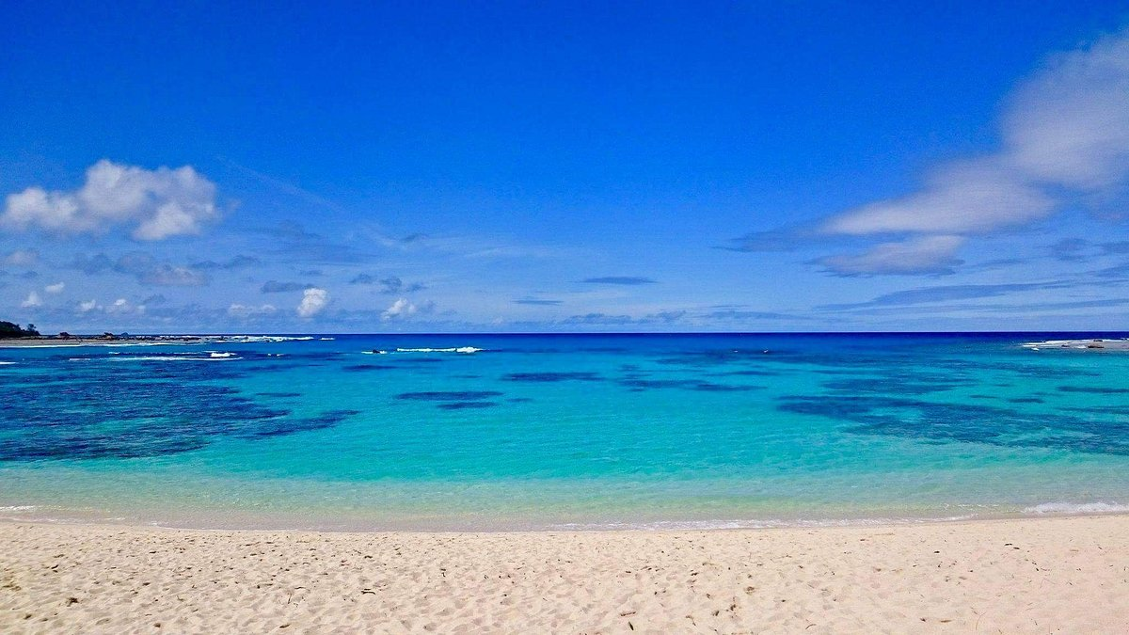
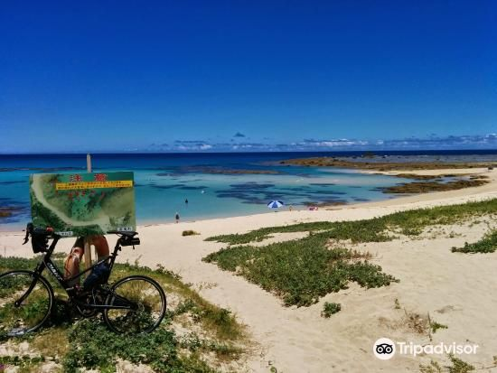
Tomori Beach
What makes Tomori coast special is its clean white sand, where you can swim, snorkel, and catch crabs.

Slide 16
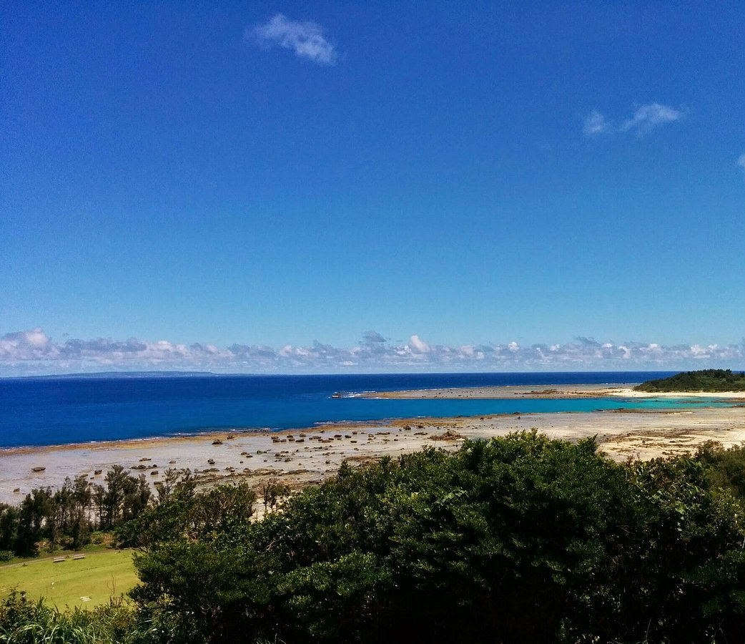
Cape Ayamaru Kanko Park
Located in the northernmost part of Amami Oshima, Ayamaru Misaki Cape Park offers great views of the Pacific Ocean. Visit the lookout or the ocean-facing café to soak up the scenery. The cape is surrounded by nature, including a large coral reef just below the ocean’s surface and a subtropical jungle of sago palm trees. In the large park area, there are plenty of places to explore and activities to enjoy. Check out the ocean water pool and sago palm jungle or enjoy a ride on a bicycle or miniature train. There is also an extensive children’s play park, grass skiing, ground golf and much more.

Slide 17
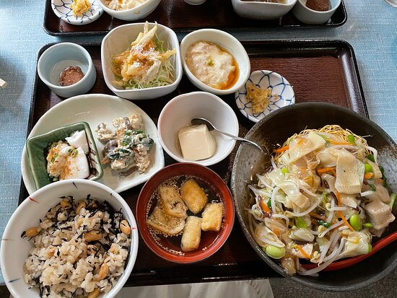
Restaurants
Many of us on the ship are foodies, so naturally, we’re always
on the hunt to eat at the most exclusive spots anytime we
travel.
Amami Kyoraumi Kobo Kasari
1254-1 Kasaricho Yoan, Amami $$ - $$$ Café European
Kitahachi
18-30 Nazeirifunecho, Amami $$ - $$$ Japanese
Minatoya
81 Kasaricho Sotoganeku, Amami $$ - $$$ Japanese
Amami Izakaya Hokorashiya
13-6 Naze Irifunecho, Amami $$ - $$$ Japanese
For those of you that just like good food, you can’t go wrong just about anywhere you go.
GOOD EATING

Slide 18
Final Thoughts
Naze is a beautiful City with a rich history and numerous attractions. Whether you're looking for stunning beaches, historic sites, or unique attractions, Naze has something for everyone.
I hope this presentation will help when we visit Naze!

Slide 19
Thanks For Coming
If you have any more questions, please ask.
I will do my best to answer them for you.
Have a great visit in Naze!

