Slide 1

Naples Italy
Port Presentation
Presented by
Marc Silver

Slide 2
What I Will Cover
My Port Philosophy
Don’t Miss the Ship
Money
Naples History
Where is the Tourist Office?
Maps
Getting Around Naples
Places to see or at least consider
A few restaurant recommendations
Best way to get around Naples

Slide 3
My Port Philosophy
I have been cruising for over 45 years and taken over 100 cruises. So I consider myself an experienced cruiser.
I always like to see how other people live.
When I am on a cruise where the city I want to visit is not the port city, I always recommend taking a ship’s tour.
But when I am in a port where many things are nearby and easy to see on my own - I will do it on my own.
This presentation is for that type of port.

Slide 4
Don’t Miss the Ship
How to Avoid Missing Your Ship
Pay attention to the time. - Ship time and local time are often different.
Put a return to ship reminder on your phone.
Choose excursions wisely.
If a ship-sponsored excursion is late returning to port for, the ship will wait for you. If you are on your own???
Be Prepared
Have your Passport, Credit Card and phone numbers for your ship port agent.
What to Do If You Miss the Ship Most cruise lines have port agents stationed in the port area to assist if your ship has left without you. If your lucky, when cruisers are late returning to the vessel, the ship's crew will often remove the passengers' essential items -- passports, cell phones and medication -- from the ship to leave with the port agents.
The Port Officials can help you with contacting your ship and making necessary travel arrangements.

Slide 5
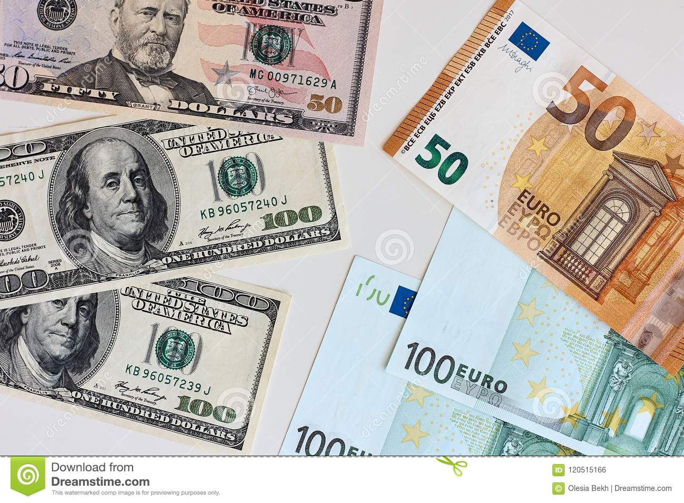
Money
The euro is the official currency of 20 European Union countries which collectively make up the euro area, also known as the eurozone.
Official Exchange is €1 to $1.079 US

Slide 6
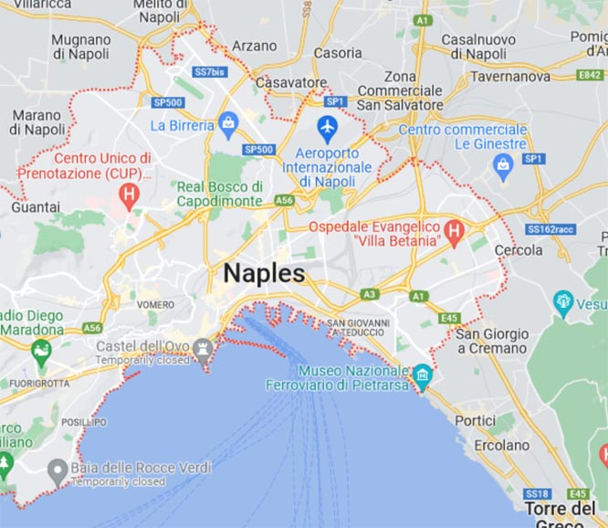
Naples Italy
Naples, or Napoli for Italians, is a major port city in the south of Italy in the Campania region.
With 4.4 million inhabitants, it is the third largest city in Italy. The chaotic city has everything for an inspiring city trip because of the rich history, cuisine and especially art and Culture, the city has a lot to offer.
In addition, a short distance from the city of Naples you will find the ruins of Pompeii, Herculaneum and the Vesuvius volcano. South of the city lies the colorful and beautiful coastal strip of the Amalfi Coast, and you can easily reach the beautiful islands such as Capri off the coast of Naples by ferry.

Slide 7
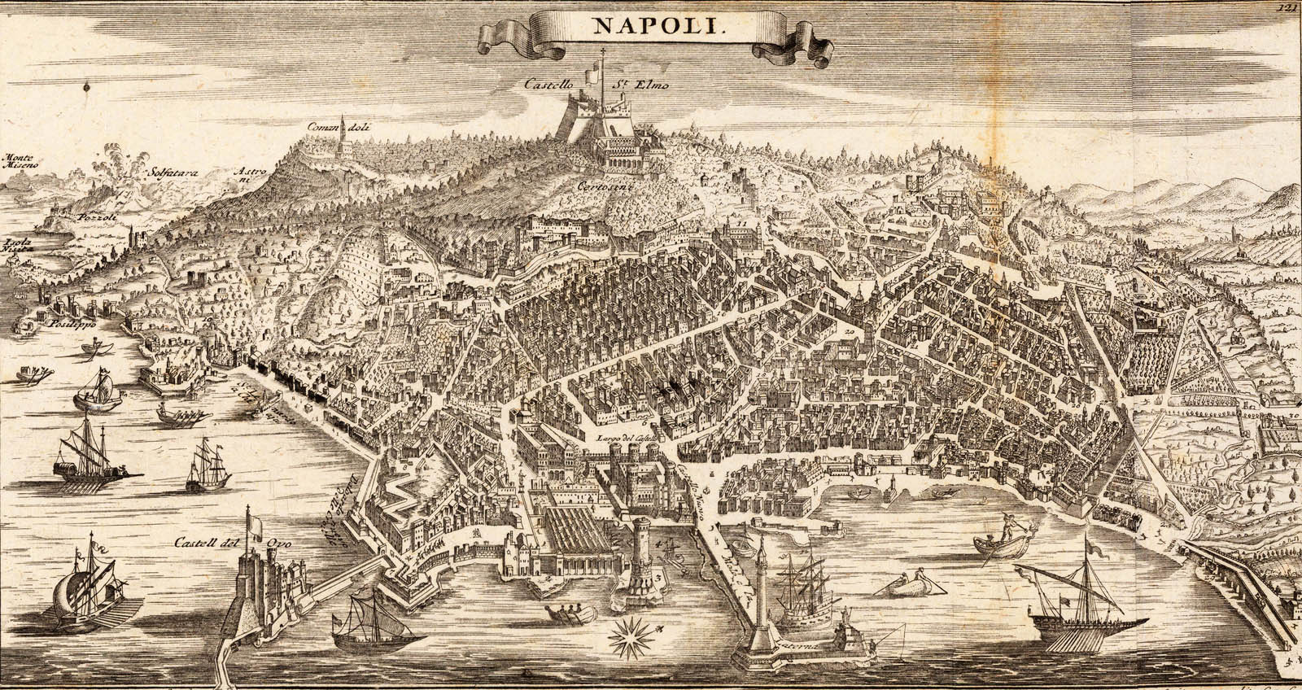
Naples Italy
Dating back some 4,000 years, Naples is one of the oldest cities in the world. Greek settlers established an early colony here about 2,000 BC, and by the 6th century BC they had erected the ancient city of Neapolis. The distinct Neapolitan culture was born then and survived even after the Romans conquered the area.
It served as the capital of the Duchy of Naples (661–1139), of the Kingdom of Sicily.

Slide 8
Naples Early History
Naples was founded about 600 bce as Neapolis (meaning “New City”), close to the more ancient Palaepolis, which had itself absorbed the name of the siren Parthenope. Both towns originated as Greek settlements, extensions almost certainly of Greek colonies established during the 7th and 6th centuries bce on the nearby island of Pithecusa (now Ischia) and at Cumae on the adjacent mainland, where remarkable Greek ruins may be visited today. Horace, Virgil, and the Neapolitan poet Statius are among numerous classical writers who attest the Hellenism of Naples. The Greek language was preserved throughout the city’s first millennium, surviving submission, in the 4th century bce, to the dominion of Rome.

Slide 9
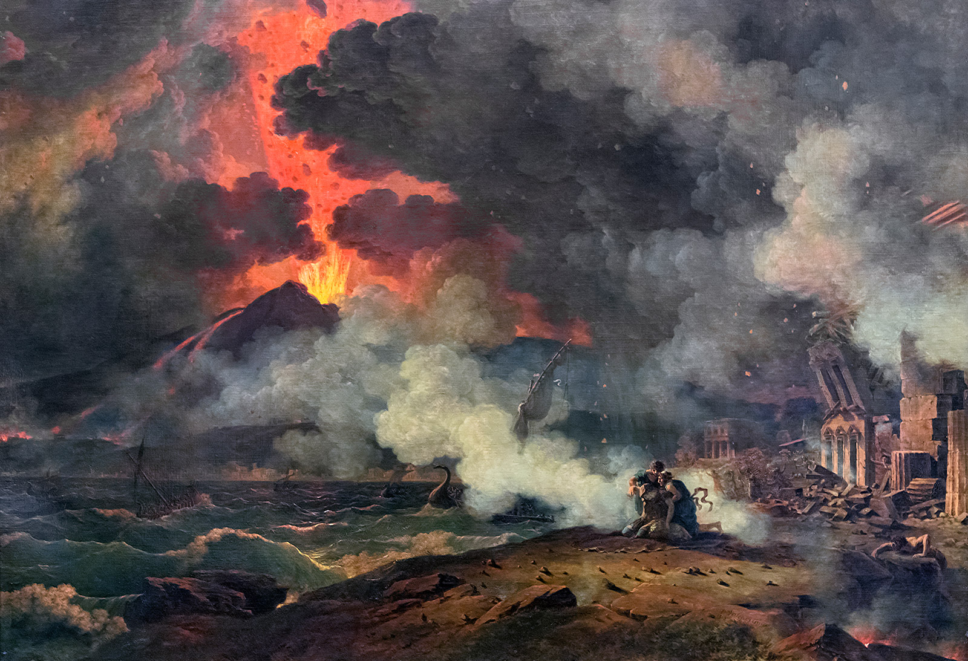
The Eruption of Pompeii
In 79 ce the great eruption of Vesuvius buried the seaside towns of Pompeii, Herculaneum, and Stabiae, also engulfing many villas confidently constructed on the slopes of a mountain that had not erupted for more than seven centuries.
A contemporary account of this event survives in two letters addressed to the historian Tacitus by Pliny the Younger about the attempt to rescue survivors by sea.

Slide 10
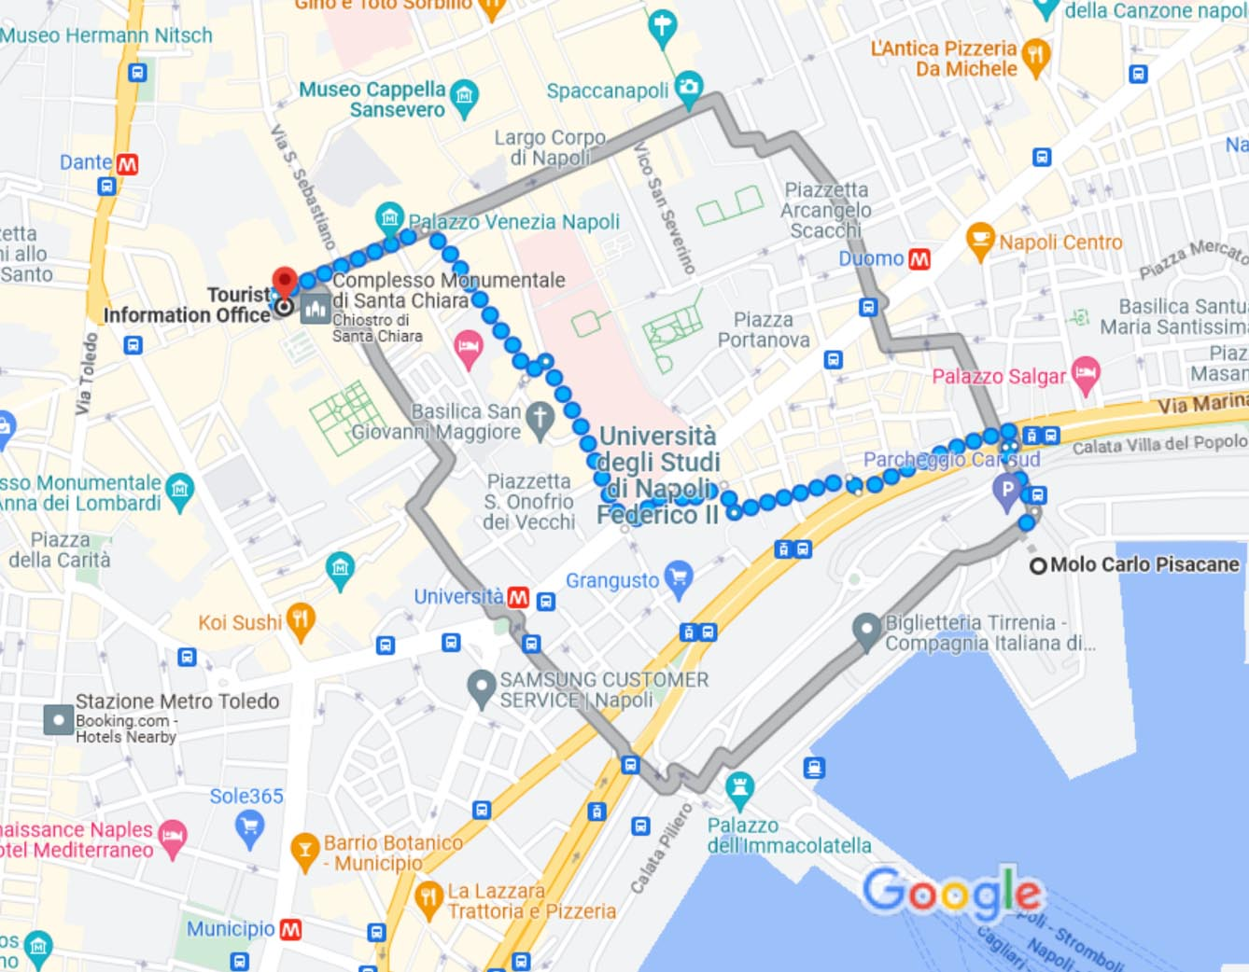
Tourist Office
Tourism Office provides a tourist information service and attention to the city's visitors.
It is about 1.5km from the ship. About a 20 minute walk.
Piazza del Gesu, Naples.

Slide 11
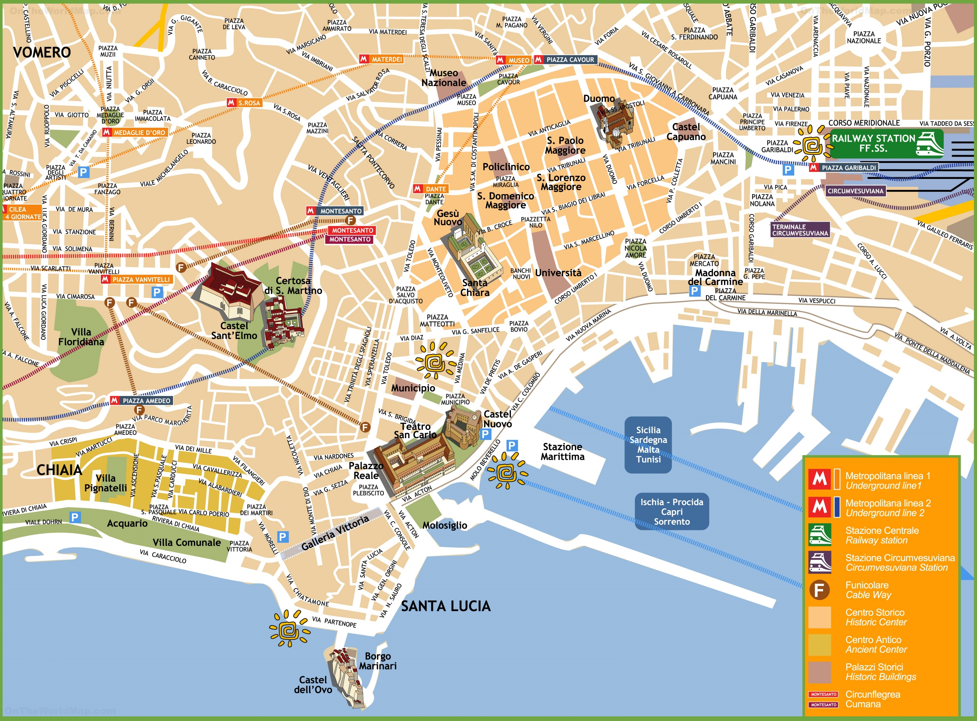
Map Of Naples

Slide 12
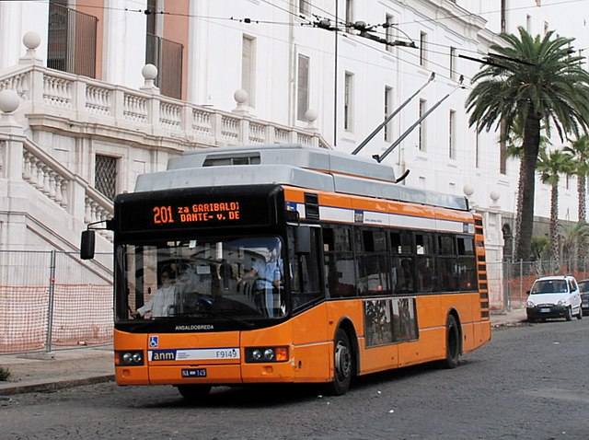
Getting Around Naples
For the most part Naples is an easy city to walk. Breathe in the aromas of Neapolitan pizza cooking in nearby ristoranti and take in the sights of the ancient city. For those who want to avoid exercise as much as possible,
Buses are the most common form of transport used in Naples. Piazza Girabaldi is the main terminus for almost all Neapolitan buses. It’s also super convenient for other means of transport, as it’s right in front of the central train station in Naples. Allday passes are €4.50 euros

Slide 13
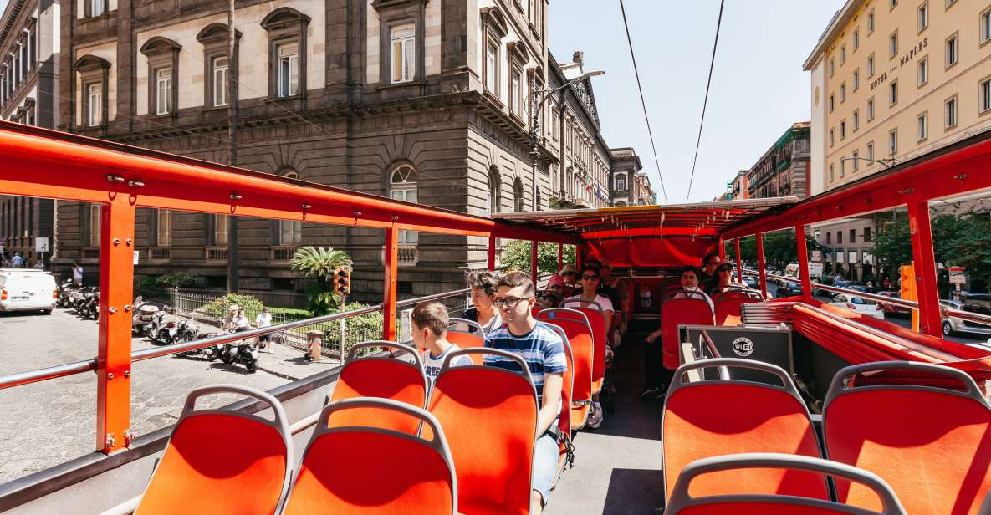
Hop on Hop Off Naples
Explore Naples with a 24-hour ticket to the panoramic, open-top, hop-on hop-off bus tour. Discover the city’s top attractions, from the Norman Castle Nuovo to quaint neighborhoods with access to 2 routes. Tickets are €25
Line B
Stop 1 - Largo Castello (Piazza Municipio)
Stop 2 - Piazza Vittoria - Via Calabritto
Stop 3 - Viale Dohrn
Stop 4 - Mergellina - Piazza del Leone
Stop 5 - Capo Posillipo - Veduta Panoramica
Stop 6 - Posillipo
Stop 7 - Parco Vigiliano
Stop 8 - Via Petrarca
Stop 9 - Piazza Vittoria
Stop 10 - Chiatamonte
Stop 11 - Via Acton/Porto Stazione Marittima, Ships pier
Line A
Stop 1 - Largo Castello (Piazza Municipio)
Stop 2 - Chiesa Del Gesu Nuovo
Stop 3 - Piazza Dante - Ingresso Ai Decumani
Stop 4 - Museo Archeologivo Nazionale
Stop 5 - Porta San Gennaro
Stop 6 - Palazzo Caracciolo
Stop 7 - Stazione Garibaldi
Stop 8 - Corso Umberto I
Stop 9 - Piazza Bovio/Universita

Slide 14
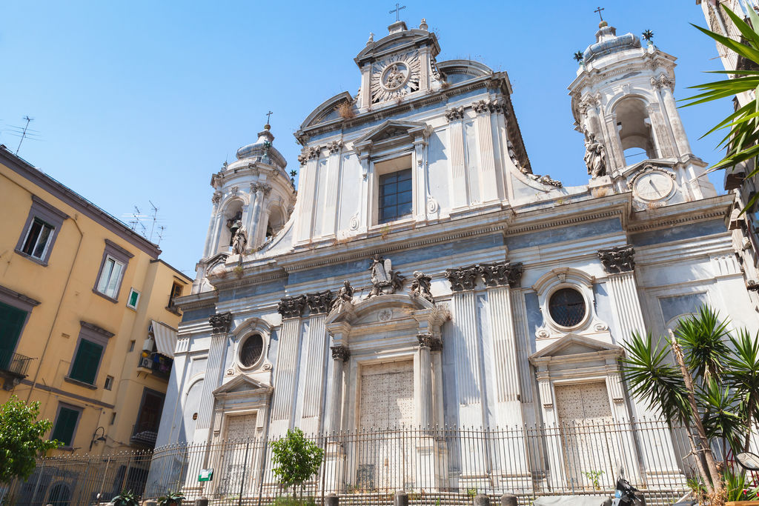
Pio Monte della Misericordia
This church holds several valuable works of art. Its most famous piece is The Seven Works of Mercy by Caravaggio which hangs above the high altar. The church is also home to work by Carlo Sellitto, Luca Giordano, Battistello Caracciolo and Fabrizio Santafede. The church belonged to the Pious Mount of Mercy brotherhood of charitable noblemen established in 1601 to provide interest-free loans to the poor. The brotherhood still exists today and continued its charitable work. They commissioned the construction of a church designed by Gian Giacomo di Conforto
From 1658 to 1678 the church underwent renovations and was expanded by annexation of neighboring properties. The improved octagonal-shaped church and facilities were designed by Francesco Antonio Picchiati and include a palace and church within the complex.

Slide 15
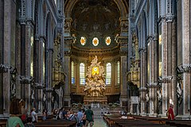
Naples Cathedral
The Duomo di Santa Maria Assunta or Duomo di San Gennaro is a medieval cathedral established in the 4th century but the baptistery is the only surviving part of the original structure. The present building is in the Gothic-style and was completed in 1323. Antonio Baboccio redesigned the west façade in 1407 following damage from an earthquake. Again in 1877-1905 the façade was renovated by Enrico Alvino. The portal has survived from the medieval structure.
Calle Virgen de la Palma
Calle Virgen de la Palma
The church has a large nave with over 100 granite columns brought from the Africa and the Far East. Most of the interior décor is in the baroque-style. The cathederal is an excelent place for the art enthusiest.

Slide 16
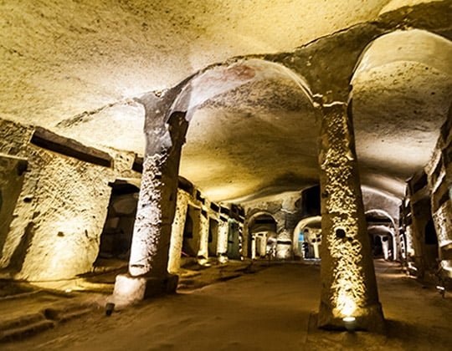
Naples Sotterranea
Travel back 2400 years to the heart of where Naples began. The historic site is situated underground beneath the Naples old town. The underground world shows marks and signs
from many eras in the history of Naples. The
subterranean world tells the story of Naples’
history and is full of legends and myths.
Running beneath the city are geothermal zones
originating at Mt. Vesuvius. The geothermal
pressure caused volcanic sandstone, tufa, which
is easy to work with and used to build the city.
Tickets 10 €
65+ 7.50 €
Children under 17 years 6.50 €

Slide 17
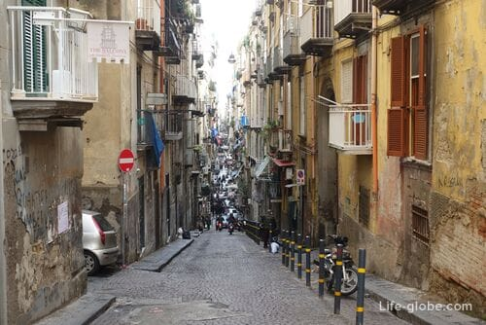
Spaccanapoli
This street is 6 meters wide and runs for 2km from Piazza Gesu Nuovo where it is called Via Benedetto Croce, changes name to Via S. Biagio dei Librai and continues across Via Duomo becoming Via Vicaria Vecchia going out of the old town. It is the main stretch for tourists which splits the center of the historic old town (centro storico) in half. The street was one of three Greco-Roman parallel main streets originally called Decumanus
Naples Cathedral
inferior. The street is not only an attraction in itself but is conveniently close to many of the city’s top attractions like Santa Chiara, Santa Maria, San Biagio Maggiore and several of the well known city squares. It is a straight narrow cobbled street running through a vibrant, colorful, noisy and exciting neighborhood also referred to as Spaccanapoli. The street will take you passed palaces, churches, shrines, stores, bars, restaurants and artists’ workshops.

Slide 18
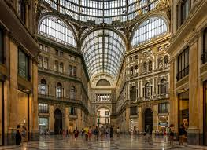
Galleria Umberto I
This shopping center is in a magnificent building with a Latin Cross layout. In fact from aerial views you can see the distinct cross with the dome at the point where the two branches of the cross meet. The longer part of the cross is 138 meters long and the shorter crossbeam is 108 meters long. At the meeting point of the two beams the cathedral theme continues with the 57 meter high dome. There are entrances at all four of the ends of the “cross” with
the main entrance being
opposite the Carlo Theatre.
Torre Tavira
The architecture was inspired by the industrial revolution’s 19th century similar to London’s Crystal Palace (1815) and the Oxford Museum (1859) with the use of exposed iron, glass and industrial materials.

Slide 19
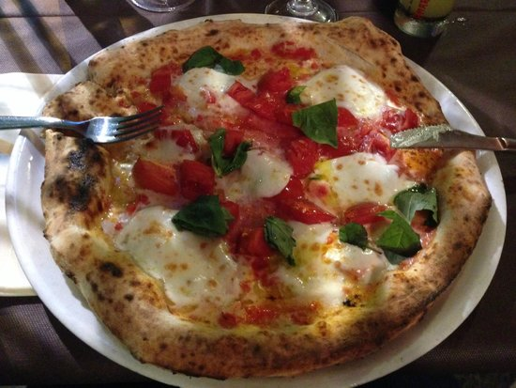
Eat At The World’s First Pizzeria
Italy is famous for pizza, and Naples is the center of that tradition. Naples is the birthplace of pizza and no city does it better.
The must do place to eat can be found at Antica Pizzeria Port’Alba. Believed to be the first pizza restaurant in the
world, Antica Pizzeria Port’Alba opened in 1830 and has served satisfied customers ever since. Amazingly, the ovens in Antica Pizzeria Port’Alba are linked to the lava rocks at Mt. Vesuvius.

Slide 20
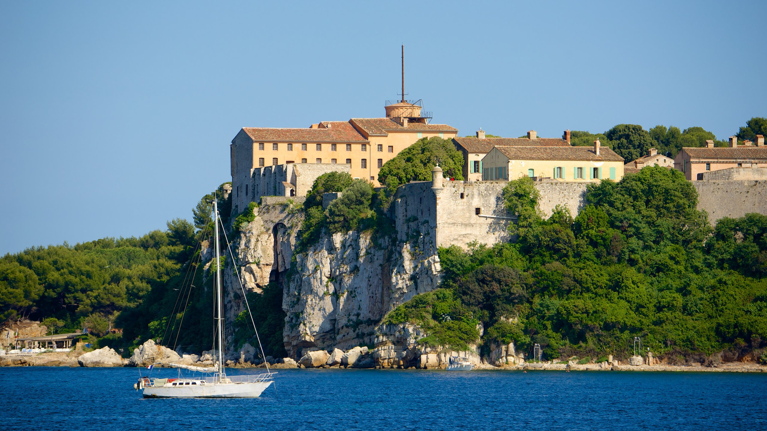
Pompeii And Mt. Vesuvius
Mt. Vesuvius could erupt at anytime, so you will want to make a trip to Pompeii before that happens again
Vesuvius is the only volcano on Europe’s mainland to have erupted in the last 100 years.
The volcano that once buried Pompeii is only six miles from Naples, making it an easy day trip from the city. Tours operate daily from multiple tour companies
Tickets cost €6 ($6.60) per person.

Slide 21

Home to Amazing Restaurants
Many of us on the ship are foodies, so naturally we’re always on the hunt to eat at the most exclusive spots anytime we travel. There are many creative restaurants to choose from that have Michelin stars, both in the city and in the surrounding area. In fact, the Campania region tied for second place for the region with the highest number of Michelin-starred restaurants in Italy in 2022. Naples has five Michelin star restaurants.
Here are a few of the Michelin Star Restaurants in Naples.
Palazzo Petrucci – 1 Michelin Star
Aria – 1 Michelin Star
Indaco – 1 Michelin Star
L’Olivo – 2 Michelin Stars
George Restaurant – 1 Michelin Star
For those of you that just like good food, you can’t go wrong just about anywhere you go in Naples. After all this is Italy!

Slide 22
Thanks For Coming
If you have any more questions, Please ask.
I will do my best to answer them for you.
Have a great visit in Naples!

Slide 23
Acknowledgement
My seminars are the result of many years of travel experience combined with many hours of research over the internet.
I would like to acknowledge the many source I have accessed.
These include: Wikipedia.com, Britannica.com, Trip Advisor and the various Museum, Park and Government websites.

