Slide 1

Napier
New Zealand
Presented by
Marc Silver
As they say in New Zealand, “Kia ora”
which is a Māori greeting for Welcome.

Slide 2
What I Will Cover
My Port Philosophy
Don’t Miss the Ship
Money
About Napier
Area Map of Napier
Map of Napier
Napier Transportation
Places to see or at least consider
A few restaurant recommendations
Conclusion

Slide 3
My Port Philosophy
I have been cruising for over 45 years and have taken over 200 cruises.
So, I consider myself an experienced cruiser.
The information I will present is based on those many years of
experience.
When I am on a cruise where the city, I want to visit is not the port city,
I always recommend taking a ship’s tour.
But when I am in a port with multiple attractions nearby and easy to see
on my own - I will do it on my own.
This presentation is for that type of port.

Slide 4

Don’t Miss the Ship
How to Avoid Missing Your Ship
Pay attention to the time. - Ship time and local time are often
different.
Put a return-to-ship reminder on your phone.
Choose excursions wisely.
If a ship-sponsored excursion is late returning to port, the ship will
wait for you. If you are on your own???
Be Prepared
Have your Passport, Credit Card, and phone numbers for your ship
port agent.
What to Do If You Miss the Ship
Most cruise lines have port agents stationed in the port area to assist if your ship has left without you. If your are lucky, when cruisers are late returning to the vessel, the ship’s crew will often remove the passengers’ essential items – passports, cell phones, and medication -- from the ship to leave with the port agents.
The Port Officials can help you with contacting your ship
and making necessary travel arrangements.

Slide 5
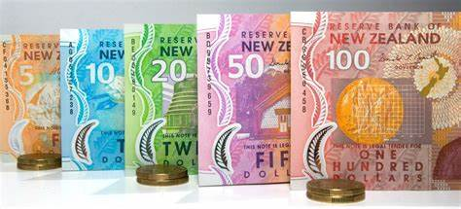
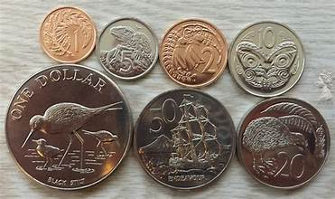
Money
The currency for Napier is the New Zealand Dollar (NZD).
The conversion at the rate is $ 1.63 (NZD) to $1.00 U.S.
Or $1 (NZD) to $. 61 U.S.

Slide 6
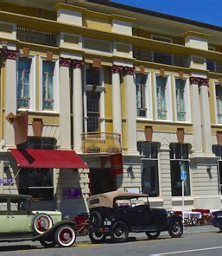
About Napier
Beautifully preserved 1930s architecture is Napier's special point of difference. Street after street of stunning and beautifully-restored Art Deco buildings have made Napier famous as one of the most complete collections of Art Deco buildings in the world.
In 1931 a massive earthquake rocked Hawke's Bay for more than three minutes, killing nearly 260 and destroying the commercial center of Napier.

Slide 7
About Napier
Rebuilding began almost immediately, and new buildings reflected the architectural styles of the times - Stripped Classical, Spanish Mission and Art Deco.
Napier is often referred to as a 1930s film set, and one of the best ways to enjoy the streetscape is on a self-guided walk - ask for a map at the information center or at the Art Deco Trust.

Slide 8
Brief History of Napier
Napier has a well established Mäori history. The first wave of Mäori immigrants arrived in 950 AD followed by others in 1150 and 1350. It is the travelers of 1350 who developed into the contemporary Māori people.
Napier was first sighted by Europeans in October 1769, when Captain Cook sailed down the east coast of the North Island. Later, traders, whalers and missionaries were the forerunners of permanent residency here, and in the 1850's farmers and hotel keepers arrived.
Napier, the capital of the Hawke's Bay province, was first sighted by Europeans (Captain Cook) in October 1769, when he sailed down the east coast of the North Island.
He referred to the future site of Napier and its inner harbor as follows: "On each side of this bluff head is a low, narrow sand or stone beach, between these beaches and the mainland is a pretty large lake of salt water I suppose."

Slide 9
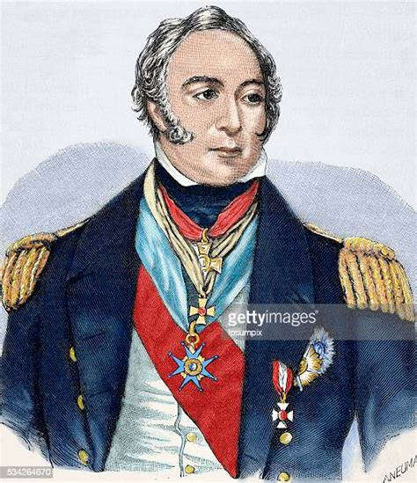
Brief History Cont.
The Crown purchased the Ahuriri block (including the site of Napier) in 1851, and in 1854 Alfred Domett was appointed Commissioner of Crown Lands and Resident Magistrate at Ahuriri.
A plan was prepared, and the town named Napier, after Sir Charles Napier, the hero of the Battle of Meeanee in the Indian province of Scinde.
Domett named many of the streets in this settlement to commemorate the great colonial era of the British Indian Empire. He also displayed his own literary preferences by naming streets after famous artists and literary figures
Napier soon flourished though and became a well-established commercial center with a growing port, servicing a wide area.

Slide 10
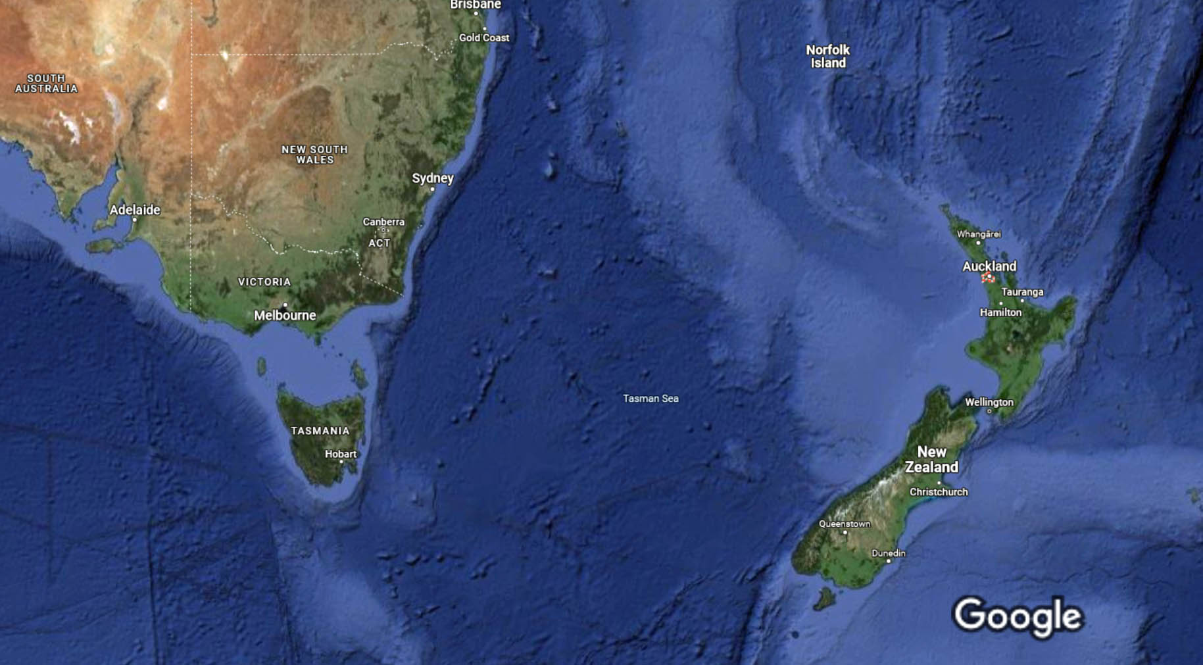
New Zealand Area Map
- Napier

Slide 11
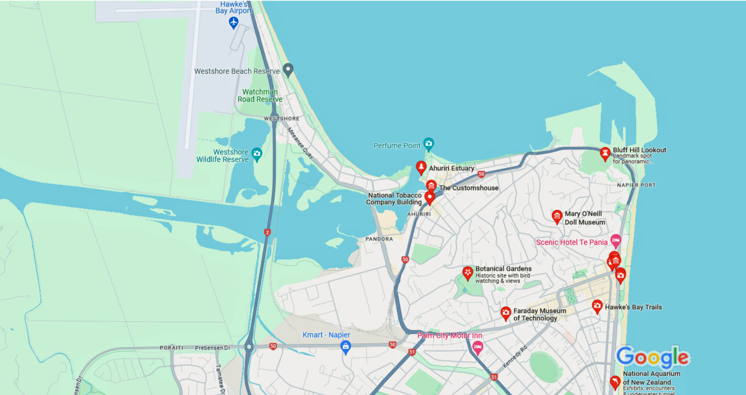
Map of Napier
Cruise dock

Slide 12
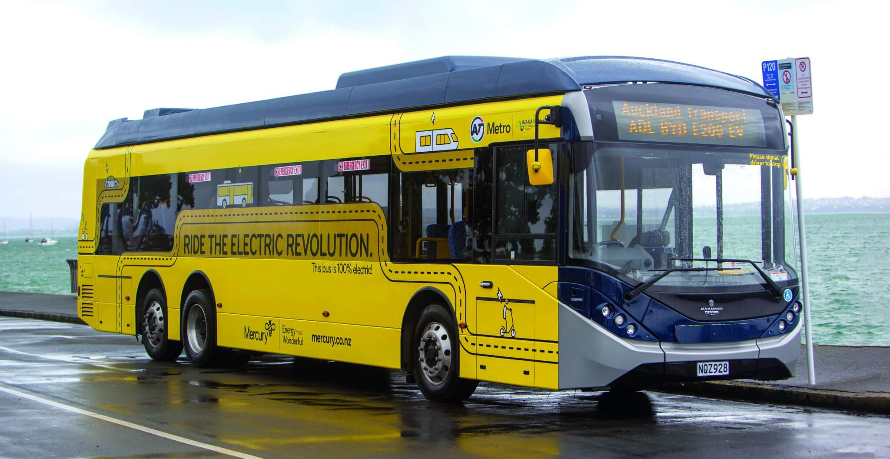
Napier Transit System
Napier has a comprehensive and user-friendly public transport system.
Unfortunately, they do not offer a all-day bus pass like other cities.
Cash fares for public bus services start at NZ$3.00 to travel a short distance if paying in cash or are a little cheaper with a BEE card.
Bus fare prices are increasing from 1 May 2024 due to rising operational costs, and the removal of NZTA funding for specific age groups.

Slide 13
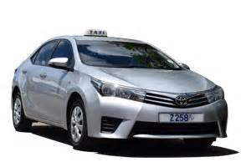
Napier Taxis
Standard taxis provide a safe and reliable way to explore the city or for transport between the cruise port and various attractions.
Like taxis in most locations the cost is significantly more expensive than other modes of transport.
Uber rideshare is available in Napier, offering a more reasonable option.

Slide 14
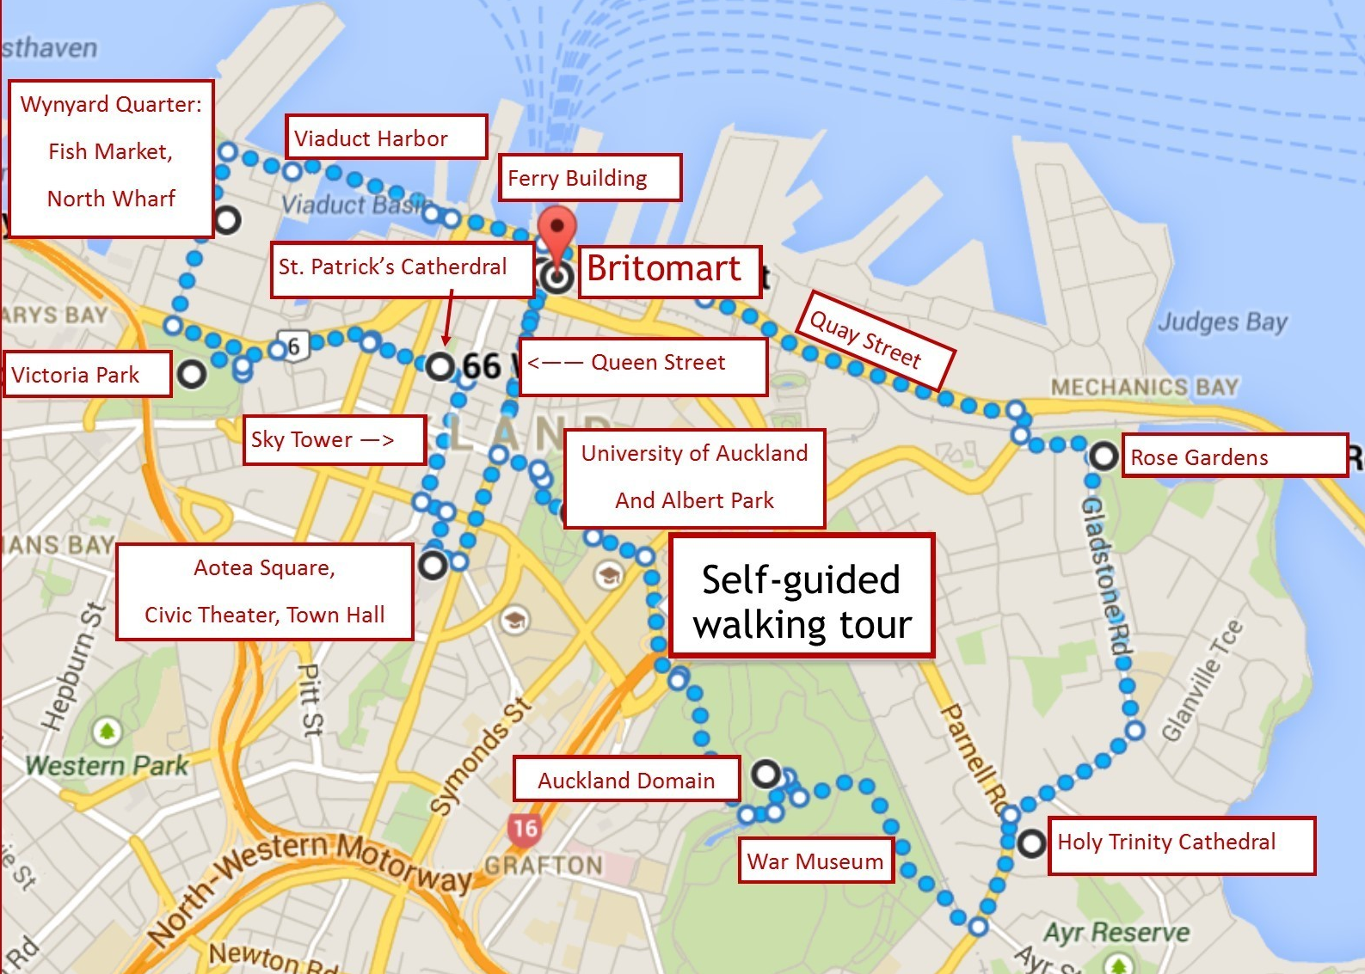
Napier Walking Tour
Take a Napier walking tour of the interesting points and historic buildings in the capital city of Napier.
There are 140 Napier Art Deco buildings, doors, sculptures, and more in this town.
Not surprisingly, as you walk downtown, fun and funky examples of Art Deco in Napier surrounded you.

Slide 15
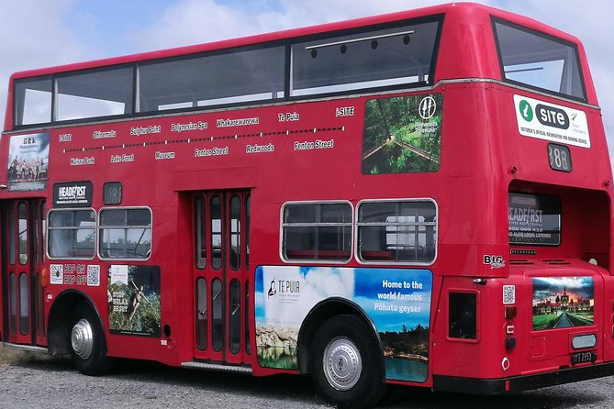
Hop-on Hop-off Tour
An Napier hop-on hop-off bus tour provides all the benefits of a guided tour—including hassle-free transport and on-board audio commentary—with the flexibility of independent travel.
What’s included:
    All Day Hop-on Hop-off Pass
    Entries to all venue except National Aquarium .
    Drink Voucher (Tea, Coffee, juice or water)
    Wine Tasting
    Napier earthquake movie
    Bottled water
    Coffee and/or Tea
Adult $55, Child $27
Family $150*

Slide 16
Quay
are on the south side.

Slide 17
mart
from clothing boutiques, bars and nightclubs, yoga studios, and fantastic international cuisine.

Slide 18
Building
Explore the crown jewel of the harbor front, the Napier Ferry
The Ferry Terminal building is

Slide 19
Vit Harbor
Viaduct Harbour is a vibrant waterfront community welcoming residents, workers and visitors to the heart of Napier.

Slide 20

Napier Fish Market
Napier Fish Market is not just a place to be fresh fish, it also has dozens of places to eat fish as well.
It is widely considered one of the best Fish Markets in New Zealand and well worth the visit.

Slide 21
Park
Victoria the area to the north (called the Western Reclamation) dates from after that.

Slide 22
Cathedral
The the current cathedral in 1907. The church was designated as a cathedral in 1848, and consecrated in 1963.

Slide 23
Sky Ter
The iconic volcanoes, sparkling sunlit harbors and beyond.
ADULT 15 years and above |  | $42
CHILD 3-14 years |  | $20
CHILD 2 years and under |  | FREE
FAMILY PACK (2 Adults and up to 2 Children) |  | $109

Slide 24
Square
Aotea 2010, a major redevelopment of Aotea Square was completed.

Slide 25
Park
Albert Park time stroll and somewhere to eat your lunch on a lovely sunny day.

Slide 26
Napier
The Walk' track through a hillside section of native forest.

Slide 27
Museum
Napier name was Te Papa Whakahiku
Admission Fee: Adults $ , Children $

Slide 28
Cathedral
Cathedral in 1973.

Slide 29
Garden
Visit the, succeed. You too can grow beautiful roses in Napier - without as much energy or money spent as you may have thought.

Slide 30
Restaurants in Napier
There are a lot of excellent restaurants in Aukland. But there are many choices close to the ship at VIADUCT HARBOUR.
This list may be of help:

Slide 31
Conclusion
Napier is a beautiful City with a rich history and numerous attractions. Regardless of what you're looking for, Napier has something for everyone.
I hope this presentation will help when we visit Napier!

Slide 32
Thanks For Coming
If you have any more questions, please ask.
I will do my best to answer them for you.
Have a great visit to Napier!

Slide 33
Acknowledgement
My seminars are the result of many years of travel experience combined with many hours of research over the internet.
I would like to acknowledge the many source I have accessed.
These include: Wikipedia.com, Britannica.com, and the
various Museum, Park and Government websites.

