Slide 1
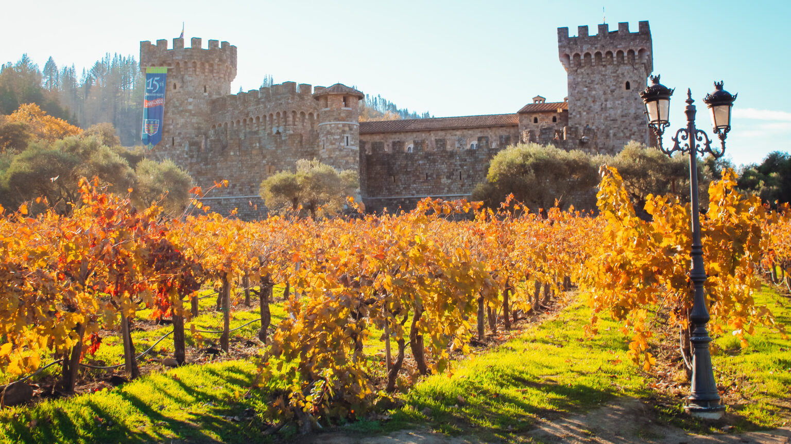
California’s Wine Royalty Presented by Marc Silver
Exploring Napa and Sonoma

Slide 2
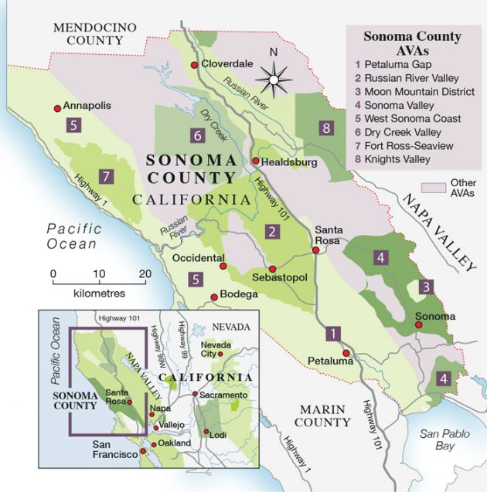
Exploring Napa and Sonoma
When you think of California wine, Napa and Sonoma are likely the first places that come to mind, and for good reason.
These neighboring regions, just an hour north of San Francisco, are the crown jewels of American winemaking. Napa dazzles with its iconic Cabernet Sauvignons and luxurious wineries, while Sonoma charms with its down-to-earth vibe and incredible diversity, from cool-climate Pinot Noir to bold Zinfandel.
But there’s another region, a bit further afield, that deserves its place in the spotlight: the Sierra Foothills.
Located about three hours east of San Francisco, this historic area was California’s first significant wine region, thanks to its roots in the Gold Rush era.
Together, these three regions offer a dynamic snapshot of California’s rich wine heritage and its exciting future.

Slide 3
A History of Grit and Glory
California’s wine story begins not in Napa or Sonoma but in the Sierra Foothills.
During the Gold Rush of the mid-1800s, the area around Placerville and El Dorado became a hub of winemaking as settlers planted vineyards to satisfy the miners’ thirst.
The warm days, cool nights, and volcanic soils proved perfect for growing European grape varieties like Zinfandel, which quickly became the region’s star.
By the late 19th century, the Sierra Foothills were producing more wine than any other part of the state.

Slide 4
A History of Grit and Glory
However, as gold fever faded, so too did the Foothills’ prominence in the wine world. Meanwhile, Napa and Sonoma were quietly establishing themselves.
Charles Krug opened Napa’s first commercial winery in 1861, and pioneers like Agoston Haraszthy were busy introducing European winemaking techniques to Sonoma.
Over time, these regions gained fame, and events like the 1976 Judgment of Paris, where Napa wines outshone their French competitors, cemented their place in the global spotlight.
While Napa and Sonoma grabbed headlines, the Sierra Foothills remained a quieter player. Yet today, it stands as a hidden gem, with some of California’s oldest vines and a growing reputation for robust, character-filled wines.

Slide 5
Wine Regions and Terroir
Each of these regions has a unique story to tell through its landscapes and wines.
Napa Valley: Napa may be compact, but it packs a punch. Stretching just 30 miles long and 5 miles wide, the valley is home to an astonishing variety of microclimates and soils, from volcanic to alluvial. The result? Some of the most complex and age-worthy wines in the world, particularly its legendary Cabernet Sauvignons. These wines often boast bold flavors of blackberry, cassis, and hints of oak, perfect for pairing with hearty dishes like grilled steak.

Slide 6
Wine Regions and Terroir
Sonoma County: With its sprawling landscapes and cooler vibe, Sonoma feels like Napa’s laid-back cousin.
Its diversity is unmatched, offering everything from the fog-draped Russian River Valley, ideal for delicate Pinot Noir and creamy Chardonnay, to the sunny Dry Creek Valley, home to bold, spicy Zinfandels.
Thanks to its proximity to the Pacific Ocean, Sonoma’s wines are often balanced, with refreshing acidity and a more approachable price point.

Slide 7
Nearby Wine Region
Sierra Foothills: Now, let’s talk about the Sierra Foothills. If you’re up for a road trip, head three hours east of San Francisco and prepare to step back in time.
This is where you’ll find some of California’s oldest vines, still producing bold, flavorful Zinfandels, Syrahs, and even some Italian varietals like Barbera.
The region’s higher elevation, volcanic soils, and warm summer days produce wines with intense concentration and rich character.
It’s an off-the-beaten-path experience, perfect for anyone looking to explore California’s wine roots.

Slide 8
Varietal Highlights
Each of these regions brings something unique to the table when it comes to varietals.
Napa Valley is all about Cabernet Sauvignon. These wines are big, bold, and built to age, with dark fruit flavors, firm tannins, and just the right touch of vanilla from oak barrels. Chardonnay also shines here, ranging from bright and citrusy to lush and buttery.
Sonoma County boasts incredible diversity. Pinot Noir from the Russian River Valley is a standout, with flavors of ripe cherry, earthy undertones, and a silky texture. Zinfandel from Dry Creek Valley is rich and spicy, perfect for barbecue or even a chocolate dessert. And don’t overlook Sonoma’s sparkling wines, which rival those from Champagne.

Slide 9
The Culture of Wine
Wine isn’t just a beverage in these regions, it’s a way of life.
In Napa, it’s all about luxury. Think grand estates, Michelin-starred restaurants, and wine tastings that feel more like a VIP experience. Sonoma offers a more relaxed vibe, with farm-to-table eateries and friendly, family-run wineries. Meanwhile, the Sierra Foothills provide a window into California’s past, with a slower pace, charming tasting rooms, and a focus on heritage wines.
Each region has its festivals and traditions, from Napa’s star-studded Wine Auction to Sonoma’s Harvest Fair and the laid-back wine trails of the Foothills. Wherever you go, you’ll find a community that celebrates wine as both an art and a way to bring people together.

Slide 10
What’s New in California Wine?
Innovation is the name of the game. Napa and Sonoma are leading the charge in sustainable winemaking, with organic and biodynamic practices becoming the norm.
Sonoma, in fact, is almost entirely certified sustainable, while Napa’s winemakers are tackling climate change with new vineyard techniques and drought-resistant rootstocks.
In the Sierra Foothills, there’s a growing focus on preserving old vines and experimenting with lesser-known varietals, ensuring this historic region remains a vital part of California’s wine future.

Slide 11
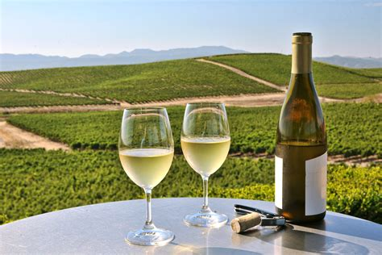
Wine Defines Napa and Sonoma
Key Varietals That Define Napa and Sonoma wine. While Napa and Sonoma is home to an incredibly diverse range of wine grapes, several key varietals stand out for their exceptional quality and global recognition.
These varietals have not only become synonymous with Napa and Sonoma wine but have also elevated the state's reputation as a world-class wine-producing region.
The distinct terroirs of California, from the cool coastal regions to the warmer inland valleys, allow for the cultivation of these varietals with remarkable versatility, producing wines that range from elegant and refined to bold and powerful.

Slide 12
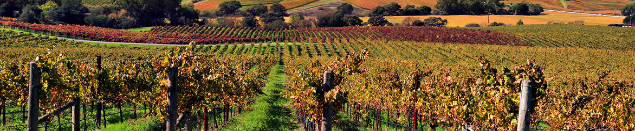
Varietals That Define Napa and Sonoma
The prominent varietals for Napa and Sonoma include: Cabernet Sauvignon, Chardonnay, Zinfandel, Pinot Noir, Sauvignon Blanc, and Syrah. But there are There are over 100 grape varieties grown in California
These varietals have become the pillars of Napa and Sonoma’s wine industry, representing the region’s diversity and innovation. Whether showcasing classic varietals like Cabernet Sauvignon and Chardonnay or embracing Napa and Sonoma's heritage. with Zinfandel, the winemakers continue to push the boundaries of quality, craftsmanship, and global influence.

Slide 13
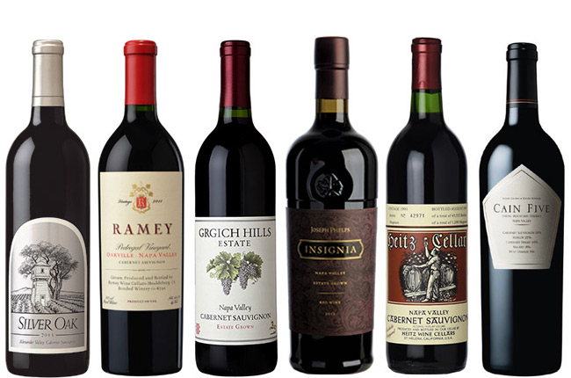
Cabernet Sauvignon
Cabernet Sauvignon is a natural cross between Cabernet Franc and Sauvignon Blanc grapes that occurred in the 17th century creating this easy growing, tough-skinned variety in France's Médoc appellation, finding favor with cold hardiness, late bud break, and October harvest.
Napa and Sonoma Cabernet Sauvignon is prized all over the world.
It is known for sharp tannins and high acidity.
They offer an herbal, light floral taste, frequently breathing earthy aromas of tobacco, graphite, licorice, and green pepper. Sauvignon is known for showing deep, opaque red in the glass, often flashed with strikes of blue-violet.
Richly textured with an alcohol level around 13.5 to 15 percent. These warmer weather versions deliver mature, dark fruit flavors like blackberry, cassis, and plum, with additional cocoa, black pepper, and tobacco notes.

Slide 14
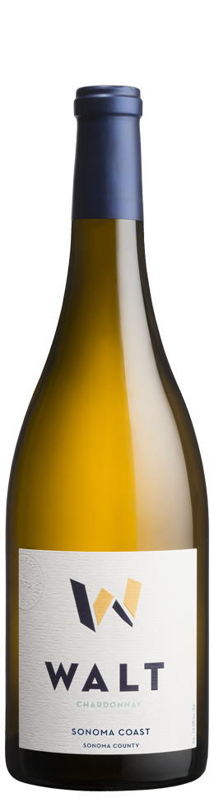
Chardonnay
Chardonnay The Queen of Napa and Sonoma Wine
This adaptable and versatile Chardonnay grape is one of the most popular varietals around the world. Chardonnay is an Old World noble grape variety bearing French heritage. It is a cross between Pinot Noir grapes and the now obscure Medieval Gouais Blanc variety
In California, Chardonnay is second only to Cabernet Sauvignon in terms of importance. There are roughly 98,000 acres of farmland dedicated to Chardonnay production in the state. Chardonnay is the most planted varietal in the state.
Grown in cooler regions such as Sonoma and Napa and Sonoma, California Chardonnay can range from rich and oaky to crisp and minerally.
Spending time in contact with the wood creates pleasing aromas like cloves and cinnamon, while buttery caramel, smoke, and vanilla flavors develop. Some wineries produce a Chardonnay produced in all Steel intended to bring out the fruit and crispness in the wine.

Slide 15
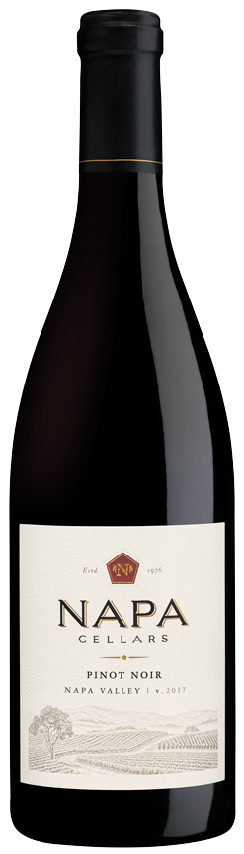
Pinot Noir
Pinot Noir: In 2023, Pinot Noir was the third-most planted grape by acreage in the California, as it has been for years.
But unlike California’s first and second-most planted grapes, Cabernet Sauvignon and Chardonnay, respectively, high-end Pinot Noir is produced in relatively few places.
California’s cooler coastal regions, like Sonoma and Napa and Sonoma, produce some of the world’s finest Pinot Noir, characterized by its complexity and elegance.
Sonoma boasts a dizzying array of soil types, elevation differences and wind patterns, not to mention the looming presence of the Pacific Ocean as you travel closer to the coast.

Slide 16
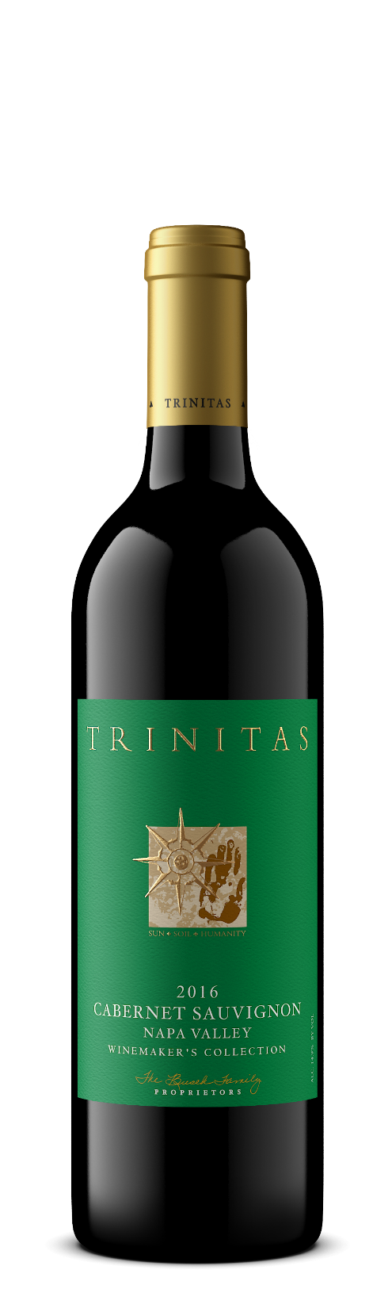
Zinfandel
Zinfandel: Often referred to as America’s heritage grape, Zinfandel is known for its robust, fruity profile.
Zinfandel wine is a bold, fruit forward red that’s loved for its Jamy fruit and smoky, exotic spice notes. It’s also made into a sweet rosé called White Zinfandel.
It pairs well with Moroccan and Turkish spices that mirrors the wine’s cinnamon-spice subtleties. Pizza, or calzone stuffed with roasted onions, tomatoes, anchovies, and olives is also a great match.
Taste notes: Zinfandels are Dry, Medium to full Body wine with Medium to high Tannins and Medium to low Acidity. It’s ABV is typically Over 15%.

Slide 17
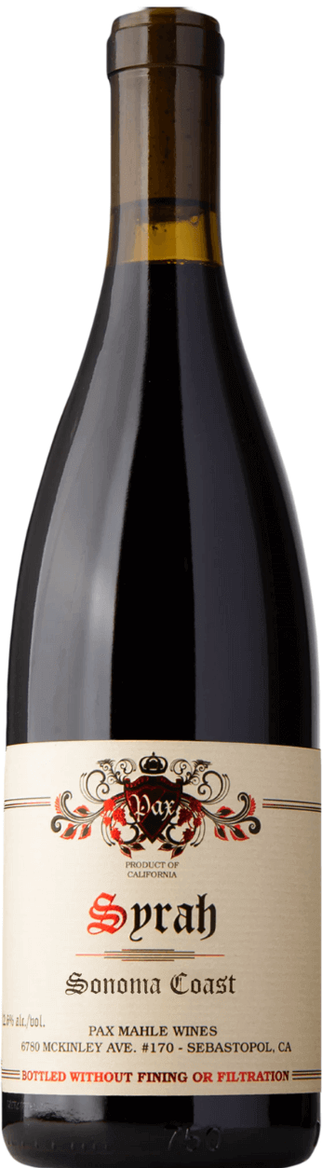
Syrah
Syrah: While not as widely known as Cabernet Sauvignon or Chardonnay, Syrah thrives in regions like central coast and is often used in Rhône-style blends. In fact the original pioneers of Californian Syrah are affectionately known as the Rhone Rangers.
It comes from a historic, dark-skinned, egg-shaped grape. In its best examples, it is every bit as drinkable and cellar able as the finest Burgundy and Bordeaux wines.
High tannins, low acidity, and rich structure make Syrah a global favorite, finding particular favor in the vineyards of Australia where it is known as Shiraz. The wine is fruit-forward with lots of spice. Because of it’s characterizes Syrah is perfect for aging.
Flavors and Aromas include: Pepper, Raspberries, Gooseberries, Blueberries, Blackberries, Boysenberries, Violets, Mignonette, Truffle, Chocolate, Rosemary, and Black Olive.

Slide 18
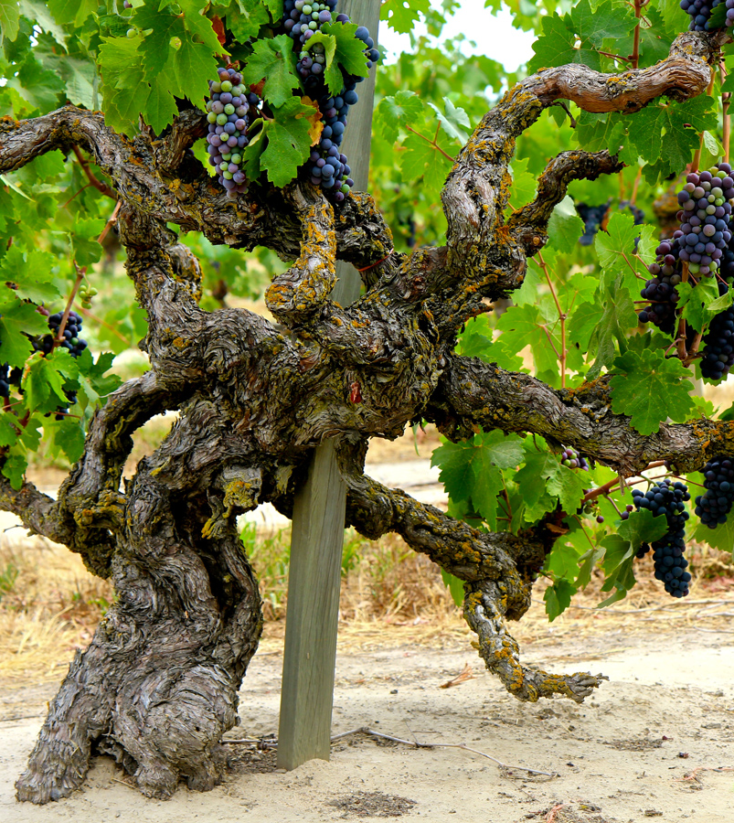
Conclusion
California’s wine story isn’t just about one region, it’s a tale of resilience, diversity, and innovation told through the vineyards of Napa, Sonoma, and the Sierra Foothills. Whether you’re sipping a world-class Cabernet in a Napa tasting room, exploring the quiet charm of Sonoma’s backroads, or discovering the bold flavors of the Sierra Foothills’ old vines, each glass is a reflection of the Golden State’s unique wine legacy.
So, what are you waiting for? Grab a map, pack your bags, and experience California’s wine royalty for yourself. Cheers!
Whether you’re strolling through a vineyard, savoring a bold Syrah, or toasting with a crisp Chardonnay, Napa and Sonoma is a wine lover’s paradise.
So grab your glass and let the flavors, scenery, and charm of Napa and Sonoma wine country create memories you’ll savor long after your visit. Cheers!

Slide 19
Acknowledgement
My seminars are the result of many years of experience combined with many hours of research over the internet.
I would like to acknowledge the many source I have accessed.
These include Wine Spectator, Wine Enthusiast, BKWine Magazine, Wine & Spirits Magazine, American Vineyard Magazine, The Grapevine Magazine, Wikipedia.com, Britannica.com, and the various Government websites.

Slide 20
References and Citations
Sullivan, Charles L. A Companion to California Wine: An Encyclopedia of Wine and Winemaking from the Mission Period to the Present. University of California Press, 1998.
Taber, George M. Judgment of Paris: California vs. France and the Historic 1976 Paris Tasting That Revolutionized Wine. Scribner, 2005.
Robinson, Jancis, and Julia Harding. The Oxford Companion to Wine, 4th ed., Oxford University Press, 2015.
California Wine Institute. “California Wine Facts.” Accessed September 2024. https://www.discovercaliforniawines.com.
History, Geography and Climate of Napa and Sonoma Wine Country: San Bernardino County Wines
Au Bon Climat: Established in 1982, Au Bon Climat is renowned for its Burgundian-style Pinot Noir and Chardonnay, emphasizing balance and traditional winemaking techniques. Aubon Climat
Presqu’ile Winery: Food & Wine
Napa and Sonoma Vintners Association: Offers comprehensive information on the region's wineries, events, and wine trails.
Napa and Sonoma Wine Country Guide: Provides insights into the AVAs, history, and unique aspects of Napa and Sonoma's wine regions. Wine Folly

