Slide 1
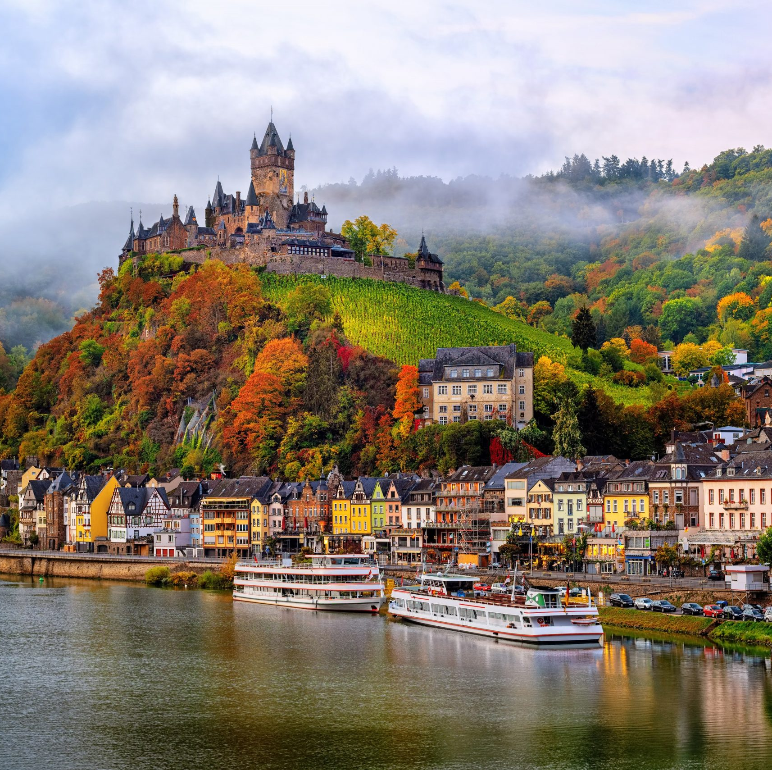
Exploring the Mosel Wine Region
With
Marc Silver
A Journey through the Mosel Region

Slide 2
What I Will Cover
Exploring the Mosel
German Wine Regions
German Wine History
Terroir
Riesling
Climate and Geography
Cultural Charms
Wine Types
Conclusion

Slide 3
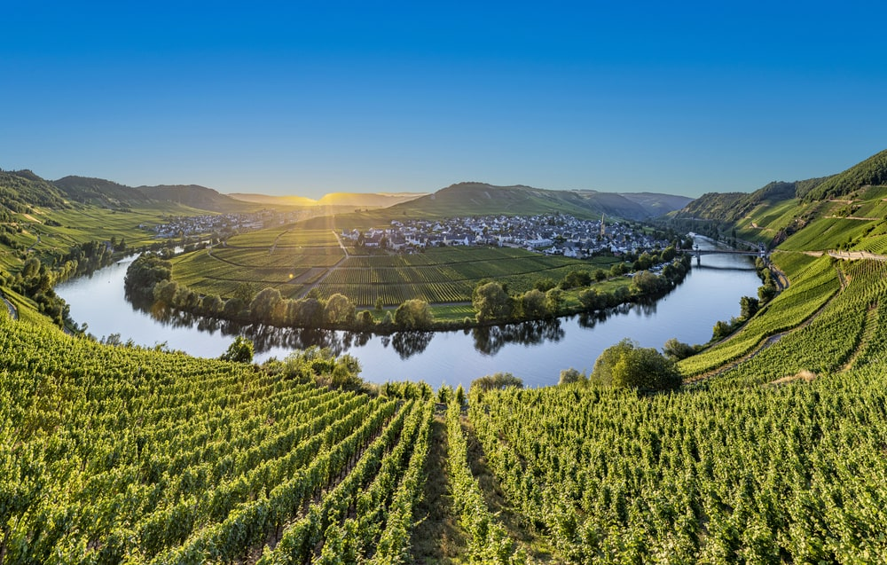
Exploring the Mosel
The Mosel wine region, is a place where nature’s grandeur and human ingenuity intertwine in a symphony of flavors.
Join me as we embark on a journey through time to uncover the history behind this remarkable terroir.
Nestled along the banks of the meandering Mosel River in Germany, the Mosel wine region boasts a rich viticultural heritage dating back over two millennia. Here, amidst the rugged terrain and slate-rich soils, lies a winemaking tradition as old as civilization itself.

Slide 4
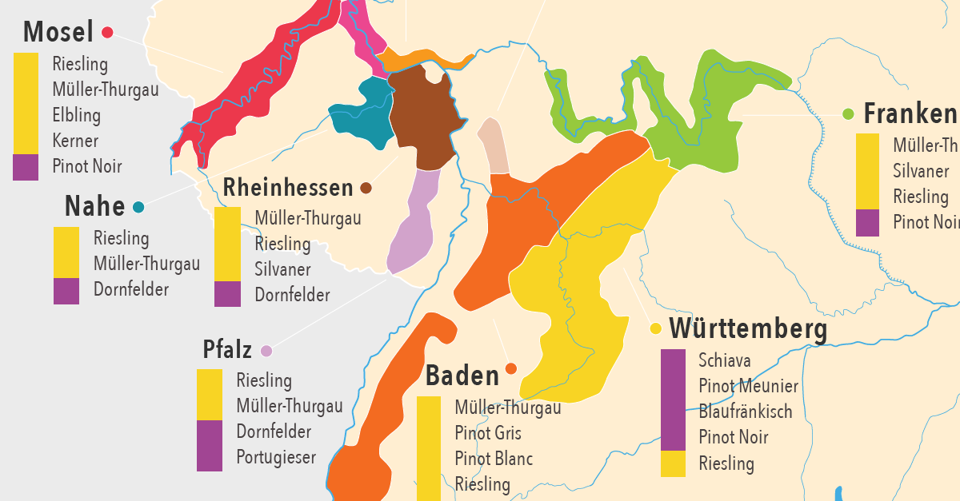
German Wine Regions
The Mosel is one of 13 German wine regions for and takes its name from the Mosel River. Prior to 1 August 2007 the region was called Mosel-Saar-Ruwer, but the name change was considered more consumer-friendly. The wine region is Germany's third largest in terms of production, but some consider it the leading region in terms of international prestige.
The German wine makers have championed single-varietal wines since the first mass plantings of Riesling at Schloss Johannesburg in 1720. Each region has it’s own single-varietal wine.

Slide 5
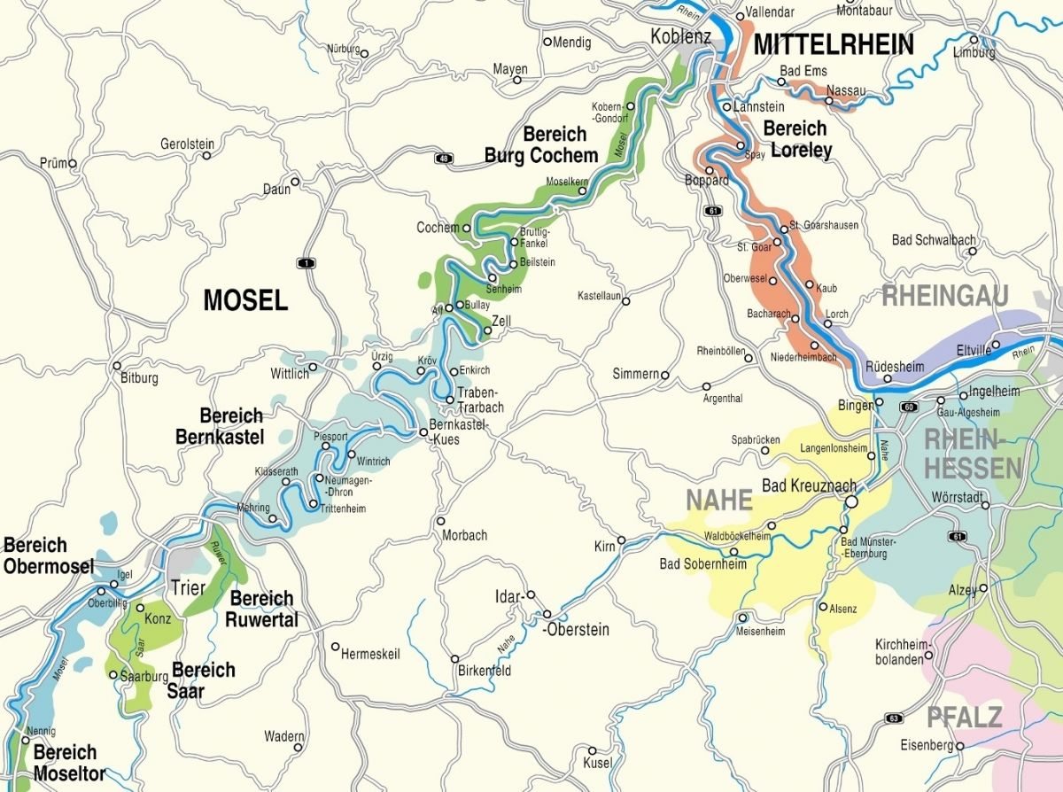

Slide 6
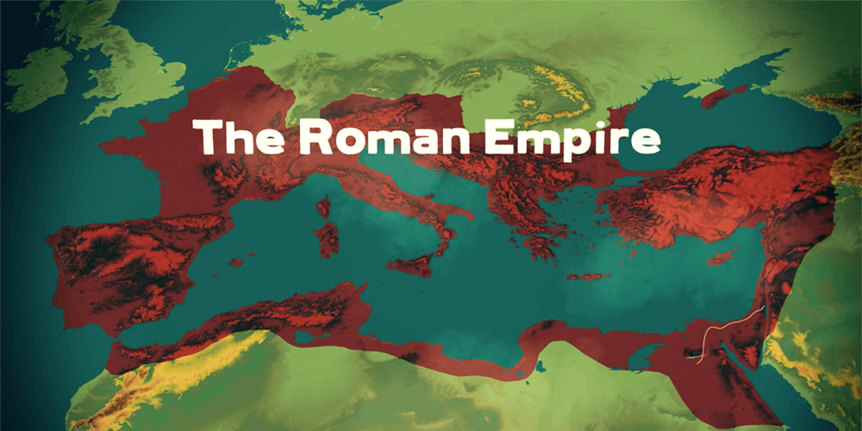
German Wine History
Historically with the arrival of the Romans in the first century AD, who recognized the potential of the Mosel's unique microclimate for viticulture. With their expertise in vine cultivation and winemaking, they transformed these verdant slopes into thriving vineyards, introducing grape varieties that would shape the region’s winemaking legacy for centuries to come.
Throughout the Middle Ages, it was the monastic orders that preserved and expanded the art of winemaking in the Mosel valley.
Monks meticulously tended to the vines, refining techniques passed down through generations and elevating winemaking to a sacred craft.

Slide 7
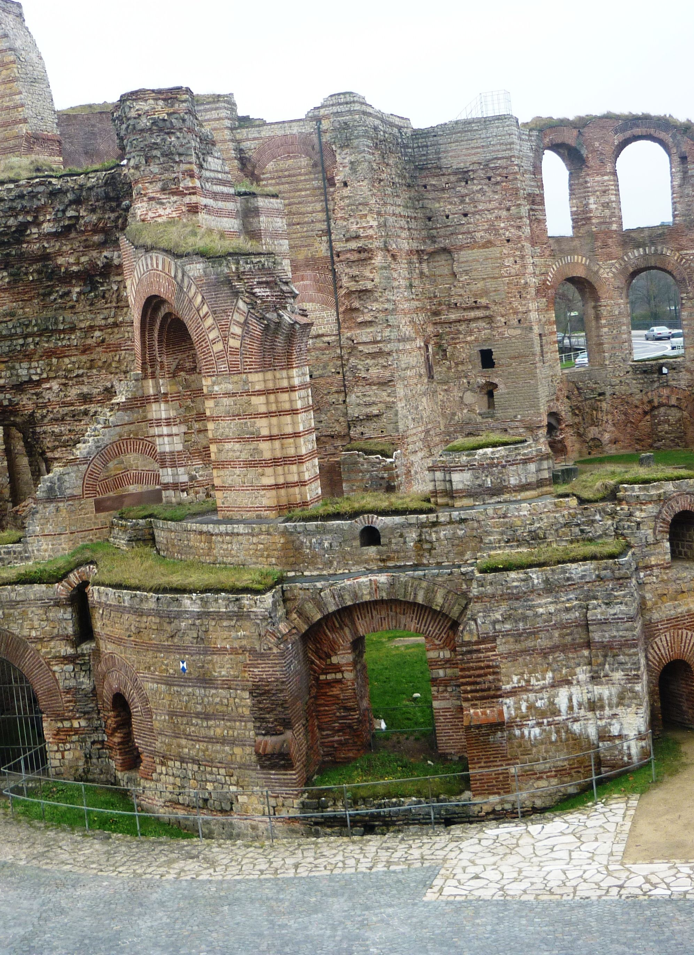
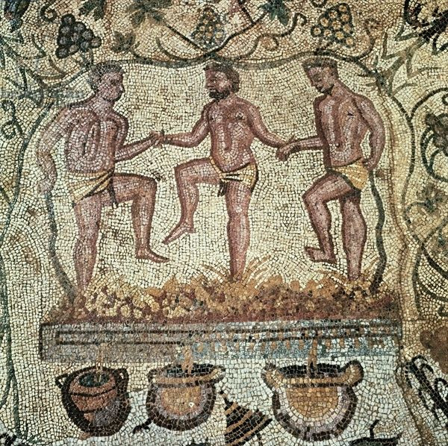
Historic Legacy
It is believed that viticulture was brought to this area by the Romans who planted vineyards along the Mosel and the Rhine to have a local source of wine for their garrisons. The cost of transporting wine up from the Italian Peninsula or across the Vosges Mountains and the Roman vineyards in Gaul was very high and impractical. The Romans considered creating a canal between the Saône and the Rhine rivers before ultimately deciding to plant vines in the area.
Trier was a major Roman outpost founded 16 BC, and it is likely that the first Mosel vineyards were planted in the surrounding hillsides sometime in the 2nd century. Viticulture was certainly flourishing in the area by the 4th century when the Roman poet Ausonius wrote a poem about the beauty of the land at harvest time.

Slide 8
Historic Legacy
The Mosel wine region boasts a rich winemaking history dating back as far as Romes's control of the region and vines were first planted along the river.
Over the centuries , vintners and monks tended the vines and refined the craft making wines of the Mosel some of the finest in the world.
As the centuries passed, the Mosel wine industry flourished, fueled by the region's reputation for producing some of Europe's finest wines. Wine coinsures flock to the region, eager to procure casks of Riesling and other coveted varietals from the Mosel's cellars.

Slide 9
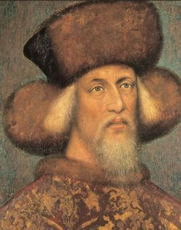
Wine History Cont.
In the Middle Ages, villages sprung up that were centered on the region's wine industry. These "wine villages", known as "Winzerdörfer", included paths from the town center up to the area's vineyards.
At the center was a community wine cellar where all the area's growers could store their wines. Probably most well-known among the Winzerdörfer was the village of Bernkastel which was granted town rights in 1291.
In 1435 when Count Johann IV of Katzenelnbogen planted Riesling in the nearby town of Rüsselsheim the first time he owned vineyards in Winningen like the Destil, in Burgen and Kochem one half of the city and many vineyards more along the Mosel.

Slide 10
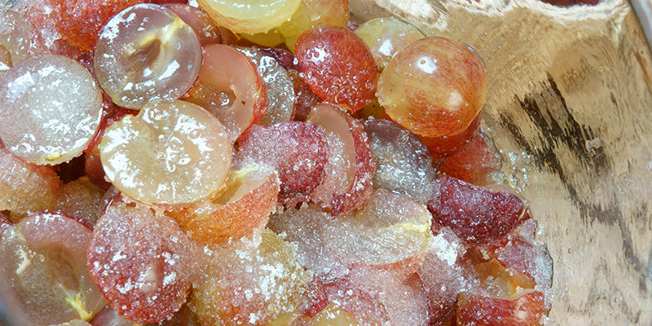
Wine History Cont.
To create more suitable land for vineyards, vineyard owners in the 16th century used explosives to break up the vertical spurs of rock along the rivers.
However, the 19th century brought both triumph and tribulation to the Mosel valley, due to wars and conflicts that ravaged the landscape, while the scourge of phylloxera devastated vineyards across Europe. Amid the turmoil, the resilient spirit of the Mosel winemakers endured, as they rebuilt their vineyards and revitalized their traditions.
By the 1850s, wine-makers in the Mosel had discovered the benefits of chaptalization in helping to compensate for bad weather vintages and under ripened grapes.
Chaptalization and acidification are two such methods of tweaking the winemaking process to ensure a better final product. More specifically, these techniques involve adding something to the mix: whether that be sugar (chaptalization) or acid (acidification).

Slide 11
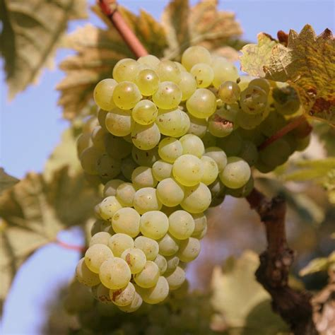
Wine History Cont.
Another significant boom came a couple decades later when the British Prime Minister William Ewart Gladstone lowered the duties on light wine which opened up the British market to lower cost Mosel wines.
This increased prosperity had the net effect of encouraging more quantity in production rather than quality. Many areas that were not ideal for Riesling were soon planted with the easier to grow Müller-Thurgau and other Riesling crossings. In the 20th century, a North American taste for sweet wines saw the prominence of Liebfraumilch and brands like Blue Nun dominate the German import wine market.

Slide 12
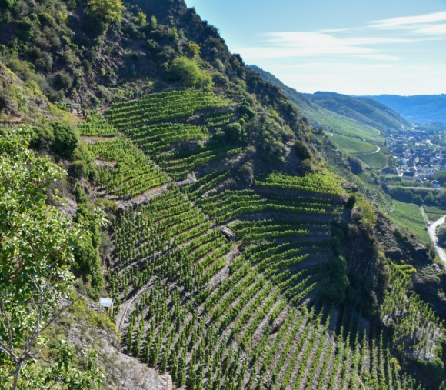
A Tapestry of Terroir
At the heart of the Mosel wine region lies its distinctive terroir, shaped by millennia of geological evolution and human ingenuity. The region's steep slopes, primarily composed of Devonian slate, offer a perfect environment for grape cultivation, absorbing and radiating heat, and imparting a distinct minerality to the wines.
These challenging vineyard sites, often planted on vertiginous inclines, demand meticulous hand labor and exemplify the profound connection between the land and the wines it produces.

Slide 13
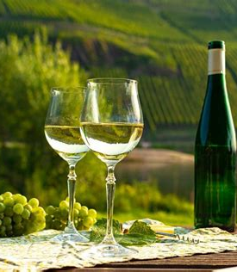
Riesling Reigns Supreme
The Mosel wine region is synonymous with Riesling, a noble grape variety that thrives in the cool climate and mineral-rich soils of the area.
Revered for its remarkable versatility and ability to reflect the terroirs, Mosel Rieslings captivate the senses with their ethereal aromas, brilliant acidity, crystalline purity and color. From bone-dry to lusciously sweet, these wines span a spectrum of styles, each expressing the nuances of their vineyard of origin.

Slide 14
Beyond Riesling
The Riesling grape accounts for nearly 60% of the region's vineyards and is widely considered the most prestigious and highest quality wine grape of the Mosel but it cannot be planted on every vineyard site due to difficulties the grape has in ripening in particularly cool climates.
Factors such as altitude, aspect and sunlight exposure can have a pronounced effect not only one the resulting quality of the wine but also whether the Riesling grape will even ripen at all. A positive characteristic of the Riesling grape is that despite less than perfect ripeness it can still create a wine of finesse and elegance that would escape most other grape varieties.
While Riesling reigns supreme, the Mosel wine region also embraces a diverse array of grape varieties, each contributing to its vinicultural tapestry.
Müller-Thurgau, Pinot Blanc, and Pinot Noir thrive in the region's microclimates, producing wines of character and distinction. Moreover, the Mosel has witnessed a resurgence of interest in traditional grape varieties such as Elbling and Kerner, adding further depth and diversity to its wine portfolio.

Slide 15
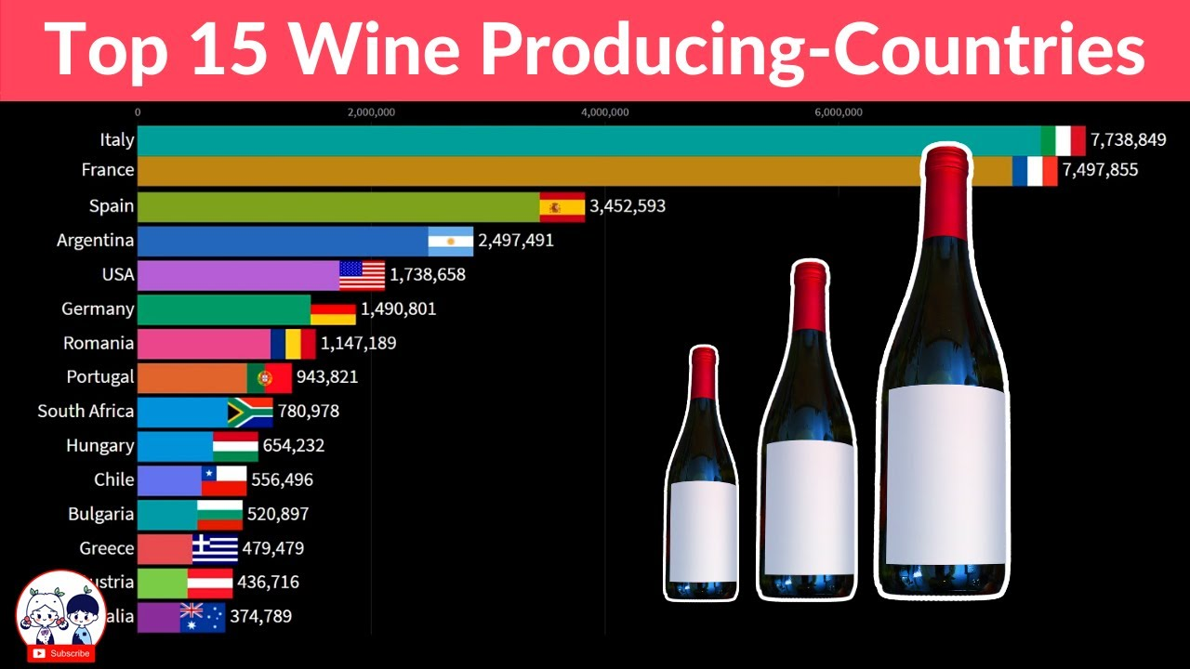

Slide 16
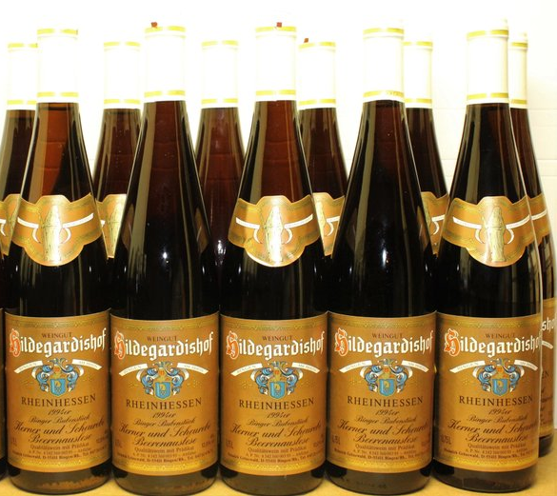
Beyond Riesling
The wines of the Upper Mosel, especially along the Saar and Ruwer tributaries, are characterized by their low alcohol content in the 6-9% range with intense fruity notes and high acidity. Once described as “The fire of the Sun, the gold of the stars, and cool moonlight”.
The wines of the Middle Mosel are considered the most complete examples of German wines with some of the finest examples being able to age gracefully for 50–100 years Mosel Rieslings rely on a strong presence of tartaric acid to balance the grape’s sugar and to help impart its fruity notes. A characteristic of all Mosel wines is their normally high acidity and transparency of clearly defined flavors.
The wines of the Mosel region are traditionally packaged in a long green colored "hock style" wine bottle. Historically the green color distinguished Mosel wines from the brown bottles of the Rheinhessen.

Slide 17
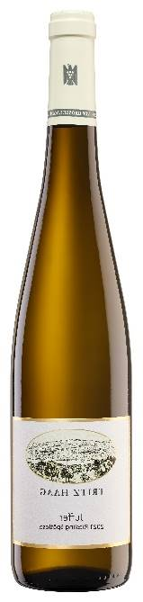
Vineyard Marvels
Exploring the Mosel wine region is a journey through a mosaic of vineyard sites, each with its own distinct character and microclimate. From the iconic slopes of the Ürziger Würzgarten to the legendary Doctor vineyard in Bernkastel, every parcel tells a story of tradition, passion, and dedication. The region's viticultural landscape is dotted with quaint villages, medieval castles, and terraced vineyards, offering a breathtaking tableau that unfolds with every twist and turn of the river.
Exploring the Mosel wine region is a journey through a mosaic of vineyard sites, each with its own distinct character and microclimate. From the iconic slopes of the Ürziger Würzgarten to the legendary Doctor vineyard in Bernkastel, every parcel tells a story of tradition, passion, and dedication. The region's viticultural landscape is dotted with quaint villages, medieval castles, and terraced vineyards, offering a breathtaking tableau that unfolds with every twist and turn of the river

Slide 18
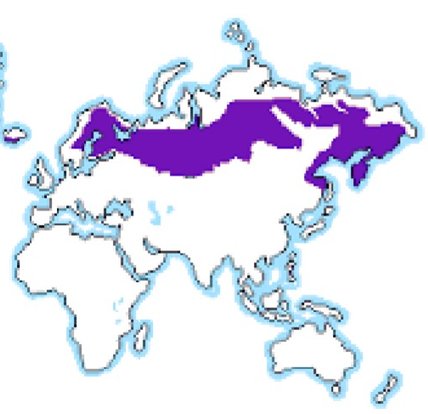
Climate and Geography
The Mosel wine region has northernly continental climate that is marked by cool temperatures. The best producing vineyard sites are located along the Mosel River and its tributary where the heat from the sun can be maximized by reflection up from the water.
South and southwest facing slopes are even more sought after because of the increased exposure to direct sunlight that can aid in ripening of the grapes.
The soil of the area is dominated by porous slate which has ideal drainage for the regions heavy rainfall and good heat retaining properties. Many of the best vineyards have no topsoil at all, just broken slate.
During the summer months the weather is warm with July's average temperatures around 64 °F.

Slide 19
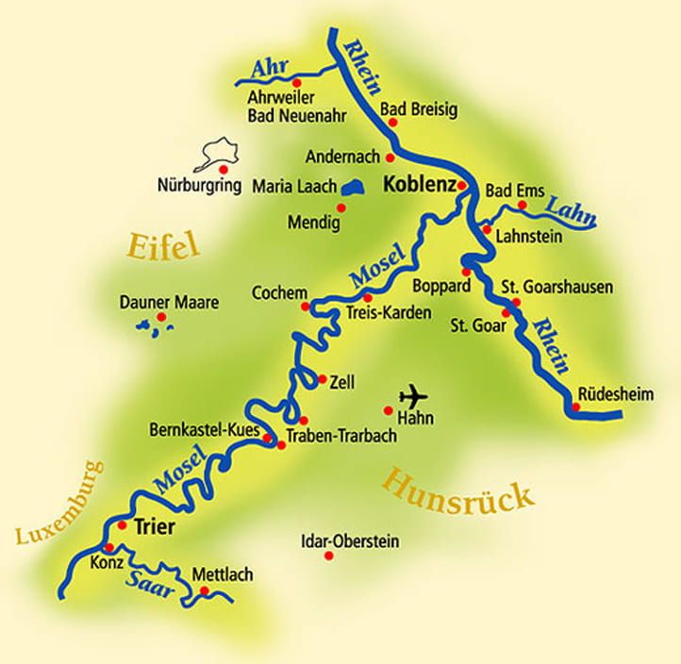
Climate and Geography
The Mosel River dominates the geography of the region which is typically divided into three main sections. The Upper Mosel is the southernmost section located closest to the river's origins along the French and Luxembourg border.
The region includes the Saar and Ruwer river tributaries and is centered on the city of Trier. The Middle Mosel or Mittelmosel is the main wine growing region and includes the villages of Bernkastel and Piesport.

Slide 20
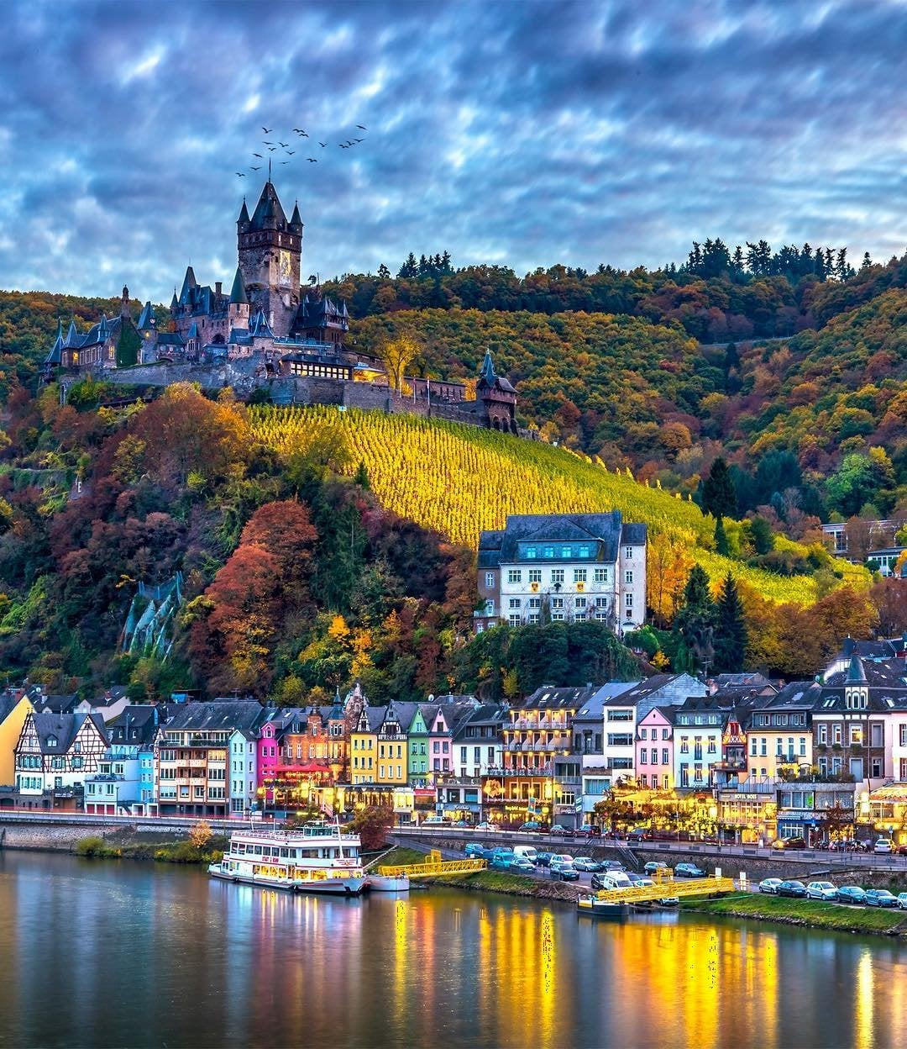
Cultural Charms
Beyond its vine-clad hills and world-class wines, the Mosel wine region is imbued with a rich tapestry of culture, history, and gastronomy. Charming towns such as Trier, the oldest city in Germany, and Cochem, with its majestic Reichsburg castle, offer a glimpse into the region's storied past.
Visitors can indulge in culinary delights ranging from hearty German fare to Michelin-starred cuisine, paired perfectly with the region's finest wines

Slide 21
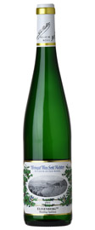
Wine Types
Aromatic White Wine
Sweet Pradikat Riesling
The late-harvested styles of Spätlese, Auslese, BA and TBA produce some of the most sought-after sweet Riesling wines in the world. These wines offer surprising depth with contrasting sweet and sour tastes and heady aromas of apricots, lime, and honey.
Tasting notes: Apricot, Honey, Lime, Young Coconut, Tarragon
2021 Max Ferd. Richter Veldenzer Elisenberger Riesling Spätlese Mosel - 93 points Wine Advocate

Slide 22
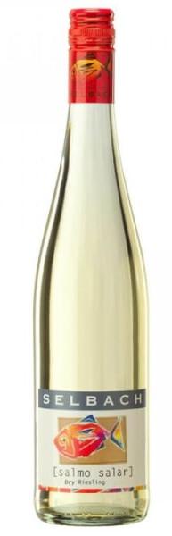
Wine Types Cont.
Light-Bodied White Wine
Dry Riesling
Dry styles of Riesling are becoming increasingly popular in Germany. You can identify a dry Pradikat Riesling by the term "Trocken" on the label or by investigating the alcohol level. Higher ABV levels typically indicate a drier style of Riesling.
Tasting notes: Honeydew Melon, White Peach, Lime, Jasmine, Smoke
Selbach Mosel Dry Riesling (Fish Label) 2020

Slide 23
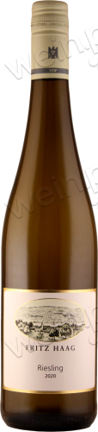

Wine Types Cont.
Aromatic White Wine
VDP Riesling
An invite-only grower association known to contain some of the best wineries in Germany. VDP also classifies vineyards. The top level is called Grosses Gewächs (“grand growth”) and a first quality vineyard is called Erstes Gewächs (“first growth”).
Various Styles and flavors
2020 Riesling VDP.Gutswein

Slide 24
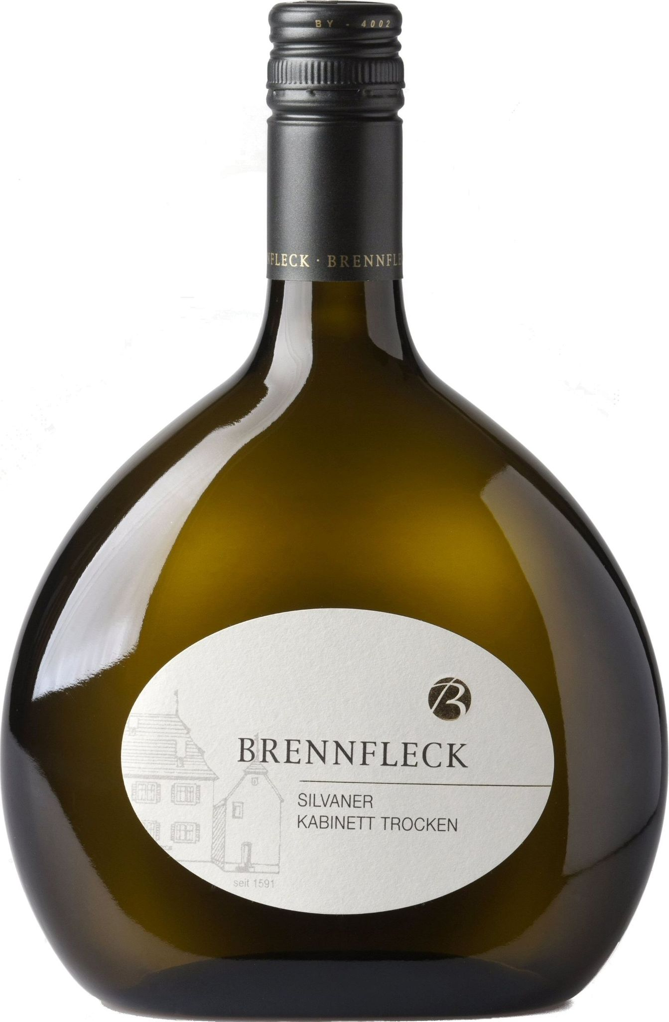
Wine Types Cont.
Light-Bodied White Wine
Silvaner
Silvaner is a great wine often found at a superb value. The primary regions producing it include Rheinhessen and Franken (where wines are bottled in stubby, green bocksbeutels). The best wines offer enticing aromas of sweet stone fruits contrasted with flinty minerality.
Tasting notes: Peach, Passion Fruit, Orange Blossom, Thyme, Flint
Silvaner Kabinett Trocken Brennfleck

Slide 25
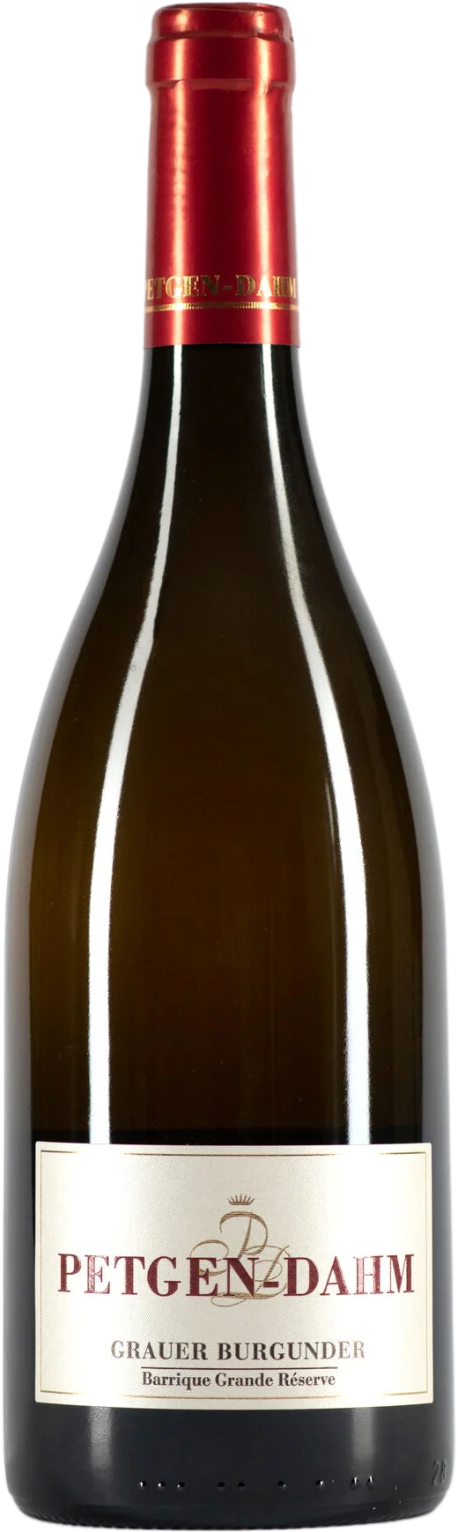
Wine Types Cont.
Light-Bodied White Wine
Grauburgunder
(aka Pinot Gris) In Germany, Pinot Gris is often very light-bodied with lovely floral notes accenting flavors of white peach, pear and minerals. The heightened acidity gives the wine a tingly quality that’s complemented with a lush, somewhat oily mid-palate.
Tasting notes: White Peach, Oil, Asian Pear, Lime, White Flowers
2020 Grauer Burgunder Auslese Barrique Grande Réserve 91 points

Slide 26
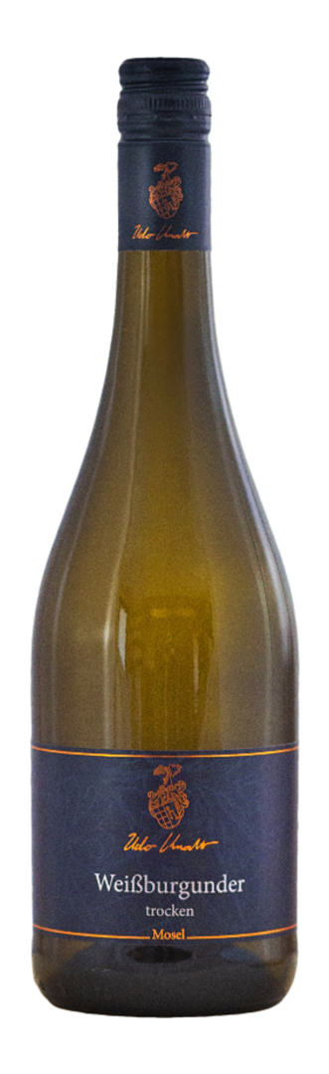
Wine Types Cont.
Light-Bodied White Wine
Weißburgunder
(aka Pinot Blanc) There are many shared flavors between Pinot Gris and Pinot Blanc but overall, Pinot Blanc is much more delicate and subtle in its flavoring. If there is any single wine to pair with high tea and cucumber sandwiches, Pinot Blanc is it.
Tasting notes: White Peach, White Flowers, Green Apple, Lime, Flint
2021 Weißburgunder trocken | Mosel Weingut Knodt-Trossen

Slide 27
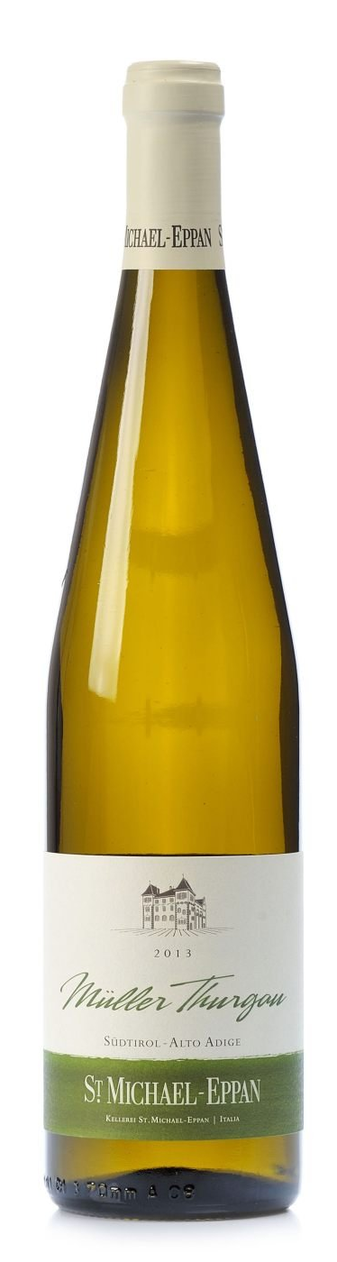
Wine Types Cont.
Aromatic White Wine
Müller-Thurgau
A cross between Madeleine Angevine and Riesling that ripens a little earlier and thus, grows well in Germany’s cooler sites. Wines have slightly more tropical fruit notes with slightly less acidity than Riesling but offer a similar flavor profile at a better price.
Tasting notes: Ripe Peach, Orange Blossom, Oil, Lemon, Dried Apricot
Muller Thurgau St. Michael- Eppan 2013

Slide 28
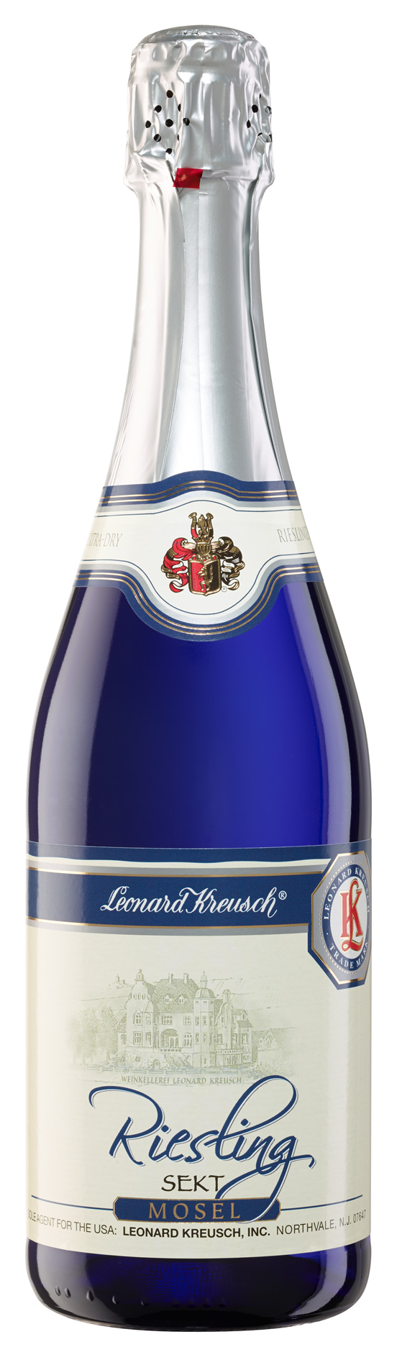
Wine Types Cont.
Sparkling White Wine
Sekt
While there is still some low quality Sekt in Germany, most isn’t exported. The Sekt with amazing potential are those wines labeled Traditionelle Flaschengärung (traditional method) and made with Pinot varieties and Chardonnay. Look into the Pfalz and Rheingau for quality.
Tasting notes: Baked Apple, White Cherry, Mushroom, Wax Lips, Lime
Riesling Sekt SS - Mosel Leonard Kreusch Wines

Slide 29
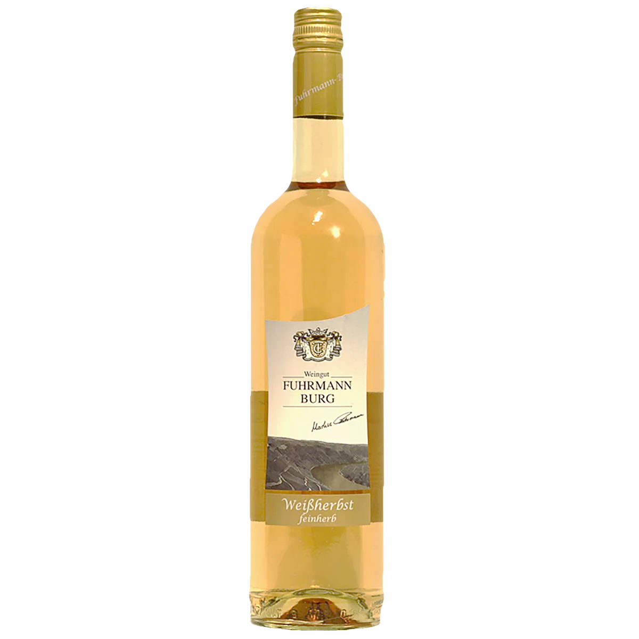
Wine Types Cont.
Light-Bodied Red Wine
Spätburgunder
(aka Pinot Noir) The warmer regions in the South and Ahr specialize in Pinot Noir. Wines exude sweet fruit flavors that are complemented with subtle earth and leafy notes. Contextually, these Pinot Noir wines taste a little bit new world and old world all at once. All 13 German winemaking regions grow Spätburgunder, with each expressing unique characteristics. Important to note is that in Ahr there are many local varieties, as well as a unique mutation of the grape called Frühburgunder which is an early ripening Pinot Noir.
Tasting notes: Dried Blueberry, Raspberry, Cinnamon, Dried Twigs, Brown Sugar
Spätburgunder Weißherbst feinherb

Slide 30
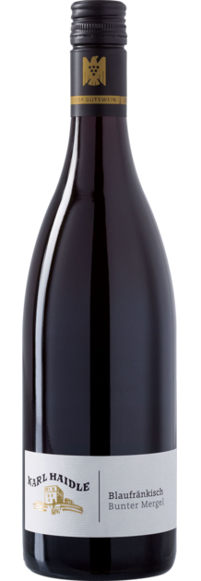
Wine Types Cont.
Medium-Bodied Red Wine
Lemberger
(aka Blaufränkisch) Hailing mainly from Baden and Würtemberg where the seasons are longer and warmer. Great examples have rich brooding chocolate and berry flavors with firm tannins and spicy acidity. Blaufränkisch is a perfect wine for the fall season.
Tasting notes: Currant Sauce, Pomegranate, Brown Sugar, Dark Chocolate, White Pepper
Bunter Mergel Lemberger 2021

Slide 31
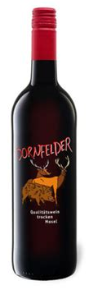
Wine Types Cont.
Medium-Bodied Red Wine
Dornfelder
A popular everyday value in Germany that ranges in quality so be choosy! When made well, Dornfelder wines exude boisterous, sweet, baked berry, and vanilla aromas. Wines taste balanced with moderate tannins, spicy acidity, and an earthy-herbal finish.
Dornfelder Mosel QbA trocken, Rotwein 2020 von Lidl für

Slide 32
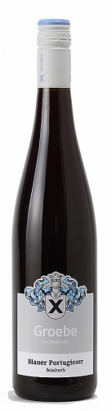
Wine Types Cont.
Medium-Bodied Red Wine
Portugieser
Blauer Portugieser is a light red German wine.
It is also grown along the Danube River including Austria, Hungary, Croatia, and Serbia. In Germany it’s primarily grown in the Pfalz and Rheinhessen and popular in rosé wines and simple reds.
Tasting notes: Dried Red Berries, Peppery Spice, Toasted Oregano
Blauer Portugieser feinherb
Weingut Groebe

Slide 33
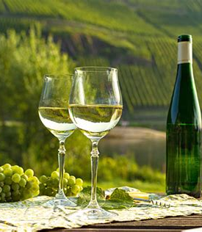
Conclusion
The Mosel winemakers, inspired by centuries of tradition, continue to produce wines of unparalleled quality and distinction.
From the ethereal elegance of its Rieslings to the robust character of its Pinot Noirs, each bottle from the Mosel tells a story of centuries of craftsmanship.
In every glass of Mosel wine lies a story – of ancient vineyards clinging to steep slopes, of passionate winemakers nurturing their craft, and of a region that embodies the timeless art of winemaking.
As you journey through the Mosel wine region, let each sip be a toast to the spirit of exploration and discovery that defines this vinicultural gem.

Slide 34
The Mosel
I hope you found these facts about The Mosel region interesting and informative.
Hopefully, you all get the opportunity to visit the beautiful and wine region for yourselves.
Thank you for coming!

Slide 35
Acknowledgement
My seminars are the result of many years of travel experience combined with many hours of research over the internet.
I would like to acknowledge the many source I have accessed.
These include Wine Spectator, Wine Enthusiast, BKWine Magazine, Wine & Spirits Magazine, American Vineyard Magazine, The Grapevine Magazine, Wikipedia.com, Britannica.com, and the various Government websites.

